Slide 1

The Recorded Home Oximetry (RHO) Program
Monthly Investigator Meeting
October 7, 2021

Slide 2
Site Selection for Implementation Waves
Wave 1
Dartmouth Hitchcock Medical Center
Boston Children’s Hospital
Massachusetts General Hospital
Maria Fareri Children’s Hospital
University of Maryland
Vanderbilt
Wave 2
Arkansas Children’s Hospital
Children’s Hospital of Philadelphia
Cincinnati Children’s Hospital
National Jewish Health
Nationwide Children’s Hospital
Peyton Manning Children’s Hospital
University of California, San Diego
University of Kentucky

Slide 3


RHO Program Implementation Timeline: Wave 1 Sites
February 2021
Baseline data collection begins
March 2021
Initiate site training
Initiate monthly phone calls
May 2021
June-August 2021
February 2022
August 2022
Complete site training
Reach 33% of eligible families
Reach 66% of eligible families
February 2023
Reach 100% of eligible families
Initiate 18-month implementation
Begin providing monthly feedback reports

Slide 4
RHO Program Implementation Timeline: Wave 2 Sites
March 2021
Baseline data collection begins
May 2021
Initiate site training
August 2021
December 2021-February 2022
August 2022
February 2023
Complete site training
Reach 33% of eligible families
Reach 66% of eligible families
August 2023
Reach 100% of eligible families
Initiate 18-month implementation
Begin providing monthly feedback reports

Slide 5
Site Training Planning
12/14 site trainings completed
The remaining should be scheduled in October
Please let Heather know your availability

Slide 6
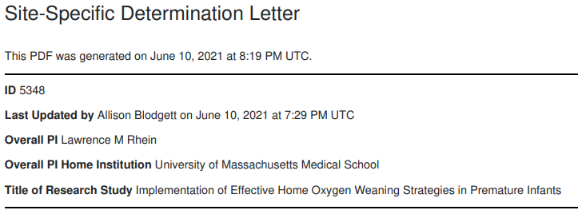
Updates on IRB Approval
UMass IRB has initiated site specific approval letters
Heather sent emails to approved sites
Please work on getting your IRBs to review and determine their willingness to cede approval

Slide 7
RAD 97s Count
We are working with Masimo to get accurate counts of RAD 97s from each home care company
Once the counts are received from Masimo we will email each site with their available home care’s and number of devices

Slide 8

Regulatory Documents
CITI Certificates
As the lead site we are required to have both Human Subject Research and Good Clinical Practice CITI certificates for each member of your site’s research team.
  7/14 sites have completed this requirement
  7/14 haven’t sent all CITI certificates

Slide 9
Site Progress on Implementation Start-Up
Site Name | Contract Executed | cIRB Approval | Local IRB Approval | Regulatory Documents | pSite Communication Plan Agreement | REDCap Access | Site Training Completed | Site Implementation Date | Downloading Schedule
Boston Children's Hospital | ᴏ | ᴏ | ᴏ | ᴏ | ᴏ | ᴏ | ᴏ | 6/1/2021 | M/T
Dartmouth-Hitchcock | ᴏ | ᴏ | ᴏ | ᴏ | ᴏ | ᴏ | ᴏ | 6/1/2021 | T/F
Maria Fareri Children's | ᴏ | N/A | ᴏ | ᴏ | N/A | ᴏ | ᴏ | 6/1/2021 | M/T
Massachusetts General Hospital | ᴏ | ᴏ | ᴏ | ᴏ | ᴏ | ᴏ | ᴏ | 6/1/2021 | M/T
University of Maryland | ᴏ | ᴏ | ᴏ | ᴏ | ᴏ | ᴏ | ᴏ | 6/1/2021 | M/T
Vanderbilt | ᴏ | N/A | ᴏ | ᴏ | N/A | ᴏ | ᴏ | 6/1/2021 | T/F
Arkansas Children's Hospital | ᴏ | ᴏ | ᴏ | ᴏ | ᴏ | ᴏ | ᴏ | 8/1/2021 | TBD
Children's Hospital of Phil. | ᴏ | ᴏ | ᴏ | ᴏ | ᴏ | ᴏ | ᴏ | 8/1/2021 | TBD
Cincinnati Children's Hospital | ᴏ | ᴏ | ᴏ | ᴏ | ᴏ | ᴏ | ᴏ | 8/1/2021 | TBD
National Jewish Health | ᴏ | ᴏ | ᴏ | ᴏ | ᴏ | ᴏ | ᴏ | 8/1/2021 | TBD
Nationwide Children's Hospital | ᴏ | ᴏ | ᴏ | ᴏ | ᴏ | ᴏ | ᴏ | 8/1/2021 | TBD
Peyton Manning Children's Hospital | ᴏ | ᴏ | ᴏ | ᴏ | ᴏ | ᴏ | ᴏ | 8/1/2021 | TBD
U. of California, San Diego | ᴏ | ᴏ | ᴏ | ᴏ | ᴏ | ᴏ | ᴏ | 8/1/2021 | TBD
U. of Kentucky Children's Hospital | ᴏ | ᴏ | ᴏ | ᴏ | ᴏ | ᴏ | ᴏ | 8/1/2021 | TBD

Slide 10
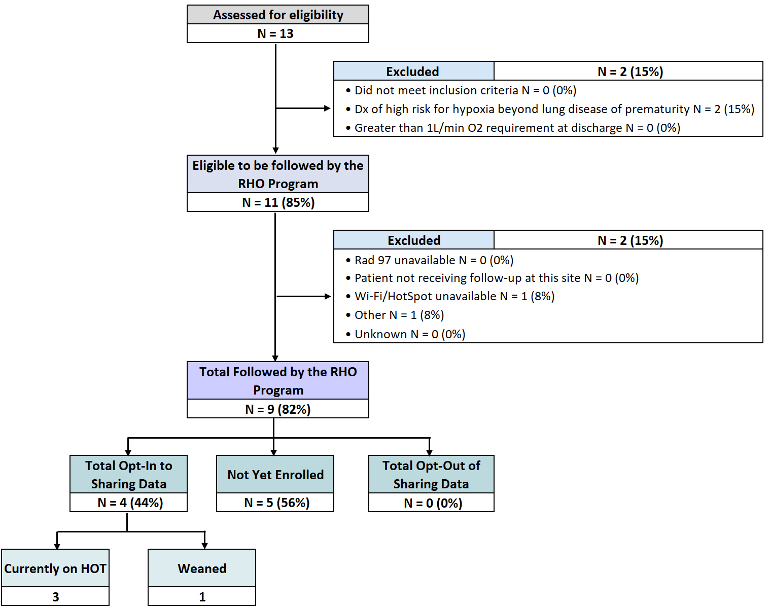
RHO Implementation Trial Consort Diagram

Slide 11
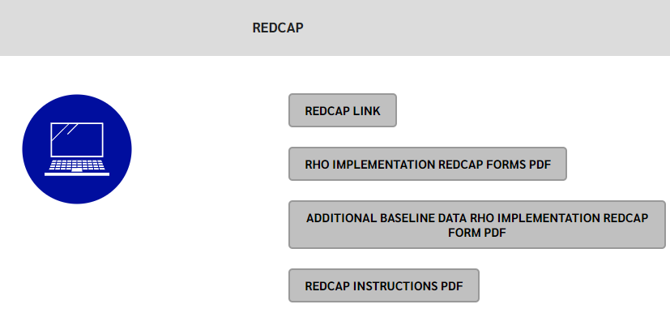
REDCap User Access Groups
Everyone who will be responsible for data entry in REDCap needs to complete a REDCap user request
The instructions on how to request an account are available on our website

Slide 12
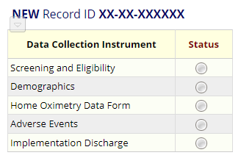
Screening and Eligibility
Please screen all potentially eligible babies in REDCap once your site goes live
This is important for the accuracy of the consort diagram and monthly reports

Slide 13


Baseline Data
Please send us baseline data once your site has received IRB approval
Baseline data will be used in your site's monthly reports
Monthly reports will start 3-months after your first patient is enrolled

Slide 14
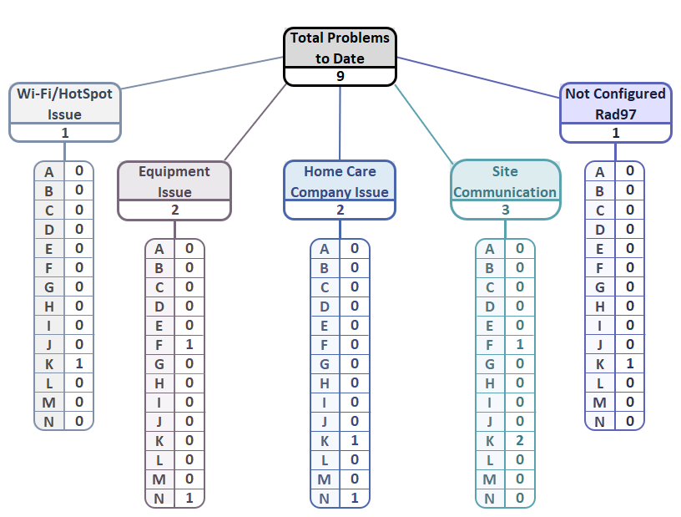
Implementation Related Problems
The goal is to identify problems early and avoid the same problems at other sites

Slide 15
The family didn't have Wi-Fi
Homecare company reset the device to factory setting which wiped its configuration to our SafetyNet
The probes stopped working
Defective cord
DCC was not informed about patient discharged on HOT
Wrong Oximeter Serial# provided
The patient received the device from a homecare company that doesn’t participate with the RHO program
The home care company didn’t train their staff on the RHO program

Slide 16
Site Communication
  Once the oximeter is delivered, assign RHO ID and notify the data coordinating center prior to NICU discharge
  Point Personnel: Heather White & Maria Matoshi
Hello [insert name of DCC contact],
We have an upcoming home oxygen discharge that will be followed by [name of pulmonologist or site name] on [anticipated discharge date]. Their ID number is [ID number] and their oximeter serial number is [oximeter serial number].
Parents [did/did not] opt out of their child’s data being collected as part of the RHO implementation project. This patient [is/is not] diagnosed with PPHN.
Best,
[insert name here]

Slide 17
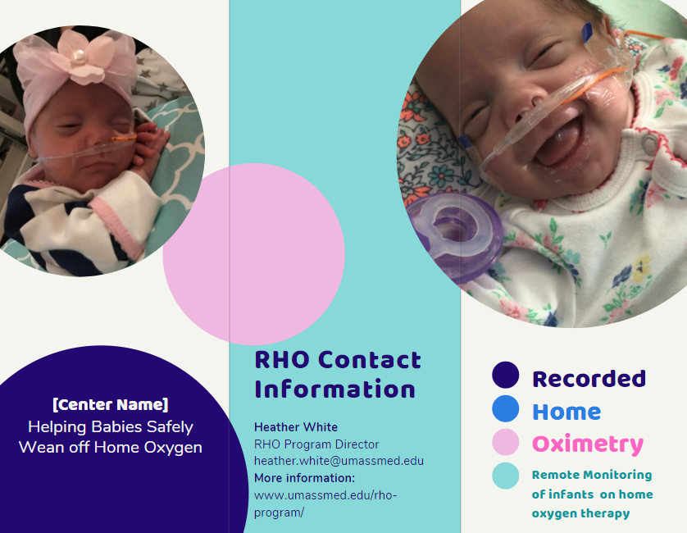
Parent Advisory Board Meeting
New parent brochure coming soon!
Bi-annual Parent Advisory Board meeting was held on 9/27/2021
Agenda Items:
    RHO Implementation progress
    Family Expectations of Weaning
    Family Communication
    Disseminating the RHO Program
PAB Suggestions
  Informational Brochure (including data and numbers)
  Invitation to Virtual Music Classes
  Facebook support group

Slide 18
Weaning Trajectory and Rate of Change in Weaning HOT by Initial Starting Flow Rate

Slide 19
Table 3. Rate Ratio of Lack of Improvement in Oxygen Weaning
Poisson Regression Model (N=26)
Risk factor | Category | RR | 95% CL |  | p | RR | 95% CL |  | p | VIF | RR | 95% CL |  | p | VIF
 |  | Univariate analysis |  |  |  | Multivariate analysis (full model) |  |  |  |  | Multivariate analysis (reduced model)
Starting O2 flowrate level | High vs Low | 1.70 | 1.20 | 2.39 | 0.0025 | 0.60 | 0.20 | 1.82 | 0.37 | 3.60
Sex | Female vs Male | 1.89 | 1.33 | 2.69 | 0.0004 | 1.74 | 0.69 | 4.41 | 0.24 | 2.09
GA at birth (weeks, reversed) | Continuous defined for each week younger | 1.17 | 1.10 | 1.26 | <.0001 | 1.32 | 1.10 | 1.58 | 0.0030 | 2.60 | 1.20 | 1.13 | 1.27 | <.0001 | 1.30
SGA | Yes vs No | 1.63 | 1.09 | 2.46 | 0.0182 | 3.26 | 1.43 | 7.42 | 0.0050 | 1.86 | 2.81 | 1.64 | 4.81 | 0.0002 | 1.41
Steroid for BPD (Inpatient) | Yes vs No | 3.20 | 2.17 | 4.71 | <.0001 | 0.64 | 0.29 | 1.42 | 0.27 | 1.61
Severe BPD | Yes vs No | 2.31 | 1.63 | 3.25 | <.0001 | 3.26 | 1.17 | 9.09 | 0.0237 | 3.07 | 2.01 | 1.30 | 3.12 | 0.0018 | 1.26
Adverse events | Yes vs No | 2.00 | 1.41 | 2.85 | 0.0001 | 4.36 | 2.18 | 8.74 | <.0001 | 2.01 | 2.97 | 1.95 | 4.52 | <.0001 | 1.15
Co-sleeping | Yes vs No | 2.16 | 1.34 | 3.48 | 0.0015 | 4.39 | 2.07 | 9.30 | 0.0001 | 1.26 | 5.86 | 3.27 | 10.49 | <.0001 | 1.10
Reflux medication | Yes vs No | 2.07 | 1.08 | 3.94 | 0.0274 | 0.69 | 0.32 | 1.46 | 0.33 | 1.32
Note: Outcome variable is lack of improvement in oxygen weaning, that is, the sum of the number of times that O2 flowrate increased from one epoch to the next epoch, and that of no changes in 4 consecutive epochs. The sum was capped at 20.
Note: Rate ratio (OR) is the ratio of the mean number of the outcome variable for a category vs that for the reference category. In case the covariate is a continuous variable, RR indicates the change in the mean number of the outcome variable corresponding to one unit increase in the covariate.
Note: VIF=variance inflation factor. It is an indicator of the degree of multicolinearity for a covariate with all other covariates in the model. It is always ≥1. A high value of VIF for a covariate is a sign of distorting the effects (parameter estimates) of all other covariates in the model. An ideal value of VIF is <2.5.
Note: SGA=small for gestational age at birth, defined as being born less than the 10th percentile for weight on the Fenton Preterm Growth Curve; BPD=Bronchopulmonary Dysplasia; adverse events include ???.

Slide 20

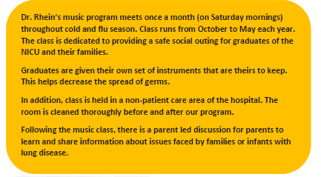
Virtual Music Class for Families with Children on Home Oxygen
Monthly music class at UMass
Parent recommendation to start a virtual music class with parents led discussion for all families at participating sites
Source of information from peer mentors

Slide 21

Parent Advisory Board Participation
Our goal is to have at least one family from each site to join the RHO Program Parent Advisory Board
Start thinking of families at your sites that may want to join our PAB

Slide 22

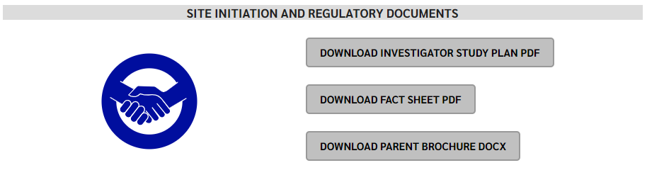
RHO Program Website
All resources, including training documents, the RHO manual, and other templates can be found on the RHO website at www.umassmed.edu/rho-program
Navigate to “Member Login” and log in with the following credentials to access the documents
  Username: RHO
  Password: Oximetry14

Slide 23



Closing Thoughts
Questions or Comments?

