Slide 1

The Recorded Home Oximetry (RHO) Program
Monthly Investigator Meeting
November 4, 2021

Slide 2

RHO Program Implementation Timeline
Feb - Mar 2021
Baseline data collection begins
Mar - May 2021
Initiate site training
Initiate monthly phone calls
May - Aug 2021
Jun 2021 - Feb 2022
Feb - Aug 2022
Aug 2022 - Feb 2023
Complete site training
Reach 33% of eligible families
Reach 66% of eligible families
Feb - Aug 2023
Reach 100% of eligible families
Initiate 18-month implementation
Begin providing monthly feedback reports

Slide 3
Site Progress on Implementation Start-Up
Site Name | Contract Executed | cIRB Approval | Local IRB Approval | Regulatory Documents | pSite Communication Plan Agreement | REDCap Access | Site Training Completed | Site Implementation Date | Downloading Schedule
Boston Children's Hospital | ᴏ | ᴏ | ᴏ | ᴏ | ᴏ | ᴏ | ᴏ | 6/1/2021 | M/T
Dartmouth-Hitchcock | ᴏ | ᴏ | ᴏ | ᴏ | ᴏ | ᴏ | ᴏ | 6/1/2021 | T/F
Maria Fareri Children's | ᴏ | N/A | ᴏ | ᴏ | N/A | ᴏ | ᴏ | 6/1/2021 | M/T
Massachusetts General Hospital | ᴏ | ᴏ | ᴏ | ᴏ | ᴏ | ᴏ | ᴏ | 6/1/2021 | M/T
University of Maryland | ᴏ | ᴏ | ᴏ | ᴏ | ᴏ | ᴏ | ᴏ | 6/1/2021 | M/T
Vanderbilt | ᴏ | N/A | ᴏ | ᴏ | N/A | ᴏ | ᴏ | 6/1/2021 | T/F
Arkansas Children's Hospital | ᴏ | ᴏ | ᴏ | ᴏ | ᴏ | ᴏ | ᴏ | 8/1/2021 | TBD
Children's Hospital of Phil. | ᴏ | N/A | ᴏ | ᴏ | N/A | ᴏ | ᴏ | 8/1/2021 | TBD
Cincinnati Children's Hospital | ᴏ | ᴏ | ᴏ | ᴏ | ᴏ | ᴏ | ᴏ | 8/1/2021 | TBD
National Jewish Health | ᴏ | ᴏ | ᴏ | ᴏ | ᴏ | ᴏ | ᴏ | 8/1/2021 | TBD
Nationwide Children's Hospital | ᴏ | ᴏ | ᴏ | ᴏ | ᴏ | ᴏ | ᴏ | 8/1/2021 | TBD
Peyton Manning Children's Hospital | ᴏ | ᴏ | ᴏ | ᴏ | ᴏ | ᴏ | ᴏ | 8/1/2021 | TBD
U. of California, San Diego | ᴏ | ᴏ | ᴏ | ᴏ | ᴏ | ᴏ | ᴏ | 8/1/2021 | TBD
U. of Kentucky Children's Hospital | ᴏ | ᴏ | ᴏ | ᴏ | ᴏ | ᴏ | ᴏ | 8/1/2021 | TBD

Slide 4
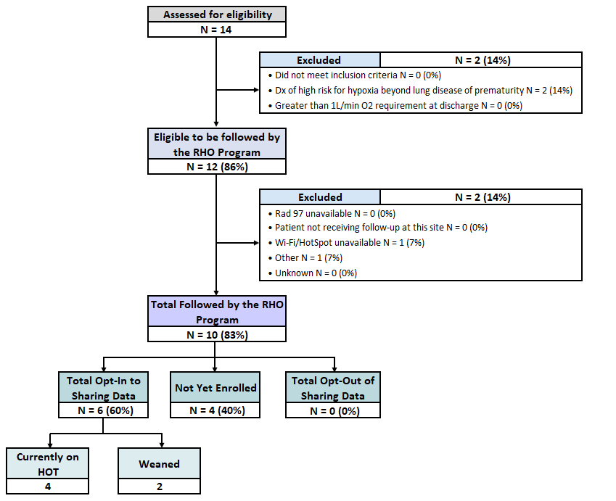
RHO Implementation Trial Consort Diagram
Notes:
44.5 days av O2 duration so far

Slide 5
Goal

Slide 6
Projected vs. Actual Enrollment Into the RHO Program
Sites IRB Approved: 10/14 (71%)
Sites IRB Approved & Enrolling: 3/10 (30%)
Site Name | Site IRB Approved | Estimate per Year | Estimate per Month | Current per Month
WAVE 1
Boston Children's Hospital | 10/4/2021 | 40 | 3.3 | 0.8
Dartmouth-Hitchcock | 10/4/2021 | 20 | 1.7 | 0.0
Maria Fareri Children's | 7/10/2021 | 14 | 1.2 | 0.0
Massachusetts General Hospital | 10/4/2021 | 13 | 1.1 | 0.5
University of Maryland | 10/4/2021 | 20 | 1.7 | 2.1
Vanderbilt | 7/21/2021 | 70 | 5.8 | 0.0
WAVE 2
Children's Hospital of Phil. | 10/20/2021 | 50 | 4.2 | 0.0
National Jewish Health | 10/4/2021 | 250 | 20.8 | 0.0
Nationwide Children's Hospital | 10/4/2021 | Not Provided | Not Provided | 0.0
U. of California, San Diego | 10/4/2021 | 65 | 5.4 | 0.0
*Only showing IRB approved sites

Slide 7
Barriers to Enrollment
What are some of the barriers your teams are facing for enrollment?
Project goal is to reach 33% of all eligible families by February 2022
  At this point, approximately 40 infants should have been followed by the RHO program
Will not know reach without sites screening logs
  Please ensure your site is screening all potential eligible infants being discharged home on respiratory support

Slide 8
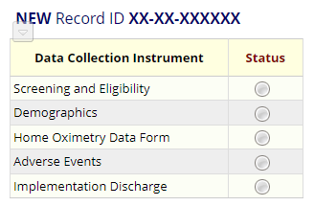
Screening and Eligibility
Please screen all potentially eligible babies in REDCap once your site goes live
This is important for the accuracy of the consort diagram and monthly reports

Slide 9
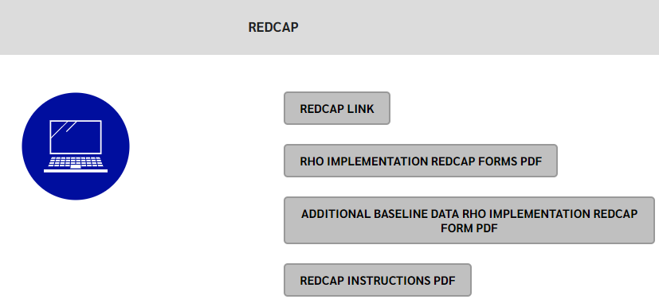
REDCap User Access Groups
Everyone who will be responsible for data entry in REDCap needs to complete a REDCap user request
9/14 sites have gotten their access to our REDCap. Thank you!
The instructions on how to request your account are available on our website

Slide 10
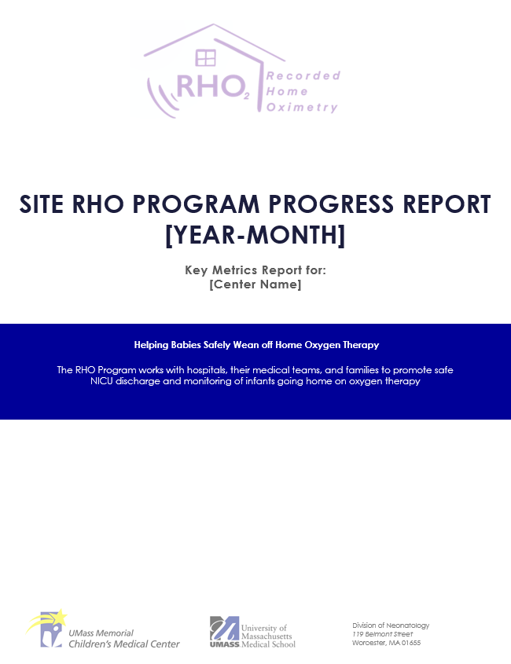

Baseline Data
Please send us baseline data once your site has received IRB approval
Baseline data will be used in your site's monthly reports
Monthly reports will start 3 months after your first patient is enrolled
Baseline data also includes non-VON variables for outpatient follow-up
  HOT Duration
  Adverse Events

Slide 11
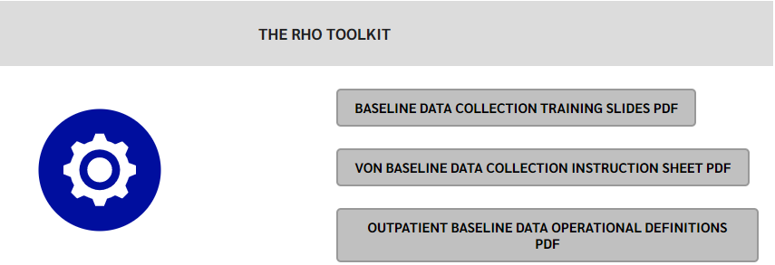
Additional Baseline Data
Please use your VON query to determine the children who went home on HOT to supply their additional baseline data (outpatient data not collected by VON)
The instructions and operational definitions are available on our website

Slide 12
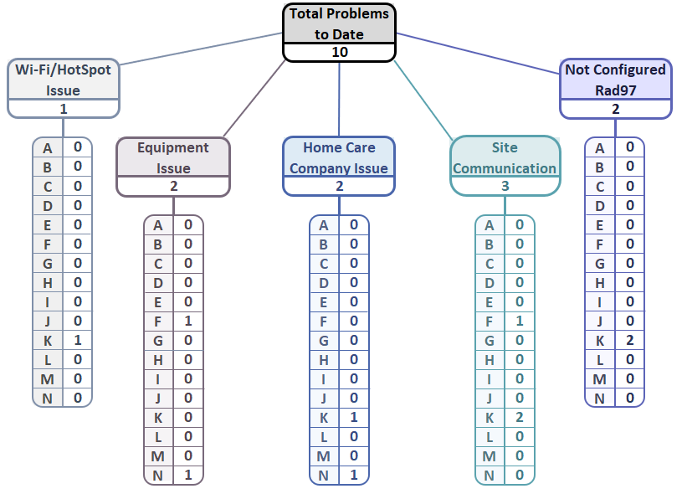
Implementation Related Problems

Slide 13
Implementation Related Problems
Goal

Slide 14
Deviation Types
Updated on 11-01-2021

Slide 15

Parent Advisory Board Participation
Our goal is to have at least one family from each site to join the RHO Program Parent Advisory Board
Start thinking of families at your sites that may want to join our PAB

Slide 16

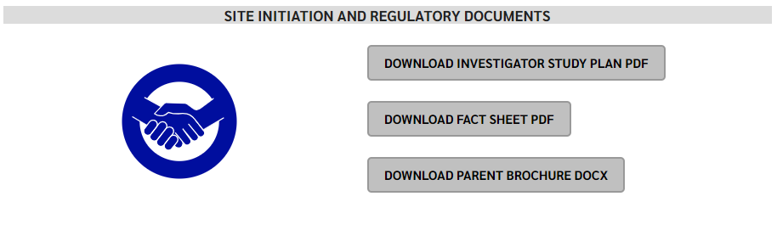
RHO Program Website
All resources, including training documents, the RHO manual, and other templates can be found on the RHO website at www.umassmed.edu/rho-program
Navigate to “Member Login” and log in with the following credentials to access the documents
  Username: RHO
  Password: Oximetry14

Slide 17



Closing Thoughts
Questions or Comments?

