Slide 1

The Recorded Home Oximetry (RHO) Program
Monthly Investigator Meeting
March 3, 2022

Slide 2

RHO Program Implementation Timeline
Feb - Mar 2021
Baseline data collection begins
Mar - May 2021
Initiate site training
Initiate monthly phone calls
May - Aug 2021
Jun 2021 - Feb 2022
Feb - Aug 2022
Aug 2022 - Feb 2023
Complete site training
Reach 33% of eligible families
Reach 66% of eligible families
Feb - Aug 2023
Reach 100% of eligible families
Initiate 18-month implementation
Begin providing monthly feedback reports

Slide 3



 | - Enrolling
 | - Activated but not enrolling
 | - Patient identified, not yet enrolled

Slide 4
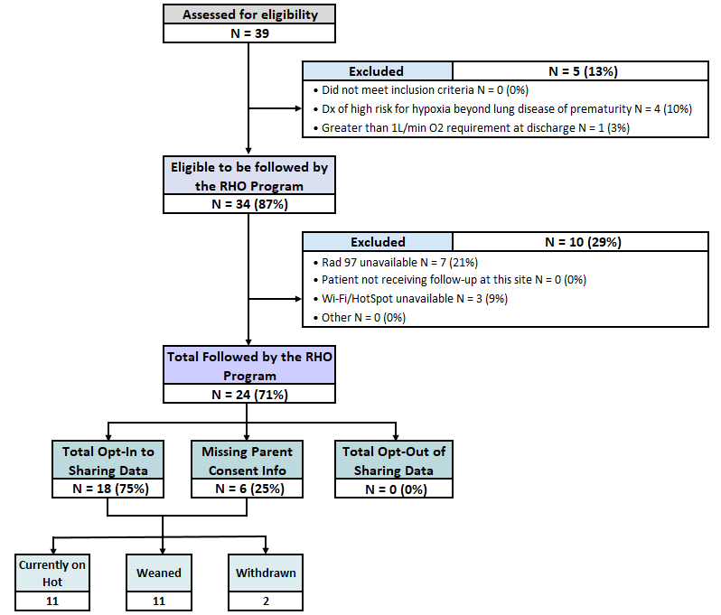
RHO Implementation Trial Consort Diagram
Average HOT Duration: 59±34

Slide 6
Projected vs. Actual Enrollment Into the RHO Program
Site Name | Estimate per Year | Estimate per Month | Current per Month | Eligible to Date | Followed to Date N(%)
WAVE 1
Boston Children's Hospital | 40 | 3.3 | 0.8 | 7 | 6 (86)
Dartmouth-Hitchcock | 20 | 1.7 | 0.0 | 0 | 0
Maria Fareri Children's | 14 | 1.2 | 0.7 | 2 | 2 (100)
Massachusetts General Hospital | 13 | 1.1 | 0.4 | 3 | 3 (100)
University of Maryland | 20 | 1.7 | 1.2 | 9 | 7 (78)
WAVE 2
Arkansas Children's Hospital | 48 | 4.0 | 0.8 | 3 | 3 (100)
Children's Hospital of Phil. | 50 | 4.2 | 0.0 | 5 | 0
Cincinnati Children's Hospital | 50 | 4.2 | 0.0 | 0 | 0
National Jewish Health | 250 | 20.8 | 0.0 | 0 | 0
Nationwide Children's Hospital | Not Provided | Not Provided | 0.0 | 0 | 0
Peyton Manning Children's Hospital | 25 | 2.1 | 0.0 | 0 | 0
U. of California, San Diego | 65 | 5.4 | 1.0 | 4 | 3 (75)
U. of Kentucky Children's Hospital | 50 | 4.2 | 0.0 | 0 | 0
*Only showing sites with executed contracts

Slide 7
Barriers to Enrollment
Screening Logs:
  Please ensure your site is screening ALL potentially eligible infants discharged home on respiratory support despite their participation status in the RHO program
  Completion of the screening form in REDCap is essential in the accuracy of the overall denominator and ensuring all eligible infants are captured across all sites
  Proper completion of the screening form would further aid in providing an accurate reach of the RHO program- a primary outcome of the implementation trial

Slide 8
Barriers to Enrollment Continued
Demographic Forms:
  Please ensure your site is filling-out demographic forms for ALL eligible infants discharged on supplemental oxygen despite their participation status in the RHO program
  The following forms should be completed in the project’s REDCap for infants who are eligible but aren’t followed by the program but opt-in to data collection
    1. Screening and Eligibility form
    2. Demographics form
    3. Implementation Discharge form (essential to obtain HOT duration on ALL eligible infants for future analysis)
    4. Adverse Events form

Slide 9
Inactive Sites
We are now one year into the project period, and 7 months into when 33% of patients across ALL sites are to being reached/followed by the RHO Program
Any site who is still inactive will start to receive weekly inquiries on their start-up status

Slide 10
Upcoming Modifications to the REDCap
PPHN-specific medication therapy
  The total number of infants excluded due to PPHN specific medication therapy at the time of enrollment isn’t being captured accurately in the project’s REDCap
  To ensure this information is properly documented for future analysis, we’ve included a follow-up question to the first exclusion criteria
  If the patient is being excluded for PPHN specific medication therapy, select “Yes” to the first exclusion criteria which will then display the follow-up question regarding their PPHN medication status
RAD 97 Alarm Parameters
  Dr. Demouro would like to obtain alarm parameter data for an additional project
  Do sites follow set guidelines for parameters?
Are there any other modifications, additions, and/or suggestions you would like to propose for the REDCap?

Slide 11
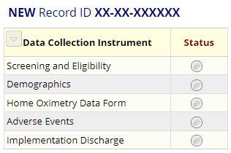
REDCap User Access Groups
11/14 sites have access to their Data Access Group (DAG)
10/10 enrolling sites have access to their DAG
9/10 enrolling sites filled out demographic forms for their patients

Slide 12
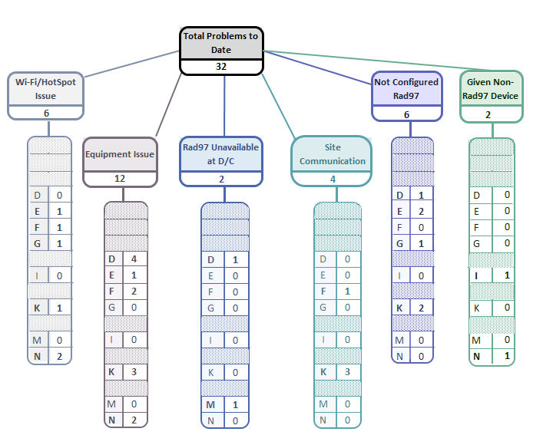
Implementation Related Problems

Slide 14


RAD 97 Configuration
Please make sure that the light of the wi-fi symbol is green
If it is blue , either:
  the device is not configured to our SafetyNet
  the device is connected to Guest Network
  the Wi-Fi signal is too low
Solution
  The providing homecare company should contact their local Masimo account manager for assistance
  If the issue persists, let the RHO Leadership know and we will contact Masimo’s leadership
How to verify the device is properly configured:
  Tap on the Wi-Fi icon
  Tap on the “I” icon next to the selected network
  Scroll to “destination IP address”
    The destination IP address should be 66.9.45.156
    If the IP address differs from the one stated above, then the device isn’t properly configured to the UMass PSN and you would need to contact your local Masimo account manager for further instructions

Slide 15
Homecare Company Readiness
Please make sure to give your homecare companies at least a week’s notice when there is a potential discharge as a new site coming onboard to ensure RAD 97 availability at time of discharge
If your current homecare companies do not carry RAD 97’s or participate in the RHO program, please make sure to seek out homecare companies who do to ensure all eligible infants who can be followed are followed by the RHO program

Slide 16
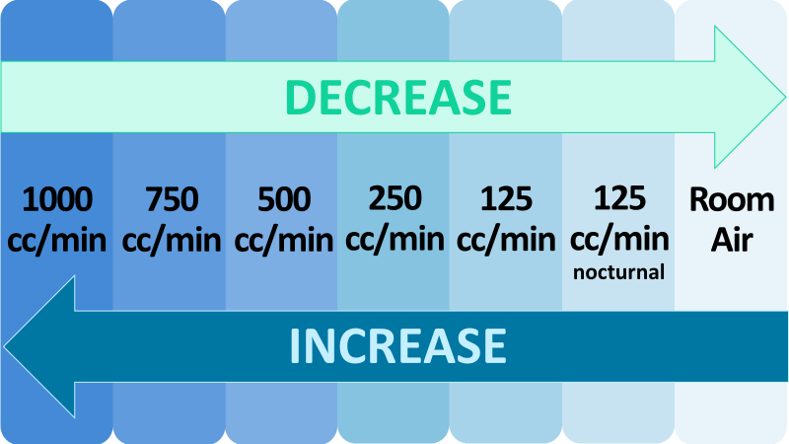
Oxygen Flow Rate Variations Between Sites
The RHO program at UMass has been operating within set oxygen flow rate parameters
Due to an increase in variation of flow rates at discharge across all active sites, standardization is required at this time for future analysis purposes
An email will be sent out to all sites outlining how we will manage those infant’s who are discharged on a flow rate outside of the set RHO parameters moving forward

Slide 17
Management of Infants Discharged on Less than 125cc/min
They will be enrolled, but encouraged to increase up to 125cc/min at time of discharge
If a patient is being managed on less than 125 cc/min and their bi-weekly oximetry report suggests an increase or a wean, the recommendation will be to increase or wean to a flowrate that is in accordance with the algorithm
If a patient is being managed on less than 125cc/min any wean below 125cc/min will not be counted as a “wean” in data analysis

Slide 18
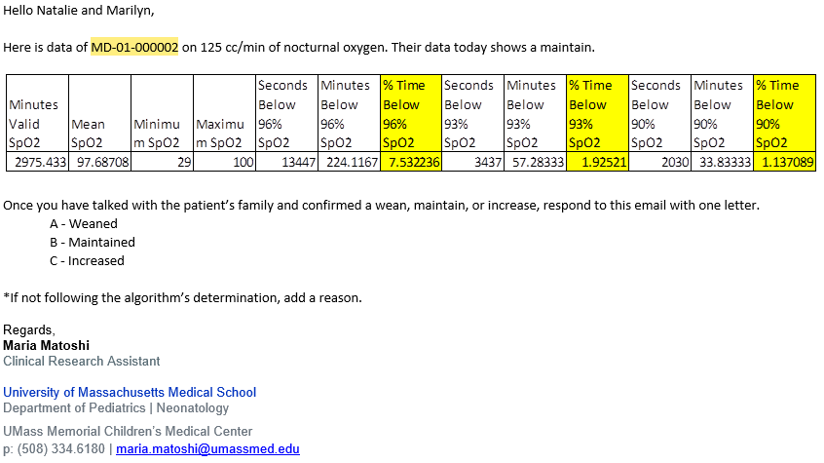
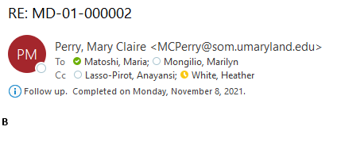
Responses to Bi-Weekly emails
Email from UMass:
If you are following the algorithm’s determination, you only need to respond with one letter.
A – Weaned
B – Maintained
C – Increased
If you are not following the algorithm’s determination, please type the appropriate letter and a reason for not following the algorithm’s determination.
To ensure proper documentation of the data, please be sure to respond to the bi-weekly emails. If we don’t receive a response, we will ask for clarification on the subsequent email
Response from a Site:

Slide 19
Deviation Types
Total Reports | Reports with Deviation(s)
520 | 190 (37%)

Slide 21

Parent Advisory Board Meeting
Bi-annual Parent Advisory Board meeting will be held on
Agenda Items:
    RHO Implementation progress
    Family Expectations of Weaning
    Family Communication
    Disseminating the RHO Program
PAB Suggestions
  Informational Brochure (including data and numbers)
  Invitation to Virtual Music Classes
  Facebook support group
  *Please be sure to notify Heather of families who would be interested in joining

Slide 22

Invoicing/ Subcontracts
Our grants office will be reaching out to all sites for invoices
Please notify Heather who will be the primary delegate at your site
If you have not received funds for the year 1 subcontract, please be sure to submit an invoice to our grant’s office as soon as possible
Year 2 subcontract funds will be sent out to all sites in the upcoming weeks

Slide 23

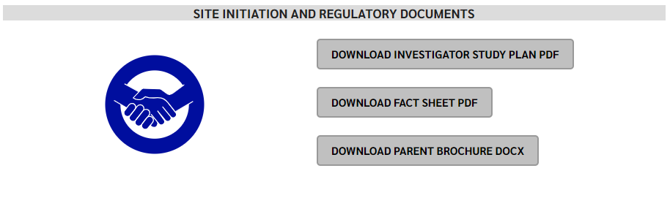
RHO Program Website
All resources, including training documents, the RHO manual, and other templates can be found on the RHO website at www.umassmed.edu/rho-program
Navigate to “Member Login” and log in with the following credentials to access the documents
  Username: RHO
  Password: Oximetry14

Slide 24



Closing Thoughts
Questions or Comments?

