Slide 1
The Recorded Home Oximetry (RHO) Program
Monthly Investigator Meeting
April 1, 2021

Slide 2
Attendance
Site Roll-Call

Slide 3
Site Selection for Implementation Waves
Wave 1
Dartmouth Hitchcock Medical Center
Boston Children’s Hospital
Massachusetts General Hospital
Maria Fereri Children’s Hospital
University of Maryland
Vanderbilt
Wave 2
Arkansas Children’s Hospital
Children’s Hospital of Philadelphia
Cincinnati Children’s Hospital
National Jewish Health
Nationwide Children’s Hospital
St. Vincent Neighborhood Hospital
University of California, San Diego
University of Kentucky

Slide 4

RHO Program Implementation Timeline: Wave 1 Sites
February 2021
Baseline data collection begins
March 2021
Initiate site training
Initiate monthly phone calls
May 2021
June-August 2021
February 2022
August 2022
Complete site training
Reach 33% of eligible families
Reach 66% of eligible families
February 2023
Reach 100% of eligible families
Initiate 18-month implementation
Begin providing monthly feedback reports

Slide 5
RHO Program Implementation Timeline: Wave 2 Sites
March 2021
Baseline data collection begins
May 2021
Initiate site training
Initiate monthly phone calls
August 2021
December 2021-February 2022
August 2022
February 2023
Complete site training
Reach 33% of eligible families
Reach 66% of eligible families
August 2023
Reach 100% of eligible families
Initiate 18-month implementation
Begin providing monthly feedback reports

Slide 6
Site Training Planning
5/6 Wave 1 Site Visits Scheduled
  COVID Travel restrictions, UMass verifying limitations
  If your site requires special testing or quarantine reach out to Heather
Starting to plan Wave 2 Visits
Masimo coordinating times to meet with sites identified home care companies

Slide 7
IRB Approval
Umass IRB will serve as the IRB of record for this trial- approved!
Sites to start reliance process
  Heather and Lindsey to help sites with process at each site as they do differ
  Contact team with any questions or local IRB concerns
Heather will serve as the liaison between IRB’s
  Reach out with any questions!

Slide 8

SMART IRB
Items to be Uploaded
Site modified “Fact Sheet”
Protocol reviewed by site
https://smartirb.org/

Slide 9
Home Care Companies Providing Masimo RAD 97s

Slide 10
Home Care Plan
Masimo will help ensure that each implementation site has 2-3 available home care companies providing RAD 97s
Licenses will be provided through grant funds
Available Trade-Ins available
Home Care’s will be contacted by Masimo Representatives

Slide 11

Analysis of Real World RHO Implementation Data

Slide 12
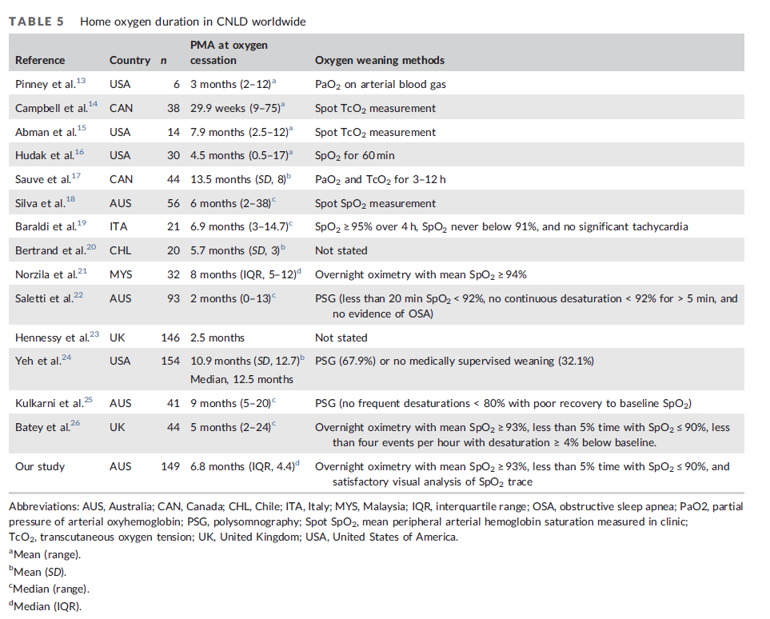
Average Home Oxygen Duration in the Literature
Wong et al. 2021

Slide 13
Current Weaning Strategies
Durations of HOT are variable due to variability in practice
Of the available literature the average duration of HOT is 6.6 months (min 2 months; max 13.5 months)
Most literature agrees preterm infants will be on HOT till 9-12 months corrected age

Slide 14
Oxygen Weaning Trajectory Using RHO
Prospective cohort study
Goal to evaluate weaning trajectory using RHO and to identify risk factors associated with infants requiring increases in flow rate
Evaluate total duration of home oxygen using RHO

Slide 15
Prospective Cohort at UMass
Figure 1. Consort Diagram of Infants Followed by the RHO Program
Infants Discharged Home on Oxygen from the UMMMC NICU from June 2019 to December 2020
N= 28
Excluded
1- Craniofacial Anomaly
4- Still weaning from oxygen using the RHO program
1- Transferred care to another institution
Infants Weaned Through the RHO Program
N= 22
*2 Received follow-up at BCH

Slide 16
Cohort Demographics
Table 1. Demographics of Infants Followed by the RHO Program
 |  |  | Infants Followed by the RHO Program (N=22)
 |  |  | N (%)
Sex
Male |  |  | 11 | 50%
Race
White |  |  | 16 | 73%
Black |  |  | 4 | 18%
Other |  |  | 2 | 9%
Hispanic |  |  | 3 | 14%
Multiplicity
Singleton |  |  | 13 | 59%
Twin |  |  | 9 | 41%
Small for Gestational Age |  |  | 4 | 18%
BPD Diagnosis at 36 0/7 wk CGA
Moderate |  |  | 14 | 64%
Severe |  |  | 8 | 36%
Oral Steroids for BPD Prophylaxis |  |  | 11 | 50%
Inhaled Steroids |  |  | 3 | 14%
PDA, by confirmed ECHO |  |  | 16 | 73%
PDA Ligation |  |  | 2 | 9%
Pulmonary Hypertension |  |  | 4 | 18%
Initial O2 Requirement at Discharge
≤125 cc/min |  |  | 15 | 68%
250 cc/min |  |  | 5 | 23%
≥500 cc/min |  |  | 2 | 9%
Public Insurance |  |  | 15 | 68%
 |  |  | Mean ± SD
Birth Weight, g |  |  | 1028.2 | 551.0
Gestational Age, wk |  |  | 26.7 | 3.3
Maternal Age at Birth |  |  | 29.4 | 7.1
Length of NICU Stay |  |  | 90.1 | 37.6
Corrected Gestational Age at Discharge |  |  | 39.9 | 3.3
NICU Days on Ventilator |  |  | 8.6 | 14.3
Last day on Positive Pressure Ventilation, CGA |  |  | 35.9 | 3.5

Slide 17
Duration of Home Oxygen
Table 2. Median and Mean Duration of Home Oxygen by Initial Flow Rate
Influence | Duration, Median* | Duration, Mean ± SD*
All Infants | 1.0 | 2.0 ± 2.4
Initial Flow Rate at Discharge
100-150 cc/minª | 0.8 | 1.8 ± 2.4
200- 300 cc/min^{b} | 0.8 | 1.7 ± 2.3
500 cc/min^{b} | 4.4 | 4.4 ± 2.4
*Duration in months corrected age
ª Low initial flow rate start
^{b} High initial flow rate start

Slide 18
Weaning Trajectory and Rate of Change in Weaning HOT by Initial Starting Flow Rate
^{A} 2 Data Epochs equals one calendar week

Slide 19
Table 4. Rate Ratio of Requiring a Flow Increase or Maintain in Oxygen Flow Rate While Weaning (Poisson Regression Model)
Model type | Risk factor | Category | RR | 95% CL |  | p
Univariate | Starting O2 flowrate level | High vs Low | 1.45 | 1.14 | 1.83 | 0.0024
 | Sex | Male vs Female | 0.80 | 0.63 | 1.01 | 0.07
 | GA at birth | Continuous | 0.89 | 0.86 | 0.94 | <.0001
 | SGA | Yes vs No | 1.37 | 1.04 | 1.80 | 0.0256
Multivariate | Starting O2 flowrate level | High vs Low | 0.97 | 0.74 | 1.28 | 0.83
 | Sex | Male vs Female | 1.31 | 0.98 | 1.75 | 0.07
 | GA at birth | Continuous | 0.85 | 0.81 | 0.90 | <.0001
 | SGA | Yes vs No | 2.22 | 1.60 | 3.09 | <.0001

Slide 20
Conclusions
Similar to the original RHO trial findings the RHO Program significantly shortens duration of home oxygen therapy
SGA infants are at a higher likelihood of requiring an increase while weaning from HOT
Lower birth weight is associated with higher chances of increases or prolonged maintains on the same flow rate
Higher N is needed to confirm results

Slide 21
Future Directions
UMass prophylactically will increase some infants to higher flow rates for discharge which may have impacted the trajectory curve represented
More follow-up variables are needed to understand impact of additional treatment therapies (reflux, inhaled steroids etc.)

Slide 22



Closing Thoughts
Questions and Comments

