Slide 1

The Recorded Home Oximetry (RHO) Program
Monthly Investigator Meeting
April 7, 2022

Slide 2

RHO Program Implementation Timeline
Feb - Mar 2021
Baseline data collection begins
Mar - May 2021
Initiate site training
Initiate monthly phone calls
May - Aug 2021
Jun 2021 - Feb 2022
Feb - Aug 2022
Aug 2022 - Feb 2023
Complete site training
Reach 33% of eligible families
Reach 66% of eligible families
Feb - Aug 2023
Reach 100% of eligible families
Initiate 18-month implementation
Begin providing monthly feedback reports

Slide 3



 | - Enrolling
 | - Activated but not enrolling
 | - Patient identified, not yet enrolled

Slide 4
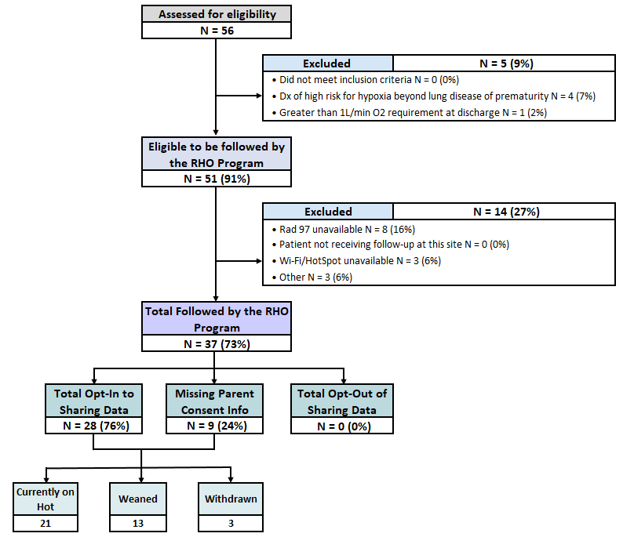
RHO Implementation Trial Consort Diagram
Average HOT Duration: 62±38

Slide 5
Goal

Slide 6
Projected vs. Actual Enrollment Into the RHO Program
Site Name | Estimate per Year | Estimate per Month | Current per Month | Eligible to Date | Eligible to be Followed but Excluded | Followed to Date N(%)
WAVE 1
Boston Children's Hospital | 40 | 3.3 | 0.7 | 7 | 1 | 6 (86)
Dartmouth-Hitchcock | 20 | 1.7 | 0.8 | 5 | 0 | 5 (100)
Maria Fareri Children's | 14 | 1.2 | 0.4 | 2 | 0 | 2 (100)
Massachusetts General Hospital | 13 | 1.1 | 0.6 | 5 | 0 | 5 (100)
University of Maryland | 20 | 1.7 | 1.2 | 11 | 2 | 9 (82)
WAVE 2
Arkansas Children's Hospital | 48 | 4.0 | 0.4 | 3 | 0 | 3 (100)
Children's Hospital of Phil. | 50 | 4.2 | 0.0 | 5 | 5 | 0
Cincinnati Children's Hospital | 50 | 4.2 | 0.0 | 0 | 0 | 0
National Jewish Health | 250 | 20.8 | 0.0 | 0 | 0 | 0
Nationwide Children's Hospital | Not Provided | Not Provided | 0.5 | 3 | 0 | 3 (100)
Peyton Manning Children's Hospital | 25 | 2.1 | 0.0 | 0 | 0 | 0
U. of California, San Diego | 65 | 5.4 | 0.8 | 5 | 1 | 4 (80)
U. of Kentucky Children's Hospital | 50 | 4.2 | 0.0 | 0 | 0 | 0
*Only showing sites with executed contracts

Slide 7
Barriers to Enrollment
Screening Logs:
  Please ensure your site is screening ALL potentially eligible infants discharged home on respiratory support despite their participation status in the RHO program
  Completion of the screening form in REDCap is essential in the accuracy of the overall denominator and ensuring all eligible infants are captured across all sites
  Proper completion of the screening form would further aid in providing an accurate reach of the RHO program- a primary outcome of the implementation trial

Slide 8
Barriers to Enrollment Continued
Demographic Forms:
  Please ensure your site is filling-out demographic forms for ALL eligible infants discharged on supplemental oxygen despite their participation status in the RHO program
  Completion of the demographics form is essential for the individualized monthly site reports, which are sent out to all active sites at the beginning of each month
  The following forms should be completed in the project’s REDCap for infants who are eligible but aren’t followed by the program but opt-in to data collection
    1. Screening and Eligibility form
    2. Demographics form
    3. Implementation Discharge form (essential to obtain HOT duration on ALL eligible infants for future analysis)
    4. Adverse Events form

Slide 9
Inactive Sites
We are now one year into the project period, and 7 months into when 33% of patients across ALL sites are to being reached/followed by the RHO Program
Any site who is still inactive will start to receive weekly inquiries on their start-up status

Slide 10
Baseline Data
As a reminder, all sites are required to submit their VON and Additional baseline data
Templates and instructions on how to extract and format the data can be found on the RHO website
2/14 sites have submitted both sets of baseline data
Please reach out to Heather or Crystal with any questions

Slide 11
Upcoming IRB Submission
  Heather is working on the IRB submission for the Family Engagement Pre and Post Implementation survey’s
  Once we receive IRB approval, we will send an email to all sites with all appropriate documents to submit to your IRB
  Please reach out to Heather with any questions

Slide 12
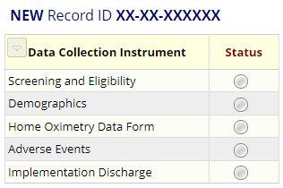
REDCap User Access Groups
11/14 sites have access to their Data Access Group (DAG)
10/10 enrolling sites have access to their DAG
9/10 enrolling sites filled out demographic forms for their patients

Slide 13
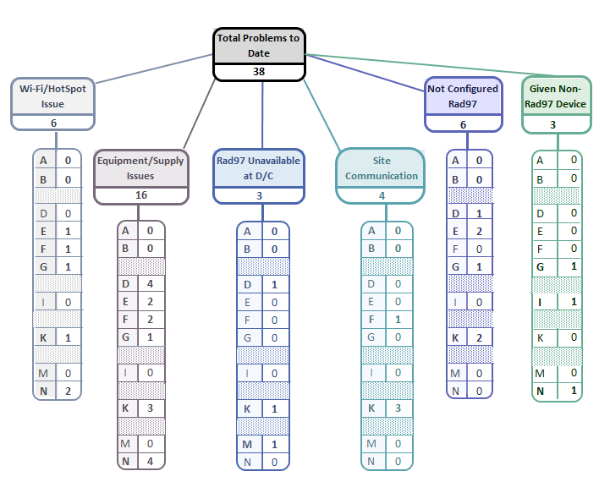
Implementation Related Problems

Slide 14
Goal

Slide 15
Deviation Types
Total Reports | Reports with Deviation(s)
723 | 263 (36%)

Slide 16
Goal

Slide 17
Most Recent Reoccurring Monitor Issues
Damaged Equipment/ Monitor Switch-outs
There has been an increase in the frequency of equipment related issues across all active sites within the last month. We’ve brought this to Masimo’s attention and are working with them to identify possible contributing factors
Probe Related Issues
Many families have been running out of probes and have been experiencing probe issues
There is currently a national shortage of probes
Families only receive 4 per month on average across states – this is different practice than in the NICU
  We are working on a fact sheet to disseminate to sites and families on how to preserve the probes for longer use
Contacting Parents to Provide Recommendation
Several sites have consistently not been able to get in contact with families to provide a recommendation
  Are there any trends/ characteristics that are notable among these families?

Slide 18
Homecare Company Readiness
Please make sure to give your homecare companies at least a week’s notice when there is a potential discharge as a new site coming onboard to ensure RAD 97 availability at time of discharge
If your current homecare companies do not carry RAD 97’s or participate in the RHO program, please make sure to seek out homecare companies who do to ensure all eligible infants who can be followed are followed by the RHO program

Slide 19
Progress and Outcomes of the Program To-Date

Slide 23
Parent Advisory Board Meeting Update
Key Points/Parent Suggestions
Families who took part in the program strongly preferred the twice a week downloads and check-ins, especially within the first month of NICU discharge
  They expressed that it provided reassurance and gave them peace of mind to have someone to turn to for questions, concerns, and issues
Suggested creating mixed media resource toolkit for parents (i.e troubleshooting guides, FAQs sheet, tips etc.)
Discussion around the family engagement pre and post parent survey

Slide 24

Invoicing/ Subcontracts
YR02 contracts have been sent to almost all participating sites
Please notify Heather who will be the primary delegate
If you have not received funds for YR01, please be sure to submit an invoice to our grant’s office as soon as possible

Slide 25

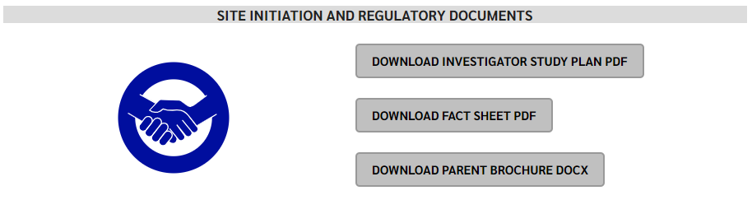
RHO Program Website
All resources, including training documents, the RHO manual, and other templates can be found on the RHO website at www.umassmed.edu/rho-program
Navigate to “Member Login” and log in with the following credentials to access the documents
  Username: RHO
  Password: Oximetry14

Slide 26



Closing Thoughts
Questions or Comments?
Are there any suggestions and/or feedback on the progress of the program that you would like to share with the team at this time?

Slide 27


RAD 97 Configuration
Please make sure that the light of the wi-fi symbol is green
If it is blue , either:
  the device is not configured to our SafetyNet
  the device is connected to Guest Network
  the Wi-Fi signal is too low
Solution
  The providing homecare company should contact their local Masimo account manager for assistance
  If the issue persists, let the RHO Leadership know and we will contact Masimo’s leadership
How to verify the device is properly configured:
  Tap on the Wi-Fi icon
  Tap on the “I” icon next to the selected network
  Scroll to “destination IP address”
    The destination IP address should be 66.9.45.156
    If the IP address differs from the one stated above, then the device isn’t properly configured to the UMass PSN and you would need to contact your local Masimo account manager for further instructions

Slide 28
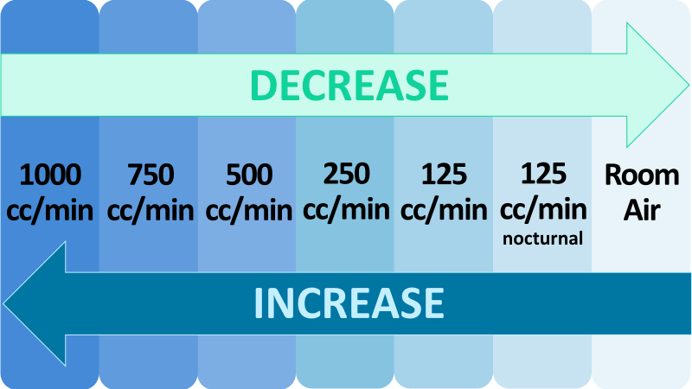
Oxygen Flow Rate Variations Between Sites
The RHO program at UMass has been operating within set oxygen flow rate parameters
Due to an increase in variation of flow rates at discharge across all active sites, standardization is required at this time for future analysis purposes
An email will be sent out to all sites outlining how we will manage those infant’s who are discharged on a flow rate outside of the set RHO parameters moving forward

Slide 29
Management of Infants Discharged on Less than 125cc/min
They will be enrolled, but encouraged to increase up to 125cc/min at time of discharge
If a patient is being managed on less than 125 cc/min and their bi-weekly oximetry report suggests an increase or a wean, the recommendation will be to increase or wean to a flowrate that is in accordance with the algorithm
If a patient is being managed on less than 125cc/min any wean below 125cc/min will not be counted as a “wean” in data analysis

Slide 30
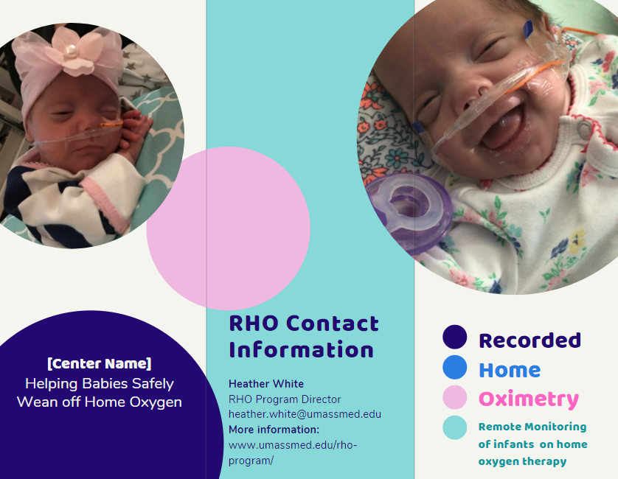
Parent Advisory Board Meeting
Bi-annual Parent Advisory Board meeting will be held on
Agenda Items:
    RHO Implementation progress
    Family Expectations of Weaning
    Family Communication
    Disseminating the RHO Program
PAB Suggestions
  Informational Brochure (including data and numbers)
  Invitation to Virtual Music Classes
  Facebook support group
  *Please be sure to notify Heather of families who would be interested in joining

Slide 31
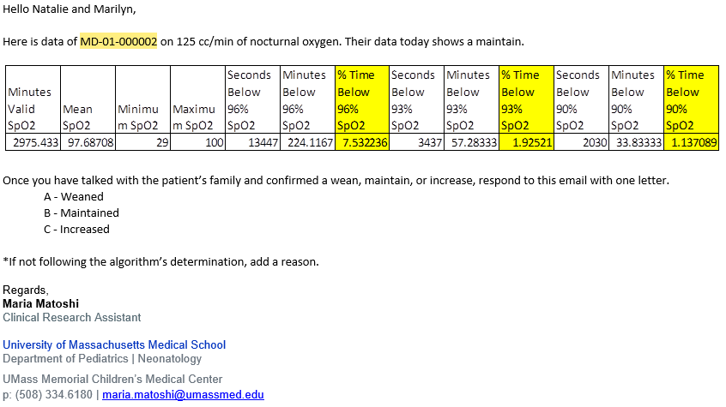
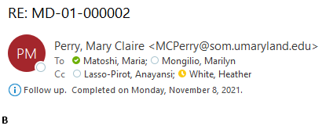
Responses to Bi-Weekly emails
Email from UMass:
If you are following the algorithm’s determination, you only need to respond with one letter.
A – Weaned
B – Maintained
C – Increased
If you are not following the algorithm’s determination, please type the appropriate letter and a reason for not following the algorithm’s determination.
To ensure proper documentation of the data, please be sure to respond to the bi-weekly emails. If we don’t receive a response, we will ask for clarification on the subsequent email
Response from a Site:

