Slide 1
The Recorded Home Oximetry (RHO) Program
Monthly Investigator Meeting
June 3, 2021

Slide 2
Site Selection for Implementation Waves
Wave 1
Dartmouth Hitchcock Medical Center
Boston Children’s Hospital
Massachusetts General Hospital
Maria Fereri Children’s Hospital
University of Maryland
Vanderbilt
Wave 2
Arkansas Children’s Hospital
Children’s Hospital of Philadelphia
Cincinnati Children’s Hospital
National Jewish Health
Nationwide Children’s Hospital
Peyton Manning Children’s Hospital
University of California, San Diego
University of Kentucky

Slide 3

RHO Program Implementation Timeline: Wave 1 Sites
February 2021
Baseline data collection begins
March 2021
Initiate site training
Initiate monthly phone calls
May 2021
June-August 2021
February 2022
August 2022
Complete site training
Reach 33% of eligible families
Reach 66% of eligible families
February 2023
Reach 100% of eligible families
Initiate 18-month implementation
Begin providing monthly feedback reports

Slide 4
RHO Program Implementation Timeline: Wave 2 Sites
March 2021
Baseline data collection begins
May 2021
Initiate site training
August 2021
December 2021-February 2022
August 2022
February 2023
Complete site training
Reach 33% of eligible families
Reach 66% of eligible families
August 2023
Reach 100% of eligible families
Initiate 18-month implementation
Begin providing monthly feedback reports

Slide 5
Site Training Planning
Wave 1 Site Visits Completed
4/8 Wave 2 Visits Scheduled
Masimo coordinating times to meet with sites identified home care companies
  Heather has also been conducting information sessions with each site’s designated home care companies

Slide 6
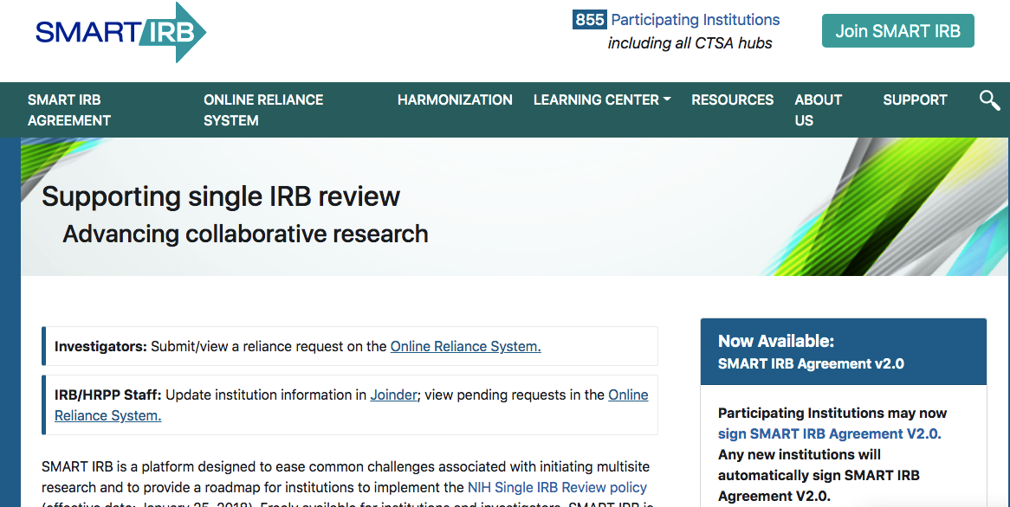
SMART IRB
Items to be Uploaded
Site modified “Fact Sheet”
Protocol reviewed by site
https://smartirb.org/

Slide 7
Updates on IRB Approval
If your IRB is requiring written informed consent- do not cede approval to UMMS
If referring hospitals are to provide VON data separate IRB will be executed- Heather working on protocol
pSite forms will be disseminated once individual site IRB has ceded approval

Slide 8
Questions or concerns regarding IRB approval?
Site specific problems we can help with?

Slide 9
Home Care Companies Providing Masimo RAD 97s
50% of sites have met the target amount of home cares!

Slide 10
Home Care Plan
Masimo will help ensure that each implementation site has 2-3 available home care companies providing RAD 97s
Licenses will be provided through grant funds
Available Trade-Ins available
Home Care’s will be contacted by Masimo Representatives

Slide 11
Site Progress on Implementation Start-Up
Site Name | Contract Executed | cIRB Approval | Local IRB Approval | Regulatory Documents | pSite Communication Plan Agreement | Site Training Completed | Site Implementation Date | First Enrollment Date | Downloading Schedule
Boston Children's Hospital | ᴏ | ᴏ | ᴏ | ᴏ | ᴏ | ᴏ | 6/1/2021 |  | M/T
Dartmouth-Hitchcock | ᴏ | ᴏ | ᴏ | ᴏ | ᴏ | ᴏ | 6/1/2021 |  | T/F
Maria Fareri Children's | ᴏ | N/A | ᴏ | ᴏ | N/A | ᴏ | 6/1/2021 |  | M/T
Massachuesetts General Hospital | ᴏ | ᴏ | ᴏ | ᴏ | ᴏ | ᴏ | 6/1/2021 |  | M/T
University of Maryland | ᴏ | ᴏ | ᴏ | ᴏ | ᴏ | ᴏ | 6/1/2021 |  | M/T
Vanderbilit | ᴏ | N/A | ᴏ | ᴏ | N/A | ᴏ | 6/1/2021 |  | T/F
Arkansas Children's Hospital | ᴏ | ᴏ | ᴏ | ᴏ | ᴏ | ᴏ | 8/1/2021 |  | TBD
Children's Hospital of Phil. | ᴏ | ᴏ | ᴏ | ᴏ | ᴏ | ᴏ | 8/1/2021 |  | TBD
Cincinatti Children's Hospital | ᴏ | ᴏ | ᴏ | ᴏ | ᴏ | ᴏ | 8/1/2021 |  | TBD
National Jewish Health | ᴏ | ᴏ | ᴏ | ᴏ | ᴏ | ᴏ | 8/1/2021 |  | TBD
Nationwide Children's Hospital | ᴏ | ᴏ | ᴏ | ᴏ | ᴏ | ᴏ | 8/1/2021 |  | TBD
Peyton Manning Children's Hospital | ᴏ | ᴏ | ᴏ | ᴏ | ᴏ | ᴏ | 8/1/2021 |  | TBD
U. of California, San Diego | ᴏ | ᴏ | ᴏ | ᴏ | ᴏ | ᴏ | 8/1/2021 |  | TBD
U. of Kentucky Children's Hospital | ᴏ | ᴏ | ᴏ | ᴏ | ᴏ | ᴏ | 8/1/2021 |  | TBD

Slide 12

Collaboration Possibilities
Possibilities for spin-off projects
Submit potential project ideas to Heather and Larry
Most if not, all will require a separate IRB approval
Implementation sites will then have the choice to opt-into the different spin-off projects

Slide 13



Closing Thoughts
Questions and Comments

