Slide 1

The Recorded Home Oximetry (RHO) Program
Monthly Investigator Meeting
July 1, 2021

Slide 2
Site Selection for Implementation Waves
Wave 1
Dartmouth Hitchcock Medical Center
Boston Children’s Hospital
Massachusetts General Hospital
Maria Fereri Children’s Hospital
University of Maryland
Vanderbilt
Wave 2
Arkansas Children’s Hospital
Children’s Hospital of Philadelphia
Cincinnati Children’s Hospital
National Jewish Health
Nationwide Children’s Hospital
Peyton Manning Children’s Hospital
University of California, San Diego
University of Kentucky

Slide 3

RHO Program Implementation Timeline: Wave 1 Sites
February 2021
Baseline data collection begins
March 2021
Initiate site training
Initiate monthly phone calls
May 2021
June-August 2021
February 2022
August 2022
Complete site training
Reach 33% of eligible families
Reach 66% of eligible families
February 2023
Reach 100% of eligible families
Initiate 18-month implementation
Begin providing monthly feedback reports

Slide 4
RHO Program Implementation Timeline: Wave 2 Sites
March 2021
Baseline data collection begins
May 2021
Initiate site training
August 2021
December 2021-February 2022
August 2022
February 2023
Complete site training
Reach 33% of eligible families
Reach 66% of eligible families
August 2023
Reach 100% of eligible families
Initiate 18-month implementation
Begin providing monthly feedback reports

Slide 5
Site Training Planning
Wave 1 Site Visits Completed
4/8 Wave 2 Visits Completed
6/8 Wave 2 Site Visits Scheduled
Masimo coordinating times to meet with sites identified home care companies
  Heather has also been conducting information sessions with each site’s designated home care companies

Slide 6
Updates on IRB Approval
Due to delay in SMART IRB submissions of wave 2 sites please start the process with your IRB’s now
SMART IRB for Wave 2 sites open!
Please reach out to Heather with any questions

Slide 7
Questions or concerns regarding IRB approval?
Site specific problems we can help with?

Slide 8
Home Care Companies Providing Masimo RAD 97s
100% of sites have met the target amount of home cares!

Slide 9
Site Progress on Implementation Start-Up
Site Name | Contract Executed | cIRB Approval | Local IRB Approval | Regulatory Documents | pSite Communication Plan Agreement | Site Training Completed | Site Implementation Date | First Enrollment Date | Downloading Schedule
Boston Children's Hospital | ᴏ | ᴏ | ᴏ | ᴏ | ᴏ | ᴏ | 6/1/2021 | 7/8/2021 | M/T
Dartmouth-Hitchcock | ᴏ | ᴏ | ᴏ | ᴏ | ᴏ | ᴏ | 6/1/2021 |  | T/F
Maria Fareri Children's | ᴏ | N/A | ᴏ | ᴏ | N/A | ᴏ | 6/1/2021 |  | M/T
Massachusetts General Hospital | ᴏ | ᴏ | ᴏ | ᴏ | ᴏ | ᴏ | 6/1/2021 | 7/7/2021 | M/T
University of Maryland | ᴏ | ᴏ | ᴏ | ᴏ | ᴏ | ᴏ | 6/1/2021 |  | M/T
Vanderbilit | ᴏ | N/A | ᴏ | ᴏ | N/A | ᴏ | 6/1/2021 |  | T/F
Arkansas Children's Hospital | ᴏ | ᴏ | ᴏ | ᴏ | ᴏ | ᴏ | 8/1/2021 |  | TBD
Children's Hospital of Phil. | ᴏ | ᴏ | ᴏ | ᴏ | ᴏ | ᴏ | 8/1/2021 |  | TBD
Cincinatti Children's Hospital | ᴏ | ᴏ | ᴏ | ᴏ | ᴏ | ᴏ | 8/1/2021 |  | TBD
National Jewish Health | ᴏ | ᴏ | ᴏ | ᴏ | ᴏ | ᴏ | 8/1/2021 |  | TBD
Nationwide Children's Hospital | ᴏ | ᴏ | ᴏ | ᴏ | ᴏ | ᴏ | 8/1/2021 |  | TBD
Peyton Manning Children's Hospital | ᴏ | ᴏ | ᴏ | ᴏ | ᴏ | ᴏ | 8/1/2021 |  | TBD
U. of California, San Diego | ᴏ | ᴏ | ᴏ | ᴏ | ᴏ | ᴏ | 8/1/2021 |  | TBD
U. of Kentucky Children's Hospital | ᴏ | ᴏ | ᴏ | ᴏ | ᴏ | ᴏ | 8/1/2021 |  | TBD

Slide 10

REDCap User Access Groups
Please notify Lindsey and Heather once you have been granted UMass REDCap approval to be added to your site’s data access group

Slide 11
RHO Implementation Trial Consort Diagram
Total Screened
N= 5
Total Sent Home on Oxygen
N= 5 (100%)
Total Sent Home on RAD 97 Oximeter
N= 5 (100%)
Total Opt-In
N= 2 (100%)
Not Yet Enrolled
N= 3
Total Opt-Out
N= 0

Slide 12
RHO Patient Education
Families should be informed of the RHO Program and how their child’s oxygen will be managed prior to going home
You can use the Parent Brochure in our resources
Managing expectations of weaning has come up as a concern at active sites

Slide 13
Common Parent Questions
It will be up to the child when they wean- recorded oximetry provides an objective assessment of the child’s readiness to wean or need for more support
How long will my child be on home oxygen using the RHO Program to wean?
The current literature describes upwards of 12-month durations of HOT
-The RHO trial found that infants utilizing RHO weaned in 78 days on average
Weaning is not always a step-down process- increases are still considered playing by the play book

Slide 14
Common Parent Questions
Alarm parameters are set to alarm below 90% SpO2
The oximeter never alarms, how can it be an increase?
The RHO algorithm is conservative, meaning our threshold is set to 93% SpO2. Anytime spent between 90-93% the oximeter is not alarming but contributing to time below 93%.
Too much time below 93% SpO2 will contribute to the recommendation to increase the child’s flow rate

Slide 15
Common Parent Questions
The oximeter is constantly alarming due to poor signal and artifact, is this contributing to their oximetry analysis?
No, the RAD 97 and data export report will kick out artifact.
It is possible that some artifact creeps into the report, but not enough to impact the recommendation.

Slide 16
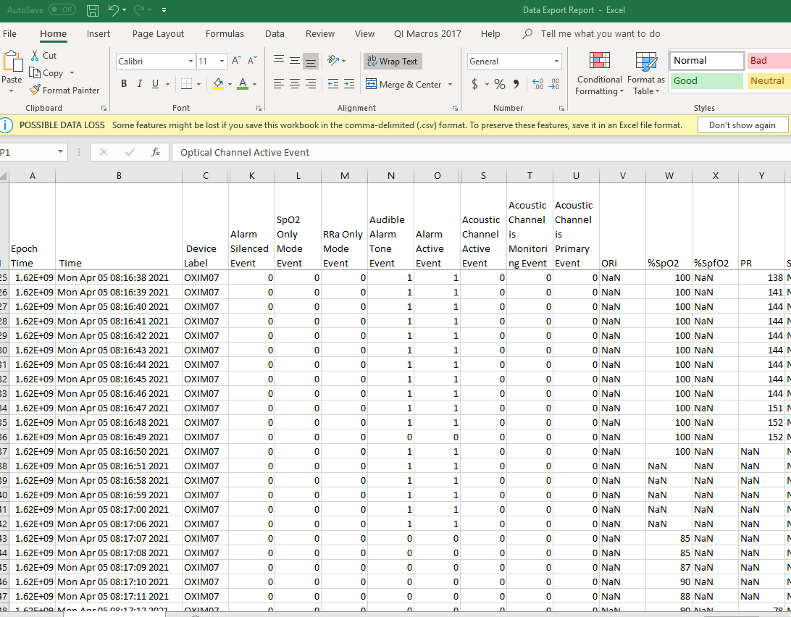
What Data are we Seeing?
Artifact data is kicked out
Averaging time set to 12-seconds
Heather meeting with Masimo engineers to understand algorithm better for kicking out artifact
Will improve python analysis program based off discussion

Slide 17



Closing Thoughts
Questions and Comments

