Slide 1
The Recorded Home Oximetry (RHO) Program
Monthly Investigator Meeting
January 7, 2021

Slide 2
Re-Introductions
RHO UMass Team Introductions
  Welcome Maria
Site Roll-Call

Slide 3
Site Selection for Implementation Waves
Wave 1
Dartmouth Hitchcock Medical Center
Boston Children’s Hospital
Massachusetts General Hospital
Maria Fereri Children’s Hospital
University of Maryland
University of Kentucky
Wave 2
Arkansas Children’s Hospital
Children’s Hospital of Philadelphia
Cincinnati Children’s Hospital
National Jewish Health
Nationwide Children’s Hospital
St. Vincent Neighborhood Hospital
University of California, San Diego
Vanderbilt

Slide 4
RHO Program Implementation Timeline: Wave 1 Sites
February 2021
Baseline data collection begins
March 2021
Initiate site training
Initiate monthly phone calls
May 2021
June-August 2021
February 2022
August 2022
Complete site training
Reach 33% of eligible families
Reach 66% of eligible families
February 2023
Reach 100% of eligible families
Initiate 18-month implementation
Begin providing monthly feedback reports

Slide 5
RHO Program Implementation Timeline: Wave 2 Sites
March 2021
Baseline data collection begins
June 2021
Initiate site training
Initiate monthly phone calls
August 2021
December 2021-February 2022
August 2022
February 2023
Complete site training
Reach 33% of eligible families
Reach 66% of eligible families
August 2023
Reach 100% of eligible families
Initiate 18-month implementation
Begin providing monthly feedback reports

Slide 6
Baseline Data Collection
One year of baseline information from all participating sites
NICU demographics to be collected from VON
Do sites currently already collect information on HOT duration or adverse events?

Slide 7
Site Survey Responses: Homecare Companies

Slide 8
Survey Responses
Site Initiation Survey Sent out on October 28th
86% of survey’s returned
All survey responses are due by January 11th
Responses necessary to move forward with onboarding necessary home care companies

Slide 9
Involvement of Home Care Companies
Limitations due to COVID-19
Buy-in concerns
Steps UMass and Masimo are taking to help ensure DME companies can provide RAD-97’s as SOC
  Bioscrip, Community Surgical and PromptCare already providing
Discussions with local DME’s

Slide 10










How the RHO Program Can Impact Healthcare for Preterm Infants on Home Oxygen Therapy
RHO BENEFITS FOR PATIENTS
RHO BENEFITS FOR PAYERS AND PROVIDERS
Decreased NICU LOS
The RHO Program allows for early NICU discharge because of a structured outpatient management strategy for weaning
More Accessible Healthcare
Bi-weekly (every Monday and Thursday) check-in’s with healthcare team can help patients access high-quality care quickly, regardless of geographic location to the medical center
Reduced Costs
Reduce NICU admission length of stays for infants whose last discharge delaying factor is an oxygen requirement
Reduce patient readmissions and lengthy patient stays by utilizing remote patient monitoring
Reduce duration of home oxygen therapy
Increase Preventative Medicine
With bi-weekly check-in’s the RHO program can prevent and in real-time monitor respiratory illness or other medical issues, and prevent them from becoming larger expenses (reduce adverse event rate)
Increased Parental Bonding
With earlier NICU discharge, the infant has reduced LOS which may lead to increased bonding with family and improved neurodevelopmental outcomes
Reduced Risk of Infection
The RHO program provides a mean of telehealth which provides a contactless solution to triage and treat patients remotely
Remote visits decrease the infection risk for this vulnerable population
Recovery of Lost Revenue
Remote patient monitoring and telehealth can help to improve overall patient experience and the appointment follow-up rate, reducing patient attrition and no-shows
Shorter Home Oxygen Duration
The RHO trial proved a 22% shorter duration of home oxygen therapy in the intervention arm. Duration was further decreased with increased reporting frequency
New Telemedicine Programs
By showing widespread generalizability the RHO program provides an opportunity for new telemedicine and remote patient monitoring programs to be created in different patient cohorts

Slide 11
Impact of RHO on Stakeholders
Impact on Stakeholders
Decrease NICU Length of Stay
Increased Family and Provider Interaction
Decrease in Home Oxygen Duration
Stakeholder | Effect on Stakeholder
Hospital | Decrease in revenue
Payor | Decrease in cost
Family | Increase in parental bonding
Family | Decrease parental stress
Stakeholder | Effect on Stakeholder
Hospital | Increase in workload
Payor | Decrease in rehospitalization rate
Family | Increase in parental reassurance
Family | Decrease parental stress and anxiety
Stakeholder | Effect on Stakeholder
Home Medical Supply Company | Decrease in revenue
Payor | Decrease in costs
Family | Decrease in parental stress and anxiety
Home Medical Supply Company | Increase in patient referrals
Remote Patient Monitoring
Increased Patient Satisfaction
Stakeholder | Effect on Stakeholder
Home Medical Supply Company | Decreased visits to home
Hospital | Increase in workload
Family | Increased monitoring and reassurance
Hospital & Payor | Increased patient satisfaction
Stakeholder | Effect on Stakeholder
Hospital | Need to employ data analyst
Payor | Decrease in cost
Family | Decrease in respiratory related adverse events
Payor | Increase in preventative medicine
Stakeholder | Effect on Stakeholder
Payor | Improved follow-up rates
Family | Positive patient/provider relationship
Hospital | Improved follow-up rates
Hospital | Decreased attrition rates

Slide 12
Proposed Data Collection
Quality Improvement Study at the site level
Implementation data to be collected in REDCap by sites
Monthly data reports will be provided to sites for ongoing improvement and identification of facilitators and barriers
Data to be collected
  NICU demographics
  Length of stay
  Compliance with RHO algorithm
  HOT duration
  Adverse events

Slide 13
Project Status Updates
PCORI to finalize and execute contract with UMass in next two weeks
Heather and Jane Erickson will be in contact with sites to execute site contracts and DUA’s
IRB approval pending

Slide 14

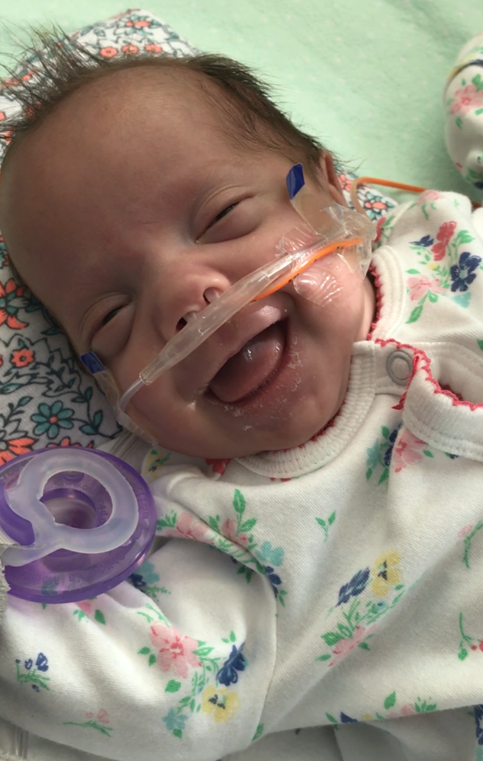
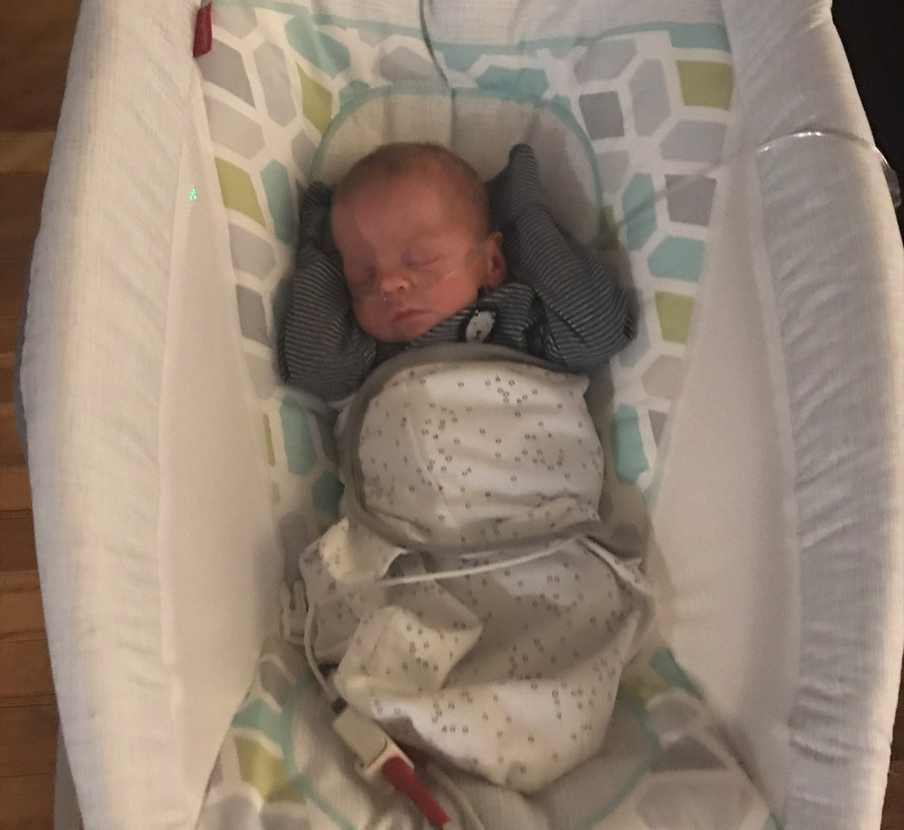
Closing Thoughts
Questions and Comments

Slide 15
History and Background
Currently, a third of preterm infants will require home oxygen therapy (HOT) after NICU discharge
Including 60% of those born at gestational ages 23-24 weeks
HOT provides a means of facilitating NICU discharge
Use is highly variable due to lack in consensus based guidelines for safe management
The RHO trial was the first multicenter trial to evaluate any home oxygen therapy (HOT) weaning strategy

Slide 16
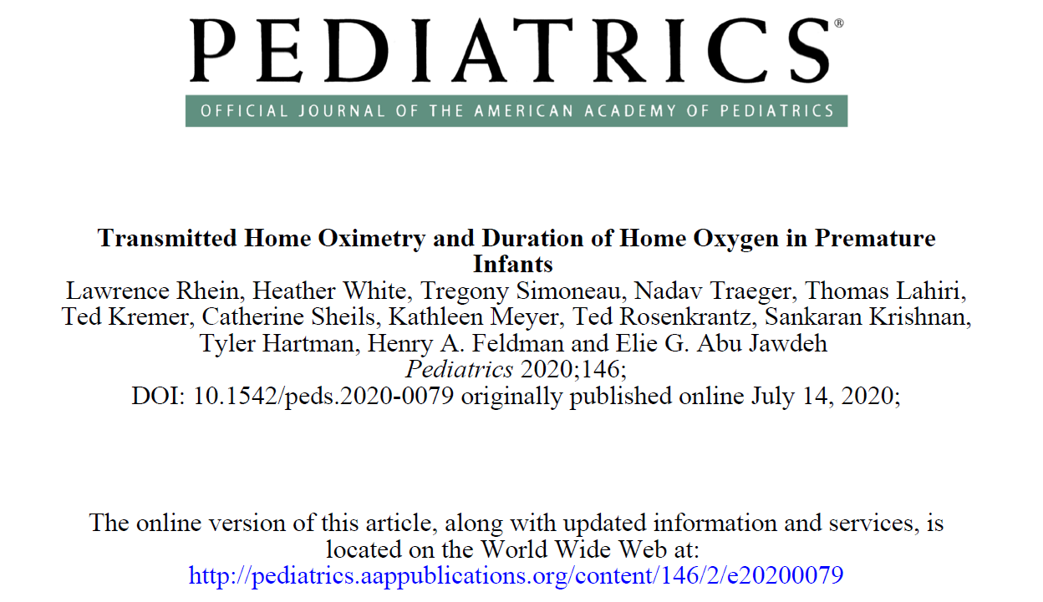
The RHO Trial
(Enrollment from December 2014- December 2017)
Methods
  The RHO Trial was a multicenter, unblinded, randomized trial (2014-2018) in 9 academic centers, to evaluate the effect of RHO on duration of HOT, patient safety, and family experience compared to routine monthly clinic-based HOT management without RHO.
Results
  Time to discontinue HOT was 22% shorter in RHO infants (78.1 ± 6.4 days) versus the standard care group (100.1 ± 8.0 days, p=0.03)
  Respective median times were 71 and 90 days
  HOT duration was shorter for participants sending more frequent RHO data reports (10.3% shorter duration for each additional report provided per month, 95% CI -15.2 to -5.3%, p=0.0001)

Slide 17
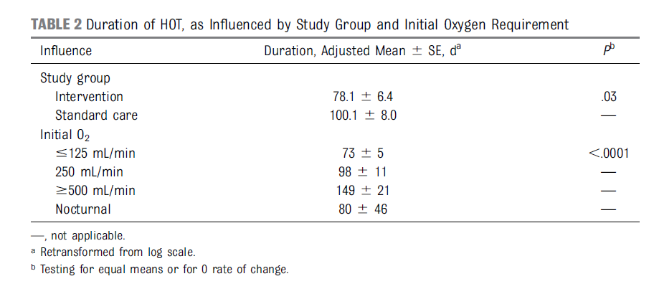
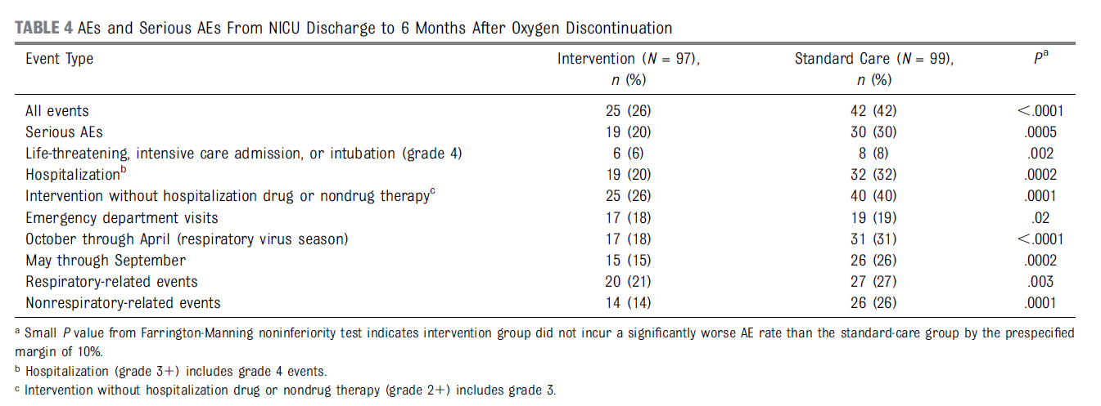
Results
Rhein et al. 2020

Slide 18
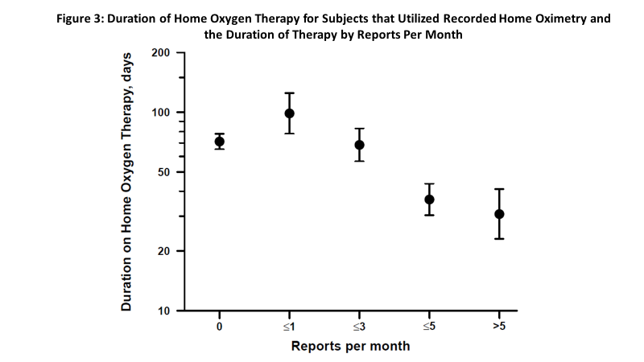
More reports, shorter duration of HOT
Duration of HOT was shorter for those participants sending more frequent reports
10.3% shorter duration for each additional report provided per month

Slide 19

RHO Implementation at UMass Medical Children’s Medical Center
November 2013
Enrollment begins for RHO Trial
December 2017
Enrollment concludes for the RHO Trial (197 Participants Enrolled)
January 2018
February 2019
June 2019
December 2019
Follow-up of RHO patients concludes
Data analysis begins
RHO Program implemented as parental opt-in choice
RHO Program implemented as standard of care at UMass
Implementation pilot at Boston Children’s Hospital at one referring NICU
September 2020
PCORI grant awarded for further widespread implementation

Slide 20
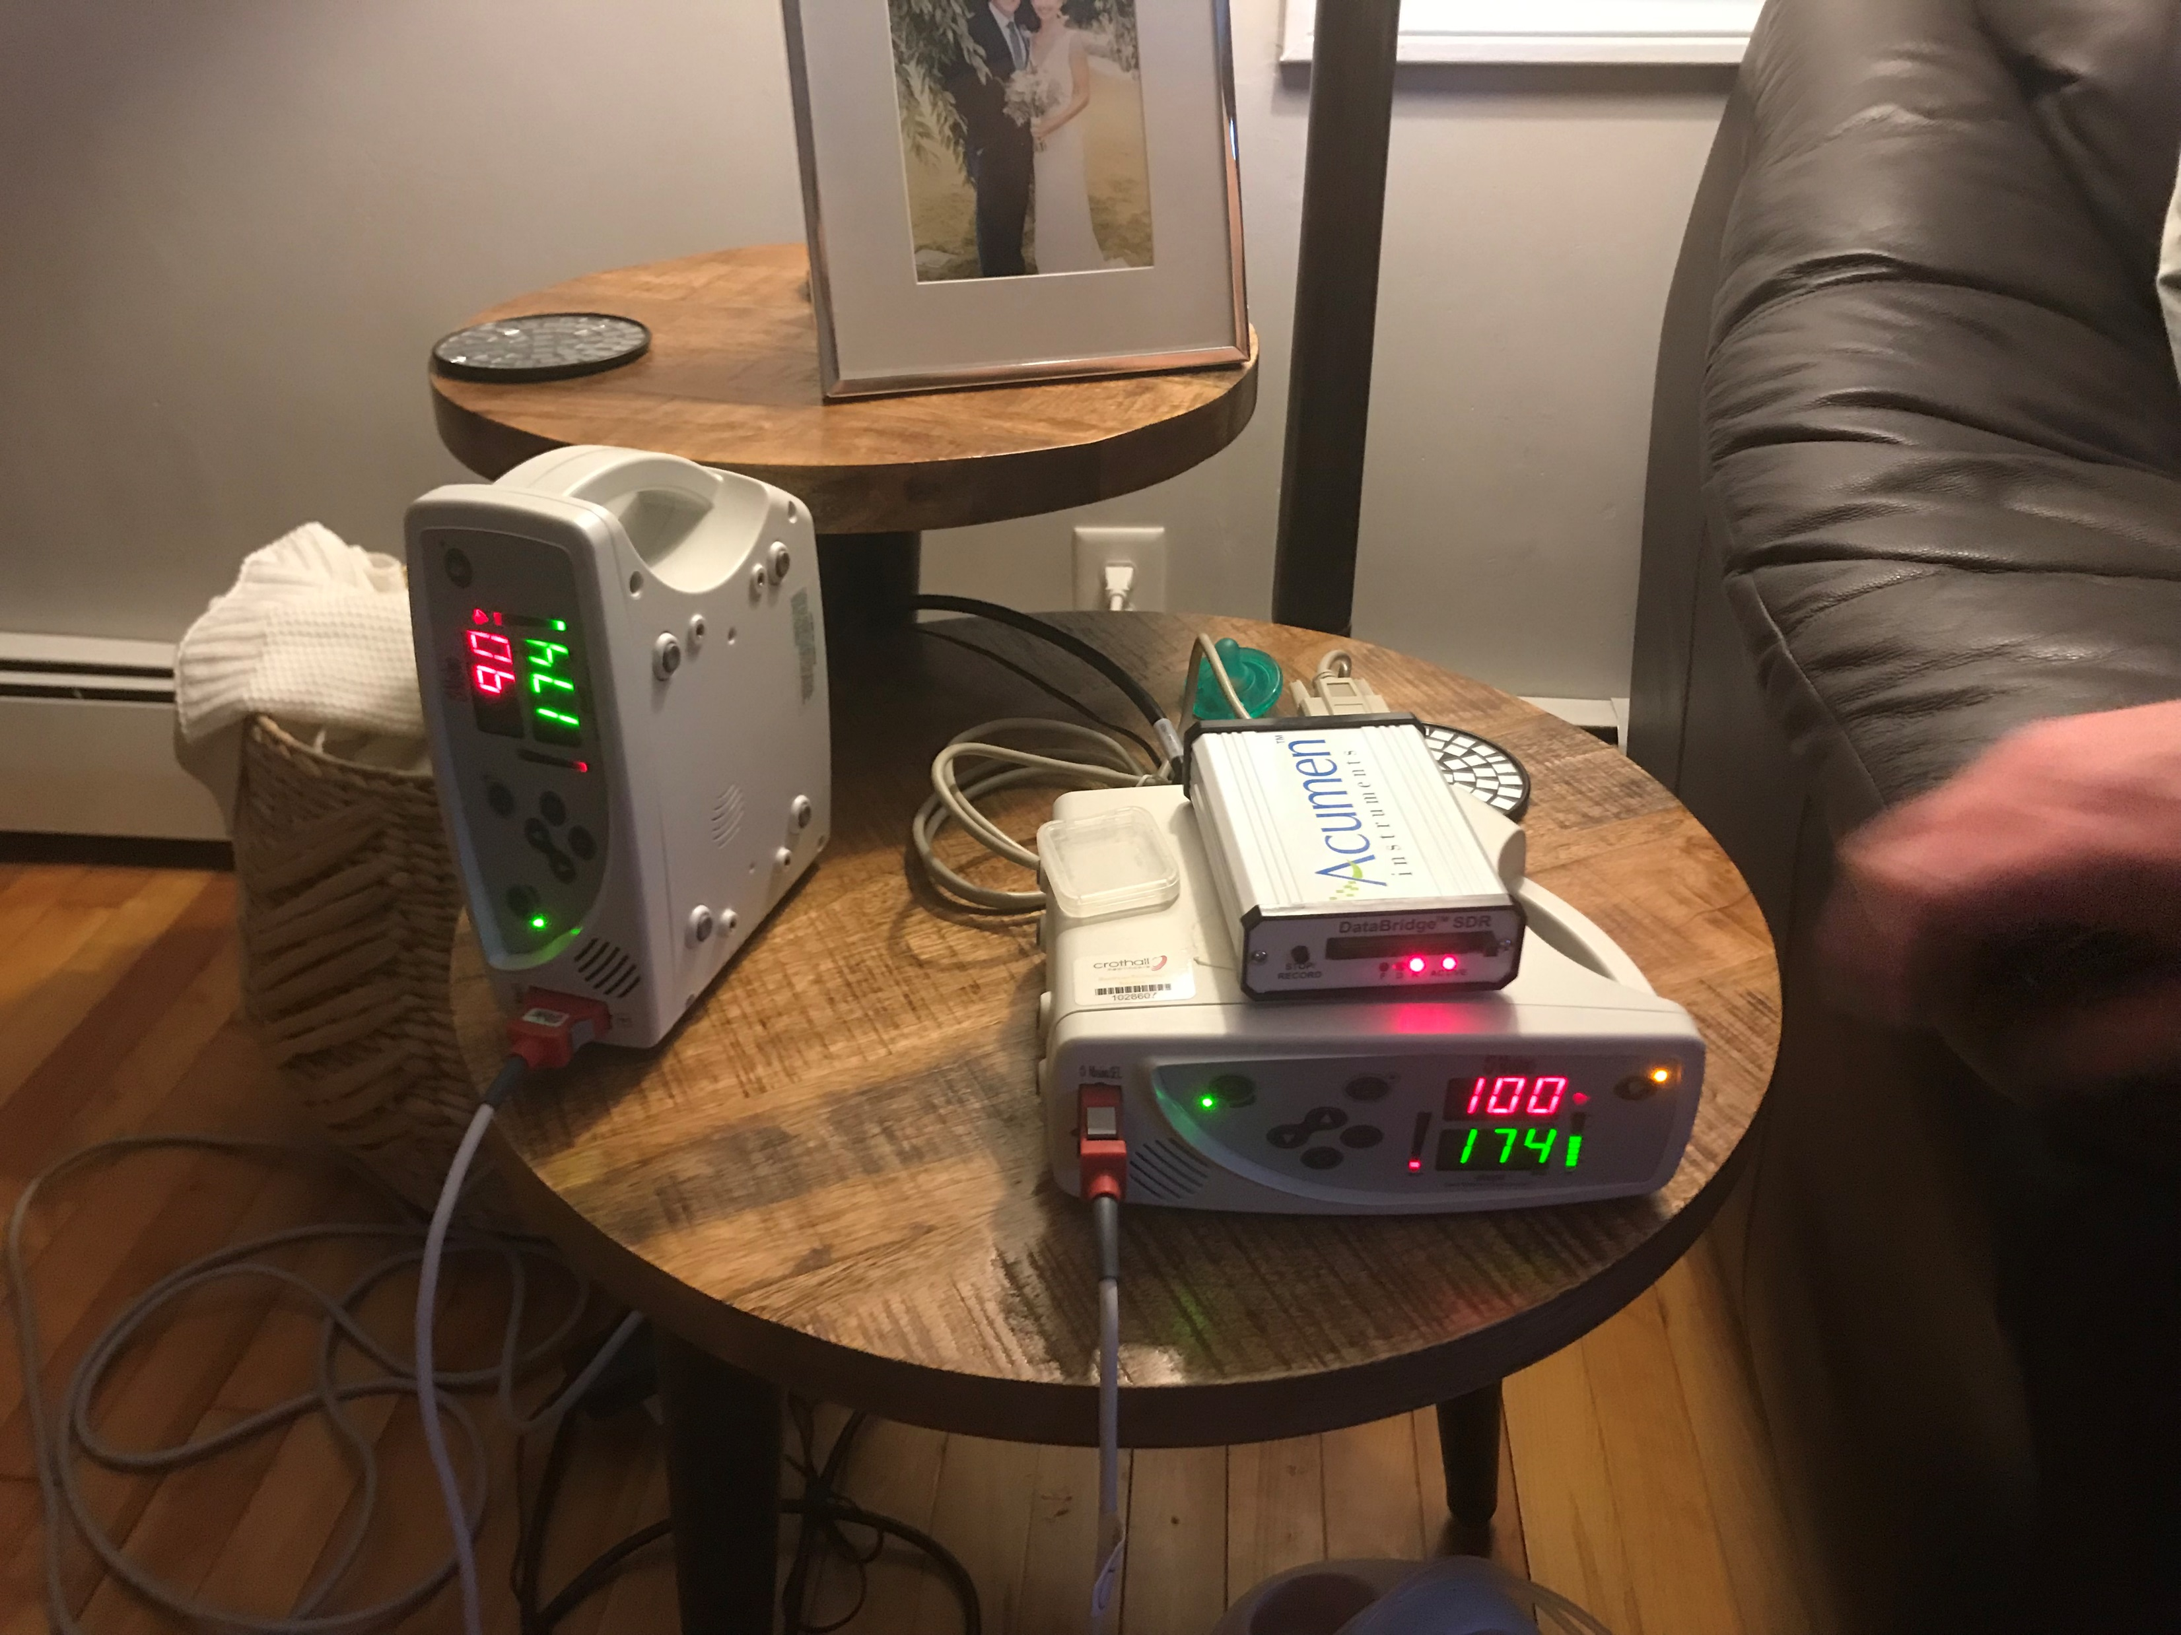
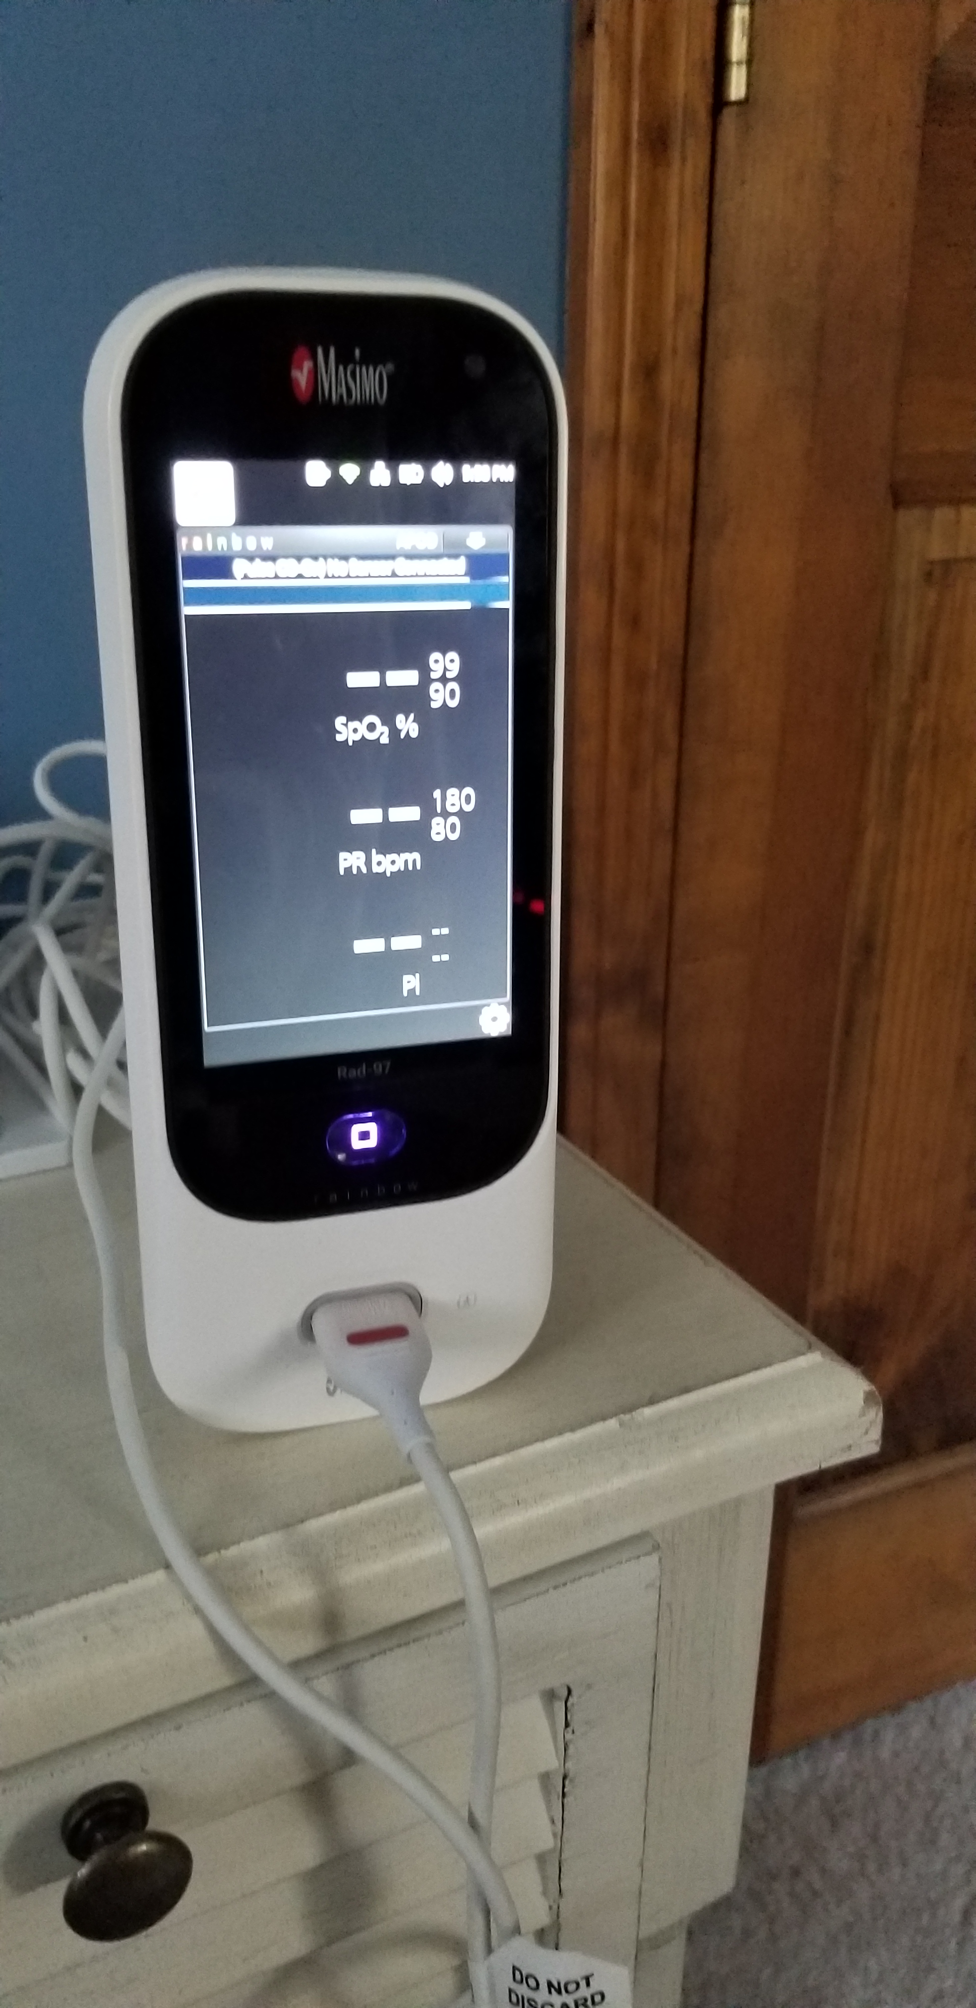
Old RHO Method vs. New RHO Method Using the SafetyNet System
Infants had to wear two monitors
Parents had to take active steps in order to receive feedback
Sensitive technology meant a lot of troubleshooting for parents
Infants only need to wear one monitor
Parents involvement is limited and decreases the burden of home oxygen therapy
Remote troubleshooting through SafetyNet

Slide 21
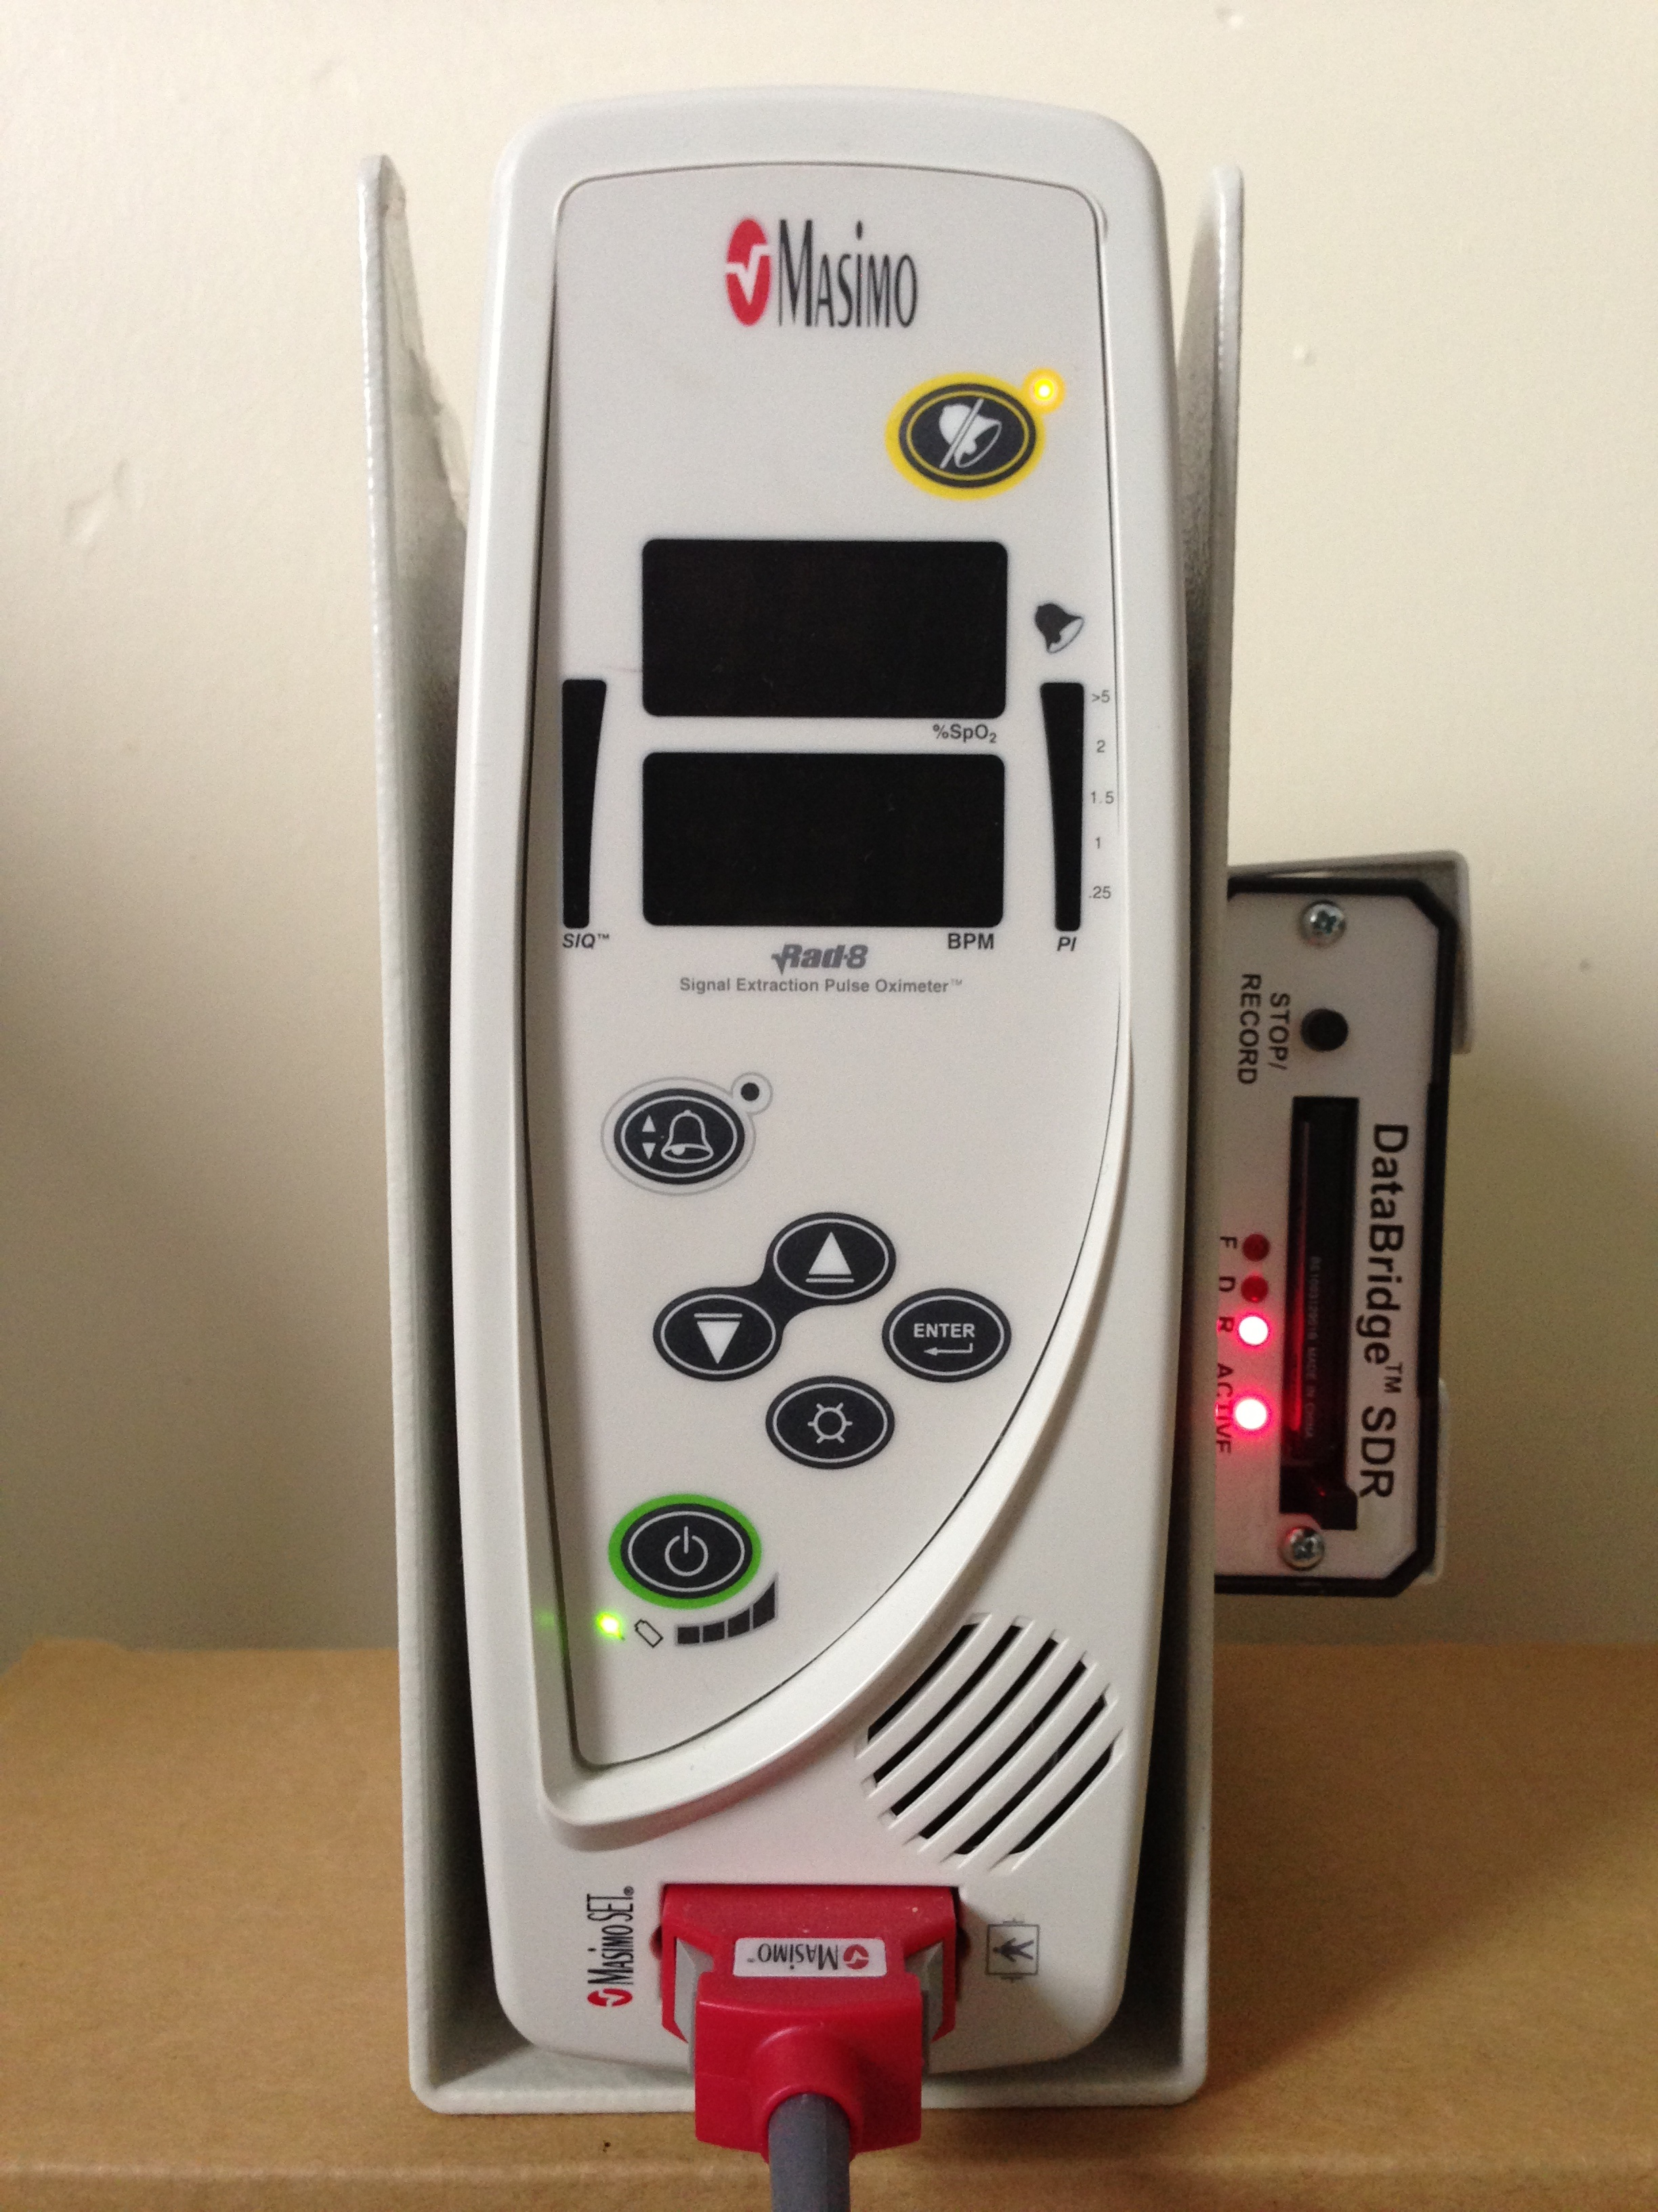
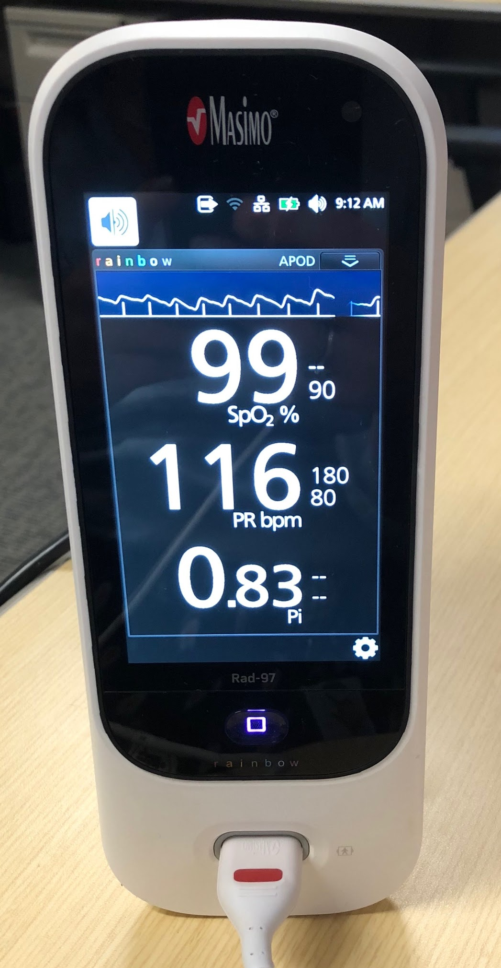
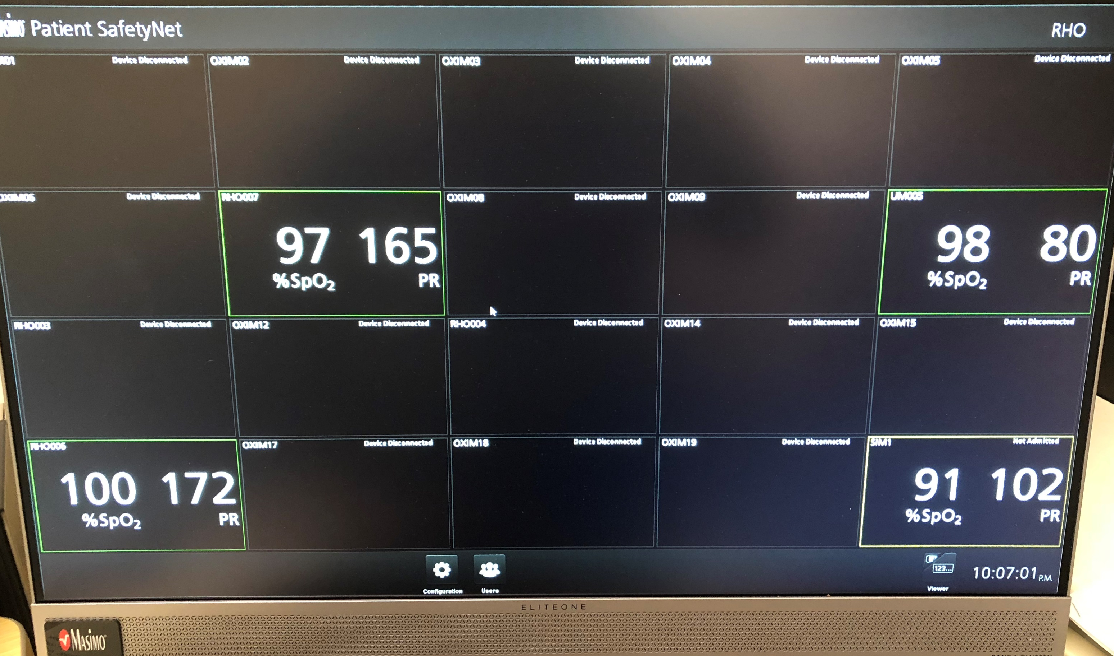
Simplified Data Transfer with the SafetyNET and RAD 97 Oximeters
Parents are no longer required to make proactive efforts to enable data transfer.

Slide 22
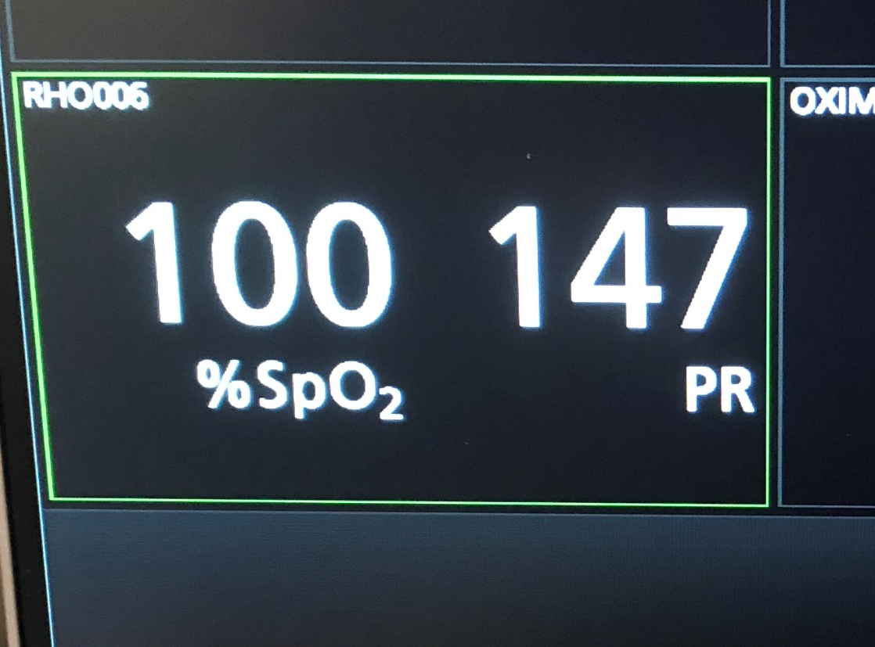
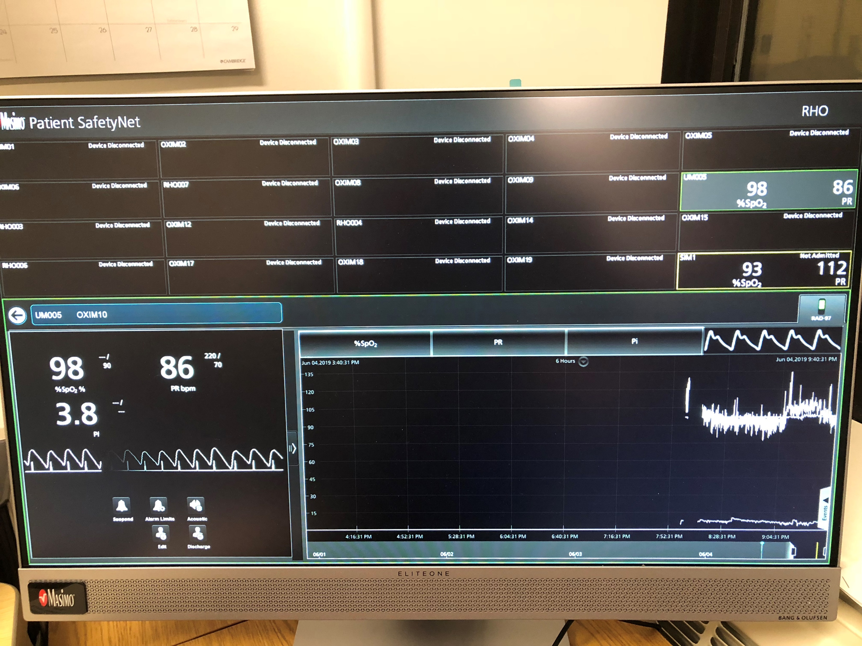
In Office Monitoring of Recorded Home Oximetry
Single Monitoring View: Allows the provider to see trends in %SpO2, PR bpm, and Pi in real time
*Can change alarm parameters if needed from afar
Bi-weekly downloading of recorded home oximetry data
The SafetyNet also allows providers to monitor multiple babies at once
RAD 97- Recorded Home Oximetry Monitoring

Slide 23
Neonatal Intensive Care Unit (NICU) Admission
Outpatient Pediatric Pulmonary Follow Up
(RHO Management)
Follow-Up Period After HOT Discontinuation
Premature Infant Identified as Needing Home Oxygen Therapy (HOT)
1 Month Post-Wean Visit
Adverse Event Report
Growth Assessment
HOT Discontinued
3 Month Post-Wean Visit
Growth Assessment
Home Care Company Notified
NICU Discharge
Discharged on HOT
Flow rate determined by NICU team
Home Care Company completes HOT teaching and provides transmission capable oximeter and all necessary equipment determined by clinical care team
Primary team contacts UMMMC for discharge plans
Fall into normal CHILD Clinic Visit Schedule
*Dependent on age
First Outpatient Pulmonary Visit
Adverse Event Report
Growth Assessment
Monthly Pulmonary Visits
Until HOT is Discontinued
Adverse Event Report
Growth Assessment
Implementation Sites to Complete Data Collection for Enrolled Subjects: NICU Discharge up until 6-months post discontinuation of HOT
Recorded Home Oximetry (RHO) transmitted bi-weekly to UMMMC

Slide 24
Structured Follow-up Schedules for Infants on HOT
What are some current follow-up guidelines at participating sites?
Thoughts on Monthly Follow-up schedule being proposed?

Slide 25
RHO Algorithm
LFNC WEANING PARAMETERS
 | RHO OXYGEN MANAGEMENT ARM
CRITERIA FOR INCREASING O2 FLOW RATE | INABILITY TO MAINTAIN O2 SAT >93% FOR >95% OF RECORDED TIME
CRITERIA FOR MAINTAINING CURRENT O2 FLOW RATE | ABILITY TO MAINTAIN O2 SAT >93% FOR >=95% OF RECORDED TIME BUT UNABLE TO MAINTAIN O2 SAT >96% FOR >=95% OF RECORDED TIME
CRITERIA FOR WEANING O2 FLOW RATE | ABILITY TO MAINTAIN O2 SAT >96% FOR >=95% OF RECORDED TIME
* Clinical pass and fail will be determined per clinic assessment of oximeter alarms and infant status. ** RHO pass and fail will be determined by assessment of recorded oximetry.
Email notification will always state what the current flow rate is and the RHO determination by the algorithm
Provider has the right to not follow the algorithm as long as it is justified (recent respiratory infection, poor weight gain etc.)

Slide 26
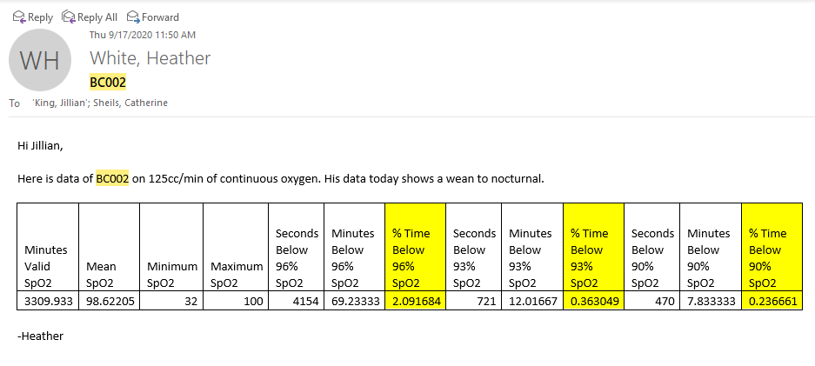
Bi-Weekly RHO Downloads
(Monday and Thursdays)
Workflow
Sample email text
RHO data is downloaded Monday and Thursday by Data Coordinating Center (Umass)
Results provided to the provider
Families contacted with data results by pulmonary team

Slide 27
RHO Recording Analysis
Minutes Valid SpO2 | Mean SpO2 | Minimum SpO2 | Maximum SpO2 | Seconds below 93% SpO2 | Seconds below 90% SpO2 | Seconds below 96% SpO2
1802.8 | 95 | 74 | 100 | 9466 | 2238 | 60128
90.14* |  |  | Minutes | 157.767 | 37.3 | 1002.133
 |  |  | %time | 8.751 | 2.069 | 55.588
Increase
Minutes Valid SpO2 | Mean SpO2 | Minimum SpO2 | Maximum SpO2 | Seconds below 93% SpO2 | Seconds below 90% SpO2 | Seconds below 96% SpO2
1739.5 | 96.8 | 78 | 100 | 2997 | 1091 | 16951
86.975* |  |  | Minutes | 49.95 | 18.183 | 282.517
 |  |  | %time | 2.872 | 1.045 | 16.241
Maintain
Minutes Valid SpO2 | Mean SpO2 | Minimum SpO2 | Maximum SpO2 | Seconds below 93% SpO2 | Seconds below 90% SpO2 | Seconds below 96% SpO2
1922.2 | 98.6 | 79 | 100 | 225 | 86 | 4116
96.11* |  |  | Minutes | 3.75 | 1.433 | 68.6
 |  |  | %time | 0.195 | 0.074 | 3.569
Wean
* 5% of total time

Slide 28
Documentation and Billing of RHO
UMASS documents each contact with family in EMR as telephone encounter
Potential billing opportunities with new telemedicine codes made available by payors
UMASS team piloting a billing schedule for implementation

Slide 29
Results of the RHO Program at UMass

Slide 30
Goal

Slide 34
Further Widespread Implementation of the RHO Program
Implementation Project
Study Specific Aims
PCORI Funded grant to implement RHO at 14 academic medical centers across the U.S.
Site specific adaptations to optimize implementation
Creation of additional Data Coordinating Centers (Dartmouth Hitchcock Medical Center)
(1) Test the implementation of the RHO program in 12 diverse medical systems;
(2) Test the hypothesis that implementation of RHO will be associated with:
(a) increased number of sites offering RHO and number of patients utilizing RHO;
(b) reductions in duration of HOT in infants utilizing RHO and decreased NIUC LOS;
(c) increased number of neonatologists utilizing HOT and number of patients offered HOT;
(d) Specific determinants will affect implementation; and
(e) sustained compliance, including increased providers and DME companies using RHO as standard care
(3) Identify the recipient factors: Organizational characteristics, (i.e. cohorted NICU follow-up program versus general pediatric pulmonary clinic), and Patient/family characteristics, (i.e. socio-demographic characteristics, disease burden of prematurity, and parental knowledge and beliefs) that predict variation in the adoption of RHO across sites, to inform iterative improvements and future widespread dissemination.

Slide 35
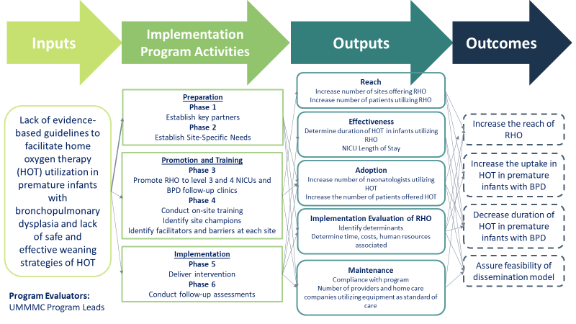

Slide 36
Oximeter Averaging Time
Current Neonatal Profile on RAD 97 is 12 second averaging time and display time
Thoughts on averaging time?
Should the averaging time outpatient be the same as inpatient?

Slide 37
Common Questions about Generalizability
What if my patient doesn’t have WIFI
  100% (35) patients followed by the RHO program have had WIFI in the home
Heath equity concerns
  Nearly 45% of all patients that have been successfully weaned utilizing RHO have identified as low-socioeconomic status

