Slide 1
The Recorded Home Oximetry (RHO) Program
Monthly Investigator Meeting
March 4, 2021

Slide 2
Attendance
Site Roll-Call

Slide 3
Project Status Updates
PCORI contract executed with Umass
  Jane Erickson and Heather will be reaching out to site contacts for local contract execution
IRB approved
  Central SMART IRB pending

Slide 4
Site Selection for Implementation Waves
Wave 1
Dartmouth Hitchcock Medical Center
Boston Children’s Hospital
Massachusetts General Hospital
Maria Fereri Children’s Hospital
University of Maryland
Vanderbilt
Wave 2
Arkansas Children’s Hospital
Children’s Hospital of Philadelphia
Cincinnati Children’s Hospital
National Jewish Health
Nationwide Children’s Hospital
St. Vincent Neighborhood Hospital
University of California, San Diego
University of Kentucky

Slide 5
RHO Program Implementation Timeline: Wave 1 Sites
February 2021
Baseline data collection begins
March 2021
Initiate site training
Initiate monthly phone calls
May 2021
June-August 2021
February 2022
August 2022
Complete site training
Reach 33% of eligible families
Reach 66% of eligible families
February 2023
Reach 100% of eligible families
Initiate 18-month implementation
Begin providing monthly feedback reports

Slide 6
RHO Program Implementation Timeline: Wave 2 Sites
March 2021
Baseline data collection begins
June 2021
Initiate site training
Initiate monthly phone calls
August 2021
December 2021-February 2022
August 2022
February 2023
Complete site training
Reach 33% of eligible families
Reach 66% of eligible families
August 2023
Reach 100% of eligible families
Initiate 18-month implementation
Begin providing monthly feedback reports

Slide 7
Baseline Data Collection
One year of baseline information from all participating sites
NICU demographics to be collected from VON
Do sites currently already collect information on HOT duration or adverse events?

Slide 8
Baseline Data Collection
Implementation Site Personnel
RHO Study Team
Abstract data from VON
Complete additional variable spreadsheet
Provide instructions, tutorial, and operational definition lists
Organize VON query & additional variable files and upload into REDCap
Create site-specific baseline reports

Slide 9
VON Variables

Slide 10
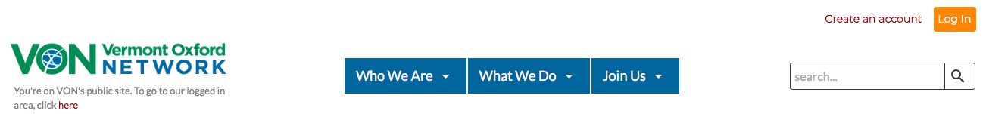
Step 1: Log In
You must have access to the VON Nightingale Reporting System
  If you do not have access, please contact your VON administrator(s)
Go to the VON website: www.vtoxford.org
Log in by clicking the orange “Log in” button and entering your log in information
Step 1

Slide 11
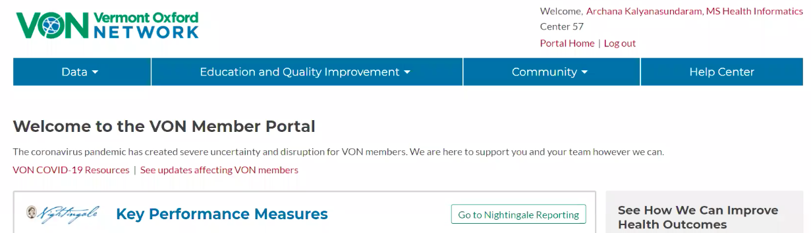
Step 2: Navigate to Reporting
Click “Go to Nightingale Reporting” or select “Nightingale Reporting” from the “Data” drop-down
Step 2

Slide 12
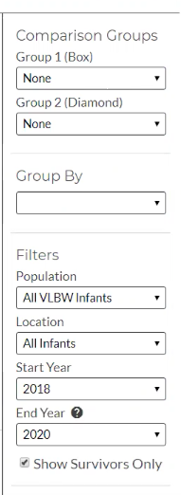
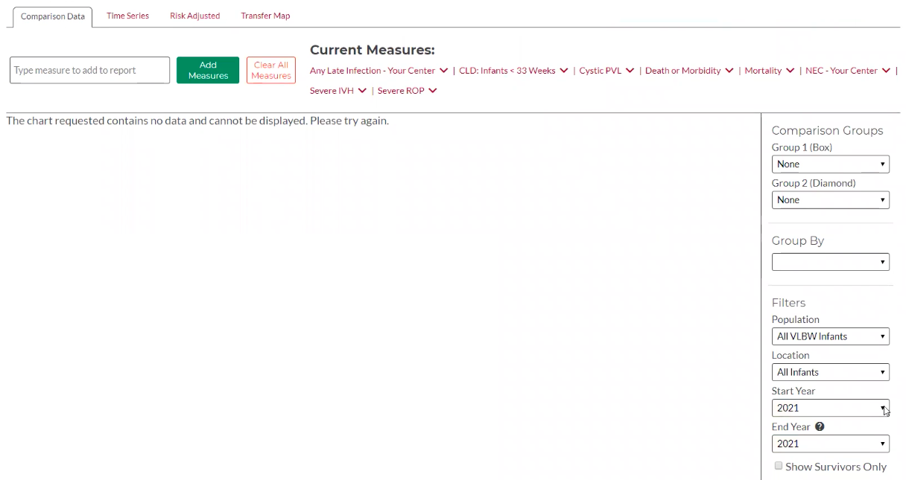
Step 3: Set Parameters
In the right panel, set the following parameters:
  Population: All VLBW Infants
  Location: All Infants
  Start Year: 2018
  End year: 2020
Step 3

Slide 13
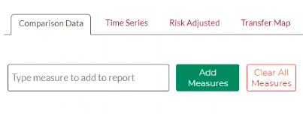
Step 4: Clear All Measures
Click “Clear All Measures”
After you complete this step, there should be no measures listed under “Current Measures”
This section should be empty after completing Step 4
Step 4

Slide 14
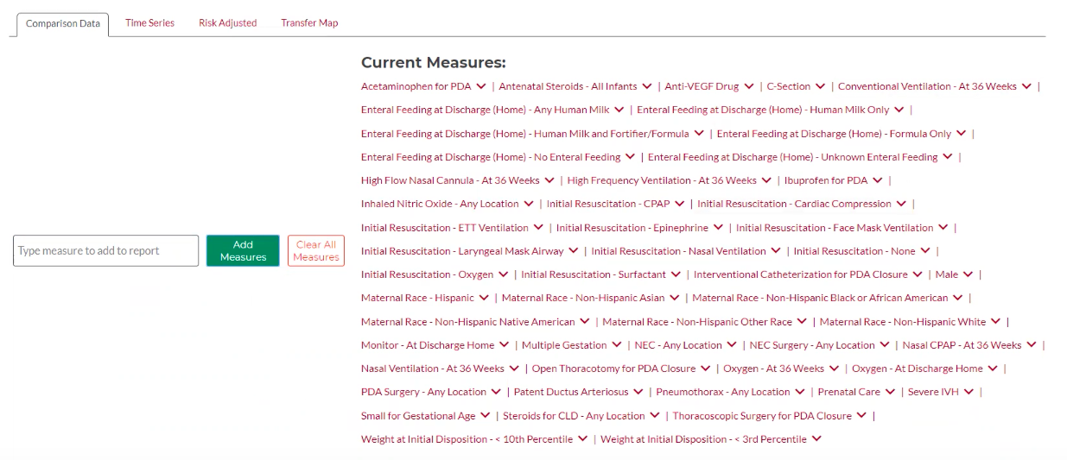
Step 5: Select Measures
Using the “Type measure to add to report” functionality, select all the measures outlined in the written instructions included in this toolkit
Click “Add Measures” once they have been selected
Your list should resemble the one below once all measures have been added
Step 5

Slide 15
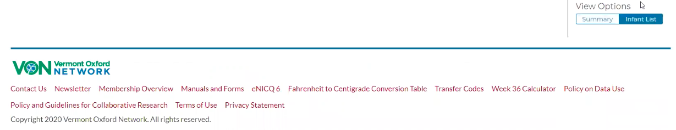
Step 6: Adjust Your View
Scroll to the bottom of the screen
Under “View Options,” select “Infant List”
  If Infant List is already selected, skip this step
Step 6

Slide 16
Step 7: Export CSV File
Click “Export Data to CSV” and download the report
Open the CSV file to ensure that it has downloaded correctly
Step 7

Slide 17
Other Baseline Variables

Slide 18
Other Baseline Variables
Some variables not available from VON will need to be collected to establish proper baselines for your site
As part of the baseline data collection toolkit, UMMS will provide you a CSV file and operational definition list for the variables that will be manually obtained

Slide 19



Closing Thoughts
Questions and Comments

