Slide 1
The Recorded Home Oximetry (RHO) Program
Investigator Meeting
November 5, 2020

Slide 2
Introductions
RHO UMass Team Introductions
Site Introductions

Slide 3
History and Background
Currently, a third of preterm infants will require home oxygen therapy (HOT) after NICU discharge
Including 60% of those born at gestational ages 23-24 weeks
HOT provides a means of facilitating NICU discharge
Use is highly variable due to lack in consensus based guidelines for safe management
The RHO trial was the first multicenter trial to evaluate any home oxygen therapy (HOT) weaning strategy

Slide 4
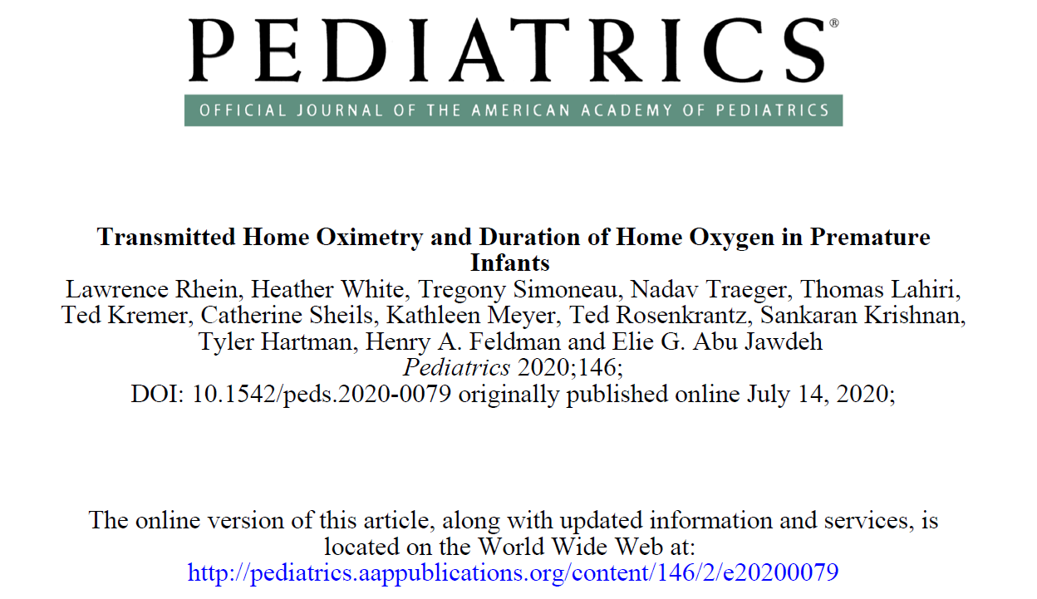
The RHO Trial
(Enrollment from December 2014- December 2017)
Methods
  The RHO Trial was a multicenter, unblinded, randomized trial (2014-2018) in 9 academic centers, to evaluate the effect of RHO on duration of HOT, patient safety, and family experience compared to routine monthly clinic-based HOT management without RHO.
Results
  Time to discontinue HOT was 22% shorter in RHO infants (78.1 ± 6.4 days) versus the standard care group (100.1 ± 8.0 days, p=0.03)
  Respective median times were 71 and 90 days
  HOT duration was shorter for participants sending more frequent RHO data reports (10.3% shorter duration for each additional report provided per month, 95% CI -15.2 to -5.3%, p=0.0001)

Slide 5
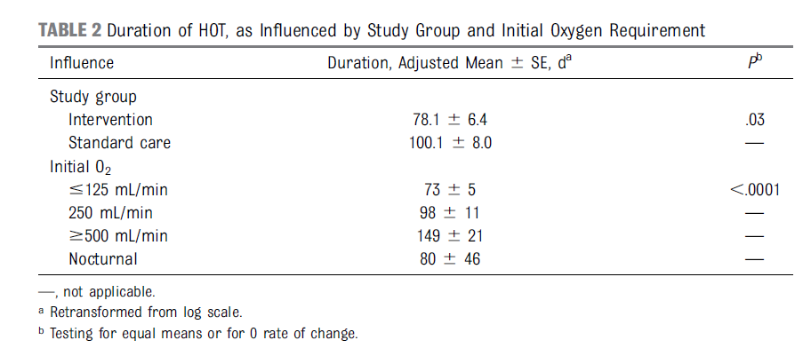
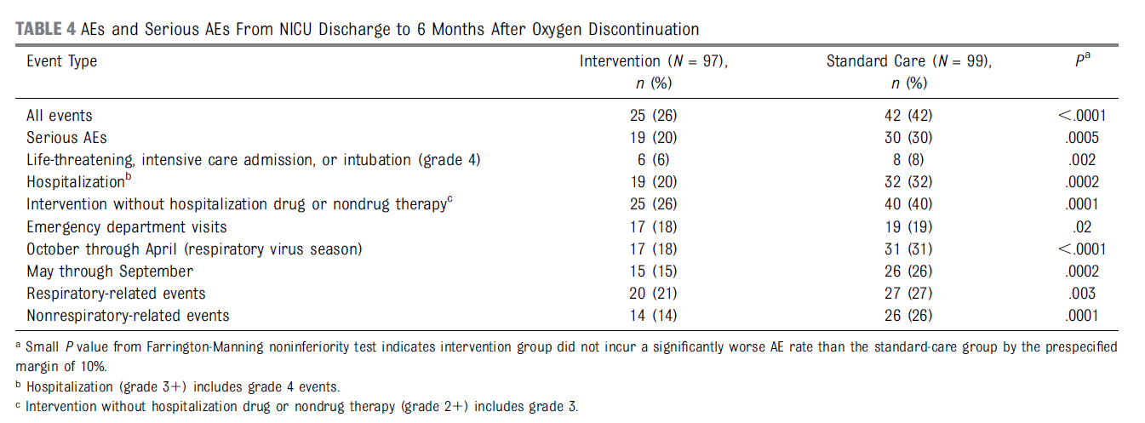
Results
Rhein et al. 2020

Slide 6
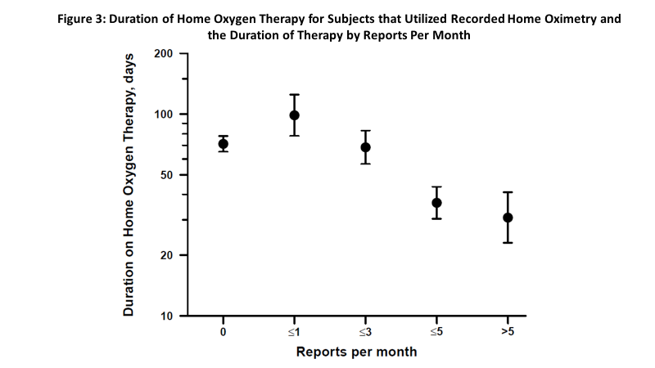
More reports, shorter duration of HOT
Duration of HOT was shorter for those participants sending more frequent reports
10.3% shorter duration for each additional report provided per month

Slide 7

RHO Implementation at UMass Medical Children’s Medical Center
November 2013
Enrollment begins for RHO Trial
December 2017
Enrollment concludes for the RHO Trial (197 Participants Enrolled)
January 2018
February 2019
June 2019
December 2019
Follow-up of RHO patients concludes
Data analysis begins
RHO Program implemented as parental opt-in choice
RHO Program implemented as standard of care at UMass
Implementation pilot at Boston Children’s Hospital at one referring NICU
September 2020
PCORI grant awarded for further widespread implementation

Slide 8
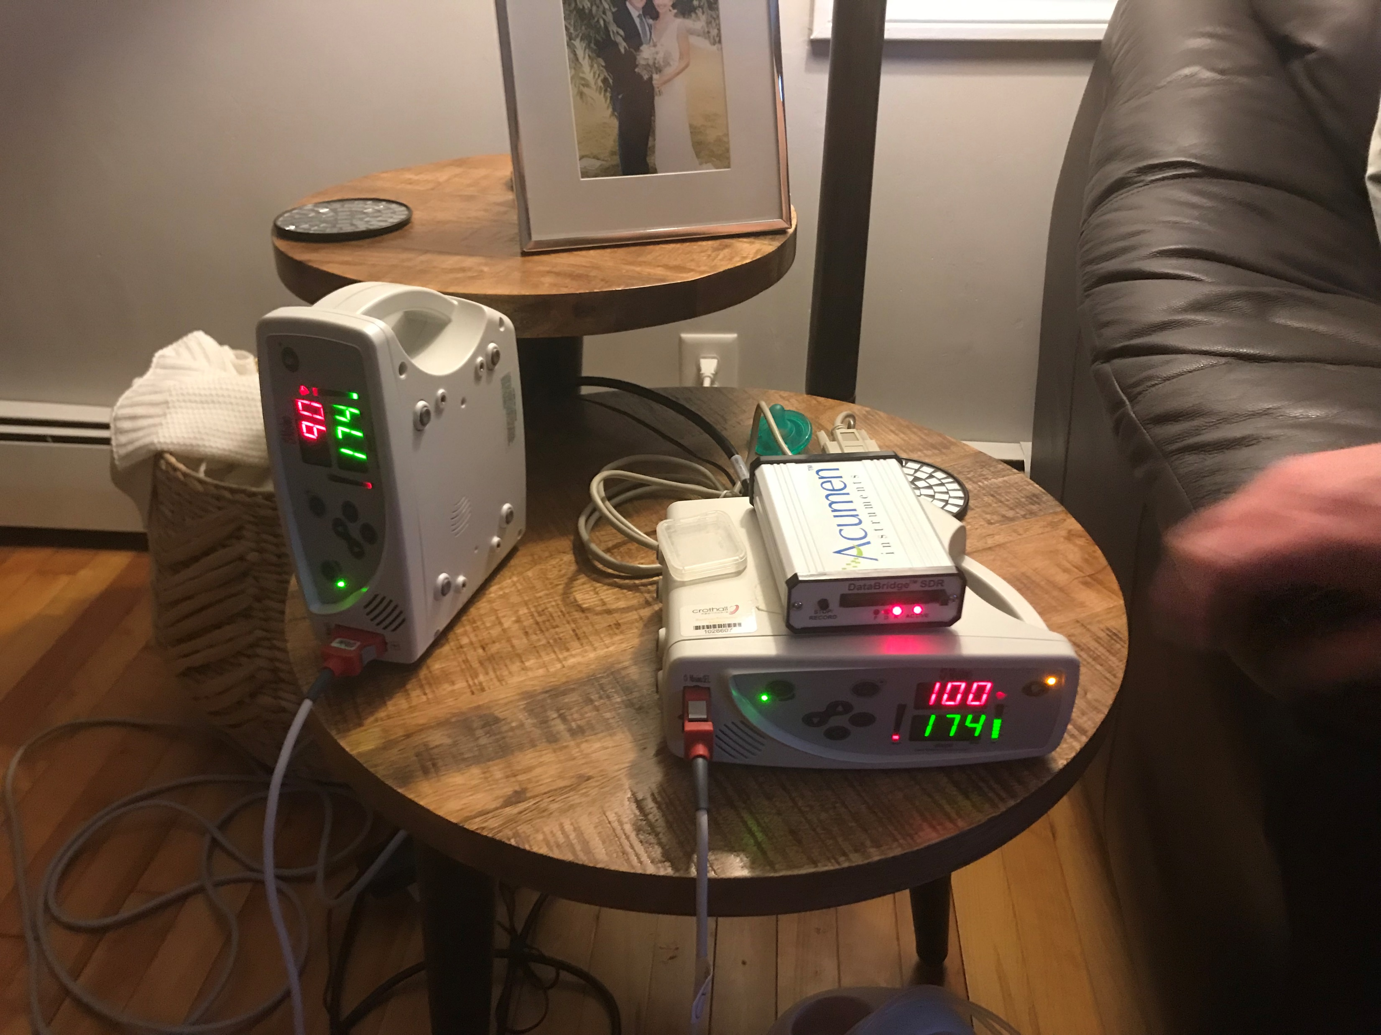
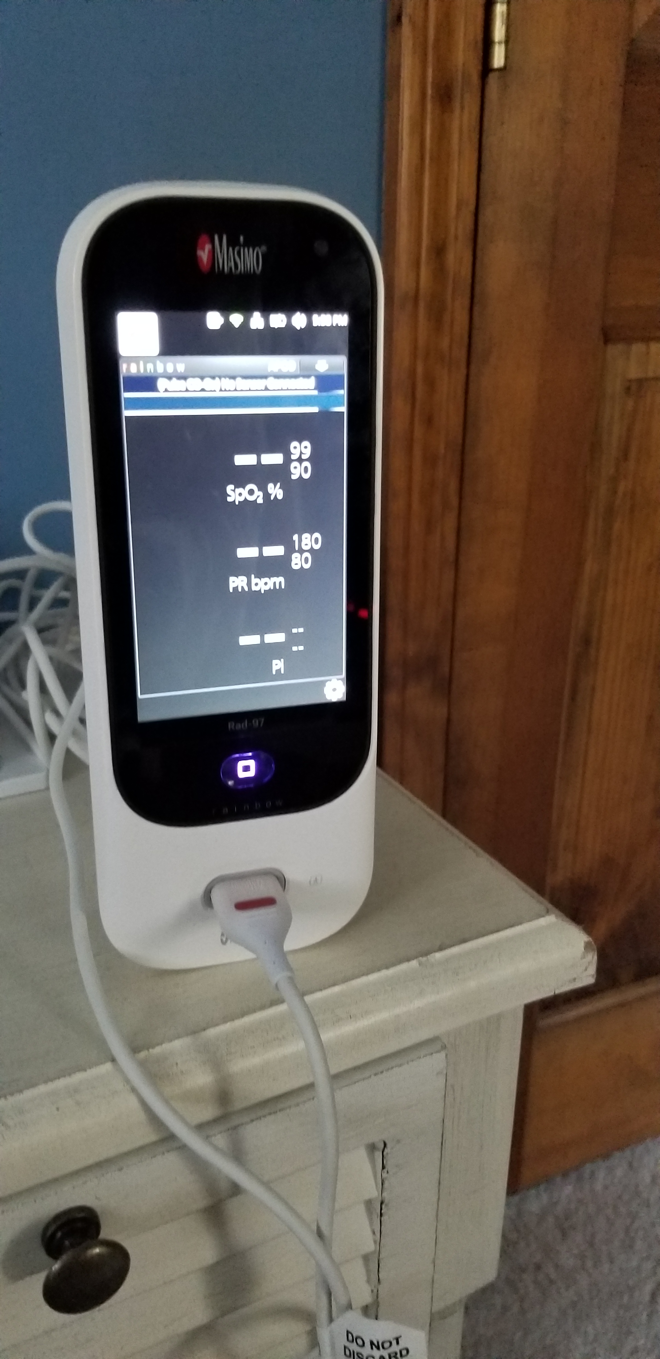
Old RHO Method vs. New RHO Method Using the SafetyNet System
Infants had to wear two monitors
Parents had to take active steps in order to receive feedback
Sensitive technology meant a lot of troubleshooting for parents
Infants only need to wear one monitor
Parents involvement is limited and decreases the burden of home oxygen therapy
Remote troubleshooting through SafetyNet

Slide 9
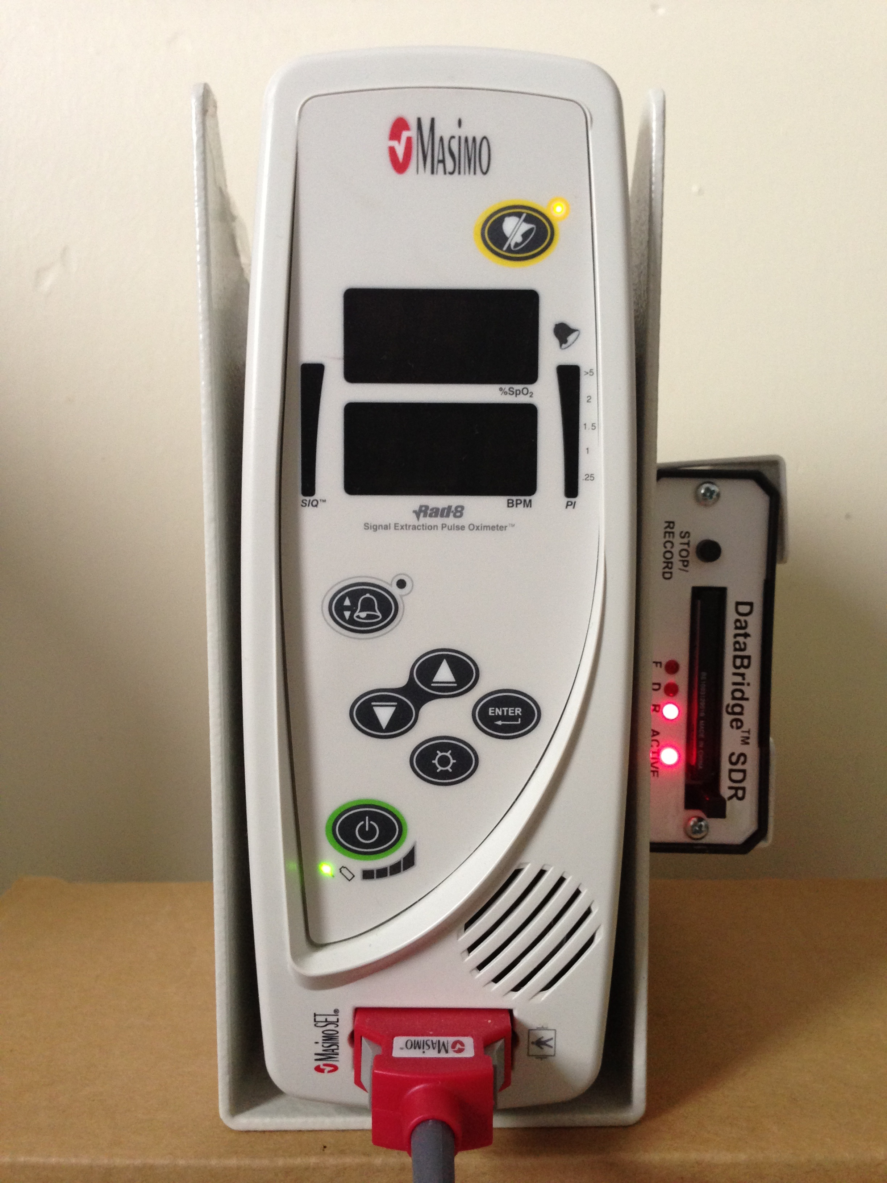
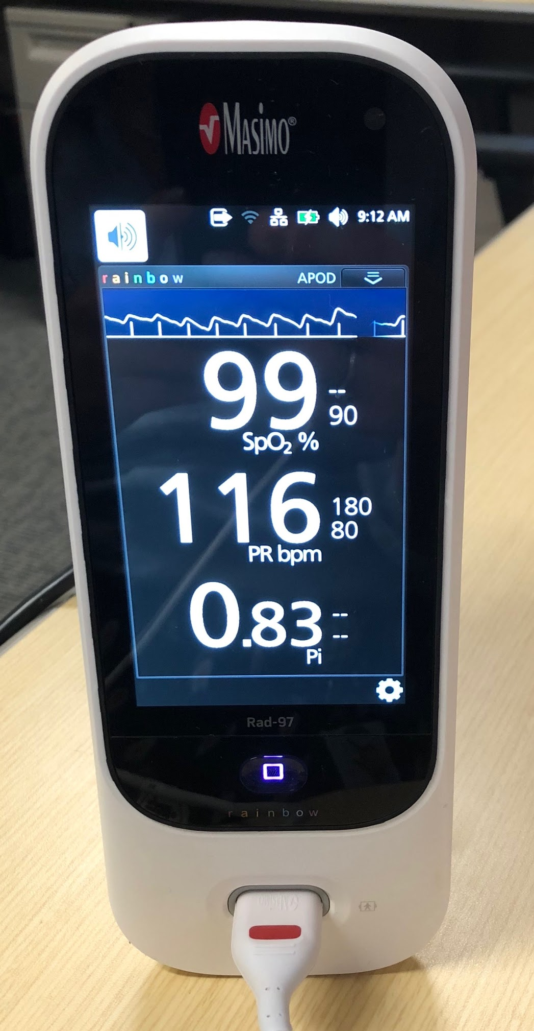
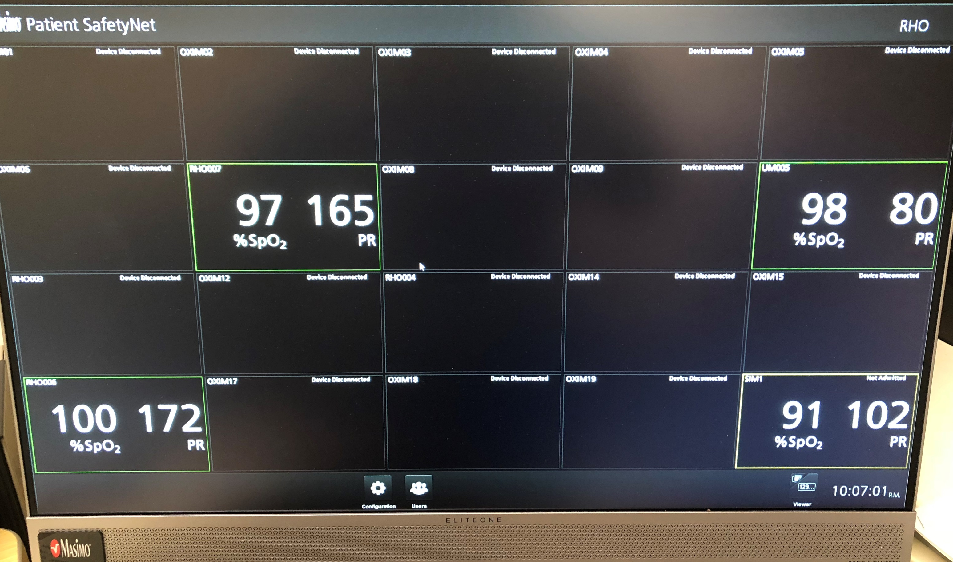
Simplified Data Transfer with the SafetyNET and RAD 97 Oximeters
Parents are no longer required to make proactive efforts to enable data transfer.

Slide 10
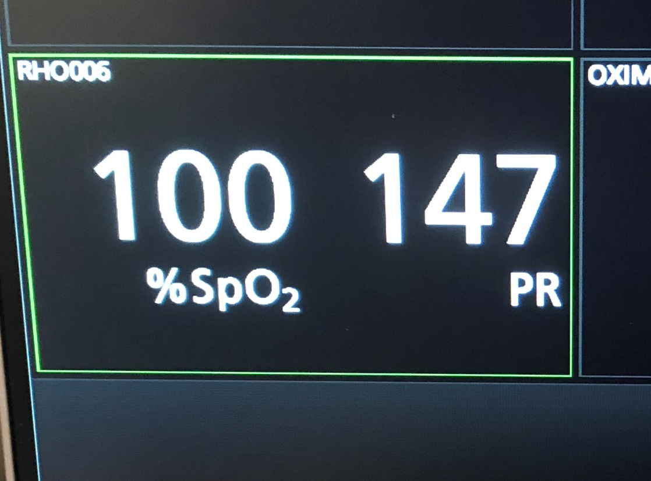
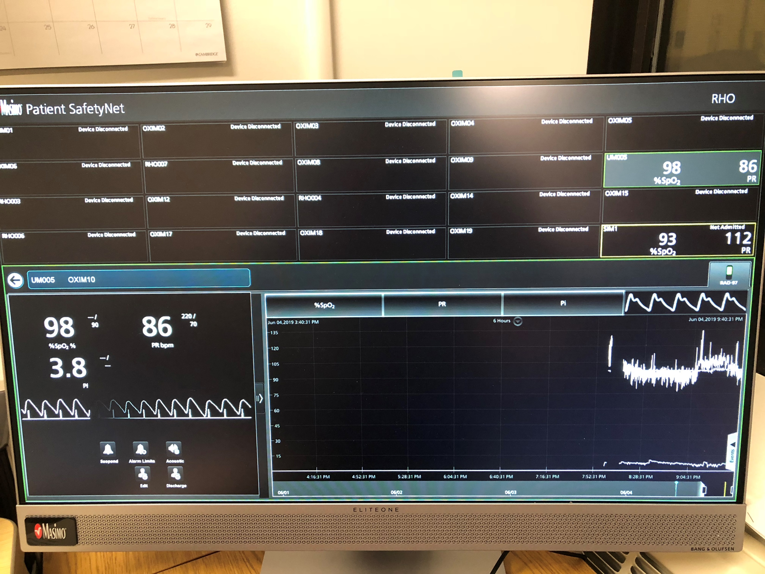
In Office Monitoring of Recorded Home Oximetry
Single Monitoring View: Allows the provider to see trends in %SpO2, PR bpm, and Pi in real time
*Can change alarm parameters if needed from afar
Bi-weekly downloading of recorded home oximetry data
The SafetyNet also allows providers to monitor multiple babies at once
RAD 97- Recorded Home Oximetry Monitoring

Slide 11
Neonatal Intensive Care Unit (NICU) Admission
Outpatient Pediatric Pulmonary Follow Up
(RHO Management)
Follow-Up Period After HOT Discontinuation
Premature Infant Identified as Needing Home Oxygen Therapy (HOT)
1 Month Post-Wean Visit
Adverse Event Report
Growth Assessment
HOT Discontinued
3 Month Post-Wean Visit
Growth Assessment
Home Care Company Notified
NICU Discharge
Discharged on HOT
Flow rate determined by NICU team
Home Care Company completes HOT teaching and provides transmission capable oximeter and all necessary equipment determined by clinical care team
Primary team contacts UMMMC for discharge plans
Fall into normal CHILD Clinic Visit Schedule
*Dependent on age
First Outpatient Pulmonary Visit
Adverse Event Report
Growth Assessment
Monthly Pulmonary Visits
Until HOT is Discontinued
Adverse Event Report
Growth Assessment
Implementation Sites to Complete Data Collection for Enrolled Subjects: NICU Discharge up until 6-months post discontinuation of HOT
Recorded Home Oximetry (RHO) transmitted bi-weekly to UMMMC

Slide 12
Structured Follow-up Schedules for Infants on HOT
What are some current follow-up guidelines at participating sites?
Thoughts on Monthly Follow-up schedule being proposed?

Slide 13
RHO Algorithm
LFNC WEANING PARAMETERS
 | RHO OXYGEN MANAGEMENT ARM
CRITERIA FOR INCREASING O2 FLOW RATE | INABILITY TO MAINTAIN O2 SAT >93% FOR >95% OF RECORDED TIME
CRITERIA FOR MAINTAINING CURRENT O2 FLOW RATE | ABILITY TO MAINTAIN O2 SAT >93% FOR >=95% OF RECORDED TIME BUT UNABLE TO MAINTAIN O2 SAT >96% FOR >=95% OF RECORDED TIME
CRITERIA FOR WEANING O2 FLOW RATE | ABILITY TO MAINTAIN O2 SAT >96% FOR >=95% OF RECORDED TIME
* Clinical pass and fail will be determined per clinic assessment of oximeter alarms and infant status. ** RHO pass and fail will be determined by assessment of recorded oximetry.
Email notification will always state what the current flow rate is and the RHO determination by the algorithm
Provider has the right to not follow the algorithm as long as it is justified (recent respiratory infection, poor weight gain etc.)

Slide 14
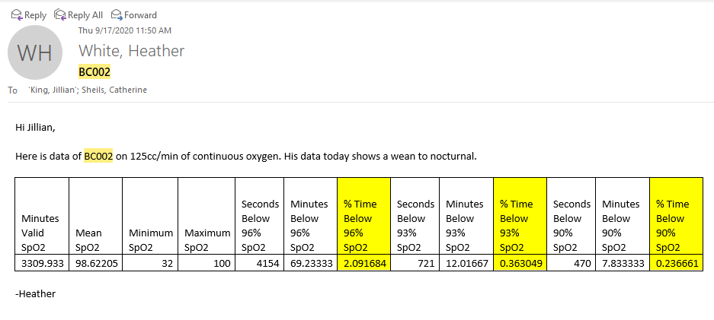
Bi-Weekly RHO Downloads
(Monday and Thursdays)
Workflow
Sample email text
RHO data is downloaded Monday and Thursday by Data Coordinating Center (Umass)
Results provided to the provider
Families contacted with data results by pulmonary team

Slide 15
RHO Recording Analysis
Minutes Valid SpO2 | Mean SpO2 | Minimum SpO2 | Maximum SpO2 | Seconds below 93% SpO2 | Seconds below 90% SpO2 | Seconds below 96% SpO2
1802.8 | 95 | 74 | 100 | 9466 | 2238 | 60128
90.14* |  |  | Minutes | 157.767 | 37.3 | 1002.133
 |  |  | %time | 8.751 | 2.069 | 55.588
Increase
Minutes Valid SpO2 | Mean SpO2 | Minimum SpO2 | Maximum SpO2 | Seconds below 93% SpO2 | Seconds below 90% SpO2 | Seconds below 96% SpO2
1739.5 | 96.8 | 78 | 100 | 2997 | 1091 | 16951
86.975* |  |  | Minutes | 49.95 | 18.183 | 282.517
 |  |  | %time | 2.872 | 1.045 | 16.241
Maintain
Minutes Valid SpO2 | Mean SpO2 | Minimum SpO2 | Maximum SpO2 | Seconds below 93% SpO2 | Seconds below 90% SpO2 | Seconds below 96% SpO2
1922.2 | 98.6 | 79 | 100 | 225 | 86 | 4116
96.11* |  |  | Minutes | 3.75 | 1.433 | 68.6
 |  |  | %time | 0.195 | 0.074 | 3.569
Wean
* 5% of total time

Slide 16
Documentation and Billing of RHO
UMASS documents each contact with family in EMR as telephone encounter
Potential billing opportunities with new telemedicine codes made available by payors
UMASS team piloting a billing schedule for implementation

Slide 17
Results of the RHO Program at UMass

Slide 18
Goal

Slide 22
Further Widespread Implementation of the RHO Program
Implementation Project
Study Specific Aims
PCORI Funded grant to implement RHO at 14 academic medical centers across the U.S.
Site specific adaptations to optimize implementation
Creation of additional Data Coordinating Centers (Dartmouth Hitchcock Medical Center)
(1) Test the implementation of the RHO program in 12 diverse medical systems;
(2) Test the hypothesis that implementation of RHO will be associated with:
(a) increased number of sites offering RHO and number of patients utilizing RHO;
(b) reductions in duration of HOT in infants utilizing RHO and decreased NIUC LOS;
(c) increased number of neonatologists utilizing HOT and number of patients offered HOT;
(d) Specific determinants will affect implementation; and
(e) sustained compliance, including increased providers and DME companies using RHO as standard care
(3) Identify the recipient factors: Organizational characteristics, (i.e. cohorted NICU follow-up program versus general pediatric pulmonary clinic), and Patient/family characteristics, (i.e. socio-demographic characteristics, disease burden of prematurity, and parental knowledge and beliefs) that predict variation in the adoption of RHO across sites, to inform iterative improvements and future widespread dissemination.

Slide 23
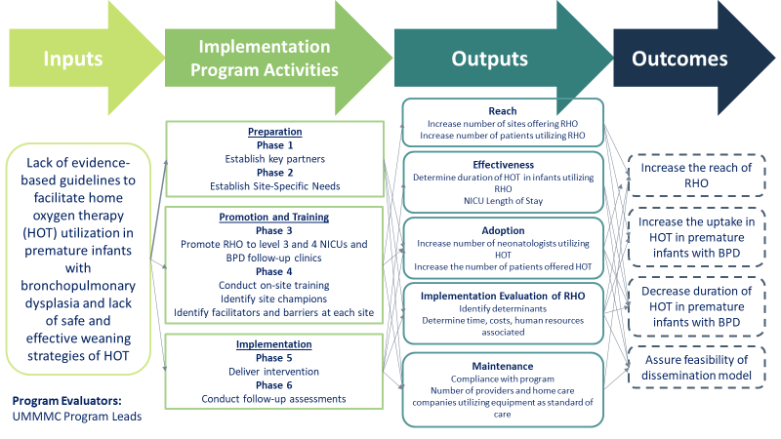

Slide 24
Oximeter Averaging Time
Current Neonatal Profile on RAD 97 is 12 second averaging time and display time
Thoughts on averaging time?
Should the averaging time outpatient be the same as inpatient?

Slide 25
Common Questions about Generalizability
What if my patient doesn’t have WIFI
  100% (35) patients followed by the RHO program have had WIFI in the home
Heath equity concerns
  Nearly 45% of all patients that have been successfully weaned utilizing RHO have identified as low-socioeconomic status

Slide 26
Baseline Data Collection
One year of baseline information from all participating sites
NICU demographics to be collected from VON
Do sites currently already collect information on HOT duration or adverse events?

Slide 27
Proposed Data Collection
Quality Improvement Study at the site level
Implementation data to be collected in REDCap by sites
Monthly data reports will be provided to sites for ongoing improvement and identification to facilitators and barriers
Data to be collected
  NICU demographics
  Length of stay
  Compliance with RHO algorithm
  HOT duration
  Adverse events

Slide 28
Survey Responses
Site Initiation Survey Sent out on October 28th
50% of survey’s returned
Site Number | Site | PI | REDCap Survey Sent | Response To Survey
1-01 | Arkansas Children's Hospital | Agarwal | 1 | 0
1-02 | Boston Children's Hospital | Sheils | 1 | 1
1-03 | Children's Hospital of Phil. | Fierro | 1 | 1
1-04 | Cincinnati Children's Hosp | Hysinger | 1 | 1
1-05 | Colorado | Gross | 1 | 1
1-06 | Dartmouth | Hartman | 1 | 1
1-07 | Maria Fareri Children's | Krishnan | 1 | 0
1-08 | Mass General | Nelson | 1 | 1
1-09 | Nationwide Children's | Shephard | 1 | 0
1-10 | St. Vincent Neighborhood Hosp, Indianapolis | Tauscher | 1 | 0
1-11 | U. of California, San Diego | Ryu | 1 | 0
1-12 | U. of Kentucky Children's Hosp | Abu Jawdeh | 1 | 0
1-13 | University of Maryland | Davis | 1 | 0
1-14 | Vanderbilt | Austin | 1 | 1

Slide 29
Initial Site Survey Responses
Already provide RAD 97’s as Standard of Care

Slide 30
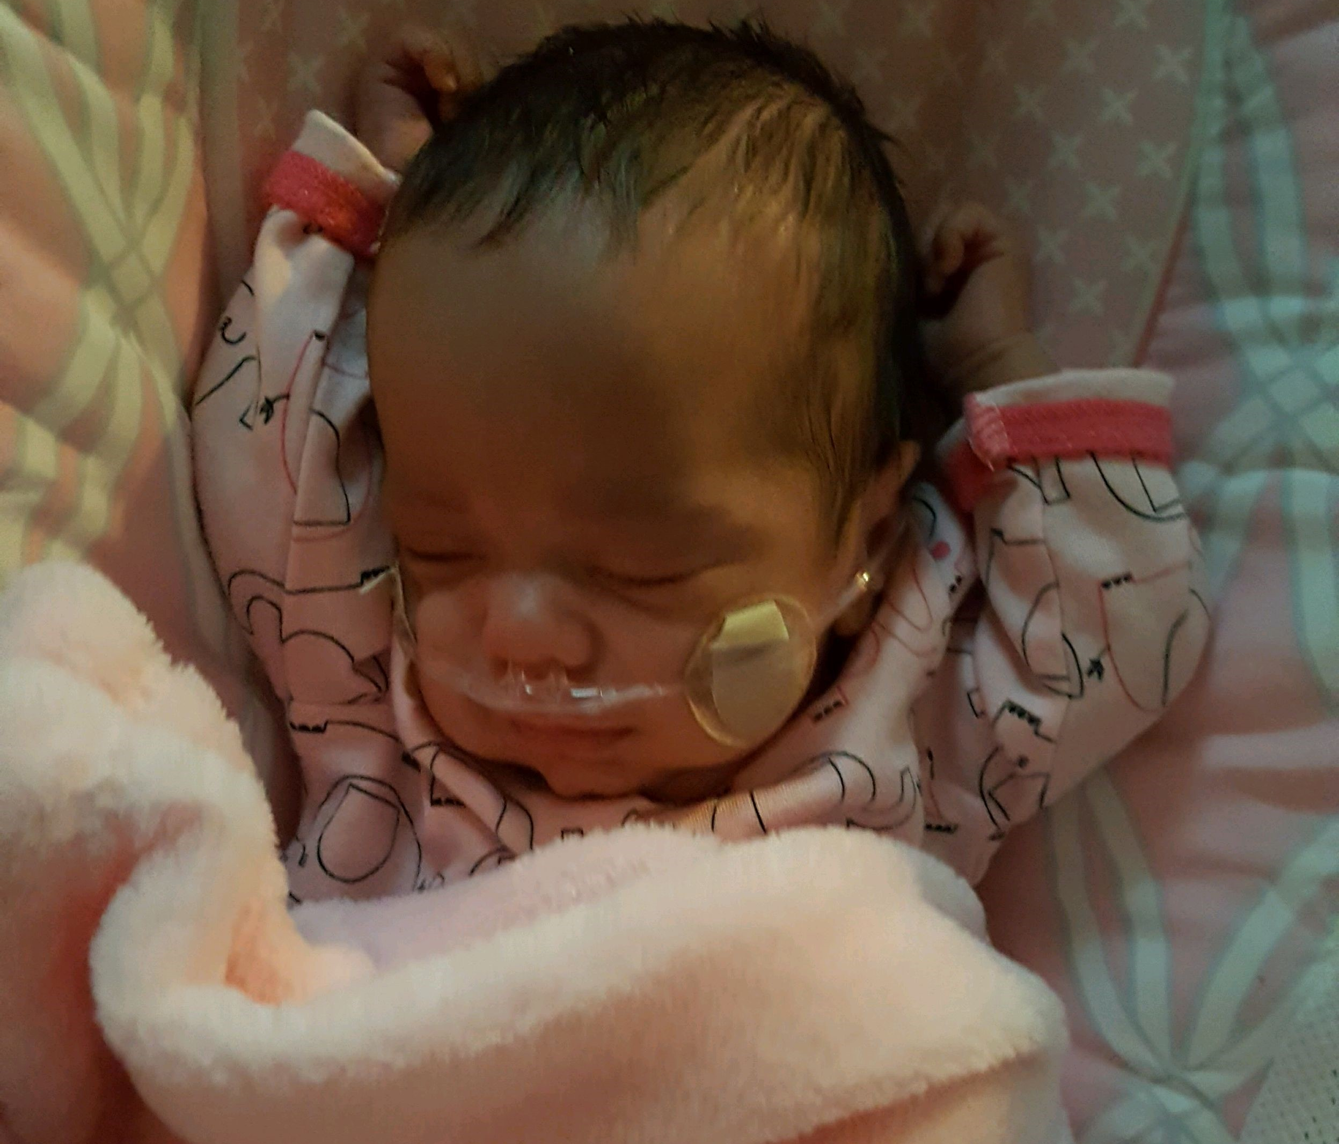
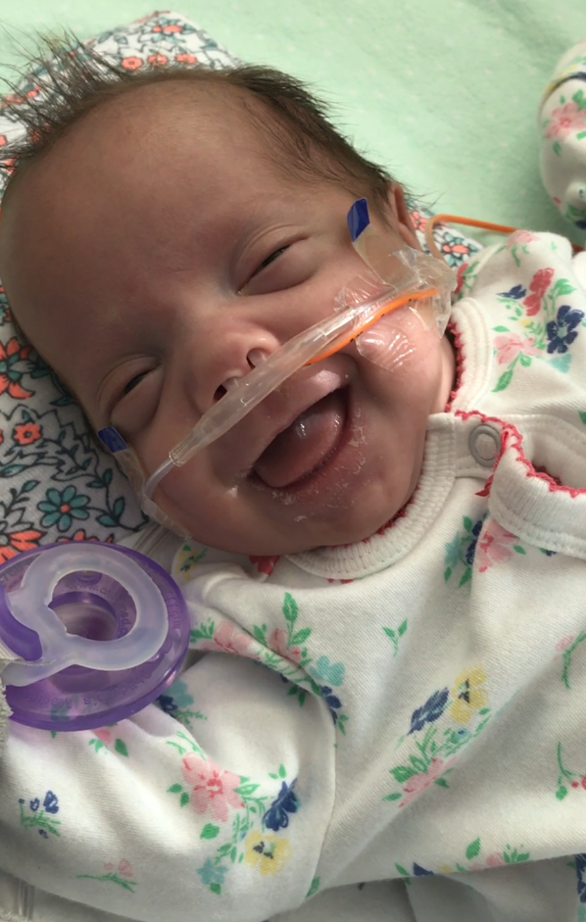
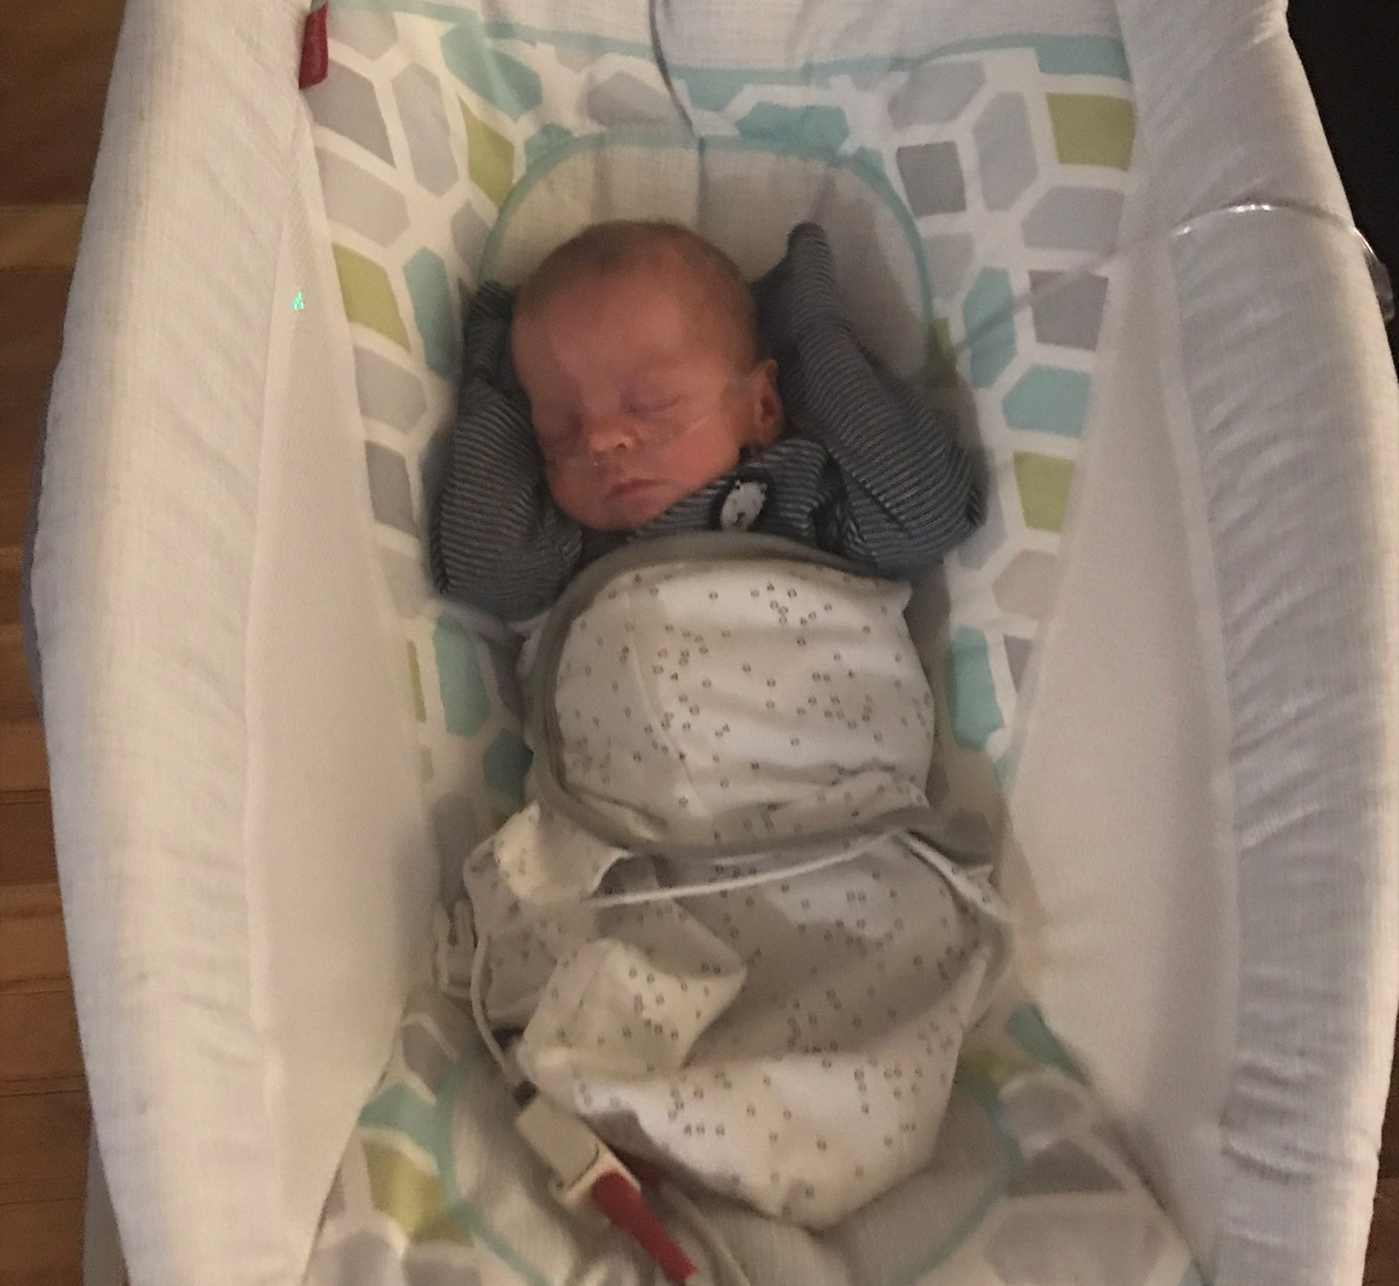
Closing Thoughts
Questions and Comments

