Slide 1


Population–Based Urban and
Rural Community Health
(PURCH)

Slide 2

Getting to Know PURCH
Welcome Video
  Overview of PURCH
  Learn about Baystate Medical Center and Baystate Health
PURCH Interviews
  8 MMI (Multiple Mini Interviews)
  Q & A with Faculty
Virtual Coffee Hour with Students
  Q & A with current PURCH students
Notes:
We have several resources that we will make available to you that we hope you will find helpful in your evaluation of PURCH program. The first of these is this welcome video in which I will give you an overview of PURCH as well as a brief introduction to Baystate Medical Center in Baystate health. For those invited to interview for PURCH, you will participate in 8 multiple mini interviews which will be followed by a Q&A with faculty. Finally, throughout the interview season, there will be several virtual coffee hour sessions where applicants can ask questions of current PURCH students.

Slide 3
PURCH
Population–Based Urban and
Rural Community Health
Notes:
The PURCH track allows a subset of University of Massachusetts medical school students the opportunity to focus from day one of medical school on how to optimally deliver care to patients in urban and rural communities. This focus on patients who have historically been marginalized from the health care system is integrated into all aspects of your clinical skills training within the PURCH program.

Slide 4
PURCH Track
Same content presented at UMMS-Worcester
Different Framework
Teaching through the lens of Population Health as well as the traditional Doctor-Patient dyad
Excellent Clinical Learning Environment

Slide 5
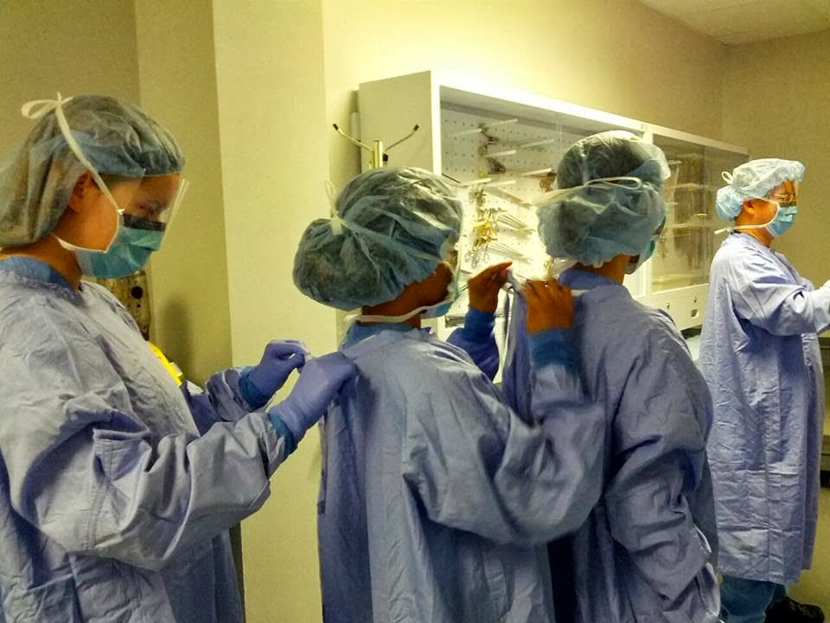
PURCH Guiding Principles
We train physicians through patient-centered education to develop doctors who are:
  Team-oriented
  Leaders, who can also be led
  Excellent Diagnosticians
  Self-Reflective
  Empathetic
Notes:
The design of the PURCH track included a series of discussions with the physician teaching faculty and a group of non physician community members from multiple agencies with whom we partner to improve the health of our communities. These community members make up our community faculty and many participate in an ongoing basis as standardized patients and discussion leaders in PURCH. These design meetings lead to the PURCH guiding principles noted here. These principles inform how we augment the curriculum. The result is a learning environment that allows you to be enculturated in a very different way that has traditionally been the case in medical training.

Slide 6
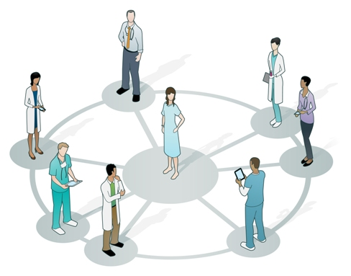
Team Oriented and
Leaders Who Can Be Led
Students are part of a multidisciplinary team, exploring evidence-based practice and team-based care in real-world settings
Notes:
I want to take a moment to focus on 2 of these guiding principles : team oriented and leaders who can be led .
When I reflect on my medical school training many decades ago , I was train in a very doctor centric model. This model had the doctor and the patient in the center of the circle. Later in my career, the model in most medical schools evolved to a model where the doctor and the patient were in the center of a circle and a team of supporting individuals were available to assist this doctor/patient diad. Today, most doctors continue to be trained in a fairly doctor centric culture.
Our community faculty challenged us to design a culture that is not so doctor centric.
From day one of medical school you will be trained in this model where the patient is in the center of the circle, and the doctor is but one member of the large support team.. Some of the time, the doctor is directing the team, but much of the time another team member is directing the care . Depending upon the problem at hand, this might be a social worker , a case manager, a nutritionist, or another member of the team. , the doctor is a leader who can be lead.
I want to give you a real world example of this. In the past I was precepting in a community Health Center in which I work and a resident came to tell me about a gentleman he was seeing. The gentleman had poorly controlled hypertension and diabetes. The resident went on to describe his plan regarding adjusting the patients hypertensive and diabetic regiments. As he wrapped up his presentation he shared that the patient was currently living in the Woods. We stop our discussion regarding medications and explored the issues around this gentleman’s current situation. It seems he had a family who was living nearby and he could not afford housing near this family member. He wanted to be closer to them so he chose 2 live in the Woods. It was clear to me that our plan to adjust this gentlemen’s medical regimens what’s the wrong plan. There are no refrigerators in the Woods in which the store insulin We needed to engage the help of a social worker. Until we could help this gentleman with this housing situation, we would likely have little success in helping him get his hypertension and diabetes under better control.
Physicians need to be enculturated to think of themselves as leaders who can be led. We need to have the humility and the team skills to step out of the center of the circle and request the help of our colleagues when appropriate. This is particularly important when social determinants of health create barriers for the patients we serve.

Slide 7
How Do We Achieve These Goals
Create a Community with Shared Values
Community and Physician Faculty who Deliver this Care
Augmenting the Curriculum
Experiential Learning
  Jail Health
  Homeless Shelter
  Poverty Simulation
Note: PURCH is not an MPH
PURCH is for EVERY Doctor

Slide 8
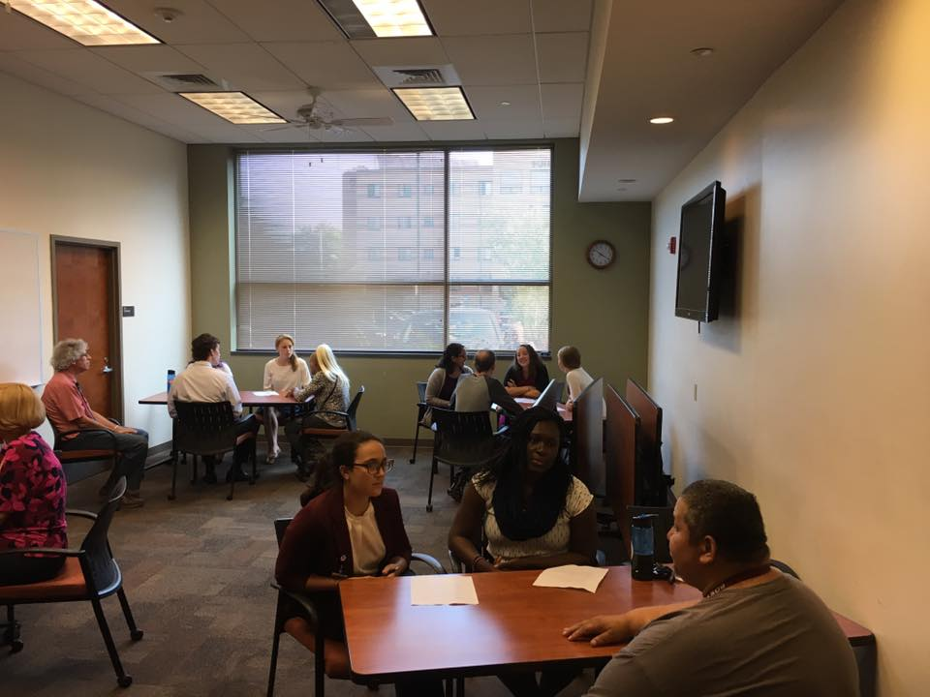
Notes:
learning the basic skills of interviewing in unique settings such as a homeless shelter or the County jail not only allows you to develop these critical skills, but it allows you to confront and recognize your own biases. Learning to take a social history and ask about substance use and mental health challenges is all the more powerful when speaking with individuals in these settings. Nowhere more so than in our homeless shelters and our jails will you encounter individuals whose lives have been dramatically impacted by substance abuse and mental health disorders.

Slide 9
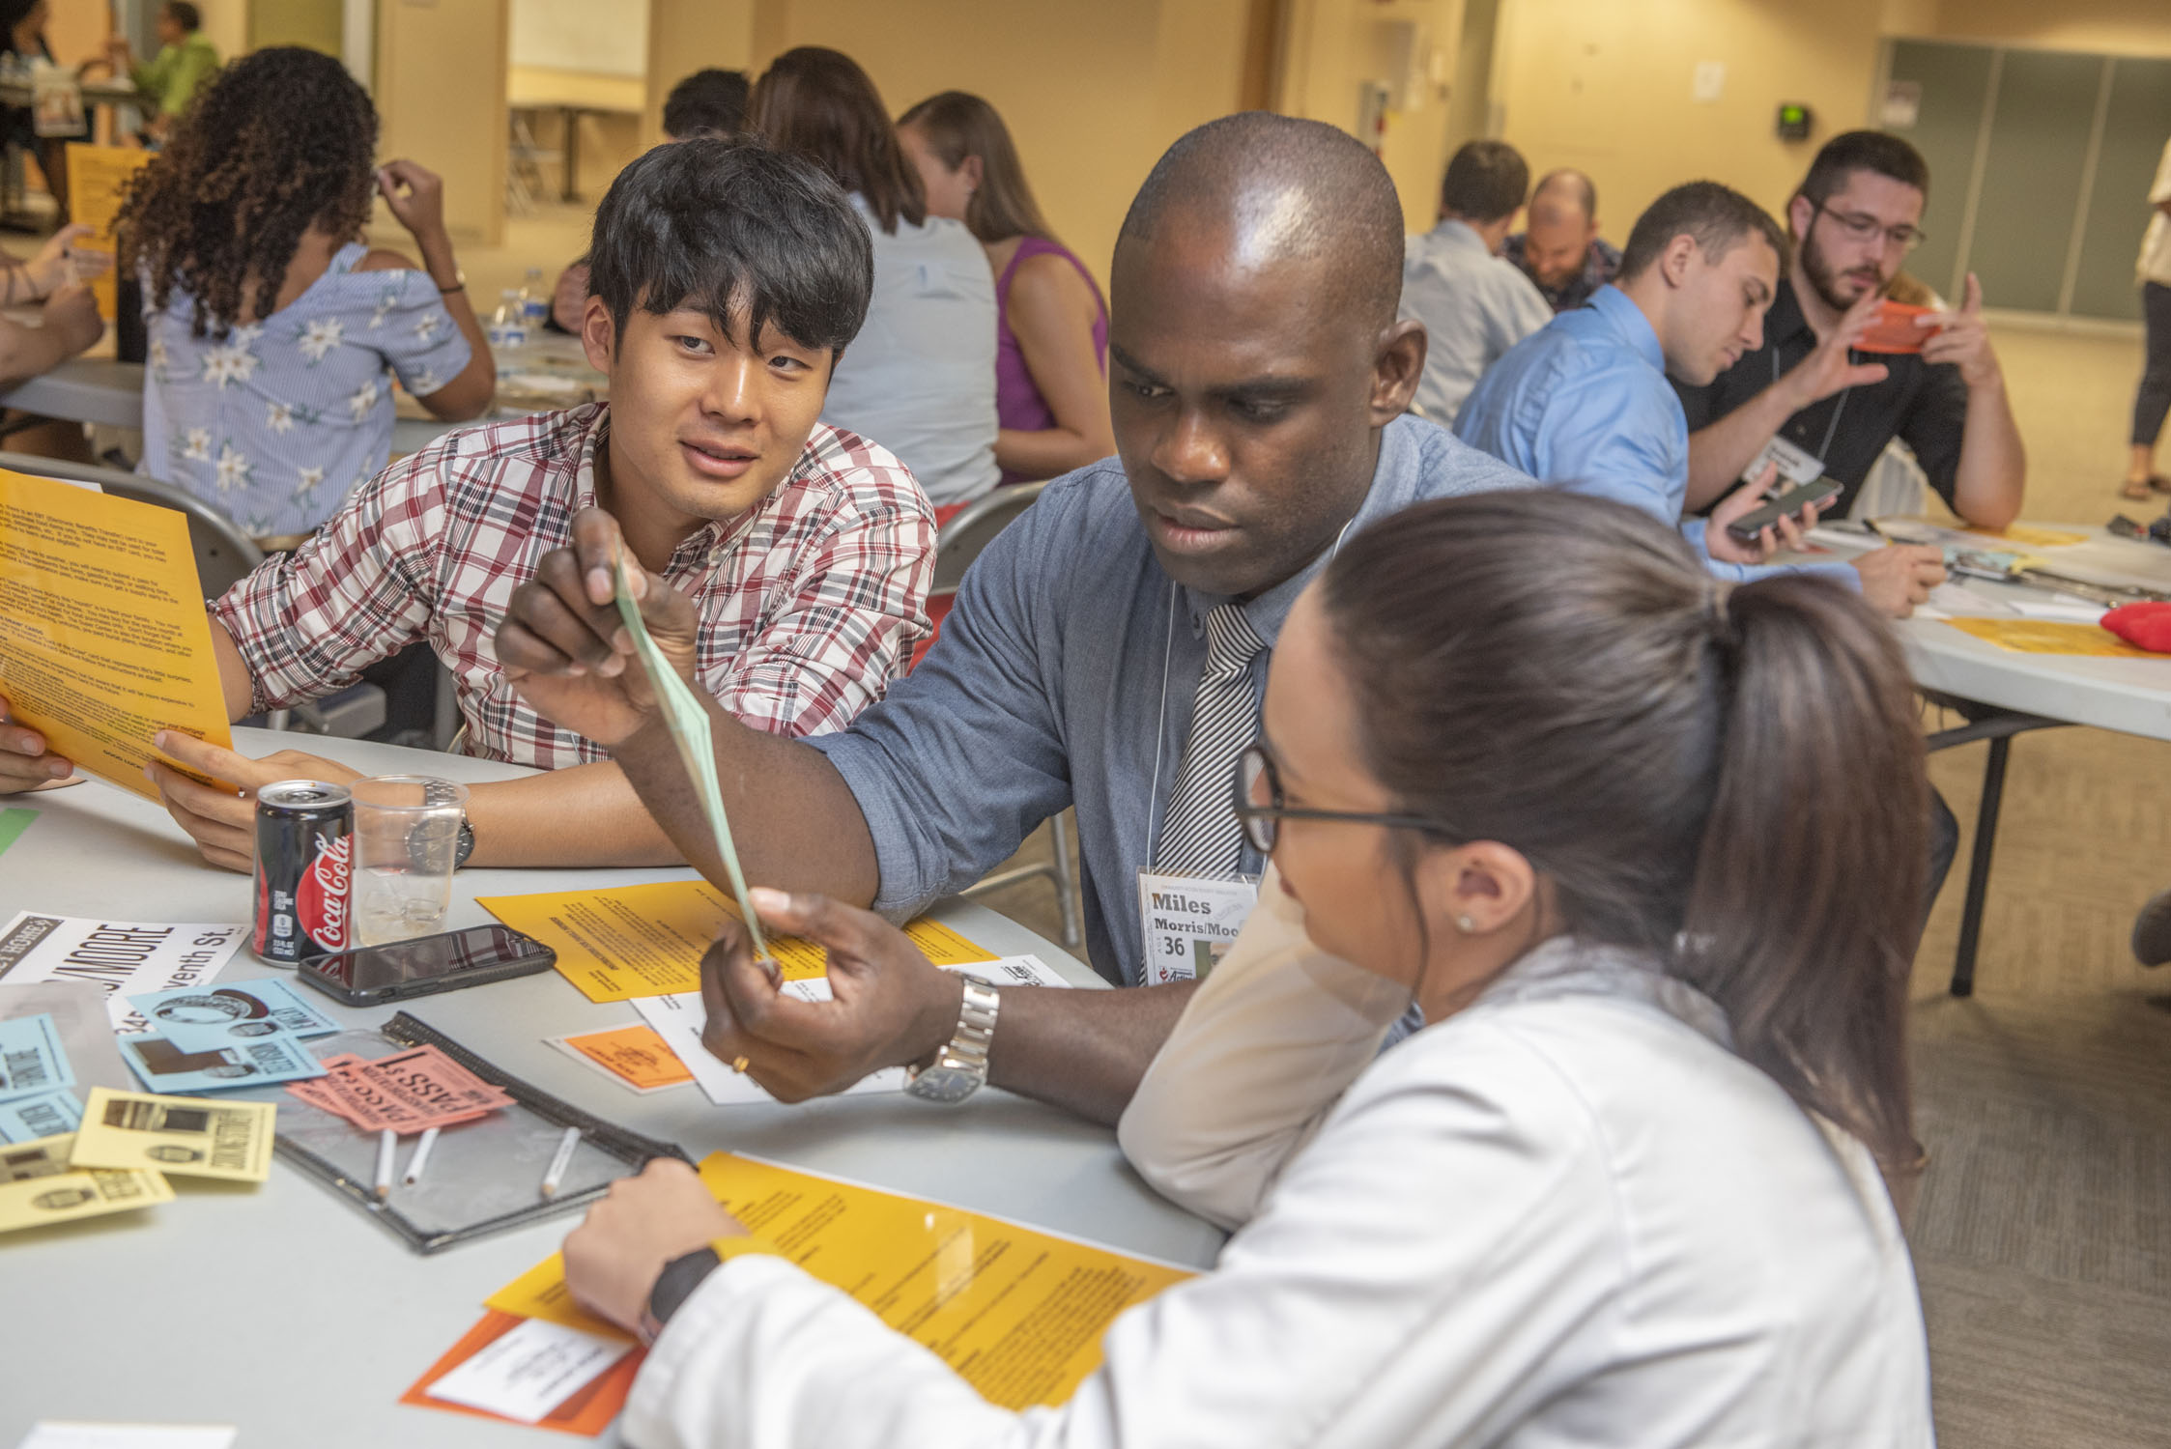
Notes:
The next several slides demonstrated an exercise called the poverty simulation. This is a powerful way in which students can spend an afternoon facing the challenges that many of our patients face on a daily basis

Slide 10
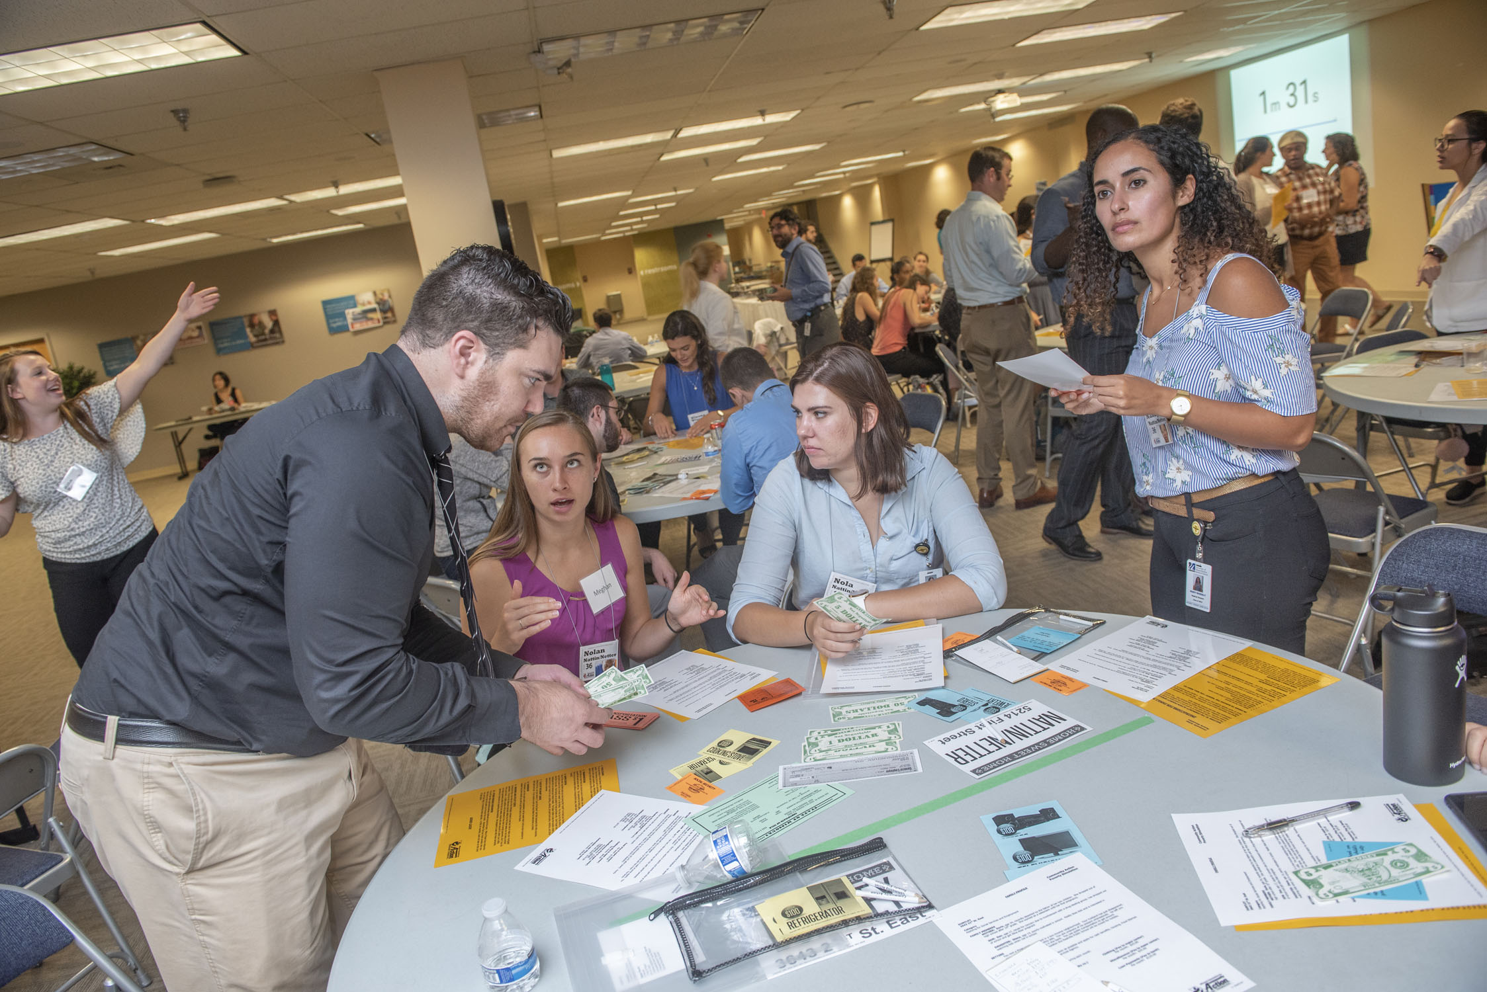
Notes:
The exercise is conducted in an intradisciplinary fashion and facilitated by academic and community faculty.

Slide 11
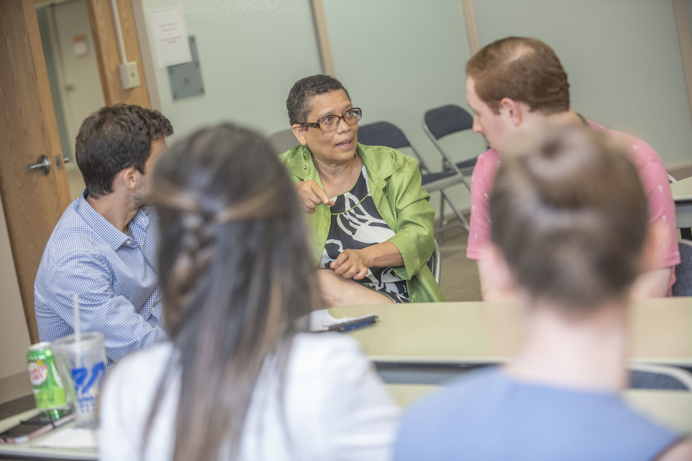
Notes:
The exercise concludes with an opportunity to debrief with our community faculty and reflect upon the experience. Many of these experiential learning exercises are fundamental in helping develop a culture in which physicians are more sensitive to the challenges patients face.
When I was an intern, I remember counseling a mother in the Ferber method, a strategy to help her teach her infant child how to comfort itself back to sleep. This method involves progressively moving yourself further away from the baby until you are reassuring the baby with your voice but you are outside the room. As I explain the technique, this mother nodded and smiled appreciatively. I remember feeling very satisfied with my counseling after the encounter. Approximately 18 months later I had the opportunity to do a home visit with the visiting nurse to this same family who had just had another baby. As we entered their studio apartment, with the cooking area in one corner and several adjacent mattress In another corner, I realized there was no separate bedroom for the children. I thought back to my counseling session and realize my navte in presuming they had a separate bedroom. This mother had smiled politely to me as I explained the Ferber method. I had failed to create a safe enough environment in which this mother had sufficient agency to correct my errors. By making this and countless other mistakes over my career, I have had to learn the hard way how to conduct a more patient centered interview. Through PURCH, we hope to enculturate you from day one of medical school training how to better create empathetic, trusting, and welcoming environments for disadvantaged patients.

Slide 12

Logistics – Where am I?
First & Second Years
Primarily in Worcester
2-3 Wednesdays per month in Springfield

Slide 13
Logistics – Where am I?
Third & Fourth Years: Clinical
Primarily at Baystate
In Worcester on occasion

Slide 14


About Baystate Health
Baystate Health is an integrated health care delivery system serving over 850,000 people throughout western New England
Notes:
Baystate health is a 5 hospital integrated not for profit health care system that is the largest health system in western Massachusetts. Bay State serves patients in urban and rural settings in the region’s only level one trauma center and Level 3 NICU. It also provides the majority of health care in the city of Springfield through its 4 community health centers. In many ways, it is very similar to the University of Massachusetts memorial healthcare system in Worcester, a multi hospital integrated health system. Both have comparably sized large primary teaching hospitals with approximately 750 beds and 38000 admissions per year at each institution.

Slide 15
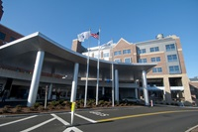
Baystate Medical Center - Springfield
Baystate Medical Center’s Emergency Department is the busiest in Massachusetts and one of the highest volume Emergency Departments in the northeast.
BMC provides training to over 350 residents and fellows in 10 residencies and 23 fellowship programs
BMC also provides education to Advanced Practitioners, Allied Health, Nursing and Pharmacy
Notes:
As the primary Health System in the region, Bay State boasts one of the highest volume emergency departments in the northeast. Our large teaching hospital is home to 10 residencies and over 20 fellowships, training over 350 residents and fellows.

Slide 16
Educating Learners for over 75 years
Education
Medical Residency (10)
RN Residency
Pharmacy Residency
Hospitalist (APN & PA) Residency
School of Midwifery
Medical Students
Fellowships (23)
PA Students
Allied Health
Students
NP
Students
Notes:
For most of the past 50 years Bay State has been one of the primary teaching hospitals for the Tufts University School of Medicine. Approximately 5 years ago, Baystate changed it’s primary affiliation and became a University of Massachusetts medical school teaching hospital. Of all the teaching hospitals Tufts students rotated through, Baystate was frequently ranked at the top by Tufts students for the learning climate. We have been educating physicians for over 75 years, and there is a wonderful culture of teaching at Baystate Medical Center. Bay State also has a very intimate learning climate. While the primary hospital in the health system is comperable to the University Hospital in the Umass health system, with comparable numbers of attendings and residents, there are far fewer students. This allows Bay State to provide a particularly strong learning environment. While the focus of the PURCH curriculum is the primary reason many students are interested in PURCH, the exceptional learning climate is a close second.

Slide 17
Summary
The PURCH track offers a unique education that is team-based, integrated within the community and focused on healthcare disparities and population health
Baystate Health is a 5-hospital integrated health system where educating the provider of the future is a top priority
PURCH is based out of UMMS-Baystate, the first regional campus of UMass Medical School

Slide 18
The Application Process
Post-Interview
  Applicants reflect on the information about PURCH and make a determination within 7 days after the Q&A:
    Continue with PURCH application
    Continue with UMMS only
  After 7 days you will be considered for PURCH unless you choose to withdraw

Slide 19
Thank You
Best of Luck in your Medical Career

