Slide 1




TEST - Translating Evidence to Support Transitions:
Improving Outcomes of Youth in Transition with Psychiatric Disabilities by Use and Adoption of Best Practice Transition Planning

Slide 2
Translating Evidence to support transitions
Marsha Langer Ellison, Transitions ACR
Deanne Unruh, NTACT
Sloan Smith, Charleston County School District
Alycia M. Trakas, Connecticut
Missy Wrigley, Connecticut
Roberta Lucas, Maine

Slide 3


Acknowledgements
The mission of the Transitions ACR is to promote the full participation in socially valued roles of transition-age youth and young adults (ages 14-30) with serious mental health conditions. We use the tools of research and knowledge translation in partnership with this at risk population to achieve this mission.
http://www.umassmed.edu/TransitionsACR
The contents of this banner were developed under a grant with funding from the National Institute on Disability, Independent Living, and Rehabilitation Research (NIDILRR) (ACL GRANT # 90RT5031). NIDILRR is a Center within the Administration for Community Living (ACL), United States Department of Health and Human Services (HHS). The contents of this banner do not necessarily represent the policy of NIDILRR, ACL, HHS, and you should not assume endorsement by the Federal Government.

Slide 4
TEST Partners
Transitions ACR, UMMS - Marsha Ellison (PI), Sloan Smith, Laura Golden, Emma Pici-D’Ottavio
SRI International – Mary Wagner
NTACT - Deanne Unruh, Catherine Fowler, David Test
AIR – Joann Starks

Slide 5
TEST: The Basics
A NIDILRR-funded Knowledge Translation Project to adapt NIDILRR funded findings for use and adoption by relevant stakeholders. Implementation Science, specifically the NIRN framework was used to design the project.

Slide 6
Basis of TEST: NLTS-2 Findings¹
Post-high school employment and enrollment in postsecondary education for students with Emotional Disturbance enrolled in special education were correlated with these transitions practices:
    Student-led IEPs
    A concentration of career & technical education courses (4 credits)
    Community partnerships in transition planning¹

Slide 7
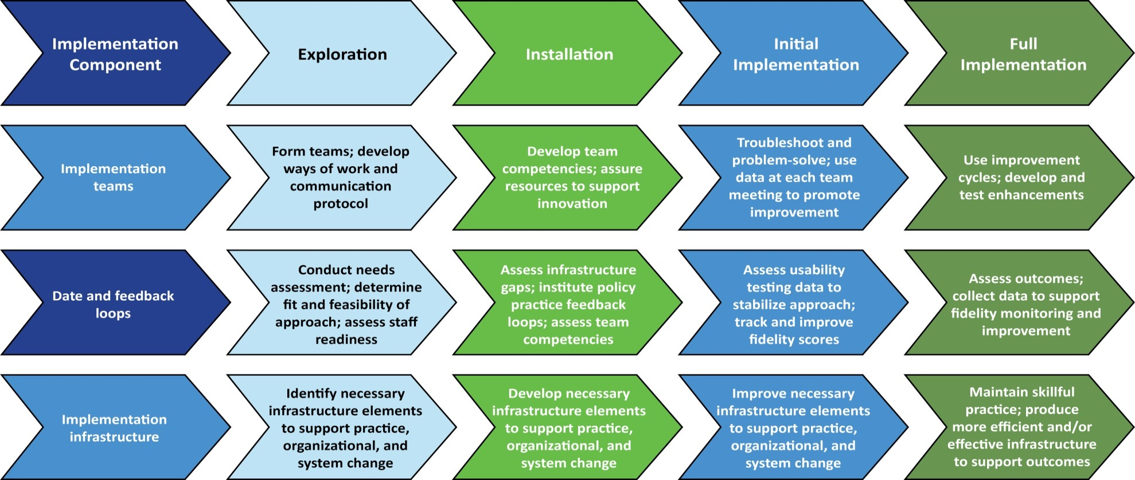
TEST FRAMEWORK
National Implementation Research Network (NIRN)²

Slide 8
TEST Process
Evidence Based Practices
Curriculum Development
District Level Implementation
Year 1: Exploration
curriculum development
consultation with state and national partners
elicit feedback from district and school level stakeholders
Year 2: Instillation and Initial Implementation
Identify district level partners
secure feedback on curricula
provide training and follow along coaching
elicit feedback from staff, parents, and students

Slide 9
TEST Process
Select states
Train and Coach
Evaluate & Dissemin-ate
Years 3 and 4 – Full Implementation
Implement TEST in state(s)
Involve stakeholder implementation
Provide training and technical assistance
Collect iterative feedback
Evaluate TEST and revise guides
Year 4 and 5 – Dissemination and Technical Assistance
Prepare TEST implementation guidance
Disseminate at NTACT Capacity Building Institute (CBI)
Disseminate through Transitions ACR
Develop TA capacity

Slide 10
Rationale for Practice Guides
Poor outcomes of students with EBD
  Lower rates of employment
  Living below poverty level
  Higher rates of substance abuse
  50% of failure to complete high school is attributable to mental health conditions
  Higher rates of arrest than typical peer group population
  higher rates of probation and parole
  Low success rates in vocational rehabilitation
  Early parenting
  Challenges leaving child welfare and foster care
  Housing instability

Slide 11
Rationale continued…..
Beneficial impacts on target population
Increase of high school completion rates from 42% to 74%
18% to 35% Increased post-secondary education enrollment
Increased odds of full time employment with 4 or more credits of career and technical education
Increased rates of post-secondary education enrollment with student leadership role in IEP
Involvement of adult agencies in transition planning, particularly a representative of an institute of higher education, increase the odds of engagement in post-secondary education

Slide 12
Considerations
Emotionally based characteristics
  duration, frequency and intensity
  interferes significantly with educational performance requiring special education services
Difficulty is emotionally based
Cannot be excluded due to other factors

Slide 13
Beyond the definition…….
Who we really have
  Students who
    Often violate school and norms
    Don’t get along with peers
    Are good at the wrong things
    Have poor self esteem/ feel shame and guilt
What kinds of things we need to know
  Learn needed skills
  Motivated by age appropriate goals
  Benefit from function focused support

Slide 14


Moving students from……
Suicide Squad
Justice League
http://cdn1-www.comingsoon.net/assets/uploads/2016/05/Suicide.jpg
http://www.dccomics.com/sites/default/files/GalleryMovies_1920x1080_JusticeLeague01_57be61d14b0303.09859959.jpg

Slide 15
The TEST Guides

Slide 16
Student Led IEP
High School is not real life, but it can build the foundation for what comes next…..
Increase student engagement
Facilitate growing self-advocacy and self-knowledge
Develop a purposeful, coherent vision for what comes next

Slide 17
Student-led IEPs Practice Guide ⁴
Lesson plans for student-led IEPs for students with EBD
  Lesson 1 – Understanding your IEP
  Lesson 2 – Build self-determination
  Lesson 3 – Create goals for your IEP
  Lesson 4 – Preparing to lead your IEP
  Lesson 5 – Practice leading your IEP
Implementing the student-led IEP meeting
  How to prepare for IEP meeting
  What happens during IEP meeting
  Measure outcomes/impact of student-led IEP

Slide 18
Lesson Plans
Lesson 1 – Understanding your IEP. Review of IDEA and past goals and performance through the IEP.
Lesson 2 – Building self-determination. Understand student’s strengths, needed supports, preferences and goals.
Lesson 3 – Creating goals for your IEP. Identify IEP and transition planning goals and relevant community partners.
Lesson 4 – Preparing to lead your IEP. Determine how student will participate in/lead their IEP.
Lesson 5 – Practicing leading your IEP. Role play the IEP meeting.

Slide 19

Community Partners
Moving from childhood and adolescence to adulthood while minding the gap…..
Learn about supports
Understand available
resources
Connect before crisis

Slide 20
Importance…..
Students with 3-6 community partners involved with their transition planning are more likely to be engaged in post secondary employment than those with 2 or fewer community partners involved
Students with a representative of an IHE involved in their transition planning are 29 times more likely to be engaged in post secondary education

Slide 21
Importance of planning for these partnerships
Students
“fall off the grid” after high school
lose SSI benefits and have no other supports
are “independent” with few independent living skills
are unemployed with no prospects for employment
become parents at an early age
are at a loss for pursuing post secondary education

Slide 22
Community Partnerships Practice Guide ⁵
Involving adult community agencies (e.g., institutions of higher education, vocational rehabilitation, non-profits) in transition planning for high school students with EBD
Planning for Community Partnerships
  Engaging with Current, Previous, or New Adult Service Agencies/Organization Partners
  Making the IEP Meeting Work
  Sustaining Connections with Community Agencies

Slide 23
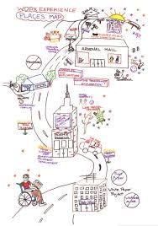
Career and Technical Education
Begin with the end in mind……..
Explore interests and aptitudes
Acquire skills and training during high school
Establish clear path to future employment
Complete steps to enter workforce or continue/complete training upon high school exit

Slide 24
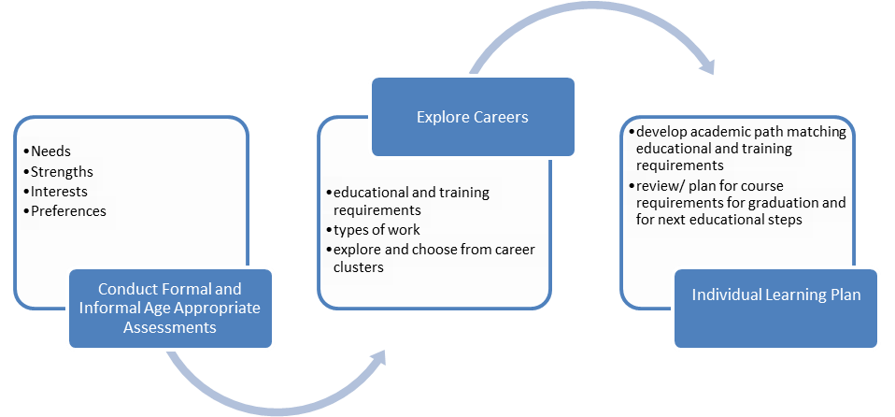
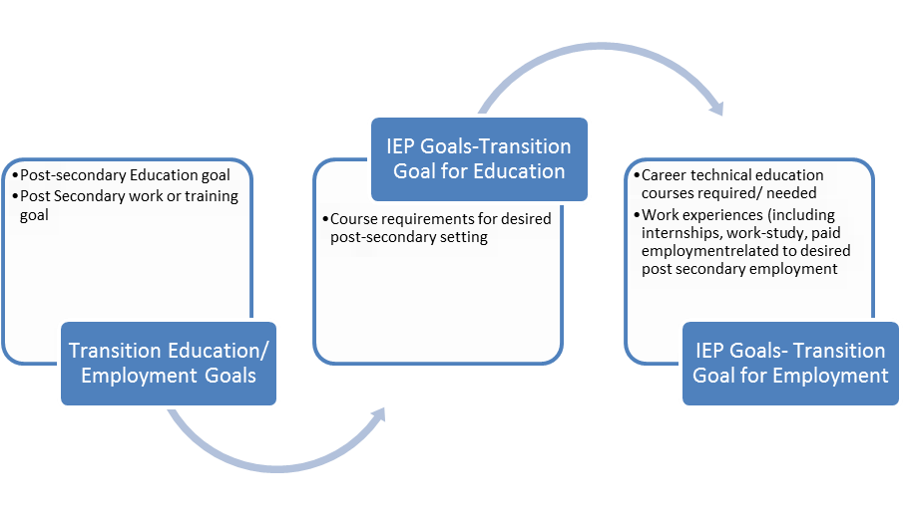
Career and Technical Education³
CTE coursework can be used to address underestimation of career potential, promote consideration of higher education, create realistic career plans, and combat the historic discouragement of students with psychiatric disabilities from pursuing work.

Slide 25
Specify Progression of CTE Courses
Be flexible and creative
Connect with community based opportunities for CTE experiences
Include coursework in IEP
Allow high school exit and post secondary plans to guide coursework selections

Slide 26
CTE
Trade Certificate – requirements may be completed during high school years
Employment – placement in a job related to CTE courses (carpentry)
Higher Education- foundational courses for college course of study (graphic design), identify accommodations available for achievement tests and college courses

Slide 27
Remember *
You may be the first person to challenge your student to think ahead and plan for their future and career
Anecdotal evidence suggests that a caring adult with high expectations can be a “holding” factor for students at risk of dropout

Slide 28
IMPLEMENTATION

Slide 29
TEST Implementation Years 1 and 2
Development of Guides with Stakeholder Group: Transition Alliance of South Carolina (TASC)
Usability Testing at NTACT conference with teachers
Piloting of Guides in one school district (Initial Installation)
Iterative feedback with teachers, administrators, students
Revision of Guides

Slide 30
TEST Implementation Year 3
Selection of States (assisted by NTACT)
Identification of state “champion” committed to TEST
Criteria for state selection
  Connecticut
    3 schools implementing Student-led IEPs Practice Guide
    3 schools implementing Community Partnerships Practice Guide
  Maine
    4 schools implementing Career & Technical Education Practice Guide

Slide 31
TEST Implementation Year 3
Implementation Training – January 2018
One day in-person training for each state
  4 teachers, 2 administrators
  2 hours per curricula
  Training evaluation Pre and Post Test of Knowledge and Skills and of Satisfaction

Slide 32
TEST Implementation Year 3 and 4
Implementation by Schools (Feb. 2018 – Dec.2018)
Monthly “virtual coaching” for each practice guide led by NTACT and Huckabee with state champions, teachers, school administrators for transition
Virtual meetings: opportunities for review, questions, problem-solving, sharing strategies between schools

Slide 33
TEST Implementation Year 3 and 4
End-of-semester evaluation:
  Implementation checklist (google docs)
  De-identified IEPs
  Audio recordings of coaching calls - coded
  Practice Guide Evaluation
  Coaching Call Evaluation
  Student and parent satisfaction questionnaire
  Community partner questionnaire

Slide 34
TEST Implementation Year 3 and 4
Evaluation results used to enhance and improve guides
Example changes made:
  Strategies for involving parents
  Using transition fairs for community partners
  Address unique needs for accommodations
  Slow down learning for freshmen
  Consider other disability groups (LD, OHI)

Slide 35


CONNECTICUT STATE DEPARTMENT OF EDUCATION
National Technical Assistance Center on Transition (NTACT) Capacity Building Institute (CBI)
Translating Evidence to Support Transitions (TEST)
Connecticut Pilot
Thursday, May 9, 2019

Slide 36


Connecticut Pilot Schools
EQUITY.EXCELLENCE.EDUCATION.
Community Partners
EASTCONN, Columbia
Manchester Regional Academy, Manchester
Pomperaug Regional High School, Southbury
Student-led IEPs
Southington High School, Southington
Wilton High School, Wilton
Non-Pilot Schools
North Haven High School, North Haven

Slide 37
Connecticut Pilot Timeline
EQUITY.EXCELLENCE.EDUCATION.
Implementation Training
  January 18, 2018 ~ full day
  January 19, 2018 ~ half day
Implementation/Data Collection
  Winter/Spring semester(s) 2018
  Fall semester 2018
Evaluation
  Winter/Spring semester(s) 2019
Coaching Conference Calls
  October 2018
  December 2018
  January 2019
Practice Guide and Coaching Call Evaluation
Feedback Forms
De-identified IEPs
Implementation Checklist
CONNECTICUT STATE DEPARTMENT OF EDUCATION

Slide 38
Connecticut Pilot Comments
EQUITY.EXCELLENCE.EDUCATION.
A Student’s Perspective:
I feel the lessons helped me learn my rights for special education.
It was the first time I was at my PPT. Now I know more about what I am doing.
I was involved in my meeting way more than ever before.
I feel like I want to participate in my PPT more because I understand the process better and what an IEP is for.
The IEP is personal and individual to you. You do not need to share the information with other students.
I learned about the laws like IDEA that I never knew about.
Students from North Haven, CT

Slide 39
Connecticut Pilot State Liaisons
EQUITY.EXCELLENCE.EDUCATION.
Alycia M. Trakas, Education Consultant,
Connecticut State Department of Education (CSDE),
Bureau of Special Education,
alycia.trakas@ct.gov; 860-713-6932
Missy Wrigley, Consultant,
State Education Resource Center (SERC),
wrigley@ctserc.org; 860-632-1485 ext. 397
CONNECTICUT STATE DEPARTMENT OF EDUCATION

Slide 40
TEST Years 4 & 5
Publish final TEST Practice Guides
Publish TEST Implementation Guide
Disseminate TEST practice guides at NTACT Capacity Building Institute and other professional forums
TEST can begin to be implemented nationwide by interested educators
Provide TEST technical assistance, training, and coaching

Slide 41
References
1. Mary Wagner, Lynn Newman Promoting Successful Transitions for Youth with Serious Mental Health Conditions: Findings from the National Longitudinal Transition Study-2 (NLTS2) . October 2014. Retrieved from: . https://www.youtube.com/watch?v=BXIT94bFh04 2. Metz, A., Naoom, S. F., Halle, T., & Bartley, L. (2015). An integrated stage-based framework for implementation of early childhood programs and systems (U.S. DHHS) OPRE Research Brief. Washington, DC. National Implementation Research Network (NIRN). Retrieved from https://nirn.fpg.unc.edu/ 3. Kathleen Biebel, Laura Golden, Sloan Huckabee, Marsha Langer Ellison December 2018 Supporting Student-Led Transition Planning for Students with Emotional Behavioral Disturbance.
4. Marsha Langer Ellison, Sloan Huckabee, Laura Golden, Kathleen Biebel. December 2018. Incorporating Career and Technical Education in Transition Planning for Students with Emotional Behavioral Disturbance 5. Sloan Huckabee, Laura Golden, Marsha Langer Ellison, Kathleen Biebel. December 2018Partnering with Community Agencies in Transition Planning for Students with Emotional Behavioral Disturbance Guides are available at: https://www.umassmed.edu/TransitionsACR/research/projects-by-grant/translating-evidence-to-support-transitions/

Slide 42
Contacts
Marsha Ellison, Marsha.Ellison@umassmed.edu
Catherine Fowler, chfowler@uncc.edu, www.transitionta.org
Laura Golden, Laura.Golden@umassmed.edu
Deanne Unruh, dkunruh@uoregon.edu
Sloan Smith, sloanshuckabee@gmail.com
Download the guides at: https://www.umassmed.edu/TransitionsACR/research/projects-by-grant/translating-evidence-to-support-transitions/
Sign up for our newsletter and visit us for our tip sheets and resources at: https://www.umassmed.edu/TransitionsACR/

