Slide 1
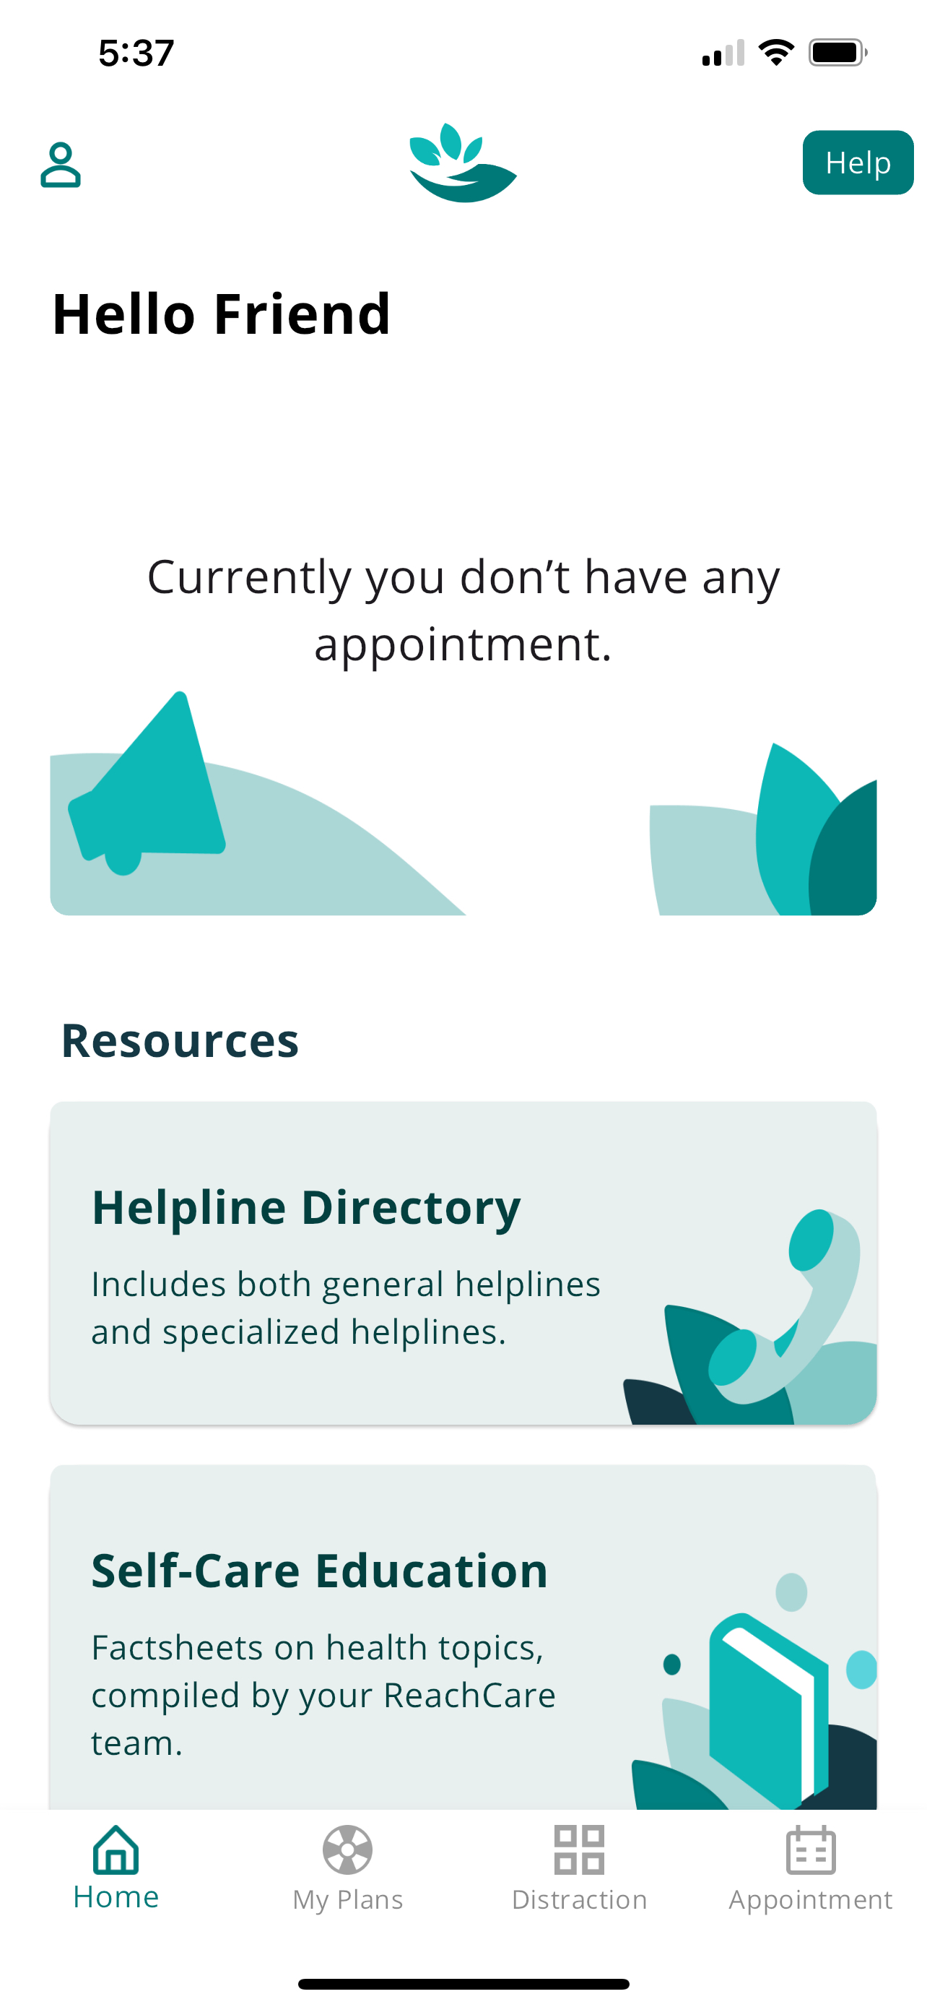
R03 Pilot Project: Optimizing ReachCare for Primary Care
AIMS
Adapt the ReachCare patient app for use in primary care to facilitate at-home safety planning, life planning, behavioral health action planning, and access to resources until BH follow-up occurs.
2. Test the refined ReachCare patient app for use in primary care.
conduct 2 testing cycles (n=5 pts per cycle) to obtain iterative qualitative and quantitative (usability, acceptability, appropriateness, feasibility) feedback
3. Explore adaptation needs for diverse clinic populations.
an exploratory aim in parallel with Aim 1
conduct 2 sets of focus groups with Hispanic patients (n~10)
further adapt ReachCare to meet needs of this underserved subgroup

Slide 2
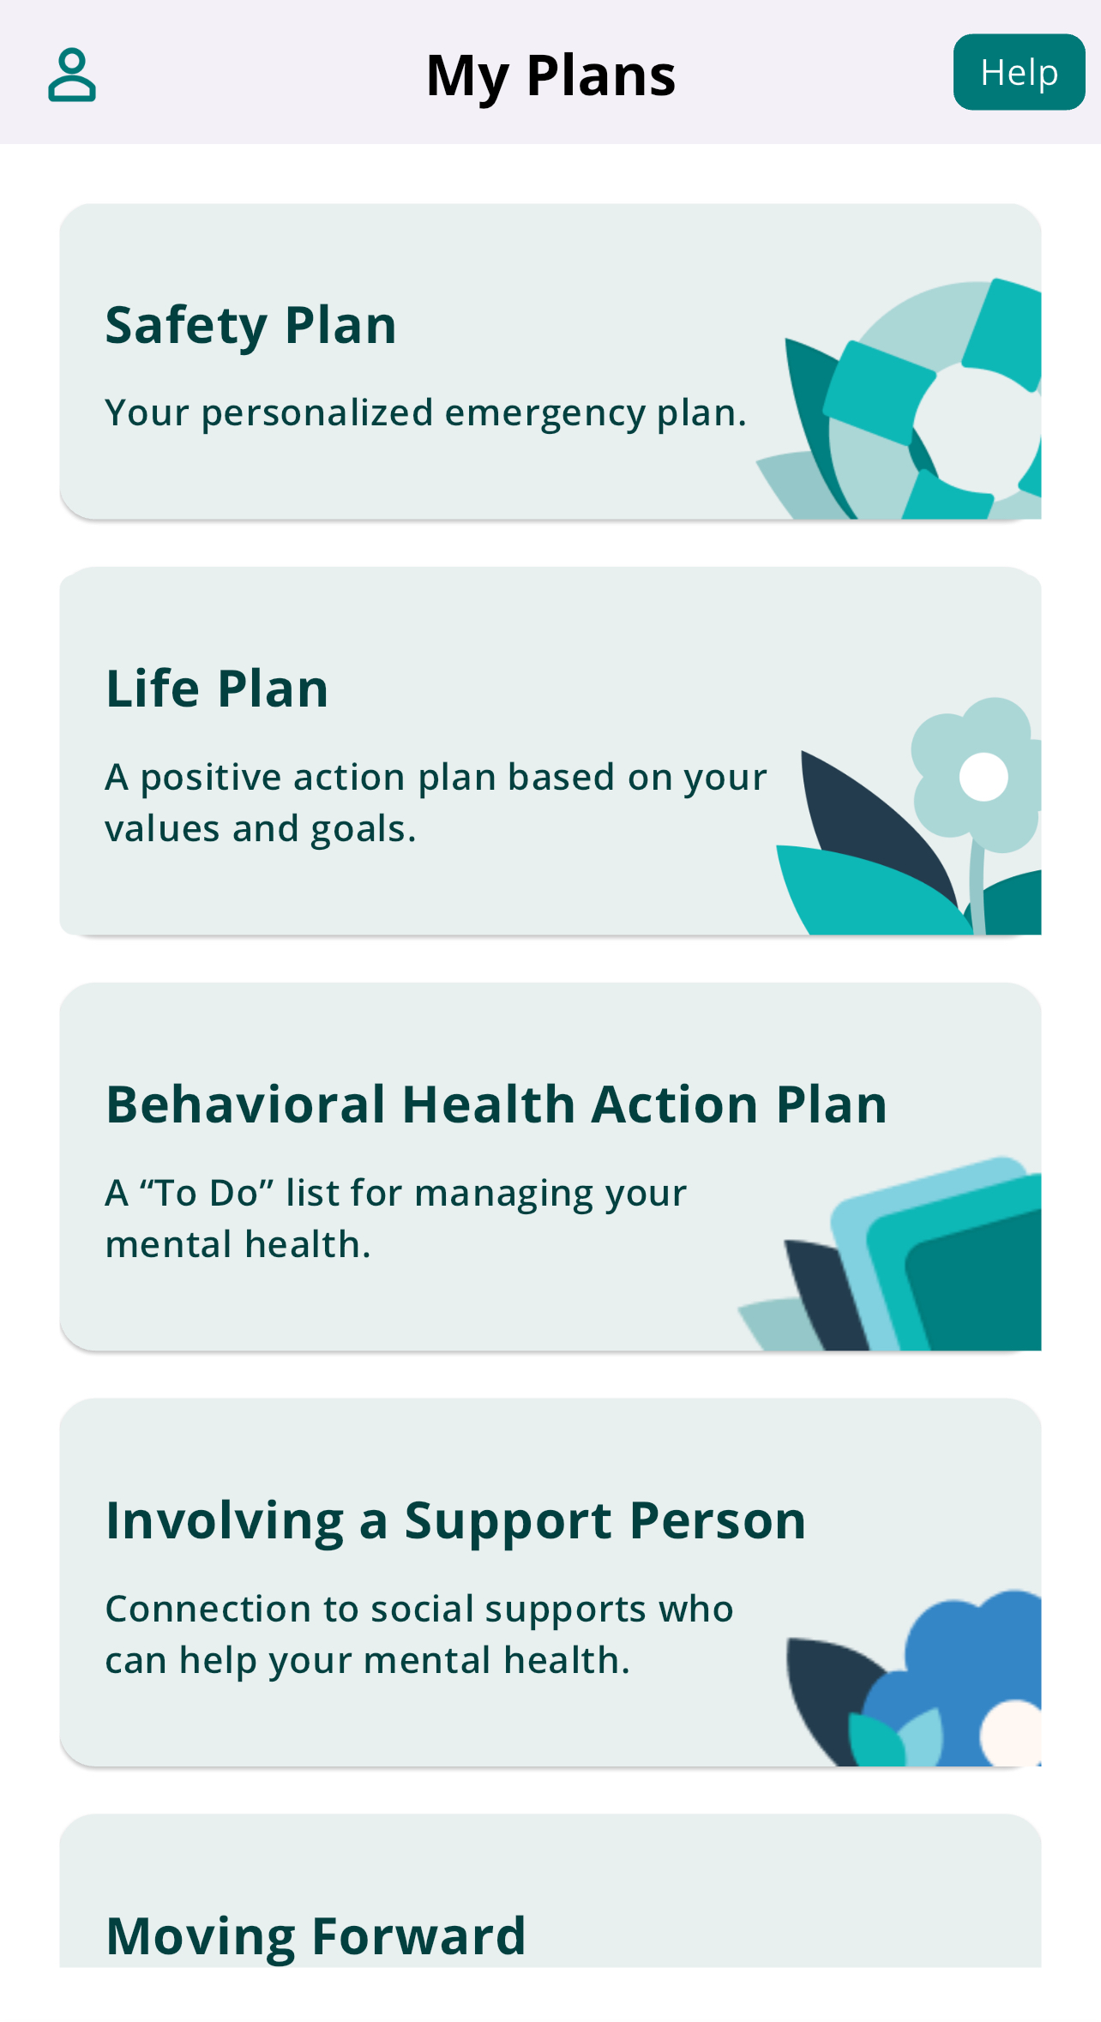
Aim 1
Completed Tasks
Wrote scripts and created chatbots for Safety Plan, Behavioral Health Action Plan, Values Clarification, and Life Plan
Created introductory videos to for Plans components
Created push notification schedule
Updated referral base for Find a Provider
Conducted iterative internal user testing to address bugs and improve functionality

Slide 3
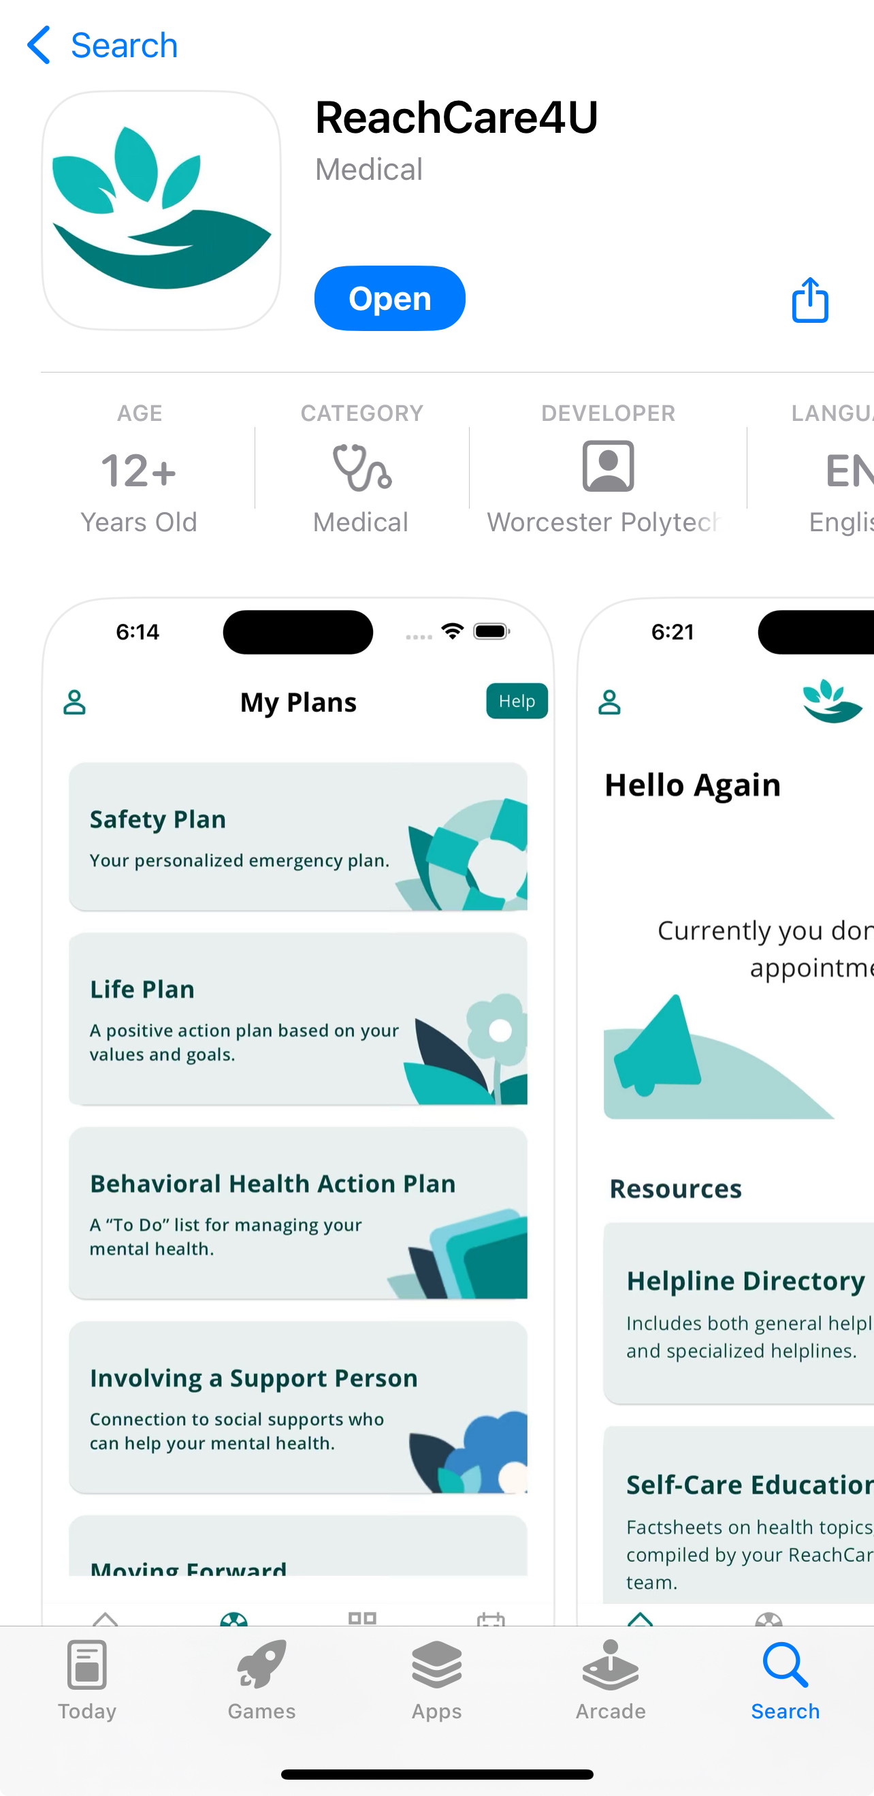
Aims 2 and 3
In progress
Delays:
11 months for IRB approval
Google Play and App Store approval
Competing studies at clinic
Study team schedules
Next steps:
Entire clinic will be educated on study end of June
Recruitment will begin mid-July
Recruitment of both groups occurring simultaneously
Anticipate 4 months for completed data collection

