Slide 1
CAPES Retreat Executive Summary
Highlights, Strategy, Vision
Edwin Boudreaux, PhD - May 21, 2025

Slide 2
Year 2 at a Glance
Y3 funding, minimal DEI revisions!
Submitted 10 extramural grants
Received new grant from Four Pines Fund
139 peer-reviewed publications
Expanded collaboration with other P50s, Faculty Exchange built
All Exploratory Projects all under way

Slide 3
Leadership Transitions
Catarina Kiefe, PhD, stepped down as CAPES Co-Director
Chengwu Yang, PhD, left CAPES
JungAe Lee, PhD, joined the DAU
Anthony Nunes, PhD, departing UMass in June
Kate Pivovarova, PhD, taking lead for Education and Scientific Development Unit
Sharina Person, PhD, joined the DAU

Slide 4
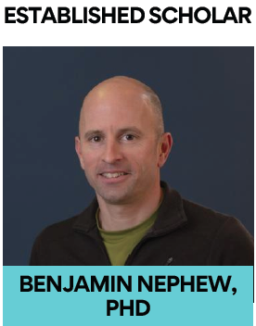
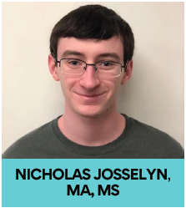
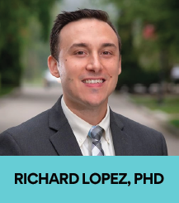
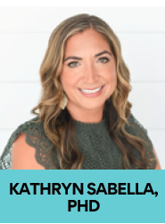
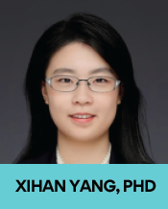
5 New CAPES Scholars

Slide 5
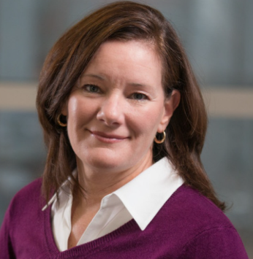
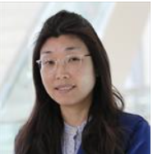
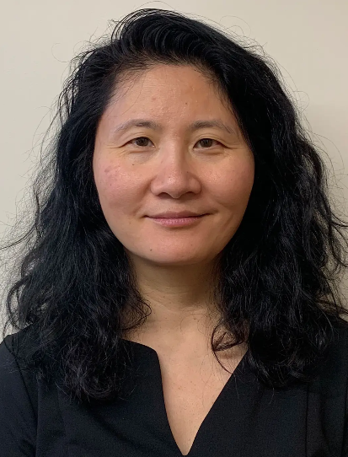
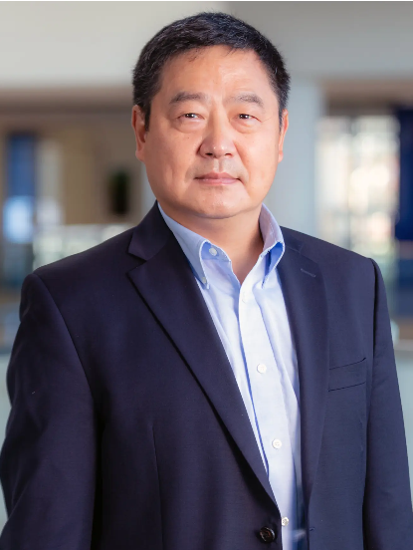
Added Four Faculty
Rosemarie Martin, PhD
UMass Chan
JungAe Lee, PhD
UMass Chan
Hong Yu, PhD
UMass Lowell
Wenjun Li, PhD
UMass Lowell

Slide 6
Added Four Organizational Affiliates
RAE Health, focused on biosensing: https://www.raehealth.com/
New England Addiction Technology Transfer Center: https://attcnetwork.org/center/new-england-attc/
Center for Biomedical and Health Research in Data Sciences (CHORDS)
https://www.uml.edu/research/chords/
Cogitas consulting: https://www.cogitasconsulting.com/

Slide 7
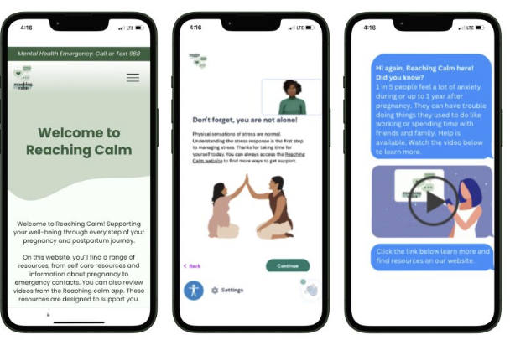
Pilot Projects
Dixon-Gordon: ASSIST (Advancing Student Suicide Interventions with Scalable Technologies)
Zimmermann: Beta-Testing Reaching Calm (Exploring Digital Approaches to Address Suicide Risk in Obstetric Settings)
Year 3: Changed to supplement current projects with intention to catalyze grant submissions, rather than new projects

Slide 8
Thank you to our Units! Provided Extensive Consultation *See appendix

Slide 9
Update from Last Year’s Retreat
DEI among CAPES – Could not get traction, lack of resources, uncertainty
Improve networking – PP emphasized cross-project collab, Showcase series initiated
LLM applied to suicide – Cross-unit discussions, Retreat topic, Submitted NSF grant
Identifying databases – Database tracker created, to be shared
Outcome measures (SDOH, PRO, Others) – Could not get traction, lack of resources

Slide 10
Continue these efforts?
DEI among CAPES – Anyone want to take the lead?
Improve networking –Share ideas with Lourah Kelly
LLM applied to suicide – Design, submit grants!
Identifying databases – Anyone want to take lead? Need to ID points of contact for each of the databases
Outcome measures (SDOH, PRO, Others) – Anyone want to take the lead?

Slide 11
Developed Center Strategy
Double down on federal grant submissions
Diversify institutes, NIMH, NIDA, NIAAA
Diversify agencies, DOD, VA, PCORI
Diversify funding portfolio outside of federal grants
AFSP, Four Pines Fund
State contracts
Notes:
CAPES Faculty and Scholars will need to double down on federal grant submissions. This should include diversifying within NIIH to different institutes, not just NIMH, and expanding to NSF, DOD, and the VA. Even though we have to seek funding outside of the fed, see below, we still will require federal funding to support our work. Volume matters, especially in the face of shrinking funding. We should therefore figure out ways to support faculty and scholars in their efforts to develop competitive grant proposals, help identify good fits within the various federal departments, and submit to every possible cycle.
CAPES will need to identify good-fit opportunities for funding outside of federal funding. This primarily includes foundations and state funding. The most important foundation is the American Foundation for Suicide Prevention, but we need to identify others. And, we need to begin diving deep into the possible funding from state government as well. The state does not really support research, but they support building and evaluating clinical programs, and they support training and technical assistance.

Slide 12
Developed Center Strategy (cont. 1)
Foster greater collaboration across CAPES
UMass 5 campuses, WPI
MPI model: subject matter expert, methodologist
Diversify business line
Training, technical advising, consulting
Commoditize our intellectual property
Notes:
We need to work hard to build teams within CAPES to maximize cross-coverage of ourselves and our colleagues. All grants submitted should maximize use of CAPES expertise and resources, primarily at UMass Chan and WPI, and they all should consider strongly the MPI model we developed for the P50, with a subject matter expert and methodologist co-leading all applications. The more we collaborate, the better the chance of getting some coverage, and the more we help support each other and the CAPES infrastructure. We have to develop ways of making sure that all faculty and scholars are very aware of the expertise that exists and foster networking and team building.
CAPES will need to diversify its business lines. Currently, we're nearly 100% funded by research dollars and research results are our primary output. We need to branch out to provide training and consultation related to suicide-related care. We have already started this with a grant from the Four Pines Fund. We have to continue with developing both the relationship with FPF, which helps diversify our funding agencies, and with building products and a business development plan to commoditize and commercialize the products. Along these lines, we should consider developing a more robust effort to solicit donations from individuals and corporations. We may be able to do this through the UMass Office for Advancement.

Slide 13
Developed Center Strategy (cont. 2)
Prioritize artificial intelligence (AI)
Everyday AI
Ethically
High tech + high touch
Notes:
WE need to expand our use of AI for our everyday business to improve efficiency as well as study AI in suicide prevention and implementation.

Slide 14
Four Pines Fund: Planning Grant
https://www.fourpines.org/
Maximize CAPES’ impact on suicide prevention in healthcare settings
Fund efforts that NIH might not fund
Lead to direct, rapid, measurable impact

Slide 15
Four Pines Fund: Planning Grant (cont. 1)
Improve our understanding of the crisis care continuum
Formulate major barriers to implementation
Identify CAPES strengths/weaknesses/existing “know how” materials
Consolidate/organize our “know how” to make it more easily accessible by our team

Slide 16
Organizational chart
Past Projects
Scattered throughout shared drive folders
Uniform Folder Structure
Toolkit organization
MS Teams
Indexed
Excel

Slide 17
Four Pines Fund: Planning Grant (cont. 2)
Write a proposal to transform this accumulated “know how” into products and services that will rapidly impact in the field
Develop a business development plan that addresses demand for the products and services, as well as how the products and services will be delivered (supplied)
Grant due Sept 1

Slide 18
Suicide Care Catalyst
Pathway Builder
(Software)
Pathways matched to role-based trainings
Training Library

Slide 19
Looking Ahead
Find leadership for Methods Core
Submit at least 3 new extramural grants
Adapt to changes in DEI without abandoning science and values
Finalize data-related standard operating procedures
Refine, automate data analytics pipelines
September: Summit with Zero Suicide Institute

Slide 20
Thank you!
We are successful because of the fantastic people who make up CAPES
I am in constant awe and appreciation of the incredible sacrifice each of you makes
I want to especially thank Basheer, Gwen, Ancella, and Carolyn. Without them, the Center doesn’t hold.

Slide 21
Appendix

Slide 22
Admin Core - Key Achievements
Operation Unit
Held Innovation Summit + Core retreats
Launched undergrad intern program
Standardized faculty onboarding
Developed smart milestones for all CAPES units

Slide 23
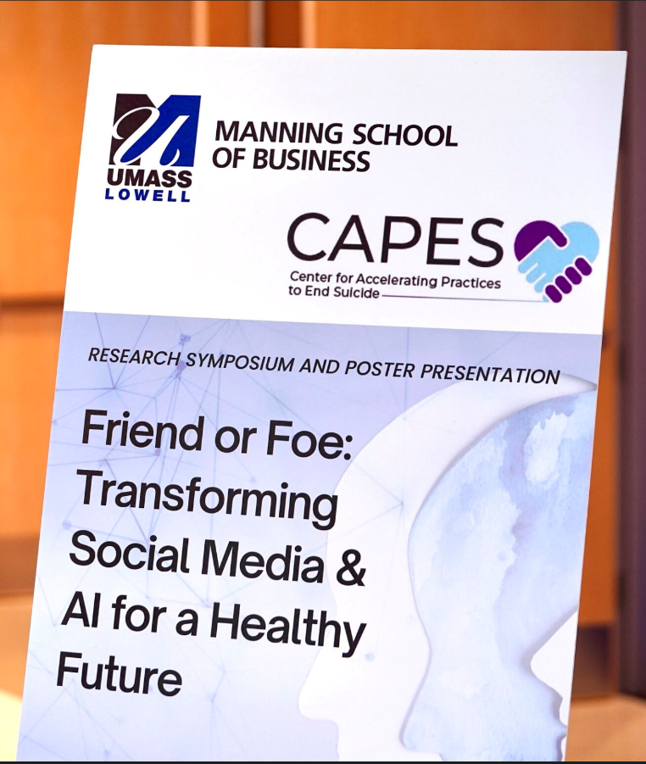
Admin Core - Key Achievements (cont. 1)
Business Development Unit
Hosted interdisciplinary symposium with 200+ attendees
Friends or Foe:
Transforming Social Media and AI for a Healthy Future

Slide 24
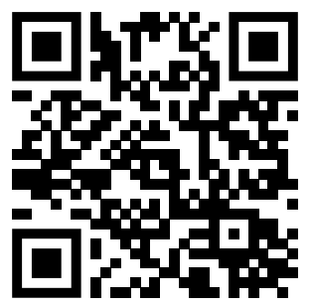
Admin Core - Key Achievements (cont. 2)
Dissemination and Community Engagement Unit
Held PLE meetings including meeting with CAPES projects (Jaspr, ADAPT)
Published best practices tipsheet for responsible reporting of suicide research
Raised funds for AFSP (out of darkness walk)
Emphasized CAPES activities on social media

Slide 25
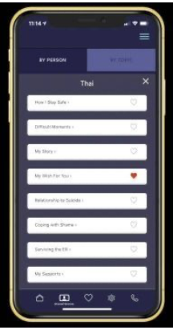
Admin Core - Key Achievements (cont. 3)
Education and Scientific Development Unit
Disseminated, evaluated, and selected R03-like projects:
Dixon-Gordan: Beta-Testing Reaching Calm (Exploring Digital Approaches to Address Suicide Risk in Obstetric Settings)
Zimmermann: ASSIST (Advancing Student Suicide Interventions with Scalable Technologies)

Slide 26
Admin Core - Key Achievements (cont. 4)
Education and Scientific Development Unit
Selected new CAPES scholars:
Hosted a Journal club with ISU:
ADAPT-ITT framework for suicide prevention.

Slide 27
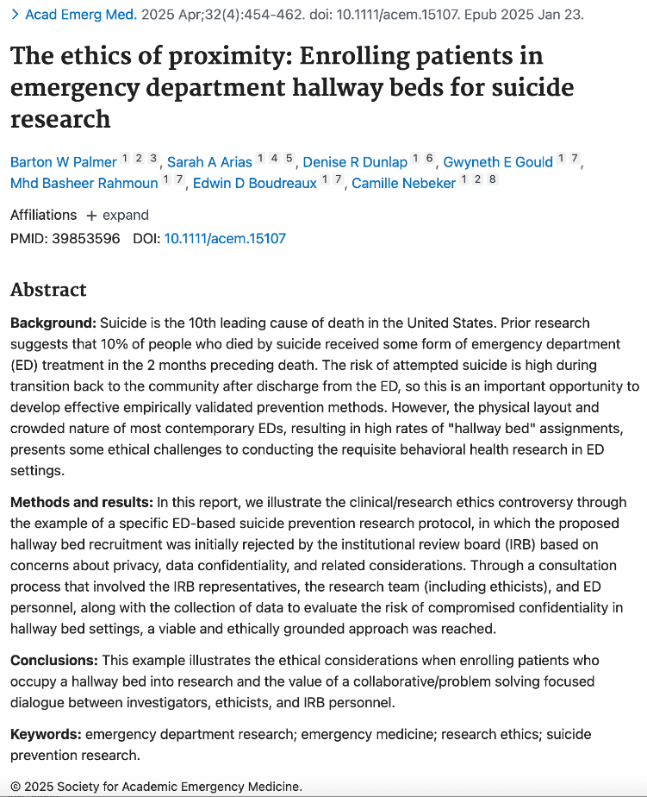
Admin Core - Key Achievements (cont. 5)
Ethical, Legal, and Social Implication Unit
Published “The ethics of proximity, enrolling patients in emergency department hallway-beds for suicide research”
Consulted with newly selected pilot projects.

Slide 28
Methods Core - Key Achievements
Design Data and Analysis Unit
Designed, generated CAPES DSMB report
Made substantial progress in obtaining the Real-World Data from Ohio Jaspr participating site
Uploaded patient demographics from Jaspr Part A to NDA

Slide 29
Methods Core - Key Achievements (cont. 1)
Economic Evaluation Unit
Jaspr: Identified the data sources for the cost analysis and developed cost collection forms.
Consulted with LEMURS, CATS, and ADAPT to review the cost component of the grants.

Slide 30
Methods Core - Key Achievements (cont. 2)
Implementation Science Unit
Disseminated EPIS grounded interview, IS instruments, and ISU recommendations.
Reviewed implementation strategies with research mPIs (signature and exploratory studies).
FRAME framework adapted for digital health
Hosted a Journal club with EDU: ADAPT-ITT framework for suicide prevention

Slide 31
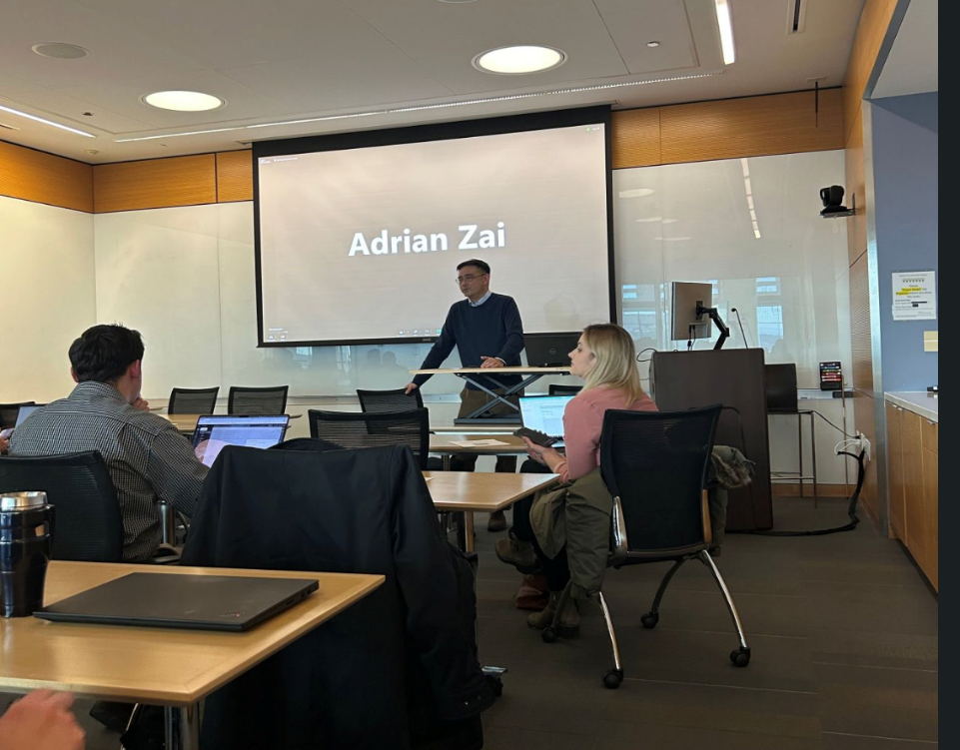
Methods Core - Key Achievements (cont. 3)
Machine Learning Unit
Conducted a comprehensive literature review to update the proposed methods of CAPES ML-based projects.
Planned a systematic review paper on “ Machine Learning issues related to already implemented/deployed ML-baed suicide prevention systems”
Hosted a webinar by Backpack
LLM for Suicide Prevention
Workshop:
AI for everyday use

Slide 32
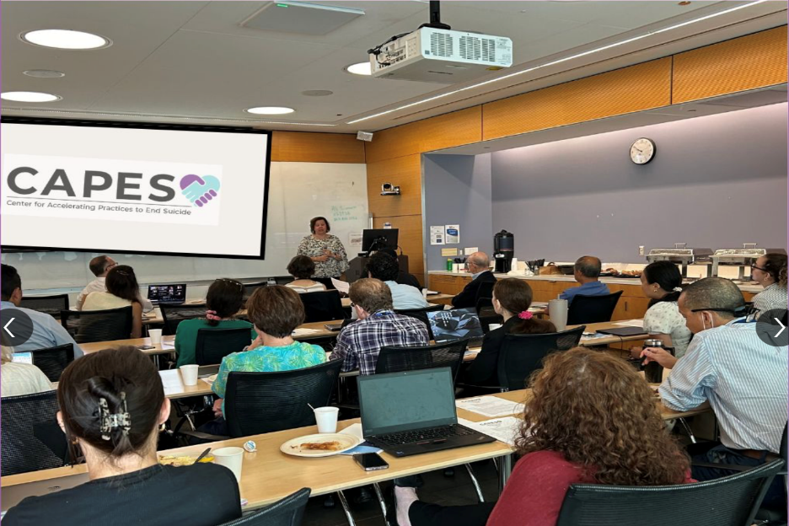
Methods Core - Key Achievements (cont. 4)
Person-Centered Design Unit
Held advisory group meeting with other PDU members including representation from EPIC.
Actively assessing Jaspr-Part A data for user experience and fidelity.
Participated in the 6th Annual UX Symposium (UXSYM)
Workshop:
Eye-Tracking technology
EHR audit log Insights for research

Slide 33
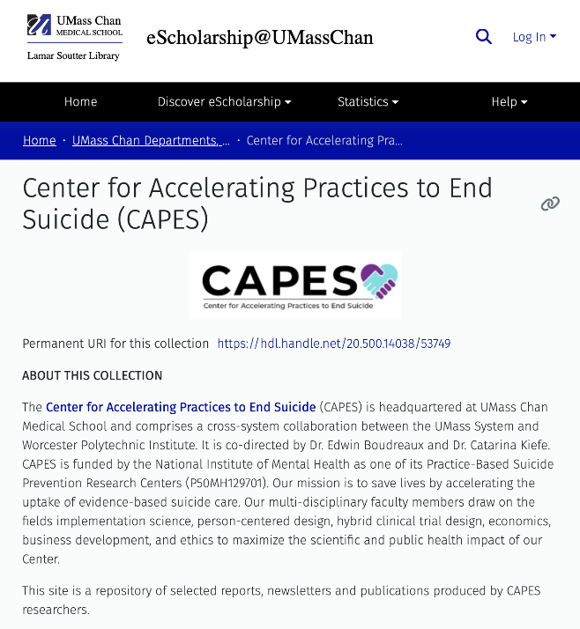
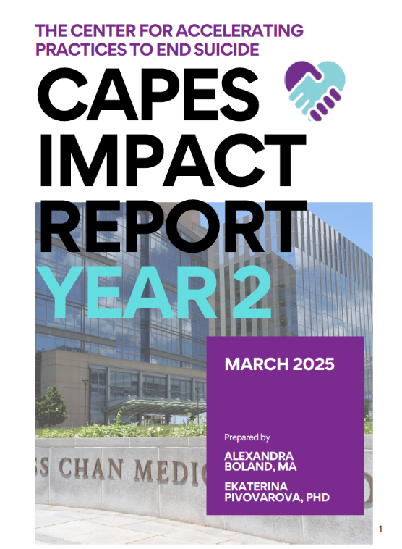
Key Achievements
Evaluation Unit
Lead Year 2 center-wide evaluation
Created CAPES repository for eScholarship to centralize dissemination products

