Slide 1
Everyday AI:
Using ChatGPT and Other LLM Tools to Support Scientific Writing and Grant Development
Adrian Zai, MD PhD MPH
Qiming (Timmy) Shi, MS
5-21-2025

Slide 2
Session Objectives
Explore how AI tools support grant writing
Learn a task-based workflow aligned to the research process
See tool-specific strengths and best-use scenarios
Walk away with practical prompts, examples, and tactical tips

Slide 3
We’ll be focusing mainly on these tools:
ChatGPT Plus (OpenAI) (Alternatives: Gemini, NotebookLM)
Perplexity.ai (search + citations)
Consensus (evidence-based answers from PubMed)
Though many others are available, such as NotebookLM and Gemini

Slide 4
AI as Co-Author: Partner, Not Pilot
AI can’t replace expertise, judgment, or originality
But it can enhance creativity, speed, and precision
Think of AI as your most tireless research assistant—but one that needs direction
📌 Key Reminders:
You lead. It follows.
You judge. It suggests.
You edit. It drafts.

Slide 5
AI: Benefits and Pitfalls
AI enhances speed and precision of writing.
Pitfalls include hallucinated facts and citations.
Benefits include faster drafting and cleaner language.
Robotic tone and vague phrasing can occur often.
Ethical gray zones exist if AI is overused.

Slide 6
News article about scientific paper with AI-generated introduction

Slide 7
Screenshots of scientific paper with AI-generated content

Slide 8
AI Grant Writing Workflow
Define the research problem clearly first.
Understand the existing literature thoroughly.
Draft Specific Aims based on the research problem.
Refine the draft for funding opportunity alignment.

Slide 9
Step 1 – Define the Research Problem
Goal: Identify gap
Use Consensus to pull evidence: "What do studies say about X?", or better: phrase it as a YES/NO question!
Use Perplexity to find current trends or gaps
Use ChatGPT to reframe questions using NIH-style language, and to iterate.
Prompt Example: "Rephrase this idea as a research question aligned with NIH review criteria."
🔑 Pearl: “Upload or reference a few key articles in your field—it improves the specificity and relevance of the LLM’s answers significantly.”*
*Only ChatGPT Plus allows uploads. Alternatively, use NotebookLM.google.

Slide 10
Step 2 - Understand the Literature
Goal: Synthesize key studies
ChatGPT: Upload 3-5 PDFs, ask: “What are the key findings?”
Consensus: Verify supporting evidence from PubMed
Perplexity: Quick summaries with sources for citation, great for popular media
Prompt Example: “Summarize the justification for targeting HPV vaccine uptake among underserved teens.”
🔑 Pearl: “To identify research gaps, ask the LLM to extract from the limitations sections—it’s one of the fastest ways to identify them.”

Slide 11
Step 3 - Draft Specific Aims Page
Goal: Write strong Specific Aims
ChatGPT:
Generate draft based on problem + gap
Define Role, Provide Context, Specify the task
Rewrite or tighten inside Canvas
🧠 Pearl: “Don’t ask ChatGPT to ‘write my Specific Aims’—ask it to ‘draft a 3-paragraph Specific Aims page that includes background, significance, and two clearly defined aims focused on [topic], using NIH-style tone.’ The more structure you give it, the better the output.”

Slide 12
Step 4 - Refine and Align to FOA
Goal: Tailor for reviewers and structure
ChatGPT: Tone shifts, structure changes, NIH-style rewrites, align with FOA
Prompt Example: “Make this more concise and NIH-appropriate.”
🔑 Pearl: “Upload the FOA to ChatGPT, so the AI understands the funder's priorities. Then ask it to critique your draft against the FOA.”

Slide 13
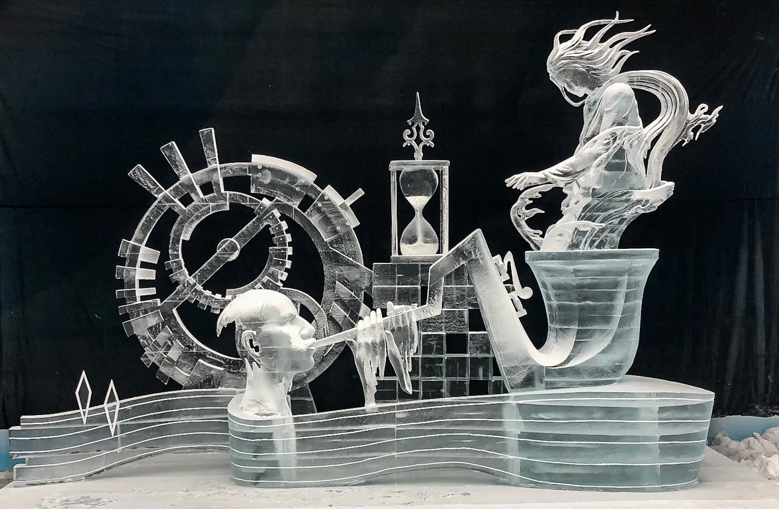
Writing in Layers – Like Sculpting Ice
This ice sculpture was titled “Illusion” and was the winning piece at the Shenhu Ice Sculpture 6th International Ice Sculpture Masters competition in Nantong, China.

Slide 14
Writing in Layers
Like Sculpting a Proposal
Start broad, refine in stages
Begin with a high-level outline or draft using an AI template
Move to structured paragraphs with placeholder transitions
Layer in evidence, citations, and alignment with FOA
End with refinement of tone, flow, and polish
Prompt Examples:
“Create a scaffold for a Specific Aims page on [topic] with 3 paragraph sections.”
“Insert placeholders for significance and innovation, highlight where citations are needed.”
“Refine this paragraph with reviewer expectations in mind.”
🗿 Like sculpting from rough form to fine detail—each pass brings clarity.

Slide 15
Use this 3-step structure to get clear, focused responses from AI tools.
Set the Hat – Define the role:
“Act as an NIH reviewer and a clinical informatics expert specializing in implementation science.”
“You are an expert data scientist and a cardiologist, please identify potential Specific Aims addressing the FOA found in this link: [URL].”
Drop the Compass – Give project context:
“This is an R01 to NIMHD focusing on digital health equity.”
“Target journal is JAMA Network Open, audience is general medicine.”
Pin the Section – Focus the task:
“Polish the 300-word Significance section to describe the problem, the gap, and the proposed solution.”
“Simplify the last paragraph of this Aim to a grade 8 reading level.”

Slide 16
Refining Your Draft: Prompting for Structure, Clarity, and Reviewer Expectations
🧱 Structure & Framing
“Give me 3 framings of this Specific Aim—one focused on significance, one on methods, one on innovation.” “Create a 3-paragraph outline with suggested topic sentences.”
🔍 Clarity & Reviewer Insight
“Which parts of this paragraph are too vague for a reviewer?” “Act like a journal editor. What would you flag as weaknesses?”
🔗 Flow & Transitions
“Add one compelling transition sentence to improve paragraph flow.” “Make this paragraph more cohesive and logically ordered.”
📚 Support & Citations
“Insert [CITATION NEEDED] tags where references are required.” “Suggest one foundational article I should reference here.” 📌 Pro Tip: Use AI to simulate peer or reviewer feedback during revision.

Slide 17
Does This Sound Like Me? Humanizing AI Output
AI-generated text may show limitations:
Ornate or embellished language
Impersonal tone
Overly conceptual writing
Recommendations:
Request simplification (e.g., 12th-grade level)
Specify tone: “academic but clear”
Eliminate filler (e.g., “This is important because…”, “Keep it concise without losing any content)
Use readability tools (e.g., Grammarly)
📎 Upload samples of your writing and ask it to generate a prompt to describe your writing style

Slide 18
Tool Comparison Cheat Sheet
Task | ChatGPT | Gemini | Perplexity | Consensus
Research gap | ✅ | ⚪️ | ✅ | ✅
Literature summary | ⚪️ | ⚪️ | ✅ | ✅
Aims drafting | ✅✅ | ✅ | ⚪️ | ⚪️
FOA alignment | ✅ | ✅ | ⚪️ | ⚪️
Final edits | ✅ | ✅✅ | ⚪️ | ⚪️

Slide 19
Organizing Projects in ChatGPT
Use folders to organize prompts by grant, paper, or task type
e.g., “R21 HPV Project,” “K01 Career Development,” “Reviewer Responses”
Create Custom GPTs for repeat workflows
Example: “GrantGPT” that knows your NIH biosketch, publications, CV, research focus areas
Benefits of a ‘Digital Twin’ GPT:
Saves time with repeated tasks (letters, summaries, email drafts)
Offers suggestions grounded in your past work
Enhances continuity across writing projects

Slide 20
Ethical Use of LLMs for Scientific Writing (1/2)
Verify all citations and outputs: LLMs can sometimes provide inaccurate information or hallucinate citations. Always double-check every piece of information for accuracy.
Do not fabricate evidence: Never use LLMs to create or misrepresent data or findings. Maintain the integrity of your research and writing.
Acknowledge AI assistance when appropriate: Disclose when and how you have used LLMs in your writing process. Follow any institutional, journal, or funding agency guidelines regarding AI tool usage and disclosure.

Slide 21
Ethical Use of LLMs for Scientific Writing (2/2)
Use LLMs to enhance, not replace, your expertise: LLMs are powerful tools for assistance, but they should not replace your own knowledge, critical thinking, and judgment. You are ultimately responsible for the content.
Assume full responsibility for the final output: Regardless of AI assistance, the final responsibility for the accuracy, integrity, and originality of your work rests with you.
Authorship considerations: Be aware of and adhere to guidelines regarding AI and authorship, such as those provided by the Committee on Publication Ethics (COPE).

Slide 22
Summary: Mastering the Prompts
🧠 Role-Play: Assign the LLM a specific role (e.g., "NIH reviewer," "biostatistician," "patient advocate") for more tailored and insightful feedback.
📎 FOA Focus: Upload the Funding Opportunity Announcement (FOA) so the AI can align language and priorities to match reviewer expectations.
📖 Gap Discovery: Ask the LLM to extract and synthesize limitations sections from relevant studies to identify research gaps efficiently.
📌 Context is Key: Provide key articles or background information as context to improve the specificity and relevance of the AI's responses.
⛓️ Prompt Chaining: Break down large tasks into smaller, sequential prompts for more focused and accurate outcomes.
📝 Style Guide: Provide examples of your preferred language and tone for the LLM to imitate, ensuring the output matches your voice.

Slide 23
Summary: Mastering the Prompts (cont.)
📊 Visual Aids: Use AI to draft tables, timelines, logic models, or figures to enhance the visual appeal and clarity of your proposal.
✂️ Reviewer-Ready: Request reviewer-friendly rewrites by specifying desired characteristics: "More concise," "less jargon," "clearer logic," "stronger impact."
🔄 Iterate and Refine: Don't settle for the first AI response. Treat it as a starting point and iterate through multiple revisions for a stronger final product.
🤝 Human Touch: Always review and edit AI-generated content to ensure accuracy, originality, and alignment with your own expertise and style.
✨ Early & Often: Integrate AI throughout your writing process—from brainstorming and outlining to editing and polishing—to maximize its benefits.

Slide 24
Takeaways
Use the right tool for the right research task
Combine tools: e.g., NotebookLM + Gemini; Perplexity + ChatGPT
Iterate often: prompt, revise, refine
Practical, not perfect: focus on progress, not perfection

Slide 25
Thank You
Contact info:
adrian.zai@umassmed.edu
qiming.shi@umassmed.edu
Join us at our workshop where you will be creating a Specific Aims page based on an FOA of your choice.

