Slide 1
Informed Consent
Allison Blodgett, PhD, CIP
Director of IRB Operations
UMass Medical School

Slide 2
Tuskegee Study
This study was initiated in the 1930s as an examination of the natural history of untreated syphilis; it continued until 1972
400 black men with syphilis participated
200 men without syphilis served as controls
The men were recruited without informed consent
misinformed that some of the procedures done in the interest of research (e.g., spinal taps) were actually "special free treatment"

Slide 3
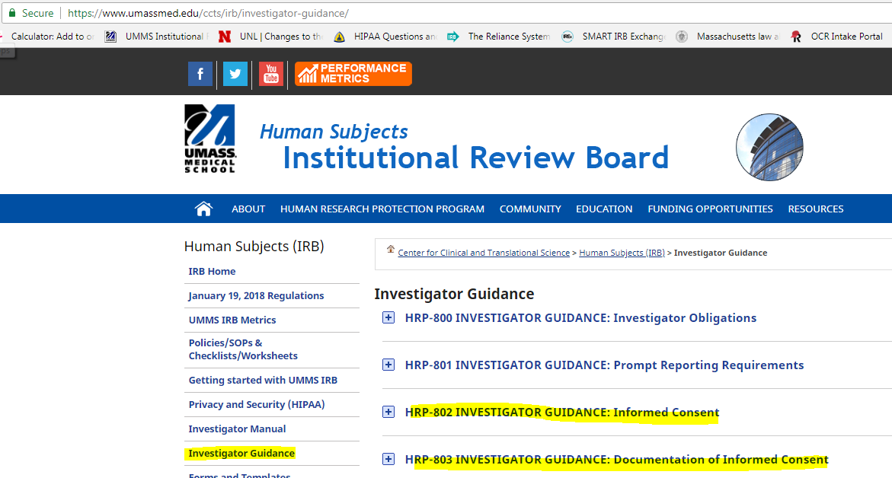

Slide 4
INVESTIGATOR GUIDANCE
Informed Consent HRP-802
This guidance describes a process that in general is suitable to obtain informed consent.
Other procedures may be suitable when approved by the IRB.

Slide 5
“Person providing consent”
In the case of a cognitively intact adult, the individual being asked to take part
In the case of an adult unable to consent, that individual’s Legally Authorized Representative (LAR)
In the case of a child:
  One parent, if the other parent is deceased, unknown, incompetent, or not reasonably available, or when only one parent has legal responsibility for the care and custody of the child.
  One parent if the IRB determined that permission from one parent was sufficient
  An individual who is authorized under applicable State or local law to consent on behalf of a child to general medical care
  Both parents

Slide 6
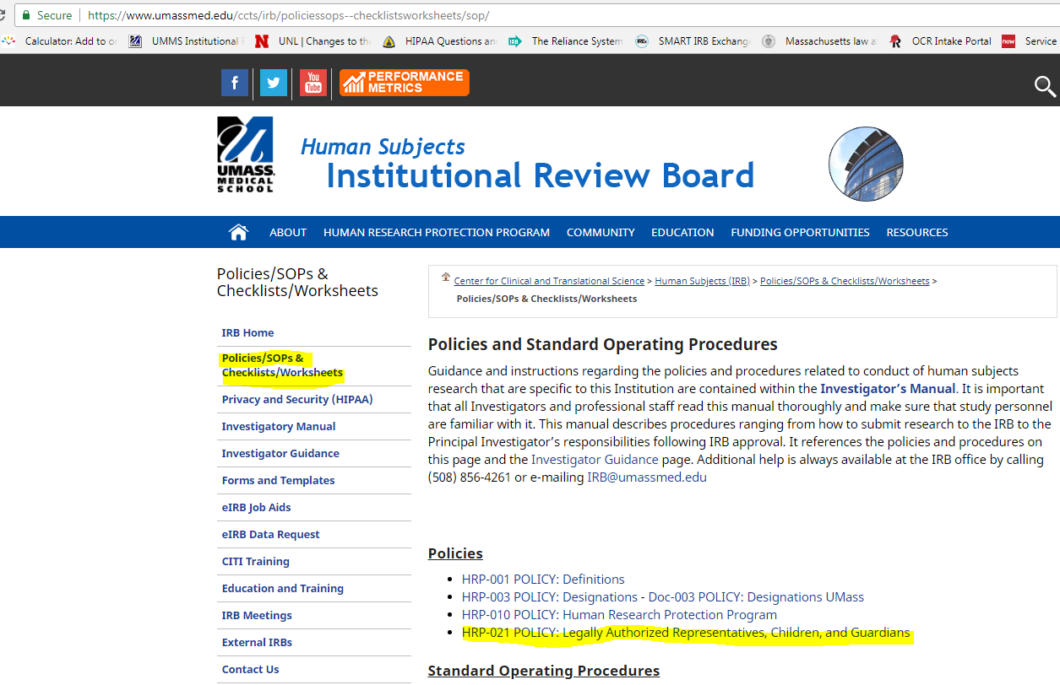

Slide 7
Consent Information
Long form consent document
  when the IRB requires the long form of consent documentation
Short form consent document and summary
  when the IRB allows the short form of consent documentation
Script or fact sheet
  when the IRB has approved a waiver of documentation of consent
Communicate in the preferred language of the person providing consent

Slide 8
Subject Populations
Unless the IRB affirmatively approves a protocol to include the following populations, such subjects may not be enrolled:
  Adults unable to consent
  Children
  Neonates of uncertain viability
  Nonviable neonates
  Pregnant women
  Prisoners
  Individuals unable to speak English

Slide 9
Other Procedures
The short form of consent documentation may be use only if affirmatively approved by the IRB.
For the short form of consent documentation:
  The short form is a standard template translated into the subject’s language.
  The summary is the English version of the long form.
For waiver of documentation of consent, the script is the long form without a signature block.

Slide 10
Interpreters:
  Conversant in both English and the language understood by the person providing consent
  The interpreter may be a member of the research team, or a family member or friend of the subject or person providing consent
Impartial Witness:
  Is to be present during the entire consent discussion and to attest that the information in the consent form and any other information provided was accurately explained to, and apparently understood by, the subject/LAR, and that consent was freely given
  May not be a person involved in the research

Slide 11
Obtain the IRB-approved consent document, short form consent document, or script, as applicable.
  Verify that you are using the most current IRB-approved information.
  Verify that the consent document, if any, is in language understandable to the person providing consent.
If the person providing consent cannot read or the short form of consent documentation is used, obtain an <Impartial Witness>.

Slide 12
If the person providing consent cannot speak English, obtain the services of an interpreter.
Go over the information in the consent document using language understandable to the person providing consent.
  Do not provide any information to the person providing consent through which the person providing consent is made to waive or appear to waive any of the subject’s legal rights, or releases or appears to release the investigator, the sponsor, the institution or its agents from liability for negligence.
  When providing information about treatments or compensation for injury, provide factual information and avoid statements that imply that compensation or treatment is never available.
Invite and answer questions.

Slide 13
Evaluate whether the following is true for the person providing consent. If not, take steps to correct or determine that the person providing consent is incapable of providing consent:
  The person providing consent has been provided sufficient information.
  The person providing consent understands the information
    If the person providing consent has a disease or condition that may affect cognition, assess whether the person providing consent has sufficient cognitive capacity to legally provide informed consent.
    If the subject is pregnant, ensure the person providing consent is fully informed regarding the reasonably foreseeable effect of the research on the fetus or neonate.

Slide 14
  The person providing consent does not feel coerced or unduly influenced.
    Ensure there is no threat of harm or adverse consequences for a decision to not participate.
    Ensure that outside parties (family or caretakers) do not coerce or unduly influence the person providing consent, especially if that person is vulnerable to coercion or undue influence.
    Ensure that the amount of payment does not coerce or unduly influence economically disadvantaged individuals.
    For persons providing consent who are in a subordinate position to a member of the research team (e.g., employee or student), ensure that there is no threat of harm or adverse consequences to the subject’s position for a decision to not participate.

Slide 15
The person providing consent has sufficient time to make a decision.
  Provide the person providing consent with sufficient time to understand the information. Spend as much time as needed
  Provide the person providing consent with sufficient time to ask questions.
The individual providing consent understands the consequences of a decision.
The individual providing consent can communicate a choice.
Once a person providing consent indicates that he or she does not want to consent, stop.

Slide 16
If the subject is a child or adult unable to consent:
  Explain the research to the extent compatible with the subject’s understanding.
  Ensure that parents or guardians do not coerce or unduly influence children.
  Ensure that outside parties (family or caretakers) do not coerce or unduly influence adults unable to consent.
If the IRB determined that assent was a requirement and the subject is capable of being consulted, request the assent (affirmative agreement) of the subject.
  If the subject indicates that he or she does not want to take part, stop.

Slide 17
Requirements for Informed Consent
Statement that the study involves research
Explanation of the purposes of the research
Expected duration of the subject’s participation
Description of procedures to be followed
Description of any reasonably foreseeable risks or discomforts

Slide 18
A disclosure of appropriate alternative procedures or courses of treatment
Statement describing the extent of confidentiality of records
If greater than minimal risks are involved, an explanation of any medical treatments available if injury occurs
Explanation of who to contact for answers to pertinent questions
Statement that participation is voluntary

Slide 19
When preparing consents, be sure to download a fresh template
The Revised Common Rule has added requirements
  Reasonable person standard
  Opportunity for discussion
  Presentation of key information first in a concise, focused, and organized fashion to facilitate understanding
And added new elements of informed consent
  Whether clinically relevant research results will be disclosed
  If collecting identifiable private information or biospecimens, whether data/specimens may be shared (even if de-identified)
  If collecting biospecimens, any prospect of whole genome sequencing, and commercial profit & whether subjects will share in profits

Slide 20
Templates available
Consent form
Assent Form
Fact Sheet
Short Forms
https://www.umassmed.edu/ccts/irb/forms_templates/

