Slide 1


ICD-10 Transition:
Implications for the Clinical Research Community
Jesica Pagano-Therrien, MSN, RN, CPNP
HRPP Educator
UMCCTS Office of Clinical Research

Slide 2
Objectives
To understand what ICD-10 is, and what it is used for.
To become familiar with the new features of ICD-10, including differences in the code structure.
To understand benefits of the transition to ICD-10.
To learn about implications of this transition for clinical research staff.

Slide 3
What is ICD-9?
International Classification of Diseases, 9th Edition
Originally designed for the purpose of comparing mortality data internationally.
ICD-9-CM (clinical modification) codes classify diseases, injuries, health encounters and inpatient procedures.
Federal, state, and local public health officials rely on this data for a variety of disease-related activities:
  Surveillance of chronic disease and injury
  Health care utilization
  Health care-associated adverse events
  Identify cases of reportable conditions

Slide 4

Why the change?
ICD-9 is old.
  The U.S. has used ICD-9 since 1979 and many terms are now outdated.
There have been many changes within medical and health care fields.
Available codes do not always allow for the capture of clinically accurate data.
The structure of ICD-9 codes limits the number of new codes that can be created.
Most developed countries have already transitioned to ICD-10 codes.

Slide 5

The Department of Health and Human Services (DHHS) has mandated that all HIPAA-covered entities must transition to a new set of codes for electronic health care transactions.
October 1st, 2015

Slide 6

Introducing….ICD-10!
ICD-10-CM will be used in all U.S. health care settings.
ICD-10-PCS (Procedure Coding System) will be used in U.S. inpatient hospital settings only.
ICD-10 will not replace CPT codes.
  ICD-10 codes are diagnosis codes.
  CPT codes are billing codes.
Per the Centers for Medicare and Medicaid Services (CMS):
“The transition to ICD-10 does not affect CPT coding for outpatient procedures...Like ICD-9 procedure codes, ICD-10-PCS codes are for hospital inpatient procedures only.”

Slide 7
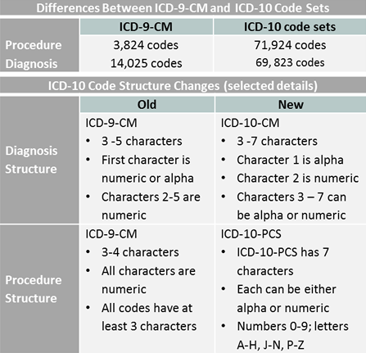
http://www.cdc.gov/nchs/icd/icd10cm_pcs_background.htm

Slide 8
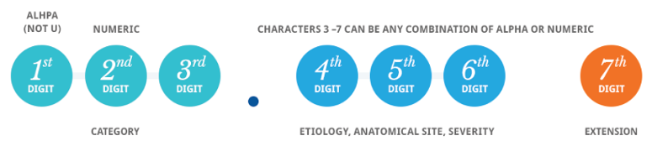
ICD-10 code structure

Slide 9
Code structure: Examples
E11.311
Type 2 diabetes mellitus, with ophthalmic complications, with macular edema
O24.012
Preexisting diabetes mellitus, Type 1, in pregnancy, 2nd trimester.
Z3A.16
16 weeks gestation
http://cloud.aapc.com/documents/OB-GYN-Quick-Reference_ICD-10-CM.pdf
www.aafp.org

Slide 10
New features and additions achieve greater specificity in code assignment
New clinical concepts
Expansion of existing codes
  Injuries, diabetes, substance abuse
Combination codes for conditions and commonly associated symptoms or manifestations
Combination codes for poisonings and their external cause
Obstetric codes that identify trimester
Laterality
Character “x” used as a placeholder to allow for future expansions of the code
Exclusions
Distinction between intraoperative and post-procedural complications

Slide 11
Benefits of ICD-10-CM
Tracking public health and risks
Measuring the quality, safety and efficacy of care
Reducing the need for attachments to explain the patient’s condition
Designing payment systems and processing claims for reimbursement
Conducting research, epidemiological studies and clinical trials
Setting health policy
Operation and strategic planning
Designing health care delivery systems
Monitoring resource utilization
Improving clinical, financial and administrative performance
Preventing and detecting health care fraud and abuse

Slide 12
What does this mean for clinical research staff?
So what…

Slide 13
Implications and potential challenges for clinical research staff
Only ‘covered entities’ must change to ICD-10; study sponsors may continue to use ICD-9.
Ask any external sponsors on how they are planning for this transition in case report forms, protocols and other documents.
If a protocol continues to use ICD-9, a protocol amendment to include ICD-10 codes and any associated changes to the names of specific diagnoses may help avoid an eligibility or other protocol violation.

Slide 14
Implications and potential challenges for clinical research staff (continued)
Electronic Medical Record (EMR) systems must change, but systems used in clinical research (eCRFs) may not.
Know whether the research systems you use will change from ICD-9 to ICD-10. If your systems do not change, you should document how you plan to map ICD-10 codes back to ICD-9 codes.
A wide variety of online tools are available to help ICD-9 to ICD-10 conversions.
  To look up ICD-10 codes, CMS has an online tool: https://www.cms.gov/medicare-coverage-database/staticpages/icd-10-code-lookup.aspx
  To perform a crosswalk, you may use sites such as https://www.aapc.com/icd-10/codes/

Slide 15
Implications and potential challenges for clinical research staff (continued)
Feasibility assessments and data mining
When thinking about a potential new research study, or when you’re looking at inclusion/exclusion criteria, your data mining may need to be done by both ICD-9 and ICD-10 codes.
UMMS Information Technology staff are aware of this and are willing to help!

Slide 16
Implications and potential challenges for clinical research staff (continued)
Existing or longitudinal data
Ensure that there is a plan in place for mapping ICD-9 to ICD-10 codes, especially for studies that are collecting data before and after the transition.

Slide 17
Important code for research
V70.7
ICD-9
Examination of participant or control in clinical research.
Z00.6
ICD-10
Encounter for examination of normal comparison and control in clinical research program.

Slide 18

Clinical Research coding hint
The reason for the “experimental” or “investigational” encounter should be the primary diagnosis.
The Z00.6 code is listed as the secondary diagnosis.
(Gray, 2011)

Slide 19

Plan ahead!
Discuss a transition plan with your study team and/or sponsor to avoid the 307.81! (Soon to be G44.209!)
Notes:
307.81 → G44.209 = tension headache!

Slide 20
Questions?
Please review the references and resources listed on the previous slides.
For questions or comments about this presentation, please email HRPeducation@umassmed.edu

Slide 21
References
Eakin, A.D. (2014). Clinical research and ICD-10: Tools for success. Rheumatology Practice Management. Retrieved from http://rheumatologypracticemanagement.com/rpm-issues/june-2014-vol-2-no-3/2326-clinical-research-and-icd-10-tools-for-success
Gray, L. (2011). ICD-10 Corner: Clinical Trial Participants. Code it right online. Retrieved from https://www.codeitrightonline.com/ciri/icd-10-corner-clinical-trial-participants.html
Vulcano,D. (2015). ICD-10 conversion and the impact on clinical research. Journal of Clinical Research Best Practices. Retrieved from https://firstclinical.com/journal/2015/1501_ICD-10.pdf

Slide 22
Other valuable resources
https://www.cms.gov/Medicare/Coding/ICD10/Downloads/ICD-10QuickRefer.pdf
http://www.cdc.gov/nchs/icd/icd10cm_pcs_background.htm

