Slide 1
Diversity & Inclusion Office
Shaping the future through equity and meaningful inclusion
Marlina Duncan
Vice Chancellor for Diversity and Inclusion

Slide 2
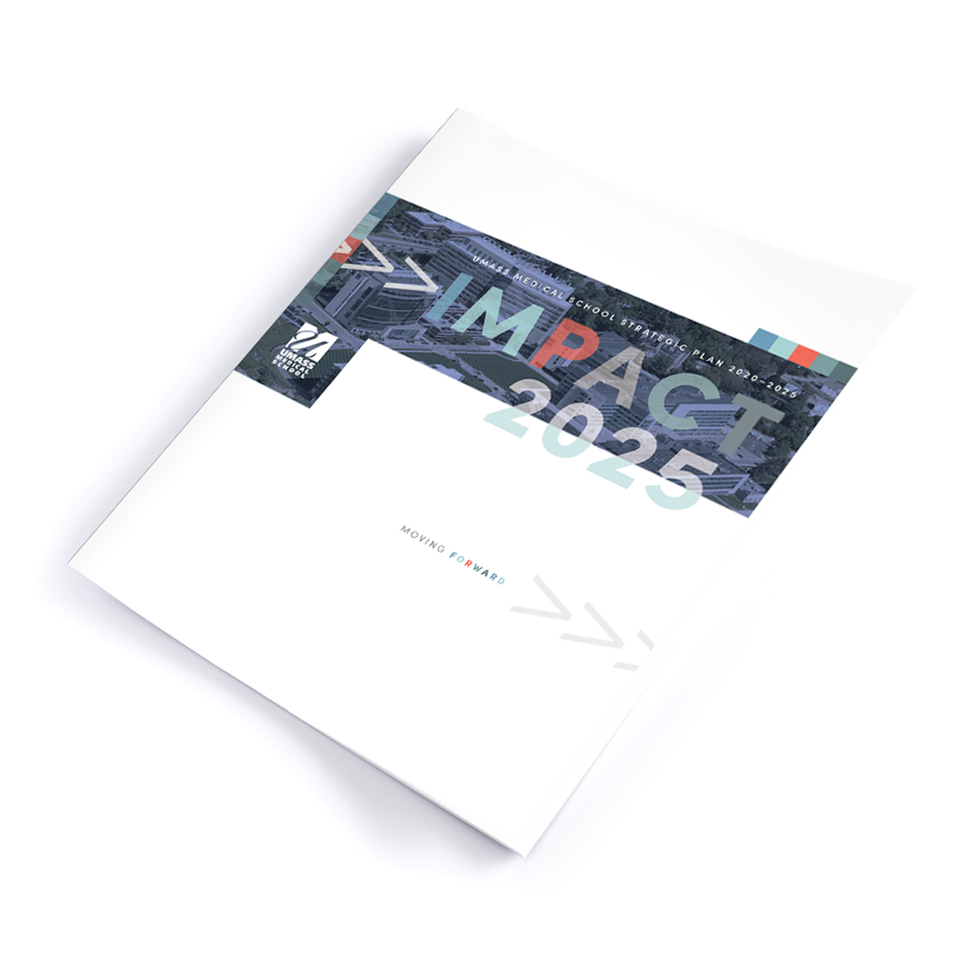
IMPACT 2025
EDUCATION
BASIC SCIENCE RESEARCH
TRANSLATIONAL RESEARCH
COMMUNITY & GLOBAL IMPACT
OPERATIONAL EXCELLENCE & FINANCIAL STEWARDSHIP

Slide 3
STRATEGIC PLANNING: PREPARING THE INSTITUTION FOR CHANGE
EDUCATION
BASIC SCIENCE RESEARCH
TRANSLATIONAL RESEARCH
COMMUNITY & GLOBAL IMPACT
OPERATIONAL EXCELLENCE & FINANCIAL STEWARDSHIP
DIVERSITY, EQUITY & INCLUSION

Slide 4
Women and members of marginalized groups continue to face systemic problems such as racism, bias, harassment, disrespect and isolation.
A Diversity Equity Inclusion (DEI) Pillar seeks to create more inclusive, equitable environments across the entire institution, so we can better attract and advance diverse staff, faculty and learners.
Rationale

Slide 5
Institutional DEI Transformative Change

Slide 6

Impact 2025 DEI Pillar
Institution-wide DEI strategic plan and scorecard, as well as tailored departmental action plans, with clear benchmarks across five priority areas.
A collective approach matters to achieve the desired results.

Slide 7
Five Priority Areas
TRANSPARENT DEI BENCHMARKS AND GOALS
CURRICULUM
Implement and integrate anti-racist and anti-biased curriculum, enhance inclusive pedagogy and practices, and increase opportunities for expanding awareness and knowledge on matters of racism in medicine and the impact of structural racism in health care.
EDUCATION & ENGAGEMENT
Increase DEI education, engagement and capacity through professional development, community building and educational opportunities for all members of the UMass Chan community.
EQUITY WITHIN RECRUITMENT, RETENTION, & ADVANCEMENT
Establish a portfolio of programs that support recruitment, mentorship and advancement of underrepresented and marginalized individuals.
IMPROVEMENT AND ACCOUNTABILITY
Create annual review processes for evaluation and assessment of ongoing DEI initiatives and programs.
CULTURE AND CLIMATE
Integrate diversity, equity, and inclusion into the organization, ensuring that DEI is a priority and develop and implement anti-racist and anti-bias inclusive policies and processes across the institution.

Slide 8

Standardize and operationalize DEI efforts
Unified DEI goals
Use DEI data to inform practice
Insight at the department level
Deconstruct silos
Ongoing data collection and analysis
Coordination of DEI Efforts

Slide 9
Utilize data to inform practice
AAMC DICE Inventory
DEI Curriculum
MA Biologics
DEI Efforts
Diversity Engagement Survey (DES)
DEI Data System
DRIVE
CWM DEI Efforts
Department level DEI data
Admissions and Hiring data

Slide 10
Implementation Process
1
2
3
4
Engaging the institution in
change
Implementing and sustaining change
Preparing for change
Creating a climate of change

Slide 11
Step 1
Preparing for Change
1
Introduce
  Institution-wide introduction of Impact 2025’s DEI pillar
Support
  Support departments with implementing DEAP
  Creation of learning opportunities to level-set DEI knowledge
  Conduct internal assessments
Educate
Assess
Plan
Department-wide introduction of the Diversity and Equity Action Plan
Strategize
  Develop a change management strategy
Pilot
  Pilot DEAP with departments
  Feb 2022
Lead
  Offer opportunities for leadership development to create more inclusive leaders

Slide 12
Strategic Plan Implementation Phases
Creating a climate of change
Engaging and enabling the institution for change
Implementing and sustaining change
Continue institution-wide engagement in DEI dialogue
Invite other departments to develop and commit to DEAP
Develop a process of offering feedback to departments
Continue to communicate the vision for change across the institution
By 2023, institution-wide implementation of DEAPs
Performance monitoring processes
Submission of annual progress reports
Generation of short-term wins
Reporting of outcomes on an annual basis
Evaluation of original plan (lessons learned)
Building capacity within departments and the institution to sustain change
2
3
4

Slide 13
Scorecard Measures
Climate and Culture
Integrate diversity, equity and inclusion into the organization, ensuring that DEI is a priority.
Education and Engagement
The organization provides training related to racism and bias and ways to assess the organization’s current climate to create a more equitable environment.
Recruitment, Retention and Advancement
Effectiveness in recruiting and hiring candidates and learners from underrepresented and other marginalized groups. Equitable and consistent retention and promotion of marginalized groups.
Diversity and Equity
Action Plan
Implement an anti-racist curriculum in each of the three schools to enhance inclusive pedagogy and practices and increase opportunities for expanding awareness and knowledge on matters of racism in medicine and the impact of bias in health care.
Curriculum
Accountability and Quality Improvement
Transparent plans and procedures for collecting, analyzing and disseminating data to monitor and achieve organizational DEI goals and objectives.

Slide 14
DEAP Implementation Timeline
 |  | 2022 | 2023 | 2024 | 2025
 | Embed DEI
 | Education and Engagement
 | Recruitment, Retention and Advancement
 | Curriculum
 | Accountability and Quality Improvement

