Slide 1
HOW TO USE THESE SLIDES:
After completing an ILM and workshop you can include these slides to indicate your commitment to DRIVE principles
Review and ensure you agree with the DRIVE goals and commitment slide text
On slide 3 - update with your or the course's contact details
Place these slides near the start of your presentation to welcome feedback and support inclusive community-building
See text regarding examples of how other people integrate or introduce these slides, feel free to edit those and make them your own
Slides 6 and 7 can be used by faculty teaching multiple sessions in the same course in lieu of repeating the formal commitment slide.
For educational formats that do not use slides consider affirming these principles verbally at the beginning of a session
Example: Introduce yourself, your pronouns, provide a brief description of DRIVE, changes you have made (as relevant), your commitment to improvement and welcoming feedback
Notes:
The above instructions can also be found in the NOTES for each slide

Slide 2
The DRIVE Goals:
To promote a representative and bias-free curriculum across our learning environments
To enhance the accuracy, representation, and inclusion of diverse populations in all our educational activities
To make space for critical conversations about diversity in teaching and learning across our community

Slide 3


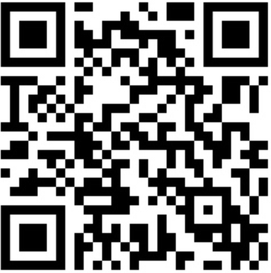
My intent is to promote inclusive learning while avoiding bias.
If you identify opportunities for addressing bias or improving representation in the course content or instructional
delivery, I encourage you to share them with either:
        <UPDATE Add your name and email>
        <UPDATE Your course faculty or leadership>​
        Contact the DRIVE Initiative at DRIVE@umassmed.edu or scan the QR code to send feedback confidentially to DRIVE
I commit to apply the DRIVE goals
Notes:
HOW TO USE THESE SLIDES:
Update with your or the course's contact details.
Place these slides near the start of your presentation to welcome feedback and support inclusive community-building.
For educational formats that do not use slides consider affirming these principles verbally at the beginning of a session:
Example: Introduce yourself, your pronouns, provide a brief description of DRIVE, changes you have made (as relevant), your commitment to improvement and welcoming feedback
V2024.2

Slide 4
Language you might use as you introduce the DRIVE commitment slide:
I share this slide to demonstrate that I have completed a DRIVE workshop/ reviewed my materials/made changes (or similar) and welcome your feedback.
I recognize that we all have biases, and I hope that your feedback will help me to identify and address those that I have missed and continue to improve both my teaching and our learning environment
I share this slide as a measure of my commitment to recognize and address the biases in my own teaching and to show my commitment to learning from and listening to you as learners
Your commitment even when you are not using the commitment slide

Slide 5
Methods to consider when using the DRIVE commitment slides
The first time you use the slides, inform your learners they will appear in each of your sessions, as you’ve completed a DRIVE workshop and are interested in their feedback so you can continue to adjust and improve your teaching
Let students know what you have changed based on the DRIVE workshop/curriculum appraisal tool or prior feedback so that they can offer feedback relating to that as well as all the materials; you could also remind students of the changes made when presenting a specific slide (consider a notation/logo on the slide)
If you have time, take a few minutes to discuss a topic or statement from a prior session. Consider what bias might exist that you were not aware of at that time; or review it through the DRIVE lens taking a few minutes to talk with the class about how to address and problem solve around bias (for example, the week after a session on what is described as the ‘obesity epidemic’, ask people to consider language bias, and problem solve around patient communication together.)

Slide 6
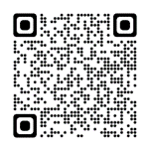
My intent is to promote inclusive learning while avoiding bias. I welcome feedback
Notes:
HOW TO USE THESE SLIDES:
These slides can be used by faculty teaching multiple sessions in the same course in lieu of repeating the formal commitment slide.

Slide 7
Questions?
My intent is to promote inclusive learning while avoiding bias. I welcome feedback
Notes:
HOW TO USE THESE SLIDES:
These slides can be used by faculty teaching multiple sessions in the same course in lieu of repeating the formal commitment slide.

