Slide 1
Breastfeeding in the 21st century
What we need to do:
Enable the breastfeeding environments:
family friendly employment policies
enforce the WHO Code for Marketing of Breastmilk Substitutes.
invest more in
  training the workforce for successful large-scale implementation and sustainability of the Baby Friendly Hospital Initiative
  community-based breastfeeding counseling
  prevent conflicts of interests with infant formula companies.
Behavior change social marketing interventions that include social media need to be designed following social network science and behavioral economics principles.
What we know:
major health and social benefits of breastfeeding
how to protect, promote, and support breastfeeding
BUT WHY do breastfeeding people not meet their goals???
recommended breastfeeding behaviors continue to be suboptimal in the 21st Century among large segments of the population, globally.
Pérez-Escamilla R. Breastfeeding in the 21st century: How we can make it work. Soc Sci Med. 2020 Jan;244:112331. doi: 10.1016/j.socscimed.2019.05.036. Epub 2019 Jun 9. PMID: 31189491.

Slide 2

Breastfeeding: recommended, healthier, cost-saving...and inequitable
‘current breastfeeding rates result in 4,981 excess cases of breast cancer, 53,847 cases of hypertension, and 13,946 cases of myocardial infarction compared with a cohort of …U.S. women who optimally breastfed….suboptimal breastfeeding incurs a total of $17.4 billion in cost to society resulting from premature death…$733.7 million in direct costs …. and $126.1 million indirect morbidity’
Disparities: see Chiang et al..MMWR Morb Mortal Wkly Rep. 2021;70(21):769-774
In longitudinal study of WIC participants, Black and Hispanic women were less likely to meet their BF intentions than White women at 1 and 3 mo pp

Slide 3
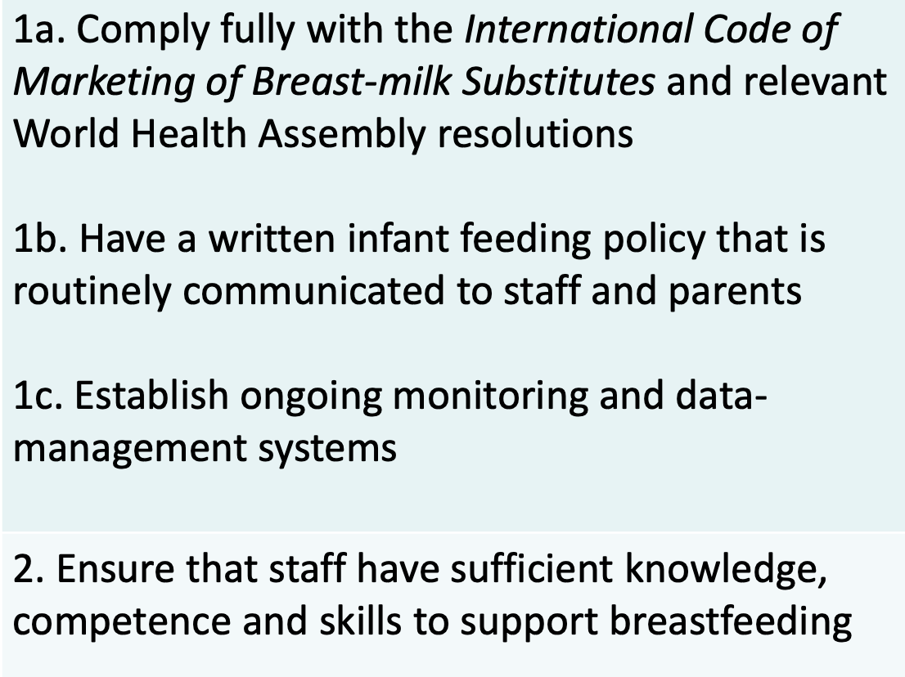
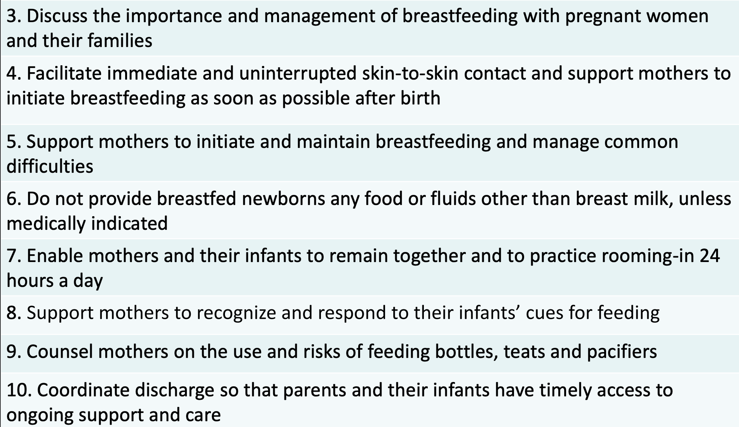
Ten Steps for Baby Friendly Hospital Initiative
positive impact short-term, medium-term and longer term
Dose–response relationship
Community support (step 10) is key for short-term benefits
BFHI study in 4 Southern states:
Decreased Disparity in BF initiation between African American and white infants by 9.6%

Slide 4
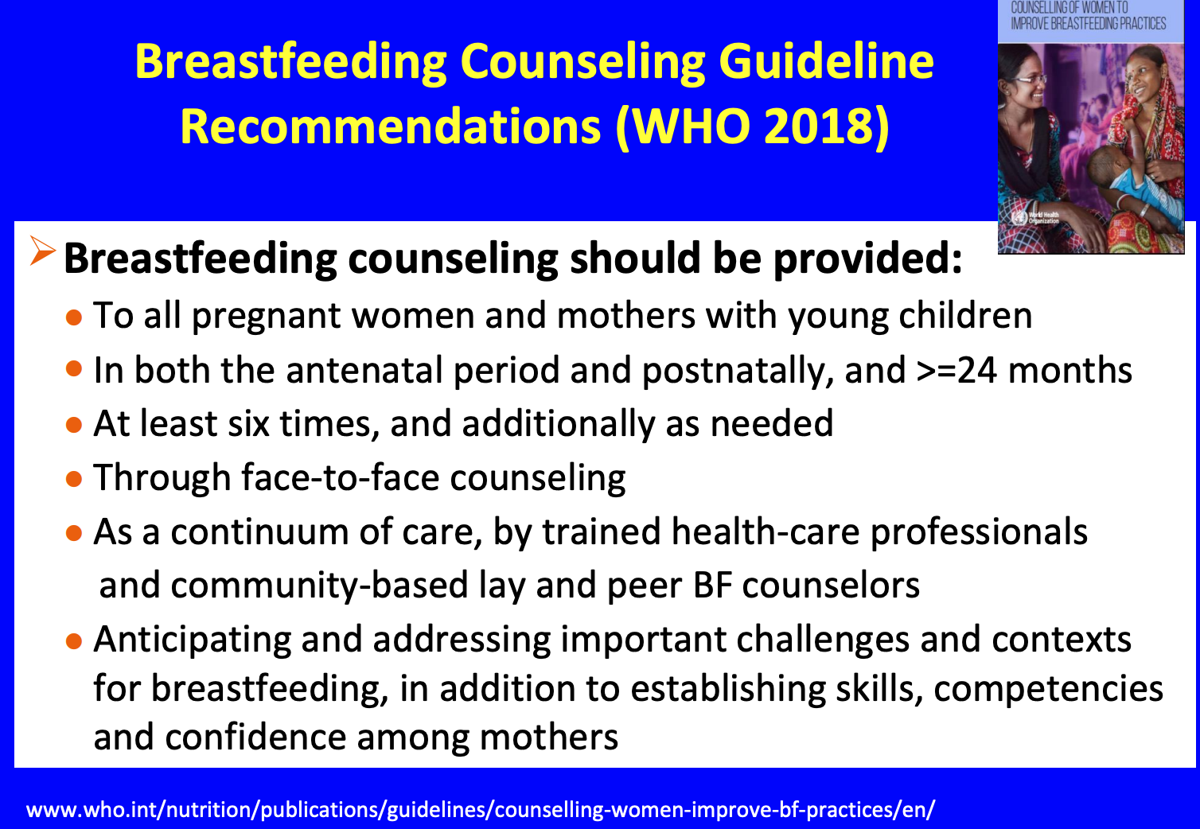

Slide 5
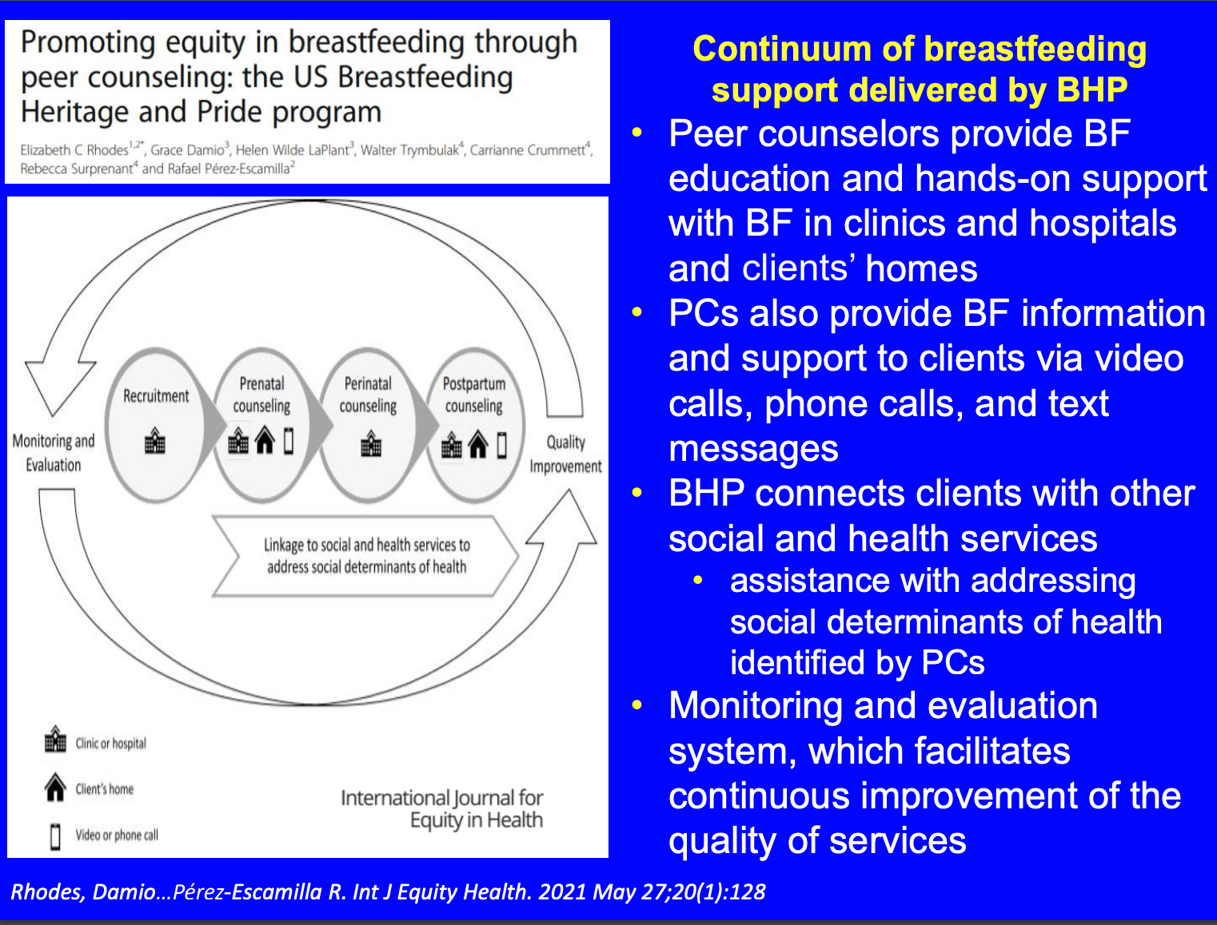
An Evidence-Based Peer Counseling Project
Notes:
Breastfeeding: Heritage and Pride This peer counseling program is a collaborative effort between Hartford Hospital, the Hispanic Health Council, and the University of Connecticut’s Family Nutrition Program. Perinatal peer support is provided to low-income Latina women living in Hartford, Connecticut. The program calls for at least one home visit during the prenatal period and daily visits during the hospital stay. Peer counselors are required to make three contacts after hospital discharge, with the initial contact made within 24 hours. Peer counselors are paid and receive benefits if they work at least 20 hours a week.

Slide 6
So How Are We Doing in Worcester?
St Vincent: Baby Friendly Hospital as of June 2019
UMass: not yet pursuing BFHI
UMass rates:
CY2020 MassHealth exclusive breastfeeding at discharge: 27% vs all pts 42%
CY2021 as of April: exclusive breastfeeding at discharge for Hispanic patients 26%, white 47%, black 16%
WIC Worcester: at 6months, 33% breastfeeding, 8% exclusive
Worcester DPH REACH Program
Dedicated funds to increase community breastfeeding support in Worcester (entering 4th year)
Breastfeeding summits 2020 and 2021
CLC training: 2 in 2020, 9 planned 2021
BACE workshop: 10 in 2021
August 2021: social media messaging
Facebook Live events
Notes:
100%
50.00%
29.84%
25.53%
30.63%
28.88%
29.57%
32.61%
27.07%
29.97%
22.66%
22.66%
27.48%
24.29%
26.32%
31.67%
26.67%
26.24%
27.20%
MassHealth Insurance Inpatients- Maternity
MAH NEWB-1: Exclusive Breast Feeding

Slide 7

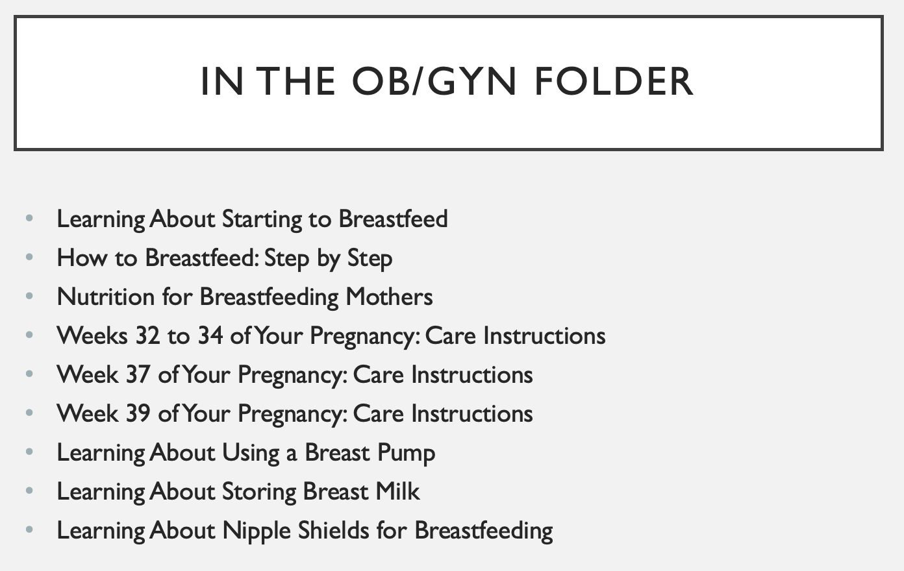
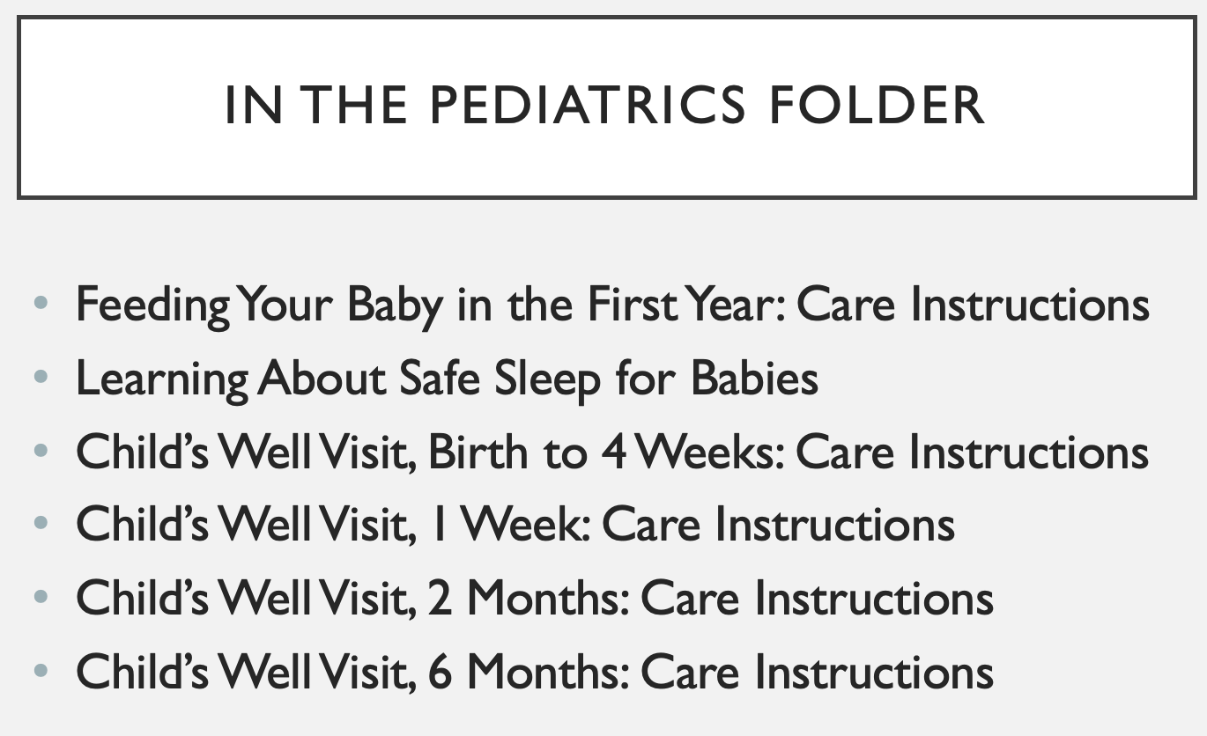
What can YOU do with your breastfeeding families?
Prenatal education
NextGen:
“Conversations” approach: https://www.nichq.org/improving-our-approach-webinar?submissionGuid=d923d04d-737d-4003-af64-309258900c04
•Focus on shared decision making, Two-sided conversations to support informed and supported decisions
•Help families develop a plan that aligns with their goals and values
•https://www.nichq.org/insight/better-approach-conversations-about-breastfeeding
Notes:
Our audit of FHCW patients: we document high rates of antenatal counseling

Slide 8
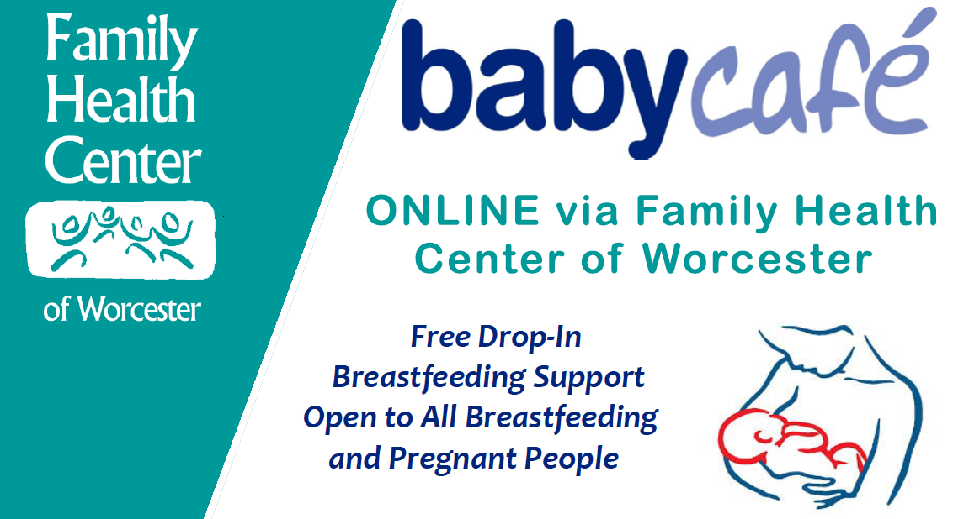

Local Resources
WIC: Peer Counselors available by phone/FaceTime/Zoom
Baby Cafe: Weds/Fri 10am-12noon (language support available) call 508-860-7748 with questions
https://zoom.us/
Meeting ID: 995 9032 7366
Worcester Breastfeeding Resources
Available in English, VN, Arabic, Spanish, Brazilian Portuguese, Twi
https://drive.google.com/drive/folders/1egMEg3RH29WnLbh-k8iwocQXTRFCKSxa?usp=sharing

Slide 9
Future Work?
What is our breastfeeding curriculum?
How do we assess it?*#
What is our breastfeeding data? Especially after discharge
What can we do to maximize equity approach?
CLC cohort--how to use them?
UMass--Baby Friendly?
*2017 faculty development study results suggested some benefit in brief, multimodal education
#2012 NH FM residency training: 6 education sessions for residents/faculty improved patient outcomes
Notes:
tThis intervention also led to non-statistical improvement in knowledge and confidence with breastfeeding medicine, improvement on specific areas of resident knowledge deficit and a reduction in the knowledge discrepancy between residents who have breastfeeding experience and those who do not.
Holmes 2012 A breastfeeding education program at a semirural residency program improved physicians’
breastfeeding knowledge. Implementation of practice changes was fair. Two years into the intervention,
breastfeeding rates improved for patients of the physicians with high levels of participation in the program.

