Slide 1
Advocacy & Health Equity for LGBTQ+ Communities
Population Community Health Clerkship
November 1, 2021

Slide 2
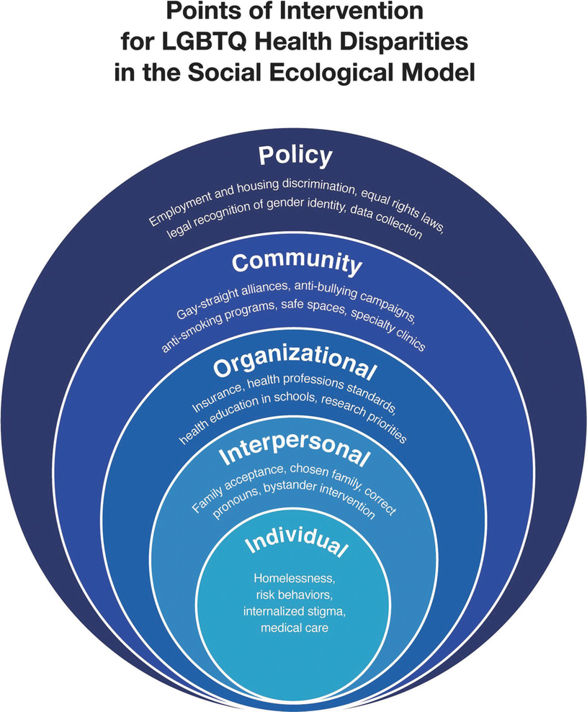
Part 1. Population of Focus
LGBTQ+ patient population
Disparities in healthcare:
  Discrimination
  Stigma
  Denial of civil & human rights
Issues:
  Behavioral & Mental health
  Alcohol & substance use
  Access to care
  Infections and chronic diseases
Reasons:
- Minority status of LGBTQ+ patient population
- Lack of education and training within the healthcare field
- Limited clinical research on LGBTQ+ health issues
- Restrictive health benefits and insurance regulations (systemic issues)
- Institutional barriers & bias
- Limited social figures and role models

Slide 3
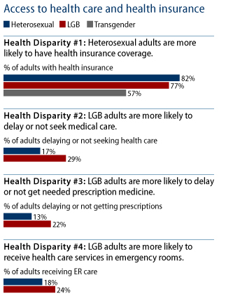
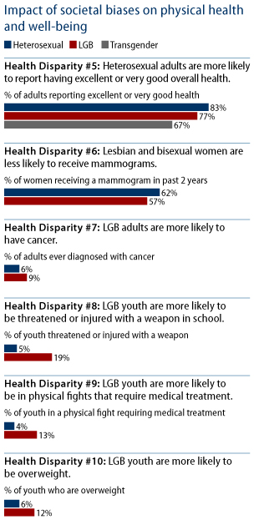
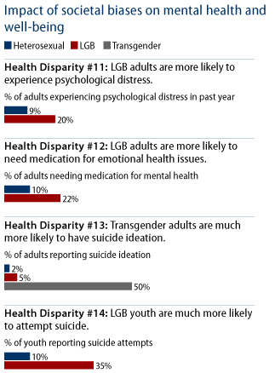
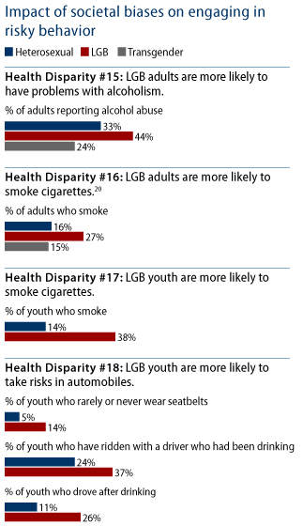
INTERSECTIONALITY

Slide 4
Part 2. Interprofessional Teams of Care
Medicine and Nursing
Community Care and Mutual Aid
Behavioral Health
Notes:
Notes: medicine

Slide 5
Part 2. Interprofessional Teams of Care
Medicine and Nursing
Provide medical care including
    Gender-affirming hormone therapy and surgery
    Reproductive healthcare
    STI testing, care, and prevention
    All other health needs
    Limited access
    Financial and insurance limitations (including limited coverage)
    Marginalization of queer folks leading to distrust in medical professions
    Microaggressions, misgendering, and outright bigotry
    Refusal to provide care, even reluctance to touch patients
    Unnecessary exams and procedures (e.g. intersex population)
Medicine and Nursing
Community Care and Mutual Aid
Behavioral Health

Slide 6
Part 2. Interprofessional Teams of Care
Behavioral Health
Behavioral health including psychiatry, therapy, and substance use treatment is especially important for this vulnerable population
    Limited access
    Central MA has long wait times to access behavioral healthcare
    Limited number of clinicians specifically trained in LGBTQ+ issues and who are queer themselves
    Behavioral health as a gatekeeper
    Most insurances and healthcare centers require behavioral health recommendation before gender affirming services can be accessed
    Moving to informed consent model would remove this barrier
Medicine and Nursing
Community Care and Mutual Aid
Behavioral Health
Notes:
Notes: medicine and

Slide 7
Part 2. Interprofessional Teams of Care
Community Care and Mutual Aid
As this population has been excluded or hurt by traditional medical care, much of their care is based in the community
    Includes:
    Peer support
    Youth mentorship and safe spaces
    Community fridges and other mutual aid networks
Medicine and Nursing
Community Care and Mutual Aid
Behavioral Health
Notes:
Also with regard to interprofessional teams of care, we wanted to discuss community care and mutual aid. Because the LGBTQ+ community has been excluded and hurt by the medical institution for so long, much of their care is community-based. This includes peer support, youth mentorship, safe spaces, community fridges, and other mutual aid networks. Many of these organizations will be talked about on the next slide.
Peer support through PFLAG,
Youth mentorship through
Lots of services happen within the community, like STI testing or

Slide 8










Part 3. Health Advocacy
Key Organizations
Local
  AIDS Project Worcester
  LGBT Asylum Task Force
  Safe Homes
  508 Pride
  Worcester LGBT Elder Network (WLEN)
  Fenway Health with Fenway Institute
State
  MA Commission on LGBTQ+ Youth
National
  Health Professionals Advancing LGBTQ Equality (GLMA)
  National LGBTQ Task Force
  Human Rights Campaign
  PFLAG
  Planned Parenthood

Slide 9
Part 3. Health Advocacy
Major Areas of Advocacy
Local – community outreach
  Health screenings and treatment
  Support groups
  Lobbying and grants
State – policy
  Policy change recommendations
  Safer schools program
National - policy
  Policy changes to protect and improve LGBTQ+ rights and protections
  Promoting health equity

Slide 10
Part 3. Health Advocacy
Providers as Advocates
Make changes to EMR and intake forms to use more inclusive, less stigmatizing language
Attend and provide training to staff to provide competent care, including but not limited to sexual history taking and screening
Understand unique needs and challenges of the LGBTQ+ population and refer patients to competent specialists
Be willing to learn from your patients and continuously improve your care

Slide 11
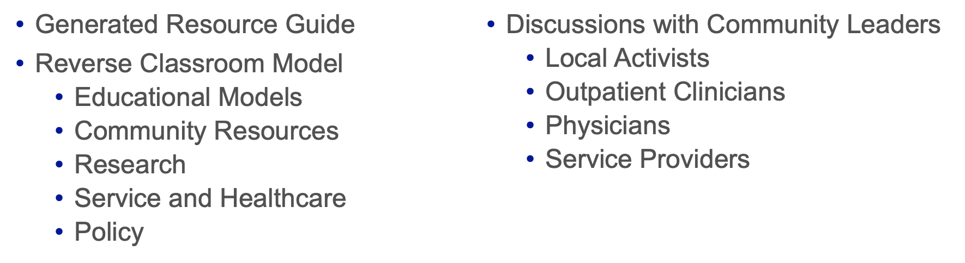



Part 4. Service / Experiential Learning
Activities and Community Engagement
Notes:
Please describe the ways in which you were actively engaged with the population of focus, providing service, giving back to community partners, and/or learning by doing.
What activities did your group perform? Were there measurable outcomes or products that could be shared?

Slide 12
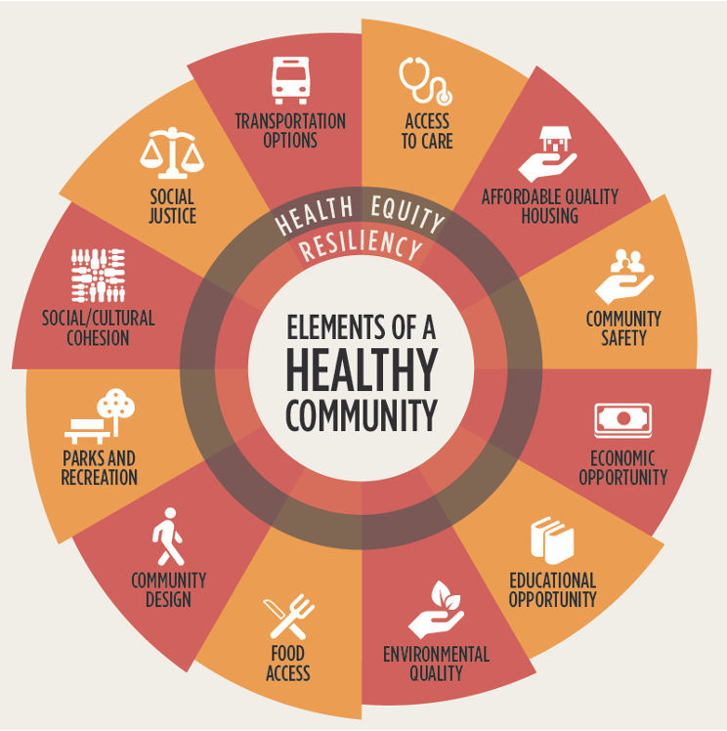
Part 4. Service / Experiential Learning
Population and Community Needs Addressed
Active Efforts to Combat
  Food Insecurity
  Social Justice
  Access to Care
  Safety
  Economic Opportunity
Notes:
What needs in the community were being addressed?
- we addressed just about every single aspect of the image on this slide through the lens of community leaders and other stakeholders.
With educational lectures, community members graciously sharing their experiences, and individual research, we identified these needs.
Specific areas of concern that we addressed with local leaders include those listed here among others.
These experiences provided context for each need while also identifying the powers at play.
In many ways, these issues are perpetuated by many powers simultaneously including the education, healthcare and legislative systems. That being said, there are still many efforts in place to combat each need as well as indivdual opportunities to make valuable changes.

Slide 13
Part 4. Service / Experiential Learning:
Shaping our Practice
How can Medical Professionals Play a Role in Policy Change?
Organized advocacy efforts: Collaboration with medical professionals across multiple sectors in healthcare to improve access & quality of care by expanding referral services.
  Education reforms/retraining programs
  Collaborative letter to request support from MNA/MMS + other health professional organizations
  Collaborative letter to WPATH to request revisions that better support access to gender affirming care services
Get involved with state agencies responsible for policy change.
  Executive Office of Health and Human Services
  MassHealth Stakeholder Workgroups
  Health Policy Commission (HPC)
Support community organizations & local advocacy and research efforts: volunteerism, philanthropy, supporting peer-led research, taking on the student role to learn from the work of members in the community.

Slide 14
Part 4. Service / Experiential Learning
Integrated and Gender-Affirming Transgender Clinical Care and Research
In the absence of solid evidence to inform “best practices” for improving and connecting clinical care and research programs in transgender health and medicine, we propose the below framework of recommendations:
Ask the 2-Step Method (Gender Identity and Assigned Sex at Birth) on Intake Forms and in Electronic Health Records
Co-Locate Services, Including Access to Hormones and HIV Prevention, Testing, and Linkage to HIV Care and Treatment Services
Partner With and Engage Local Trans Communities
Use a Multidisciplinary Team Approach to Clinical Care and Research
Design all Clinical Tools and Research Assessments to be Gender Affirming
Ensure that Clinical Care and Research are Responsive to the Social Contexts and Lived Realities of Local Trans Populations
Use Peer-to-Peer Methods to Recruit and Retain Participants in Clinical Care and Research
Create a Pipeline of Trans Clinicians and Researchers

Slide 15


Part 5. Acknowledgements
We wish to express our sincerest gratitude to guest speakers, UMMS and community faculty for their involvement in the Advocacy and Health Equity for LGBTQ+ Communities Clerkship.
Members of PCHC Planning and Oversight Group, UMMS
Jules Trobaugh, MFA, (she/her), Diversity Manager, Diversity & Inclusion Office, UMMS
Héctor Pérez, LICSW, MSW/BSW (they/he), Assistant Director of Social Services, Family Health Center of Worcester
Rebecca Thal, NP-C, (she/her), Family Health Center of Worcester
Bill Jesdale, PhD, (he/him), Assistant Professor, Population and Quantitative Health Sciences, UMMS
Germán Chiriboga, MPH, (he/him), Program Director, Population and Quantitative Health Sciences, UMMS
Jeroan Allison, MD, (he/him), Chair and Professor, Population and Quantitative Health Sciences, UMMS
Joyce McIntyre, MD, (she/her), Assistant Professor, Surgery, UMMS
Genny Beemyn, PhD, (they/them), Director, The Stonewall Center, University of Massachusetts Amherst
Renn Duffey, BS, (they/them), Director, Safe Homes Worcester
Rush Frazier, (they/them), President, 508Pride
Noah Rose, (they/them), Volunteer, Worcester Community Fridges
Lamar Brown-Noguera, AS, (they/them), Community Relations Manager, AIDS Project Worcester

