Slide 1


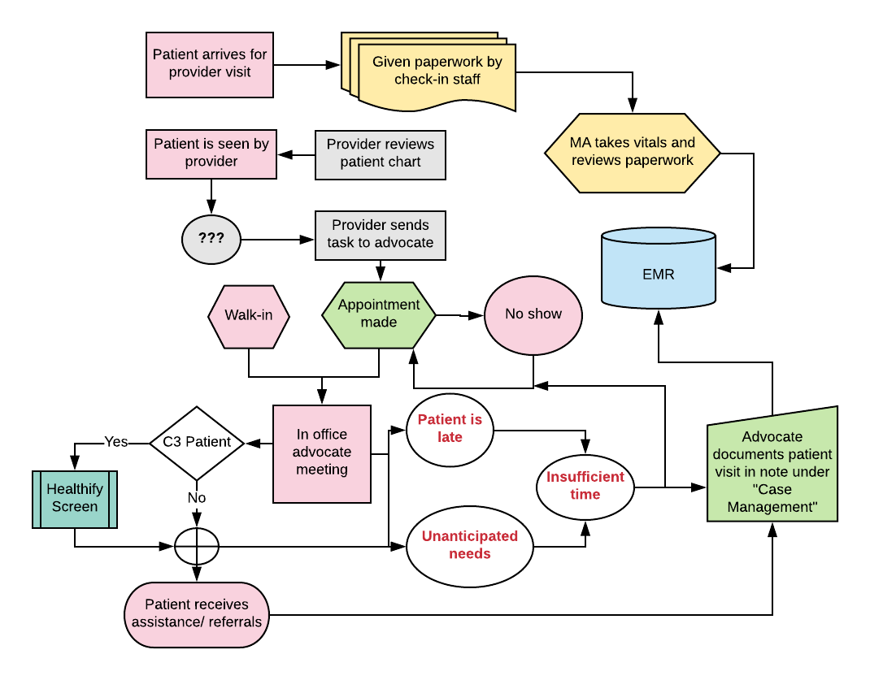
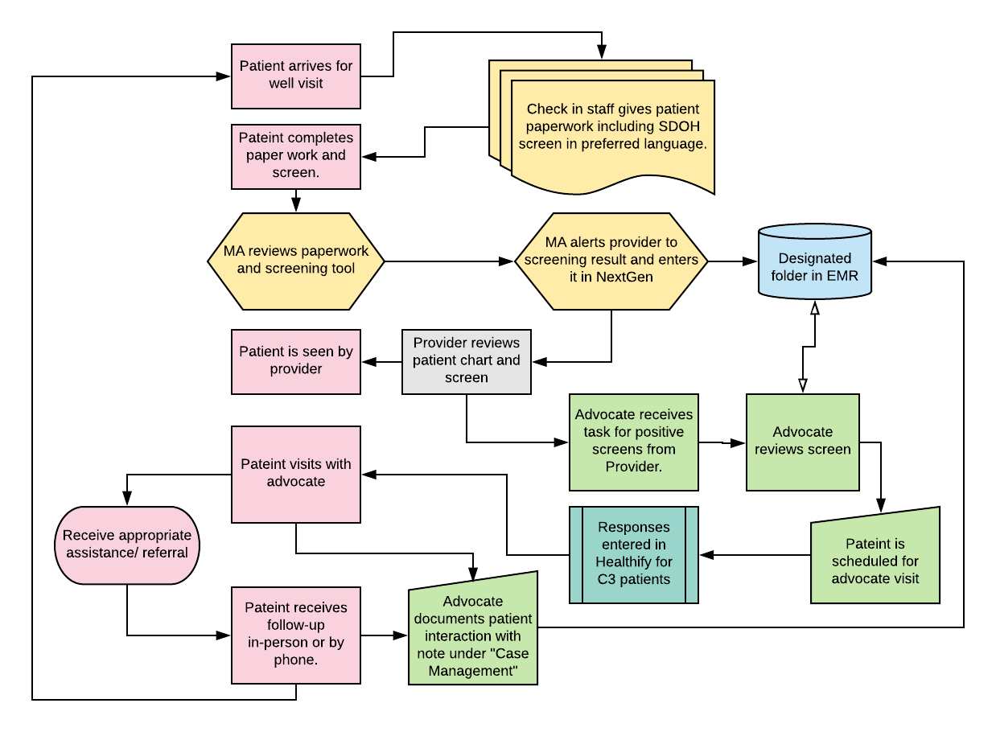
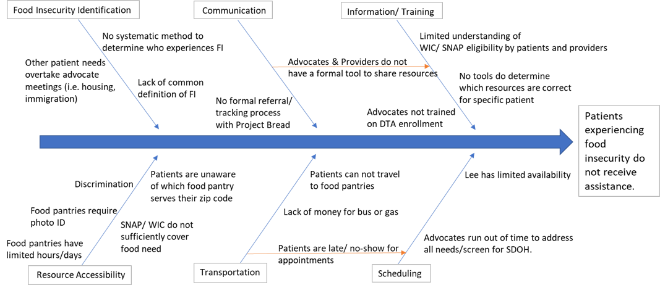
A Rational Approach to Implementing Social Determinant of Health Screening
Juliana Costanzo Dixon¹ & Melanie Gnazzo M.D.^{1,2}
University of Massachusetts Medical School; Family Health Center of Worcester
BACKGROUND
CURRENT WORKFLOW
NEW WORKFLOW
The WHO defines social determinants of health (SDOH) as “the conditions in which people are born, grow, work, live, and age, and [the broader systems shaping that environment]”¹. Research shows that SDOH are a root cause of health
disparity^{2-6 (see chart).}
To understand and address SDOH needs requires concrete
data on the individual and population level and well
defined processes for referral to assistance and resources⁷. Universal screening for SDOH could feasibly be part of the
work-flow of a busy clinical office and provide a basis for individual interventions and population data⁸⁻¹⁰.
The Family Health Center of Worcester (FHCW) is an FQHC in
the urban center of Worcester, MA. 79% of FHCW patients live below the federal poverty level, 68% receive Medicaid, and 9% are uninsured¹¹. Thus, FHCW patients are at high risk of chronic disease and negative health outcomes due to SDOH^{2,4,6}.
46% of patients do not speak English as a primary language. While the FHCW screens some patient populations, it does not have a system to methodically identify SDOH needs in their general patient population.
The FHCW is uniquely prepared to implement universal SDOH screening. It has multiple on-site patient advocates whose role is to provide patient support and assistance with food, housing, employment, immigration and other SDOH. The FHCW also has a WIC office, legal consults and partnerships with Worcester public schools and community organizations. Thus, once identified, there is capacity to address SDOH.
Adapted from countyhealthrankings.org⁶
DISCUSSION
Parameters identified as key to an improved identification and referral process were: Ability for patients to complete the screen privately and in their preferred language, brevity and simplicity, minimal additional work for staff, and ease of the health center to address positive screens.
Based on these parameters we recommended the Accountable Health Communities Health-Related Social Needs Screening Tool, developed by the Center for Medicare and Medicaid Services. It is available in multiple languages. Questions were chosen from this tool based on our capacity to address the correlating SDOH need.
We also created a space on FHCW intranet to share documents related to SDOH.
These results were presented to the Quality Working Group at FHCW which includes the Chief Medical Officer. Next steps include finalizing a screening tool, formatting it to the EMR for communication between provider and advocate and data retrieval, and trialing screening for SDOH at well visits.
METHODS
The existing process was assessed through interviews, group meetings, and one-on-one shadowing. This evaluation included providers, patient advocates, and nutritionists, as well as some government and community organizations.
Food insecurity was used as a case model.
Findings were synthesized into a fishbone diagram and process map.
Possible solutions to current road blocks were generated during meetings with various professionals at the health center.
Discussions, combined with review of current literature on this topic, were used to develop a model for an improved process.
References:
(1) Social determinants of health. World Health Organization. http://www.who.int/social_determinants/en/. Published May 31, 2018. Accessed July 17, 2018. (2) Adler NE, Boyce T, Chesney MA, Folkman S, Syme SL. Socioeconomic Inequalities in Health: No Easy Solution . JAMA. 1993;269:3140-3145. (3) Alaimo, K et al. Food insufficiency and American School-aged children’s cognitive, academic, and psychosocial development. Pediatrics 2001;108:44-53 (4) Braveman P, Gottlieb L. The Social Determinants of Health: It’s Time to Consider the Causes of the Causes. Public Health Reports. 2014;129(Suppl 2):19-31. (5) Jemal A, Thun MJ, Ward EE, Henley SJ, Cokkinides VE, Murray TE. Mortality from Leading Causes by Education and Race in the United States, 2001. American Journal of Preventive Medicine. 2008;34(1). doi:10.1016/j.amepre.2007.09.017. (6) Explore Health Rankings | What and Why We Rank. County Health Rankings & Roadmaps. http://www.countyhealthrankings.org/explore-health-rankings/what-and-why-we-rank. Accessed July 26, 2018. (7) Garg A, Sandel M, Dworkin PH, Kahn RS, Zuckerman B. From Medical Home to Health Neighborhood: Transforming the Medical Home into a Community-Based Health Neighborhood. The Journal of Pediatrics. 2012;160(4). doi:10.1016/j.jpeds.2012.01.001. (8) Garg A, Toy S, Tripodis Y, Silverstein M, Freeman E. Addressing Social Determinants of Health at Well Child Care Visits: A Cluster RCT. Pediatrics. 2015;135(2). doi:10.1542/peds.2014-2888d. (9) Kusnoor SV, Koonce TY, Hurley ST, et al. Collection of social determinants of health in the community clinic setting: a cross-sectional study. BMC Public Health. 2018;18(1). doi:10.1186/s12889-018-5453-2. (10) Page-Reeves J, Kaufman W, Bleecker M, et al. Addressing Social Determinants of Health in a Clinic Setting: The WellRx Pilot in Albuquerque, New Mexico. The Journal of the American Board of Family Medicine. 2016;29(3):414-418. doi:10.3122/jabfm.2016.03.150272. (11) Quick Facts. Family Health Center of Worcester. http://www.fhcw.org/en/AboutUs/QuickFacts. Accessed July 17, 2018.
Acknowledgements: This project was supported by HRSA Grant No. U77HP03016. The work presented here would not have been possible without the contributions of Family Health Center of Worcester staff especially Elizabeth Uceta, Esmeralda Pena, Metxy Ramirez, Beatriz Gago Psy.D, and Charlotte Vera; thank-you. Thank-you also to our partner in the WIC office Kwame O. Appiah, Lee Jackson form Project Bread, Susan Sleigh from South High School Based Health Center, and Kathleen Gervais and Billy Riley at St. John’s Food for the Poor.

