Slide 1



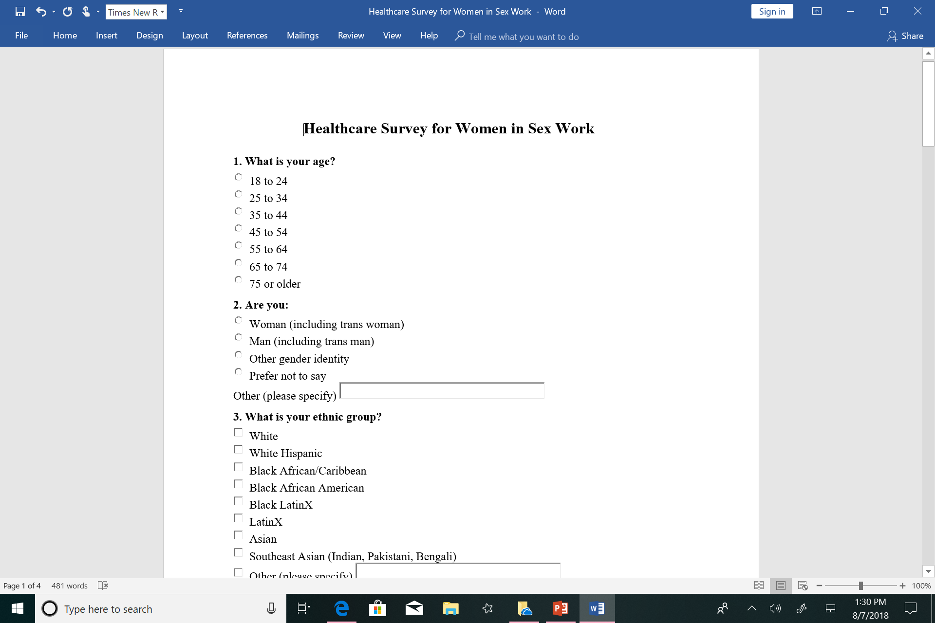

Trauma Informed Care for the Previously Sexually Exploited
Ukpong Etteh
Project Preceptor: Dr. Jennifer Bradford MD, MPH
University of Massachusetts Medical School
The Problem
In Worcester, women involved in sex trafficking are overwhelmingly burdened with substance use disorder, mental illness, homelessness and recidivism. Many of the survivors are unable to become fully self-sufficient due to their Criminal Offender Record Information (CORI), which limits their ability to obtain jobs, financial aid, and housing.
Background
"A practice by which a person achieves sexual gratification, financial gain or advancement through the abuse or exploitation of a person’s sexuality by abrogating that person’s human right to dignity, equality, autonomy, and physical and mental well-being; i.e. trafficking, prostitution, prostitution tourism, mail-order-bride trade, pornography, stripping, battering, incest, rape and sexual harassment”.
The sexually exploited population usually encompasses women who are victims of sex trafficking, homeless, previously incarcerated and many involved in the criminal justice system.
Based on the comorbidities within this population we believed it would be best to provide healthcare using a trauma-informed approach.
Causes
Sexual exploitation is a lucrative and covert business leading to isolation and vulnerability of victims.
Sexually exploited women often suffer from co-occurring disorders and trauma of abuse and exploitation can present barriers to accessing help.
Many clinicians in the Worcester area are unaware of how to adequately treat this vulnerable population from a trauma-informed perspective.
Summer Assistantship Work
Countermeasures
Creation of a clinic catering specifically to the sexually exploited population providing acute care in an accessible location.
Solidifying a partnership between LIFT, Clark University and the University of Massachusetts Medical School.
Work toward engaging healthcare providers in grand rounds and workshops concerning trauma-informed care for survivors of sexual exploitation.
Future Goals
Primary: establish a clinic solely for the purpose of treating previously sexually exploited women of the Worcester area.
Secondary: engage healthcare providers and medical students in learning about trauma-informed care for this population. .
Summer Assistantship Work
Conduct a literature review on peer recovery coaching and its successes.
Create an entry survey for survivors who could potentially benefit from the acute care clinic at LIFT.
Improve a potential healthcare model for an affordable clinic for the sexually exploited population.
Secure workshop opportunities to speak about trauma-informed care for survivors of sexual exploitation.
Future Plans
Conduct a focus group concerning healthcare needs with clients at LIFT.
Secure medical supply donations for the new clinic.
Acknowledgements
Many thanks to Dr. Jennifer Bradford and Nicole Bell for their help and support for this project.
Clinic Model | Services | Staffing
Operating out of LIFT directly Referrals to the clinic could be done through LIFT, law enforcement other agencies serving or encountering members of this population Clinic could operate one afternoons per week at first | Urgent/acute care Substance abuse care Case management Testing Service referrals Health education . | One physician attending to urgent and acute care needs Medical students to assist the physician and provide health education. Peer recovery coaches: may accompany patients to appointments, call patients reminding them of upcoming appointment, support

