Slide 1


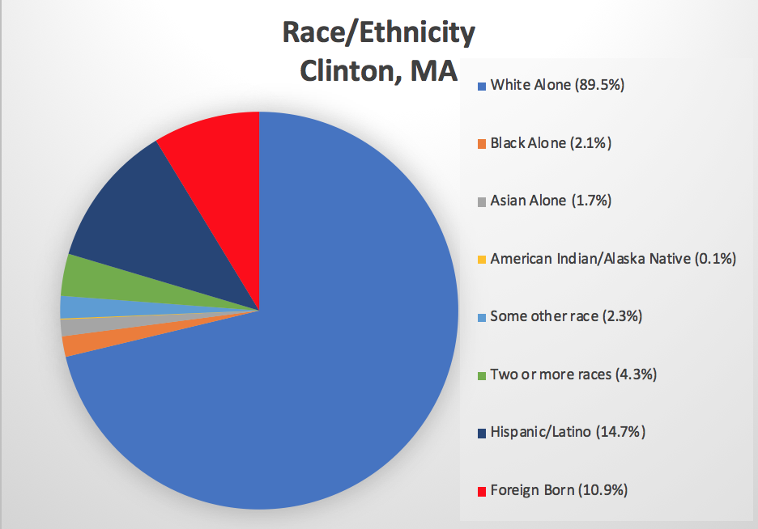
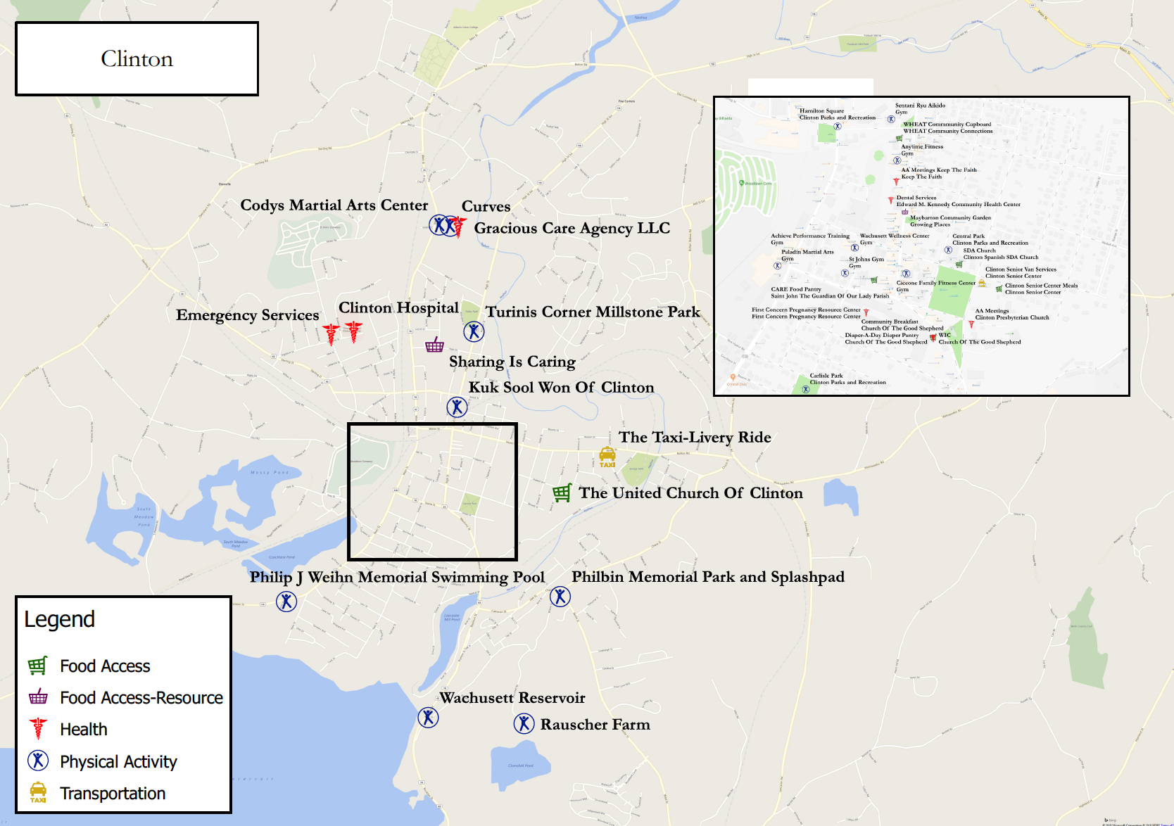

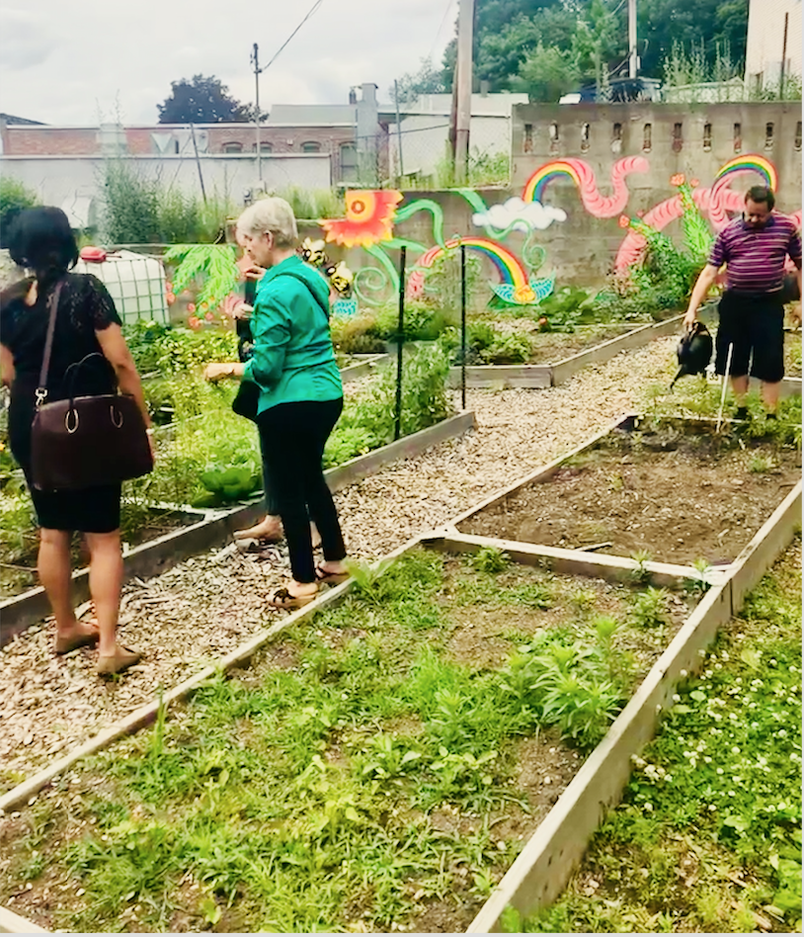



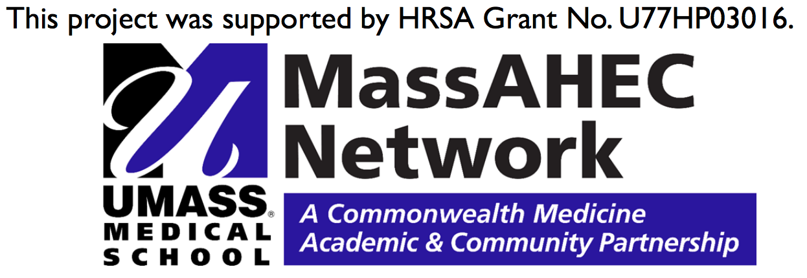
Food Access in Clinton:
Assessing and Improving Community Resources
Vanessa Villamarin, Samantha Dokus, Aaron Meneghini, Nicholas DePaula,
Ayn Yeagle, Rosa Fernandez
University of Massachusetts Medical School, Growing Places, & UmassMemorial HealthAlliance-Clinton Hospital
Background
Outcomes & Future Directions
The North Central Mass Community Health Improvement Plan (CHIP) recognizes that positive community health outcomes have a direct impact on all other aspects of community life, including: education and job access, economic sustainability and growth, and civic engagement.
Aim: to create a community where people have an equal and fair chance to pursue educational and career goals as well as a community that is safe, valued, and cherished.
5 priority areas identified→
  Healthy Eating & Active Living
  Healthy & Safe Relationships
  Mental & Behavioral Health & Substance Abuse
  Transportation & Access
  Racial Justice
Populations identified that face complex needs or significant barriers to care which require more focus:
Outcomes→
Community connections built by visiting food pantries, churches, coffee shops, local community centers
Completion of >90 CHNA9 Food Access Surveys
Pop-Up Farmer’s Market: August 22, 2018 at WHEAT Community Connections in Clinton, MA
  Partners: Growing Places, WHEAT, Fitchburg State, CHNA9, HealthAlliance-Clinton, UMMS
Map created featuring the following resources: food access, physical activity, health, transportation (available in both English and Spanish)
List of suggestions and next steps for Clinton from focus group and meeting with residents
Future Directions→
Consider hosting a consistent farmer’s market in Clinton
Translate town resources into Spanish (i.e. newspaper, town websites)
Provide healthy cooking classes, along with a meal, at community resource centers
Exploration of grants to increase transportation access
Summer Service Learning Assistantship
Objectives
Identify and involve key stakeholders across multiple community sectors that have a role in the community food system, health and wellness.
Disseminate the CHNA9 Food Security Survey to residents.
Host a listening tour with community leaders to identify potential food access strategies for Clinton.
Create a map of Clinton’s local food system and active living assets.
Identify locations (physical and virtual) to disseminate the map to and increase awareness of where healthy activities already exist in Clinton.
Host a pop-up Farmers Market event in Clinton.
Healthy Eating and Active Living
This poster focuses on the Healthy Eating and Active Living priority area.
This priority was based on high rates of diabetes, heart disease, and obesity in the area.
Within the study area, the 2015 Community Health Assessment of North Central Massachusetts found that the percentage of overweight adults as well as those with diabetes was higher than within the Commonwealth¹
Overweight: 63.2% (North Central MA) vs 59.3% (state-wide)
Diabetes: 9.3% (North Central MA) vs 8% (state-wide)
References
¹Community Health Assessment of North Central Massachusetts-May 2015
Community Health Needs Assessment 2018
North Central Mass Community Health Improvement Plan 2020 and 2017 Annual Report
Acknowledgements
This project would not have been possible without Rosa Fernandez, Growing Places, UMassMemorial HealthAlliance-Clinton Hospital, Dr. Heather-Lyn Haley, Dr. Suzanne Cashman, WHEAT Community Connections, and of course the wonderful community members of Clinton MA

