Slide 1
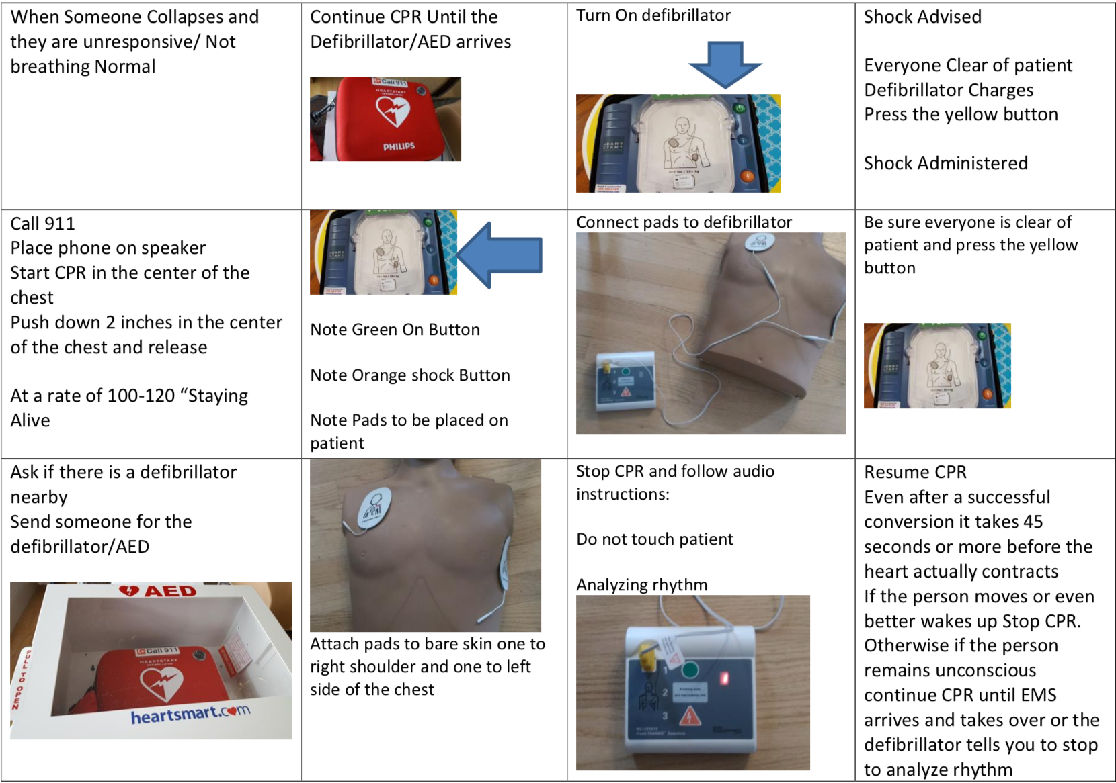

A Targeted Approach to Increasing Bystander CPR Training and Access in the Worcester Community
Eileen McGarry, Medical Student Class of 2023
University of Massachusetts Medical School
Background
Preliminary Training Event
Train the Trainer Event
Materials
The goal of this project was to design a self-sustaining bystander CPR program that could be integrated into college freshman orientation programs.
CPR is a vital, life-saving skill that increases public safety and security.
Integrating CPR education into freshman orientation is an effective and efficient way to increase CPR proficiency amongst a student body.
Several barriers exist to receiving bystander CPR training: cost, time, and availability of classes. Currently, no colleges in the Worcester area require CPR training during freshman orientation and CPR classes offered sporadically throughout the school year suffer from low attendance.
Worcester EMS and UMass Medical School will staff and equip the first training event, providing 10-20 instructors.
50-100 college students will be trained in each session to maintain a student: instructor ratio of 5:1.
Each ~30 minute session will consist of an instructional and a didactic period.
Instructional
Sessions will begin with a brief instructional period.
Instructions will consist of basic hands-only CPR utilizing posters and postcards to enhance retention.
  Didactic
  Students will assemble in groups of 5 or less
    One instructor and one mannequin
  The instructor will demonstrate CPR using the mannequin.
  Students will then practice CPR
    After all students have practiced, the training session will end.
Add your information, graphs and images to this section.
This ~1-hour program will be held later in the semester.
Any student may attend in this program, however our goal is to target this program toward an existing student group (i.e. EMS Squads). Participation in a yearly refresher course is required to maintain proficiency.
This program reiterates the importance of CPR and walks students through the utilization of training materials. Students will also be instructed on evaluating and correcting CPR technique.
After completing this course, students will be qualified to lead future CPR training events.
  Students may also run future Train the Trainer events
During the Preliminary Training period, equipment and trainers will be provided; however, a self-sustaining program will require a small initial investment to outfit subsequent training events.
Suggested materials are as follows:
  CPR Mannequins
  AED Trainers
  UMass bystander CPR Posters
  UMass bystander CPR Post Cards
  Floor Mats
The number of CPR training mannequins and AED trainers is dependent on the school size. A student: mannequin ratio of 5:1 should be maintained during all training events.
Community Outreach Opportunities
Prescription CPR
UMass Medical primary care offices work to identify high risk patient populations and connect them with local CPR training opportunities.
Students can assist at-risk populations by hosting CPR training events on campus.
Free Clinic Volunteers
The UMass Medical School is beginning to offer bystander CPR training at free clinic locations.
Interested and qualified students may have the opportunity to assist with these training events.
Community CPR Training
Campuses can organize, advertise, and run their own CPR training initiatives.
This may include training events for campus staff, teachers, and workers.
Longevity
Integrate a self-sustaining CPR program into the freshman orientation curriculum.
Empower students to become leaders in CPR advocacy and training in
Foster interest in addressing health disparities, and minimizing barriers to health education
Cardiac Health Outreach Program (CHOP) is a student-run organization at the UMass Medical School.
CHOP has expressed interest in assisting with campus training events.
It is our hope that CHOP will serve as a resource for college programs into the future
Figure 1. Overarching goals of this CPR program.
Figure 2. Example of AED instructional postcard A) original version designed by Dr. Joseph Sabato and B) proposed updated version below.
A)
Acknowledgements
Laurel O’Connor, MD
  Faculty advisor
Joseph Sabato, MD
  Faculty advisor and CPR program director
Heather-Lyn Haley, PhD
    Summer program director
  A special thanks to CHOP, EMS service members, and CPR instructors who assisted in the development and feasibility assessment of this program.
A)
B)
Overview
B)
The bystander CPR instruction was designed by Dr. Joseph Sabato and shown to be efficacious. Proposed updates to his training materials were created.
Training will be broken up into two discrete events:
  The Preliminary Training event
  The Train the Trainer event
Figure 3. Example of CPR instructional postcard A) original version designed by Dr. Joseph Sabato on left and B) proposed updated version on right.
Notes:
Hi Everyone- thank you for stopping by my poster regarding a program to increase bystander CPR training in Worcester. The overarching goal of this summer project was to design a self-sustaining bystander CPR program that could be integrated into freshman orientation on college campuses
The reason behind designing this program was to address the low rates of bystander CPR that are currently plaguing the Worcester area by minimizing barriers to CPR training. The training model used in this program was designed by Dr. Joseph Sabato and shown to be efficacious. Examples of his training materials have been included in this poster. I have also included my proposed updated versions to these posters.
This particular model has been designed to be integrated into freshman orientation, however the premise of these trainings could be applied to other organizations such as local fire departments. The goal is to create trainers within an organizational structure to continue training/educating others within their organization. This creates an exponential increase in availability of training and number of people being trained.
The training for campuses is broken down into two discrete events: the preliminary event and the train the trainer sessions. Starting out, the campus won’t have any of their own trainers, so we will jumpstart the program by hosting, staffing, and equipping the first freshman orientation to be trained.
Later in the semester, volunteers will return to campus to train interested students on CPR instruction during the Train the Trainer event. Our hope is to target a student group on campus to pioneer this such as an EMS squad, Varsity sports team, or interest group. Once students have been trained on CPR instruction they have the ability to run their own CPR training events for campus staff, professors, workers as well as training their future freshman orientations.
Our hope in designing this is to increase the number and location of free bystander CPR training throughout Worcester. For example, it would be wonderful to link colleges into the Prescription CPR program that Dr. Joseph Sabato has been organizing.
When looking to the future, several questions still exist with this training. We hope that the (CHOP), will be interested maintaining this program and organizing yearly CPR trainer refreshers at college campuses. This would allow the responsibility to be handed down with each passing medical school class. Any ideas or feedback you have on assuring longevity of a program like this would be appreciated. In addition, your thoughts and feedback on the program structure and goals in general are always welcome.
Finally, I would like to acknowledge Dr. Laurel O’Connor and Dr. Joseph Sabato both of whom contributed their time and energy this summer. I would also like to thank Dr. Heather lyn Halehy who is the summer program director. A special thanks to CHOP, EMS members, and CPR instructors who assisted with designing this project.

