Slide 1

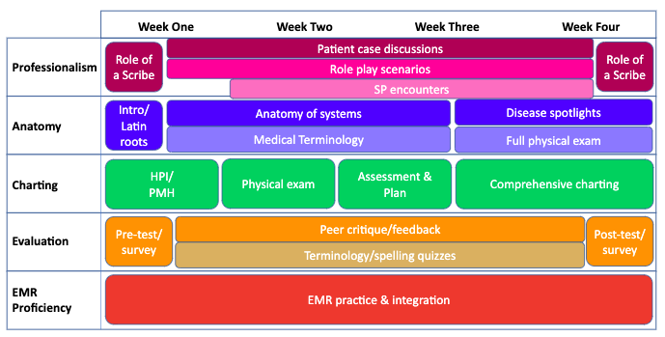
Designing a UMass Bacc-MD Medical Scribe Fellowship
Training Curriculum
Haley Clark, Class of 2023
University of Massachusetts Medical School, Worcester, Massachusetts USA
INTRODUCTION
RESULTS
FUTURE DIRECTIONS
Medical scribes are important and productive additions to health care teams. Not only do they support the physician in thorough charting, but they also expose the scribes themselves to valuable experiences in the health care field. UMass Medical School and UMass Memorial Health Care are developing a medical scribe fellowship program that will hire students underrepresented in medicine through the UMass Bacc-MD program to provide them with a gap year opportunity while applying to health careers professional schools.
The training curriculum for this program was developed to give scribes a comprehensive and integrated understanding of anatomy, medical terminology, and components of the patient visit. Training and recruitment materials were created, integrating feedback from current UMass medical students who were formally scribes, as well as current UMass undergraduate students in the Bacc-MD program.
Integrate Epic EMR practice into the curriculum via quick reference sheets, short reference videos, and established practice patients
Present and acquire program approval
Develop and elicit objective & subjective evaluations of the curriculum
  pre-training
  post-training
  post-fellowship
Figure 1. Scribe Training Curriculum Overview by Competency
REFERENCES
Lin, Steven, Jason Khoo, and Erika Schillinger. "Next big thing: integrating medical scribes into academic medical centres." (2016): 27-29.
Martel, Marc L., et al. "Developing a medical scribe program at an academic hospital: the Hennepin County Medical Center experience." The Joint Commission Journal on Quality and Patient Safety 44.5 (2018): 238-249.
Centers for Disease Control and Prevention. Recommended Training Effectiveness Questions For Postcourse Evaluations User Guide Atlanta, GA: CDC, 2019.
Chabner, Davi-Ellen. Medical Terminology: A Short Course-E-Book. Elsevier Health Sciences, 2017.
METHODS
Figure 2. Outline of a training day
Figure 3. Student Feedback and Perspective
Search literature surrounding medical education and evaluation
 | Topic | Competency
1. | Anatomy/medical terminology quiz | Anatomy
2. | Practice encounter | Charting
3. | Peer-critique of charting | Evaluation
4. | New chart section overview | Charting
5. | EMR work | EMR
6. | New body system | Anatomy
7. | New medical terminology work | Anatomy
8. | Disease spotlight | Anatomy
9. | End-of-week debrief | Professionalism
UMMS Student Feedback
Emphasized that scribes should not be afraid to ask questions to learn more.
“…you learn an essential skill in every physician’s repertoire – communication.”
“I also gained extremely valuable practice using EMRs and writing patient notes, which is something that most people do not have experience with until residency.”
Bacc-MD Student Feedback
Inquired about direct clinical contact and how the experience can be useful in applications/interviews.
Approximately 50% of students expressed interest in applying.
Elicit feedback from current medical students regarding their most notable experiences as scribes
Utilize student feedback from MS1 curriculum to outline an integrated 4-week training curriculum
ACKNOWLEDGMENTS
Create a comprehensive schedule, anatomy lessons, periodic evaluations, and practice patient encounters
This project was supported by the MassAHEC Network, HRSA Grant No. U77HP03016 from the Health Resources and Services Administration of the US Dept. of Health and Human Services. This information should not be construed as the official position or policy of, nor any endorsements be inferred by HRSA, HHS or the US Government.
Present proposed program to UMass Bacc-MD students and elicit feedback

