Slide 1
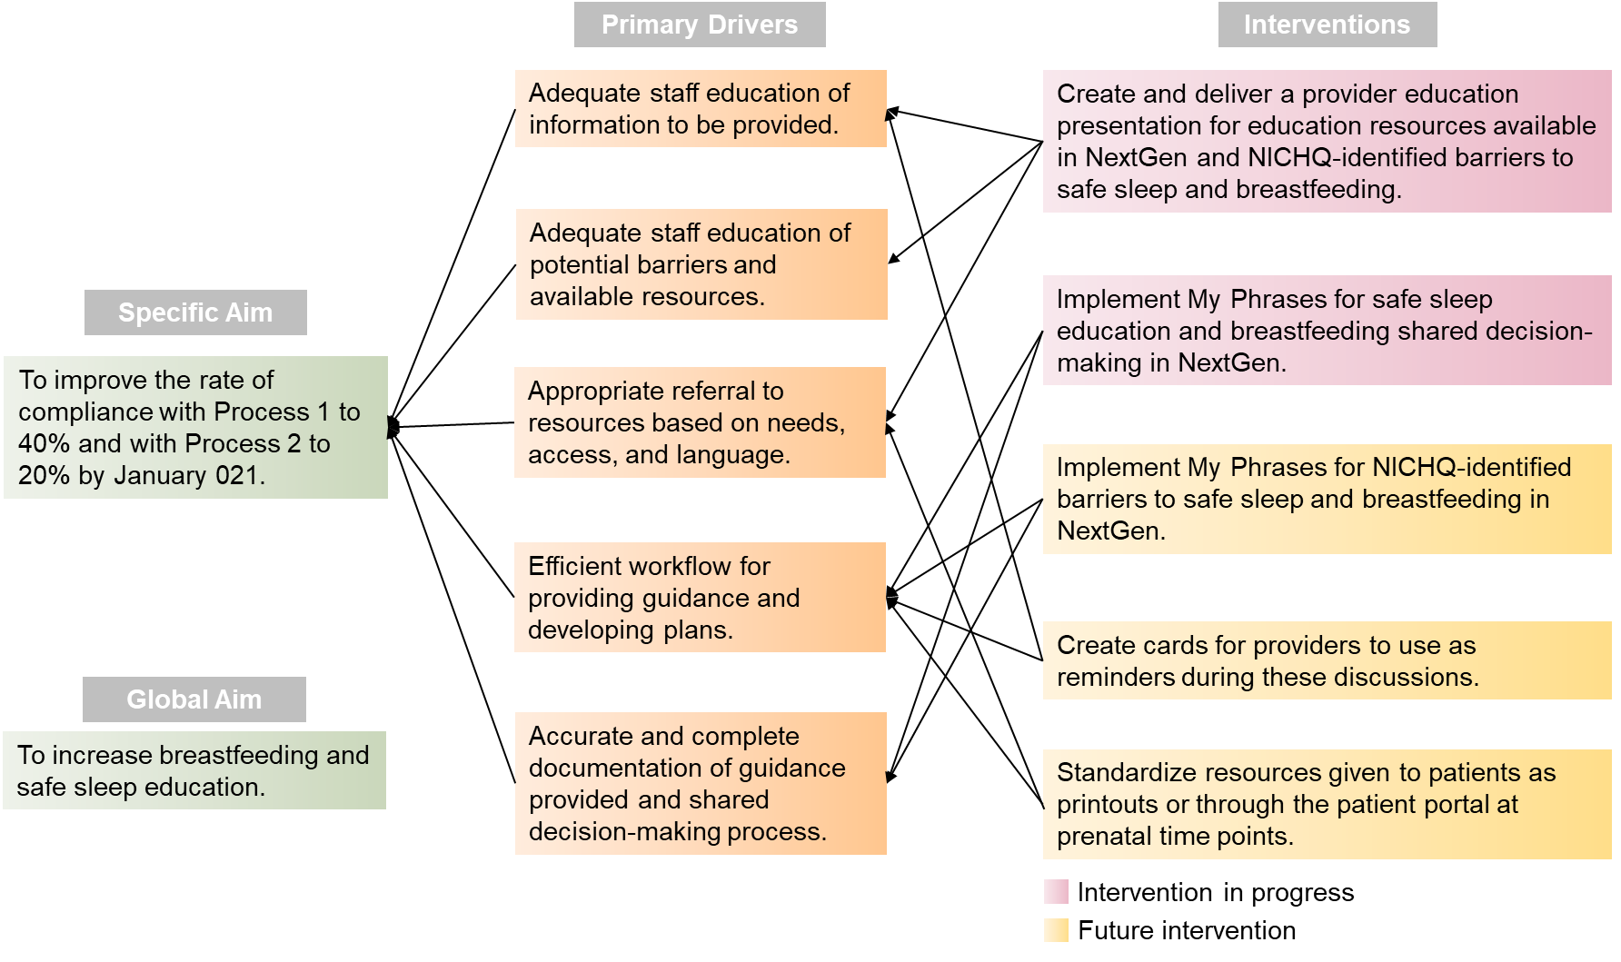
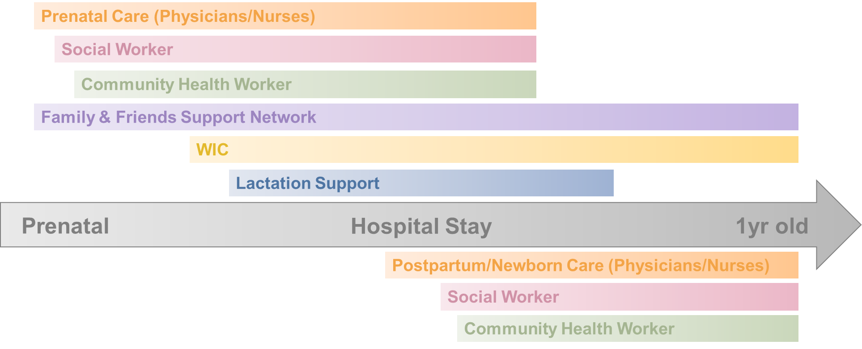
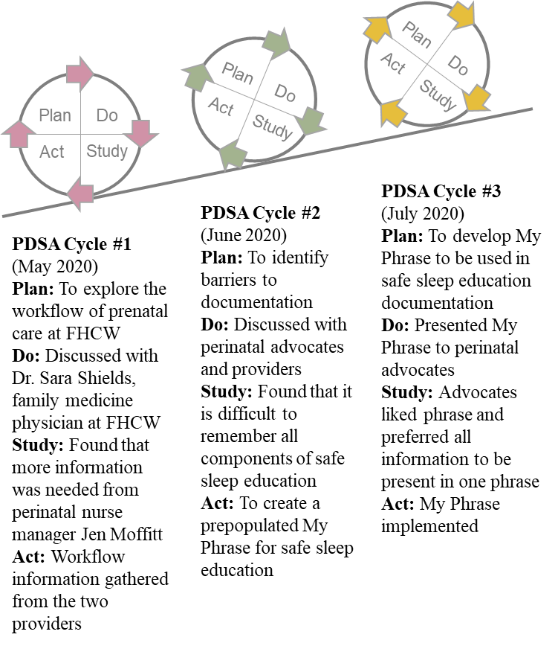
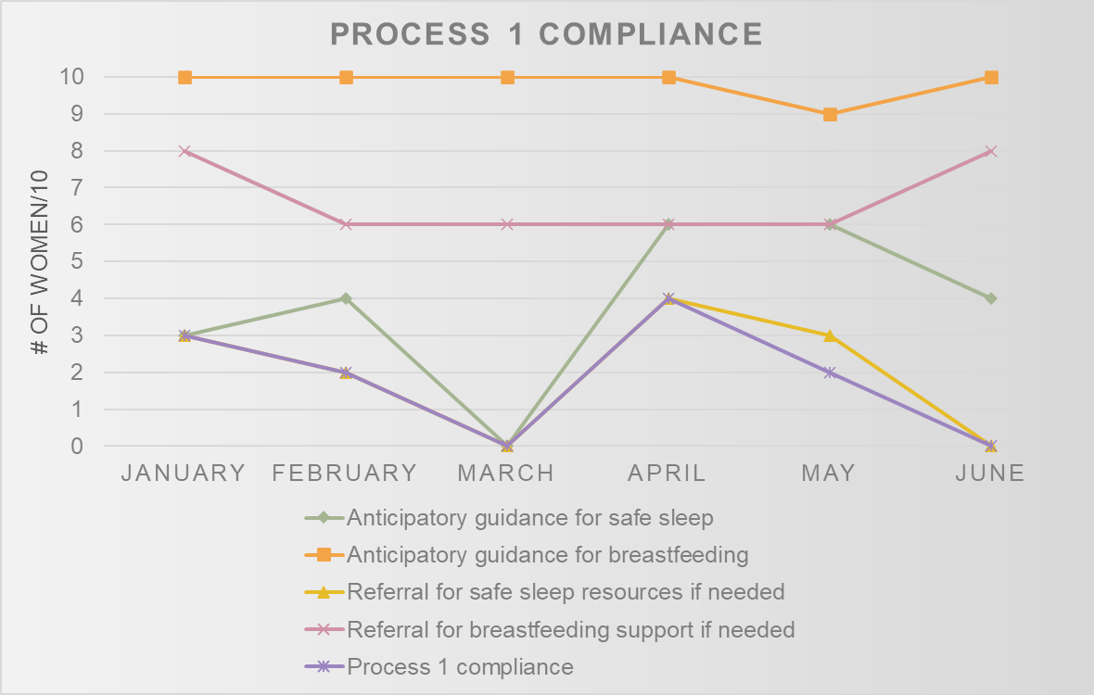
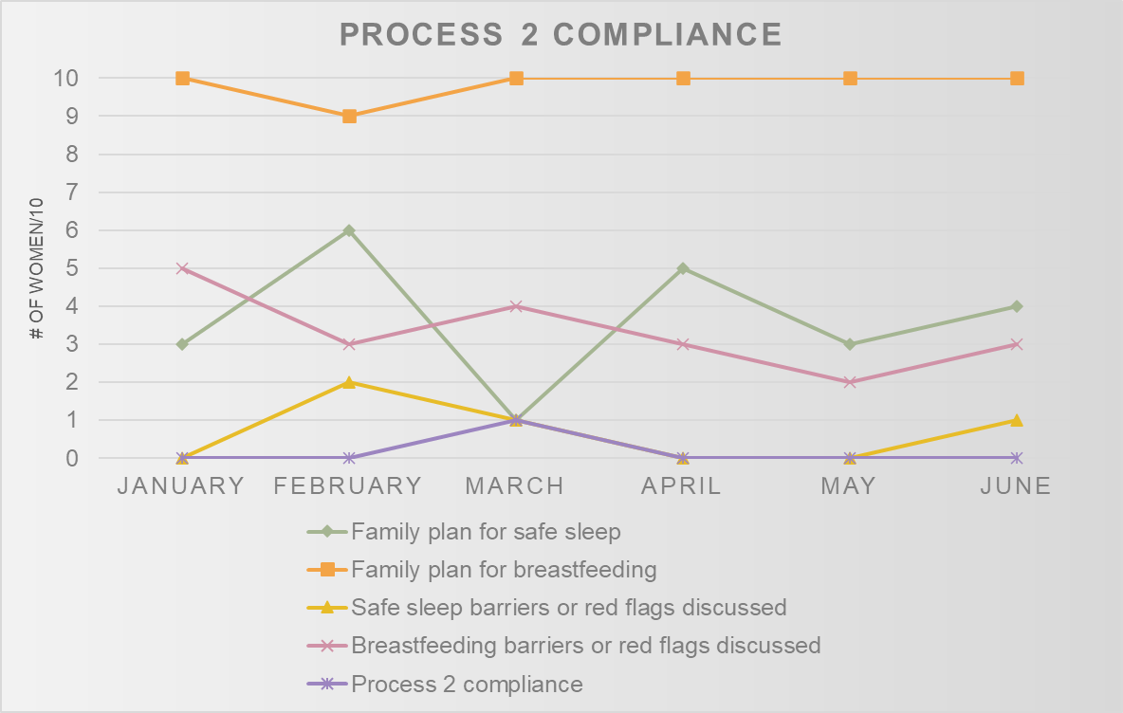
Improving Prenatal Safe Sleep and Breastfeeding Education in the Outpatient Setting
Elizabeth Makris
University of Massachusetts Medical School
Introduction
Key Drivers
Interventions
Worcester infant mortality rate: 5.2 per 1,000 live births in 2013-2015¹
American Academy of Pediatrics (AAP) recommends safe sleep environment and breastfeeding to reduce the incidence of sleep-related infant death²
American Academy of Family Physicians (AAFP) recommends the infant feeding discussion begin as early as possible, as women make decisions about breastfeeding very early on³
We are interested in looking at how breastfeeding and safe sleep education takes place during prenatal care in the outpatient setting
We examined the current processes and timeline for prenatal care and education to identify opportunities for improvement
Discussions with FHCW staff led to introduction of a My Phrase, a prepopulated phrase to be used in documentation in the electronic medical record (NextGen):
Reviewed safe sleep practices: back to sleep, alone, on firm mattress, without blankets or stuffed toys, avoid smoking exposure, avoid overheating, rooming in but not bedsharing, breastfeeding, use of sleep sack.
We are focused on:
Patient-centered conversations and shared decision making between expectant mothers, families, and providers
Standardized information provided to families regarding breastfeeding and safe sleep
Systematized documentation and reporting
4
Baseline Data
Goals
1.) Measure the degree to which safe sleep and breastfeeding education Is taking place at the Family Health Center of Worcester (FHCW)
2.) Assess compliance with education processes outlined by NAPPSS-IIN initiative (below) by auditing charts of women who receive prenatal care at FHCW
3.) Improve rates of compliance with these processes through a series of interventions
4.) Ultimately decrease infant mortality rates in Worcester
Next Steps
Overall Process 1 Compliance:
18.33%
Breastfeeding processes are doing well, while safe sleep processes need improvement
Additional interventions will be implemented to address identified issues, in accordance with Key Driver diagram
Following these interventions, we will dive deeper into the racial and ethnic disparities present among the Worcester community with respect to infant mortality
NAPPSS-IIN
National Action Partnership to Promote Safe Sleep Improvement and Innovation Network (NAPPSS-IIN) is an initiative of the National Institute for Children’s Health Quality (NICHQ)
Initiative aimed at making safe sleep and breastfeeding the national norm and focused on providing families with evidence-based instruction
Two processes outlined by the initiative for achieving this goal:
Process 1: Adequate information provided to the family regarding safe sleep and breastfeeding
Includes anticipatory guidance and referral to resources if needed
Process 2: Conversation with the family to develop a plan for safe sleep and breastfeeding
Includes family plan and discussion of any barriers or red flags⁵
Acknowledgments
Many thanks to Dr. Sara Shields and Dr. Sherman Chu for their endless guidance, support, and expertise. Thanks to the perinatal advocates and providers of the Family Health Center of Worcester, the members of the Worcester Healthy Baby Collaborative, and other community partners for lending their knowledge and time. Thanks to Dr. Heather-Lyn Haley and the UMMS Community Health Service Learning Assistantship for making this project possible.
Overall Process 2 Compliance:
1.67%
References
¹https://www.worcesterhealthybaby.org/what-is-infant-mortality/
²https://www.aap.org/en-us/advocacy-and-policy/aap-health-initiatives/safe-sleep/Pages/Safe-Sleep-Recommendations.aspx
³https://www.aafp.org/about/policies/all/breastfeeding-support.html
⁴https://www.flickr.com/photos/diaz/10399136265
⁵https://www.nichq.org/project/national-action-partnership-promote-safe-sleep-improvement-and-innovation-network-nappss

