Slide 1
Prevalence of Hypertension in African Americans Compared to the General Population in Massachusetts
Presented by:
Emmanuel Appiah Kubi (North High School) Gia-Han Le (South High Community School) Rudalys Ruiz (Kipp Academy Lynn Collegiate)

Slide 2
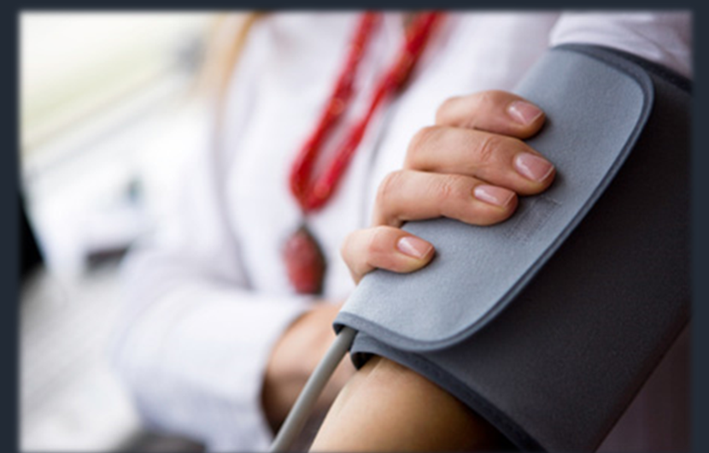
What is Hypertension?
Hypertension (HBP) is a common condition where one’s BP is consistently too high. The more blood in your circulatory and the more resistance and narrower your arteries/veins are - the higher the BP.
Health: Essential Hypertension - /www.healthline.com

Slide 3

What is a health disparity?
A health disparity is “the difference in the incidence, prevalence, mortality, and burden of disease and other adverse health conditions that exist among specific population groups in the US, when compared in contrast to larger group (general population).”
(National Institutes of Health - NIH)
African American Health Institute - www.graahi.org/Education
Bureau of Health Information, Statistics, Research, & Evaluation Bureau

Slide 4
What are some SymptomS & Effects?
Hypertension is known as a “silent killer,” since symptoms are hard to differentiate. . .
SYMPTOMS:
chest pain
shortness of breath
back pain
numbness/weakness
changes in vision
difficulty speaking
CAN CAUSE:
Heart Failure
Sexual dysfunction
Osteoporosis
Arteriosclerosis
Dementia

Slide 5
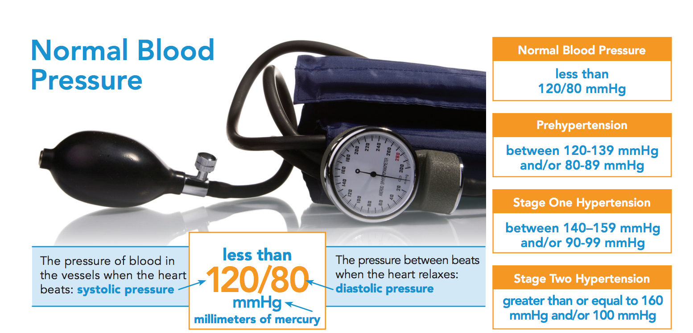
General Information
Normal: 120/80 mm Hg
Abnormal: 140/90 to 180/100 mm Hg
⅓ of Adult Americans have REPORTED Hypertension in MA
52% of African Americans, who have HBP, have other chronic diseases.

Slide 6
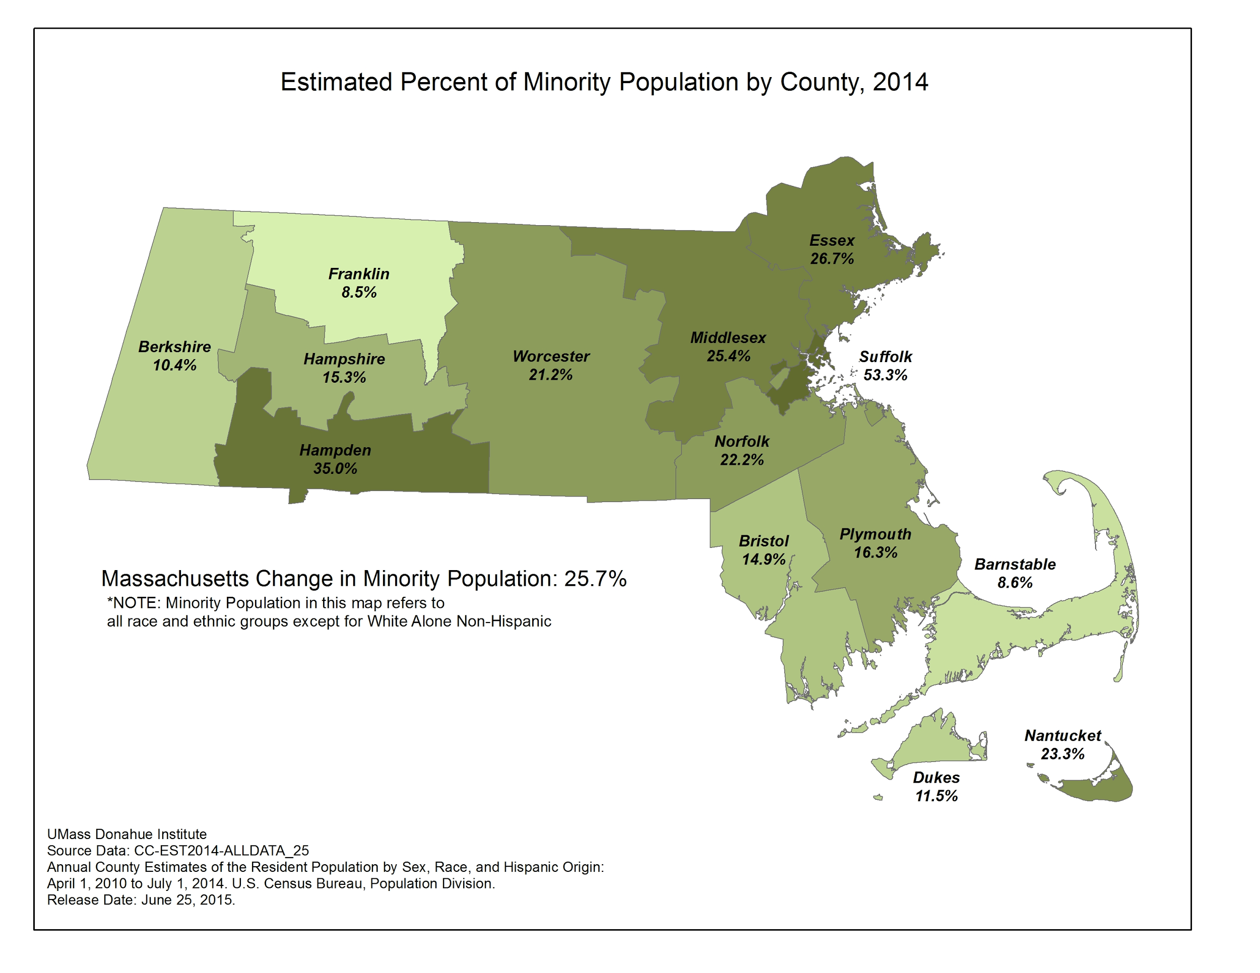
http://www.massbenchmarks.org/statedata/news.htm

Slide 7
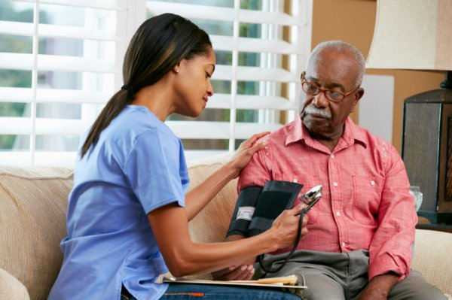
Ethnic Group: African AmericanS in Massachusetts
The prevalence of Hypertension among African Americans are one of the highest within Massachusetts.
Blood Pressure Clip - https://www.123rf.com

Slide 8
Why is HBP more prevalent amongst African Americans?
The two main factors are…
Genetics & Socioeconomics

Slide 9
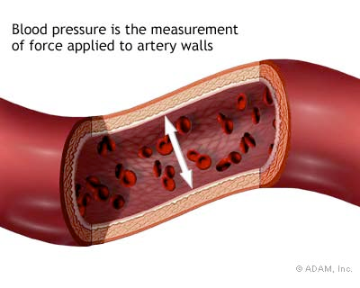
Genetics: Small Arteries
-African Americans generally have smaller arteries, increasing pressure.
-Higher probability of having Hypertension.
http://www.nytimes.com/health/guides/disease/hypertension/print.html

Slide 10
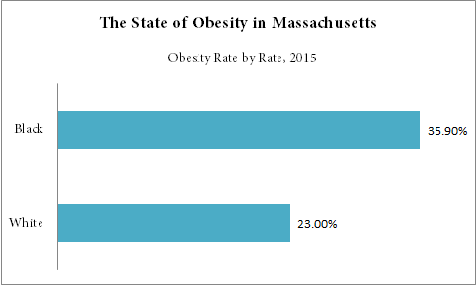
Socioeconomic: Poverty=Poor health
21.6% of African Americans in MA live in poverty.
Healthy foods=expensive=low income families are more inclined to have a poor diet
Poor health: higher risk of Hypertension
http://stateofobesity.org/states/ma

Slide 11
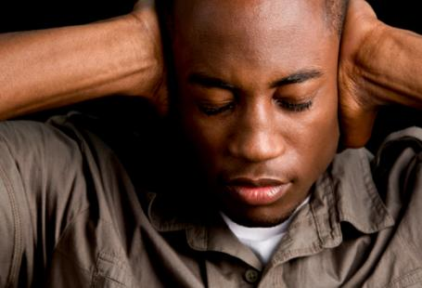
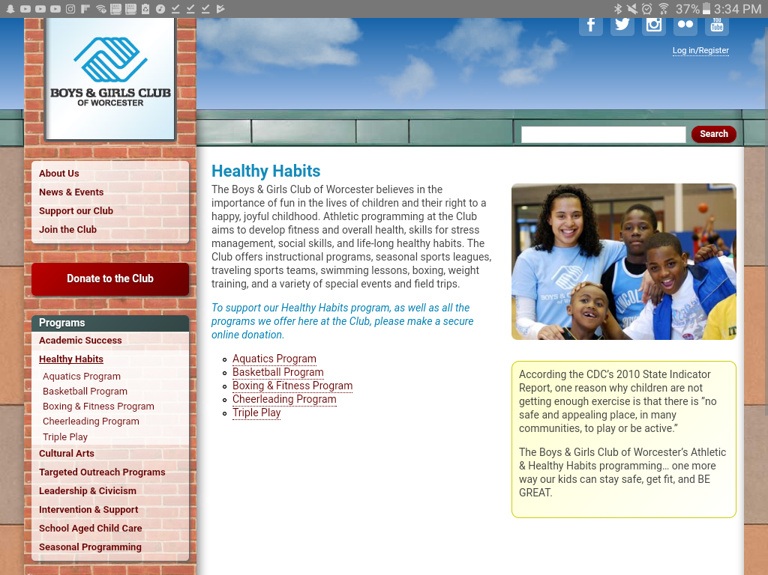
SOCIOECONOMIC: poor ENVIRONMENT
Unsafe environment leads to lack of exercise due to feelings of paranoia
African Americans surrounded by racism & discrimination
Increase in stress=higher blood pressure
Centers for Disease Control and Prevention

Slide 12
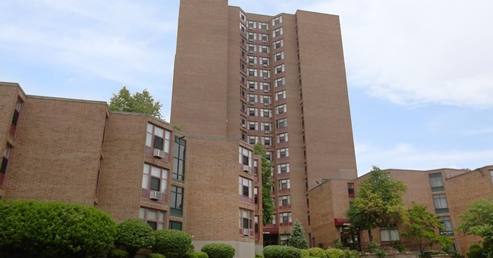
EFFECTS of environment
Corner stores everywhere while walking home
Altercations outside at night
Personally at a higher risk of getting hypertension
Plumley Village - Worcester, Ma (Poverty Neighborhood)
Researchers from Brigham and Women's Hospital Report Recent Findings in Heart Attack (Comparison of Delay Times from Symptom Onset to Medical Contact in Blacks Versus Whites With Acute Myocardial Infarction)." Obesity, Fitness & Wellness Week, 20 May 2017, p. 4011. Health Reference Center Academic, libraries.state.ma.us/login?gwurl=http://go.galegroup.com/ps/i.do?p=HRCA&sw=w&u=mlin_c_northhs&v=2.1&it=r&id=GALE%7CA491680075&asid=8273d53b74c85d832bd1f97de6733fb0. Accessed 19 July 2017.
Notes:
“[African Americans] were also more likely to live in urban communities with lower socioeconomic status, lower rates of long-term residence, and higher proportion of single-person households than white patients.”

Slide 13




Neighborhood Resources
These programs provide healthier options for African Americans living in poverty

Slide 14

SOLUTIONS/GOALS
The KEY is PREVENTION.
Heart-healthy diet; sodium intake less than 1,500 mg per week.
Physical Activity.
Keep a healthy weight.
Stressmanagement.
Refrain from tobacco/alcohol.
Possible Medication.

Slide 15
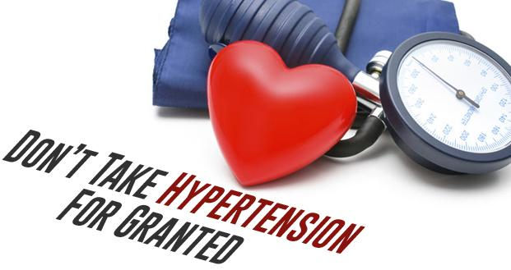
Conclusion
Hypertension is a Cardiovascular disease that is more prevalent amongst the African American community.
Main factors that affect AA: Genetics & Socioeconomic factors.
Prevention/Main Goal: To spread awareness/show severity of disease

Slide 16
WORKS CITED
"Hypertension." 404 Error Page. N.p., n.d. Web. 26 July 2017
404 Error Page. N.p., n.d. Web. 26 July 2017.
Observer, Medical. "Busting Hypertension Myths." Medical Observer. N.p., n.d. Web. 26 July 2017.
Medscape Log In. N.p., n.d. Web. 26 July 2017.
"High Blood Pressure (hypertension): Controlling This Common Health Problem." Mayo Clinic. Mayo Foundation for Medical Education and Research, 09 Sept. 2016. Web. 26 July 2017.
"What Is hypertension?" Khan Academy. N.p., n.d. Web. 26 July 2017.
"Massachusetts Report - 2016." Talk Poverty. N.p., n.d. Web. 26 July 2017.

