Slide 1

GNOME
Learner centered educational planning:
GOALS
NEEDS ASSESSMENT
OBJECTIVES
METHODS
EVALUATION
Roberts, K.B. (1996). Educational Principles of Community-based Education. Pediatrics December 1996; 98 (6): 1259–1263. 10.1542/peds.98.6.1259; https://publications.aap.org/pediatrics/article-abstract/98/6/1259/61355/Educational-Principles-of-Community-based
Notes:
Picture public domain: https://www.rawpixel.com/image/5912685/image-christmas-public-domain-celebration

Slide 2
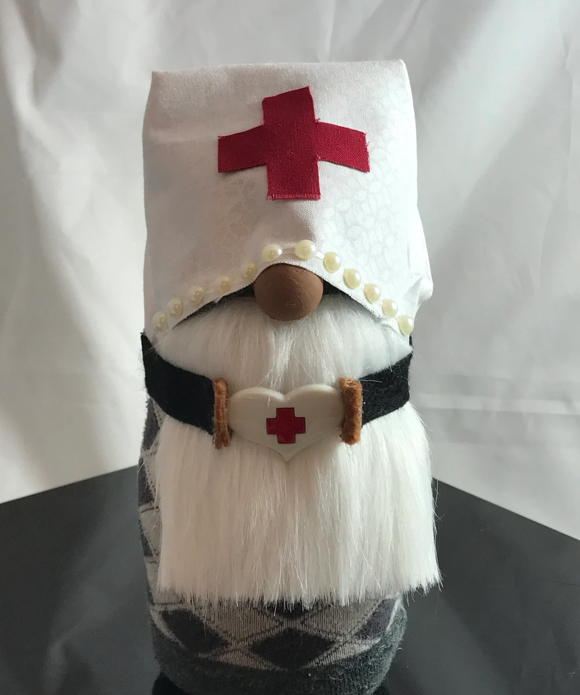
GNOME
GOALS
Set up mutually agreed upon goals:
Broad, aspirational
  Preceptor
  Student
Notes:
https://www.etsy.com/listing/777750452/handmade-african-american-ethnic-nurse?gpla=1&gao=1&&utm_source=google&utm_medium=cpc&utm_campaign=shopping_us_c-home_and_living-home_decor-ornaments_and_accents-other&utm_custom1=_k_EAIaIQobChMI6qrBkNev9wIVbXxvBB29sQIlEAQYByABEgJNuvD_BwE_k_&utm_content=go_1843970815_73688737590_346398228133_pla-371215830637_c__777750452_12768591&utm_custom2=1843970815&gclid=EAIaIQobChMI6qrBkNev9wIVbXxvBB29sQIlEAQYByABEgJNuvD_BwE

Slide 3

GNOME
Needs Assessment
Determine needs or competency gaps:
  What you see, hear
  What the student identifies
  Remember to assess:
    NP educational developmental level, past experiences
Notes:
https://pixabay.com/illustrations/gnome-coronavirus-bart-imp-5019546/

Slide 4
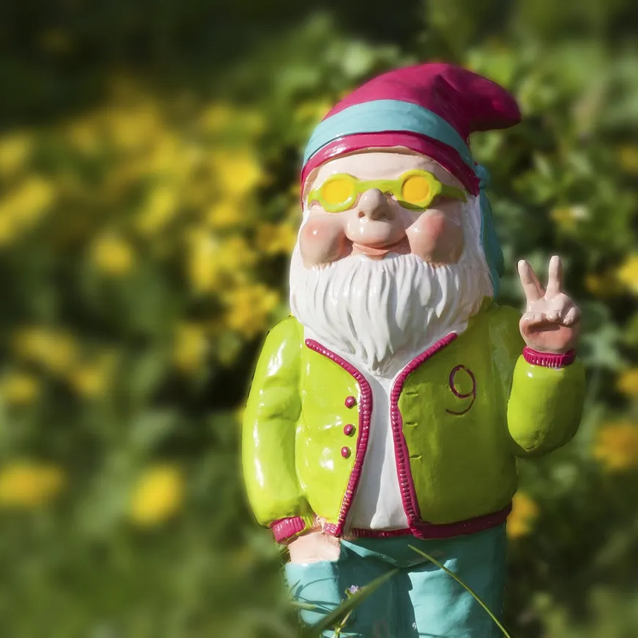
GNOME
Objectives
Student objectives:
  Linked to goals
  Measurable
  Realistic for:
    the setting and population
    Where the student is in their development
Review periodically to determine if need to be revised or updated based on progress
Notes:
https://www.rawpixel.com/image/5944136/free-public-domain-cc0-photo

Slide 5
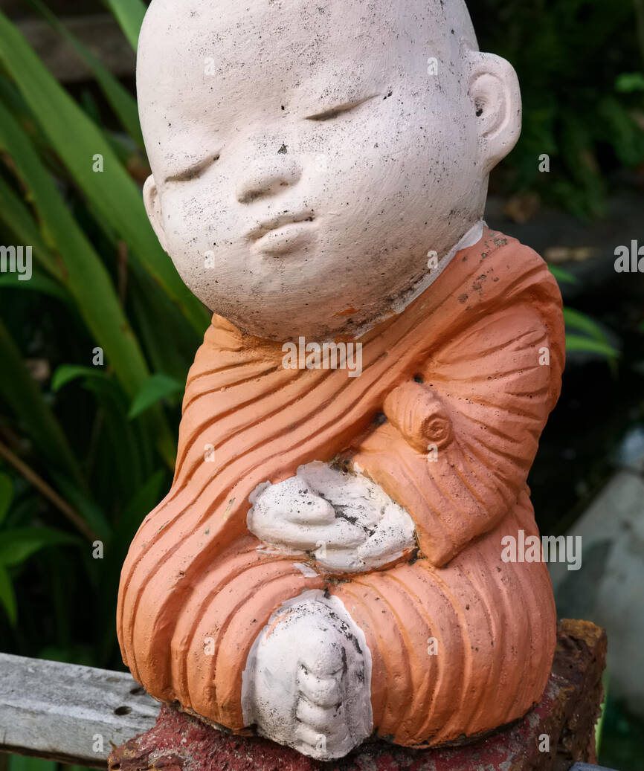
GNOME
Methods
Need to meet the objectives
Observation with progression to more independence
Simple to complex
Quality then quantity
Notes:
https://www.alamy.com/stock-photo/garden-gnome-thailand.html

Slide 6
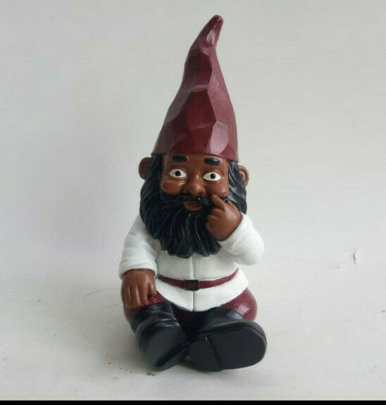
GNOME
Evaluation
Were objectives met
Should be based on developmental level of student
Structured from school
  Mid semester and end of semester
Your practice’s system for evaluation
Obtain feedback from any colleagues who have worked with the student
Notes:
https://www.ebay.com/itm/324448329365?chn=ps&var=513517021542&norover=1&mkevt=1&mkrid=711-117182-37290-0&mkcid=2&itemid=513517021542_324448329365&targetid=1493511200585&device=c&mktype=pla&googleloc=9001840&poi=&campaignid=16178122713&mkgroupid=134484880018&rlsatarget=pla-1493511200585&abcId=9300819&merchantid=6296724&gclid=EAIaIQobChMIuuW32tiv9wIVTxPUAR3nGQoAEAQYAiABEgKTx_D_BwE

