Slide 1

User Training

Slide 2
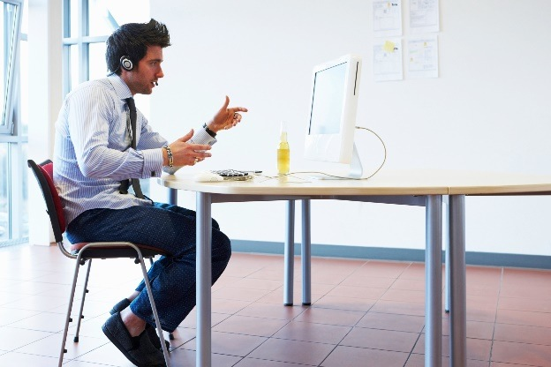


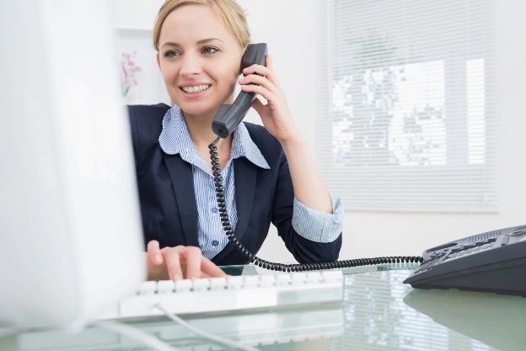
Any device Anywhere
Desktop and Laptop
Tablet and Mobile
Room Systems (Zoom Rooms &
H.323/SIP)
Telephone
(Call-in & Call-out)

Slide 3
Agenda
Introduction
Web Portal
  Login
  Profile Settings
  Meetings Settings
Desktop Client for Meetings
  Meeting Settings
Schedule and Join Meetings
  Desktop Client
  Web Portal
Connecting to a Meeting
In Session Controls
  Host – Camera View
  In Meeting Control Bar
  Participant Control
  Invite and Group Chat
  Share Screen
  Annotate, More and End Meeting
Things to Remember
Helpful Links
Q & A

Slide 4
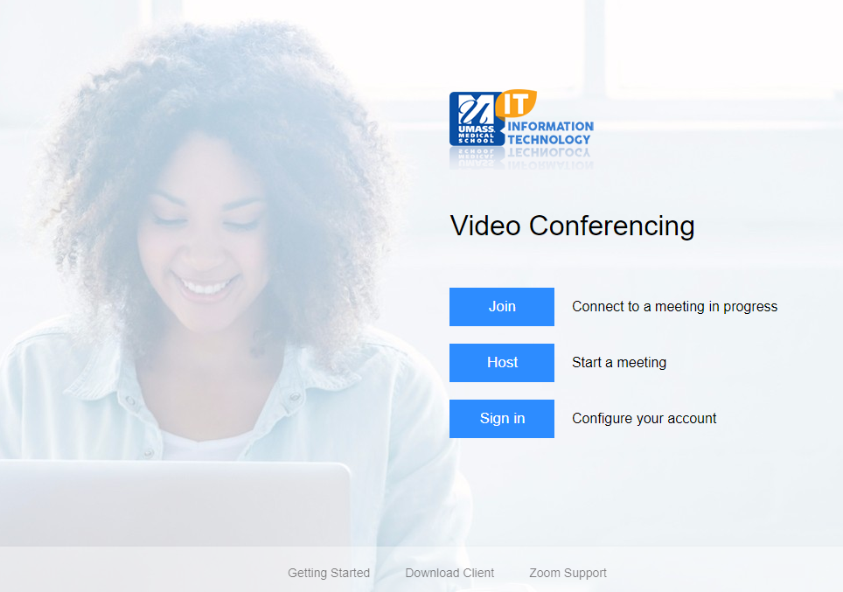
umassmed.zoom.us

Slide 5
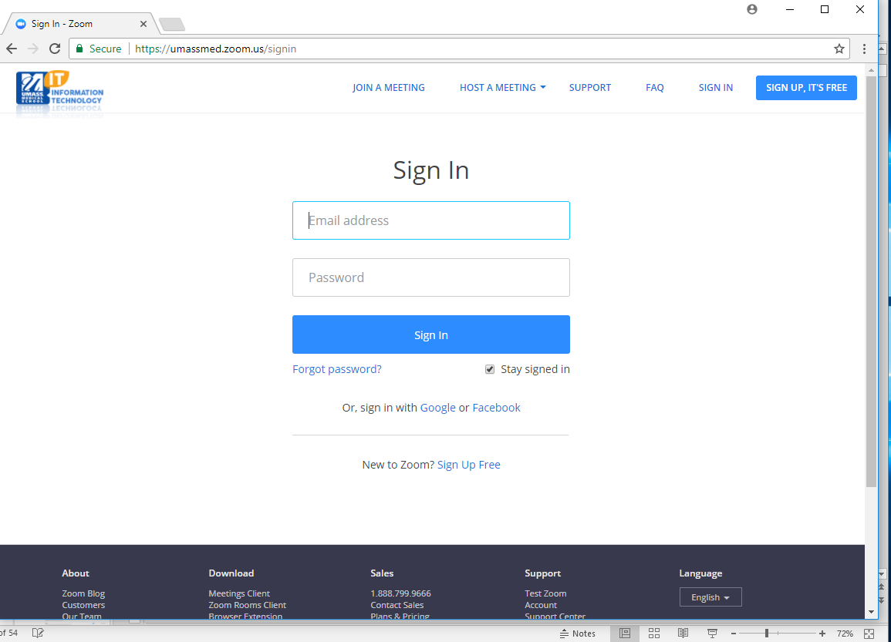
Login

Slide 6
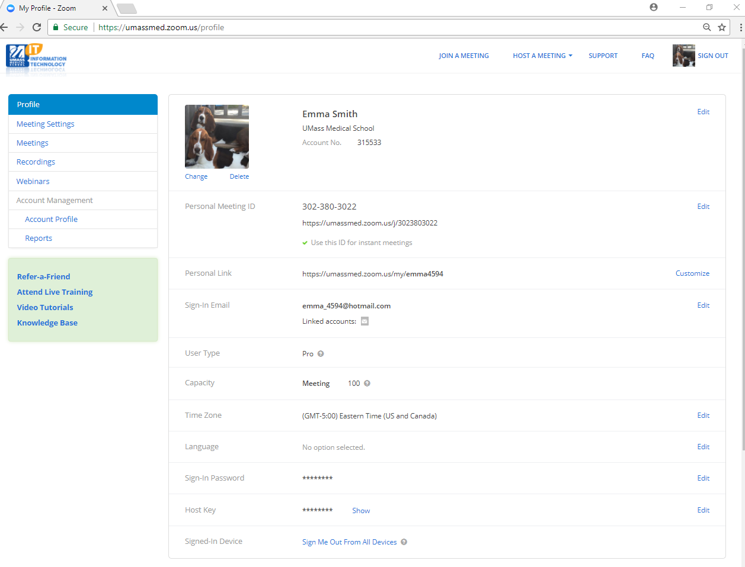
Web Portal Configure Profile
Personal Meeting ID (PMI): Assigned to you
automatically as a permanent virtual room. You can
start it any time or schedule it for future use.
Personal Link: Your Personal Link is your personal URL
that is associated with your Personal Meeting ID.

Slide 7
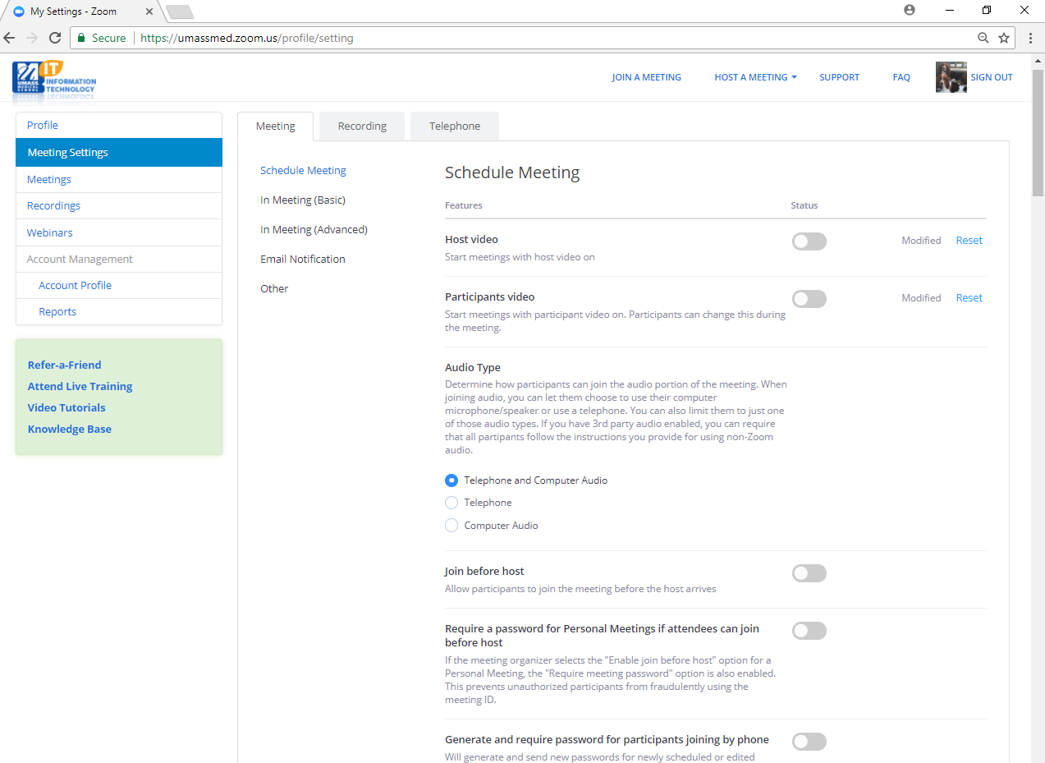
Web Portal Configure Meeting Settings

Slide 8
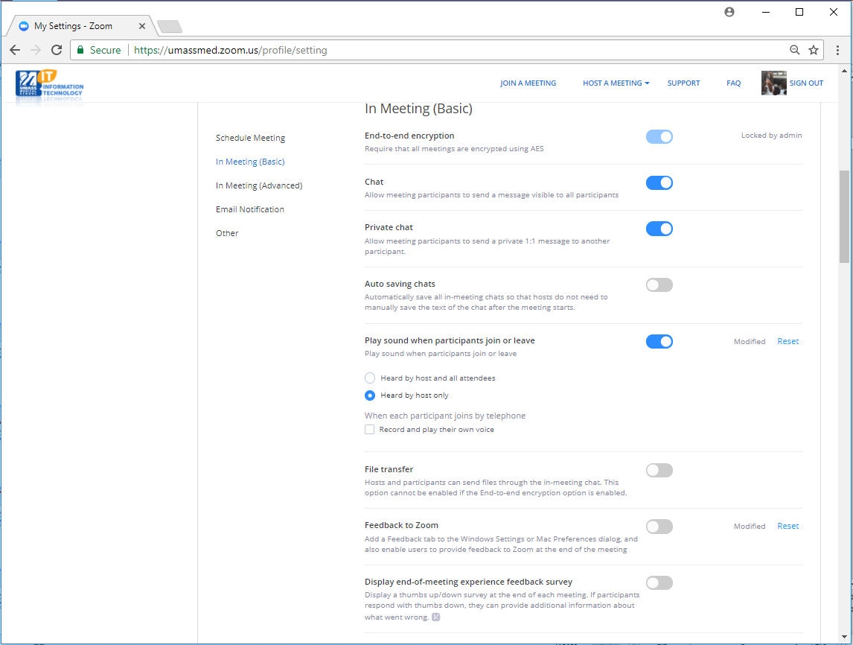
Web Portal Configure Meeting Settings

Slide 9
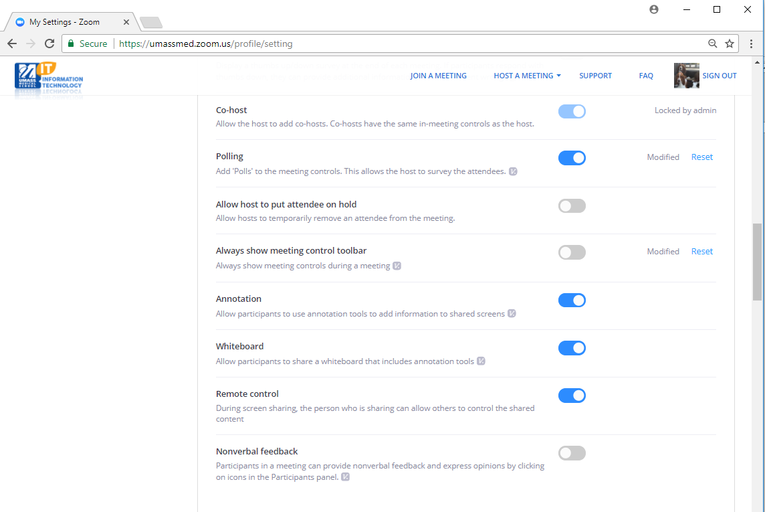
Web Portal Configure Meeting Settings (Continued)

Slide 10
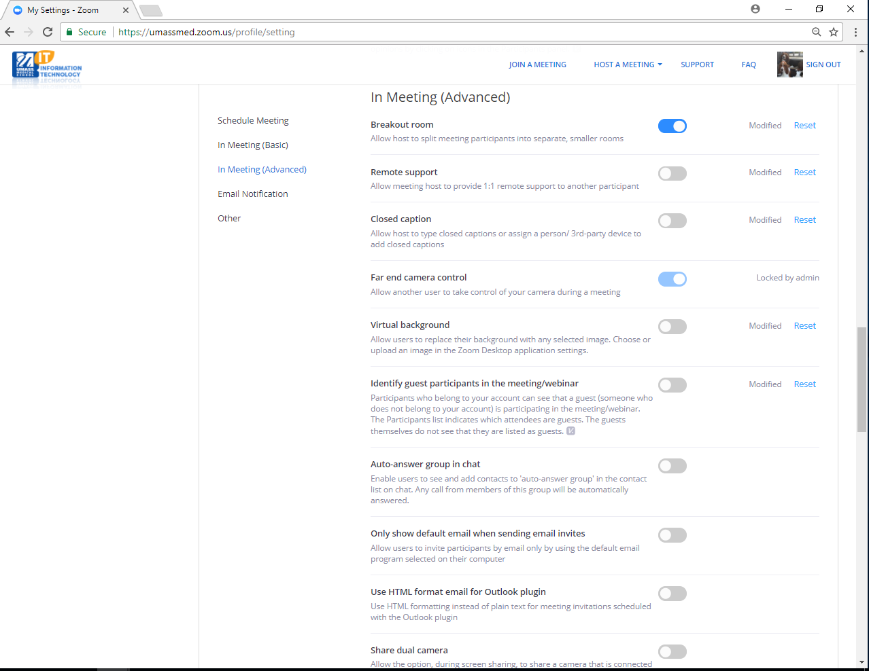
Web Portal Configure Meeting Settings (Continued)

Slide 11
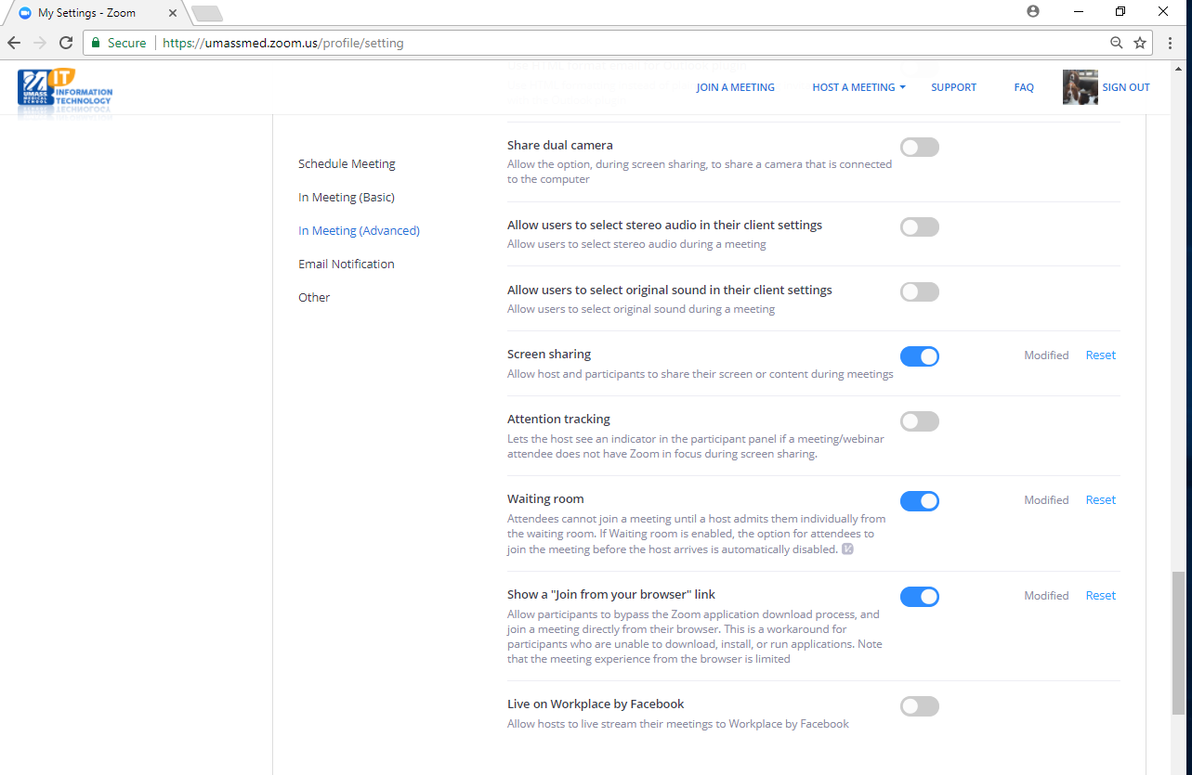
Web Portal Configure Meeting Settings (Continued)

Slide 12
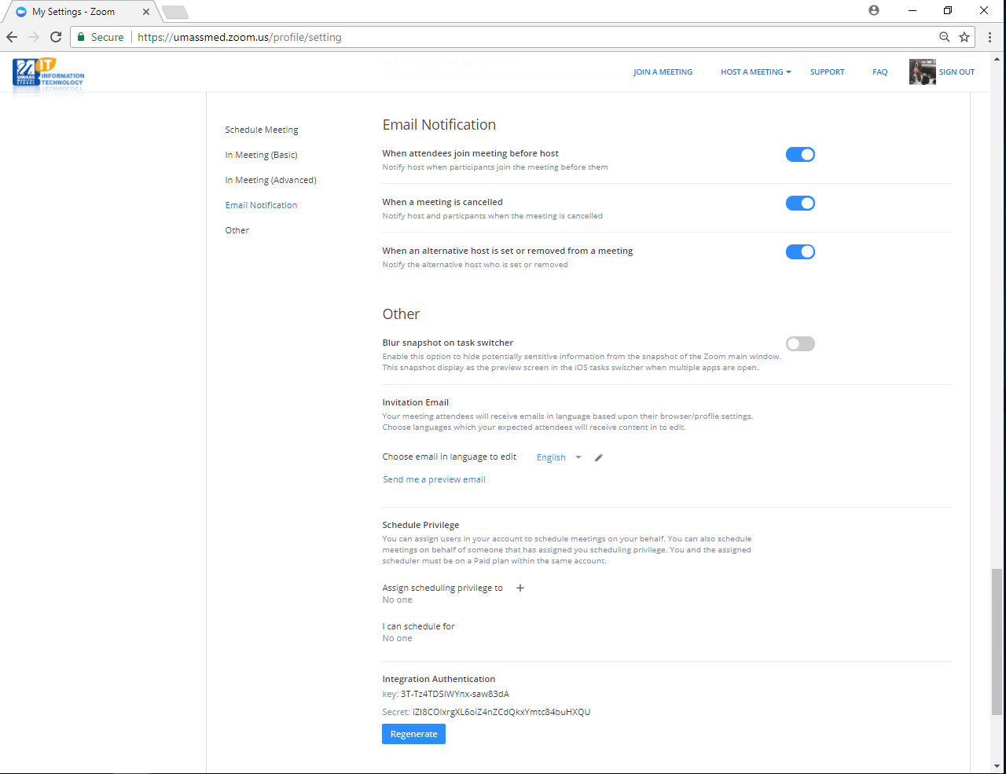
Web Portal Configure Meeting Settings (Continued)

Slide 13
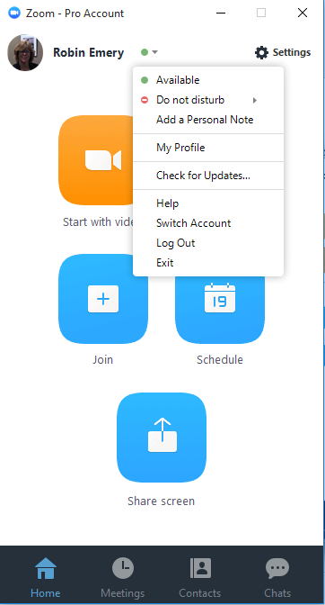
Desktop Client
zoom.us/download
Profile Picture from web portal
Application Settings
Start meetings with or without
video
Join Meetings
Schedule Meetings
Share Screen

Slide 14
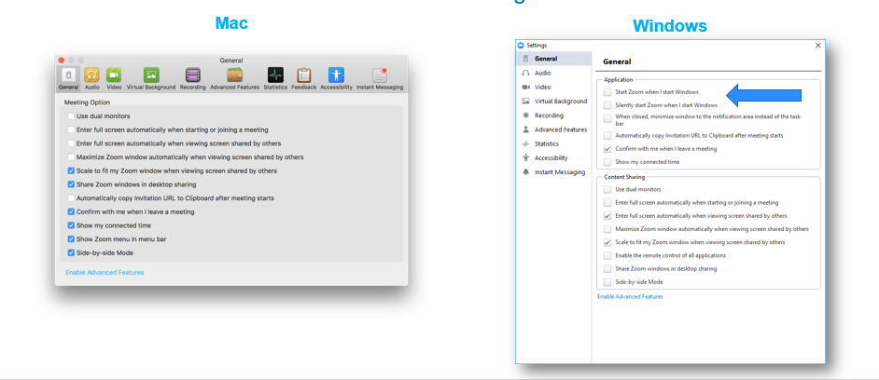
Desktop Client General Settings

Slide 15
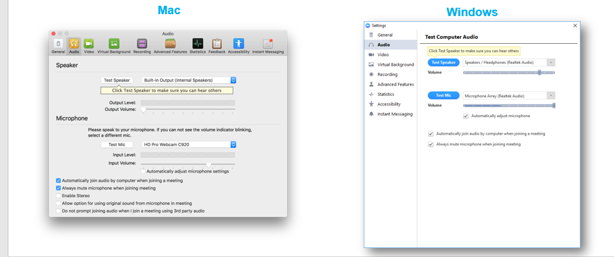
Desktop Client Audio Settings

Slide 16
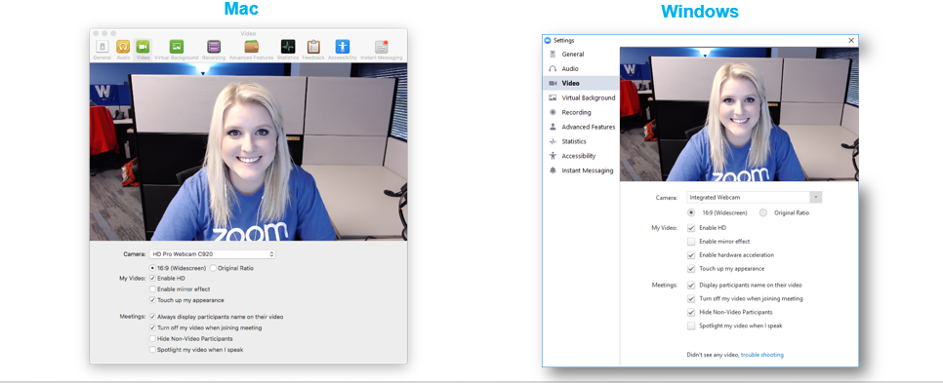
Desktop Client Video Settings

Slide 17
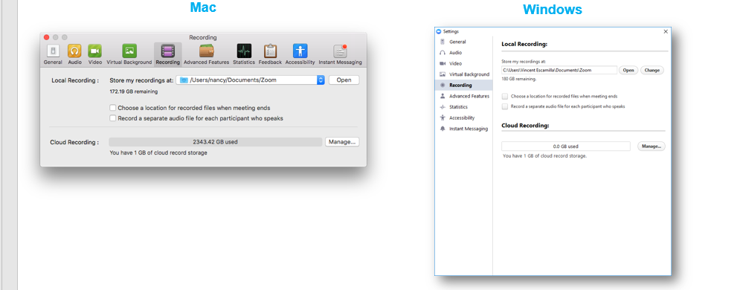
Desktop Client Recording Settings

Slide 18
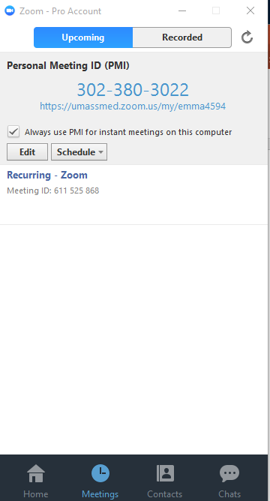
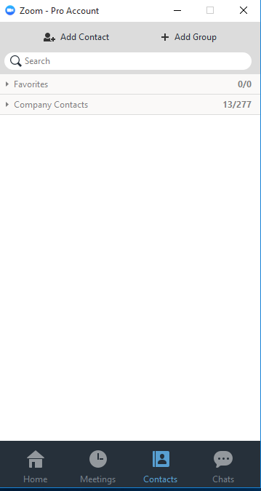
Desktop Client Meetings and Contact

Slide 19
Scheduling with Zoom
Why Schedule a Zoom meeting
Generate unique ID specific to that meeting
Registration option available to control who gets ID
Integrated with calendar for ease of scheduling
Ways to schedule with Zoom
Web portal
Desktop Application
Outlook
Mobile Application

Slide 20
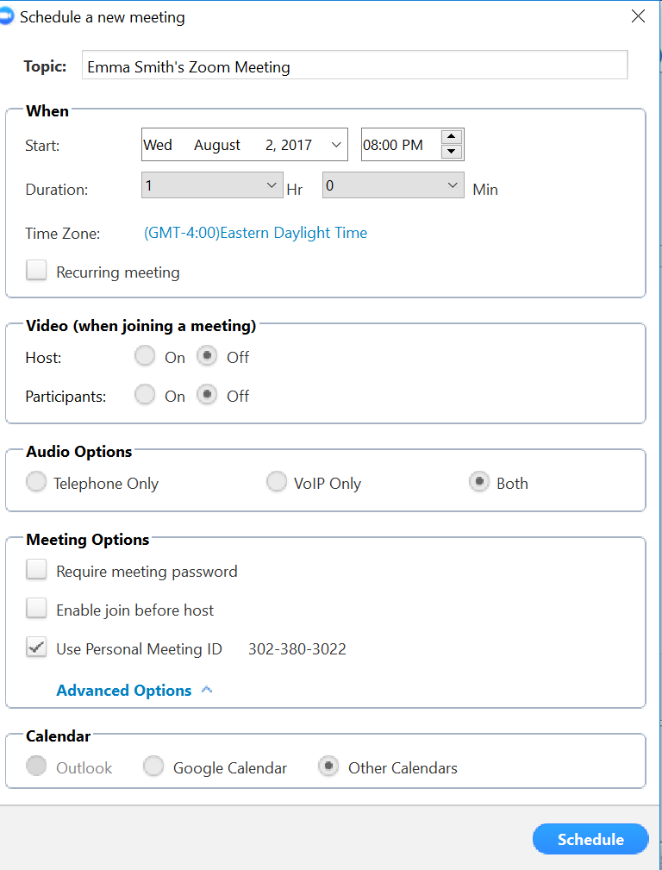
Desktop Client Schedule Meeting preferences

Slide 21
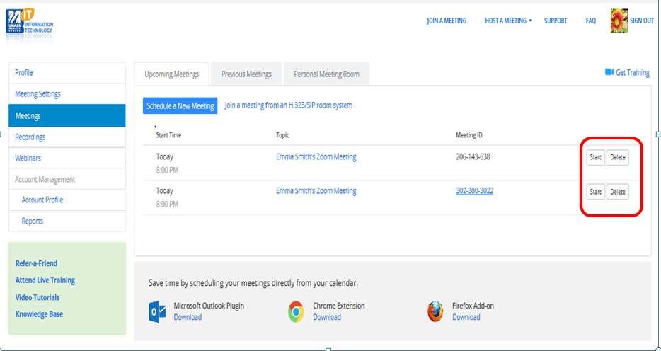
Web Portal Schedule a meeting

Slide 22
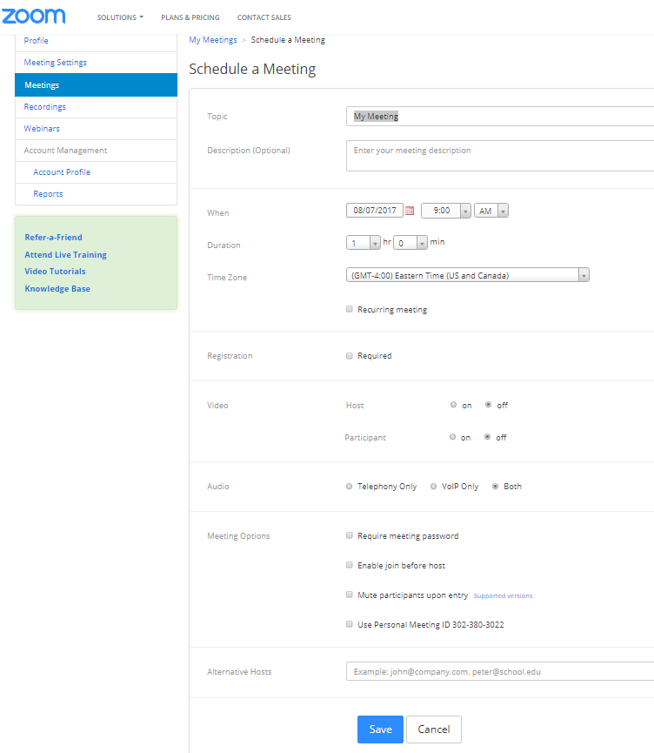
Web Portal Select your preferences

Slide 23
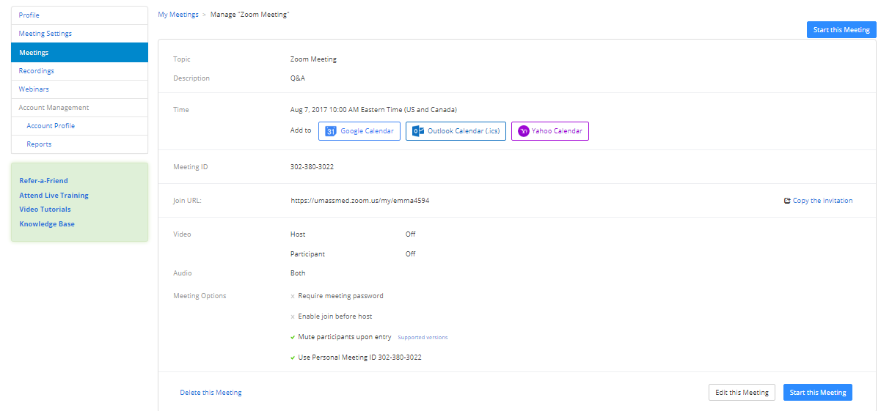
Web Portal Scheduled Meeting

Slide 24
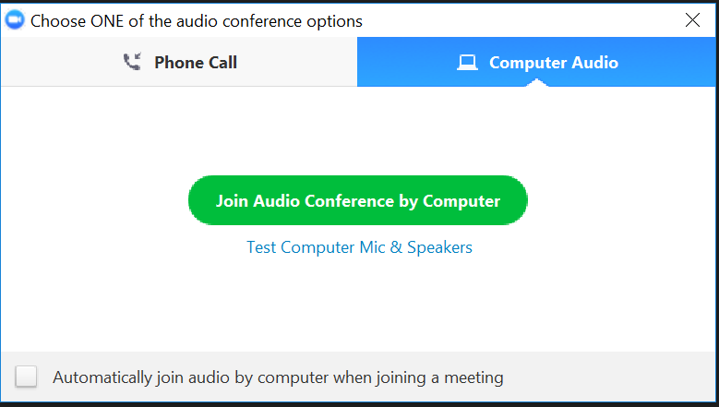
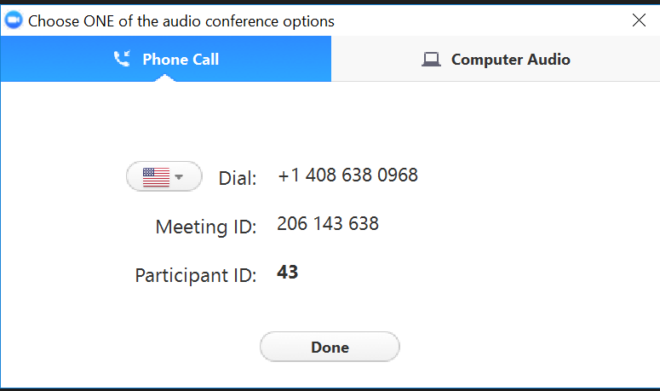
Connecting to a Meeting

Slide 25
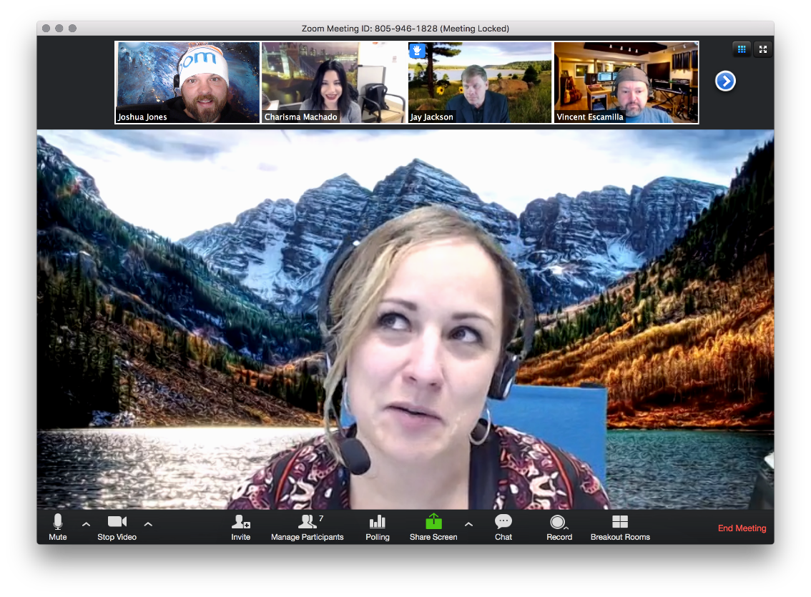
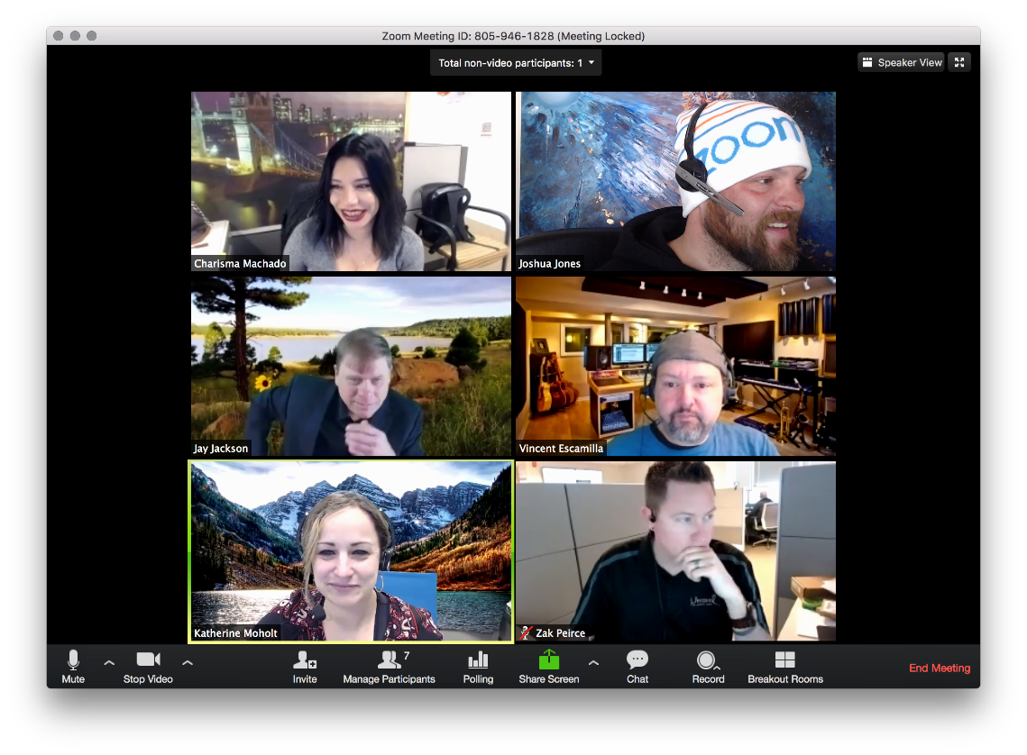
Host Controls Camera View
Active Speaker View
Gallery View

Slide 26
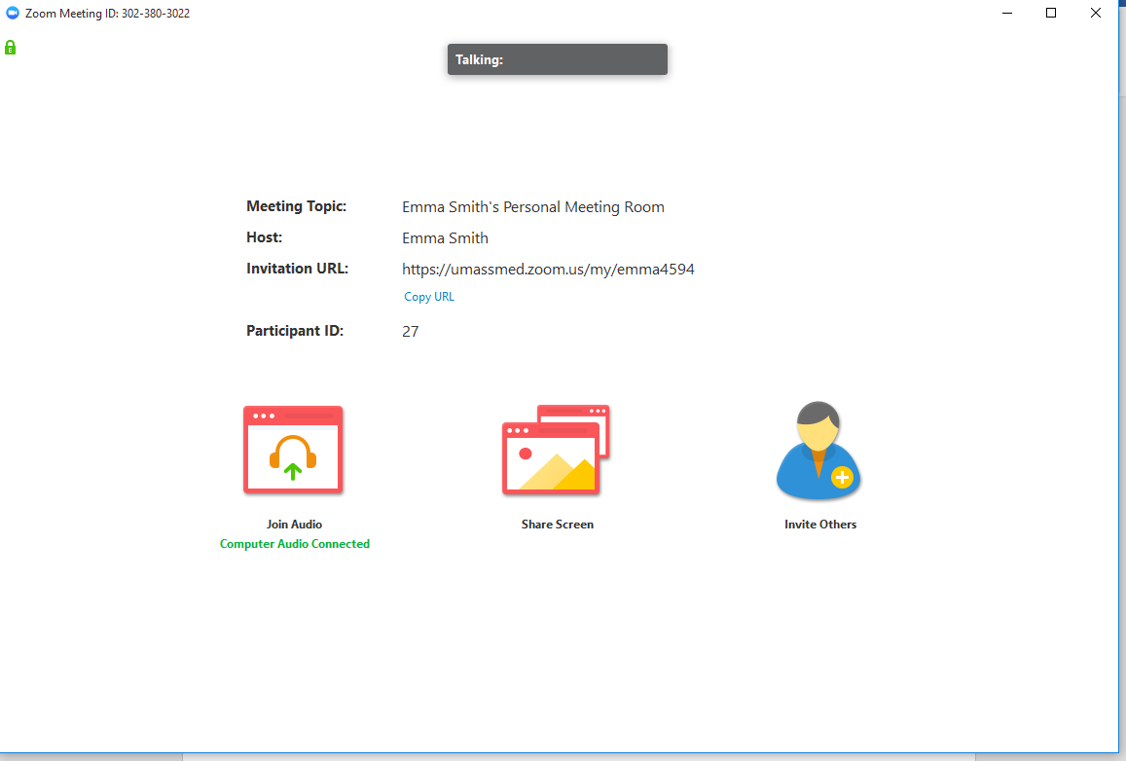
In Meeting Controls Meeting Interface
In Meeting Control Bar

Slide 27
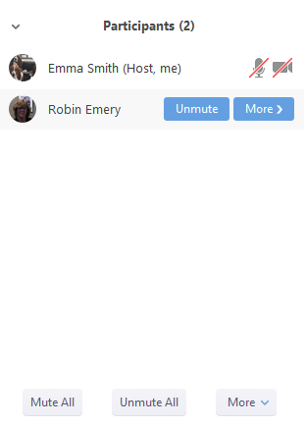
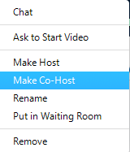
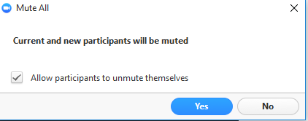

In Meeting Controls Participant Controls

Slide 28
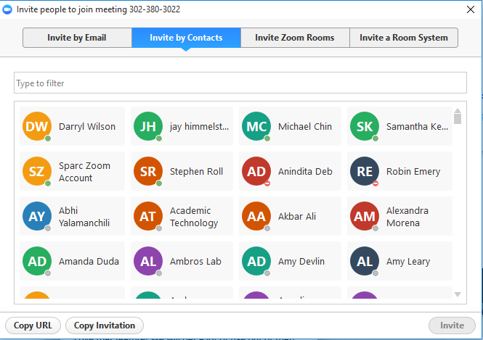
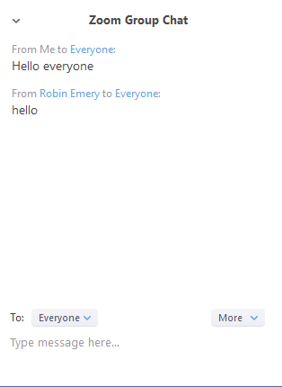


In Meeting Controls Invite and Group Chat

Slide 29

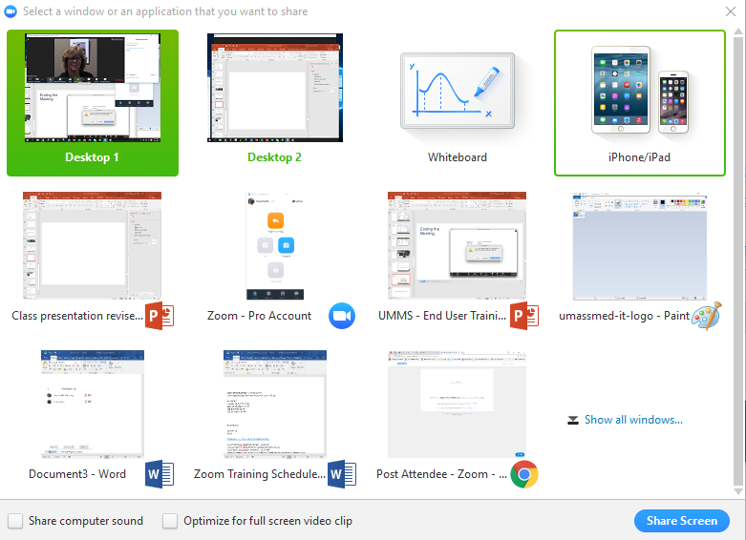
In Meeting Controls Share Screen

Slide 30


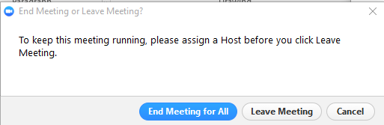
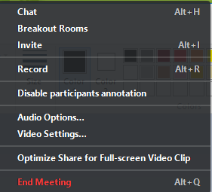
In Meeting Controls Annotate, More, End Meeting

Slide 31
Things to Remember
Before the Meeting:
Test your Audio and Video
Have the content you intend to share prepared ahead of time
Close applications that have pop ups
Hosting a Meeting:
Mute your microphone if others are presenting/speaking
Use Gallery View for group/team meetings
Share your screen
  Share specific applications to control displayed content
  Use “New Share” to seamlessly transition between shared applications
Use the Annotation feature to grab and direct attention
Turn the camera on:
Position your webcam at eye level or higher – experiment for best angles
Use the gestures and mannerisms that you would typically use in person
Make eye contact – try to look at your webcam as often as possible

Slide 32
Helpful Links
UMass Web Portal
umassmed.zoom.us/signin
UMass Information Technology Web site
http://www.umassmed.edu/it/services/Academic-Technology-and-Curriculum-Innovation/zoom/
Zoom download site for client and plugins
umassmed.zoom.us/download
Zoom Tutorial Site
https://support.zoom.us/hc/en-us
Zoom Live online and recorded training Sessions
https://support.zoom.us/hc/en-us/sections/201740096-Training

