Slide 1
Improving Safety After Hospitalization in Older Persons on High-Risk Medications
Clinical Pharmacist Training

Slide 2




The Meyers Primary Care Institute is a joint endeavor of the University of Massachusetts Medical School, Reliant Medical Group, and Fallon Health.
This training module was developed as part of a toolkit for the implementation of a clinical pharmacist home-based intervention that includes the following components:
Home-based assessment of high-risk medications;
Home-based patient medication education;
Primary Care Provider communication;
Follow-up: telephone patient assessment (and additional PCP communication as necessary).
The toolkit was developed as a resource from the Improving Safety After Hospitalization in Older Persons on High-Risk Medications (“ISAH”) Study (R18HS023774) funded by the Agency for Healthcare Research and Quality.

Slide 3
Training Objectives
1. Provide background information.
2. Understand the home visit protocol, including pre-visit, home visit, and post-visit workflow.
3. Provide information on the Primary Care Provider (PCP) communication.
4. Describe the follow-up (patient call and PCP communication).

Slide 4
Training Outline
Session 1: Background (15 Minutes)
Session 2: Preparation for Home Visit (30 Minutes)
Session 3: In-Home Activities (60 Minutes)
Session 4: Post-Visit Documentation (30 Minutes)
Session 5: Home Visit Role Play and Documentation to PCP Exercise (90 Minutes)
Session 6: Follow-up Phone Call Overview and Role Play (30 Minutes)

Slide 5
Session 1:
Background

Slide 6

Background
Nearly one in five older adults newly discharged from the hospital will experience an Adverse Drug Event (ADE)¹
  An ADE is defined as an injury due to a medication
Medication prescribing and monitoring errors are particularly common during this high-risk, post-hospital discharge period¹
Kanaan AO, Donovan JL, Duchin NP, et al. Adverse drug events after hospital discharge in older adults: types, severity, and involvement of Beers criteria medications. J Am Geriatr Soc. 2013 Nov; 61(11):1894-9.

Slide 7
Background
The National Action Plan for ADE Prevention targeted three high-risk drug classes²:
  Anticoagulants
  Anti-Diabetic Agents (insulin and oral agents)
  Opioids
These three medication classes accounted for the greatest number of measurable drug-related harms to patients³⁻⁵
U.S. Department of Health and Human Services, Office of Disease Prevention and Health Promotion. (2014). National action plan for adverse drug event prevention. Washington, DC. http://www.health.gov/hai/pdfs/ADE-Action-Plan-508c.pdf (accessed January 12, 2015).
Budnitz DS, Pollock DA, Weidenbach KN, Mendelsohn AB, Schroeder TJ, Annest JL. National surveillance of emergency department visits for outpatient adverse drug events. JAMA. 2006; 296:1858-66.
Budnitz DS, Lovegrove MD, Shehab N, Richards CL. Emergency hospitalizations for adverse drug events in older Americans. N Engl J Med. 2011; 365:2002-2012.
Budnitz DS, Shehab N, Kegler SR, Richards CL. Medication use leading to emergency department visits for adverse drug events in older adults. Ann Intern Med. 2007; 147:755-765.

Slide 8
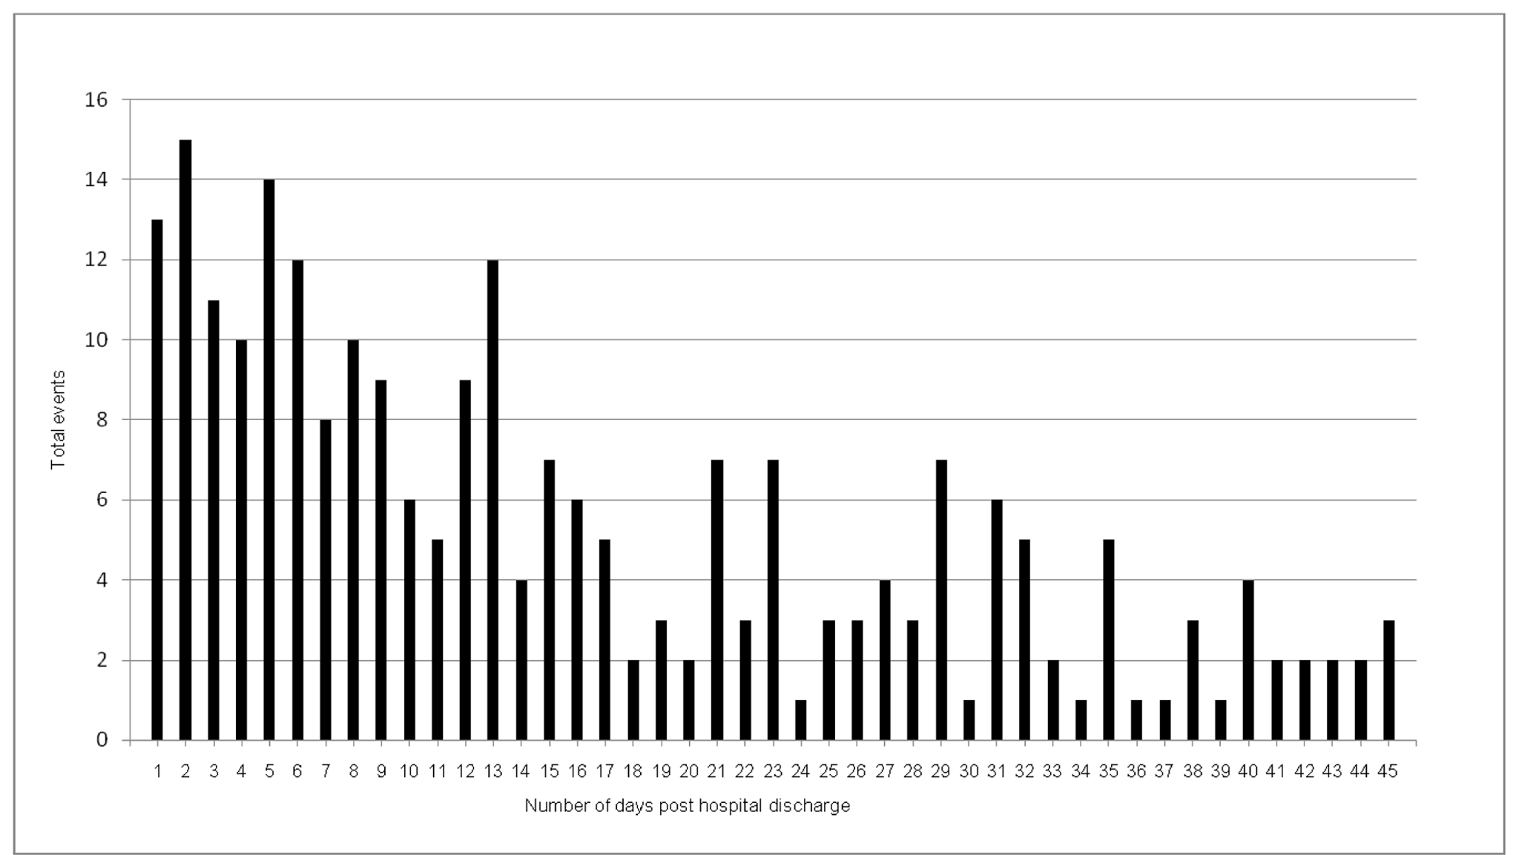
Number of Days Post-Discharge to First ADE¹
Kanaan AO, Donovan JL, Duchin NP, et al. Adverse drug events after hospital discharge in older adults: types, severity, and involvement of Beers criteria medications. J Am Geriatr Soc. 2013 Nov; 61(11):1894-9.
Notes:
Here we present data from a prior study conducted by members of the ISAH study team. We looked at Adverse Drug Events (ADEs) in older patients during the 45-day post-hospital discharge period. On the x-axis you will find the number of days post-hospital discharge when an ADE occurred, and on the y-axis you will find the total number of identified ADEs.
As is clear to see here, we previously found that the majority of ADEs occurred relatively soon after hospital discharge.
Kanaan AO, Donovan JL, Duchin NP, et al. Adverse drug events after hospital discharge in older adults: types, severity, and involvement of Beers criteria medications. J Am Geriatr Soc. 2013 Nov; 61(11):1894-9.

Slide 9
Goals of the Intervention
Identify patients at a higher-risk of experiencing an ADE following hospital discharge
Intervene immediately following hospital discharge
  Within 3-4 days
Provide a home-based intervention to:
  Identify potential medication-related problems
  Educate patients on safe medication use
  Communicate with the patient’s Primary Care Provider team
    Findings from the home visit medication assessment
Improve outcomes!

Slide 10


Accomplishing the Intervention
Engaging with patients after hospital discharge can be challenging
  Difficult to reach patients by telephone
  Patients don’t feel well
Recommend making the intervention a standard of practice scheduled at discharge
    Schedule the home visit as part of the hospital discharge process!
10
Notes:
Attempting to intervene with patients as soon as possible after discharge was a critical component of the ISAH study. However, getting patients to agree to a home visit soon after hospital discharge posed a challenge for a variety of reasons. Some of the most common reasons included an inability to reach the patient by phone, and patients reporting that they did not feel well enough for a visit.
We advise a health system trying to implement the intervention in the post-hospital discharge period to make the intervention part of the routine discharge activities (make scheduling the visit a part of hospital discharge activities if possible).

Slide 11
Questions

Slide 12
Session 2:
Preparation for Home Visit

Slide 13

Prepare Home Visit Kit
A printed copy of the Pre-Visit Checklist, Home Visit Checklist, and Home Visit Worksheet
Two (2) copies of the printed educational leaflets, specific to patient’s high-risk medications
Back-up copies of all printed educational leaflets (2 copies of each)
  2 copies: 1 for the patient, 1 for a caregiver (if applicable)
Pill organizer & pill cutter
Pen, highlighter & hard writing surface/clipboard
Address and directions to the home
Patient/caregiver’s phone number

Slide 14
Pharmacist Preparation: Before the Home Visit
Review patient’s electronic health record (EHR)
  Review discharge summary and hospital medication list
  Review outpatient medication list
Review all medications with particular attention paid to high-risk medications
  Check for discrepancies between medication lists
  Check for clinically significant drug-drug interactions
  Check for high-risk drug combinations
Begin assessment with EHR data utilizing the Home Visit Worksheet

Slide 15

Pharmacist Preparation
Familiarize yourself with health literacy and medication adherence principles

Slide 16

Health Literacy: Non-Verbal & Environment
Establish rapport with the patient/caregiver
Sit down; make eye contact with the patient/caregiver
Make it comfortable for patients/caregivers to voice questions, doubts and concerns
Be conscious of any hearing impairment
  If the patient cannot hear well:
    Inquire about a preferred side to sit on
    Inquire about the need to put hearing aids in
    Minimize background noise, if possible

Slide 17
Health Literacy: Verbal Communication
Speak clearly and slowly
Use plain language
Explain any medical terms that the patient should know
Break your information into chunks
  Start each “chunk” with an orienting sentence
    For example: “Now let’s talk about what might be causing this. It could be due to your blood pressure medication.”
Be explicit about what is important and why

Slide 18

Health Literacy: Written Communication
Put the most important points in writing
Add to or highlight the written educational leaflets
  Highlights what is most important
  Serves as a memory aid
  Facilitates communication with family and caregivers who help the patient manage his/her health

Slide 19
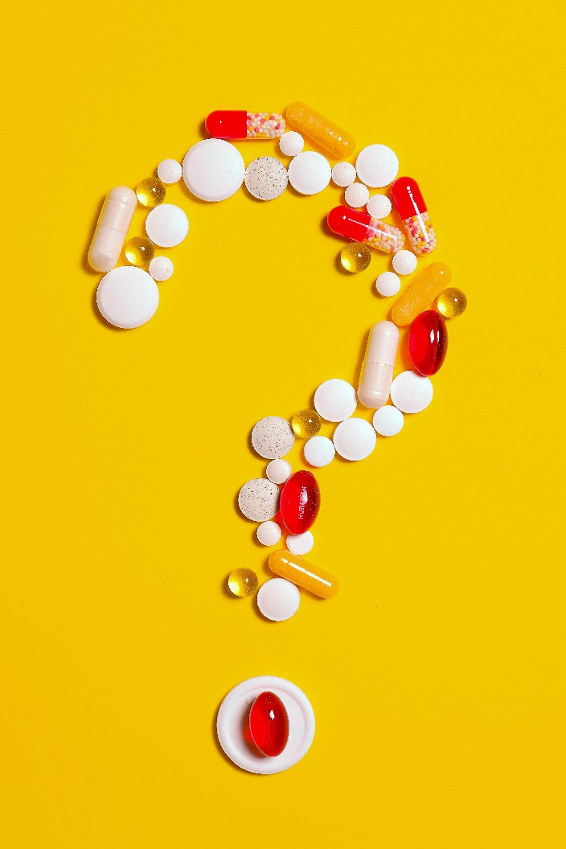
Health Literacy: Assessing Comprehension
Check for understanding using the “teach back” method
  Have patients repeat back information in their own words
Ask open-ended questions
Ask “What questions do you have?”
  Avoid using the phrase “Any questions?”

Slide 20
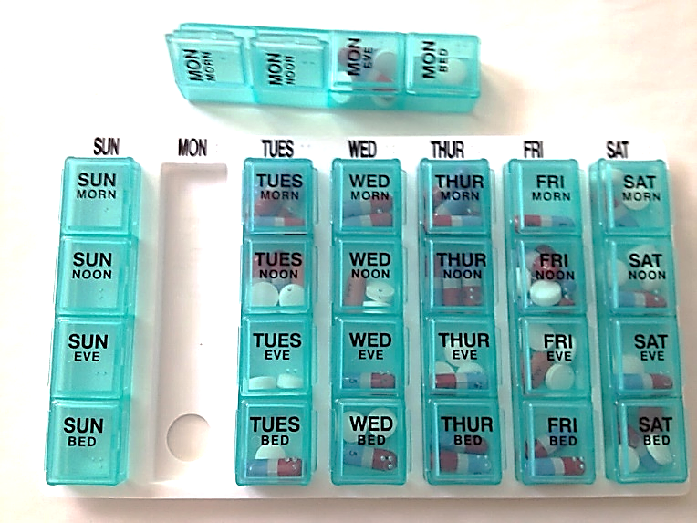
Medication Adherence
Factors that contribute to non-adherence⁶
Healthcare system related:
  Patient-provider relationship
Condition related:
  Lack of symptoms
Therapy related:
  Complexity
  Adverse side effects
Social & Economic related:
  Cost
  Low health literacy
  Limited support; elder abuse
⁶ http://www.champ-program.org/static/ImprovingMedAdherenceOlderAdultslyer_final_508C.pdf
Notes:
There are many reasons for medication adherence difficulties. A few include: (1) Healthcare system related barriers (e.g., patient-provider relationship); (2) Condition related barriers (e.g., lack of symptoms); (3) Therapy related barriers (e.g., complexity, adverse side effects); and (4) Social and economic related barriers (e.g., cost, low health literacy, limited support/elder abuse).
Social/economic barriers are likely the most modifiable with appropriate support services.

Slide 21
Medication Adherence: Assessing Barriers
If the patient is not taking a medication, politely try to find out what the barriers are.
Is it…
  a side effect?
  the cost of the prescription?
  an inability to see units on a syringe?
  a transportation (to the pharmacy) issue?

Slide 22
Medication Adherence: Assessing Barriers
Opioid Use in Older Adults:
Older adults may underreport pain
It is important to inform them of the difference between dependence, tolerance, and addiction
  Educate them on safe use, including storage and disposal
    Utilize appropriate opioid educational leaflet
  Discuss the importance of constipation management
  Is there an alternative therapy that is likely to have an equivalent or better therapeutic index for pain control in this patient?
  Does the patient have medical problems that might increase risk of opioid –related side effects?
  Is the patient (or caregiver) likely to manage the opioid therapy responsibly?
Notes:
Resources:
Prevention, Diagnosis, and Management of Opioids, Opioid Misuse and Opioid Use Disorder in Older Adults. https://effectivehealthcare.ahrq.gov/products/opioids-older-adults/protocol (accessed February 28, 2020)

Slide 23
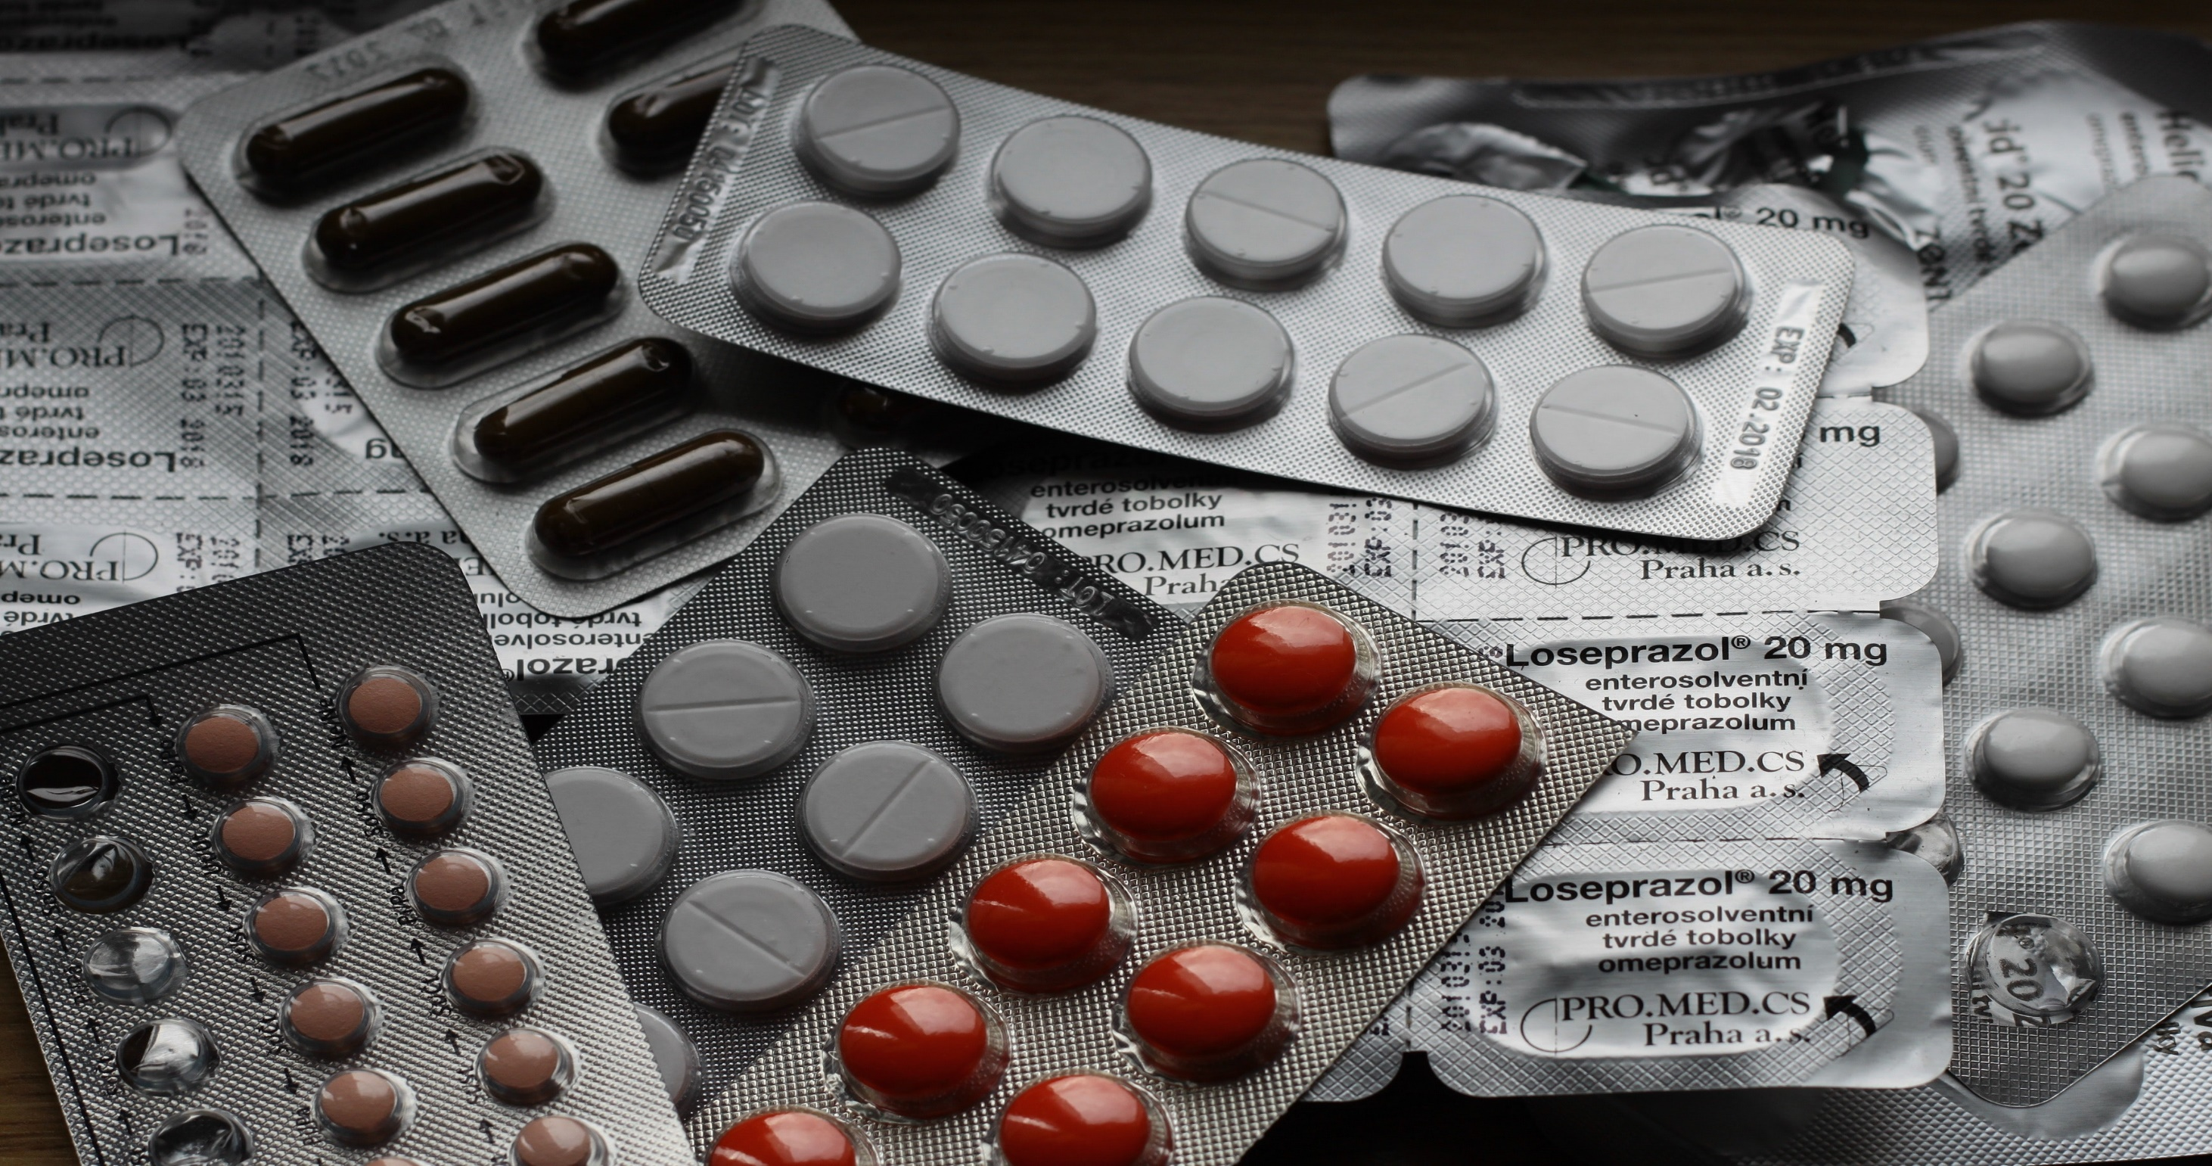
Medication Adherence: Finding Solutions
Attempt to find a solution to barriers:
  Inform their PCP that the patient could benefit from a social work or care coordinator consultation due to socioeconomic issues, if applicable
  Is there a once-a-day formulation of the medication?
  Is there a pharmacy that delivers?
  Is there a pharmacy that pre-packages medications?

Slide 24
Questions

Slide 25
Session 3:
In-Home Activities

Slide 26
In-Home Protocols: Overview
Identify/confirm who you’ll be communicating with
  Patient, caregiver, or other person
Identify medication discrepancies
Identify clinically significant interactions
  Drug interactions that require a dosage adjustment or consist of a drug combination that is contraindicated due to its high potential for clinical adverse effects
Identify high-risk medication combinations
Conduct visit with health literacy principles in mind

Slide 27
In-Home Protocols: Overview (Cont.)
Focus on high-risk medications first
Ask patient to identify each medication
Query patient’s understanding of each medication
Ask about any potential side effects
Assess barriers to medication adherence

Slide 28
In-Home Protocols: Overview (Cont.)
Observe medication
  Organization
  Administration
    Discuss timing and missed doses
  Storage
  Disposal (when applicable)

Slide 29
In-Home Protocols: Overview (Cont.)
Review relevant educational leaflets
Provide individualized recommendations
Describe the follow-up plan
Ask what questions or concerns they have
Complete documentation

Slide 30
Home Visit Flow Diagram
1. Identify if communications will be with the patient and/or his/her proxy or caregiver (Section 3.3)
3. Identify clinically significant interactions and high-risk combinations
(Section 3.5)
For each high-risk medication:
4. Reconcile (Section 3.6)
5. Query patient understanding (Section 3.7)
6. Observe medication organization, storage, and disposal (Section 3.8)
7. Observe medication administration (Section 3.9)
8. Query patient on timing and missed doses of medication (Section 3.10)
2. Collect medications, most recent discharge summary, and assess medication organization and storage (e.g., pill box, pill organizer)
(Section 3.4)
9. Select appropriate education leaflet(s); review and discuss with patient
(Section 3.11)
10. Reconcile other medications.
Once the process is complete for each high-risk medication, reconcile other prescription medications and OTC medications
Educate on non high-risk medication only if a clinically significant interaction or high-risk combination has been identified
11. Provide recommendations (Section 3.12)
Review pill organizer and/or present pill organizer to patient and instruct on use
12. Describe follow-up plan
(Section 3.13)
Inform patient that PCP will receive documentation of visit with clinically appropriate information
Discuss with patient the approximate time frame for follow-up call
13. Query patient on final questions or concerns
(Section 3.14)
“What questions do you have for me at this time?”
“What concerns can I address or clarify?”
14. Complete home visit checklist
(Section 3.15)
Address any steps that were missed
Sections referenced on this slide can be found in the Pharmacist Reference Manual

Slide 31
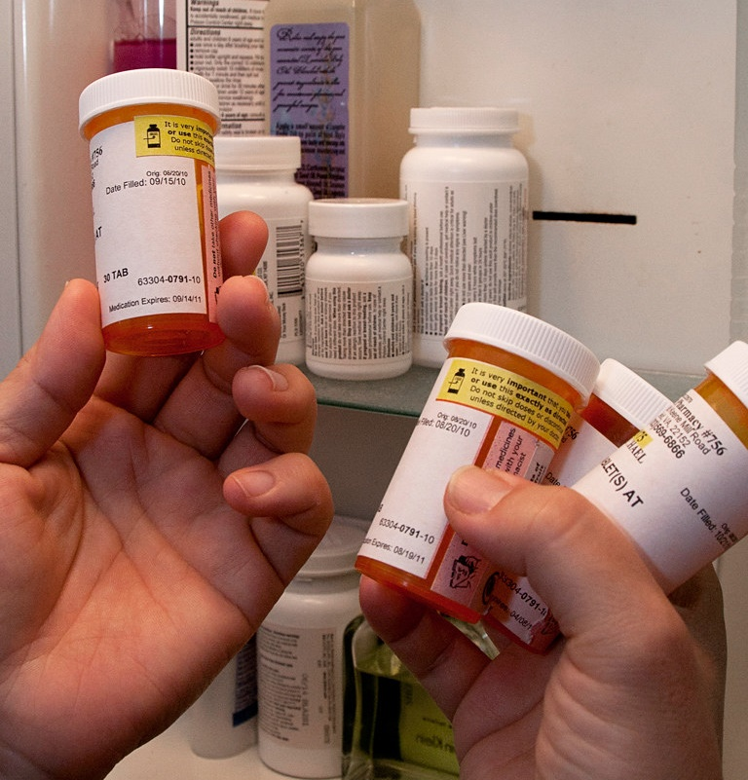
Home Visit Introduction
Introduce yourself to the patient/ caregiver
Ask patient to produce the following:
  All medications (bottles)
    Including OTCs, herbals and supplements
  Most recent hospital discharge summary
    Patient may not have this, be prepared
  Pill organizer
    Or whatever they use for medication storage

Slide 32
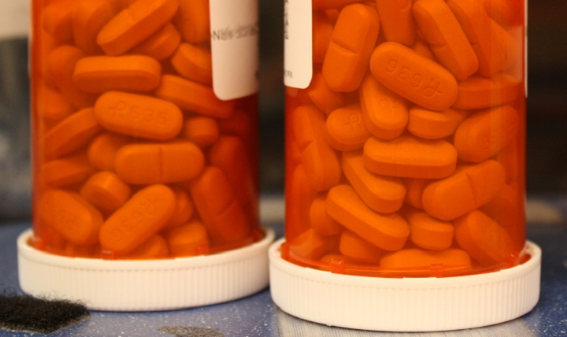
Medication Reconciliation
Begin medication reconciliation using discharge summary/hospital medication list, outpatient medication list, and what patient is actually taking:
  Focus on high-risk medications first
  Record discrepancies on the Home Visit Worksheet
  Once a medication has been reconciled, turn the prescription bottle on its cap to keep organized

Slide 33

Medication Education
Query patient/caregiver’s understanding (and provide education) on the following:
  Dietary restrictions
  Side effects
  Administration & timing
    Missed doses
  Organization, storage and disposal
    Refills
    Review pill organizer with patient
    if patient/proxy desires

Slide 34
Patient-Specific Recommendations
Utilize educational leaflets for high-risk medications
  Utilize Pharmacist Notes section to customize for the patient
Describe the follow-up plan to the patient:
  Inform the patient that their PCP will receive documentation of the home visit with clinically appropriate information
  Discuss with patient approximate time frame of follow-up call
    Within 14 days
    Consider scheduling before leaving the home visit

Slide 35
Wrapping Up
Address any patient concerns or questions
  “What concerns can I address or clarify?”
  “What questions do you have for me at this time?”
Complete Home Visit Checklist
  Address any steps which were missed before ending visit

Slide 36

Alternate Telephone Intervention
Confirm with whom the telephone visit will be conducted
Confirm patient’s date of birth
Ask patient/caregiver to gather all prescription bottles including over-the-counter medications, as-needed medications, and herbal and other supplements
Ask patient/caregiver to retrieve their most recent discharge summary
  Pharmacist to have discharge summary open in EHR

Slide 37
Alternate Telephone Intervention (Cont.)
For each high-risk medication:
Reconcile medication with discharge and outpatient medication lists, and document any issues on the Home Visit Worksheet
Query patient’s understanding
Provide education and recommendations

Slide 38
Alternate Telephone Intervention (Cont.)
For each non-high-risk medication, supplement, or over-the counter-medication, reconcile and document any issues:
Provide education and recommendations only if a high-risk combination or clinically significant interaction is identified
Education and recommendations take place at the end of call
Describe the follow-up plan and inform the patient/caregiver that their PCP will receive documentation of the phone call with clinically appropriate information
Query the patient on any final questions or concerns

Slide 39
Questions

Slide 40
Session 4:
Post-Visit Documentation

Slide 41
Post-Visit Documentation
Complete the Post-Visit Checklist
Document home-visit in EHR
  Via an encounter
  Within 24 hours of the home-visit
Shred or securely file paper documentation once home-visit EHR documentation is complete

Slide 42
Post-Visit PCP Communication
Complete within 24 hours of home visit
  Sooner if possible
Document in the Electronic Health Record (EHR)
  Inform PCP of concerns relevant to the use of high-risk medications, as well as other urgent medication safety concerns
  Make concise recommendations/observations
    3-5 “bullet points”

Slide 43
Communication to
PCP Template
Open EHR Communication Template For Review

Slide 44
EHR Communication Template
Title: High-Risk Medication Assessment
[Home Visit Summary] [Patient’s high-risk medications listed here]
High-Risk Medication Recommendations for PCP:
Other Medication Observations/Plans:
Medication Discrepancies:
Clinically Significant Interactions/High-Risk Medication Combinations:
Complaints and Potential Side-Effects:
Notes:
Presented here is the template used for Communication to the Primary Care Provider team via the Electronic Health Record following the home visit assessment.

Slide 45
EHR Communication Template (Cont.)
Medication Management
  Identification:
  Organization:
  Administration and Timing:
  Storage:
  Understanding:

Slide 46
EHR Communication SMARText
Medication Discrepancies:
  1. No concerns were identified.
  2. Patient is taking additional medication(s) not included on discharge list, but included on outpatient list.
  3. Patient is taking additional medication(s) not included on outpatient list, but included on discharge list.
  4. Patient is taking additional medication(s) not included on discharge list or outpatient lists.
  5. Patient is not taking medication(s) included on discharge list.
  6. Patient is not taking medication(s) included on outpatient list and should not be discontinued.
  7. Patient is not taking medication(s) in one of the high-risk medication categories.
  8. Patient is taking the wrong medication(s) [drug, dose and/or frequency] in one of the high-risk medication categories.
[add details as appropriate]
Notes:
The following SMARText options were programmed into the Electronic Health Record system to make communication more efficient.

Slide 47
EHR Communication SMARText (Cont.)
Clinically Significant Interactions/High-Risk Medication Combinations:
  1. No clinically significant interactions or high-risk medication combinations were identified.
  2. Clinically significant interactions and/or high-risk medication combinations were identified and addressed with the patient/caregiver. [add details]
  3. Clinically significant interactions and/or high-risk medication combinations were identified and will be conveyed to the PCP. [add details]
Complaints and Potential Side-Effects:
  1. No complaints or side effects were reported by patient/caregiver.
  2. Complaints and/or side effects identified; pharmacist addressed with the patient/caregiver. [add details]
  3. Complaints and/or side effects identified and will be conveyed to the PCP. [add details]

Slide 48
EHR Communication SMARText (Cont.)
Medication Management
  Identification:
    1. The patient/caregiver can identify all medications correctly.
    2. The patient/caregiver cannot identify all medications correctly. [add details]
  Organization:
    1. The patient/caregiver organizes medications appropriately.
    2. The patient/caregiver does not organize medications appropriately. [add details]
  Administration and Timing:
    1. The patient/caregiver administers medication correctly.
    2. The patient/caregiver administers medication incorrectly. [add details]
  Storage:
    1. The patient/caregiver stores medication correctly.
    2. The patient/caregiver stores medication incorrectly. [add details]
  Understanding:
    1. The patient/caregiver has adequate understanding of the indications for medications.
    2. The patient/caregiver has inadequate understanding of the indications for medications. [add details]

Slide 49
EHR Instructions
Progress Notes
  Enter pharmacist name as “Provider”
  Utilize EHR Communication Template & SMARText
Routing
  Route EHR note to PCP with normal priority
    If communication is high priority, place a call to the PCP’s office with issues/concerns
Send note to PCP

Slide 50
Questions

Slide 51
Session 5:
Home Visit Role Play and Documentation to PCP Exercise

Slide 52
Home Visit Role Play
Role play the home visit workflow/wording

Slide 53
PCP Communication Exercise
Case 1: Anticoagulant/Opioid (Ms. Brown)
Case 2: Medications for Diabetes (Mr. Jones)

Slide 54
Case 1: Anticoagulant/Opioid
Ms. Brown is an 83-year-old female discharged yesterday from the hospital for a DVT and is receiving anticoagulant therapy with warfarin. She is also being treated with trimethoprim/sulfamethoxazole (Bactrim) for a symptomatic UTI which was found during hospitalization. Ms. Brown was discharged home where she lives alone. It is now 3 days post-discharge and she has not seen nor spoken with her PCP since returning home. She is not aware of when her INR should be checked next.
EXPAND DETAILS OF CASE AS DESIRED

Slide 55
Case 1: Model EHR Communication to PCP
Title: High-Risk Medication Assessment
A home visit was performed on 7/6/2016 with Ms. Brown by [Pharmacist Name, Credentials]. Discharge from the hospital took place on 7/2/2016. Ms. Brown was prescribed the following high-risk medications: warfarin, oxycodone-acetaminophen.
High-Risk Medication Recommendations for PCP:
  Monitor INR closely due to concurrent Bactrim therapy.
Other Medication Observations/Plans:
  I observed the patient’s medication organization and found that she mixes her pills together in single bottle. Pill organizer provided and instructed in use.
  Follow-up – I plan to call patient in 3 days to ensure INR monitoring has occurred.
Medication Discrepancies:
  Patient is taking additional medication(s) not included on discharge list, but included on outpatient list.
  Patient is taking both lisinopril and valsartan. Discharge medication list indicated lisinopril only. Review concurrent administration of both an ACE inhibitor and an ARB since both is not recommended due to increased risk of renal dysfunction.

Slide 56
Case 1: Model EHR Communication to PCP (Cont.)
Clinically Significant Interactions/High-Risk Medication Combinations:
  Bactrim-warfarin: Monitor INR closely since Bactrim can increase risk of bleeding with warfarin.
  Aspirin-warfarin: Monitor for bleeding complications.
  Lisinopril-Valsartan: Increased risk of renal dysfunction (see medication discrepancies above).
Complaints and Potential Side-Effects:
  Complaints and/or side effects were identified and will be conveyed to the PCP.
  Metformin: Diarrhea

Slide 57
Case 1: Model EHR Communication to PCP (Cont.)
Medication Management
  Identification:
  The patient/caregiver can identify all medications correctly.
  Organization:
  The patient/caregiver does not organize medications appropriately.
  Patient mixes her pills together in single bottle; inappropriate organization. Pill organizer provided and instructed in use.
  Administration and Timing:
  The patient/caregiver administers medication correctly.
  Storage:
  The patient/caregiver stores medication correctly.
  Understanding:
  The patient/caregiver has adequate understanding of the indications for medications.
  Patient shows good level of understanding the purpose of the medications and how to take them. Provided warfarin and oxycodone-acetaminophen educational leaflets.

Slide 58
Case 1: Recommendations to the Patient
Pharmacist Recommendations to the Patient During Home Visit
  Informed patient to avoid OTC pain relievers like ibuprofen since they interacts with warfarin.
  Educated patient that oxycodone-acetaminophen contains acetaminophen (Tylenol) and thus to ensure she is not taking too much acetaminophen since she also has acetaminophen as needed. Counsel patient on maximum amount of acetaminophen use per day and include on Pharmacist Notes section on educational leaflet for Percocet.

Slide 59
Case 2: Medications for Diabetes
Mr. Jones was hospitalized for hypoglycemia resulting in a fall. He is a 74 year old diabetic with a history of congestive heart failure (CHF), chronic back pain, and falls. He lives at home with his daughter’s family. Mr. Jones’ daughter is his caregiver. His bedroom is on the second floor. He was discharged from the hospital yesterday.
EXPAND DETAILS OF CASE AS DESIRED

Slide 60
Case 2: Model EHR Communication to PCP
Title: High-Risk Medication Assessment
A home visit, which focused on high-risk medications, was performed on 7/10/2016 with Mr. Jones by [Pharmacist Name, Credentials]. Discharge from the hospital took place on 7/9/2016. Mr. Jones was prescribed the following high-risk medications: metformin, insulin aspart, and insulin glargine.
High-Risk Medication Recommendations for PCP:
  Review rapid acting insulin regimen with patient since he is non adherent due number of daily injections and difficulty seeing units on syringe (see medication discrepancy and complaints below). Encouraged patient to follow discharge instructions on insulin aspart to minimize hypoglycemia.
  Evaluate appropriate metformin dose with patient (see medication discrepancy below).
Other Medication Observations/Plans:
  Patient is non-adherent to furosemide dose due to increased urinary frequency- follow up with patient regarding possible alternate dosing.
  Verify appropriate aspirin dose with patient. Patient is unsure why hospital increased aspirin dose.
  Follow-up – I plan to call patient in 1 week to discuss insulin aspart use and metformin dose.

Slide 61
Case 2: Model EHR Communication to PCP (Cont.)
Medication Discrepancies:
  Patient is taking the wrong medication(s) [drug, dose and/or frequency) in one of the three high-risk medication categories.
  Insulin aspart- discharge notes 4 units before each meal; patient takes 8 units before largest meal once a day to minimize # of injections.
  Patient is taking the wrong medication(s) [drug, dose and/or frequency) in one of the three high-risk medication categories.
  Metformin- discharge notes 500mg twice daily; patient has 850mg tablets and takes twice daily.
  Patient is taking the wrong medication(s) [drug, dose and/or frequency) in one of the three high-risk medication categories.
  Furosemide- discharge notes dose increase to 80mg in morning and 40 mg in afternoon; patient refuses to increase to 80mg in morning due to increased urinary frequency.
  Patient is taking the wrong medication(s) [drug, dose and/or frequency) in one of the three high-risk medication categories.
  Aspirin- discharge notes 325mg daily; patient takes 81mg daily.

Slide 62
Case 2: Model EHR Communication to PCP (Cont.)
Clinically Significant Interactions/High-Risk Medication Combinations:
  No clinically significant interactions or high-risk medication combinations were identified.
Complaints and Potential Side-Effects:
  Complaints and/or side effects were identified and will be conveyed to the PCP.
  Patient strongly dislikes injections and thus only using insulin aspart once daily to minimize injections. Patient also notes 4 units is too hard to see and he is able to see the 8 unit mark more easily.
  Patient refuses to take 80mg furosemide in morning due to increased urinary frequency.

Slide 63
Case 2: Model EHR Communication to PCP (Cont.)
Medication Management
  Identification:
  The patient/caregiver can identify all medications correctly.
  Organization:
  The patient/caregiver organizes medications appropriately.
  Administration and Timing:
  The patient/caregiver administers medication incorrectly.
  See Medication Discrepancies above. Not taking insulin at appropriate times.
  Storage:
  The patient/caregiver stores medication correctly.
  Understanding:
  The patient/caregiver has adequate understanding of the indications for medications.

Slide 64
Case 2: Recommendations to the Patient
Pharmacist Recommendations to the Patient During Home Visit
  Discussed insulin injection technique.
  Discussed hypoglycemia symptoms.

Slide 65
Questions

Slide 66
Session 6:
Follow-Up Phone Call

Slide 67
Follow-Up Phone Call
Pharmacist will call the patient and/or caregiver within 14 days of the home visit
  Discuss any interim problems
  Review/reinforce instruction provided during the home-visit
Make call attempts on different days and different times to try to reach the patient/caregiver for the follow-up call
  May be easiest to schedule the follow-up phone call prior to leaving the home visit

Slide 68
Follow-Up Phone Call Documentation
Write follow-up communication to the PCP, as needed, in EHR
Communication to the PCP can include any urgent medication-related issues that need to be immediately addressed that were identified during follow-up call
    Follow-up call documentation will only be routed to PCP if there are actionable items

Slide 69
Follow-Up Phone Call Script
Open Follow-Up Phone Call Script

Slide 70
Follow-Up Phone Call Script
Hello. May I please speak to [PATIENT’S NAME]?
This is [NAME], the pharmacist from [organization’s name]. I met with you on [DATE], and I am calling to follow-up on that home-visit. Do you have a few moments to speak with me now about how things have been going with your medication(s) since I last saw you?
  If “YES”, continue.
  If “NO”: Is there a better time for me to call? [SCHEDULE TIME]
Great! First, I’d like to ask you if you’ve had any problems with your medications since [DATE OF HOME VISIT].
  If “YES”, discuss medication problems.
  If “NO,” continue.
Okay, thanks for sharing that with me.

Slide 71
Follow-Up Phone Call Script
When I met with you on [DATE OF HOME VISIT], we went over a few things that could help you safely take your medications. We talked about: [REVIEW INSTRUCTIONS; INSTRUCTIONS WILL BE RECORDED IN THE COMMUNICATION TO THE PCP].
How are you doing with [INSTRUCTIONS]?
  [DISCUSS AND REINFORCE INSTRUCTIONS].
Do you have any questions about anything else related to your medications?
  If “YES”, answer questions.
  If “NO” continue.
Okay. Thank you! We are all done. Please continue to follow-up with your primary care provider as you usually would. I appreciate your taking the time to talk with me and have a good day!
[END PHONE CALL]

Slide 72
Follow-Up Phone Call Documentation Template
Open Template

Slide 73
Follow-Up EHR Communication Template
Title: High-Risk Medication Assessment
[Follow-up Call Summary]
High-Risk Medication Recommendations for PCP:
Other Medication Issues Identified During Call:
Pharmacist Follow-up:
  Options:
    Encounter routed to PCP
    Call was placed to PCP and encounter routed to PCP
    No issues identified; no follow up necessary
Notes:
Presented here is the template used for Communication to the Primary Care Provider team via the Electronic Health Record following the follow-up phone call assessment.

Slide 74
Follow-Up EHR Communication Sample
Title: High-Risk Medication Assessment
A follow-up call was made to Jane Doe on 6/28/2016 by Bob Smith, PharmD. The home visit took place on 6/15/2016.
High-Risk Medication Recommendations for PCP:
  Patient has stopped taking metformin due to nausea. Patient did not inform PCP.
Other Medication Issues Identified During Call:
  Patient ran out of furosemide 2 days ago. No refills remain.
Pharmacist Follow-up:
  Call was placed to PCP and encounter routed to PCP for follow up with patient directly regarding these issues.
    Call was placed to PCP and encounter routed to PCP

Slide 75
Questions

Slide 76
Home Visit Resources

Slide 77
Resources
Needle Disposal
  Provide Patients Information on Safe Needle Disposal As Needed
  https://safeneedledisposal.org/
Pill Identifier
  Mobile: Epocrates (free app)
  Web-based: https://online.epocrates.com/pill-search

Slide 78
Resources (Cont.)
Drug Resources
  UpToDate
    Mobile app
    Web-based: https://www.uptodate.com/home
Drug-drug Interaction Resources
  UpToDate
    Lexicomp: address DDI level D and X with PCP, if clinically significant
  Epocrates

Slide 79
Thank You

