Slide 1
Annual Library Update to Faculty
Mary Piorun, PhD. - June 6, 2024

Slide 2
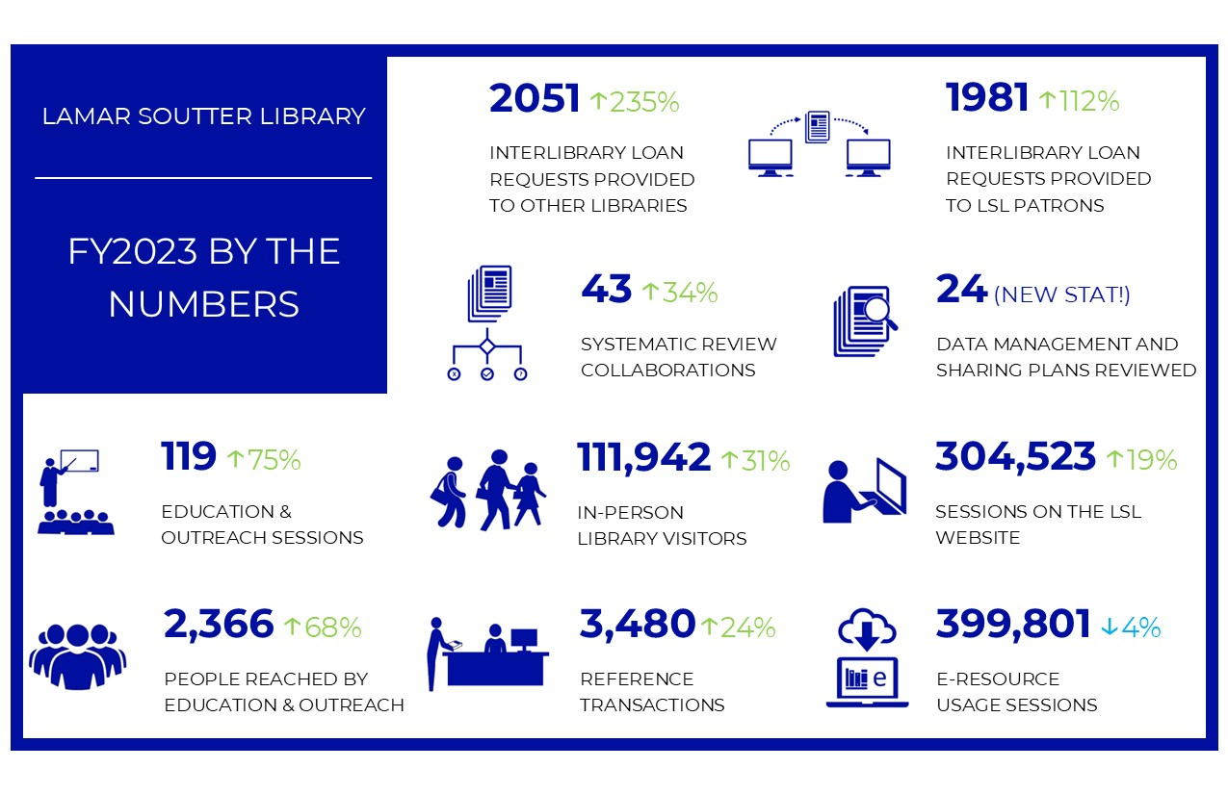

Slide 3

Highlights
(June 23-May 24)
Artist-in-Residence: Science Illuminated: An artistic exploration
  Featuring works developed by UMass Chan’s Biochemistry & Molecular Biotechnology department’s scientific art exhibit
21st Annual J. Worth Estes Lecture
  David T. Courtwright, Ph.D. gave a lecture on Limbic Capitalism and Mass Addiction Before and After the Digital Revolution
Clinical System Outreach
Pathways Program and DRIVE initiative
Graphic Medicine Review (GMR) ISSN 2993-8252
  Publishes scholarly works relevant to both the comics medium and healthcare, medicine, wellness, patient experience, and public health policy. GMR is an open-access resource primarily produced in English but international in scope and concerns.
Read & Publish Agreements

Slide 4
Strategic Priorities FY25
Administration | Education & Clinical Services
Review data collection, analysis, and presentation to support advocacy, promotion, and storytelling. Thoughtfully and deliberately identify and address issues associated with organizational culture and values to ensure an inclusive and innovative working environment. | Expanding clinical outreach to unserved/underserved health professionals within UMass Memorial Increase participation in professional service and scholarship among Education & Clinical Services staff
Access Services | Research & Scholarly Communications
Create a welcoming and safe space for learning Provide an intuitive path to Library resources Streamline process to ensure equitable and timely service | Provide services in support of the Nelson Memo and associated implications for read and publish agreements Customized, targeted outreach via new GSBS newsletter Identify issues associated with the preservation of institutional repository objects
Network of the National Library of Medicine: Region 7 | National Public Health Coordinating Office
Strategize Education and Outreach with Teaching Staff in LSL | Review data points to replicate and enhance program evaluation process

Slide 5
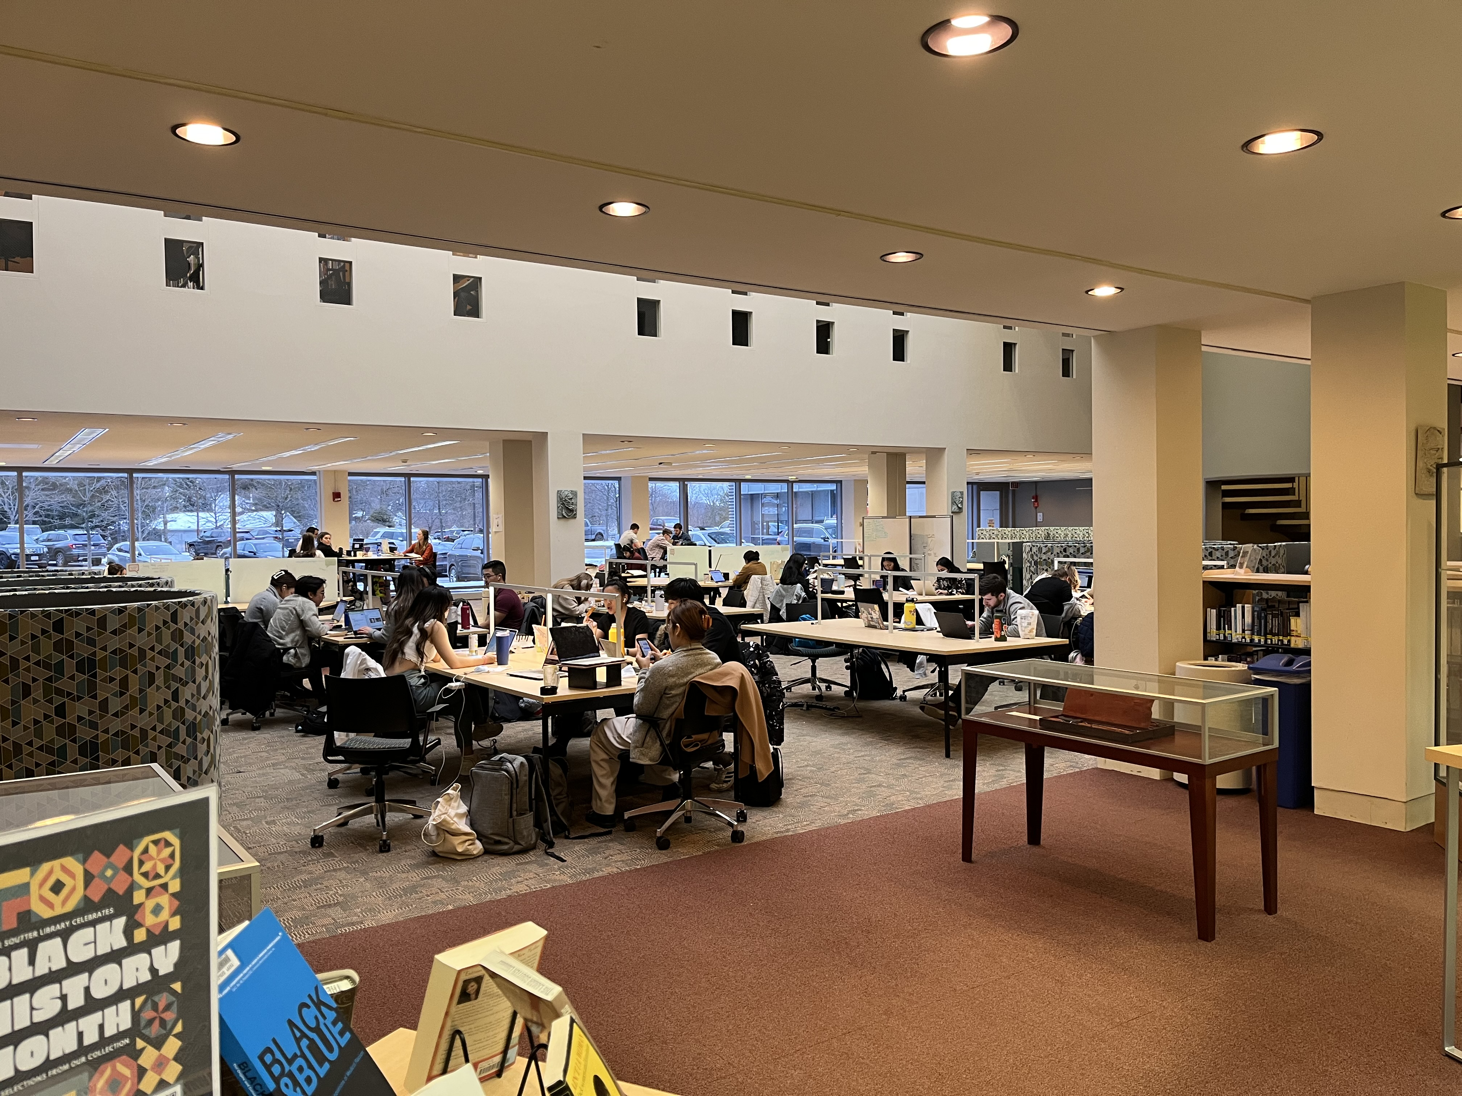
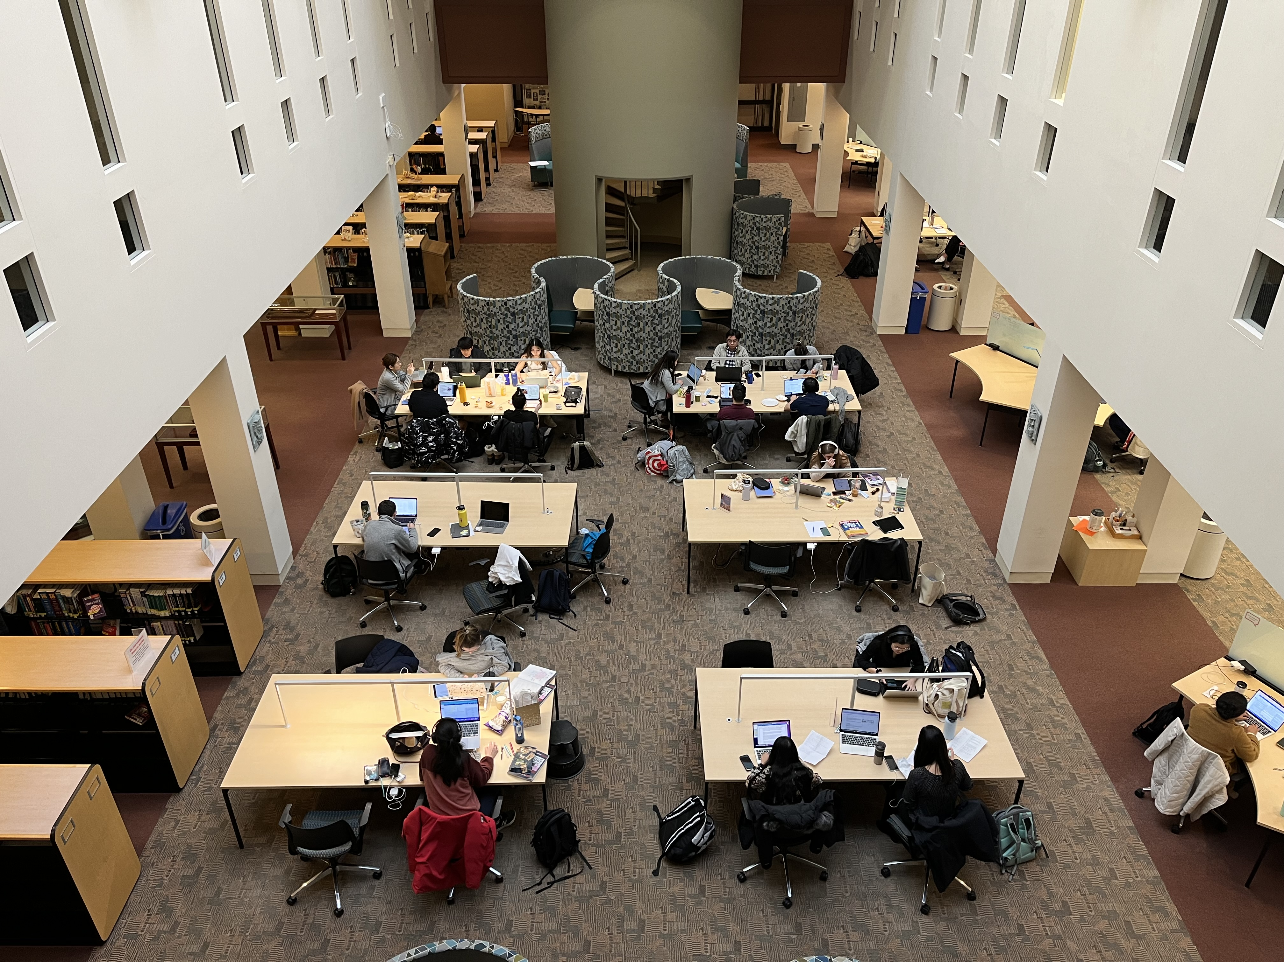
Averaging approximately
2,600 visitors a week

Slide 6
Questions / Comments https://library.umassmed.edu
Mary.Piorun@umassmed.edu

