Slide 1

& Note Writing Tips/Tricks
Dr. Kate Wynne (+ Audience Suggestions/Tips Please!)
August 8, 2022

Slide 2
Overview
Customize Epic
Inpatient workflow and efficiency
Progress notes
Transfer notes
H&P
Hospital course
AVS Patient Instructions
Woo Insider/Tech supports

Slide 3
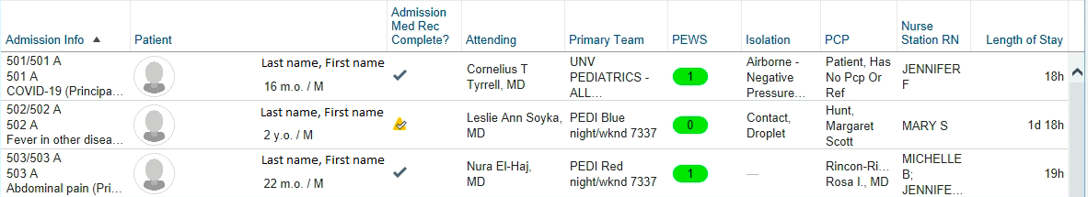
Customize Epic: As you begin your block…
Set yourself up for success early in the block
1. Personalize your patient lists
2. Personalize your tabs

Slide 4
1. Personalize your patient lists
Demo? Make a pt list
Help your medical students, too!
Helpful columns:
Can make an ED patient list, a PICU patient list, etc. with different columns and different lists of patients
  Admission Info
  Room/bed
  Patient
  Primary Team
  New Results
  New Notes
  Age/Gender
  Weight
  Length of Stay
  Problem
  Registered Nurse
  Discharge order signed?
  Last Attending Provider
  PEWS
  Bed Request Status
  PCP
  Isolation
  Admit Med Rec Complete

Slide 5
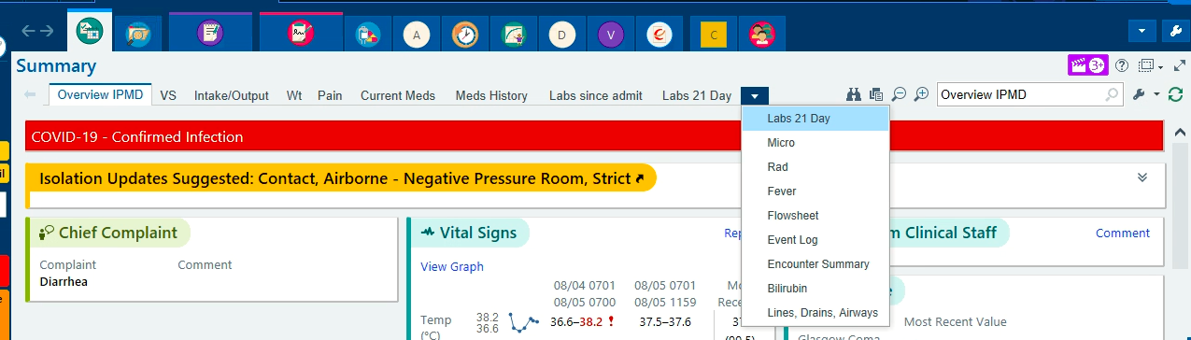
2. Personalize your tabs
Set the order up so you can mindlessly click through in the same order you generally pre-round

Slide 6
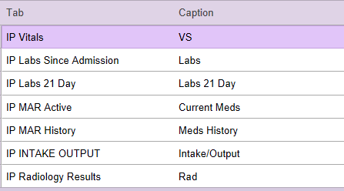
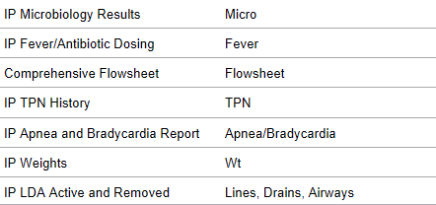
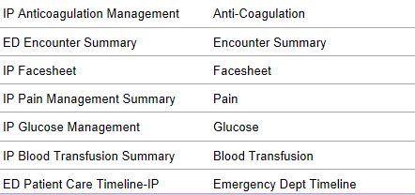
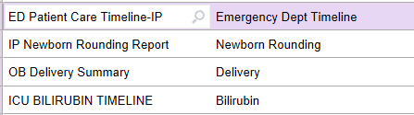
Some Helpful Tabs
Demo? Edit tabs

Slide 7
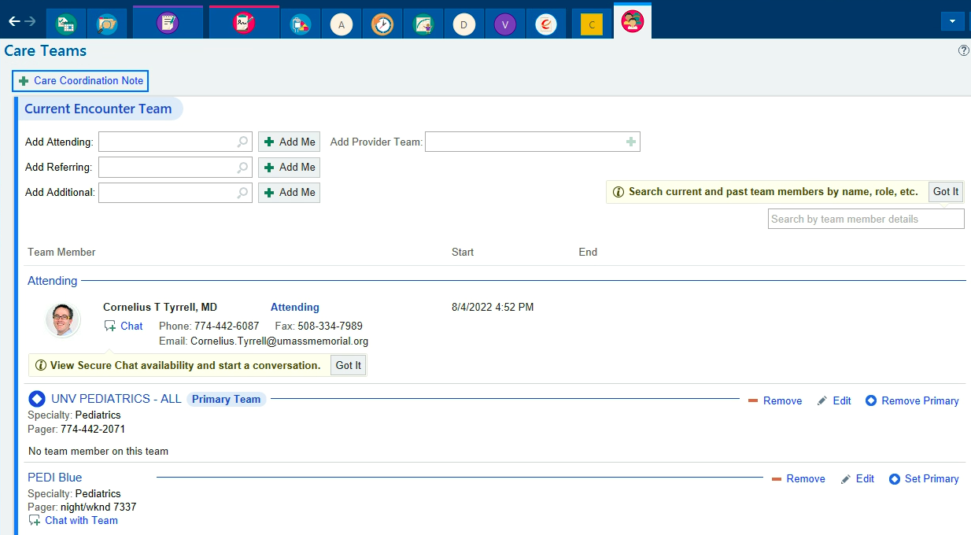
Inpatient workflow and efficiency
Starting your day: Pre-Rounding
Sign in to your team and identify “First Call Provider”
2. Make sure each
patient has a
Primary Team
3. Preround with
your fabulously
organized chart tabs
(#s, Lab/Rad/Micro,
Nurse/Consult Notes)

Slide 8
Progress Notes
4. Tip!! Start a note (*if needed) while pre-rounding!
Open and pend a progress note for each patient. You’ll see an “incomplete note” reminder so you won’t forget one!
A good template should pull in a lot of pre-rounding information to SAVE YOU TIME
If you have time to prep your A&P, type it in and print out the note to bring on rounds and it’ll be done for later
*To copy forward a note, hit “copy” at the top left corner of the note
  Please don’t hit “edit” as you will overwrite the note for that date

Slide 9
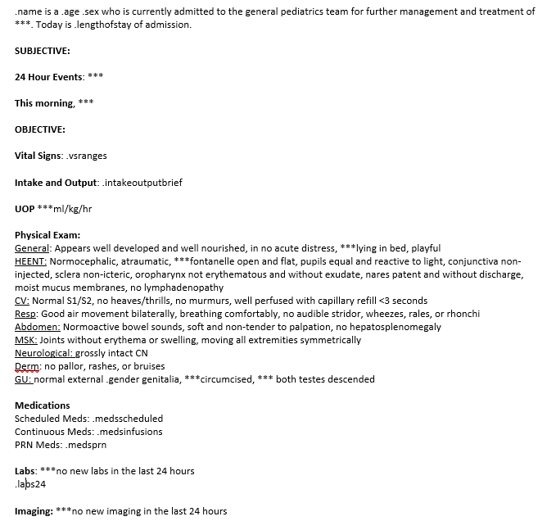
Progress Note Templates
There is a built-in template…
  and you can make your own
  And you can borrow from others
Start with the one that is there
and modify it
Quick demo?
Smartphrase manager

Slide 10
More Progress Note Tips!!
Remember, progress notes needs to be accurate at the time you sign it… The shorter, the easier to keep it correct and current
Minimize repeating information in multiple places (eg med dosing, issues that overlap a couple systems)
Always put dates, never “today” or “yesterday”
If you copy forward, make sure *all* info is still correct, and always reduce unneeded info
  If something isn’t relevant anymore but you don’t want to delete it forever, put it in the hospital course for safe keeping

Slide 11
*If needed - Time saver!
In general, each patient only needs one note per day
  EXCEPTIONS:
    the PICU!
    same day admission (H&P) and discharge (DC summary)
    or a special note like a Transfer Note, Rapid Response, Procedure, or Event Note
So for the floor, if an H&P is done overnight and no attending sees the patient, the attending will re-date that note to the AM and sign it after seeing the patient… so you do not need a progress note for that day!

Slide 12
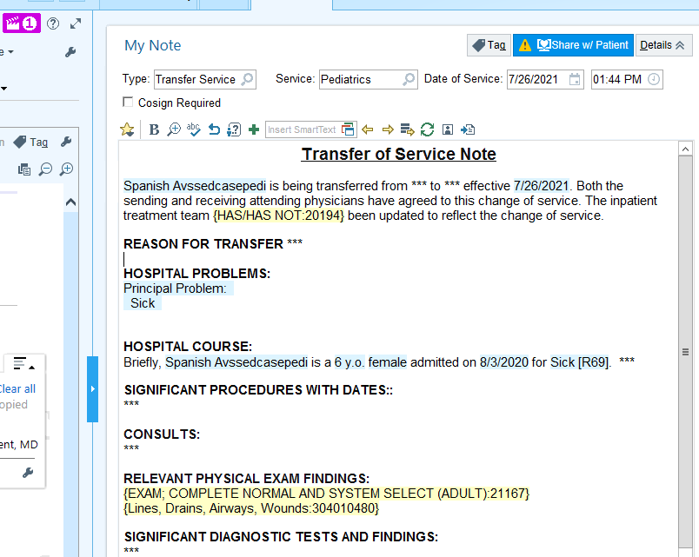
Transfer Notes & Logistics
Magnifying tip
There are 2 transfer notes that happen on day of transfer:
  The transferring team writes a note with a fairly detailed course of what has happened so far, with a typical A&P at the bottom
  The accepting team note briefly summarizes what has happened so far, and then the A&P again

Slide 13
Admission Pager Goes Off! *some tips!!
H&P
When you call the ED, open the patient’s chart and start an H&P
  Again, have your templates picked and ready!
Type into the HPI section as the ED resident tells you about the patient
Do chart review, fill out all H&P information you find
Consider putting in basic admit orders now for best patient flow
  Can wait to add things like home meds until you confirm them
Print out PTA med list (and your H&P if you like), bring and annotate while you meet the patient
Demo? Can you print the PTA med list?

Slide 14
Back upstairs, use the Admission Navigator
Use the ADMISSION NAVIGATOR and finish your orders
  It’ll make sure you correctly do the home med rec
    Which will make the Saturday afternoon discharging resident happy
  It’ll help document PMH/Surg Hx/Fam Hx/Social Hx in the correct locations
    Which again makes the weekend discharging resident happy
    note… you’ll need to make sure the correct smart phrases are in your note templates. Hit “refresh” when back in your H&P to pull in the info
  Which means it’ll save time with your current H&P, your future discharge summary, and any future admissions
  It’ll help keep everyone on the same page!!!
Demo? Med Rec and Hx Details

Slide 15
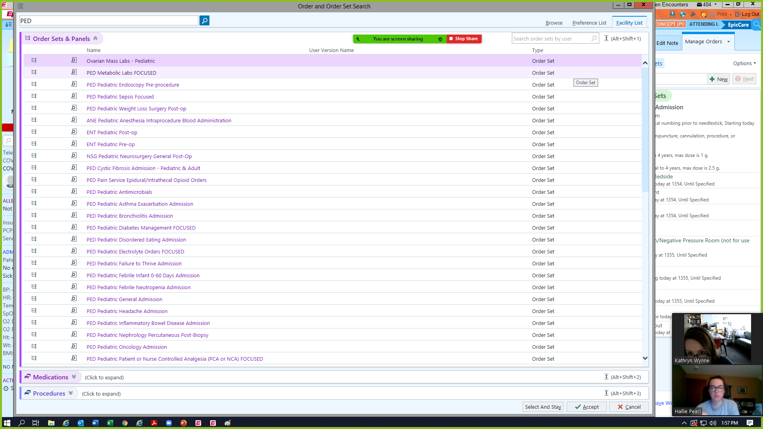
There are SO MANY good admission order sets as well as order panels!
Search “ped”
Let Kate know if there should be one that doesn’t exist

Slide 16
Last thoughts on notes
*Be objective in your notes… especially for abuse/neglect/CPP notes*
Consider adding media (photos or videos) via Haiku
  Pic of a parent’s phone pic, too!
Info put in the correct locations pulls through for everyone’s ease
Notes should be detailed, but again, aim for short and sweet
  If it were the good ol days and you were writing by hand… what would you say?

Slide 17
Discharging a Patient/ Hospital Course
Use the DISCHARGE NAVIGATOR!
Work on the hospital course first, which will automatically pull into the discharge summary
If the patient has been admitted for a while, you will need to cut down the hospital course to only very important information
  Think: What does the PCP need to know?
There should only be 1 hospital course!! NOT separate floor and PICU courses… just 1!!
  Again think about the busy PCP in the middle of clinic!
Always triple triple triple check med lists

Slide 18
Hospital Course
Written for the PCP to read in 30 seconds before seeing the patient for follow up
3 parts
  1-liner including the diagnosis, mentioning if patient needed the PICU
  List by problem or system (if there were multiple) with a brief description of what happened
  What needs to be done in the future: pending labs, new medications, follow ups, repeating labs, etc.
Tip!! Update the hospital course EVERY SINGLE FRIDAY (even if you don’t think the patient will be discharged over the weekend!)

Slide 19
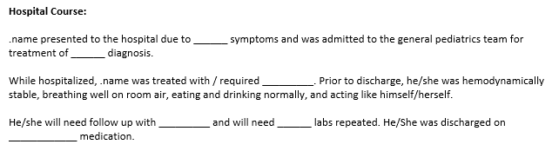
Example of a Very Short Hospital Course
Most should be short. *Exception = patients being transferred to other medical facilities, e.g. rehab, need more detail

Slide 20
AVS Patient Instructions (3 main text boxes)
Use easy to understand language (no medical jargon)
Don’t repeat the same information in multiple places
  Eg don’t write in follow-up appts in your text… it already has its own box. Repetition = potential for confusing errors
Dot phrases are really helpful here because we write the same things all the time

Slide 21
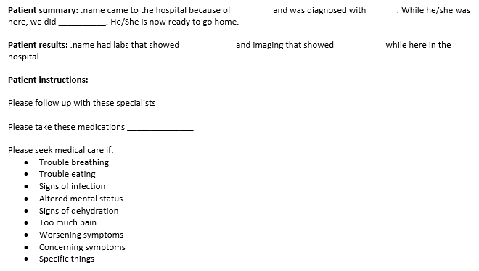
Example
Wound care includes:
Diet recommendations at discharge include:
Any other patient specific items
Best not to repeat follow-up appts/meds here!
*Most of this stuff is true for every patient, and then you can add on specifics as needed*

Slide 22
More general Epic tips!!
If you think there should be a dot phrase or an order set for something, you can help make that happen!
Find someone who is good at using Epic and learn what they are doing
If you are treating the same conditions over and over (asthma, bronchiolitis, viral gastroenteritis, post-op T&A) create a really good A&P, discharge instructions, hospital course, etc. ONCE and then use that as a template/dot phrase
  Highlight the text you want to keep, right click, save as a new smartphrase
Please really do triple triple triple check med lists on admit and discharge

Slide 23
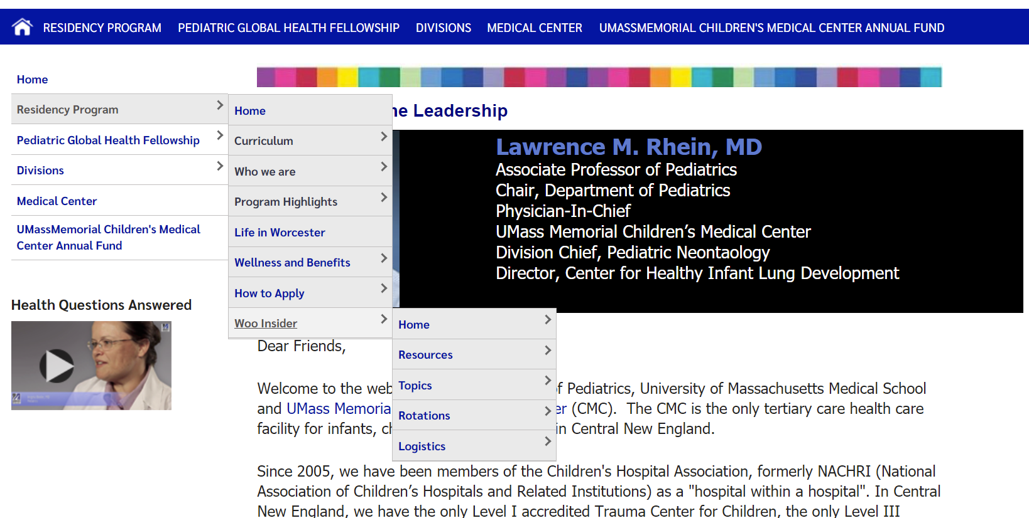

Slide 24
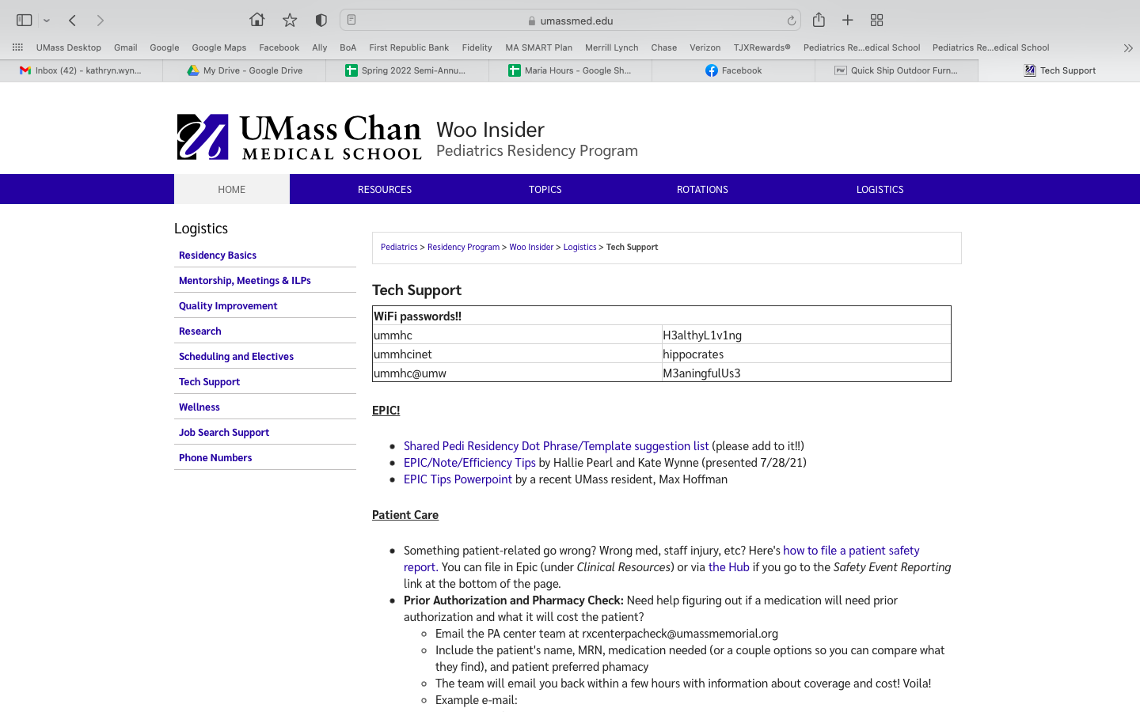

Slide 25
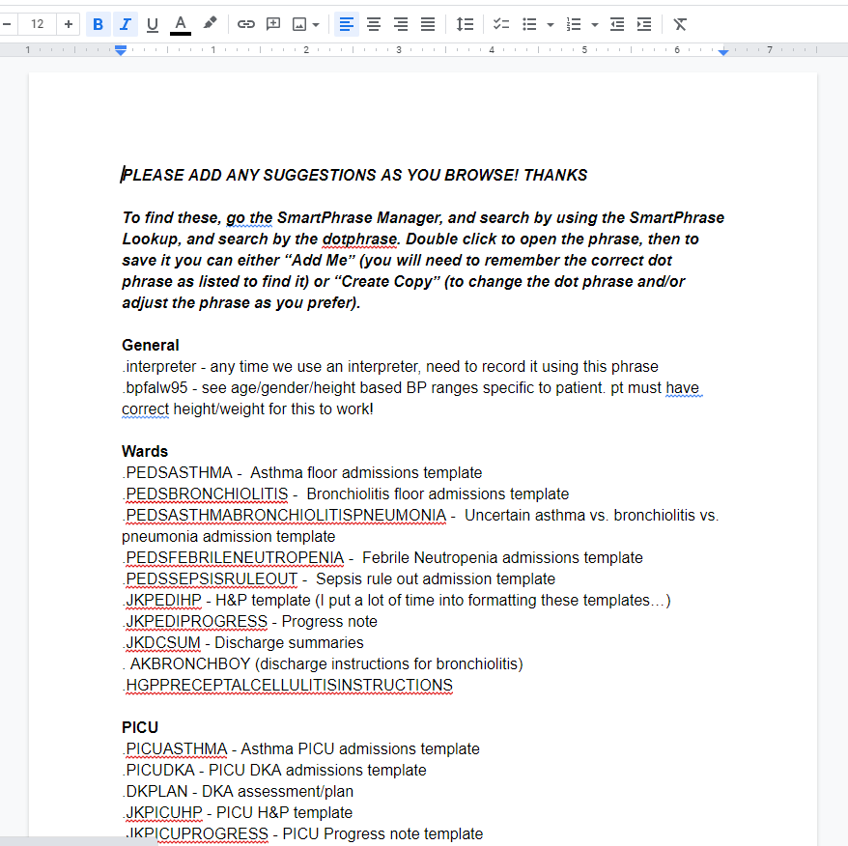

Slide 26
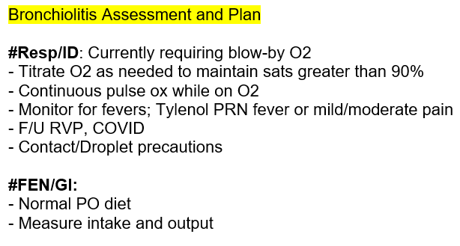
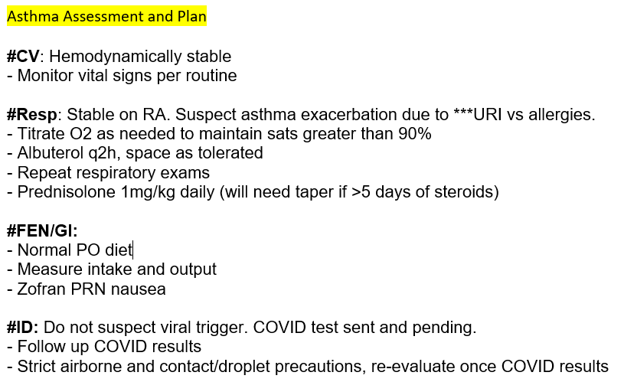
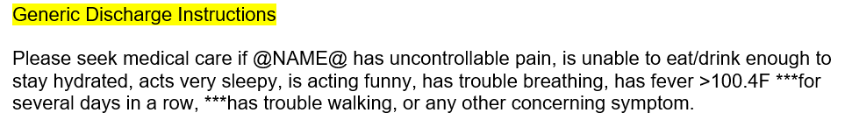
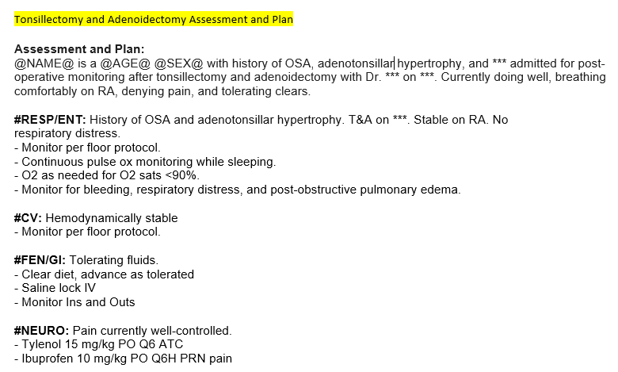
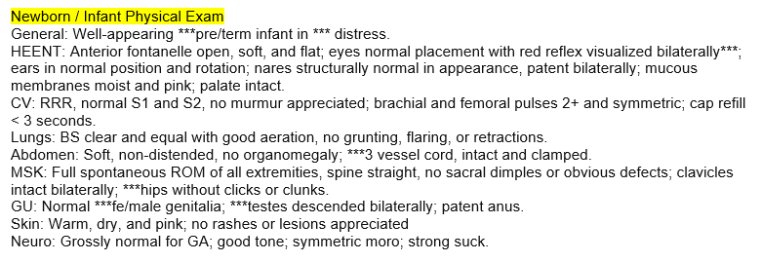
More Specific Examples

Slide 27
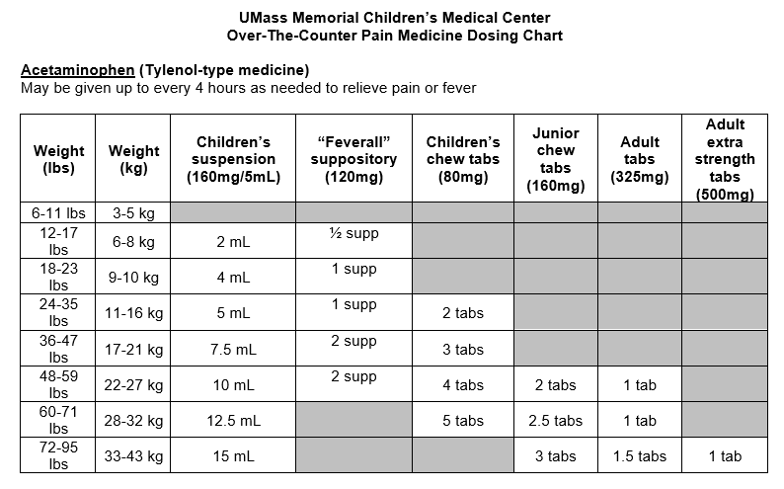
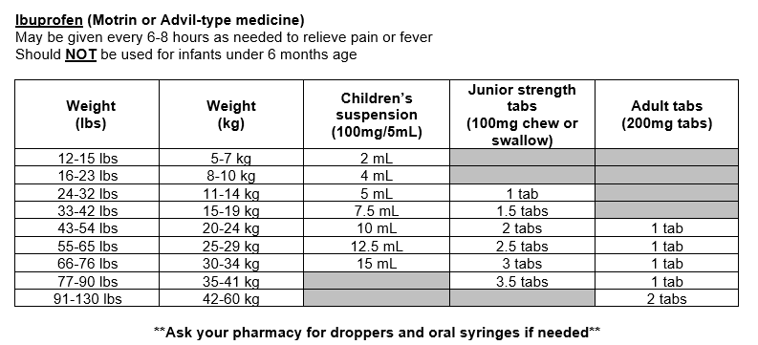
.pedotcpaindosingchart

Slide 28
Overview
Top Take-homes
Customize Epic - Personalize columns/tabs/templates/phrases…
… which helps with… Inpatient workflow and efficiency
Progress notes Short.
Don’t forget Transfer notes
H&P: Prep upstairs and use the Admission Navigator
Hospital course: great 1-liner with the diagnosis and PCP pertinent follow up needs
AVS Patient Instructions: no jargon, consider dot phrases
Woo Insider/Tech supports. Talk to Kate with requests, suggestions, problems!

