Slide 1
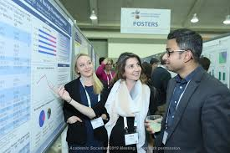
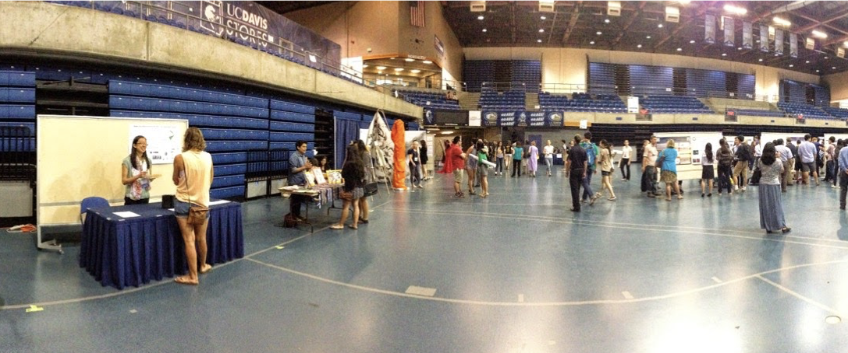
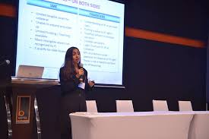
Writing abstracts & presenting at academic meetings
Trish McQuilkin

Slide 2
Objectives:
Why present at meetings?
Writing and submitting abstracts to meetings
Making a poster presentation
New technology for poster presentations
Platform presentations

Slide 3

Why present at conferences?
Get your work noticed
Meet people doing the same type of work
Find you academic “home”
Network with faculty from other institutions
Join working groups, collaborate and produce manuscripts, etc.

Slide 4
Real Life Example: Global Health at Academic Meetings:
2008
2014
2019
2012
AAP SOICH
20 Members
AAP SOICH
300 Members
Resident GH Tracks
Started
AAP SOICH
500 Members
GH Educator Subgroups
Fellowships Started
AAP SOICH
PAS: ICH Group
APPD : GH Educators &
GH Fellowship Directors
ABP: GH Fellowship Credentialling

Slide 5
Academic Output from Working Groups:
Publications (20+)
Collaborative posters and workshops at PAS, AAP, APPD, IPA (countless)
Handbook for Global Health Educators (with ABP)
Book Chapters
Creation of Global Health fellowships
Accreditation of GH fellowships

Slide 6
How to write an abstract and get it accepted

Slide 7

What to write an abstract about?
Project not yet ready for manuscript
Get important results “out there” while writing a manuscript
Work in progress
Quality improvement projects
Teaching Projects

Slide 8
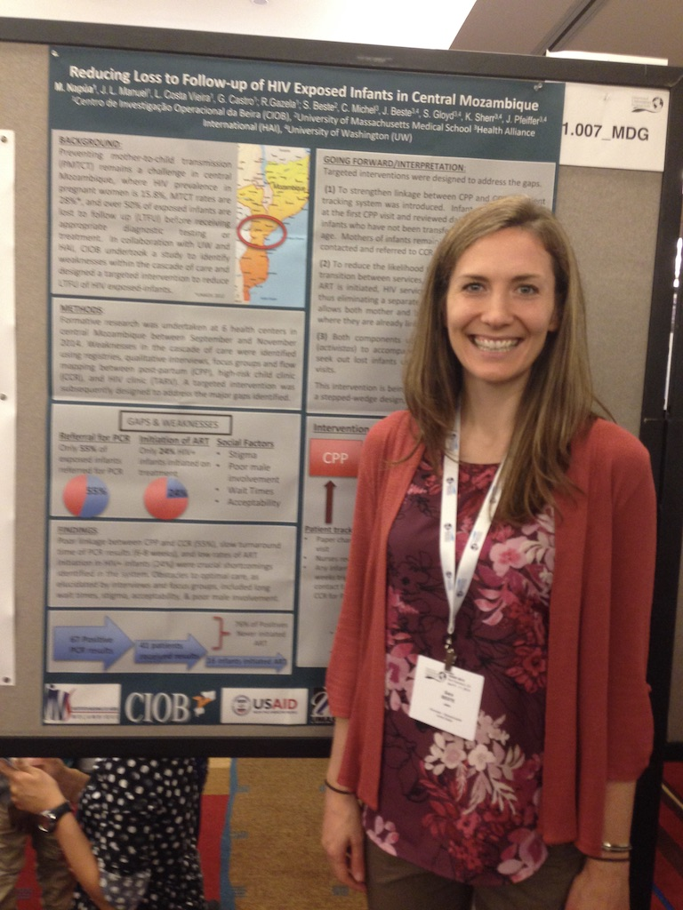
Metanalysis on treatment of Perinatal HIV infection performed at WHO

Slide 9
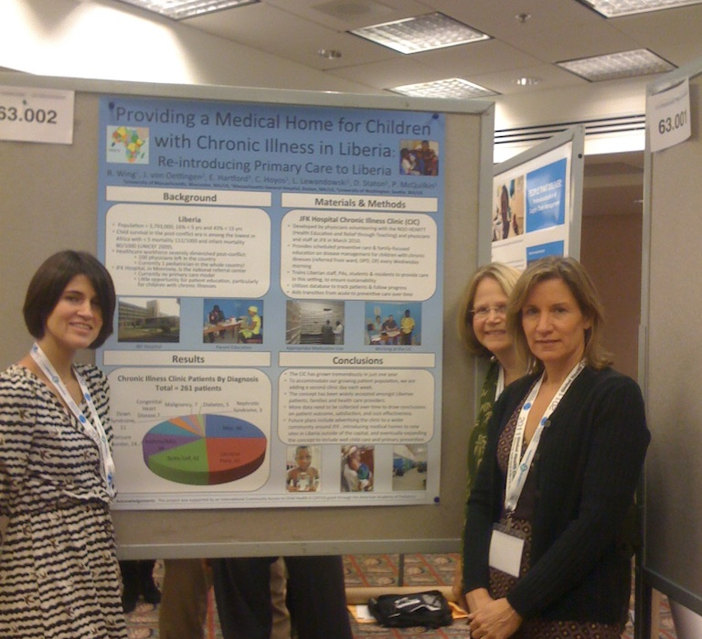
Creation of a Pediatric Chronic illness Clinic in
Liberia: 5 residents involved

Slide 10
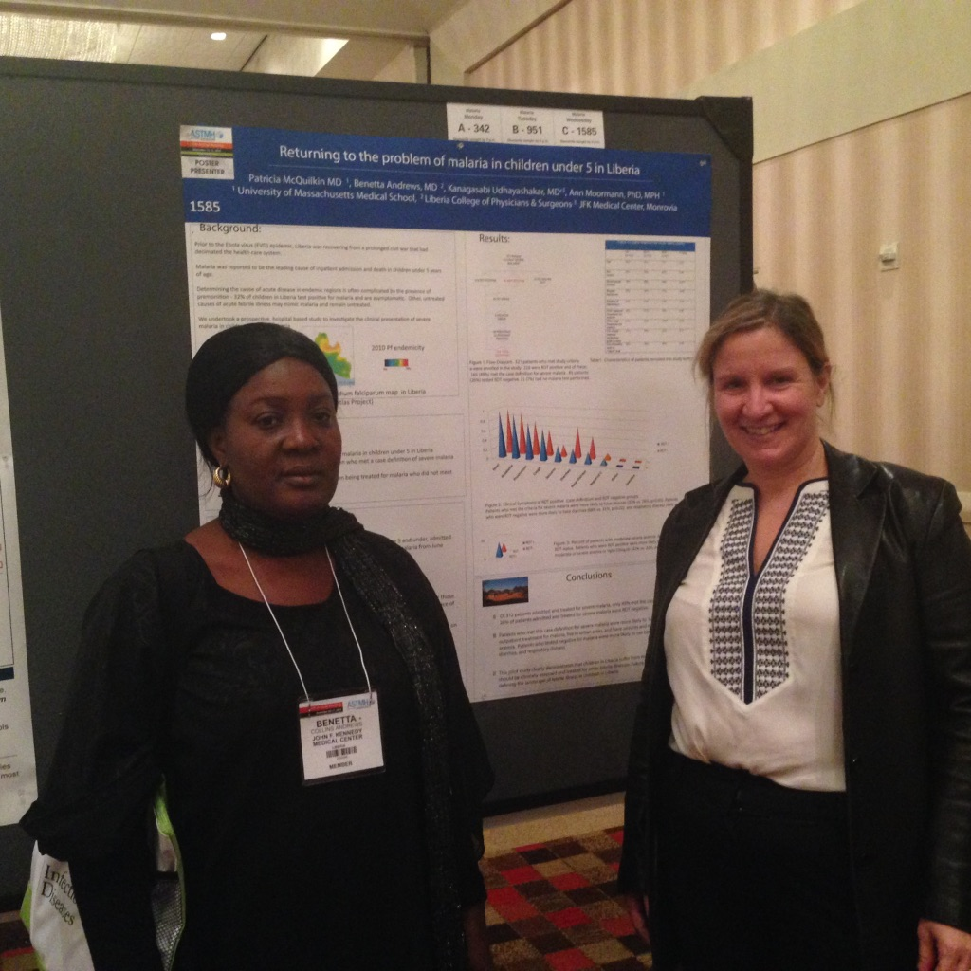
Quinine vs Artusenate to treat Malaria in Children

Slide 11
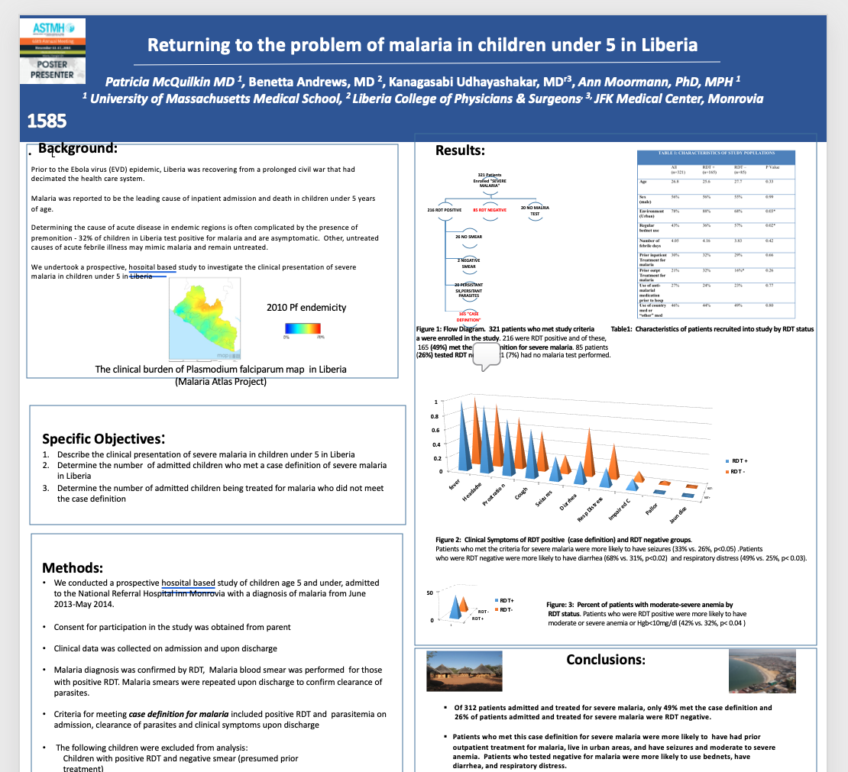
The completed study: Presentation of malaria in children under 5 in Liberia

Slide 12
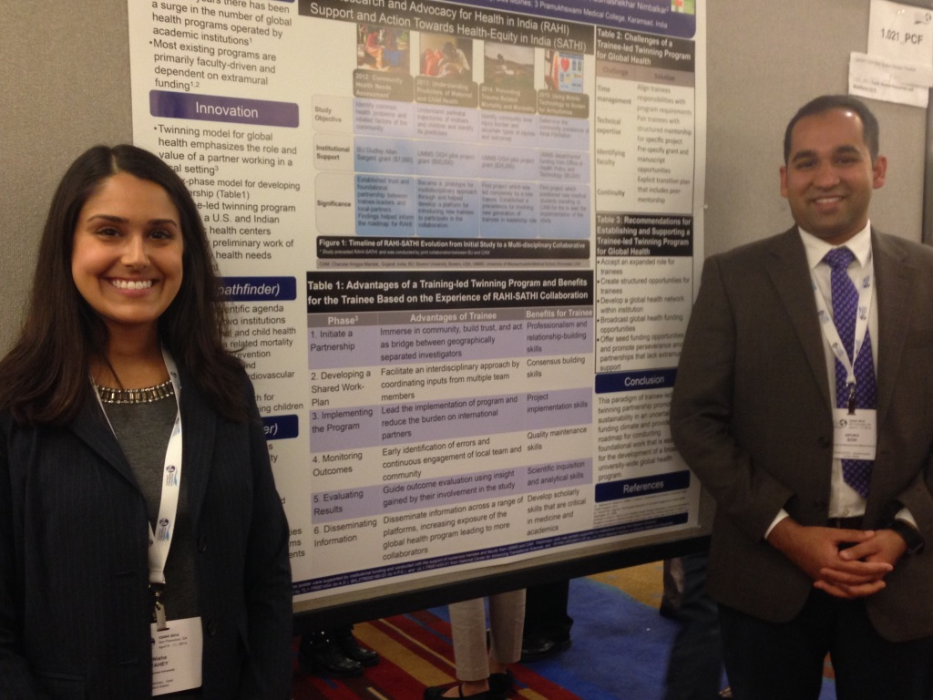
Creation of a Research partnership between UMMS and CAM in India
Won a prize for best medical student abstract at the CUGH conference!!!

Slide 13
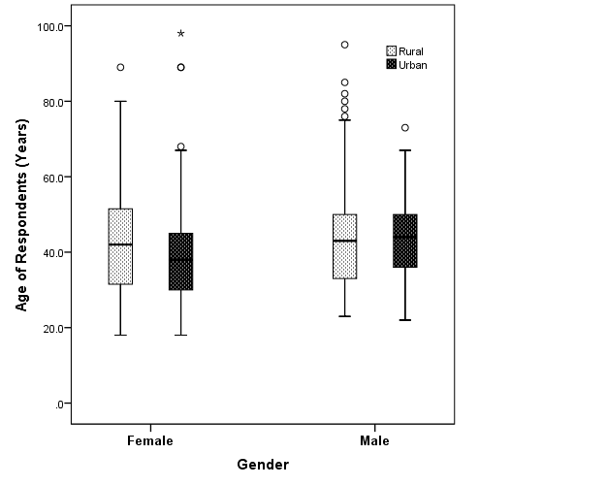
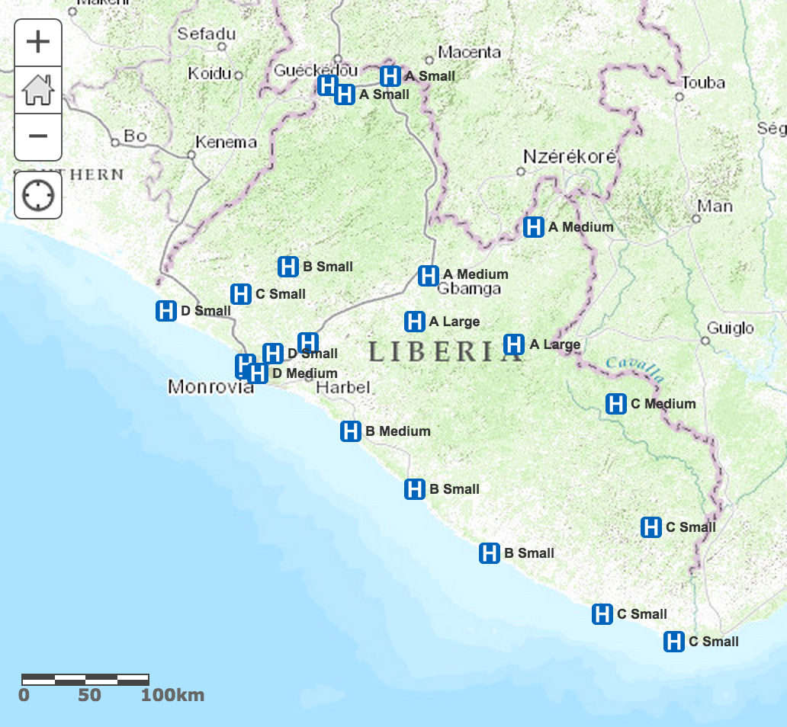
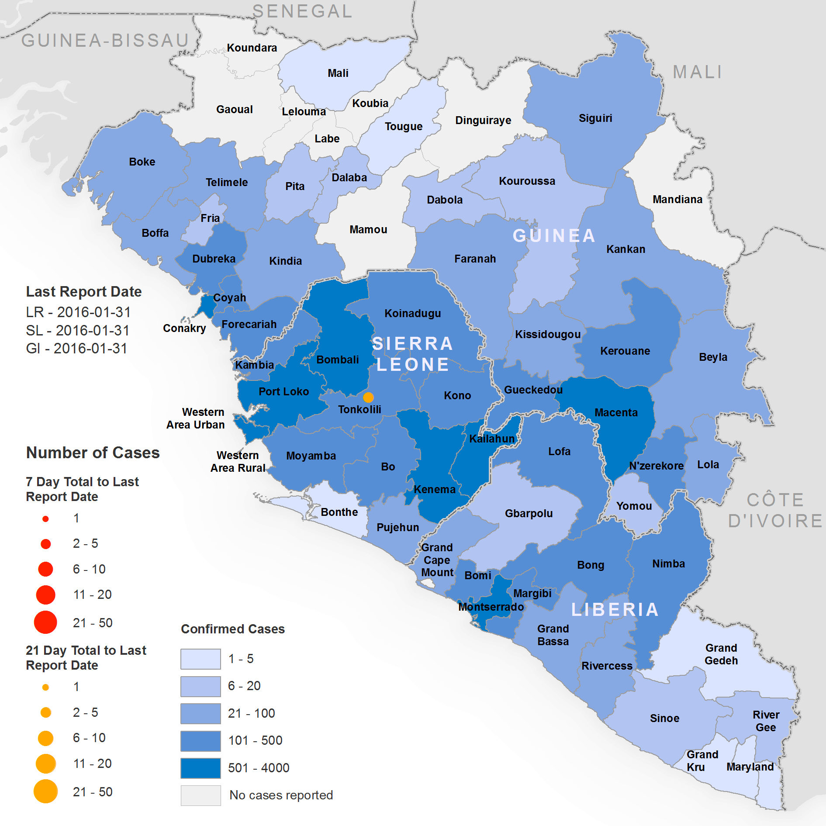
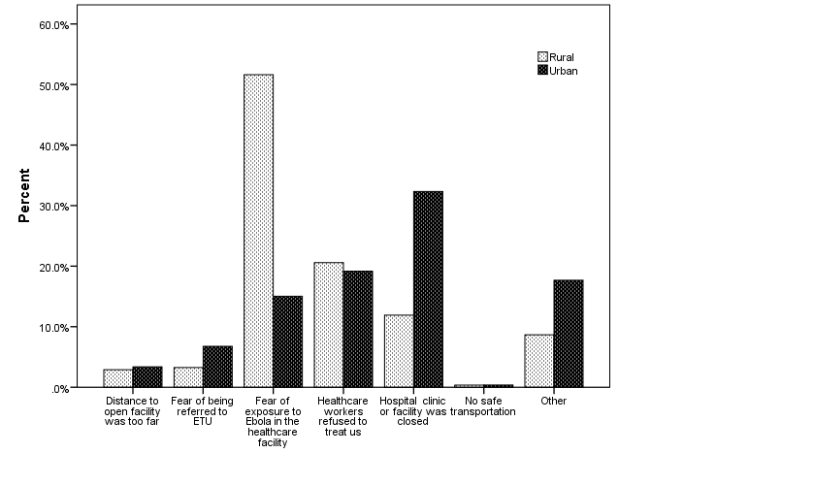


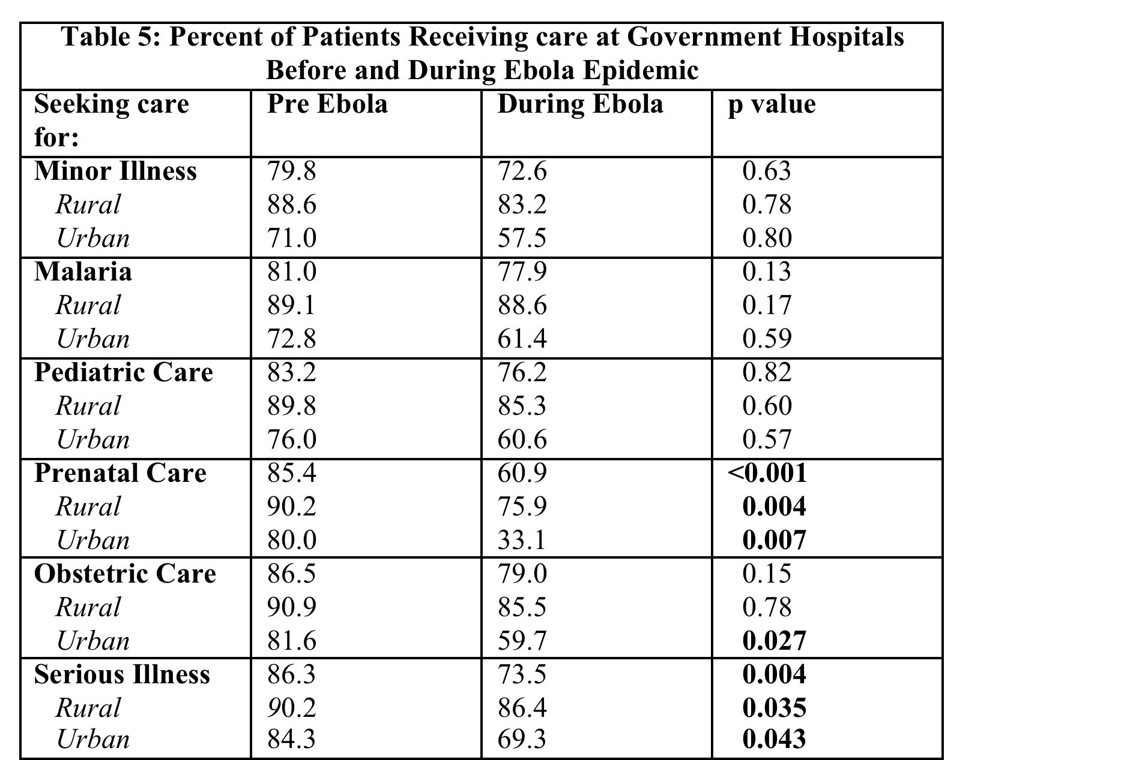




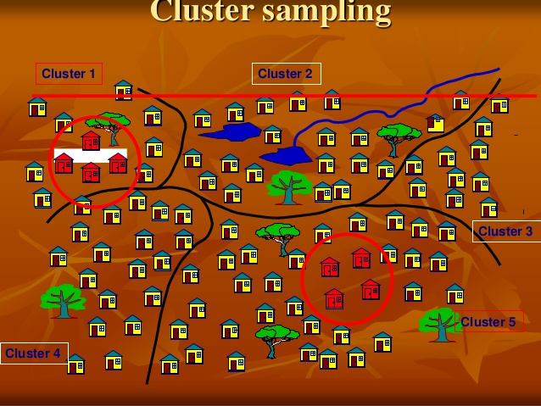
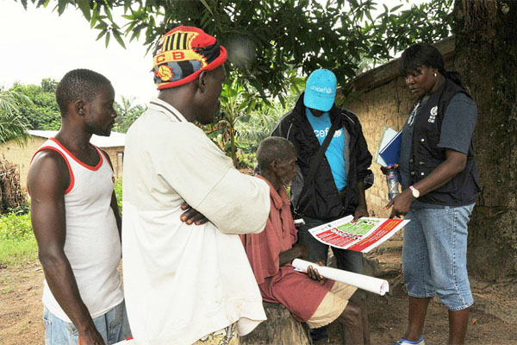
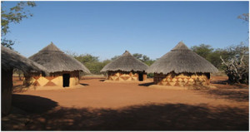
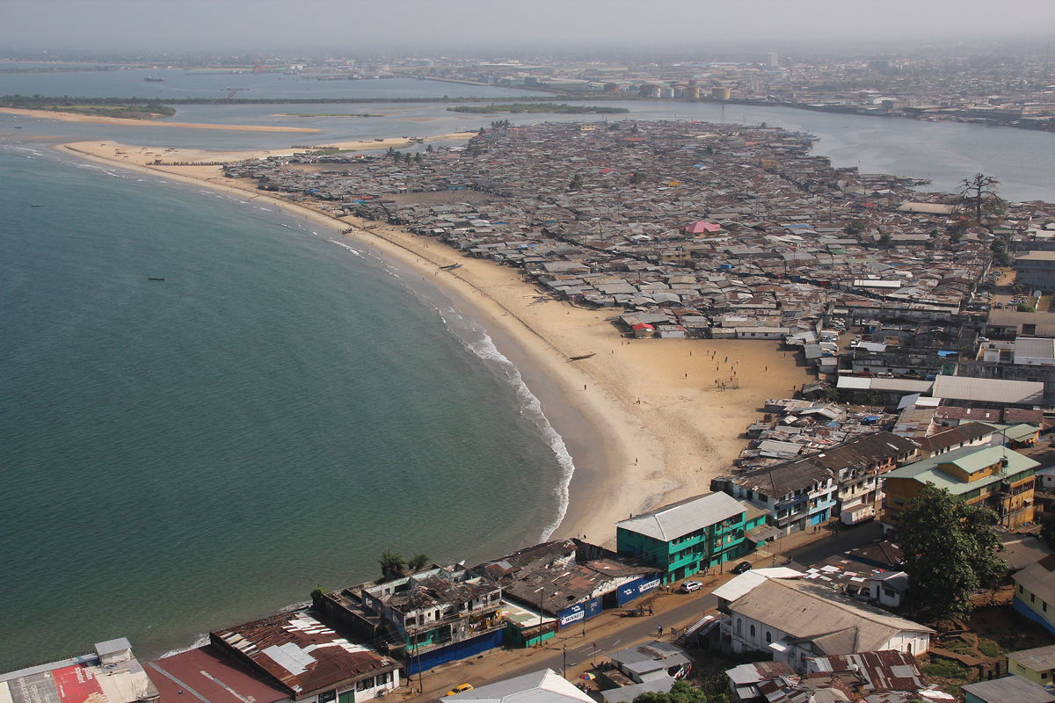

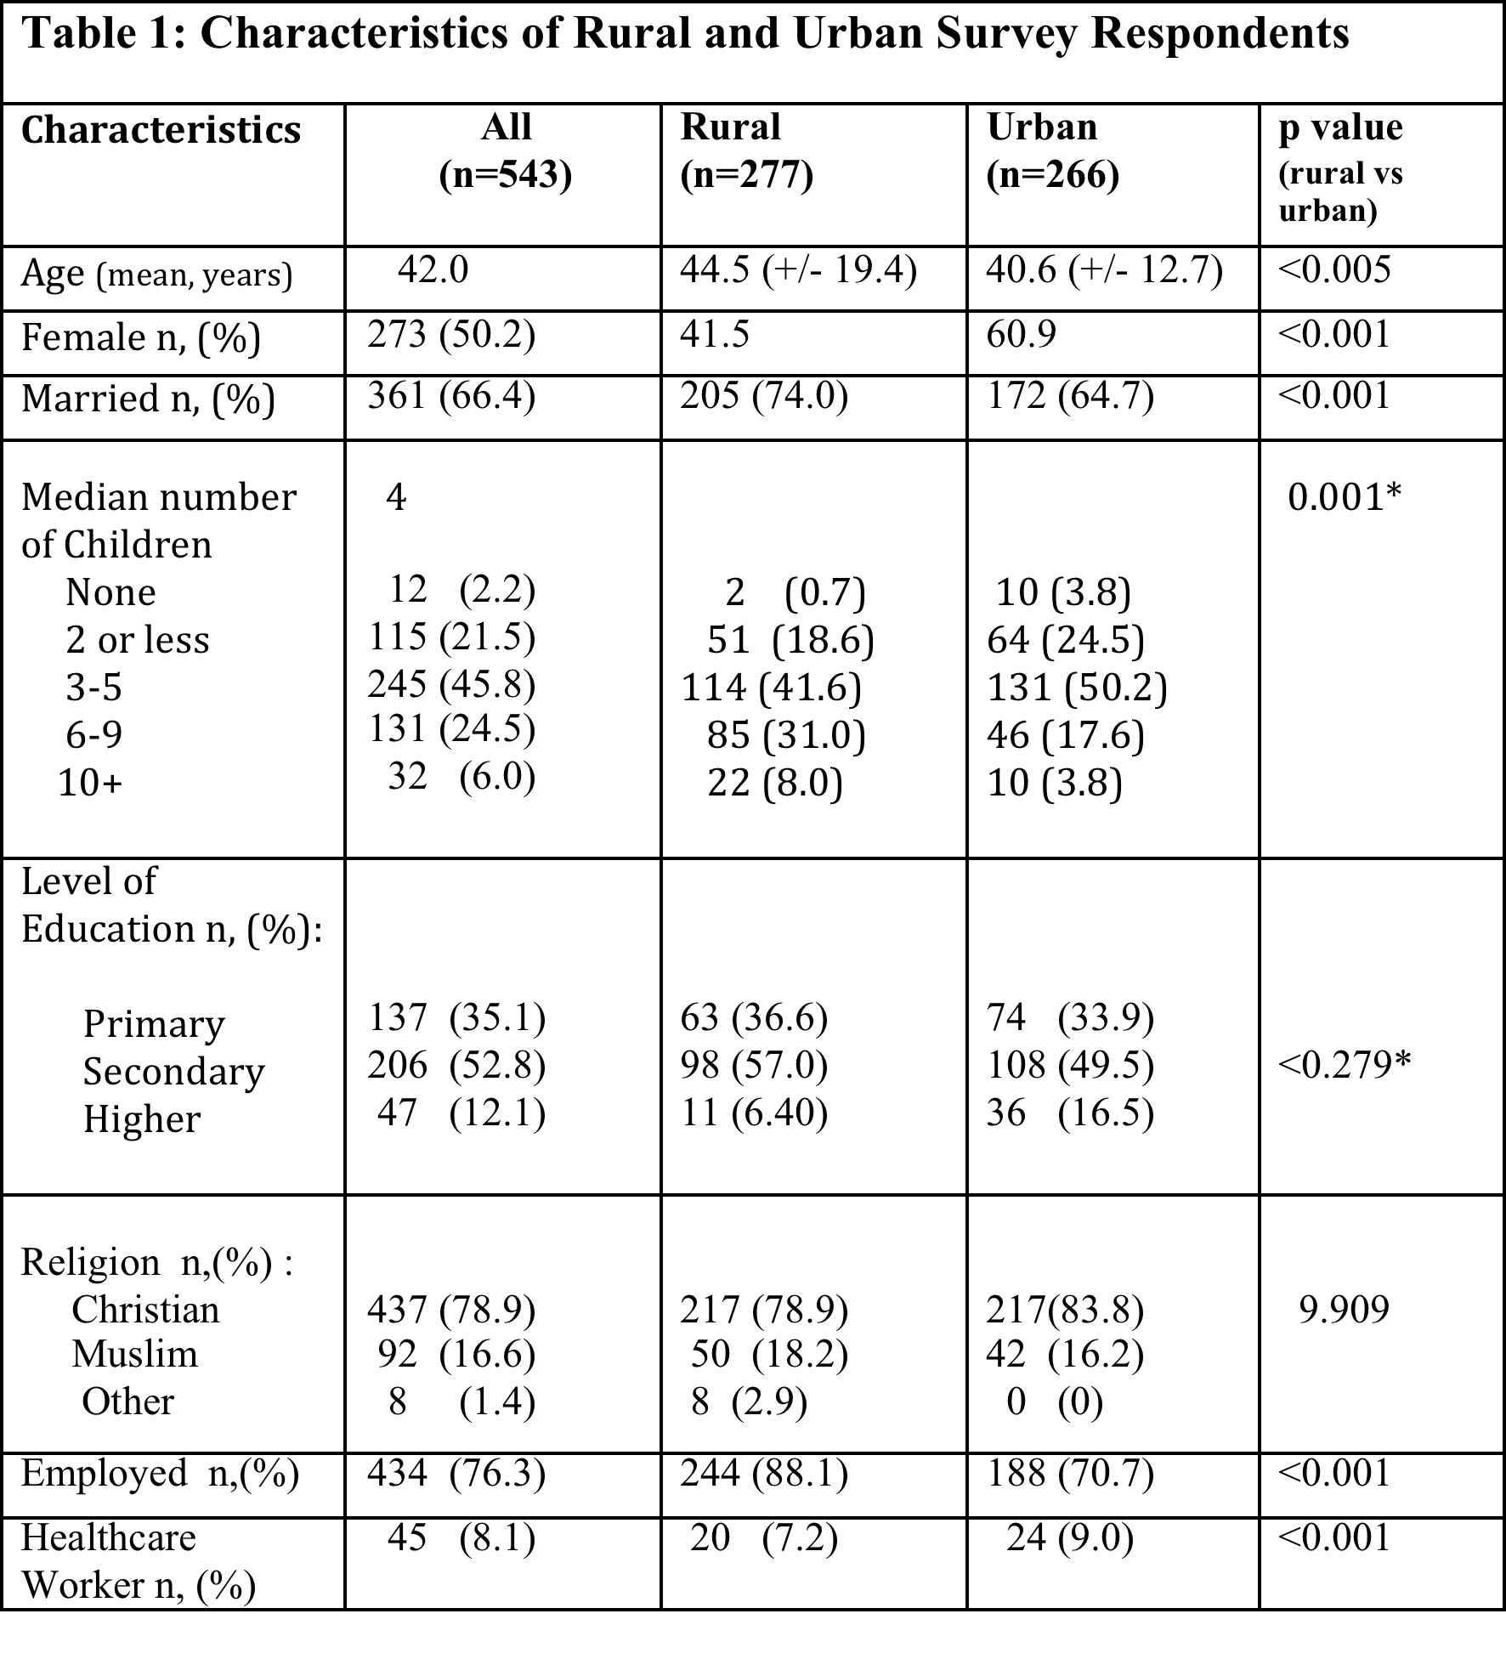
Health care access during the Ebola epidemic in Liberia
Patricia McQuilkin MD ¹, Kanagasabai Udhayashankar MD MPH ², Michelle Niescierenko MD MPH ^{3,} Louise Maranda, PhD ¹
¹ University of Massachusetts Medical School, ² Liberia College of Physicians & Surgeons
³ Harvard Medical School
Background:
Results:
The Ebola Virus (EVD) epidemic in West Africa has claimed over 11,000 lives
Liberia was one of the countries hardest hit with almost 5,000 fatalities
Ebola had the additional effect of paralyzing heath care in this country;
at the height of the epidemic, almost all government hospitals were either
closed or acting at a very limited capacity
Little is known about what impact EVD had on access to basic healthcare and where patients were accessing health care at this time.
Figure 1: Distribution of Survey respondents by gender and environment
Population Surveyed:
Surveys completed in all 15 counties
543 heads of household completed survey
Equal distribution between male and female, urban and rural
respondents (Figure 1)
Urban population was younger, had higher % of females
smaller families, more unemployment and more HCWs vs rural
populations (Table 1)
Map of Government Hospitals in Liberia
Epidemiologic Surveillance Map
Late Outbreak – January 2016 Source WHO
Figure 2: Barriers to obtaining healthcare: Rural vs Urban
Specific Objectives:
To describe the impact that EVD had on access to basic healthcare in both rural and urban environments
To describe the barriers to accessing healthcare during the EVD epidemic
To assess risk factors associated with difficulty in finding care
To assess the impact on various subgroups of patients
Barriers to Obtaining Care:
Figure 2:
In rural areas fear of exposure to Ebola virus and health care workers
Refusal to see patients were the major barriers to care. In urban areas,
Closure of facilities and healthcare workers refusal to see patients
Were the major barriers to care.,
Methods:
Health care access by type of care sought:
Academic Consortium Combatting Ebola in Liberia (ACCEL) was conducting national training for healthcare workers in Infection, Prevention and Control in all 15 counties across Liberia
During training weeks social mobilization and psychosocial support staff went into communities around the hospitals that were being trained to provide education on the hospitals status for patient care and encourage community members back to using hospitals again.
A survey using Liberian English was designed to assess community members knowledge on, attitudes towards and perceptions of Ebola
Randomized cluster sampling methodology was used to sample 35 community members per county for a total sample size of 500, plus 10% non-completion/drop out for a target of 550
A 95 question survey taking approximately 30 minutes was conducted with heads of household in and interview format
Data was recorded using smartphones and was uploaded to the open source mobile data platform Magpi
Data was then exported and analyzed using SPSS
Patients seeking care for a variety of different conditions had difficulty accessing care. This was most pronounced in urban areas and the difference between accessing care in rural vs. urban environment was statistically significant for each type of condition (Table 2).
In comparing use of government hospitals both before and during the Ebola epidemic, use was decreased especially for prenatal and obstetric patients, and those seeking emergency care (p<0.05). (Table 3)
Conclusions:
Our results support the observations that health care access was severely affected during the Ebola epidemic in Liberia, and was most difficult to access in urban areas
Although closure of healthcare facilities was a large barrier, other factors such as fear of contracting Ebola in healthcare facilities, and refusal of healthcare workers to see patients were other factors which reduced access.
Prenatal, obstetric and emergency care were especially difficult to access at government hospitals in urban areas
during this time. This has likely caused additional morbidity and mortality.
Strategies to maintain health system functioning at the time of humanitarian crisis, and to reassure the public of the safety of these facilities are critical. This will prevent additional morbidity and mortality from preventable causes.
Funded By: Paul G. Allen Family Foundation

Slide 14
Where to submit your abstract ?
Regional Conferences: Northeast APPD meetings, Mass Med Society,
AAP- section meetings
PAS-section meetings
Specialty Themed Conferences: (ASPHO, APPD, CUGH)
Research Conferences: American Society for Pediatric Research, American Society for Tropical Medicine and Hygiene

Slide 15

Great for generalist pediatricians, both academic and non-academic
Advocacy
Continuing Medical Education
Subspecialty sections
Generalist sections
  Breastfeeding
  Community Pediatrics
  LGBTQ health and wellness
  International Child Health
  Simulation and Learning
  Resident and fellow sections
  Each section has meetings and poster sessions

Slide 16

Geared towards Academic Medicine
Research Focus
Subspecialty Sessions with poster sessions, platform presentations
Workshops on academic career development and teaching
Sections for residents, fellows
Member organizations:
American Pediatric Society (APS) I
Society for Pediatric Research (SPR)
Academic Pediatric Association (APA)
American Academy of Pediatrics (AAP)
Alliances:
American Society of Pediatric Nephrology (ASPN)
Pediatric Infectious Diseases Society (PIDS)

Slide 17
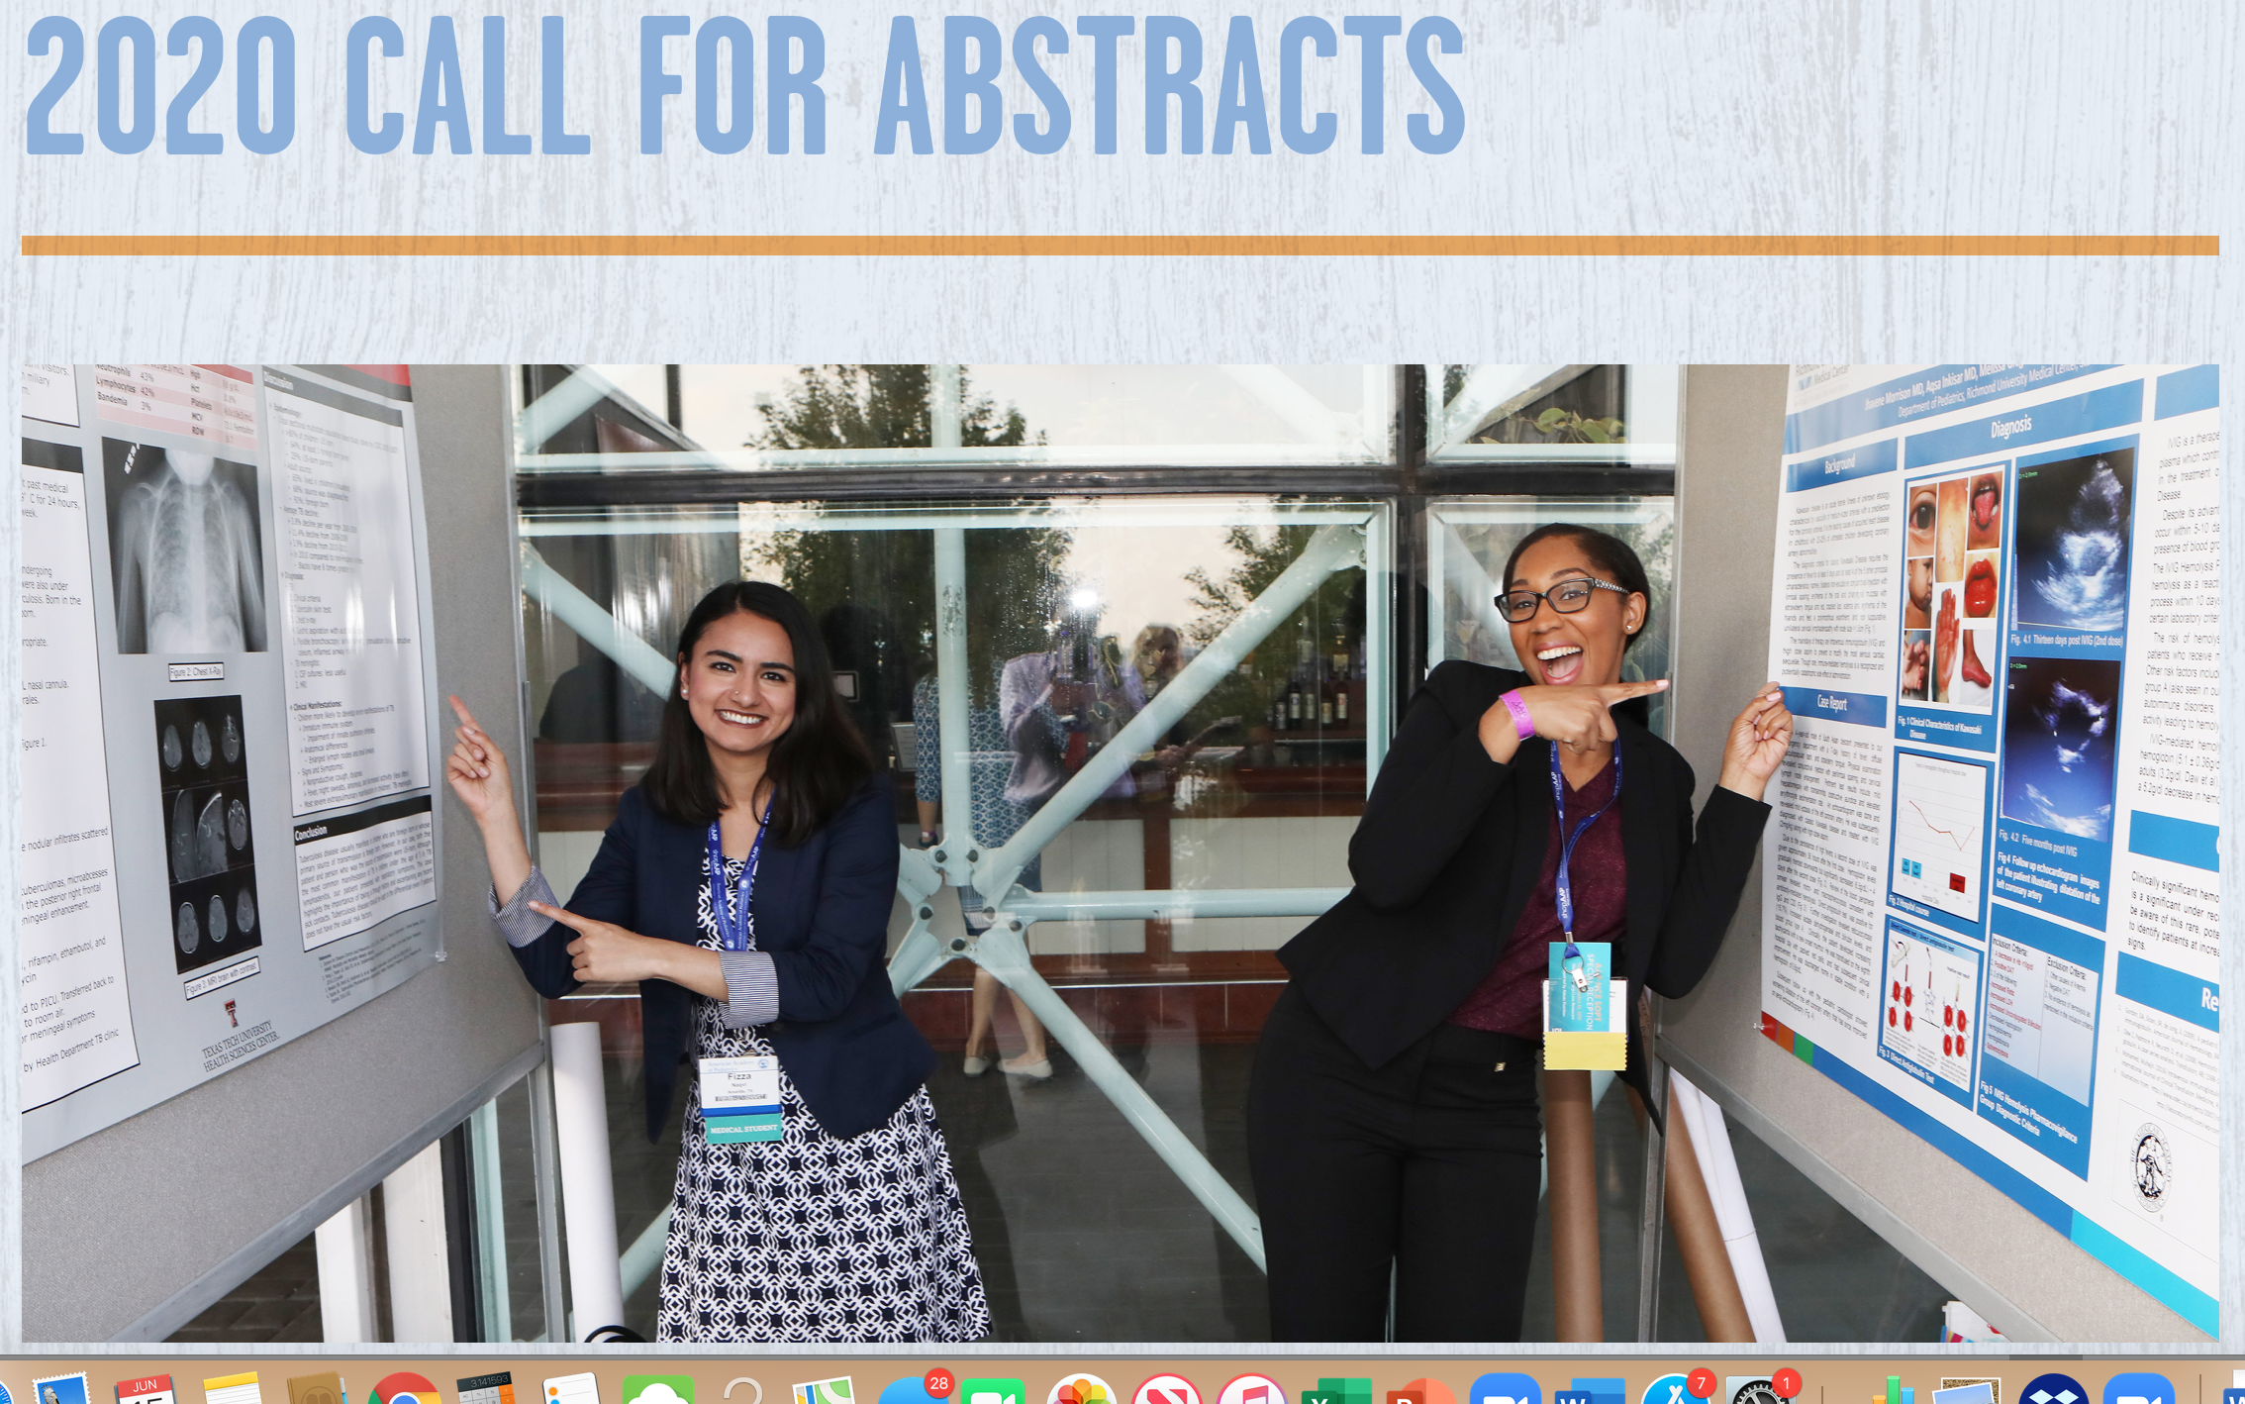
Find a Conference to submit to:
Once you know have something to present the first step is finding a meeting to submit to
Conferences generally call for abstracts about 4-6 months before the meeting
For AAP and PAS, look at individual sections for guidelines about what they are looking for

Slide 18
How to write an abstract: Mini Manuscript
Title
Authors and institutions
Abstract
Intro/Background
Methods
Results
Conclusions

Slide 19
Title is important!!
Conference attendees scan abstract titles to decide which they want to see
  Choose the right name for your story
  Catch the eye of your audience
  Keep it simple, avoid jargon
  Use Key words in your title

Slide 20
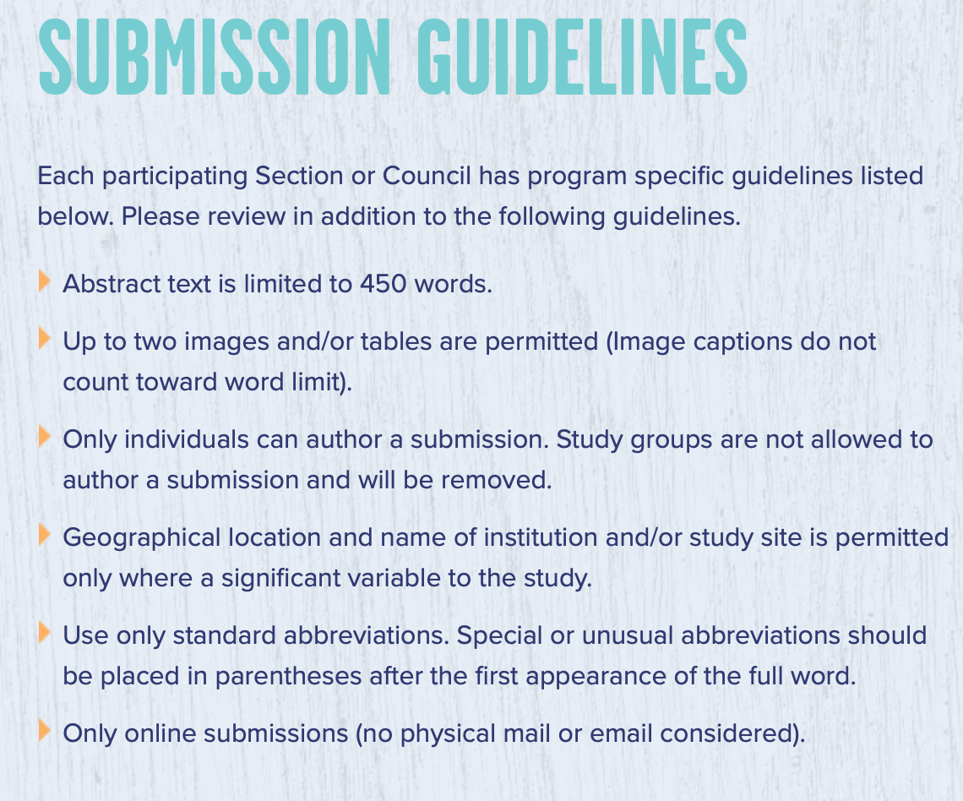
Important!! Check submission guidelines:

Slide 21

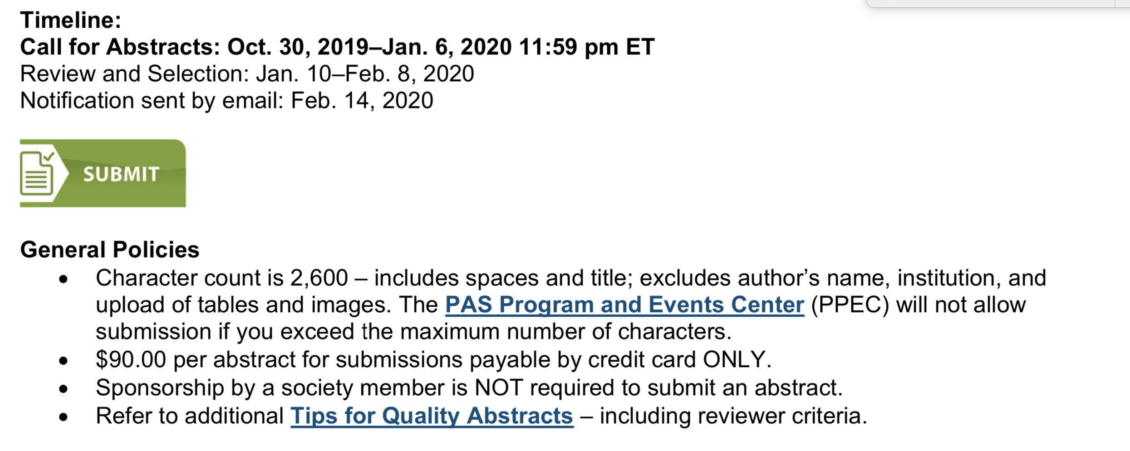
Submission guidelines:

Slide 22
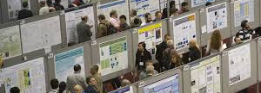
How to Make a Great Poster
;

Slide 23

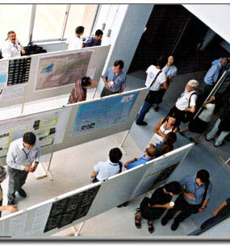
What is an academic poster?
A form of Academic Expression
Summary of Research (5 – 10 minutes)
Visually augmented
Stimulates discussion/interaction
At conferences viewers come to
you (or you can invite)
  People search published
  abstracts
  Posters may be grouped by
  field & folks may wander
New Information
Characteristic Fields
Appearance/Content varies by Field

Slide 24
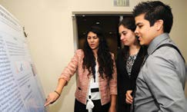
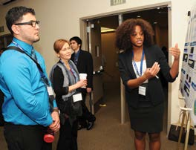
Why are they important?
Represents you and your institutions research at:
• Conferences
• Symposia
• Hallways
• Informational Days
Demonstrate expertise
Practice public speaking
Learn about most current results in field
Opportunity for teaching and
learning
Share ideas
Create collaborations

Slide 25
Principles of presentation
Tell a story (if you can: people remember stories!)
Use visuals to focus attention, not distract your audience
Use text but keep it short!
Light backgrounds are generally better
Aim for uniform columns (generally 3, maybe 4)

Slide 26
Principles of presentation
Important information should be readable from about 10 feet away
Title is short and draws interest
Word count of about 300 to 800 words
Text is clear and to the point
Use of bullets, numbering, and headlines make it easy to read
Effective use of graphics, color and fonts
Consistent and clean layout
Includes acknowledgments, your name and institutional affiliation

Slide 27
Here’s how not to do it

Slide 28
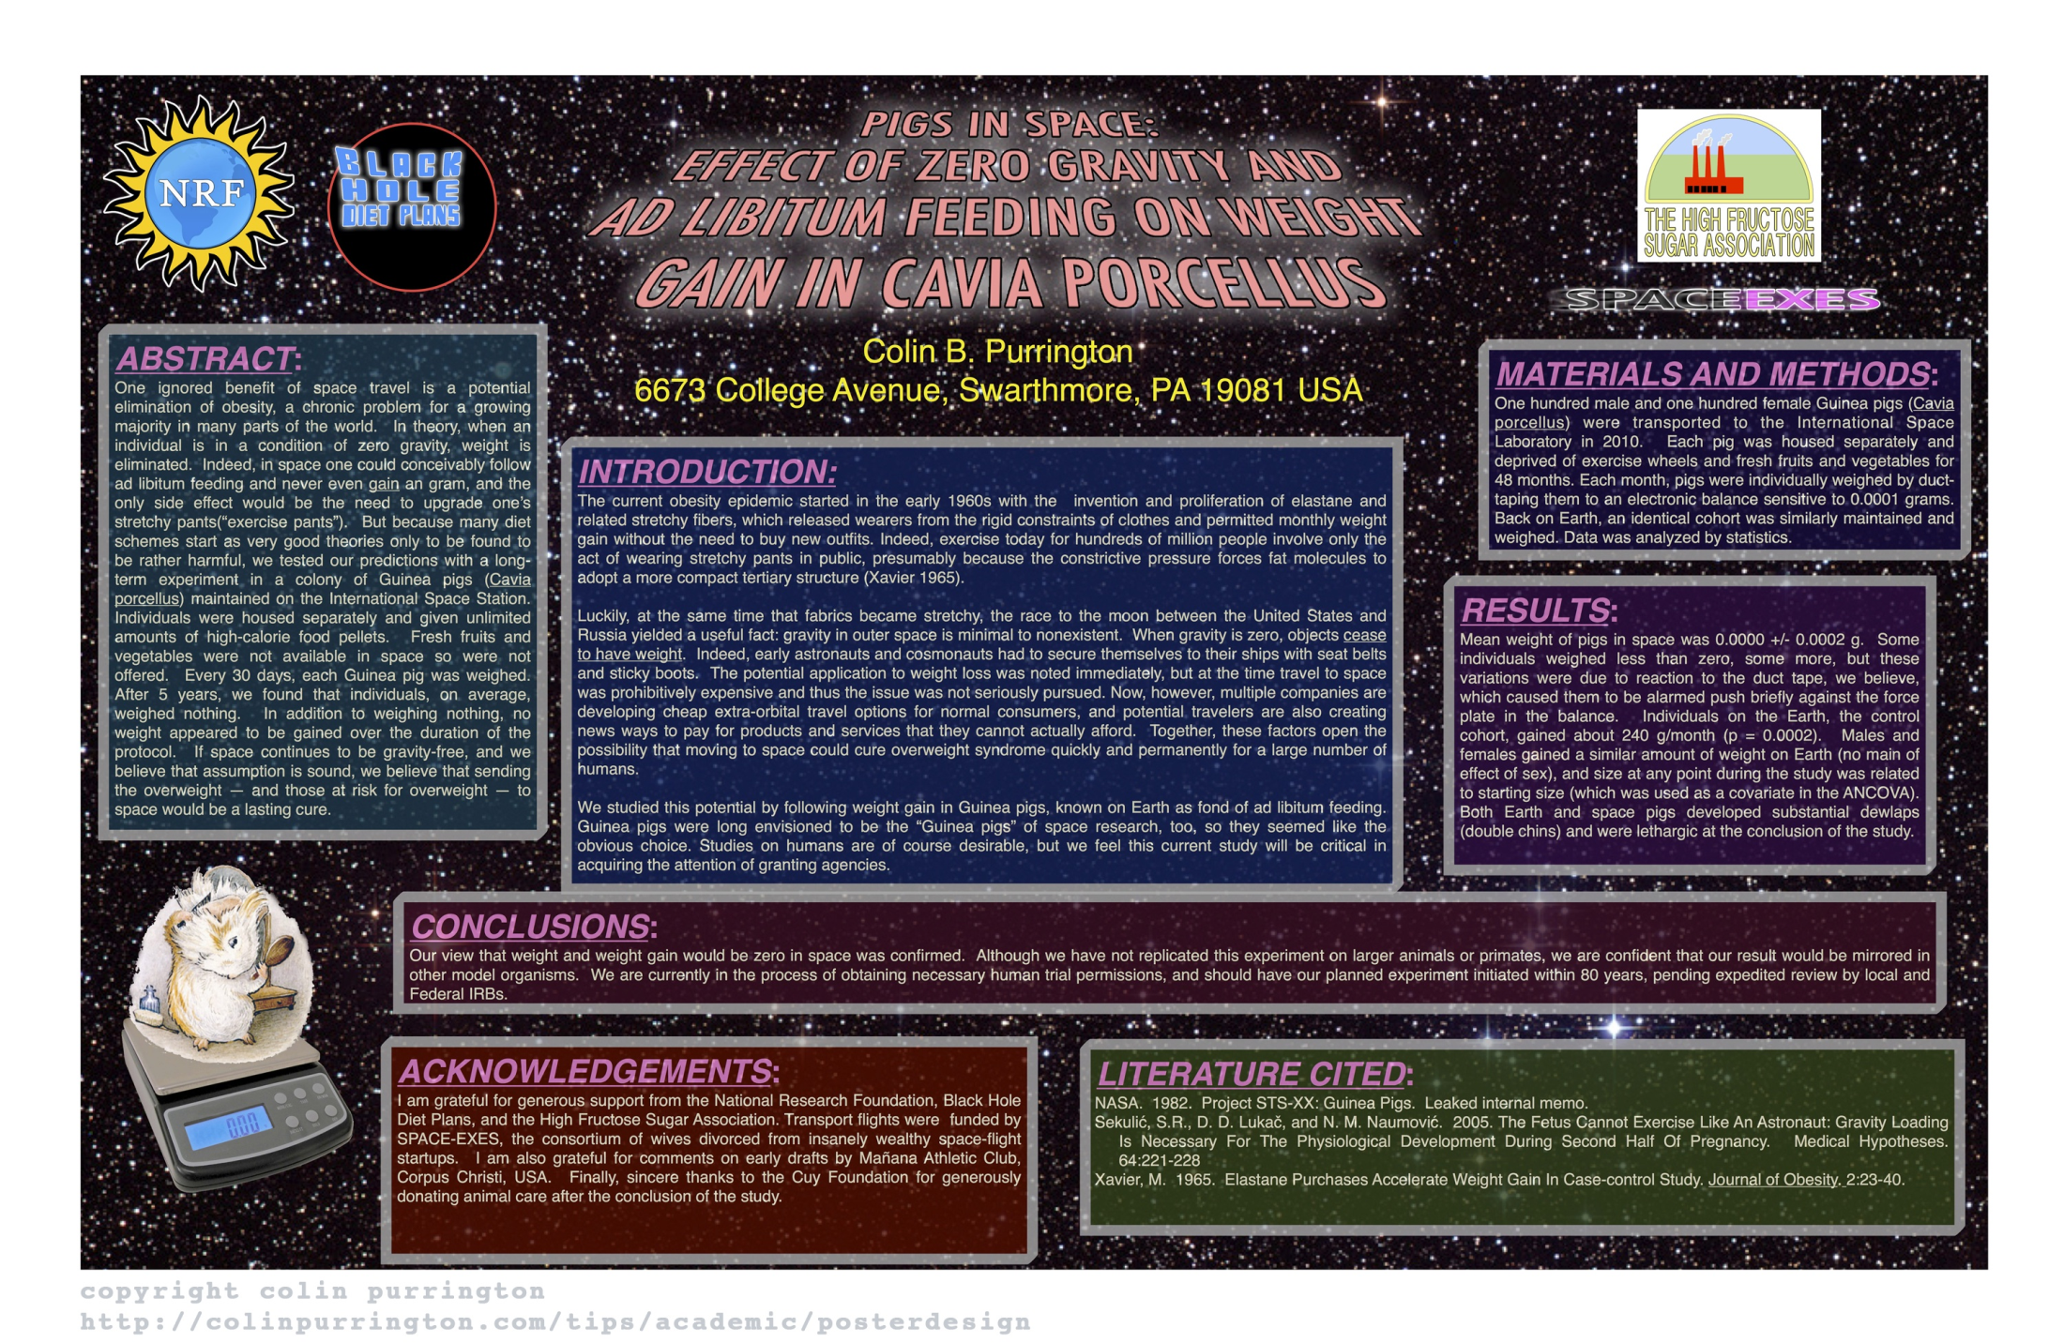

Slide 29
Here’s how to do it

Slide 30
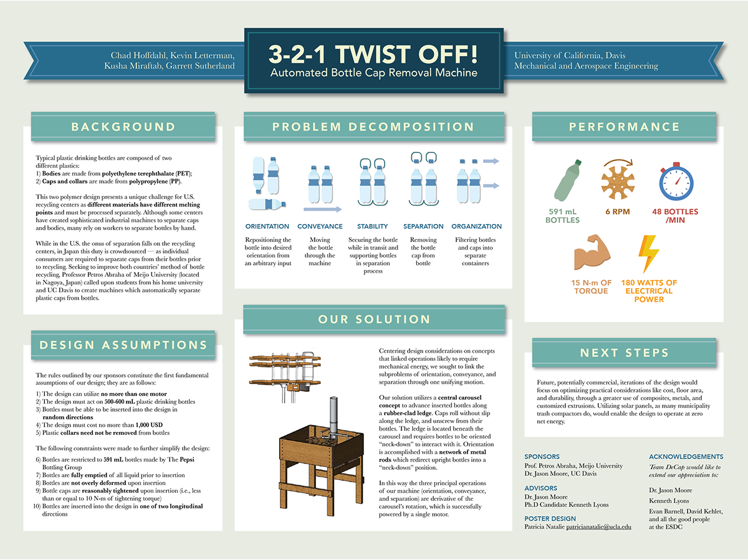

Slide 31
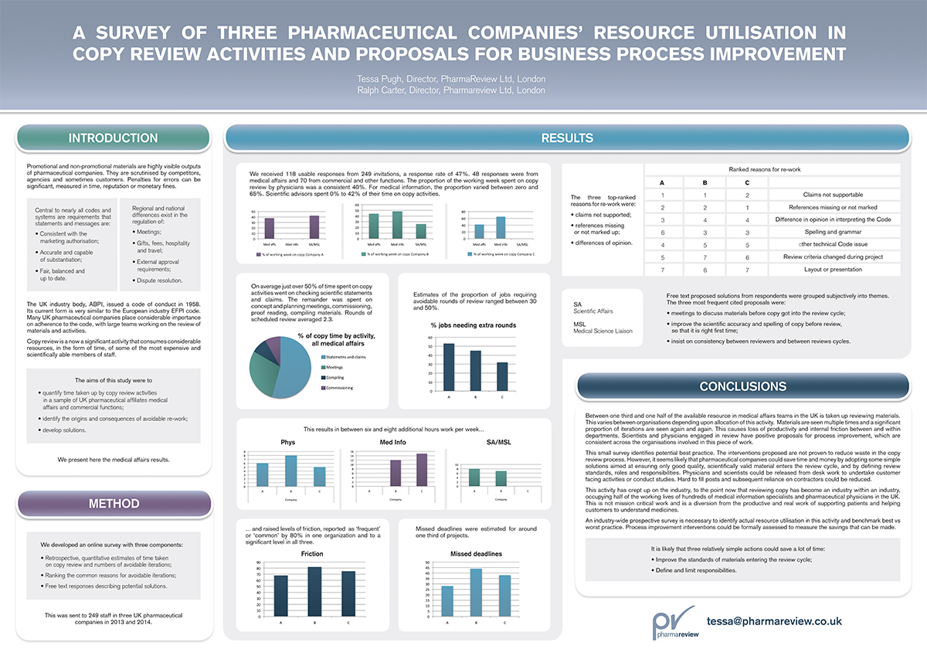

Slide 32
Look at these graphs!

Slide 33
The conclusion is a bit wordy;
could use bullet points

Slide 34
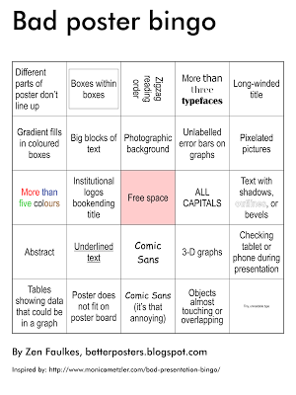

Slide 35
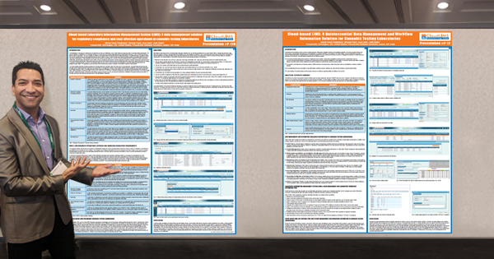
Be prepared to give a brief talk about your poster for people who are interested
During your poster session, you should be at your poster ready to present
Prepare a 5 minute talk from start to finish about what you accomplished
Optional: leave a one page handout summary with your poster for when you are not at the poster.

Slide 36
New Conference Technology

Slide 37
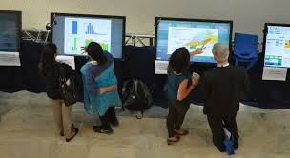
Electronic Posters:
Single Page with static text and tables
Displayed on LCD Monitor
Format is usually powerpoint but others can be used.
”poster of the future” as it is more green, easier for presenters to use, don’t have to lug poster tubes on airplanes!

Slide 38

Using QR codes
QR code allows viewers phone to upload content such as poster content , or website for additional information

Slide 39
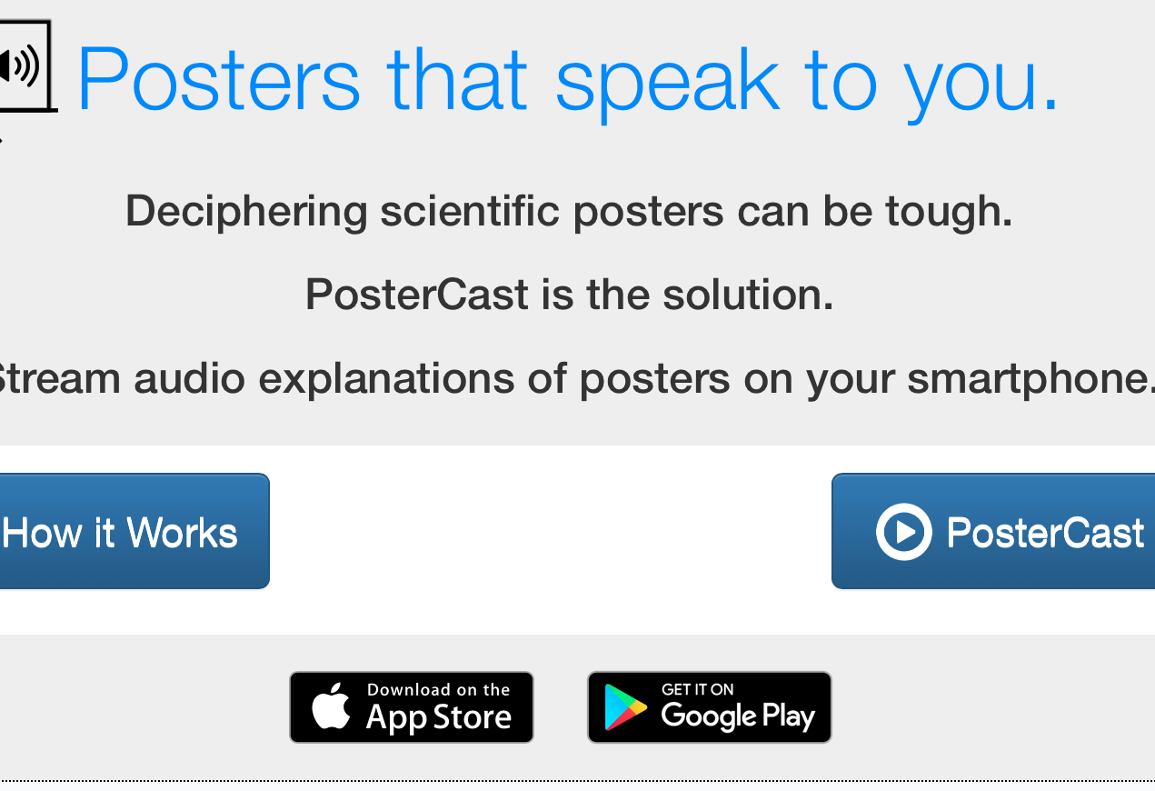
New for PAS 2020 : Poster Cast

Slide 40
AAP National Conference & Exhibition to be Virtual in 2020
More details on our new virtual meeting will be coming soon. Rest assured, we will provide the same world-class pediatric education that you expect from the AAP and come together virtually to share our experiences. Meanwhile, please continue to "save the date" and plan to join us for a one-of-a-kind AAP Experience. We can't wait to "see" you!

Slide 41

Platform Presentations

Slide 42
What are platform presentations?
Each specialty section at the conference will have it’s own session
At each session there are poster sessions and platform presentations
If your abstract is of great interest to the reviewers, it will be chosen for a platform presentation
Only a small percentage of abstracts are chosen for oral presentation, considered an honor

Slide 43
Important Points
Most presentations are 10 minutes with a few minutes for questions
Aim for about 10-15 slides maximum:
  Title
  Non disclosure
  Background (2-3 slides)
  Methods (2-3)
  Results (4-5)
  Conclusions (2-3)

Slide 44
Good luck with your abstracts!!
Questions??

