Slide 1










PHYSICAN EXPERIENCE MAP
UMass Memorial Health (UMMH) and UMass Medical School (UMMS)
ARRIVAL &
ONBOARDING
HEALTH &
WELLBEING
LEARNING &
DEVELOPMENT
TRANSFORMATION & INNOVATION
RECOGNITION &
CELEBRATION
Choice of Generous UMMH Benefits Plans
(Health, Wellness, Retirement, Child Care, Tuition Assistance, etc.)
New Physician Luncheon with President & CEO, Dr. Eric Dickson
New UMMS
Faculty Orientation*
Epic training
  Clinician Experience Officer (CXO)
  Provider Wellness Resources
  (e.g., Center for Mindfulness, Physicians Health Services, Peer Support Network, House Office Counseling Services. See attachment)
  Wellness Coaching for Physicians by Physicians
  Employee Assistance Program
  and Counseling
  Personal Health Nurse Program
  Financial: Emergency Assistance Support for Employees (EASE)
  Lean Belt Program
  (White, Yellow, Green, Black)
  Professional Development
  UMMH: Quality Scholars, Speed of Trust, Crucial Conversations
  UMMS: Junior Faculty Development, Preparing for Promotion Workshop*
  Leadership Development
  (e.g., Coaching, Elevating Leadership, Physician Leadership Development Program, UMMS EMPOWER Summit*, etc.)
  SPARK (Online Personal / Professional Growth Platform)
  Standards of Respect (SOR)
  Coaching for development
  Idea Systems
  Innovation Station Innovation Fund Grants
  Quality Improvement and Clinical Innovation ECOG Grant
  Diversity, Equity and
  Inclusion Grant Fund
  Prize for Academic Collaboration and Excellence (PACE)
  UMatter Central Online Recognition Portal
  Innovators of the Year
  (Recognize Best Ideas
  and Idea systems)
  Innovation Celebrations (Monthly Celebrations of Improvement Work)
  Service Recognition Program
  (Milestone Anniversaries)
  Employee Gift
* Dually employed physicians only
COMMUNITY INVOLVEMENT
Anchor Mission
Volunteer Opportunities
Community Activities
Financial Investment in Community
DIVERSITY, EQUITY AND INCLUSION
Employee Resource Groups (ERGs)
Cultural Celebrations and Activities
DEI Office (Diversity, Equity and Inclusion)
Ethics Point (Confidential Reporting)

Slide 2
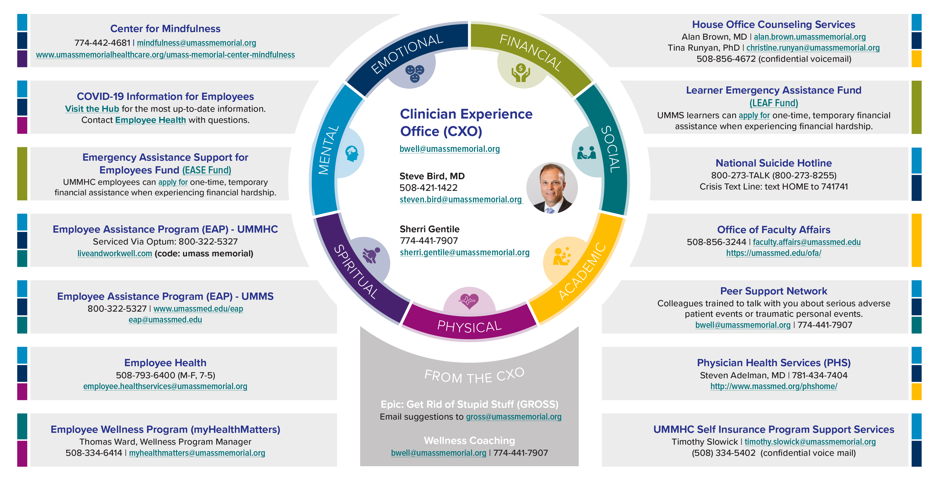
PROVIDER WELLNESS RESOURCES

