Slide 1

The Recorded Home Oximetry (RHO) Program
Monthly Investigator Meeting
January 5, 2023

Slide 2

RHO Program Implementation Timeline
Feb - Mar 2021
Baseline data collection begins
Mar - May 2021
Initiate site training
Initiate monthly phone calls
May - Aug 2021
Jun 2021 - Feb 2022
Feb - Aug 2022
Aug 2022 - Feb 2023
Complete site training
Reach 33% of eligible families
Reach 66% of eligible families
Feb - Aug 2023
Reach 100% of eligible families
Initiate 18-month implementation
Begin providing monthly feedback reports
Notes:
- Unchecked the goal to reach 66% as we have not fulfilled throughout the milestone period but are on our way

Slide 3



 | - Enrolling
 | - Activated but not enrolling
 | - Patient identified, not yet enrolled

Slide 4
RHO Implementation Trial Consort Diagram
Average HOT Duration:
66 ± 22

Slide 5
Goal

Slide 6
Enrollment by Site
Site Name | 1st Patient Enrolled | Duration of Implementation | Estimate Per Year | Estimate Per Month | Current Per Month | Followed | Withdrawn | Weaned from HOT | Active on HOT | Average | SD
Boston Children's | 7/8/2021 | 18.17 | 40 | 3 | 0.8 | 14 | 3 | 9 | 2 | 96.11 | 69.63
Dartmouth-Hitchcock | 1/1/2022 | 12.27 | 20 | 2 | 1.6 | 20 | 1 | 15 | 4 | 62.20 | 69.82
Maria Fareri Children's Hospital | 11/18/2021 | 13.73 | 14 | 1 | 0.1 | 2 | 0 | 2 | 0 | 90.00 | 37.00
Massachusetts General Hospital | 7/8/2021 | 18.17 | 13 | 1 | 0.4 | 7 | 1 | 6 | 0 | 92.83 | 50.62
University of Maryland | 8/21/2021 | 16.70 | 20 | 2 | 1.1 | 19 | 6 | 10 | 3 | 55.00 | 36.35
Vanderbilt | 4/28/2021 | 20.53 | 70 | 6 | 0.1 | 3 | 2 | 0 | 1
Arkansas Children's Hospital | 10/20/2021 | 14.70 | 48 | 4 | 1.1 | 16 | 5 | 5 | 6 | 86.80 | 45.91
Children's Hospital of Philidelphia | 5/26/2021 | 19.60 | 50 | 4 | 0.2 | 4 | 1 | 2 | 1 | 51.00 | 27.90
Cincinnati Children's Hopsital | 9/21/2022 | 3.50 | 50 | 4 | 0.6 | 2 | 0 | 0 | 2
National Jewish Health | 8/24/2022 | 4.43 | 250 | 21 | 3.2 | 14 | 3 | 0 | 11
Nationwide Children's Hospital | 3/4/2022 | 10.20 | 75 | 6 | 3.6 | 37 | 8 | 16 | 13 | 42.88 | 29.81
Payton Manning Children's Hospital | 7/19/2022 | 5.63 | 25 | 2 | 1.2 | 7 | 3 | 2 | 2 | 11.00 | 5.91
U. of California, San Diego | 11/10/2021 | 14.00 | 65 | 5 | 0.5 | 7 | 2 | 4 | 1 | 88.25 | 73.50
U. of Kentucky Children's Hospital |  |  | 50 | 4 | 0.0 | 0 | 0 | 0 | 0
Total |  |  |  |  |  | 121 | 25 | 55 | 36 | 65.94 | 21.74

Slide 7
Implementation Trial Outcomes

Slide 10
Implementation Related Problems

Slide 12
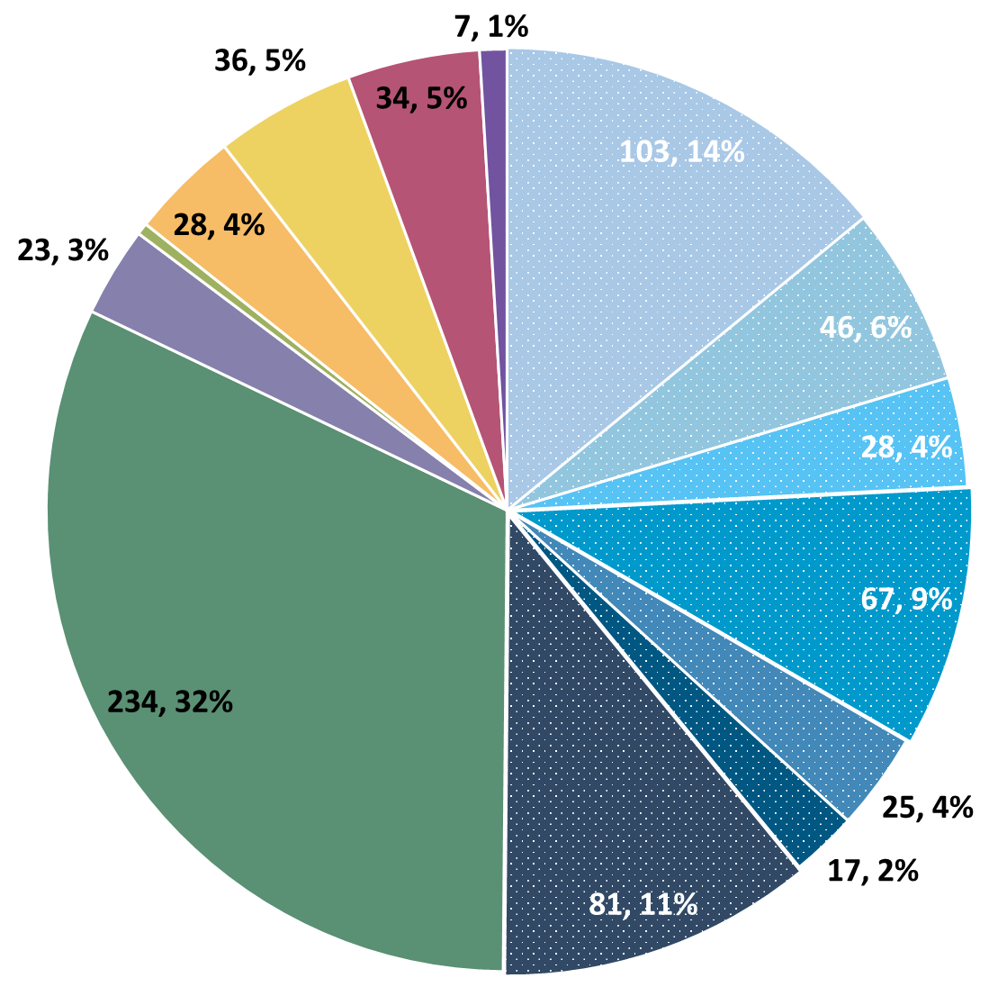
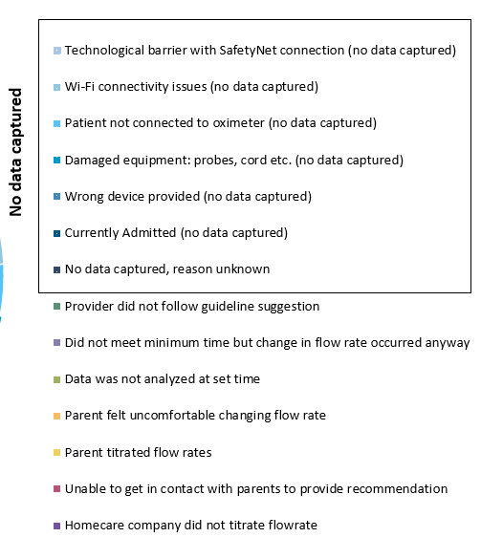
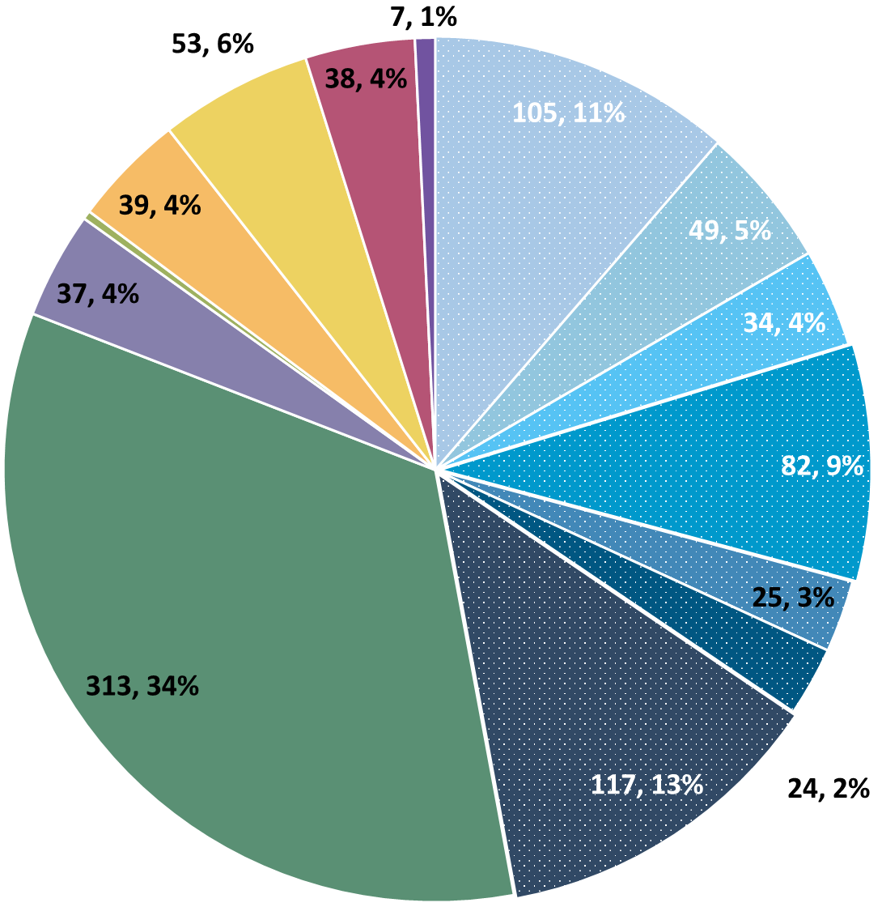
Deviation Types
Total Reports | Reports with Deviations | Reports with Deviations (excluding no data captured)
2,230 | 693 | 377
Last Months

Slide 13
Goal

Slide 14
Updates

Slide 15
Low-Quality Signal Exclusion
New Algorithm Update Started 11/21/22
Automatically Excludes Data Tagged “Low-Quality” by RAD97
Specific Babies Impacted More By Artifact Than Others
Further Investigation Necessary

Slide 16
Low-Quality Improvement Examples
Notes:
Important to note these include the two most severe cases found… of the 50 babies we currently have on the program (6% affected rate)… i.e. yes some babies were drastically affected by the update but they constitute a small portion of the overall sample size and are shown here only to demonstrate the power of this new tool

Slide 17
Discussion Points

Slide 18
Importance of Changing Probes
Minutes Valid SpO2 | Mean SpO2 | Minimum SpO2 | Maximum SpO2 | Seconds Below 96% SpO2 | Minutes Below 96% SpO2 | % Time Below 96% SpO2 | Seconds Below 93% SpO2 | Minutes Below 93% SpO2 | % Time Below 93% SpO2 | Seconds Below 90% SpO2 | Minutes Below 90% SpO2 | % Time Below 90% SpO2
1713.183 | 97.8144 | 71 | 100 | 53496 | 891.6 | 52.04347 | 49650 | 827.5 | 48.30189 | 49581 | 826.35 | 48.23477
SpO2 > 96% | 90% - 96% SpO2 | SpO2 < 90%
822 Minutes | 65 Minutes | 826 Minutes
Notes:
Reading the above spit-out it says that the baby in question spen…
822 Minutes Above 96% SpO2
65 Minutes Between 90-96% SpO2
826 Minutes Below 90% SpO2
The above information, logically does not make sense… if you see data like this CHANGE THE PROBE… we as coordinating site cannot make this recommendation as that would bias the data… all we can do is report on what the algorithm tells us, and it is up to individual sites to interpret that recommendation in the unique situation of each baby

Slide 19
Upper Respiratory Infections
RSV Season
If Serious Enough for Hospital Visit
Please fill out REDCap AE form
If Not Serious Enough for Hospital Visit
Please still inform us in download response emails
We are looking to record this data incase it has a future impact

Slide 20
No Heather
Heather has reduced presence
Please email Katie if you need anything
Emails to Heather will not be answered swiftly

Slide 21
Reminders

Slide 22
Data Queries
Sent Out December 1st
Still Missing From Some Sites

Slide 23
Reporting AEs
We Are Looking for All AE Data Until 6 Months Post-Wean
All Babies On Program Including Controls
REDCap AE Form
Notes:
We still want AE data for 6-months post wean… some sites fill out implementation discharge form as soon as weaning is done which is great! But please set a reminder or something to check back in after 6 months and see if baby has

Slide 24
Family Engagement Survey
For Sites w/out IRB Approval:
Instructions to submit to local IRBs sent out on 6/7
Please reach out to Heather and Katie with any questions/concerns/barriers
For Sites w/ IRB Approval:
Please Send Survey Links At Initial Discharge and After HOT Weaning
Spanish Version Live!
If UMASS is Sending Emails for Your Site… Please Give Us Parent Emails ASAP

Slide 25

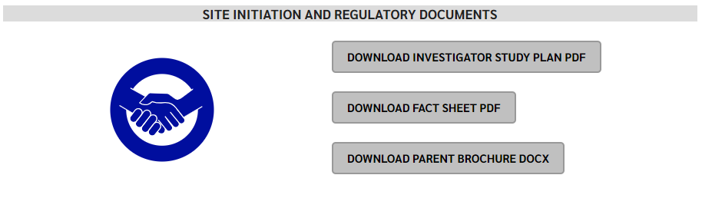
RHO Program Website
All resources, including training documents, the RHO manual, and other templates can be found on the RHO website at www.umassmed.edu/rho-program
Navigate to “Member Login” and log in with the following credentials to access the documents
  Username: RHO
  Password: Oximetry14

Slide 26



Closing Thoughts
Questions or Comments?
Are there any suggestions and/or feedback on the progress of the program that you would like to share with the team at this time?

