Slide 1

The Recorded Home Oximetry (RHO) Program
Monthly Investigator Meeting
February 2, 2023

Slide 2

RHO Program Implementation Timeline
Feb - Mar 2021
Baseline data collection begins
Mar - May 2021
Initiate site training
Initiate monthly phone calls
May - Aug 2021
Jun 2021 - Feb 2022
Feb - Aug 2022
Aug 2022 - Feb 2023
Complete site training
Reach 33% of eligible families
Reach 66% of eligible families
Feb - Aug 2023
Reach 100% of eligible families
Initiate 18-month implementation
Begin providing monthly feedback reports
Notes:
- Unchecked the goal to reach 66% as we have not fulfilled throughout the milestone period but are on our way

Slide 3



 | - Enrolling
 | - Activated but not enrolling
 | - Patient identified, not yet enrolled

Slide 4
RHO Implementation Trial Consort Diagram
Average HOT Duration:
73 ± 22

Slide 5
Goal

Slide 6
Enrollment by Site
Site Name | 1st Patient Enrolled | Duration of Implementation | Estimate Per Year | Estimate Per Month | Current Per Month | Followed | Withdrawn | Weaned from HOT | Active on HOT | Average | SD
Boston Children's | 7/8/2021 | 19.07 | 40 | 3 | 0.8 | 16 | 3 | 96.11 | 68.26 | 101.63 | 72.76
Dartmouth-Hitchcock | 1/1/2022 | 13.17 | 20 | 2 | 1.7 | 23 | 1 | 73.13 | 77.37 | 71.25 | 73.72
Maria Fareri Children's Hospital | 11/18/2021 | 14.63 | 14 | 1 | 0.1 | 2 | 0 | 90.00 | 37.00 | 90.00 | 37.00
Massachusetts General Hospital | 7/8/2021 | 19.07 | 13 | 1 | 0.4 | 8 | 1 | 92.83 | 54.17 | 112.00 | 59.33
University of Maryland | 8/21/2021 | 17.60 | 20 | 2 | 1.1 | 19 | 7 | 52.18 | 35.73 | 57.67 | 37.75
Vanderbilt | 4/28/2021 | 21.43 | 70 | 6 | 0.1 | 3 | 2
Arkansas Children's Hospital | 10/20/2021 | 15.60 | 48 | 4 | 1.1 | 17 | 5 | 89.00 | 47.73 | 98.00 | 59.55
Children's Hospital of Philidelphia | 5/26/2021 | 20.50 | 50 | 4 | 0.2 | 4 | 1 | 51.00 | 27.90 | 51.00 | 27.36
Cincinnati Children's Hopsital | 9/21/2022 | 4.40 | 50 | 4 | 1.1 | 5 | 0
National Jewish Health | 8/24/2022 | 5.33 | 250 | 21 | 3.0 | 16 | 3
Nationwide Children's Hospital | 3/4/2022 | 11.10 | 75 | 6 | 3.6 | 40 | 8 | 65.79 | 58.33 | 46.33 | 38.86
Payton Manning Children's Hospital | 7/19/2022 | 6.53 | 25 | 2 | 1.2 | 8 | 3 | 11.00 | 5.63 | 11.00 | 6.24
U. of California, San Diego | 11/10/2021 | 14.90 | 65 | 5 | 0.5 | 8 | 2 | 88.25 | 70.74 | 91.67 | 78.45
U. of Kentucky Children's Hospital | 11/21/2022 | 2.37 | 50 | 4 | 0.0 | 0 | 0
Total |  |  |  |  |  | 169 | 25 | 72.78 | 22.12 | 73.05 | 23.78

Slide 7
Implementation Trial Outcomes

Slide 10
Implementation Related Problems

Slide 12
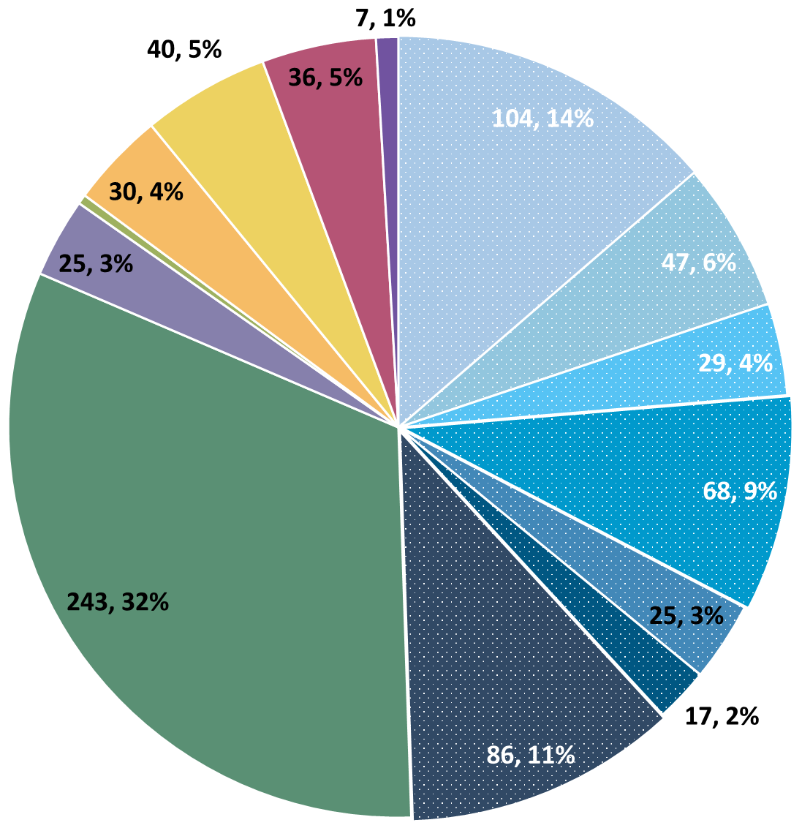
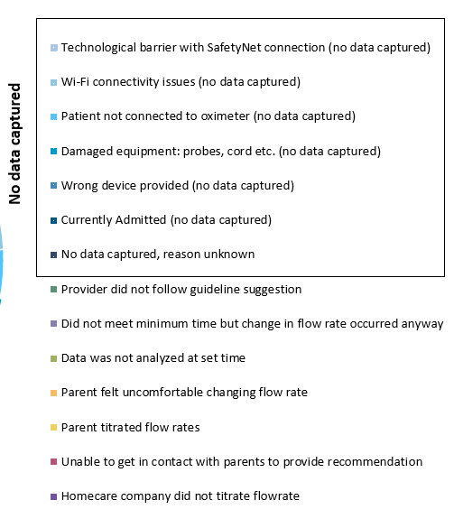
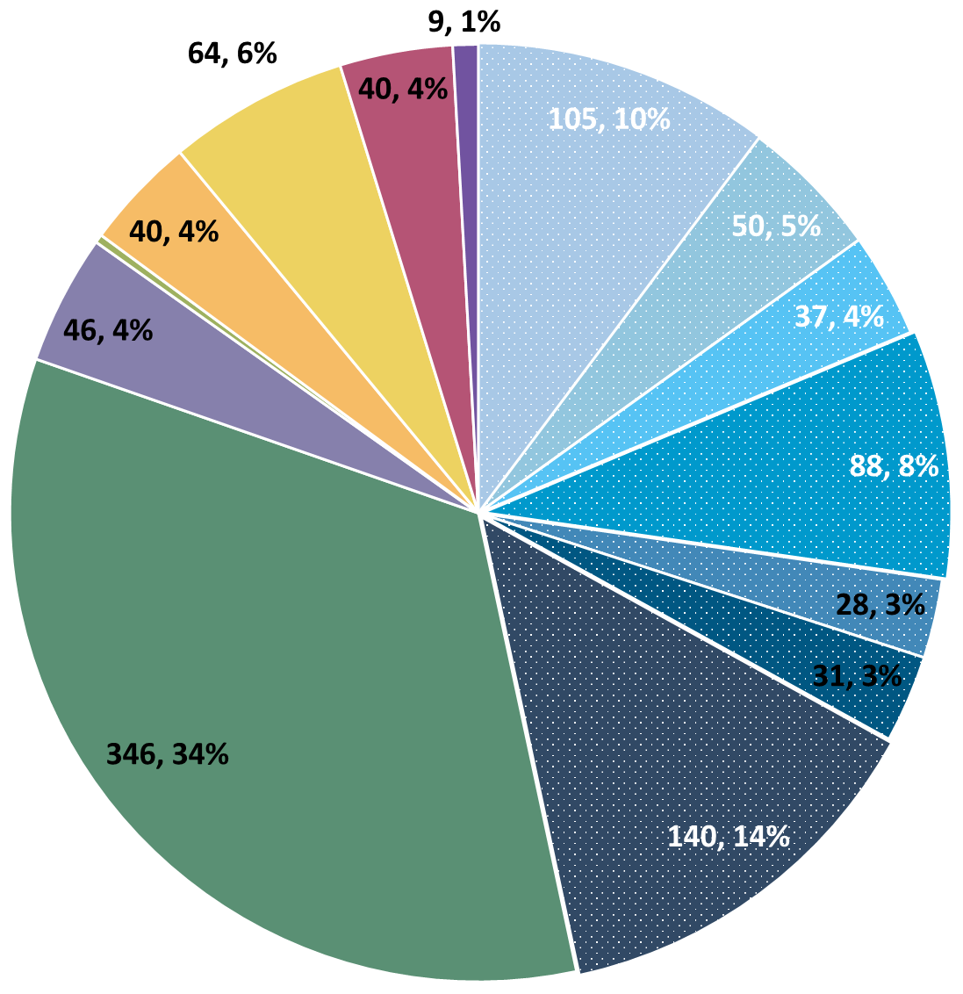
Deviation Types
Total Reports | Reports with Deviations | Reports with Deviations (excluding no data captured)
3424 | 1016 | 539
Last Months

Slide 13
Goal

Slide 14
Updates

Slide 15
Oximeter Troubleshooting

Slide 16
Follow-Up To Low-Quality Signal
Causes
Placement of the Sensor
Poor Perfusion (PI < 1)
Hands/Feet are Cold
Motion (exacerbates other issues)
Cardiac Conditions
Solves
Repeated Sensor Training
Cozies/Socks for Feet
Additional Ideas Welcome!

Slide 17
Troubleshooting Devices That Transmit Data
Most device issues are with devices that have never sent data.
But sometimes devices will send data that is known to be incorrect.
Before replacing the device, check…
that there are cozies/socks over the sensor.
that the sensor is properly attached.
that the sensor has been replaced if necessary (example on next slide).
that the patient is attached to the monitor.

Slide 18
Importance of Changing Probes
Minutes Valid SpO2 | Mean SpO2 | Minimum SpO2 | Maximum SpO2 | Seconds Below 96% SpO2 | Minutes Below 96% SpO2 | % Time Below 96% SpO2 | Seconds Below 93% SpO2 | Minutes Below 93% SpO2 | % Time Below 93% SpO2 | Seconds Below 90% SpO2 | Minutes Below 90% SpO2 | % Time Below 90% SpO2
1713.183 | 97.8144 | 71 | 100 | 53496 | 891.6 | 52.04347 | 49650 | 827.5 | 48.30189 | 49581 | 826.35 | 48.23477
SpO2 > 96% | 90% - 96% SpO2 | SpO2 < 90%
822 Minutes | 65 Minutes | 826 Minutes
Notes:
Reading the above spit-out it says that the baby in question spen…
822 Minutes Above 96% SpO2
65 Minutes Between 90-96% SpO2
826 Minutes Below 90% SpO2
The above information, logically does not make sense… if you see data like this CHANGE THE PROBE… we as coordinating site cannot make this recommendation as that would bias the data… all we can do is report on what the algorithm tells us, and it is up to individual sites to interpret that recommendation in the unique situation of each baby

Slide 19
Discussion Points

Slide 20
PAB Meeting – Forum Creation
Their Ideas
The creation of a “parent’s corner” on the RHO website.
Asking graduating parents for advice/tips/tricks for new parents.
The ability to read general testimonial from parents who have graduated on their experience.
Our Ask
Is this something you think parents at your sites would be interested in?
Thoughts on moderated vs unmoderated forums and ways to maintain validity?
Any additional ideas you’d like to share?
Notes:
Feel free to give advice/opinions here or to email us separately after the meeting

Slide 21
PAB Meeting – Reframing Expectations
Move away from telling parents this will always shorten O2 duration.
Instead emphasize increased safety and other similar benefits during pitch.
Make clear from start that the journey will likely include increases of flow rate and similar events.
Be very upfront about what alternative options would be for the patients.
Keep an open dialogue, i.e., if you notice repeated missed downloads maybe ask, “do you find this program is still working for you or would you rather try something else.”

Slide 22
Reminders

Slide 23
Reporting AEs
To Confirm Safety, We Are Looking for All AE Data Until 6 Months Post-Wean
We Require This For All Babies On Program Including Controls
The AE Form Is Available on REDCap (Katie Can Help w/ REDCap Access)

Slide 24
SAE vs AE
AE: Grades 1-3
1. Emergency Room Visit, No Intervention
2. Emergency Room Visit, Intervention
3. Hospital Admission
SAE: Grades 4-5
4. Intensive Care Admission (PICU/NICU) for Life Threatening Causes
5. Death
If Admission to Any Form of ICU, Report as SAE

Slide 25
Family Engagement Survey
For Sites w/out IRB Approval:
Instructions to submit to local IRBs sent out on 6/7
Please reach out to Heather and Katie with any questions/concerns/barriers
For Sites w/ IRB Approval:
Please Send Survey Links At Initial Discharge and After HOT Weaning
Spanish Version Coming Very Soon! (waiting on IRB)

Slide 26

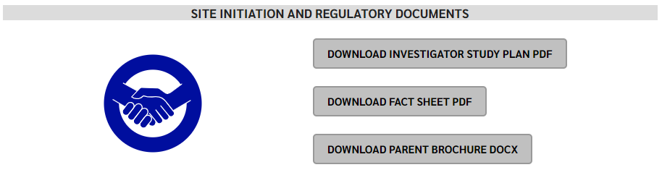
RHO Program Website
All resources, including training documents, the RHO manual, and other templates can be found on the RHO website at www.umassmed.edu/rho-program
Navigate to “Member Login” and log in with the following credentials to access the documents
  Username: RHO
  Password: Oximetry14

Slide 27



Closing Thoughts
Questions or Comments?
Are there any suggestions and/or feedback on the progress of the program that you would like to share with the team at this time?

