Slide 1

The Recorded Home Oximetry (RHO) Program
Monthly Investigator Meeting
March 2, 2023

Slide 2

RHO Program Implementation Timeline
Feb - Mar 2021
Baseline data collection begins
Mar - May 2021
Initiate site training
Initiate monthly phone calls
May - Aug 2021
Jun 2021 - Feb 2022
Feb - Aug 2022
Aug 2022 - Feb 2023
Complete site training
Reach 33% of eligible families
Reach 66% of eligible families
Feb - Aug 2023
Reach 100% of eligible families
Initiate 18-month implementation
Begin providing monthly feedback reports
Notes:
- Unchecked the goal to reach 66% as we have not fulfilled throughout the milestone period but are on our way

Slide 3
RHO Implementation Trial Consort Diagram
Average HOT Duration:
73 ± 63

Slide 4
Goal

Slide 5
Enrollment by Site
Site Name | 1st Patient Enrolled | Duration of Implementation | Estimate Per Year | Estimate Per Month | Current Per Month | Followed | Withdrawn | Weaned from HOT | Active on HOT | Average | SD
Boston Children's | 7/8/2021 | 19.07 | 40 | 3 | 0.8 | 16 | 5 | 10 | 1 | 87.50 | 67.81
Dartmouth-Hitchcock | 1/1/2022 | 13.17 | 20 | 2 | 1.6 | 23 | 1 | 16 | 6 | 73.13 | 77.37
Maria Fareri Children's Hospital | 11/18/2021 | 14.63 | 14 | 1 | 0.1 | 2 | 0 | 2 | 0 | 90.00 | 37.00
Massachusetts General Hospital | 7/8/2021 | 19.07 | 13 | 1 | 0.5 | 10 | 1 | 7 | 2 | 89.14 | 52.73
University of Maryland | 8/21/2021 | 17.60 | 20 | 2 | 1.1 | 20 | 7 | 11 | 2 | 52.18 | 35.45
Vanderbilt | 4/28/2021 | 21.43 | 70 | 6 | 0.1 | 3 | 2 | 0 | 1
Arkansas Children's Hospital | 10/20/2021 | 15.60 | 48 | 4 | 1.4 | 23 | 6 | 7 | 10 | 77.86 | 43.09
Children's Hospital of Philidelphia | 5/26/2021 | 20.50 | 50 | 4 | 0.2 | 4 | 1 | 2 | 1 | 51.00 | 27.90
Cincinnati Children's Hopsital | 9/21/2022 | 4.40 | 50 | 4 | 1.5 | 8 | 0 | 1 | 7
National Jewish Health | 8/24/2022 | 5.33 | 250 | 21 | 2.6 | 16 | 3 | 3 | 10
Nationwide Children's Hospital | 3/4/2022 | 11.10 | 75 | 6 | 3.5 | 42 | 9 | 21 | 12 | 65.43 | 57.52
Payton Manning Children's Hospital | 7/19/2022 | 6.53 | 25 | 2 | 1.2 | 9 | 3 | 4 | 2 | 37.75 | 26.69
U. of California, San Diego | 11/10/2021 | 14.90 | 65 | 5 | 0.5 | 8 | 2 | 4 | 2 | 88.25 | 70.74
U. of Kentucky Children's Hospital | 11/21/2022 | 2.37 | 50 | 4 | 0.0 | 0 | 0 | 0 | 0
Total |  |  |  |  |  | 169 | 25 | 88 | 56 | 72.64 | 62.74

Slide 6
Implementation Trial Outcomes

Slide 9
Implementation Related Problems

Slide 11
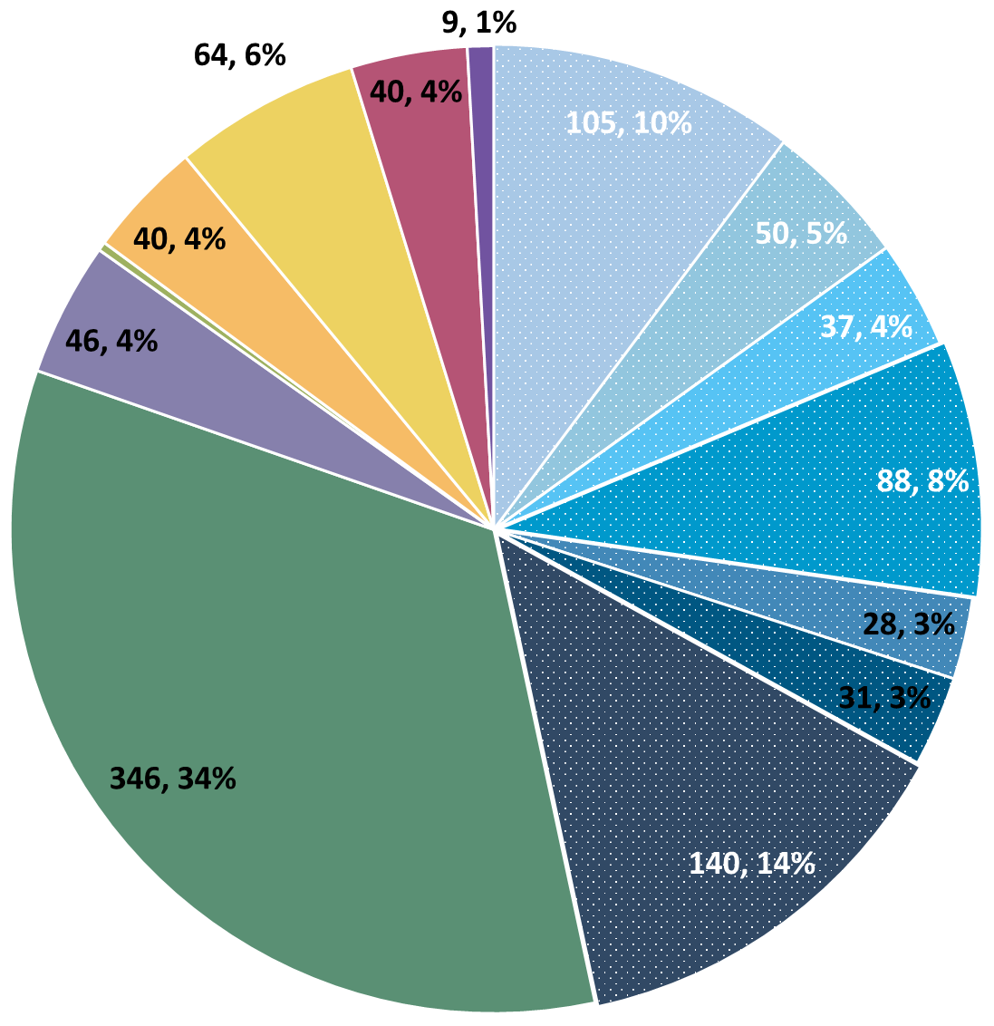
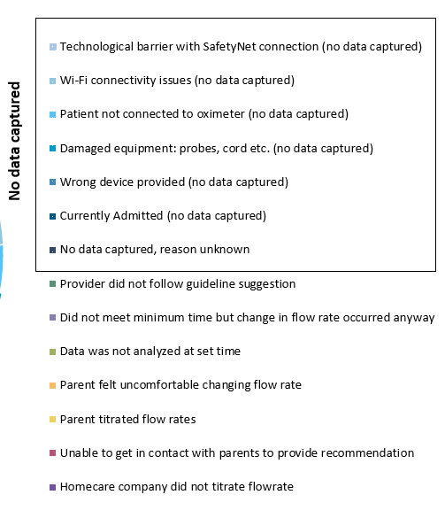
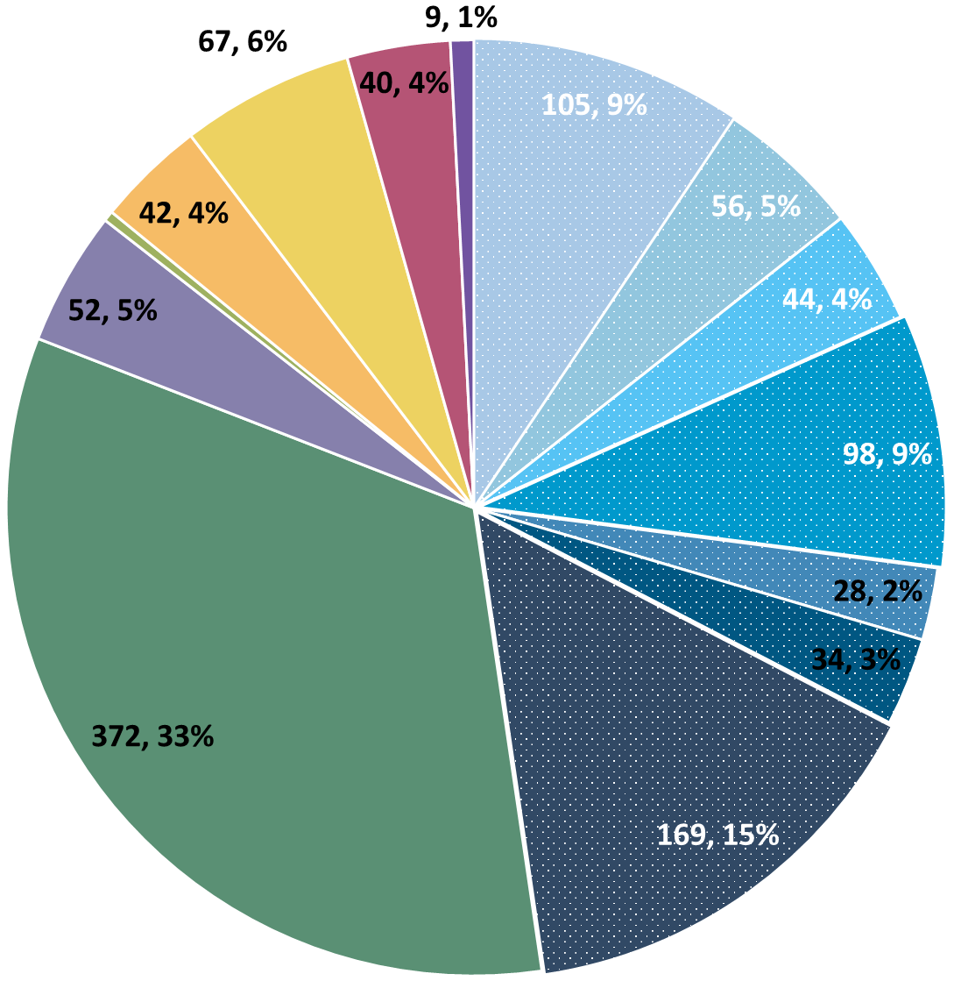
Deviation Types
Total Reports | Reports with Deviations | Reports with Deviations (excluding no data captured)
3777 | 1138 | 577
Last Months

Slide 12
Goal

Slide 13
Updates

Slide 14
Parent Forum → Parent Information Guide
Based on feedback we will be creating information packets to distribute to families as needed
We will be creating these with the help and feedback of our PAB
It may be a couple of months to get everything set and ready for distribution
We can offer real-time information but not real-time support

Slide 15
Update on the New Algorithm
We’ve now had the new algorithm for two full months
Feedback from sites has been positive
The below table is a comparison of wean/maintain/increase rates for the 4 weeks before and after the implementation of the updated algorithm
 | Old Algorithm (n=265) | New Algorithm (n=331) | Change
Increase | 30.1% | 17.8% | -12.2%
Maintain | 46.4% | 50.7% | +4.2%
Wean | 23.5% | 31.5% | +8.0%
p = 0.001

Slide 16
ESPR and PAS
Two RHO Presentations
Impact of Low-Quality SiQ on Algorithm Recommendations
Impact of Compliance on HOT Duration
Come Say Hi!

Slide 17
Discussion Points

Slide 18
Quick Poll
Which EMR does your site use?

Slide 19
Potential Protocol Change
We’ve heard feedback that for older babies, the twice weekly calls become a burden for both families and providers.
Should we amend the protocol to allow for decreased communication past a certain age?
Decreased communication could include only calling if there is a change in algorithm recommendation or something else.
We’d also like to remind sites that they can communicate with their patients through EMRs when the recommendation is a maintain as another way to minimize this burden.

Slide 20
Reminders

Slide 21
Importance of Changing Probes
Minutes Valid SpO2 | Mean SpO2 | Minimum SpO2 | Maximum SpO2 | Seconds Below 96% SpO2 | Minutes Below 96% SpO2 | % Time Below 96% SpO2 | Seconds Below 93% SpO2 | Minutes Below 93% SpO2 | % Time Below 93% SpO2 | Seconds Below 90% SpO2 | Minutes Below 90% SpO2 | % Time Below 90% SpO2
1713.183 | 97.8144 | 71 | 100 | 53496 | 891.6 | 52.04347 | 49650 | 827.5 | 48.30189 | 49581 | 826.35 | 48.23477
SpO2 > 96% | 90% - 96% SpO2 | SpO2 < 90%
822 Minutes | 65 Minutes | 826 Minutes
Notes:
Reading the above spit-out it says that the baby in question spen…
822 Minutes Above 96% SpO2
65 Minutes Between 90-96% SpO2
826 Minutes Below 90% SpO2
The above information, logically does not make sense… if you see data like this CHANGE THE PROBE… we as coordinating site cannot make this recommendation as that would bias the data… all we can do is report on what the algorithm tells us, and it is up to individual sites to interpret that recommendation in the unique situation of each baby

Slide 22
Reporting AEs
To Confirm Safety, We Are Looking for All AE Data Until 6 Months Post-Wean
We Require This For All Babies On Program Including Controls
The AE Form Is Available on REDCap (Katie Can Help w/ REDCap Access)

Slide 23
Family Engagement Survey
For Sites w/out IRB Approval:
Instructions to submit to local IRBs sent out on 6/7
Please reach out to Heather and Katie with any questions/concerns/barriers
For Sites w/ IRB Approval:
Please Send Survey Links At Initial Discharge and After HOT Weaning
Spanish Version Coming Very Soon! (waiting on IRB)

Slide 24

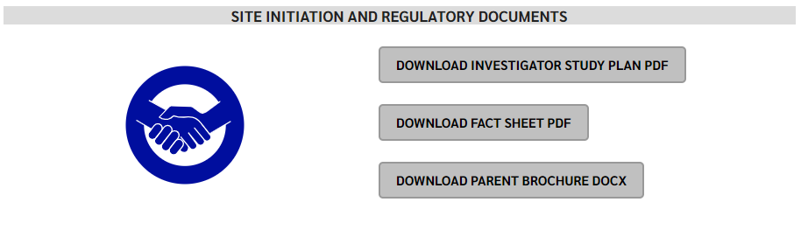
RHO Program Website
All resources, including training documents, the RHO manual, and other templates can be found on the RHO website at www.umassmed.edu/rho-program
Navigate to “Member Login” and log in with the following credentials to access the documents
  Username: RHO
  Password: Oximetry14

Slide 25



Closing Thoughts
Questions or Comments?
Are there any suggestions and/or feedback on the progress of the program that you would like to share with the team at this time?

