Slide 1

The Recorded Home Oximetry (RHO) Program
Monthly Investigator Meeting
March 7th, 2024

Slide 2

RHO Program Implementation Timeline
Feb - Mar 2021
Baseline data collection begins
Mar - May 2021
Initiate site training
Initiate monthly phone calls
May - Aug 2021
Jun 2021 - Feb 2022
Feb - Aug 2022
Aug 2022 - Feb 2023
Complete site training
Reach 33% of eligible families
Reach 66% of eligible families
Feb - Aug 2023
Reach 100% of eligible families
Initiate 18-month implementation
Begin providing monthly feedback reports
Notes:
- Unchecked the goal to reach 66% as we have not fulfilled throughout the milestone period but are on our way

Slide 3
RHO Implementation Trial Consort Diagram
Average HOT Duration:
76 ± 62

Slide 4
Goal
Notes:
Only 4 enrollments in December

Slide 6
Enrollment by Site
Site Name | 1st Patient Enrolled | Duration of Implementation | Estimate Per Year | Estimate Per Month | Current Per Month | Followed | Withdrawn | Weaned from HOT | Active on HOT | Average | SD
Boston Children's | 7/8/2021 | 32.23 | 40 | 3 | 1.0 | 32 | 10 | 18 | 4 | 67.56 | 51.63
Dartmouth-Hitchcock | 1/1/2022 | 26.33 | 20 | 2 | 1.1 | 29 | 1 | 27 | 1 | 81.19 | 85.29
Maria Fareri Children's Hospital | 11/18/2021 | 27.80 | 14 | 1 | 0.4 | 12 | 5 | 6 | 1 | 76.50 | 44.22
Massachusetts General Hospital | 7/8/2021 | 32.23 | 13 | 1 | 0.4 | 12 | 1 | 10 | 1 | 80.60 | 49.31
University of Maryland | 8/21/2021 | 30.77 | 20 | 2 | 1.7 | 51 | 18 | 31 | 2 | 49.87 | 36.18
Vanderbilt | 4/28/2021 | 34.60 | 70 | 6 | 0.2 | 6 | 6 | 0 | 0
Arkansas Children's Hospital | 10/20/2021 | 28.77 | 48 | 4 | 1.2 | 35 | 13 | 20 | 2 | 102.25 | 64.33
Children's Hospital of Philadelphia | 5/26/2021 | 33.67 | 50 | 4 | 0.1 | 4 | 1 | 3 | 0 | 105.33 | 77.86
Cincinnati Children's Hospital | 9/21/2022 | 17.57 | 50 | 4 | 1.8 | 32 | 8 | 20 | 4 | 58.70 | 42.93
National Jewish Health | 8/24/2022 | 18.50 | 250 | 21 | 1.6 | 29 | 18 | 6 | 5 | 165.17 | 76.25
Nationwide Children's Hospital | 3/4/2022 | 24.27 | 75 | 6 | 2.5 | 61 | 24 | 35 | 2 | 74.80 | 58.10
Payton Manning Children's Hospital | 7/19/2022 | 19.70 | 25 | 2 | 0.8 | 15 | 5 | 9 | 1 | 67.11 | 63.89
U. of California, San Diego | 11/10/2021 | 28.07 | 65 | 5 | 0.4 | 11 | 4 | 7 | 0 | 89.00 | 69.20
U. of Kentucky Children's Hospital | 11/21/2022 | 15.53 | 50 | 4 | 0.0 | 0 | 0 | 0 | 0
Total |  |  | 790 | 66 | 13 | 329 | 114 | 192 | 23 | 75.99 | 62.39

Slide 7
Implementation Trial Outcomes

Slide 8
Average HOT Duration:
76 ± 62
Goal

Slide 11
Average Control HOT Duration:
123 ± 97

Slide 12
Implementation Related Problems

Slide 13
Implementation Quarter-Year

Slide 14
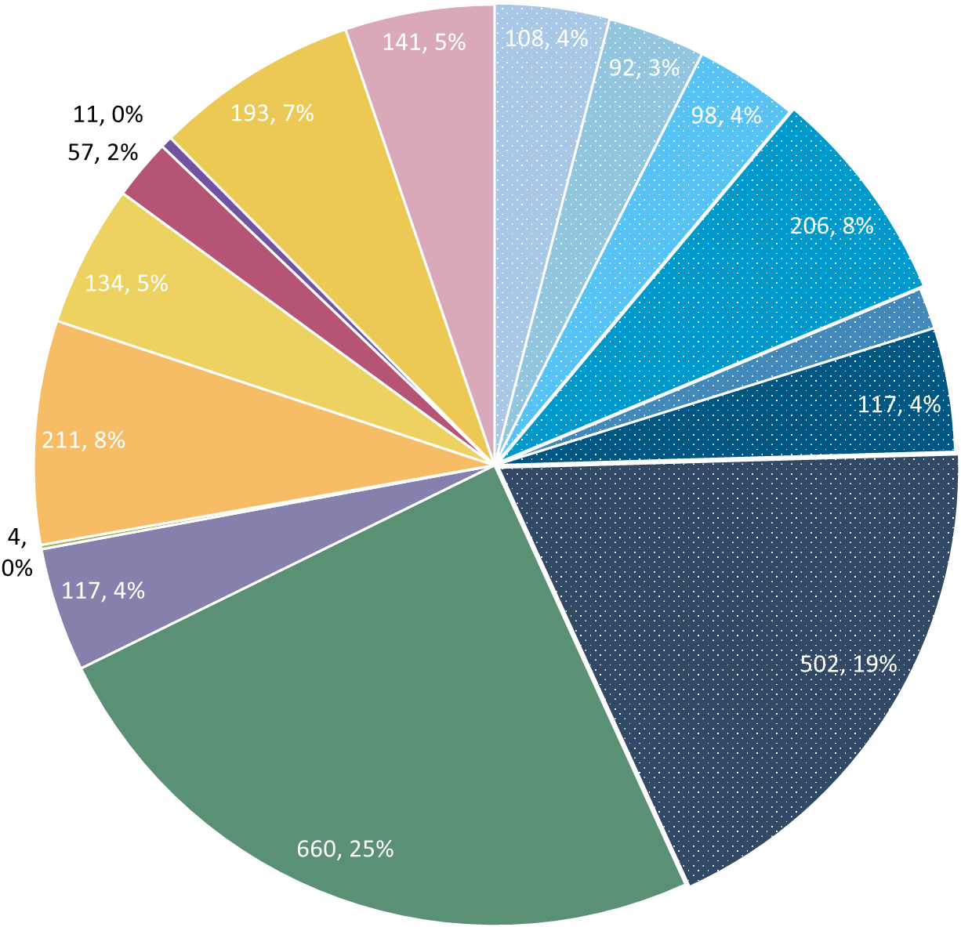
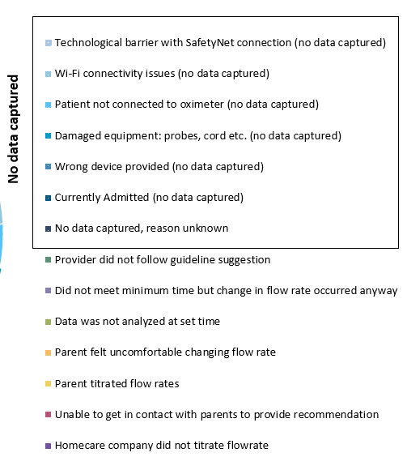
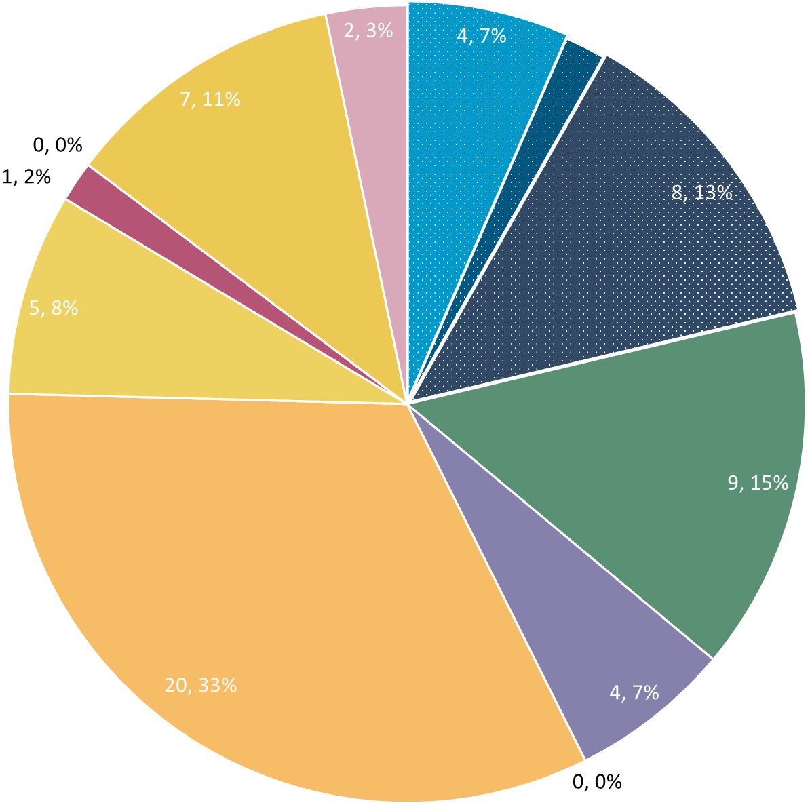
Deviation Types
Total Reports | Reports with Deviations | Reports with Deviations (excluding no data captured)
8058 | 2644 | 1528
Total
Last Month

Slide 15
Goal

Slide 16
Updates

Slide 17
New Variables (Not Mandatory)
New Variables
COI
Growth/Nutrition
Pulmonary Medications
REDCap Forms Are Out!
Contact Heather/Katie w/ Questions
Examples on Next Slides

Slide 18
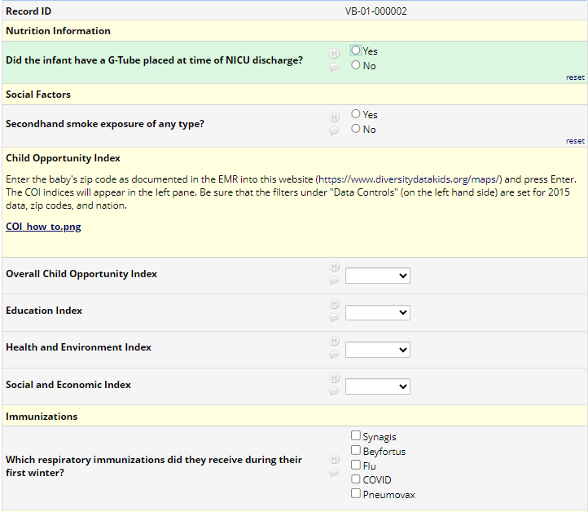
Additional Variable Forms

Slide 19
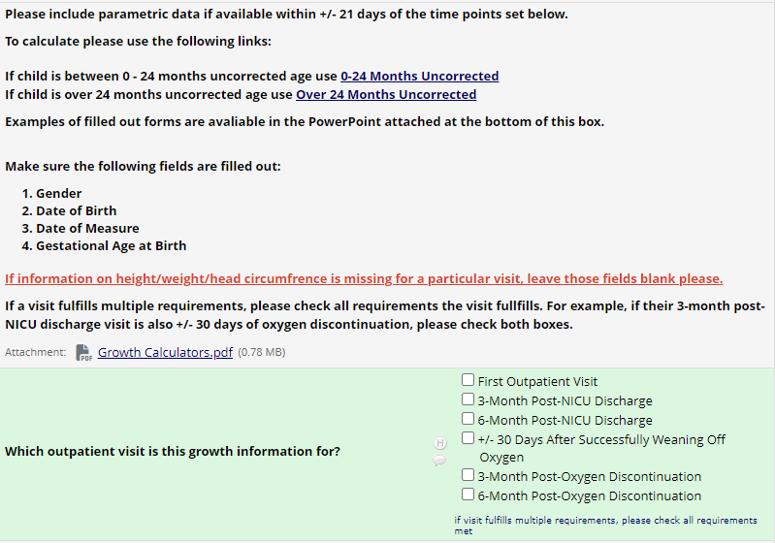
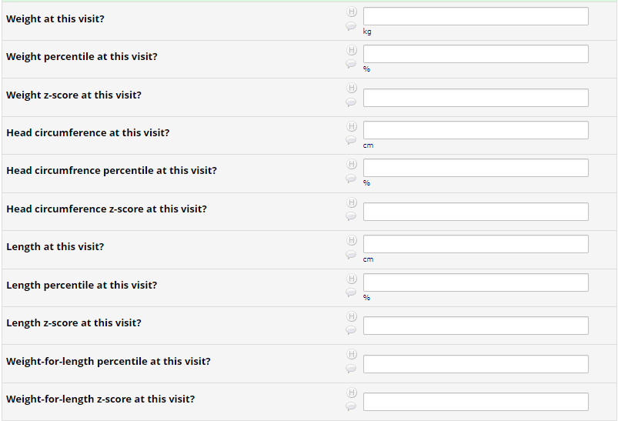
Growth Forms

Slide 20
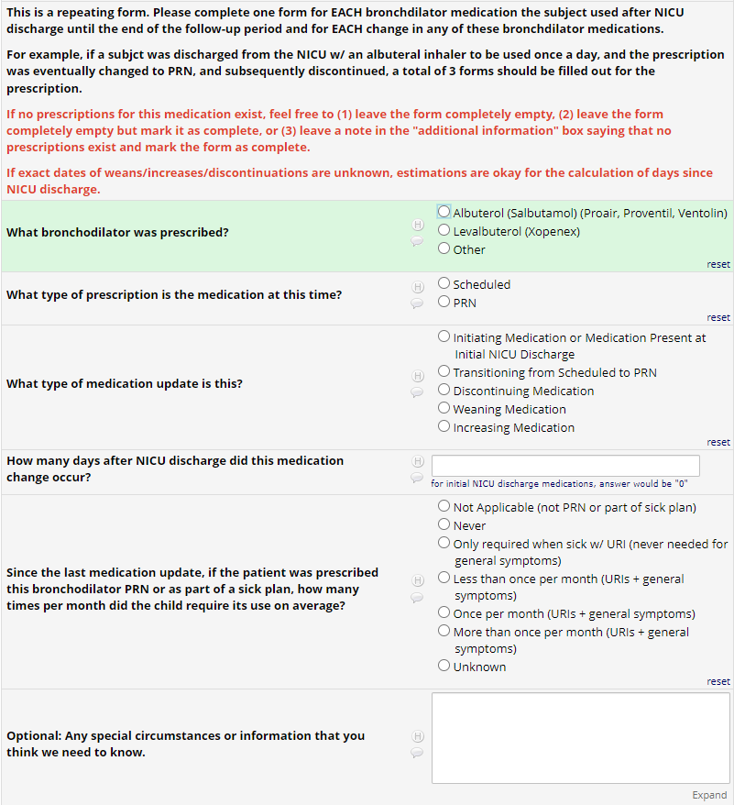
Medication Forms

Slide 21
Quantitative Cost Analysis Surveys
Coming out in March
Necessary to know how best to continue RHO after study ends
Questions about volume, start-up costs, and operating costs at your site
Should be filled out with/by someone knowledgeable about the budget at your site

Slide 22
Discussion

Slide 23
Reminders

Slide 24
Family Engagement Survey
Reminder for all sites that have IRB approval that survey links should be sent to all families enrolled
Defined project milestone
Severely behind enrollment schedule (0.01% response rate)

Slide 25



Closing Thoughts
Questions or Comments?
Are there any suggestions and/or feedback on the progress of the program that you would like to share with the team at this time?

Slide 26
Consenting Reminders
OKAY to consent at first pulmonary follow-up if missed at NICU discharge.
Consent is for SHARING data not USING program.
If RHO not feasible, please still present fact sheet and ask for permission to use data as control.

Slide 27
Controls
Reminder: subjects withdrawn are still counted as controls if possible
Control Infant REDCap Forms
Screening
Demographics
AEs
Implementation Discharge
6 Months Post-Wean = Forms Complete
Controls Needed for Further Analysis

Slide 28
Contacting Patients Through the EMR
If the RHO recommendation is a maintain, you can contact patients using your EMR instead of a phone call if you prefer.

Slide 29
Reporting AEs
To Confirm Safety, We Are Looking for All AE Data Until 6 Months Post-Wean
We Require This For All Babies On Program Including Controls
The AE Form Is Available on REDCap (Katie Can Help w/ REDCap Access)

Slide 30
Importance of Changing Probes
Minutes Valid SpO2 | Mean SpO2 | Minimum SpO2 | Maximum SpO2 | Seconds Below 96% SpO2 | Minutes Below 96% SpO2 | % Time Below 96% SpO2 | Seconds Below 93% SpO2 | Minutes Below 93% SpO2 | % Time Below 93% SpO2 | Seconds Below 90% SpO2 | Minutes Below 90% SpO2 | % Time Below 90% SpO2
1713.183 | 97.8144 | 71 | 100 | 53496 | 891.6 | 52.04347 | 49650 | 827.5 | 48.30189 | 49581 | 826.35 | 48.23477
SpO2 > 96% | 90% - 96% SpO2 | SpO2 < 90%
822 Minutes | 65 Minutes | 826 Minutes
Notes:
Reading the above spit-out it says that the baby in question spen…
822 Minutes Above 96% SpO2
65 Minutes Between 90-96% SpO2
826 Minutes Below 90% SpO2
The above information, logically does not make sense… if you see data like this CHANGE THE PROBE… we as coordinating site cannot make this recommendation as that would bias the data… all we can do is report on what the algorithm tells us, and it is up to individual sites to interpret that recommendation in the unique situation of each baby

Slide 31

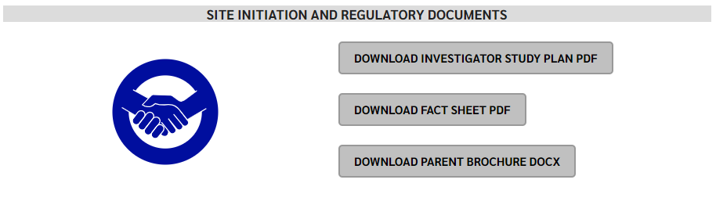
RHO Program Website
All resources, including training documents, the RHO manual, and other templates can be found on the RHO website at www.umassmed.edu/rho-program
Navigate to “Member Login” and log in with the following credentials to access the documents
  Username: RHO
  Password: Oximetry14

