Slide 1

The Recorded Home Oximetry (RHO) Program
Monthly Investigator Meeting
May 4, 2023

Slide 2




Slide 3

RHO Program Implementation Timeline
Feb - Mar 2021
Baseline data collection begins
Mar - May 2021
Initiate site training
Initiate monthly phone calls
May - Aug 2021
Jun 2021 - Feb 2022
Feb - Aug 2022
Aug 2022 - Feb 2023
Complete site training
Reach 33% of eligible families
Reach 66% of eligible families
Feb - Aug 2023
Reach 100% of eligible families
Initiate 18-month implementation
Begin providing monthly feedback reports
Notes:
- Unchecked the goal to reach 66% as we have not fulfilled throughout the milestone period but are on our way

Slide 4
RHO Implementation Trial Consort Diagram
Average HOT Duration:
79 ± 61

Slide 5
Goal

Slide 6
Enrollment by Site
Site Name | 1st Patient Enrolled | Duration of Implementation | Estimate Per Year | Estimate Per Month | Current Per Month | Followed | Withdrawn | Weaned from HOT | Active on HOT | Average | SD
Boston Children's | 7/8/2021 | 22.07 | 40 | 3 | 0.7 | 16 | 5 | 10 | 1 | 83.60 | 67.79
Dartmouth-Hitchcock | 1/1/2022 | 16.17 | 20 | 2 | 1.4 | 23 | 1 | 19 | 3 | 75.42 | 75.50
Maria Fareri Children's Hospital | 11/18/2021 | 17.63 | 14 | 1 | 0.4 | 7 | 0 | 2 | 5 | 90.00 | 45.21
Massachusetts General Hospital | 7/8/2021 | 22.07 | 13 | 1 | 0.5 | 11 | 1 | 8 | 2 | 92.50 | 52.90
University of Maryland | 8/21/2021 | 20.60 | 20 | 2 | 1.4 | 29 | 10 | 13 | 6 | 48.77 | 31.93
Vanderbilt | 4/28/2021 | 24.43 | 70 | 6 | 0.2 | 5 | 2 | 0 | 3
Arkansas Children's Hospital | 10/20/2021 | 18.60 | 48 | 4 | 1.3 | 24 | 9 | 11 | 4 | 107.73 | 67.62
Children's Hospital of Philadelphia | 5/26/2021 | 23.50 | 50 | 4 | 0.2 | 4 | 1 | 2 | 1 | 54.50 | 29.12
Cincinnati Children's Hospital | 9/21/2022 | 7.40 | 50 | 4 | 1.6 | 12 | 2 | 8 | 2 | 71.13 | 48.76
National Jewish Health | 8/24/2022 | 8.33 | 250 | 21 | 2.3 | 19 | 5 | 3 | 11 | 100.00 | 39.40
Nationwide Children's Hospital | 3/4/2022 | 14.10 | 75 | 6 | 3.0 | 42 | 12 | 26 | 4 | 85.88 | 65.39
Payton Manning Children's Hospital | 7/19/2022 | 9.53 | 25 | 2 | 1.0 | 10 | 4 | 4 | 2 | 49.75 | 35.05
U. of California, San Diego | 11/10/2021 | 17.90 | 65 | 5 | 0.5 | 9 | 2 | 5 | 2 | 78.40 | 66.72
U. of Kentucky Children's Hospital | 11/21/2022 | 5.37 | 50 | 4 | 0.0 | 0 | 0 | 0 | 0
Total |  |  |  |  | 13 | 211 | 54 | 111 | 46 | 79.37 | 61.32

Slide 7
Implementation Trial Outcomes

Slide 10
Implementation Related Problems

Slide 11
Implementation Month-Year

Slide 12
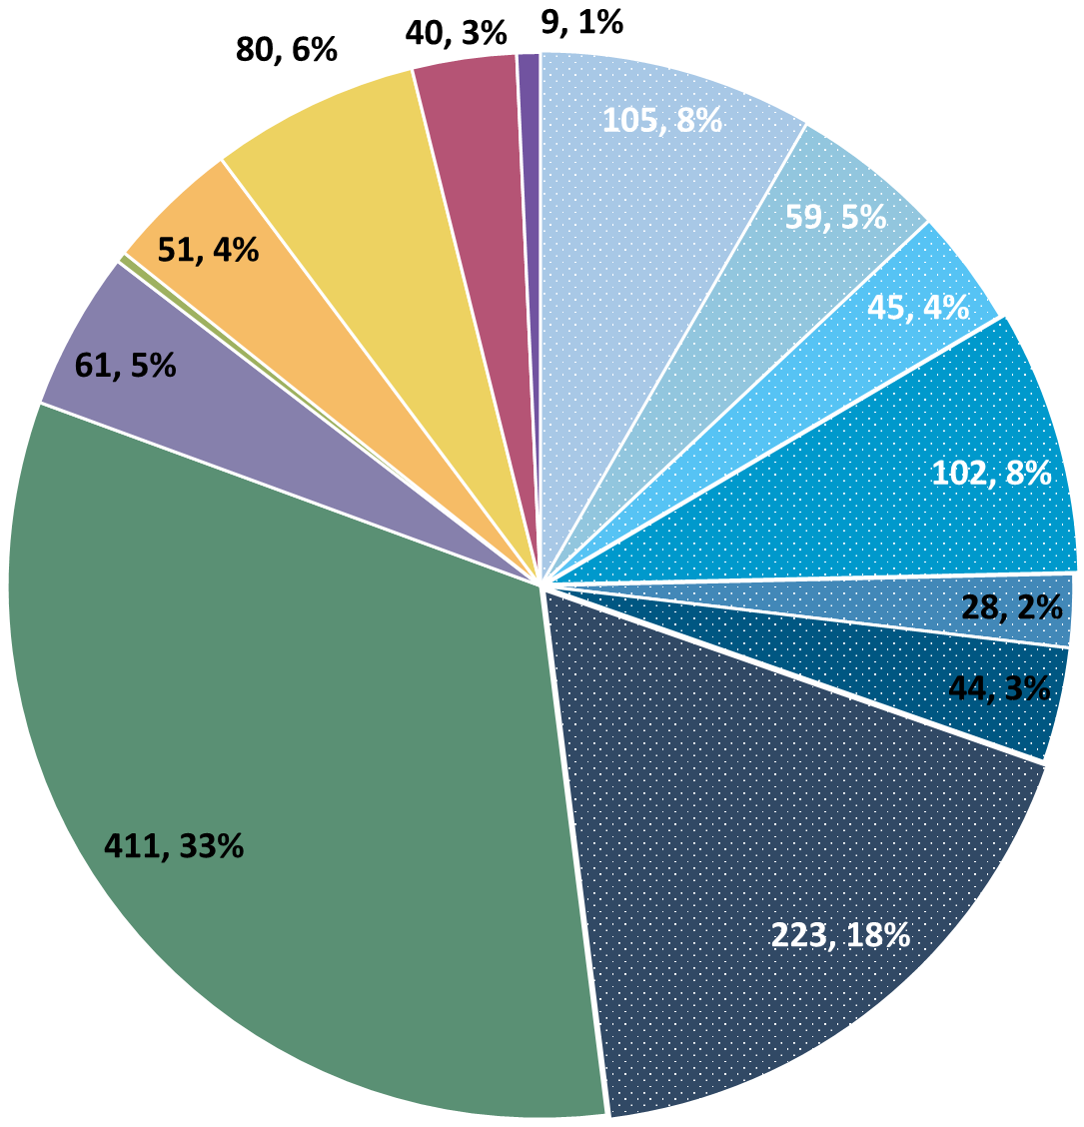
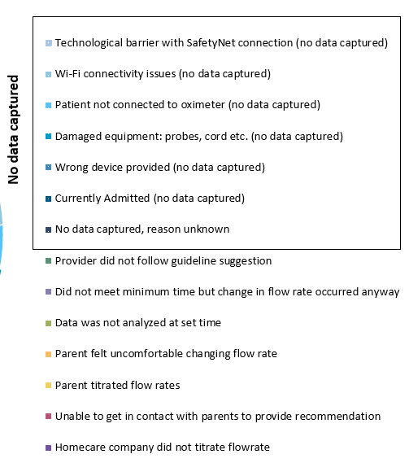
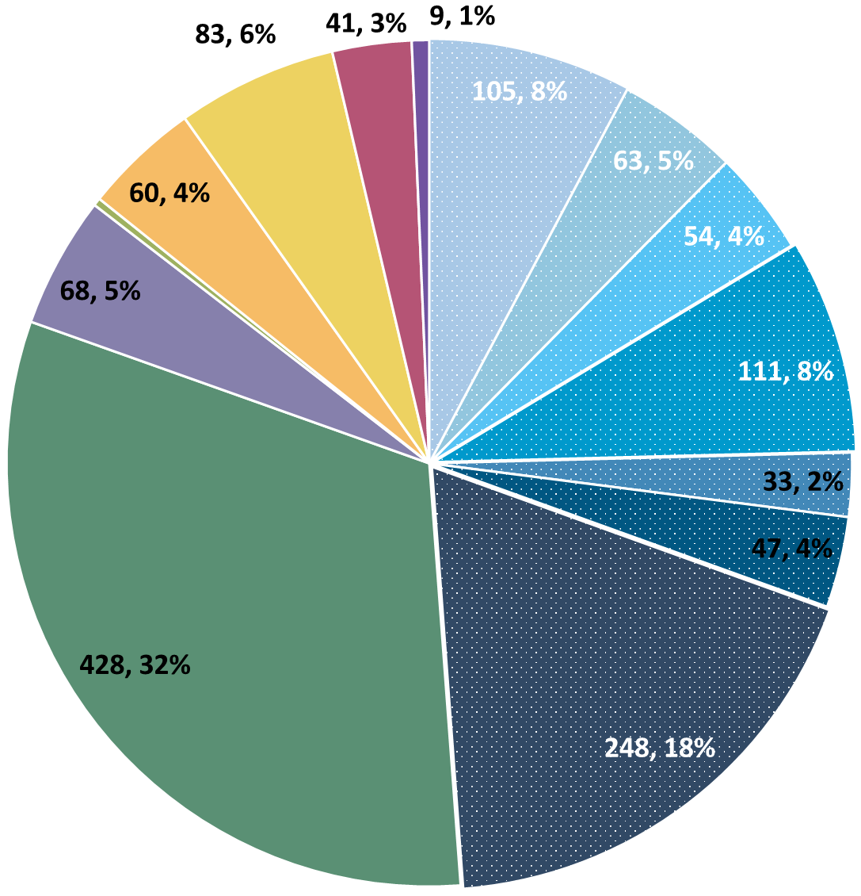
Deviation Types
Total Reports | Reports with Deviations | Reports with Deviations (excluding no data captured)
4612 | 1433 | 684
Last Months

Slide 13
Goal

Slide 14
Updates

Slide 15
ISP Updates
Two ISP Modifications
Specified that AE data may be collected even after withdrawal to standard of care
New optional growth form to be added to the REDCap once approved

Slide 16
Growth Data
New REDCap Form
Launching Soon
Optional – related author opportunities available to sites who participate
Z-Scores, Nutrition and feed information collected at set time points
Questions about participation, Email Heather

Slide 17
Upcoming Data Query
Next Biannual Audit = Late May/ Early June
Prepare REDCap In Advance
Screening Form = Every potentially eligible infant
Demographics Form = Every enrolled, withdrawn, and control infant
Implementation Discharge = 6-months post-wean
Adverse Events = As needed
Notes:
Katie will start assembling them the last few weeks of May, will send them out as they are done.

Slide 18
Cost of Implementation Analysis

Slide 19
Additional Funding Awarded
Our submission to PCORI for additional funding to analyze the cost of implementing the RHO Program was awarded
A survey will be distributed to site PI’s in June/July
Sites will be randomly queried at 2-time points to collect data and information on the time spent interpreting RHO results, calling families, documenting, and responding to RHO recommendation emails
Any questions please reach out to Heather

Slide 20
Discussion

Slide 21
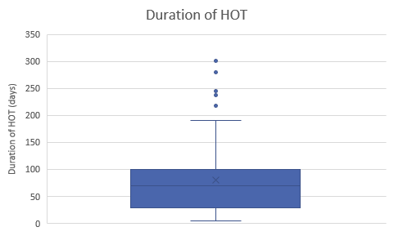
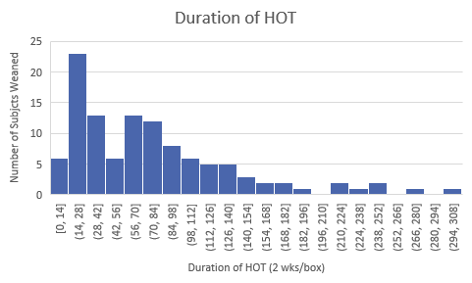
Distribution of Duration of HOT
Analysis shows a subset of patients takes significantly longer to wean from O2 then the average.
Why do we think they spend longer on O2?
  Suspected ILD
  Concern for aspiration
  Development of PPHN
Should we develop an algorithm or recommendations for these cases?
When should further testing be involved?
How have your sites traditionally handled these issues?
How should we address and account for this in our data?
  REDCap questions asking about swallow studies?
  Other assessments?

Slide 22
Reminders

Slide 23
Please email Katie when a new baby is enrolled in the program.

Slide 24
Controls
Reminder: subjects withdrawn are still counted as controls if possible
Control Infant REDCap Forms
Screening
Demographics
AEs
Implementation Discharge
6 Months Post-Wean = Forms Complete
Controls Needed for Further Analysis

Slide 25
Importance of Changing Probes
Minutes Valid SpO2 | Mean SpO2 | Minimum SpO2 | Maximum SpO2 | Seconds Below 96% SpO2 | Minutes Below 96% SpO2 | % Time Below 96% SpO2 | Seconds Below 93% SpO2 | Minutes Below 93% SpO2 | % Time Below 93% SpO2 | Seconds Below 90% SpO2 | Minutes Below 90% SpO2 | % Time Below 90% SpO2
1713.183 | 97.8144 | 71 | 100 | 53496 | 891.6 | 52.04347 | 49650 | 827.5 | 48.30189 | 49581 | 826.35 | 48.23477
SpO2 > 96% | 90% - 96% SpO2 | SpO2 < 90%
822 Minutes | 65 Minutes | 826 Minutes
Notes:
Reading the above spit-out it says that the baby in question spen…
822 Minutes Above 96% SpO2
65 Minutes Between 90-96% SpO2
826 Minutes Below 90% SpO2
The above information, logically does not make sense… if you see data like this CHANGE THE PROBE… we as coordinating site cannot make this recommendation as that would bias the data… all we can do is report on what the algorithm tells us, and it is up to individual sites to interpret that recommendation in the unique situation of each baby

Slide 26
Reporting AEs
To Confirm Safety, We Are Looking for All AE Data Until 6 Months Post-Wean
We Require This For All Babies On Program Including Controls
The AE Form Is Available on REDCap (Katie Can Help w/ REDCap Access)

Slide 27
Subcontract Amendments
New annual contracts will be initiated in coming weeks
NCE approved September 30, 2024 (8-month extension)
Any questions please contact Heather

Slide 28
Family Engagement Survey
For Sites w/out IRB Approval:
Instructions to submit to local IRBs sent out on 6/7
Please reach out to Heather and Katie with any questions/concerns/barriers
For Sites w/ IRB Approval:
Please Send Survey Links At Initial Discharge and After HOT Weaning
Spanish Version Coming Very Soon! (waiting on IRB)

Slide 29

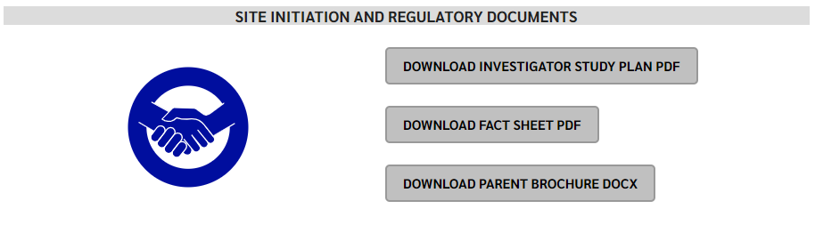
RHO Program Website
All resources, including training documents, the RHO manual, and other templates can be found on the RHO website at www.umassmed.edu/rho-program
Navigate to “Member Login” and log in with the following credentials to access the documents
  Username: RHO
  Password: Oximetry14

Slide 30



Slide 31



Closing Thoughts
Questions or Comments?
Are there any suggestions and/or feedback on the progress of the program that you would like to share with the team at this time?

