Slide 1

The Recorded Home Oximetry (RHO) Program
Monthly Investigator Meeting
September 7, 2023

Slide 2

RHO Program Implementation Timeline
Feb - Mar 2021
Baseline data collection begins
Mar - May 2021
Initiate site training
Initiate monthly phone calls
May - Aug 2021
Jun 2021 - Feb 2022
Feb - Aug 2022
Aug 2022 - Feb 2023
Complete site training
Reach 33% of eligible families
Reach 66% of eligible families
Feb - Aug 2023
Reach 100% of eligible families
Initiate 18-month implementation
Begin providing monthly feedback reports
Notes:
- Unchecked the goal to reach 66% as we have not fulfilled throughout the milestone period but are on our way

Slide 3
RHO Implementation Trial Consort Diagram
Average HOT Duration:
76 ± 61

Slide 4
Goal

Slide 5
Enrollment by Site
Site Name | 1st Patient Enrolled | Duration of Implementation | Estimate Per Year | Estimate Per Month | Current Per Month | Followed | Withdrawn | Weaned from HOT | Active on HOT | Average | SD
Boston Children's | 7/8/2021 | 25.10 | 40 | 3 | 1.0 | 25 | 7 | 12 | 6 | 65.33 | 52.96
Dartmouth-Hitchcock | 1/1/2022 | 19.20 | 20 | 2 | 1.1 | 23 | 1 | 19 | 3 | 75.42 | 75.50
Maria Fareri Children's Hospital | 11/18/2021 | 20.67 | 14 | 1 | 0.4 | 8 | 1 | 4 | 3 | 87.00 | 48.47
Massachusetts General Hospital | 7/8/2021 | 25.10 | 13 | 1 | 0.5 | 12 | 1 | 10 | 1 | 77.30 | 51.09
University of Maryland | 8/21/2021 | 23.63 | 20 | 2 | 1.6 | 39 | 11 | 21 | 7 | 42.29 | 29.30
Vanderbilt | 4/28/2021 | 27.47 | 70 | 6 | 0.2 | 6 | 5 | 0 | 1
Arkansas Children's Hospital | 10/20/2021 | 21.63 | 48 | 4 | 1.4 | 32 | 11 | 16 | 5 | 99.88 | 62.83
Children's Hospital of Philadelphia | 5/26/2021 | 26.53 | 50 | 4 | 0.1 | 4 | 1 | 3 | 0 | 105.33 | 77.86
Cincinnati Children's Hospital | 9/21/2022 | 10.43 | 50 | 4 | 2.0 | 23 | 3 | 12 | 8 | 59.92 | 44.21
National Jewish Health | 8/24/2022 | 11.37 | 250 | 21 | 2.0 | 25 | 12 | 4 | 9 | 123.50 | 49.84
Nationwide Children's Hospital | 3/4/2022 | 17.13 | 75 | 6 | 2.6 | 48 | 16 | 29 | 3 | 84.21 | 63.15
Payton Manning Children's Hospital | 7/19/2022 | 12.57 | 25 | 2 | 0.8 | 11 | 4 | 7 | 0 | 77.00 | 71.81
U. of California, San Diego | 11/10/2021 | 20.93 | 65 | 5 | 0.4 | 9 | 2 | 6 | 1 | 77.00 | 65.25
U. of Kentucky Children's Hospital | 11/21/2022 | 8.40 | 50 | 4 | 0.0 | 0 | 0 | 0 | 0
Total |  |  | 790 | 66 | 14 | 265 | 75 | 143 | 47 | 75.50 | 60.55

Slide 6
Implementation Trial Outcomes

Slide 7
Average HOT Duration:
76 ± 61

Slide 8
Average HOT Duration:
114 ± 91

Slide 9
Implementation Related Problems

Slide 10
Implementation Month-Year

Slide 11
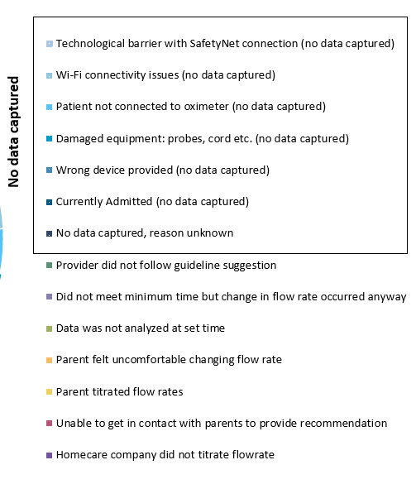
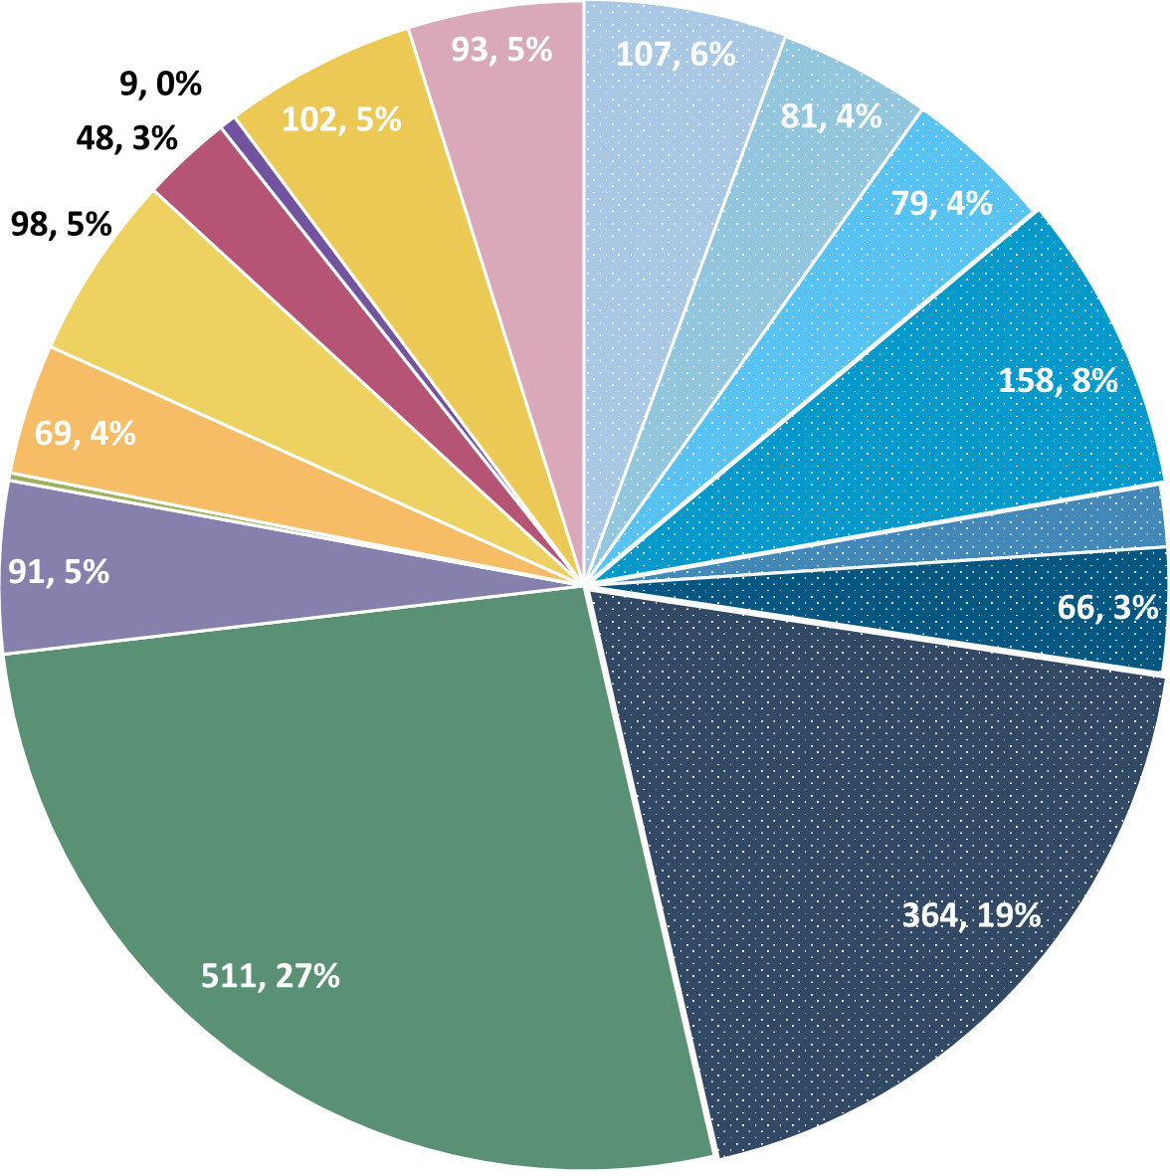
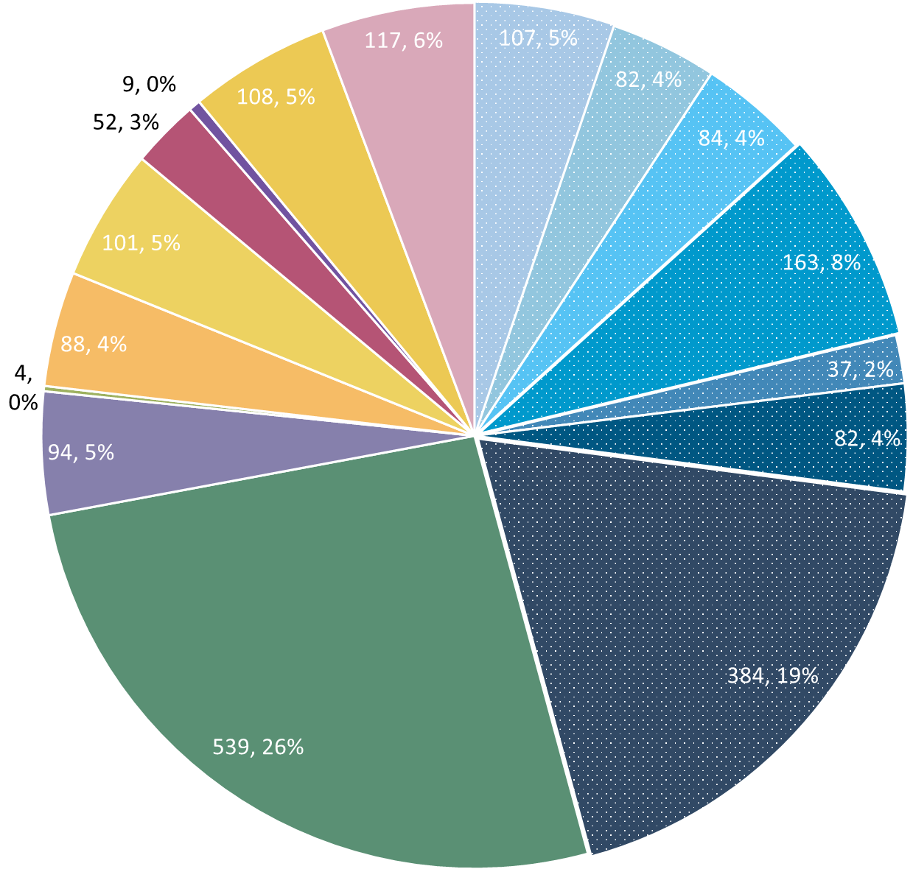
Deviation Types
Total Reports | Reports with Deviations | Reports with Deviations (excluding no data captured)
6136 | 2000 | 1112
Last Months

Slide 12
Goal

Slide 13
Updates

Slide 14

PCORI Plenary Meeting and Presentation
Submitted an abstract and invited to PCORI’s Annual Meeting in October
UMass and Maryland to represent RHO Group – highlighting provider buy-in to the program and family outcomes
Poster on next slide

Slide 15
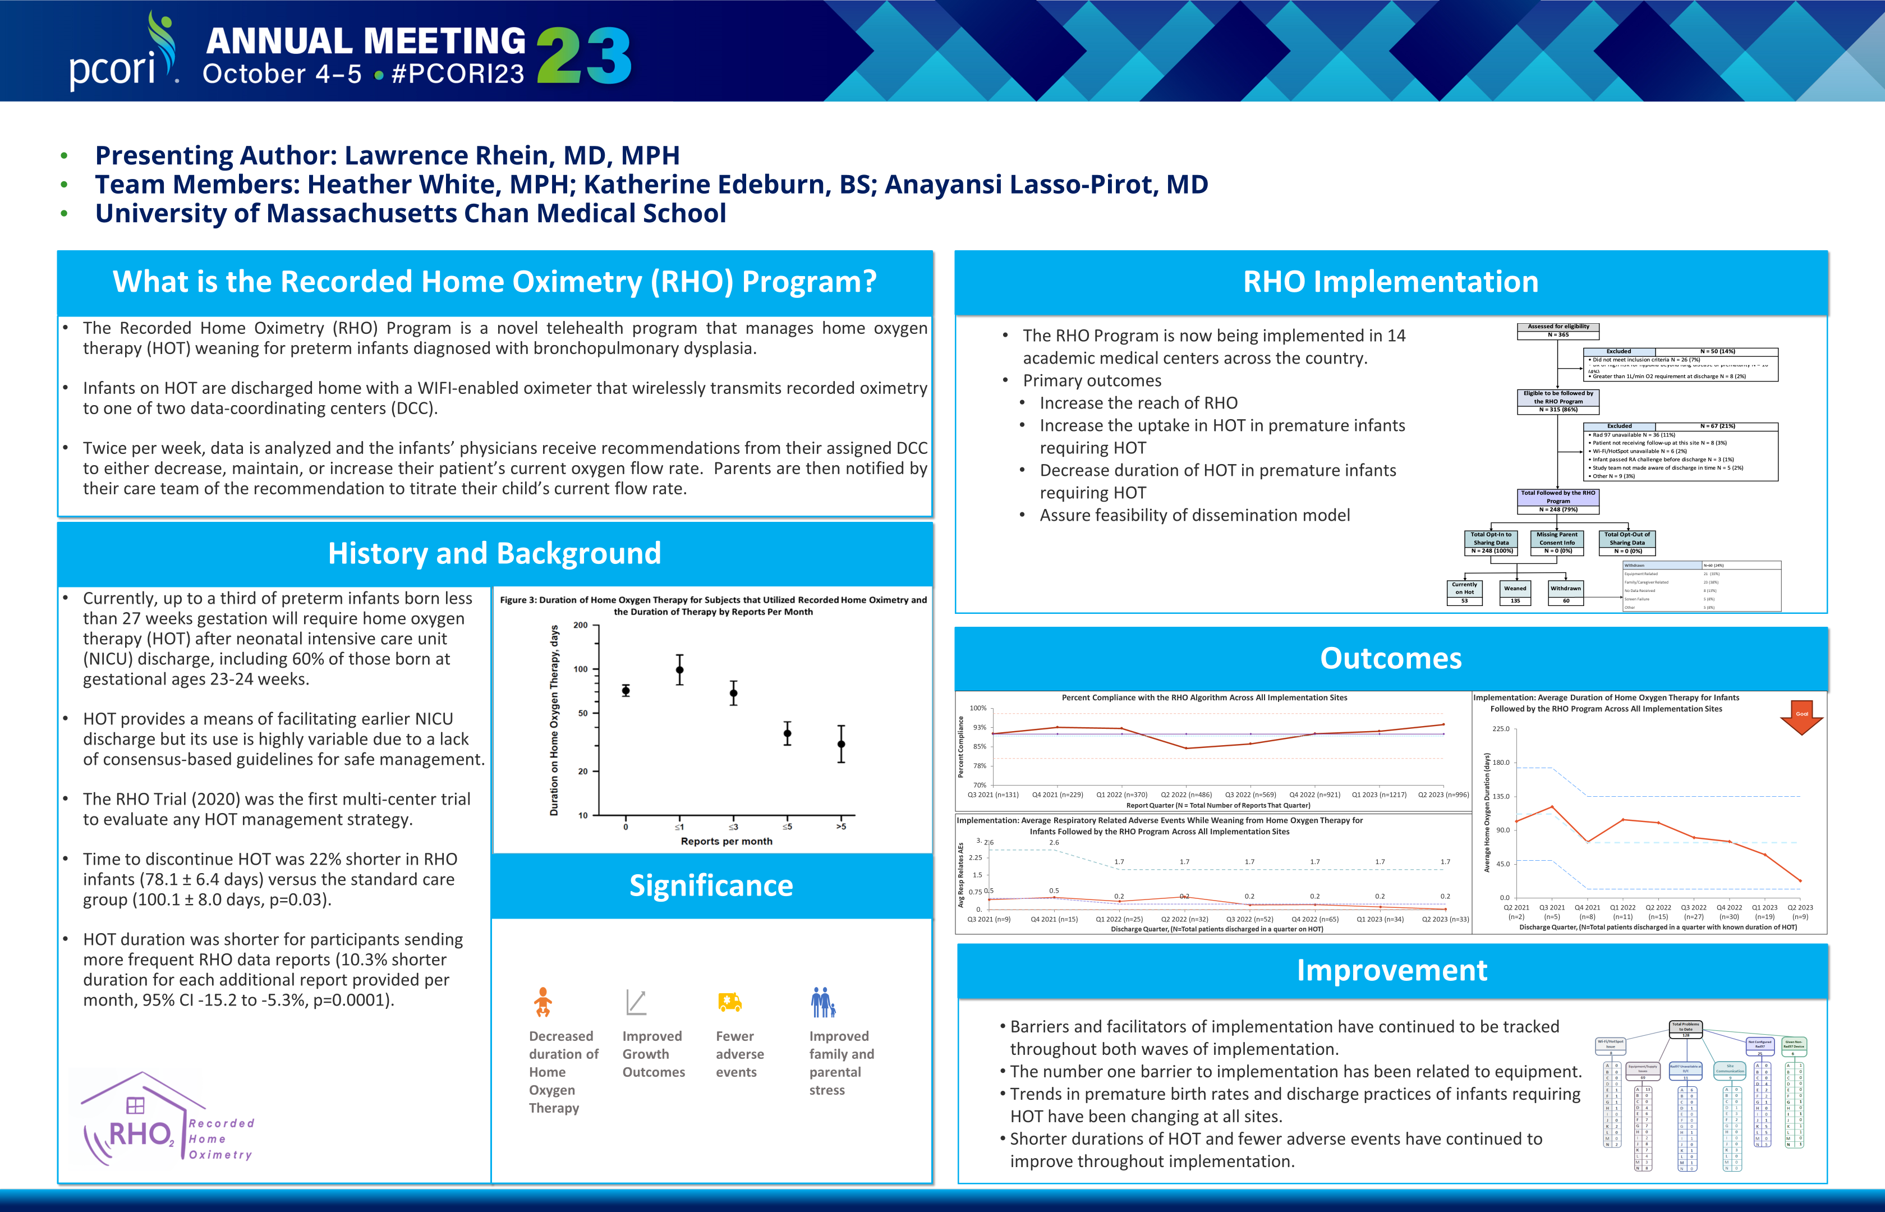

Slide 16
RHO Regulatory Update
Make sure ISPs at each IRB are up-to-date
We are on version 6

Slide 17
Discussion

Slide 18
Reminders

Slide 19
Enrollment Reminder
Multiple sites have been sending conflicting IDs/SNs for patients
Make sure your team agrees as to each subject’s IDs before sending enrollment information please

Slide 20
Family Engagement Survey
Reminder for all sites that have IRB approval that survey links should be sent to all families enrolled
Defined project milestone
Severely behind enrollment schedule (0.01% response rate)

Slide 21



Closing Thoughts
Questions or Comments?
Are there any suggestions and/or feedback on the progress of the program that you would like to share with the team at this time?

Slide 22
Contacting Patients Through the EMR
If the RHO recommendation is a maintain, you can contact patients using your EMR instead of a phone call if you prefer.

Slide 23
Reporting AEs
To Confirm Safety, We Are Looking for All AE Data Until 6 Months Post-Wean
We Require This For All Babies On Program Including Controls
The AE Form Is Available on REDCap (Katie Can Help w/ REDCap Access)

Slide 24
Controls
Reminder: subjects withdrawn are still counted as controls if possible
Control Infant REDCap Forms
Screening
Demographics
AEs
Implementation Discharge
6 Months Post-Wean = Forms Complete
Controls Needed for Further Analysis

Slide 25
Importance of Changing Probes
Minutes Valid SpO2 | Mean SpO2 | Minimum SpO2 | Maximum SpO2 | Seconds Below 96% SpO2 | Minutes Below 96% SpO2 | % Time Below 96% SpO2 | Seconds Below 93% SpO2 | Minutes Below 93% SpO2 | % Time Below 93% SpO2 | Seconds Below 90% SpO2 | Minutes Below 90% SpO2 | % Time Below 90% SpO2
1713.183 | 97.8144 | 71 | 100 | 53496 | 891.6 | 52.04347 | 49650 | 827.5 | 48.30189 | 49581 | 826.35 | 48.23477
SpO2 > 96% | 90% - 96% SpO2 | SpO2 < 90%
822 Minutes | 65 Minutes | 826 Minutes
Notes:
Reading the above spit-out it says that the baby in question spen…
822 Minutes Above 96% SpO2
65 Minutes Between 90-96% SpO2
826 Minutes Below 90% SpO2
The above information, logically does not make sense… if you see data like this CHANGE THE PROBE… we as coordinating site cannot make this recommendation as that would bias the data… all we can do is report on what the algorithm tells us, and it is up to individual sites to interpret that recommendation in the unique situation of each baby

Slide 26

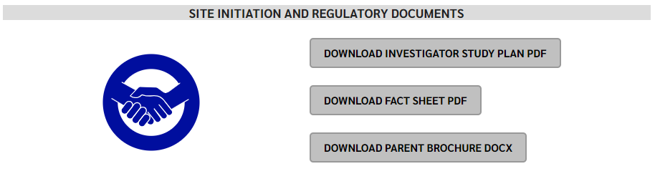
RHO Program Website
All resources, including training documents, the RHO manual, and other templates can be found on the RHO website at www.umassmed.edu/rho-program
Navigate to “Member Login” and log in with the following credentials to access the documents
  Username: RHO
  Password: Oximetry14

