Slide 1


Supporting the mental health of healthcare workers during the pandemic and beyond
Daphne Holt, MD, PhD
Director, MGH Resilience and Prevention Program and the Emotion and Social Neuroscience Laboratory
Co-Director, MGH Schizophrenia Clinical and Research Program
Associate Professor, Harvard Medical School

Slide 2
Detrimental effects of the COVID-19 pandemic
on the mental health of frontline healthcare workers
Elevated rates of anxiety, depression, and insomnia observed in healthcare workers during the pandemic across the world (Lai et al, 2020; Preti et al, 2020; Pappa et al, 2020; Salazar de Pablo et al, 2020)
psychological resilience - a capacity for, or process of, “bouncing back” or adapting during or following stressful situations or crises (Kalisch et al, 2017; Choi et al, 2019) - may be protective for healthcare workers exposed to high levels of stress
Resilience has a relationship to the severity of the stress, i.e., one cannot expect to be fully "resilient” when faced with major loss, trauma, uncontrollable events
However it is possible to modify (i.e., increase) one’s capacity for resilience

Slide 3


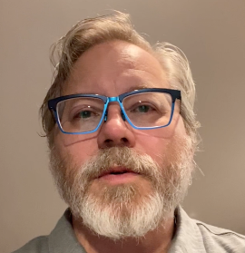
Resilience Augmentation for Medical Personnel (RAMP) during the COVID-19 Outbreak
Three separate interventions were created by the Benson Henry Institute, Bipolar Clinical and Research Program and the Resilience and Prevention Program (RAPP) and delivered via Healthstream
The RAPP intervention: Resilience Training for Healthcare Workers, consisting of three 12-20 minute-long videos, focused on 1) mindfulness 2) cognitive flexibility/mentalization 3) self-compassion
https://www.resilienceandprevention.com/healthcare-providers

Slide 4
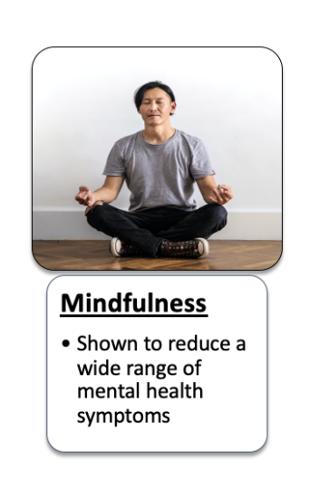
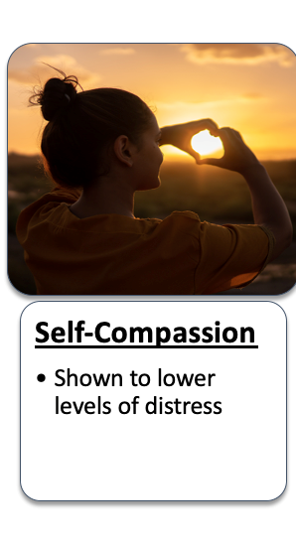
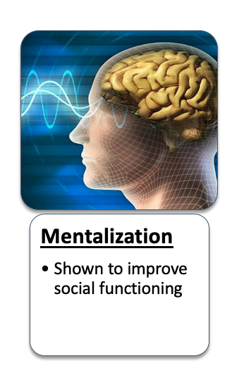
Resilience Training (RT) focuses on 3 evidence-based tools:
Shown to reduce symptoms of illness and improve brain health

Slide 5
When are you hard on yourself

Slide 6
MGB employees who took the online RT course experienced increases in resilience and decreases in distress
RT
RT
Before
After
Follow-up
Before
After
Follow-up
(n = 110)
(n = 38)

Slide 7
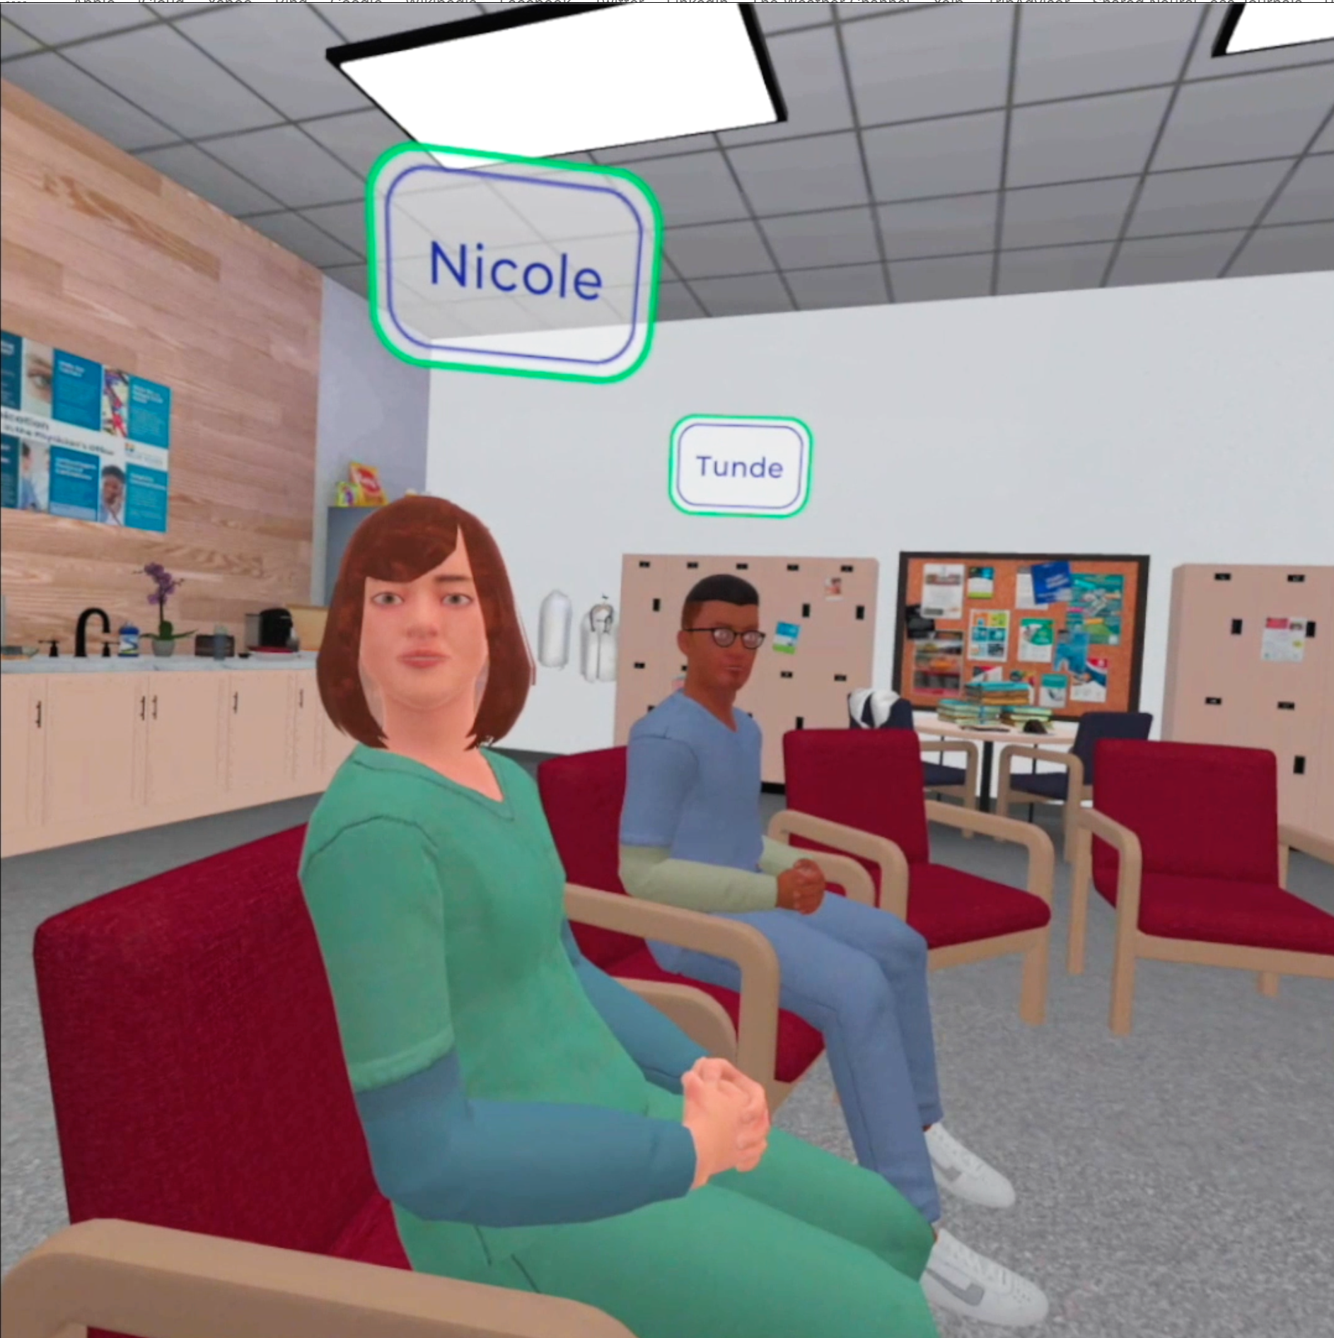
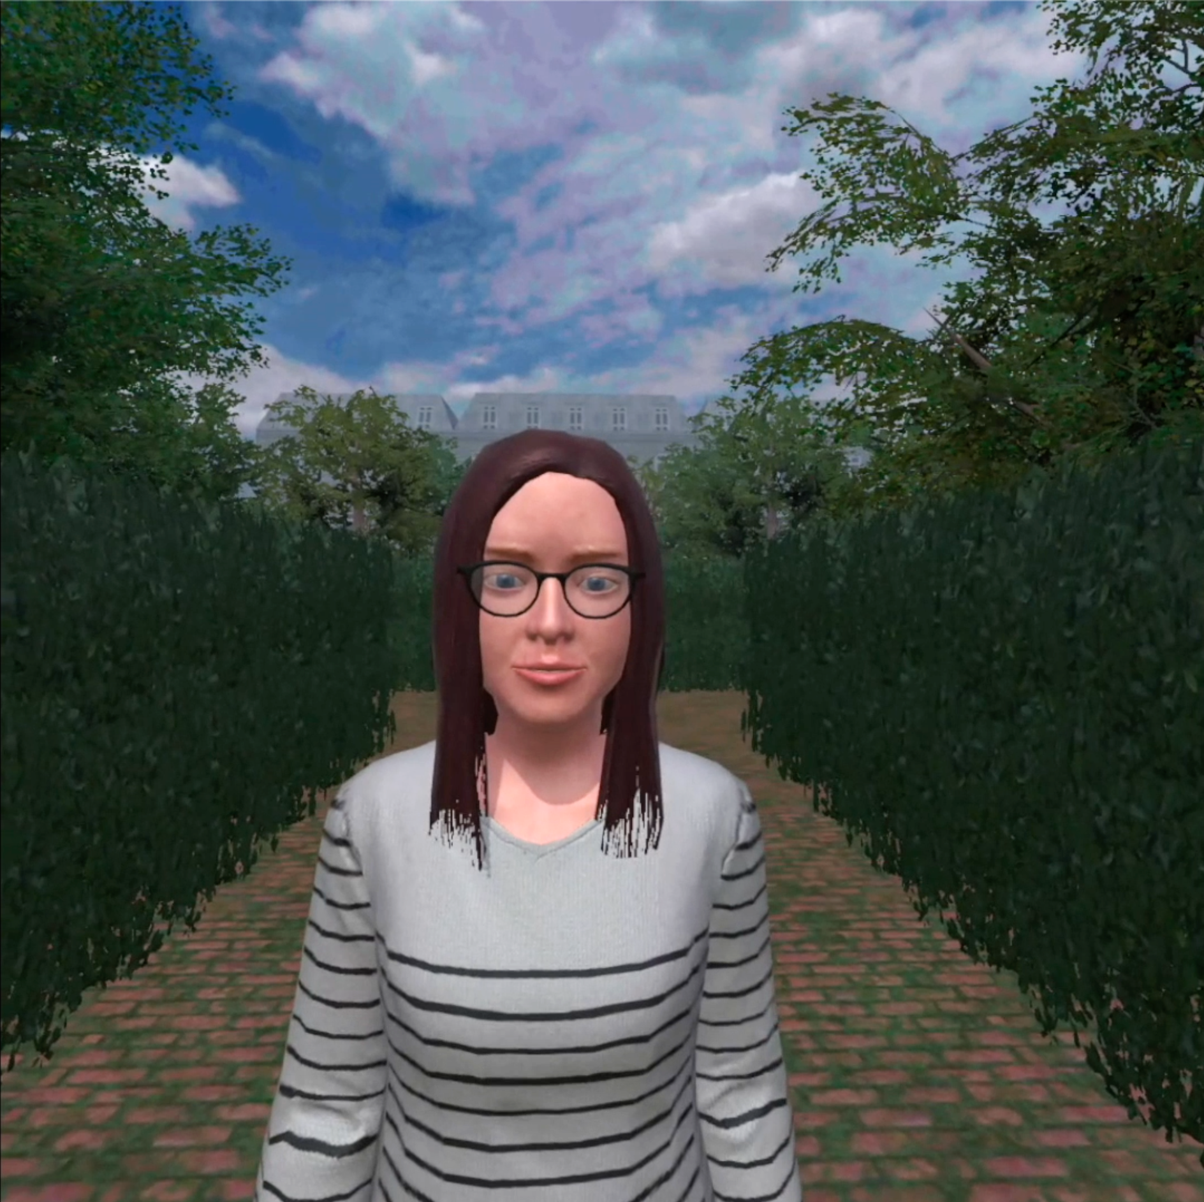
A new resilience training workshop for healthcare workers:
Reconnecting to Ourselves and Others in virtual Meetings (ROOM)
Resilience training using virtual reality

