Slide 1

Law & Psychiatry Program
Addiction & Racial Disparities Research in Criminal-Legal Settings
Gina M. Vincent, PhD, Professor
Dara Drawbridge, PhD, Assistant Professor
Spencer G. Lawson, PhD, Senior Research Scientist
Notes:
Acknowledge Dr. Dara Drawbridge could not be here today
Start by briefly describing the Law & Psychiatry program because there has been so much turnover in our dept that many folks aren’t clear what that is….. And then Dr. Lawson and I will provide an overview of a couple of our studies relevant to addiction and current legal issues today

Slide 2
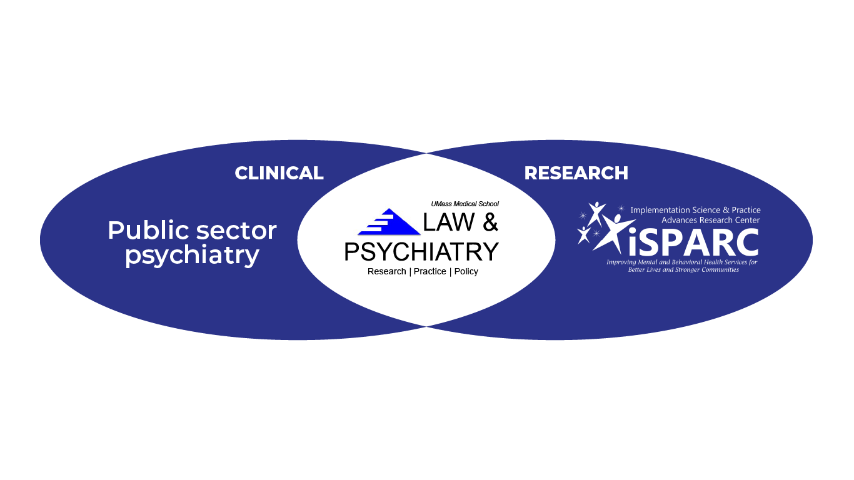
What is the Law & Psychiatry Program?
Notes:
The UMMS Law & Psychiatry Program began in 1986 with funding from the Massachusetts Department of Mental Health (MA DMH) while Paul Applebaum was chair and he hired Tom Grisso to direct the whole program. Dr Debra Pinals, directed the forensic psychiatry fellowship and by the way, I want to make a plug for the fact she will be here for a special grand rounds next week . The program is not a center or division – it is an interdisciplinary collaboration of UMass Chan Medical School faculty devoted to forensic clinical services and training– falling under Public Sector Psychiatry, and devoted to research in the interfaces of the behavioral sciences and the law – falling under iSPARC
In 2006 – we expanded to providing TA and implementation support to forensic and criminal-legal agencies nationally – in 2014 Tom retired and it was Ira and me

Slide 3
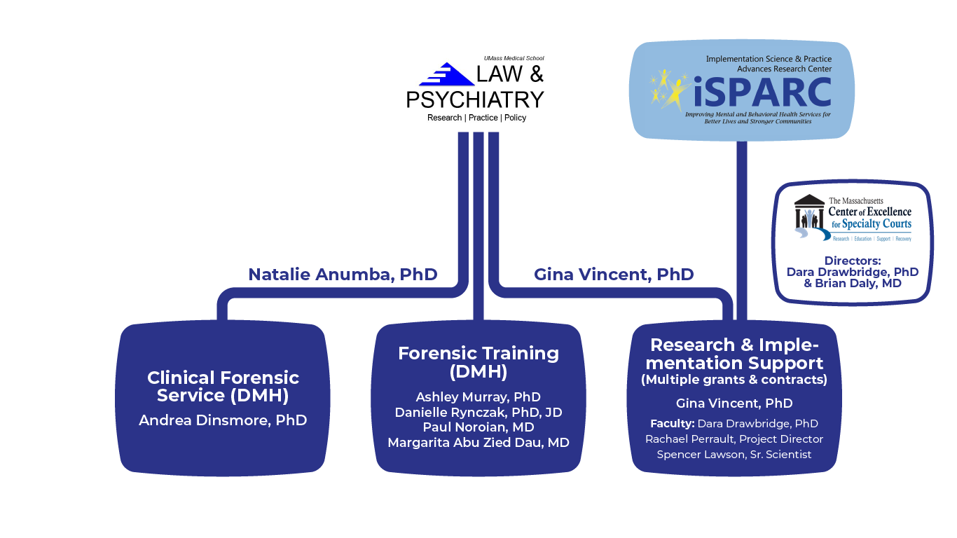
Notes:
Today, the program is – co-directed by Dr. Anumba on the clinical and training side and myself on the research side and multiple other directors because it takes a village
The Program is an interdisciplinary collaboration of Medical School faculty devoted to clinical services, research, policy, training, technical assistance, and implementation support
Very active forensic service directed by Dr. Dinsmore – completing over 1000 forensic evaluations annually
Forensic Psychiatry fellowship program – Noroian and Abu Zied Dau – psychology – Ashley Murray and Dr. Rynczak for the legal studies
Our research & implementation support side at iSPARC also includes the MA Center of Excellence for Speciality courts – directed by Dr. Drawbridge and Dr. Daly –which I will discuss a bit later

Slide 4
Law & Psychiatry Research Mission
The Law & Psychiatry Program’s research mission is to be responsive to the needs of the criminal-legal & juvenile justice systems by using implementation science methods to implement screening and assessment strategies (including risk assessment and behavioral health screening) and evidence-based practices across all justice settings (from diversion to re-entry) nationally. The research addresses a variety of questions that arise in the law concerning behavioral health, risk of reoffending, and ways to assess human characteristics that are important for criminal-legal decisions.
The Law & Psychiatry Program’s Research Arm within iSPARC works with the systems that impact criminal-legal involved youth and adults to:
a) implement and study the outcomes of evidence-based practices, and
b) improve the lives of these individuals while still protecting public safety.
Notes:
Research mission is to examine a number of questions that arise in the law concerning behavioral health and to be responsive to the needs of the criminal-legal and youth justice systems by using implementation science methods to integrate evidence-based practices into their work and into public policy

Slide 5
Presentation: Critical Issues in the Legal System
Addiction – Drug Court Studies
  Evaluation of Drug Treatment Courts that emphasize opioid addiction
  Habilitation, Empowerment and Accountability Therapy (H.E.A.T) Study
Initiatives to Reduce Racial Disparities in Access to Treatment & Incarceration
a) MA Center of Excellence for Specialty Courts (CoE) Equity Division
  Future & Current Directions/Grant studies
Notes:
Today we will highlight the work we have done in the arena of addiction - Criminal-legal involved individuals are considerably more likely to have substance use disorders than the general pop
and how this has led to our current work and efforts to assist criminal-legal settings with reducing racial disparities in access to treatment and incarceration,

Slide 6
ADDICTION:
Drug Court Studies

Slide 7
Drug Treatment Court Evaluation: Method
Vincent, Drawbridge, Rodgriguez-Monquio, Montgomery, & Packer (2021)
What are Drug Treatment Courts (DTCs)?
Quasi-Experimental, propensity-matched control group study of probationers with substance use needs in certified drug courts (n = 271) vs. traditional court (n = 271)
  Drug court probationers more likely to have opiates as primary drug of choice and to be high risk for reoffending – controlled statistically
Outcomes Studied– (follow-up spanned 7.5 mths to 3 yrs; M = 1.3 yrs)
  Relapse
  Improvements in functioning (e.g., housing, employment, education)
  New arraignments (recidivism)
Notes:
- Drug Treatment courts are a criminal-legal system response to address both a public health concern by treating the substance use, and to address the public safety concern, by applying heavy monitoring and sanctions from the criminal-legal system. Widely accepted as an EBP for reducing recidivism (reoffending) and treating substance use
The was a rigorous quasi-experimental study comparing drug court participants from 6 courts (n = 271) to a propensity-matched sample of traditional court probationers with substance use needs from 4 other courts (n = 271) who were in jurisdictions that did not have drug courts. The groups were matched on whether they were high vs low risk for reoffending using a valid risk assessment and on a number of other areas of functioning – and then followed them up for an ave 1.3 year followup from the time they initiated DTC/probation
what was innovative about the study at the time was the majority of had opiate use disorder or identified opiates as their primary drug of choice (almost 85%). Up to this point the vast majority of DTC studies were serving individuals with cocaine or MJ addiction
We examined three outcomes – relapse via weekly drug testing, which only a handful of any DTC effectiveness studies had studied as an outcome at the time – which we measured via weekly drug testing,
improvements in other areas of life functioning – which little to. No studies had done
Recidivism was defined as new arraignments on official criminal records, which are very similar to new arrests

Slide 8
Drug Treatment Court Evaluation: Findings
Relapse: DTC graduates, relative to matched controls who successfully completed probation, had significantly…
  Lower rates of relapse, and
  Longer periods of substance use service
Functioning: By graduation, DTCs significantly improved….
  Housing (from 10% with stable housing at intake to 33%)
  Employment stability (more likely to be employed full-time) – same as controls
Recidivism: No difference in recidivism between DTCs (52%) and Controls (47%)
  Most common recidivism offenses for both groups was non-violent and non-serious
  Only 11% of DTCs had a new violent offense
Notes:
So Contrary to prior studies of DTCs, recidivism was not reduced, however, there were other positive outcomes of DTC involvement.

Slide 9
Drug Treatment Court Evaluation: Conclusions
This study was novel in the following ways:
  Matched control group
  Valid assessment of risk for reoffending and high-risk sample
  DTCs focused on opioid use disorder, as opposed to cocaine or MJ
  Measured change in relapse & in areas of functioning
Findings used to recommend policy and procedural changes
  Need a greater focus on addressing individual’s criminogenic needs
  Another Key Finding: DTCs served very few individuals of color (6.6% Black, 9% Latinx)
Notes:
Why did it not show similar results to other studies w/respect to recidivism? Novel in many ways – more rigorous design
- One of the only w/a valid assessment of risk for reoffending – even though DTCs were designed to serve these individuals it isn’t clear most samples comprised only high-risk

Slide 10
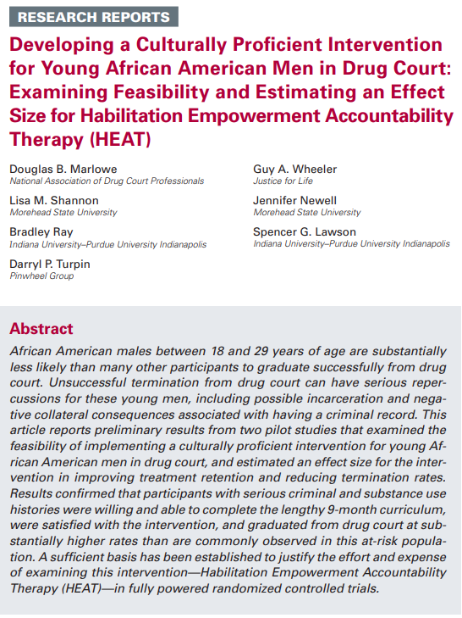
Evaluation of a DTC Model Responsive to Culture and Race
Habilitation, Empowerment and Accountability Therapy (H.E.A.T.)
NIH Stage 1B Pilot Study
Group therapy program designed for Black males, age 18 to 29 who are enrolled in drug courts.
9-month intensive curriculum (attend approx. 80 group counseling sessions) with topics presented in a cyclical format.
Notes:
While specialty courts center attention on novel principles and components that differ from those used in standard judicial processes, one similar attribute can be found between specialty and traditional courts: racial, ethnic, and gender disparities in case processing. In response, the National Association of Drug Court Professionals (NADCP) directed specialty courts in 2010 to implement policy interventions that would mitigate observed disparities. The inaugural issue of NADCP’s Journal for Advancing Justice in 2018 focused on understanding the presence and drivers of disparities and discussing cutting-edge research on efforts to rectify discrimination and cultural biases in specialty courts.
How is HEAT different from other treatment approaches used by drug courts? It applies a holistic, culturally relevant and responsive, strength-based model that emphasizes a positive and engaging approach to treatment.
Highlights and values Black culture.
Emphasizes the historical strengths of Black individuals.
Treats the whole person (i.e., the spiritual, mental, emotional, physical, environmental, and experiential factors)

Slide 11
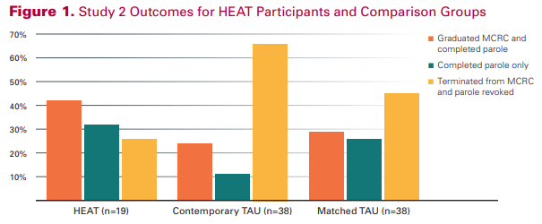
Habilitation, Empowerment and Accountability Therapy (H.E.A.T.):
Study Findings
Study 1 Feasibility (N = 10)
Goal: The feasibility of implementing the 9-month HEAT curriculum in a drug court program.
Study 2 Effect Size
Goal: Estimate an effect size for H.E.A.T. in retaining young African American men in drug court and increasing their graduation rate.
H.E.A.T. Retention
Session attendance rate | 81%
Number of sessions attended | 65.00 (10.64)
Duration of participants in days | 264.00
Completed H.E.A.T. | 90%
Notes:
Study 1 – Participants were willing and able to complete the HEAT curriculum, were satisfied with the program, and reported having good rapport with the group leader and group members.
Study 2 – HEAT participants were more likely to graduate from the program and to complete their term of parole than comparable participants receiving treatment as usual. The estimated effect size was moderate with Cramer’s V exceeding 0.30.

Slide 12
H.E.A.T. Study: Conclusions
Preliminary support for H.E.A.T. in improving success rates.
H.E.A.T. was developed by practitioners in the field. Not researchers.
Implementation scientists need to collaborate & integrate implementation principles into the interventions practitioners develop
Specialty courts must pursue promising avenues of research to rectify disparities in their programs.
Notes:
Preliminary support for H.E.A.T in improving success rates among young Black men in drug court.
HEAT was developed by practitioners in the field. Not researchers. If researchers develop interventions, they are based in scientific principles and best practice standards that are designed to be tested. When practitioners develop interventions its based on their perceived need and expertise.
Implementation scientists need to do a better job of collaborating and integrating those principles into the interventions that practitioners develop.
Evidence indicates that racial disparities exist in some specialty court graduation rates. Thus, specialty courts must pursue promising avenues of research to rectify disparities in their programs.
Some of the evidence (for reference):
Upon enrollment, Black, Hispanic, and female participants have a decreased likelihood of successfully graduating from the program relative to white individuals (Finigan, 2009; Ho et al., 2018; Marlowe, 2013; Marlowe et al., 2016), with results suggesting graduation rates may differ as much as 25 to 40 percentage points (Belenko, 2001; Dannerbeck et al., 2006; Shaffer, 2011).

Slide 13
Initiatives to Reduce Racial Disparities
Current Efforts by the Law & Psychiatry Program

Slide 14

Massachusetts Center of Excellence (CoE) for Specialty Courts (Directors: Dara Drawbridge, PhD & Brian Daly, MD)
Purpose: Improve lives and outcomes of people involved with and impacted by the criminal-legal system.
Mission: To bring innovative, evidence-based, and equitable interventions to Specialty Courts and related settings.
Vision: To become a state and national leader in behavioral health and the criminal-legal system.
Values: Authenticity, Connection, Competence
Three Divisions:
Implementation and Translation Division (Co-Directors Drawbridge & Daly)
Research, Evaluation, and Policy Division (Co-Directors, Dupuis & Kane)
Notes:
Although not here today for our presentation, my co-presenter Dr. Dara Drawbridge and our colleague Dr. Brian Daly are the Co-Directors of the Massachusetts Center of Excellence for Specialty Courts. The CoE is an initiative of the Executive Office of the Massachusetts Trial Court that is operated by them here at UMass Chan.
The CoE aims to improve lives and outcomes of people involved with and impacted by the criminal-legal system by bringing innovative, evidence-based, and equitable interventions to Specialty Courts and related settings. The predominant specialty courts here in MA are drug courts as a result of the opioid crisis in the Commonwealth but the CoE also assists with mental health courts, veterans courts, etc. The CoE does NOT provide direct service or get involved in court cases – instead, the focus is on implementation support for EBPs, research/evaluation and policy.
The CoE achieves its mission through three divisions which work together closely and work in partnership with representatives from the Trial Court
The Implementation and Translation Division is Co-Directed by Dara Drawbridge & Brian Daly. This division drives the adoption, implementation, and sustainment of evidence-based, best, and innovative interventions in Specialty Courts and related settings through activities that translate scientific knowledge for the field and build system capacity. A Division Subcommittee, co-chaired by Deputy Specialty Courts Administrator Laura Gallant and the Honorable Judge Julian supports work in this Division.
The Research, Evaluation, and Policy Division is Co-Directored by Meaghan Dupuis & Mike Kane. This division drives initiatives to advance scientific knowledge of innovative, best, and evidence-based interventions at the intersection of behavioral health and the criminal-legal system. A Division Subcommittee, co-chaired by Specialty Courts Administrator Sheila Casey and the Honorable Judge Heffernan support Research, Evaluation, and Policy Division Initiatives

Slide 15

CoE Equity Division
Diversity & Inclusion Statement:
Commitment to fostering an inclusive and equitable community that values all aspects of diversity, including but not limited to, race, ethnicity, gender identity, sexual orientation, religion, age, socioeconomic status, immigration status, and disability.
Collaborates to create an environment that recognizes differing perspectives are invaluable drivers of innovation and excellence.
Equity Division (Director, Ayorkor Gaba, PsyD) Drives evidence-informed initiatives to advance equity and reduce disparities in court access, engagement, retention, and outcomes, especially among minoritized, marginalized, and underserved populations in the court.
Notes:
But of most relevance to our talk today – is the Equity Division. The diversity & inclusion statement of the CoE is….. (on slide)
The Equity Division is Directed by Ayorkor Gaba. This division drives evidence-informed initiatives to advance equity and reduce disparities in court access, engagement, retention, and outcomes, especially among minoritized, marginalized, and underserved populations in the court. Activities aim to mitigate structural barriers, engage community members, and support courts in making diversity, equity, inclusion, and accessibility essential components of programs, policies, and practices. The Equity Division Subcommittee Co-chaired by Deputy Commissioner of Probation Pamerson Ifill and the Honorable Judge Machera support Equity Division Initiatives
Dr. Gaba has conducted some innovative research with individuals of color to get their perceptions of drug courts, access issues, etc, which she has fed back to the Executive Office of the Trial Court for procedural changes

Slide 16


Current & Future Directions in Racial Disparities
Current: Pretrial Risk Assessment: The Confounding Effects of Mental Illness, Substance Use and Race
Gina Vincent, PhD (PI), Spencer Lawson, PhD, & Karlie Rice, MA
  National and local studies to examine the feasibility and effectiveness of risk assessments for reducing disparities in incarceration due to race, MI, & substance use (adult and youth systems)
Current: Racial, Ethnic, and Area-Based Differences in Protective Factor Prevalence Among Youth in Juvenile Justice
Nana Yaa A. Marfo, PhD, Rachael Perrault, MA, & Gina Vincent (PI)
Submitted: Building Equity in Objective Prison Classification: A Model for Reducing Racial and Ethnic Disparities
Spencer Lawson, PhD (PI) & Gina Vincent, PhD (Co-I)
  In partnership with MA Department of Corrections & MA Executive Office of Public Safety and Security
Notes:
First point:
Risk assessment – assessment instruments are designed to provide an objective and accurate estimate of the likelihood one will reoffend or reoffend violently; in other words, a mechanism for identifying who is the highest risk to public safety. The idea is we identify this to tailor interventions appropriately – including separating the vast majority of individuals who did not need incarceration from the few who may need incarceration.

