Slide 1
2025 DMH Research Centers of Excellence​
Promoting Youth Mental and Behavioral Health: Understanding and Addressing Risk and Protective Factors to Improve Youth Well-Being and Outcomes
May 29, 2025​

Slide 2
HPYE: Enhancing Career Development Outcomes Among Young Adults
Michelle G. Mullen, PhD
Assistant Professor of Psychiatry
5/29/25
Notes:
I am learning so much. It is hard to go at the end...especially following these amazing scientists and scholars. What I appreciate so so much is the direct impact you all are having on young folks and their families. I am reaching out to our MGH friends to collaborate on future projects! I'm excited.

Slide 3
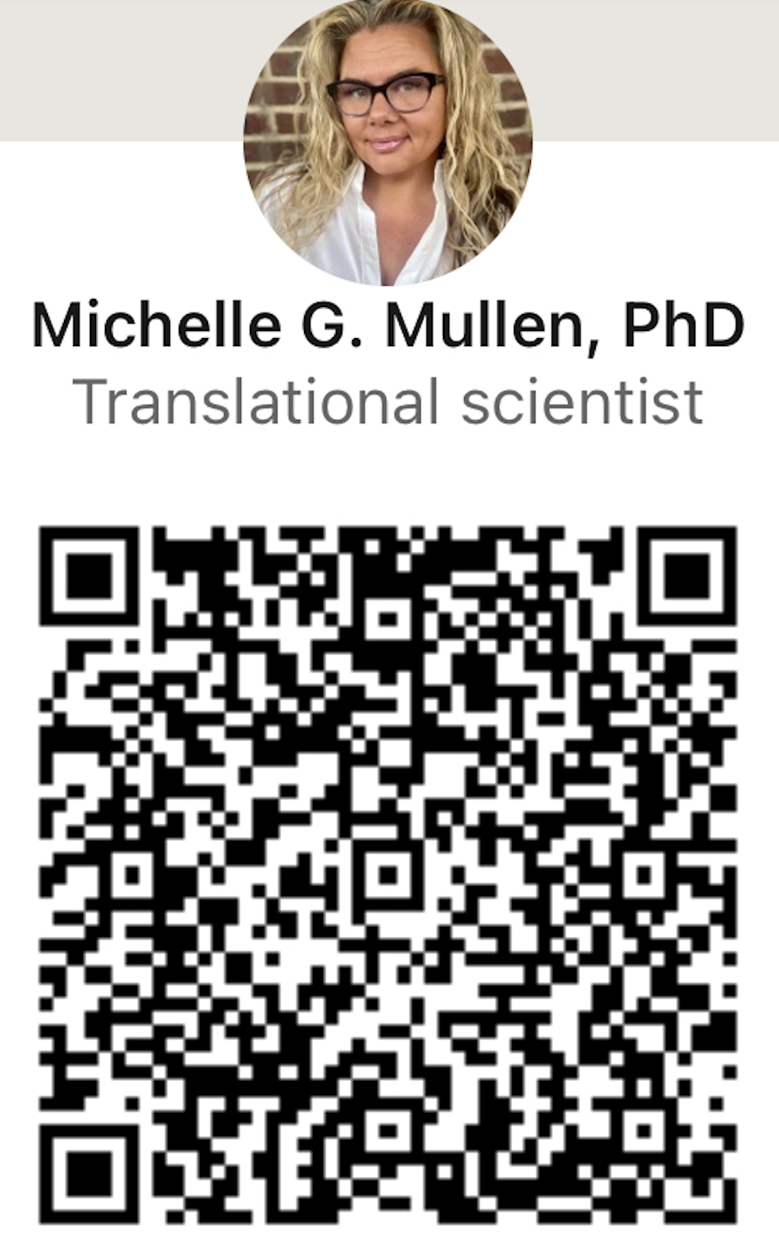
Because I aways forget
20+ years practicing, developing, overseeing, and researching career development, supported employment & education
Clinical developer of Helping Youth on the Path to Employment (HYPE) & Focused Skill & Strategy Training (FSST)
Areas of interest:
Young adult career development
Preventing disability among young adults with mental health conditions
Vocational Persistence
Executive functioning development and use
Implementation Science
Translating research to practice & practice to research
Facilitating the rewriting of damaging narratives related to vocational achievement and identity for those with mental health conditions
QR Code URL: www.linkedin.com/in/michelle-g-mullen-phd-99044736/

Slide 4
Agenda
Rationale for career services for young adults
Introduction to HYPE & FSST
Promising outcomes

Slide 5
Known Disruptions to Young Adult Career Development
Young adults with MHC struggle to complete high school, maintain employment, & have high rates of attrition in postsecondary education.
Yet,
Young adults do not have employment & education supports that match their developmental phase
Supported employment (SE) focuses on rapid employment acquisition rather than long term human capital development
Reduction of numbers and types of supports available
Lack of supported education (SE) programming to enhance postsecondary education outcomes
Encouragement to apply to SSI, despite the known impacts
Lack of purposeful development of identities and skills that are required to be successful
Notes:
Make note that FEP programs have availability of both services,
Community services are not designed to support today's young adult
Supported employment focuses on rapid job placement
Supported education is (largely) not available
Restriction of in the number and types of community-based SE services available
reduce the appeal of SSI, movement into primary labor market
Lack of purpose to develop careers with adult-livable wages with employer-sponsored benefits

Slide 6
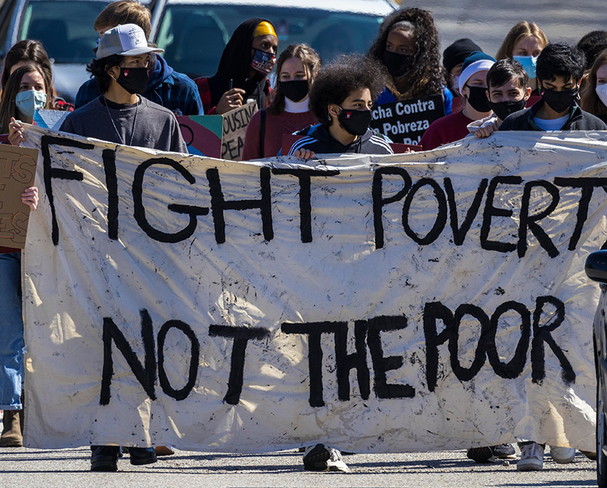
Many people consider mental health conditions as disabling. The greatest disabling condition, however, is POVERTY.

Slide 7
How HPYE works
Young adult career services focused on prioritizing education early to enhance school and work outcomes
Fluid career development approach- both education and employment supports:
Support movement between school and work
Consistent & adequate skills & supports
Developed to prevent poverty and disability-identity
Focuses on increasing persistence & reducing disruptions by refining executive functioning skills
Notes:
Fully integrated employment and educational services focused on career development for transition age youth and young adults with mental health conditions.
All levels of postsecondary education are supported: vocational to professional
Strategic development of “human capital” in order to facilitate real movement into careers that are designed to accommodate periods of symptom exacerbation.
Intentional services that focus on attaining an education early in order to maximize “return of investment”.

Slide 8
Modernizing “Supported Employment”
HYPE is a manualized intervention for both educational and employment supports
Focuses on building careers
Built on psychiatric rehabilitation principles & goals
Blending evidence-based models with innovation
IPS, BU’s Choose- Get- Keep- Leave, Cognitive Remediation
Built on TTM/ Stages of Change & Motivational Interviewing
Intentional services to leverage strengths and interests, while targeting the barriers to successful goal achievement
Focused on persistence
prevention of drop-out of both school & work
Notes:
Environmental & external barriers
Strengths & needs assessment
Executive functioning skills

Slide 9
Vision, Mission, Values & Principles:
Values:
Principles:
Flexible
Helpful
Solution-Focused
Partnering
Age-Typical
Career-oriented Services
Cultivation of Identity of Worker & Student
Informed Decision Making
Service eligibility based on choice
Purposeful Service Coordination
Attention to Preferences
Personalized Financial Planning
Rapid Goal Pursuit
Systematic Skill Development
Systematic Resource Development
Systematic Job Development
Time-Unlimited and Individualized Support
Community Integration

Slide 10
Pillars of HYPE Services
Intentional Services
Goal Development & Refinement
Skill Development
Resource Development
Accommodations & Assistive Technology Education
https://www.umassmed.edu/HYPE/
Notes:
Flexible
Helpful
Solution-focused
Partnering
Age-typical

Slide 11
Suite of Services: Together or Separate
HYPE (1 hour, weekly)
FSST (1 hour, weekly for 12 weeks)
Career-Oriented
Employment & Education Support
Skill Development to promote goal development and attainment
Connection to community-based resources to reduce number of unmet needs & increase support
Executive Functioning Skills
Goal-directed behavior
Time & Task Management
Memory
Attention
Problem Solving
Cognitive Flexibility

Slide 12
FSST Modules
Prospective Memory*
Attention
Memory
Cognitive Flexibility

Slide 13
Selected FSST Skills & Strategies
Creating habits to promote self-regulated learning
Goal setting
Time & Task Management (Prospective memory)
Calendaring: the most important self-regulation skill
To-do lists
Sequencing
Prioritizing tasks (Eisenhower’s Principle: urgent vs important)
Self-talk
Use of timers/reminders
Automatic places, task-linking
Set-shifting vs multi-tasking
Visualization
Encode- Store -Retrieve
Notes:
Goal Driven behavior
CALENDARING!!!!
One calendar: paper OR electronic
Very, very rarely both, so rarely that we say *never* use both
All syllabi assignments & exams should be in the calendar within the first week of school
Calendar should provide time and task management activities daily/weekly
Sometimes people just need a little help getting organized ☺

Slide 14
Teaching Time & Task Management
Complex skill set
Time:
what am I doing with my time?
how much time do I have?
Task:
what do I have to do?
Common companion skills/strategies:
Prioritizing tasks
Task chunking
Set shifting
Reminders
Managing Distractions (self-imposed and otherwise)

Slide 15
A HYPE Provider's Experience on Campus

Slide 16
A HYPE Trainer's Experience with Trainees

Slide 17
Randomized Control Trials
Enhancing EF Skills among College Students (FSST)
HYPE on Campus
FSST at Work
One large, competitive state school
Wrap-around support vs Information-only control
HYPE & FSST
Touch point each semester
MSW students interns provided HYPE intervention
Small pilot
Digital, remote intervention
FSST vs Information-only control
Community-recruitment
FSST vs Information-only control
Master’s trained Cognitive Specialist
Cognitive performance eligibility criteria

Slide 18
Findings Across Studies
In FSST (alone) trial:
FSST participants were more likely to academic persistent (p = .045)
Odds of persisting for one academic year were 6x more likely
Very large effect on academic persistence (d = 1.025; CI: .037, 3.69)
In HYPE on Campus trial:
FSST completers finished a greater number of courses (p=.02) and credits (p=.007)
Reduction of symptoms (p≤ .03)
FSST at Work:
Significant reduction in reported cognitive problems & increase in reported cognitive strategy use (p≤ .05)
Significant improvements were found in executive function skills at 3 and 6 months and role functioning at work at 6 months (p≤ .05)
Notes:
Given the binary outcome and how condition and time were coded,
the β value represents the marginal change in log odds with respect to persistence.
The exponential value of β (Exp (β)) is the odds ratio of an event’s occurrence, so that if Exp(β) is greater than 1, in this analysis, there are increasing odds of academic persistence.
FSST accounted for approximately 21% of the variance (R²= .208) and had an large estimated effect on academic persistence (d = 1.025; Cohen, 1992; Borenstein et al., 2021); the log odds ratio was converted to R² and Cohen’s d

Slide 19
A Young Adult's Perspective on HYPE
Notes:
DMH has for the last 6 or so years have funded FSST and HYPE –related programming here in Massachusetts. This started with FSST & Career Exploration, which then shifted when COVID hit. We moved to training MH program staff, including a young adult faciitator, to have discussions exploring career decisions- what do you want to do, how to prepare to go to work, and how to prepare to go to school...

Slide 20
Is HYPE and FSST available??
Yessssss!!
Organizations/ teams can be trained and supported to do either, HYPE of FSST,
If your organization only runs groups, Career Preparation Courses are available
Career Preparation Courses (groups) for community mental health organizations
Train young adult facilitator to run groups for young adults
Career Decisions (6 weeks)
Work Prep (7 weeks)
School Prep (6 weeks)
Colleges and universities can offer specialized HYPE/FSST services
If interested, contact us at HYPE@umassmed.edu

Slide 21
Thank you! Please contact HYPE@umassmed.edu to learn more.
Michelle.Mullen@umassmed.edu

Slide 22
Thank You!
For Attending

