Slide 1
ACADEMIC COACHING FOR COLLEGE STUDENTS WITH MENTAL HEALTH CONDITIONS BY PEER STUDENTS: PILOT RESULTS
Maryann Davis, Ph.D., Transitions to Adulthood Center for Research, Department of Psychiatry, University of Massachusetts Chan Medical School
Paul Cherchia, MA, LMHC, Center for Psychiatric Rehabilitation, Boston University
Dori Hutchinson, ScD, Center for Psychiatric Rehabilitation, Boston University
Notes:
Format as needed. Font size minimum for ADA Accessibility is 18pt.

Slide 2
Webinar Housekeeping
This webinar is being recorded and will be available on the Transitions to Adulthood Center for Research’s website.
Please use the Q&A button to send questions to the presenters.
Live captions are being auto-generated by Zoom. The icon to enable them is in the control panel at the bottom of your Zoom window.
Participants are automatically muted with webcams off.
Problems? Email Dee at Deirdre.Logan@umassmed.edu.

Slide 3


Acknowledgements
The mission of the Transitions to Adulthood Center for Research is to promote the full participation in socially valued roles of transition-age youth and young adults (ages 14-30) with serious mental health conditions. We use the tools of research and knowledge translation in partnership with this at risk population to achieve this mission. Visit us at: http://www.umassmed.edu/TransitionsACR.
The contents of this presentation were developed with funding from the National Institute on Disability, Independent Living, and Rehabilitation Research (NIDILRR), of the Administration for Community Living, and the Center for Mental Health Services, of the Substance Abuse and Mental Health Services Administration (SAMHSA), of the U.S. Department of Health and Human Services (grant number 90RT5031). The content of this presentation does not necessarily represent the policy of NIDILRR or SAMHSA, and you should not assume endorsement by the Federal Government.
Notes:
Verbally, the presenter would state something like “This study/we are from the Transitions to Adulthood Center for Research. The overall mission of this center is to…<read mission statement>. Today’s presentation is based on a study that was funded through a Rehabilitation Research and Training Center grant from NIDILRR/SAMHSA OR The study that will be presented on today was funded through a Rehabilitation Research and Training Center grant from NIDILRR and SAMHSA”.

Slide 4
PASS Team
UMass Chan Medical School
  Amanda Costa
  Laura Golden
  Kristen Roy-Bujnowski
Boston University
  David Braverman
Wright State University
  Mary Huber

Slide 5
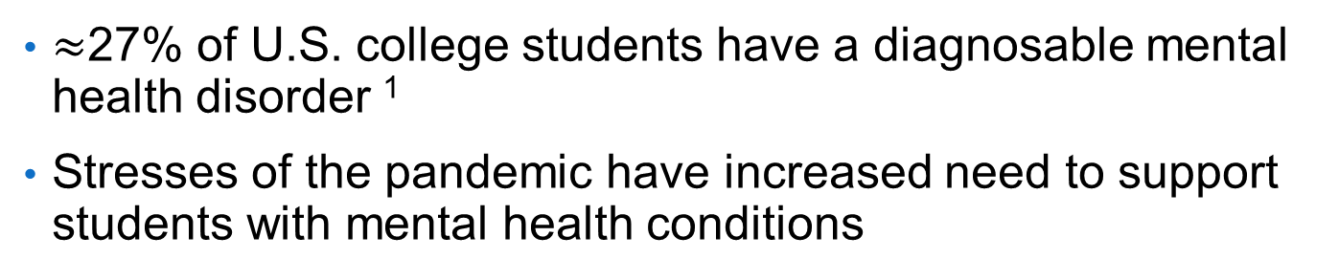
Mental Health in Higher Education
$≈$27% of U.S. college students have a diagnosable mental health disorder ¹
Stresses of the pandemic have increased need to support students with mental health conditions
Healthy Minds Study Findings Academic Year ’18-’19² vs. Winter/Spring ‘21³

Slide 6
Mental Health in Higher Education
43% of 1st year college students with mental health conditions report severe role impairment²
High school students with mental health disabilities have the highest college dropout rate of any students with disabilities³
College students with mental health conditions have high rates of college disruption⁴
Positive mental health is strongly correlated to academic success, retention, and ultimately vocational success, adult resiliency & Return on Investment⁵

Slide 7
Elements of Supported Education
Ringeisen and colleagues (2017)⁵
Specialized staff members oriented toward four objectives—supporting academic goal-setting, building academic competencies, navigation, and improving motivation;
One-on-one contacts and group workshops centered on skill-building for academic success;
Activities to help the student navigate the academic setting, coordination between postsecondary education and mental health supports, facilitating enrollment, supporting the student in obtaining financial aid, securing additional educational accommodations, and providing information about rights and resources;
Provision of general supports and linkages with mental health counseling, as appropriate.
Notes:
There is a long history of supported education programs initially for adults with serious mental illness, and a more recent emphasis on those with 1st episode psychosis who are typically young adults, as well as studies that have engaged young adults exclusively.
The PASS intervention, as you will see, roughly fits as a supported education intervention, but students are already enrolled so the activities related to getting them enrolled don’t apply.

Slide 8
Peer Academic Supports for Success (PASS):
Peer Academic Supports for Success (PASS):
An empirically supported peer coach intervention to help college students with mental health conditions succeed academically
Phase 1
Qualitative Study
Phase 2
Intervention Specification
Phase 3
Open Trial
Phase 4
Pilot Randomized Controlled Trial
Phase 1
Qualitative Study
Phase 2
Intervention Specification
Phase 3
Open Trial
Phase 4
Pilot Randomized Controlled Trial
Notes:
What we will present in detail today is the pilot randomized controlled trial comparing PASS to enhanced services as usual. This is the culmination of 3 prior phases of research. The PASS intervention and this research was designed and conducted in partnership with young adults with lived experience. In Phase 1 we conducted qualitative interviews of college students with MHC, faculty, and staff of disability services offices and counseling centers at 3 universities to assess their experience and perspectives on the academic experiences of college students with MHCs. In Phase 2 we combined the results of Phase 1 with the framework of 2 existing academic coaching supports for college students; one a peer academic coaching model from Wright State University for students with autism spectrum disorders and the second a professional academic coaching model from Boston University for students with MHC. This resulted in a specified peer academic coaching model for students with MHC, that included a Coach Manual, fidelity measures, and Coach supervisor manual. In Phase 3 we alpha tested the model and the basic research methods in an open trial with 12 students. The intervention and manuals were refined, and we launched a pilot RCT in the fall of 2018.

Slide 9
PASS Logic Model
Notes:
An essential step to developing PASS was to flesh out the logic model. Specifically, to identify intermediate targets of Coaching that could improve the outcomes, including, ultimately, graduation. You can see that PASS targets 5 intermediate goals which are hypothesized to effect the 3 main outcomes. Once the intermediate targets were identified, we then identified specific activities that Coaches could do that would impact the intermediate targets. You can see that after each Coach activity there is a number/s that correspond to a specific intermediate target. These activities then formed the basis of our fidelity measures.

Slide 10
PASS Model

Slide 11
What is
Peer Academic Coaching?
Principles of Coaching
Wellness-oriented
Person-centered
Relationship-focused
Strengths-based
Voluntary
Active
PASS Coaching Targets
Executive functioning skills
Resiliency
  Emotional agility
  Stress-coping abilities
Social supports
Academic self-efficacy
Self-determination
Ultimate goal = Graduation

Slide 12
Peer Coach Qualifications
18-25 years old
Juniors/Seniors at the University
Academically successful and thriving on-campus
Lived experience a plus but not requirement
Notes:
Peer coaches were undergraduates who were 18-25 years of age, Juniors or Seniors at the University, academically successful and thriving on campus, with an appropriately respectful and empathetic perspective on peers with mental health conditions. They did not have to be a person with direct lived experience, but we found that the majority of the strongest applicants were students with MHC.

Slide 13
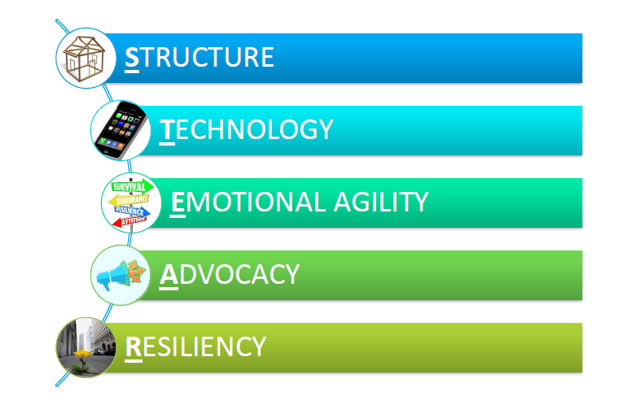
PASS Core Competencies
Structure
Technology
Emotional agility
Advocacy
Resiliency
Notes:
Addressing the intermediate targets of PASS Coaching resulted in identifying core competencies to help with student success
Structure = finding a calendaring method, goal setting for semester, time management strategies
Technology = identify wellness, academic apps for student to use
Emotional Agility = reframe experiences that student perceives as negative
Advocacy = roleplay self-advocacy conversations with professors, accessing on-campus resources including accommodations, communicating about difficulties
Resiliency = ID solutions to challenges, develop self-care routines

Slide 14
8 Domains of Wellness
Emotional
  Recent breakup
  Therapy weekly
Social
  Book club
  Dinner with coworkers
Financial
  Student loans
  Savings account
Physical
  Anxiety around the gym,
  Love to run daily
Occupational
  Job search
  How is it going
Emotional
Social
Financial
Recent breakup, therapy weekly
Book club, dinner with coworkers
Student loans, savings account
Physical
Occupational
Anxiety around the gym, love to run daily
Job search; how is it going?
Notes:
Helps inform coaching goals

Slide 15
Coaching is Doing!
Sending emails
Going to office hours
Exploring time management techniques
Planning or attending social outings
Exploring wellness apps
Sharing coping techniques
Discussing and connecting with campus resources
Creating support maps
Reframing negative experiences
Encouraging self-care
Going to the gym
Studying
Keeping accountability
Exploring healthy lifestyle
Helping with class registration, housing, etc.
Formulating SMART goals
Journaling
Supporting career goals

Slide 16
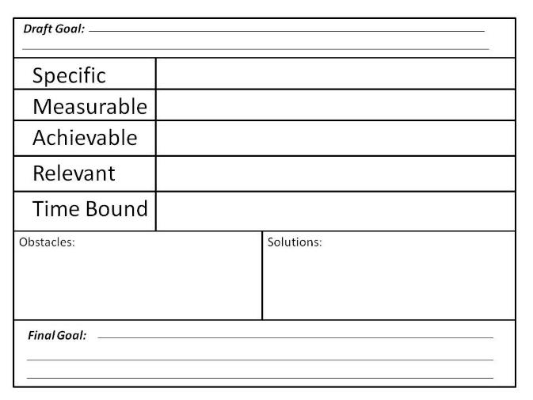
PASS SMART Goals Worksheet

Slide 17



Supports
SUPPORTS
FAMILY
PARTNER
THE GYM
ROOM
MATE
ART
PETS
THERAPIST
Notes:
Talk about other maps

Slide 18

PASS Peer Coach Manual
Topics
Hard Copy and Online Access
  Peer support approach
  Supported education
  Mental health
  Resiliency and wellness framework
  Responding with empathy
  Motivational Interviewing
  Crisis response and suicide prevention
  Reasonable Accommodations
  Peer coach self-care
  Units to work on for each competency
Notes:
The developed manual included information about mental health conditions, its impact on academic participation and progress, the basics of peer support and coaching, strategies to work successfully with students with MHC, self-care, and specific topics and exercises in the core competencies, as well as some logistics.

Slide 19
Peer Coaching Structure
Peer coach training & supervision
  12 hours of training through webinars & in-person sessions
  1 –hour group peer coach supervision meeting weekly
  Individual supervision as needed
In-person/virtual coaching sessions
  1-2x/week
  Up to 4 hours per week
Coaching session =
  rapport building
  housekeeping
  discussion
  action / activity
  review of tasks for week
  final thoughts
Notes:
Coaches are paid. They receive 12 hours of initial training prior to starting to work with a student, then weekly 1 hour group supervision. Supervisors provide individual supervision as needed. Supervisors are available for any crisis support. This has been rare in the now 4 academic years that PASS has been provided. Supervision is specified in a supervisor’s manual.
Coach and student sessions are expected to minimally be one session every two weeks, but is typically 1-2 sessions per week. Sessions are typically about an hour, with total coaching per week limited to 4 hours. After the initial open trial, each coaching session was provided some structure to facilitate productive sessions. Generally, sessions proceed in this order.

Slide 20
Pilot Randomized Controlled Trial
Methods

Slide 21

Study Setting
Large private university
  Northeast
  18,000 undergraduates
  73% live in dorms
  25% admissions acceptance rate
  98% full time Students
  Diversity
    40% White
    14% Asian
    10% LatinX
    <5% Black
    21% International
Recruited Academic Years ’18-19 and ‘19-’20
Notes:
The Pilot RCT was conducted at a large private university in the northeast that had fairly high academic admission standards, were overwhelmingly full time students living on campus. The study started in the fall of 2018, we had funding for one academic year. In the summer of 2019 we found funding for a second academic year. This proved to be extremely beneficial as in the spring of 2020, with the onset of the pandemic, March break was spent largely converting the PASS approach to remote coaching and converting our research methods to only being done remotely.

Slide 22

Participant Criteria
  18-25 years old
  Freshman/Sophomore at the University
  Mental health condition
  Academic impairment
Notes:
Student participants were traditionally-aged college students who had completed less than half of their credits towards graduation, who had a mental health condition that impacted their academic participation or performance.

Slide 23
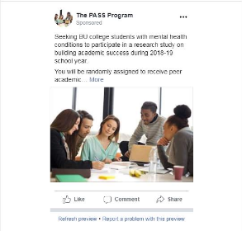
Eligibility Screening
Recruitment flyers link to a brief initial screening web survey for student status at the University & self-report mental health condition;
Final screening; research team member interview or self-administered web survey
  K-6 (Kessler et al., 2003) identifies likely serious mental illness/clinical need
  Questionnaire about recent history of educational barriers caused by MH condition
  Eligible = Combination of positive K6 (score >5) and barriers
Notes:
Recruitment flyers via Facebook or physical flyers provided a link to a brief initial screening web survey that assessed student status at the University and self-report of mental health condition;
schizophrenia or other psychotic disorders
anxiety disorders
mood disorders
eating disorders
attention deficit /disruptive behavior disorders
Positive initial screens provided choice for final screening; research team member interview or self-administered web survey
Final screen – completed K-6 (identifies likely serious mental illness/clinical need) and questionnaire about recent history of educational barriers caused by MH condition
Combination of positive K6 (score >5) and barriers = eligible

Slide 24
Consort Diagram - Recruitment
Initiated preliminary screen = 190
Did Not Complete Initial Screening = 29
Completed preliminary screen = 161
Not Eligible = 36
No mental health = 5
Not age 18-25 = 1
Insufficient enrollment = 4
Not enrolled at University = 26
Did not complete final screen = 44
Declined final screen/Not responsive = 43
Incomplete final screen = 1
Completed final screening = 81
Not Eligible = 5
No mental health = 3
No educational impairment = 2
Eligible but declined = 4
Eligible & Randomized = 72
Notes:
This diagram shows the flow of recruitment
190 individuals initiated the preliminary screen
29 of them did not complete the preliminary screen (15.2%)
161 completed the preliminary screen
36 were not eligible based on the preliminary screen (18.9%)
44 then did not complete the final screen (23.2%)
81 Completed the final screen
5 of them were not eligible for the study based on the final screen (2.6%)
4 were eligible but then declined to enroll in the study (2.1%)
72 were deemed eligible and were randomized to condition (37.9%)

Slide 25
Eligibility Screening Results for the Sample (N = 72)
K6 – eligible score ≥5
  Mean Score = 13.1+3.9,
  54.2% meet higher cutoff (>13) for likely severe mental illness
Educational barriers: Thinking about your most recent academic year, have you had difficulty with any of the following related to your academics: (e.g. managing academic stress, attending class)
  Mean Total = 48.5 + 9.4 (possible range = 18-72)
  Mean score per item = 2.7 (1 = no difficulty, 2 = little difficulty, 3 = some difficulty, 4 = a lot of difficulty)
  Average # of items with some or a lot of difficulty = 10.5+4.0 (of possible 18 items)

Slide 26
Data Collection
Students:
  Baseline surveys
  End-of-semester surveys (2 semesters)
  Transcripts
  Peer coach assessments (each semester)
Peer Coaches:
  Weekly logs of time, student goals, & activities completed
  Self-assessments (each semester)
Supervisors;
  Supervision notes

Slide 27
Measures
Notes:
For each of the intermediate outcomes we listed in the logic model, you can see the measure or measures we used to assess them. Ultimate Goals were assessed by transcripts.

Slide 28
Pilot Randomized Controlled Trial
Results

Slide 29
Participant Characteristics (n = 71)
* PASS vs Control, p<.05
Notes:
Each of these tables lists participant characteristics first by the total sample, then by their condition. There was only one variable that was significantly different between those in the PASS condition and those in the control condition, and that was the proportion who were LatinX – we ended up with almost a quarter of those in the PASS condition were LatinX and none of those in the control condition. We randomized based on gender and race but not ethnicity. You can see that the sample was predominantly made up of female students, less than half reported being heterosexual, the largest racial category was White followed by Asian, the vast majority were full time students, they were most commonly freshman and the vast majority lived on campus.

Slide 30
Participant Characteristics (n = 71)
Notes:
The vast majority of participants had received some MH treatment in the past and more than half were currently receiving some form of MH treatment. A large portion were also taking psychotropic medications. You can see that the most common type of MH treatment was outpatient individual therapy followed by seeing a psychiatrist for medication.

Slide 31
Analysis of Intermediate and Ultimate Outcomes
Based on those with 2 follow-up data timepoints; End of Semester 1 and End of Semester 2
45 of 72 had both follow-up timepoints
  No significant differences on any participant baseline characteristics between those with and without 2 follow-up timepoints
  n = 25 in PASS, n = 20 in Control
Changes in intermediate outcomes - examined with General Linear Model
  comparing Experimental Group (PASS vs. Control) by Time (Baseline, S1, S2)
Notes:
These analyses are based on those with 2 follow-up time points of data – at the end of semester one and the end of semester 2. Two participants did not complete the end of semester one assessment , and 27 did not complete the end of semester 2. When we learned that we had funds to continue the study for a 2nd year 12 (Of 19) participants who could have then continued from the spring of 2019 for another semester in the fall of 2019 declined, another 2 participants were enrolled too late in the fall of 2019 to complete a second full semester in the study, and 13 could not be reached or successfully encouraged to complete the 2nd semester’s end of semester assessment. The analyses we present here are of the outcomes are based on the 45 that completed both follow-up assessments

Slide 32
Group by Time Interactions
(n = 45)
Time = baseline, end of semester 1, end of semester 2
PASS improved more than Control
These analyses indicate that there was a difference in the patterns of these outcomes over time that were determined by their random assignment. Generally, those in the PASS condition improved more over time than those in the control condition, or sustained the improvement for longer.

Slide 33
Results 1

Slide 34
Time effect
Both groups changed comparably over time

Slide 35
Results 2

Slide 36
Results 3
Notes:
Both groups improved in the first semester, then were fairly stable thereafter.

Slide 37
No Significant Effects

Slide 38
Results 4

Slide 39
Conclusions & Next Steps
These pilot RCT results demonstrate
  Encouraging outcomes from PASS Coaching
  Adequately feasible research methods
Currently – fully powered RCT on 2 campuses started Fall 2020
  One Large Private University & One Large Public University
  Will enroll 190 participants over 3 years
    100 participants enrolled currently

Slide 40
Faculty Education
Our initial qualitative interviews and subsequent work revealed that faculty
  Often held many of the misconceptions about mental health conditions found in the general public
  Misunderstood the nature of academic accommodations
  Desired a better understanding of what they could do to support these students
PASS Team produced 5 training videos

Slide 41
Thank You!
Contact:
Maryann.davis@umassmed.edu
STAY INFORMED!
Sign up for our e-mail newsletter for our products and announcements!
Text TRANSITIONSACR to 22828
Visit us at umassmed.edu/TransitionsACR

Slide 42
References
Auerbach, R. P., Mortier, P., Bruffaerts, R., Alonso, J., Benjet, C., Cuijpers, P., Demyttenaere, K., Ebert, D., Green, J.G., Hasking., P., Murray, E., Nock, M.K., Pinder-Amaker, S., Sampson, N.A., Stein, D.J., Vilagut, G., Zaslavsky, A.M, & Kessler., R.C. (2018). WHO World Mental Health Surveys International College Student Project: Prevalence and distribution of mental disorders. Journal of Abnormal Psychology, 127, 623-638.
Alonso, J., Mortier, P., Auerbach, R.P, Bruffaerts, R., Vilagut, G., Cuijpers, P.,Demyttanaere, K., Ebert, D., Ennis, E., Gutierrez-Garcia, R.A., Green, J.G., Hasking, P., Lochner, C., Nock, M.K., Pnder-Amaker, S., Sampson, N.A., Azslavsky, A.M., & Kessler, R.C. (2018). Severe role impairment associated with mental disorders: Results of the WHO World Mental Health Surveys International College Student Project. Depression and Anxiety, 35, 802-814.
Newman, L., Wagner, M., Knokey, A.-M., Marder, C., Nagle, K., Shaver, D., Wei, X., with Cameto, R., Contreras, E., Ferguson, K., Greene, S., and Schwarting, M. (2011). The Post-High School Outcomes of Young Adults With Disabilities up to 8 Years After High School. A Report From the National Longitudinal Transition Study-2 (NLTS2) (NCSER 2011-3005). Menlo Park, CA: SRI International.
Arria, A.M., Caldeira, K.M., Vincent, K.B., Winick, E.R., Baron, R.A. & O'Grady, K.E. (2013). Discontinuous college enrollment: Associations with substance use and mental health. Psychiatric Services, 64, 165-172.
Borjas, G.J. 2013. Labor Economics. New York, NY: McGraw-Hill Irwin.
Ringeisen, H., Ellison, M.L., Ryder-Burge, A., Biebel, K., Alikhan, S.& Jones, E. (2017). Supported education for individuals with psychiatric disabilities: State of the practice and policy implications. Psychiatric Rehabilitation Journal, 40, 197-206.

