Slide 1
Enhancing Community Participation among Young Adults with Serious Mental Health Conditions from Disadvantaged Backgrounds
Kathryn Sabella, PhD & Liz Thomas, PhD
June 5, 2024
Notes:
Kathryn

Slide 2


Introductions
Kathryn Sabella, PhD
Co-Director, CIRC Center
Assistant Professor of Psychiatry,
iSPARC, Department of Psychiatry,
UMass Chan Medical School
Elizabeth Thomas, PhD
Co-Director, CIRC Center
Assistant Professor of Social and Behavioral Sciences,
Temple University College of Public Health
Notes:
Kathryn – introduce self
Liz introduce self
Liz – prompt poll

Slide 3
Acknowledgement & Disclosure
The contents of this presentation were developed under a grant from the National Institute on Disability, Independent Living, and Rehabilitation Research (NIDILRR grant number 90RTCP0010) and co-funded by the Substance Abuse and Mental Health Services Administration (SAMHSA). NIDILRR is a Center within the Administration for Community Living (ACL), Department of Health and Human Services (HHS). The contents of this presentation do not necessarily represent the policy of NIDILRR, ACL, SAMHSA, or HHS, and you should not assume endorsement by the Federal Government.
The authors have no conflict of interest.
Notes:
Kathryn

Slide 4
Outline
Current knowledge
The activities of CIRC
Community Participation and Young Adults with Serious Mental Health Conditions
Disparities among Young Adults from Disadvantaged Backgrounds
Introduction to CIRC Center
Opportunities for Collaboration and Technical Assistance
Notes:
Kathryn

Slide 5
Community Participation and Young Adults with Serious Mental Health Conditions
Notes:
Kathryn
Prompt – via Chat, what example of community participation come to mind when you think about young adults with mental health conditions from disadvantaged backgrounds?

Slide 6
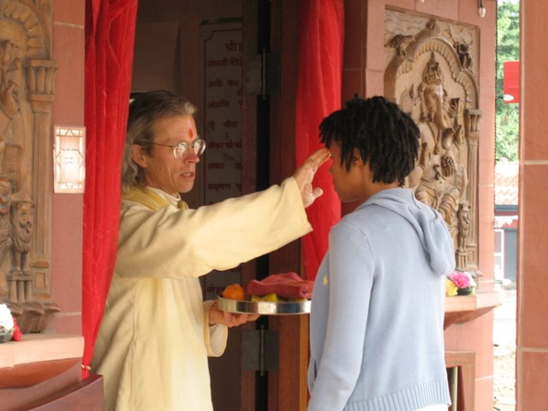




Burns-Lynch, B., & MUSA, E. B. (2016). An empirical study of the relationship between community participation, recovery, and quality of life of individuals with serious mental illnesses. Israel Journal of Psychiatry, 53(1), 46.
Community Participation:
the “choice and action that individuals make to be active in valued roles in the communities of their choice, across a variety of domains in their life.”
This Photo by Unknown Author is licensed under CC BY-NC-ND
Education
Employment
Family
Friendships
Romance
Religion
Recreation
Civic engagement
This Photo by Unknown Author is licensed under CC BY-ND
This Photo by Unknown Author is licensed under CC BY
This Photo by Unknown Author is licensed under CC BY
Notes:
Liz
I’d like to make sure we are all on the same page about what I mean by community participation, since this term can be used to refer to different things. Community participation is…
Domains include…

Slide 7
Importance of Community Participation
Community integration is a legal right.
Community participation is a medical necessity.
  Based on theories/frameworks such as the World Health Organization’s International Classification of Functioning, Disability, and Health (ICF)
Notes:
Liz
First, community integration (which is “The opportunity to live in the community, and be valued for one’s uniqueness and ability, like everyone else.” (Salzer, 2006) is a right based on the ADA that was reinforced by the Supreme Court Olmsted decision in 1999. Olmsted set off a lot of different policy actions in the federal government. President Bush put forth the New Freedom Initiative in 2001 and the New Freedom Commission Report in 2003. These really underscore the notion of community integration as a right.
Community participation is not only as a right, but a medical necessity. This Well Together document is something that was developed by the Temple University Collaborative on Community Inclusion in collaboration with an organization called Wellways Australia that includes the fundamental concepts and theories underlying the importance of community inclusion and participation and also evidence for the medical necessity of community inclusion/participation.
The argument for medical necessity is based on a number of theories and concepts, like the World Health Organization’s International Classification of Functioning, Disability, and Health (ICF), where participation is viewed as a dimension of health and health functioning. According to the ICF, participation refers to involvement in a social situation (e.g., being a student, going to church, synagogue or mosque, voting – anything that involves social interactions in meaningful activities).

Slide 8

Community Participation and Young Adults (14-26) with Serious Mental Health Conditions
Especially important to consider young adults’ community participation because:
  Participation is a way to explore social roles and identity
  Period of high risk of disability onset
  Consequences of interrupted developmental milestones
  Focus on life goals is seen as an engagement facilitator
This Photo by Unknown Author is licensed under CC BY
Lucksted, A., Essock, S. M., Stevenson, J., Mendon, S. J., Nossel, I. R., Goldman, H. H., ... & Dixon, L. B. (2015). Client views of engagement in the RAISE Connection Program for early psychosis recovery. Psychiatric Services, 66(7), 699-704.
Notes:
Liz
Community participation is a way to test out and solidify personal interests, social roles, and identity.
However, the onset of serious mental illnesses, which tends to occur during young adulthood, can interrupt or delay the pursue of community participation interests and goals. For example, it can prolong the attainment of educational achievements needed for competitive employment.
We know from research that young adults with early psychosis who do not receive treatment designed to minimize illness-related disruptions are at greater risk for health problems and poorer functional outcomes as they age. This further supports the notion that community participation is a medical necessity.
Finally, a focus on life goals (e.g., work, educational attainment, relationships) is viewed as a facilitator of engagement in mental health services (specifically coordinated specialty care) among young adults. Thus, assisting young people with developing and pursuing community participation goals is likely to promote meaningful involvement in services and longer-term retention in care.

Slide 9

Community Participation Interests of Young Adults
Focus groups with individuals aged 18-26 identified the following participation areas as being important:
  Working for pay
  Taking classes to earn an educational degree or professional certificate or for fun
  Going to public spaces (e.g., library, park, museum, restaurant)
  Going to place of worship or participating in “spiritual” activities
  Going online to socialize or get information
  Volunteering
  Participating in civic activities (e.g., marches or demonstrations)
  Going to/watching sporting events
  Doing a physical activity for fun
  Participating in artistic activities
Thomas, E. C., Snethen, G., O’Shea, A., Suarez, J., Hurford, I., & Salzer, M. S. (2020). An examination of the community participation interests of young adults with serious mental illnesses. The journal of behavioral health services & research, 47, 526-543.
Notes:
Liz
The TU Collaborative conducted focus groups with 11 participants from a CSC program or residential program for young adult men. The goal of these groups was to elicit a broad range of community participation areas and activities considered to be important to young people. Participants identified a total of 16 community participation areas and 58 specific activities that were important to them, including the ones listed on this slide.

Slide 10
Community Participation and Young Adults
Young adults value and spend more time working and going to school than those older.
  BUT, young adults report a relatively small amount of time spent in these activities.
Young adults also tend to value running errands, going shopping, going to a place of worship, and spending time with family/friends.
Young adults seem to be less satisfied with their amount of participation in important areas than those older.
Thomas, E. C., Snethen, G., & Salzer, M. S. (2017). A developmental study of community participation of individuals with serious mental illnesses: implications for policy and practice. American Journal of Orthopsychiatry, 87, 597-605.
Notes:
Liz
The TU Collaborative also conducted a study with 879 individuals with serious mental illnesses (105 of whom were between the ages of 18-30) in order to compare the amount, importance, and sufficiency of community participation across age groups.
Young adults tended to value and spend time more time working and going to school than middle-aged or older adults. However, on average, young adults reported spending only about 5 days a month working and about 2 days a month going to school.
At least 70% of young adults indicated that running errands, going shopping, going to a place of worship, and spending time with family/friends were important to them.
Finally, compared to those older, young adults were less satisfied with their amount of participation, reporting that only 36% of important areas were done enough.

Slide 11

Community Participation in a Post-COVID Context
Young adults with SMHC frequently report disruptions in the areas of work, residential situation, intimate and social relationships, and school.
Respondents in poorer physical health and poorer mental health were significantly more likely to experience multiple role disruptions, indicating they may be more at risk for long-term negative outcomes.
It’s unclear how COVID has impacted community participation in a post-COVID era for all age groups, but particularly young adults who are at a critical developmental period
Sabella, K., Jonikas, J., Aranda, F., Steigman, P., Cortex, C., and J. Cook. Life Interrupted: Pandemic-Related Disrupted Transitions Among Young Adults with Mental Illness. Poster. 6th Annual International Association for Youth Mental Health (IAYMH) Conference, Copenhagen, DK.
Notes:
Kathryn

Slide 12
Disparities among Young Adults from Disadvantaged Backgrounds
Notes:
Kathryn

Slide 13
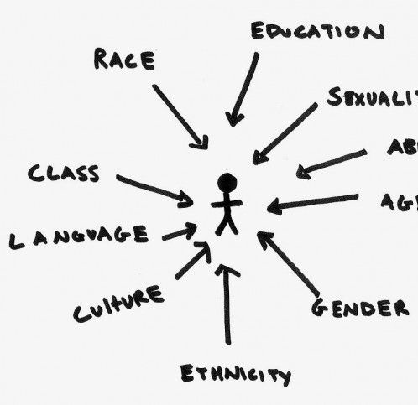
Defining Disadvantaged Backgrounds
Young adults of color (i.e., BIPOC or racial/ethnic minoritized TAY)
Lesbian, gay, bisexual, transgender, queer, intersex, asexual, and more (LGBTQIA+) young adults
Young adults in other circumstances:
  living in rural areas
  adversely affected by persistent poverty or inequality
  justice and/or child welfare system involvement
Possessing multiple marginalized identities and sources of disadvantage impacts both mental health and community participation
This Photo by Unknown Author is licensed under CC BY
Notes:
Kathryn
First, we need to clearly define what we mean by “disadvantaged backgrounds”

Slide 14
Community Participation Disparities among Young Adults from Disadvantaged Backgrounds
Community Participation Area | Disparities
Social Relationships | Young adults of color, LGBTQIA+ young adults, and those involved in the foster care system experience numerous barriers to social connection (e.g., lack of understanding from others, stigma, feelings of shame/inferiority).
Education | Economically disadvantaged young adults and those from racial/ethnic minorities backgrounds are less likely than the general student population to graduate from high school.
Employment | Justice-involved young adults often lack job readiness skills and work experience to obtain/maintain employment and are further disadvantaged by the stigma associated with having a criminal history.
Civic engagement | Structural inequities can prevent marginalized young adults from participating in civic life to the same degree as more privileged peers, referred to as the “civic engagement gap.”
Sapiro et al. (2020); Simons & Steele (2020); Schubert et al. (2018); Fitzgerald et al. (2021)
Notes:
Kathryn

Slide 15

Key Gaps Remain
Few interventions exist specifically for young adults with SMHC from disadvantaged backgrounds
  Those that do aren’t necessarily designed to promote community participation
We do not know whether interventions designed to promote community participation address the unique needs of young adults from disadvantaged backgrounds
Notes:
Kathryn

Slide 16
QuantCrit Movement
Researchers should use a critical lens to assess if and how methods of research are influenced by historical, social, political, and economic power relations as well as their own biases.
Research should work towards achieving equity and supporting social justice when possible.
Example:
  Traditionally, interventions are developed and tested with the broadest target population (i.e. “majority population) and interventions are only adapted for diverse or marginalized subgroups later, after they’ve been established as efficacious with the broader population.
Gillborn D, Warmington P, Demack S. QuantCrit: education, policy, ‘Big Data’ and principles for a critical race theory of statistics. Race Ethnicity and Education. 2018/03/04 2018;21(2):158-179. doi:10.1080/13613324.2017.1377417; Suzuki, S., Morris, S. L., & Johnson, S. K. (2021). Using QuantCrit to advance an anti-racist developmental science: Applications to mixture modeling. Journal of Adolescent Research, 36(5), 535-560.
Notes:
Kathryn
This traditional development pipeline often delays interventions from reaching marginalized subgroups which can further exacerbate health and mental health inequities.
QuantCrit would see this assumption (that researchers should start efficacy with the “majority” population, e.g., white, middle- and upper-class) as an example of White power and privilege.
This pattern is part of the increasing awareness of the historical, social, political, and economic structures and power relations evident in traditional social science research methods that contribute to inequities.

Slide 17
Introduction to CIRC Center
9/1/2023-8/31/2028
Notes:
Kathryn

Slide 18
The Center for Community Inclusion and Reflective Collaboration (CIRC Center) Overall Goal
To serve as a national leader in state-of-the-art research and knowledge translation activities to significantly advance community living and participation outcomes among young adults (14-26) with serious mental health conditions from disadvantaged, vulnerable, and marginalized backgrounds.
Notes:
Kathryn

Slide 19
Organizational Structure
UMass Chan Medical School
Temple RRTC on Community Living and Participation for People with Serious Mental Illness
Temple University (CPH)
Learning and Working During the Transition to Adulthood RRTC
CIRC
Notes:
Kathryn

Slide 20
Objectives
Generate new knowledge regarding developmentally appropriate interventions that maximize community living and participation.
1
Generate new knowledge about key systems and policy issues that affect community living and participation outcomes.
2
Provide training, dissemination, and technical assistance activities to young adults, their families, service and support providers, researchers, policymakers, and other stakeholders.
3
Notes:
Kathryn

Slide 21
Guiding Principles, Assumptions, and Values
Disability justice
Focus on intersectionality to understand experience of disability.
All research projects pay attention to multiple sources of marginalization and disadvantage.
Social model of disability
Lack of participation considered as resulting from a poor person-environment fit.
Projects seek to address environmental barriers to community living and participation (e.g., stigma and discrimination, system issues).
Developmental theories and perspectives
Recognition of unique milestones, needs and experiences of YAs
Projects incorporate a developmental lens.
Notes:
Liz
First, we approach our work from a disability justice perspective, which includes a focus on intersectionality and recognition that the experience of disability is shaped by a person’s multiple social identities and the social institutions and processes that contribute to oppression. All of our research projects attend to, and ultimately seek to address, the multiple sources of marginalization and disadvantage that TAY with SMHC experience that limit their participation.
Second, we have adopted the social model of disability into our work, with many of our projects seeking to address environmental barriers to community living and participation such as stigma and discrimination and systems issues.
Third, we approach Center activities from a developmental perspective, recognizing the normative developmental milestones, needs, and experiences of TAY. The substantial work we have already done to better understand developmental expectations for participation among TAY with SMHC serves as a foundation for our proposed work.

Slide 22
Guiding Principles, Assumptions, and Values (cont.)
(Youth) participatory action research approach
Designed to foster youth empowerment and action related to social injustices.
All projects informed by lived experiences and concerns of YAs and include Young Adult Advisory Board (YAB) as co-investigators or key collaborators.
Participatory activities enhanced by Family Advisory Board (FAB) and Multi-Stakeholder Advisory Board (MAB).
Notes:
Liz
Finally, we take a participatory action research approach. We put youth in parentheses here because we designed our Center with and for youth, but our participatory activities are enhanced by involvement from our Family Advisory Board (FAB) and Multi-Stakeholder Advisory Board (MAB).

Slide 23

Proposed Center Activities
5 Research Projects
Ongoing dissemination activities
3 Training Projects
2 Types of Technical Assistance
Notes:
Liz

Slide 24
Research Projects
Notes:
Liz→Kathryn

Slide 25

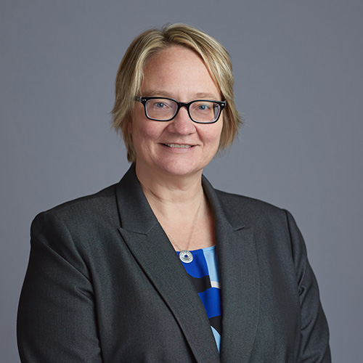

R1: Preliminary Assessment of Effectiveness, Implementation, and Research Feasibility of the bryt Intervention for BIPOC and Economically Disadvantaged High School Students
Leadership:
Kathryn Sabella, PhD (PI); Michelle Munson, PhD; Bo Wang, PhD; Paul Hyry-Dermith, PhD; 2 YAB members (Co-Is)
Kathryn Sabella
Bo Wang
Michelle Munson
Paul Hyry-Dermith
Notes:
Kathryn

Slide 26
R1: Background
Compared to their peers, high school students with serious mental health conditions struggle with
  lower graduation rates
  high rates of absenteeism, school refusal, and unexcused absences.
bryt (pronounced “bright”) = a short-term program for high school students with SMHC who are returning to school after extended absences due to psychiatric hospitalization or intensive outpatient therapy.
Given systemic inequities and the widening achievement gap worsened by COVID, BIPOC/LSES students with SMHC need support urgently.
This study will explore the feasibility, appropriateness, and acceptability of bryt specifically with this population of students.
Notes:
Kathryn

Slide 27
R1: Our Proposed Research
Research questions
  In what ways does bryt need to be adapted to better meet the needs of BIPOC/LSES students with SMHC?
  Is there preliminary evidence that the adapted bryt is effective?
  What research methods are needed for a future rigorous test of the adapted bryt?
Research activities
  Focus groups with bryt students, families, and bryt coordinators
  Intervention adaptation based on focus group findings
  Pilot feasibility randomized controlled trial

Slide 28

As a result of R1, we will have:
New knowledge about how bryt should be tailored to meet the unique needs of BIPOC/LSES youth
Intervention materials for field testing
Findings to support future research on bryt

Slide 29

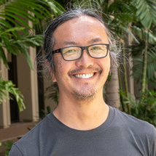
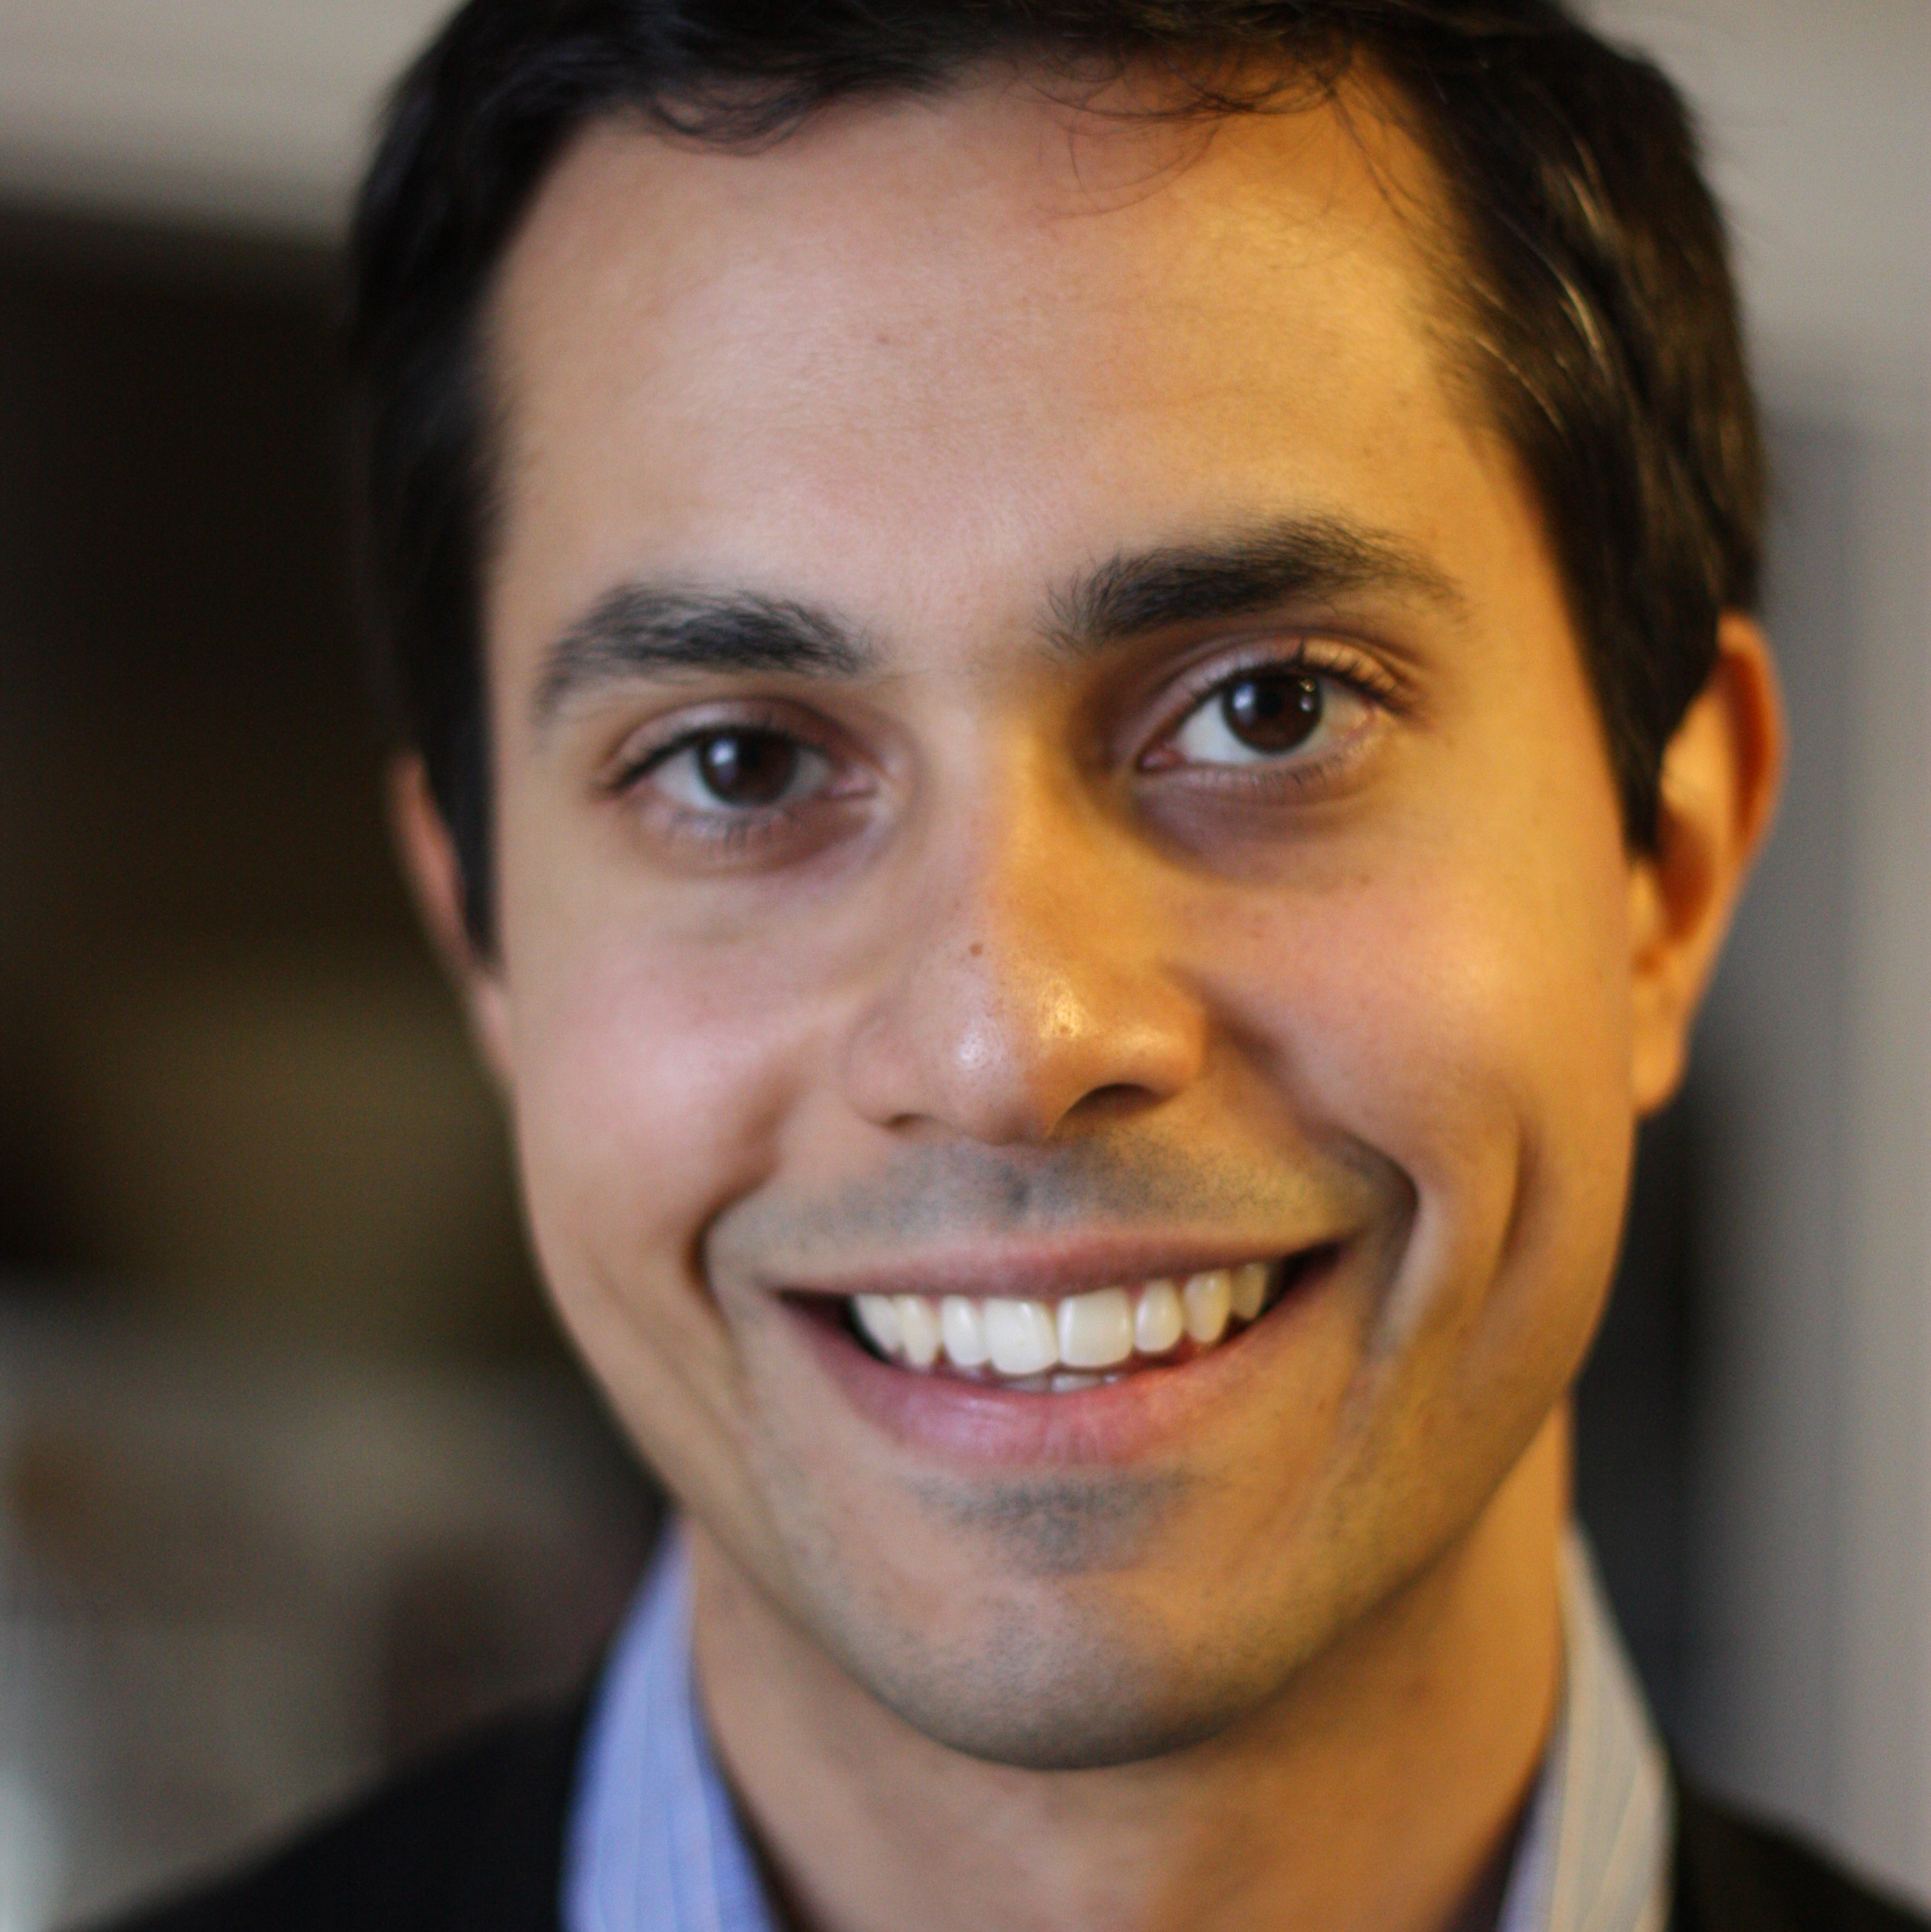
R2: The Development and Pilot Evaluation of Flexible Living and Optimal Wellness (FLOW): An Intervention to Support the Social Integration of LGBTQIA+ Young Adults with Serious Mental Health Conditions
Leadership:
Megan Kelly, PhD (PI);Ethan Moitra, PhD; Akihiko Masuda, PhD; Michelle Munson, PhD (co-Is)
Megan Kelly
Akihiko Masuda
Ethan Moitra
Michelle Munson
Notes:
Liz

Slide 30
R2: Background
LGBTQIA+ youth face higher mental health risks due to marginalization, stigma, and discrimination
LGBTQIA+ youth have a harder time finding safe, supportive communities and social connections for healthy development.
Acceptance and Commitment Therapy (ACT) is an evidence-based intervention that helps individuals commit to positive behavior change aligned with their values by accepting challenging thoughts and emotions.
This study will explore the feasibility, acceptability, and preliminary impact of Flexible Living and Optimal Wellness (FLOW), an identity-affirming adaptation of ACT for YAs with SMHC who identify as LGBTQIA+.
Notes:
Liz
We know that young people who identify as LGBTQIA+ are at increased risk for mental health issues due to negative social experiences such as marginalization, stigma, and discrimination. They also experience difficulty finding safe communities and social connections.
Acceptance and Commitment Therapy (ACT) is an evidence-based intervention that, when appropriately adapted, may be well suited to address the needs of young people with SMHC who identify as LGBTQIA+.
This project involves the development and pilot evaluation of a novel intervention called FLOW to improve social connectedness and enhance mental health among LGBTQIA+ TAY with SMHC. FLOW is an identity-affirming adaptation of Acceptance and Commitment Therapy to Improve Social Support (or ACTsocial), which was developed by Dr. Kelly to help individuals who have experienced interpersonal trauma to increase their social connectedness with family members, partners, friends, and peers.

Slide 31
R2: Our Proposed Research
Research questions
  What is the preliminary impact of FLOW on social connectedness and mental health among LGBTQIA+ YAs with SMHC?
  Is the FLOW approach acceptable to this group?
  Is FLOW feasible to be studied in a larger clinical trial?
Research activities
  Qualitative interviews with YAs with SMHC who identify as LGBTQIA+
  Intervention adaptation based on qualitative findings
  Single group pilot trial of FLOW
  Pilot randomized controlled trial of FLOW
Notes:
Liz
The project will address 3 primary research questions about the preliminary impact, acceptability, and feasibility of FLOW and will progress across 3 phases involving: 1) intervention adaptation in collaboration with LGBTQIA+ TAY with SMHC, 2) an open pilot trial, and 3) a pilot randomized controlled trial comparing FLOW to Person-Centered Therapy (a common intervention for interpersonal difficulties).

Slide 32

As a result of R2, we will have:
New knowledge about how Acceptance and Commitment Therapy (ACT) should be tailored to meet the unique needs of LGBTQIA+ youth
Intervention materials for field testing
Findings to support future research on FLOW
Notes:
Liz

Slide 33

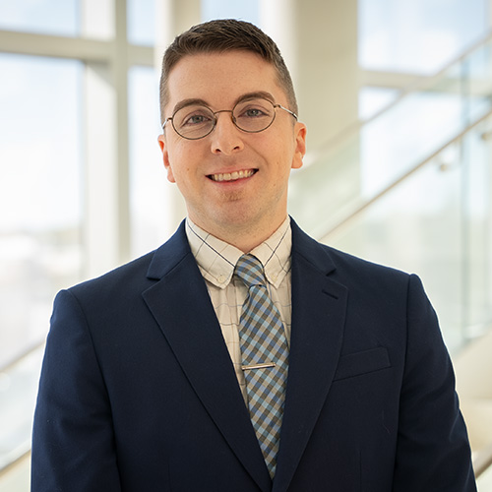
R3: Improving Implementation of Risk-Need-Responsivity: Service Accessibility for Justice-Involved Young Adults with Serious Mental Health Conditions
Leadership:
Gina Vincent, PhD & Spencer Lawson, PhD (co-PIs)
Gina Vincent
Spencer Lawson
Notes:
Kathryn

Slide 34
R3: Background
Risk-Need-Responsivity (RNR) is a proven method to help justice-involved youth with mental health challenges participate in the community and reduce justice involvement.
RNR assesses a young adult’s risk for reoffending and matches them with services to meet their needs.
In practice, implementing RNR can be difficult for a variety of reasons
Mental health services alone do not significantly reduce justice involvement, and limited availability of services can be an issue, particularly in rural areas.
This study will explore barriers and feasible solutions to implementation of the RNR model, specifically related to need-to-service matching.
Notes:
Kathryn

Slide 35
R3: Our Proposed Research
Research questions
  What are current gaps in need-to-service matching?
  What are implementation barriers and facilitators to need-to-service matching?
  What are feasible and acceptable solutions for improving need-to-service matching?
  How do questions 1-3 vary between rural and urban communities?
Research activities
  Focus groups with justice-involved YAs with SMHC who are participating in RNR programs and RNR program staff
    Rural and urban representation
    Focus on barriers and feasible solutions
Notes:
Kathryn

Slide 36

As a result of R3, we will have:
New knowledge about key systems and policy barriers and feasible solutions for overcoming implementation barriers in rural and urban settings
Notes:
Kathryn

Slide 37
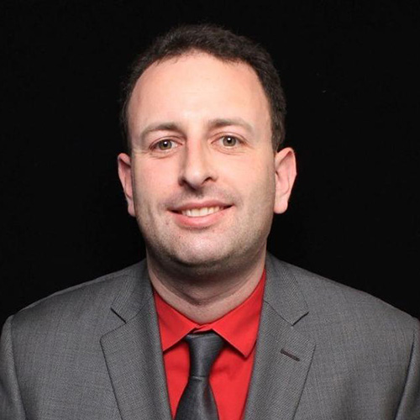


R4: Leveraging Integrated Data Systems to Elucidate Relationships between System Involvement and Community Participation Outcomes among YAs with SMHC
Leadership:
Elizabeth Thomas, PhD (PI); Caterina Roman, PhD; Eugene Brusilovskiy, MUSA; Recai Yucel, PhD, FASA (co-Is)
Elizabeth Thomas
Eugene Brusilovskiy
Caterina Roman
Recai Yucel
Notes:
Liz

Slide 38
R4: Background
Youth with SMHC are more likely to be involved in the child welfare and justice systems and to use expensive services like psychiatric hospitalizations, which can hinder their ability to participate in community activities like employment.
To improve services and systems, policymakers need to identify high-risk individuals and target interventions accordingly. However, there are gaps in our knowledge of who is most at risk for poor outcomes, suggesting that additional research is needed.
Using administrative data from Washington State, this study will explore patterns of system involvement over time and the impact of this system involvement on later employment outcomes.
Notes:
Liz
Young people with SMHC are more likely to have system involvement (child welfare, justice system, public mental health). System involvement can have a negative impact on community participation, especially employment.
We need a better understanding of the characteristics of young people who are most at risk for negative employment outcomes.
Research project 4 involves use of Washington State’s Integrated Data System, which includes over two decades of cross-system data for persons served by various state departments and service providers.
​

Slide 39
R4: Our Proposed Research
Research questions
  What distinct longitudinal trajectories of child welfare, justice, and public mental health system involvement exist for the sample before the age of 21 years?
  What between-group differences exist among the various trajectories in terms of system setting, demographic, and clinical characteristics?
  To what extent does trajectory group membership predict employment outcomes between the ages of 22 and 26 years?
Research activities
  Use a statistical approach that profiles “developmental trajectories” of an outcome over age or time to examine the questions.
Notes:
Liz
This project will assess whether there are distinct longitudinal trajectories of child welfare, justice, and public mental health system involvement that exist for TAY with SMHC before the age of 21 years. We will also examine between-group differences among the trajectories in terms of system setting, demographic, and clinical characteristic variables, and evaluate whether trajectory group membership predicts employment outcomes (employment status, number of jobs, earnings) of TAY between the ages of 22 and 26 years. ​
We will use advanced statistical modeling to profile developmental trajectories of system involvement over time.

Slide 40

As a result of R4 we will have:
New knowledge about long-term patterns of system involvement that can help improve services and policies for better integration and support
Brief on the implications of study findings for services, systems, and policies
A blueprint for other states looking to use integrated data systems
Notes:
Liz

Slide 41
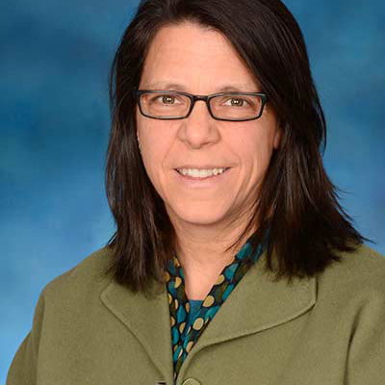
R5: Community Participation since the COVID Pandemic: A Mixed Methods Study of the Conceptualizations and Experiences of YAs with SMHC from Disadvantaged Backgrounds
Leadership:
Alicia Lucksted, PhD & Kathryn Sabella, PhD (co-PIs); Elizabeth Thomas, PhD; Eugene Brusilovskiy, MUSA; 2 YAB members (co-Is)
Alicia Lucksted
Elizabeth Thomas
Kathryn Sabella
Eugene Brusilovskiy
Notes:
Kathryn

Slide 42
R5: Background
Youth with SMHC from disadvantaged backgrounds are interested in various community activities but often participate less than they would like.
The COVID-19 pandemic changed how people engage in their communities, particularly online, and made existing barriers like poverty and stigma worse for these youth.
This study will provide an updated understanding of what community participation looks like among YAs with SMHC to design interventions, systems, and policies that meet their current experiences and needs.
Notes:
Kathryn

Slide 43
R5: Our Proposed Research
Research questions
  How are YAs with SMHC from disadvantaged backgrounds conceptualizing and experiencing community participation since COVID?
  To what extent are YAs with SMHC from disadvantaged backgrounds participating in areas that are important to them since COVID?
Research activities
  Qualitative interviews with 40 YAs with SMHC from disadvantaged backgrounds about the meaning and experience of community participation
  Survey that will allow us to measure community participation among a larger group of YAs.
Notes:
Kathryn

Slide 44

As a result of R5 we will have:
Trainings and ongoing support to young people with lived experience to foster involvement in research as interviewers, data analysts, and co-investigators
New knowledge needed to help develop better interventions, policies, and support systems tailored to meet the needs of YAs with SMHC from disadvantaged backgrounds
Notes:
Kathryn

Slide 45
Knowledge Translation
Notes:
Kathryn
Define KT

Slide 46

Ongoing Dissemination
Leadership: Marsha Ellison, PhD & Deirdre Logan
Activities:
  Journal publications and conferences
  Electronic media including podcasts, social media, and written blogs
  Other printed media (tip sheets and briefs)
Notes:
Kathryn – what topics do you want hear more about

Slide 47
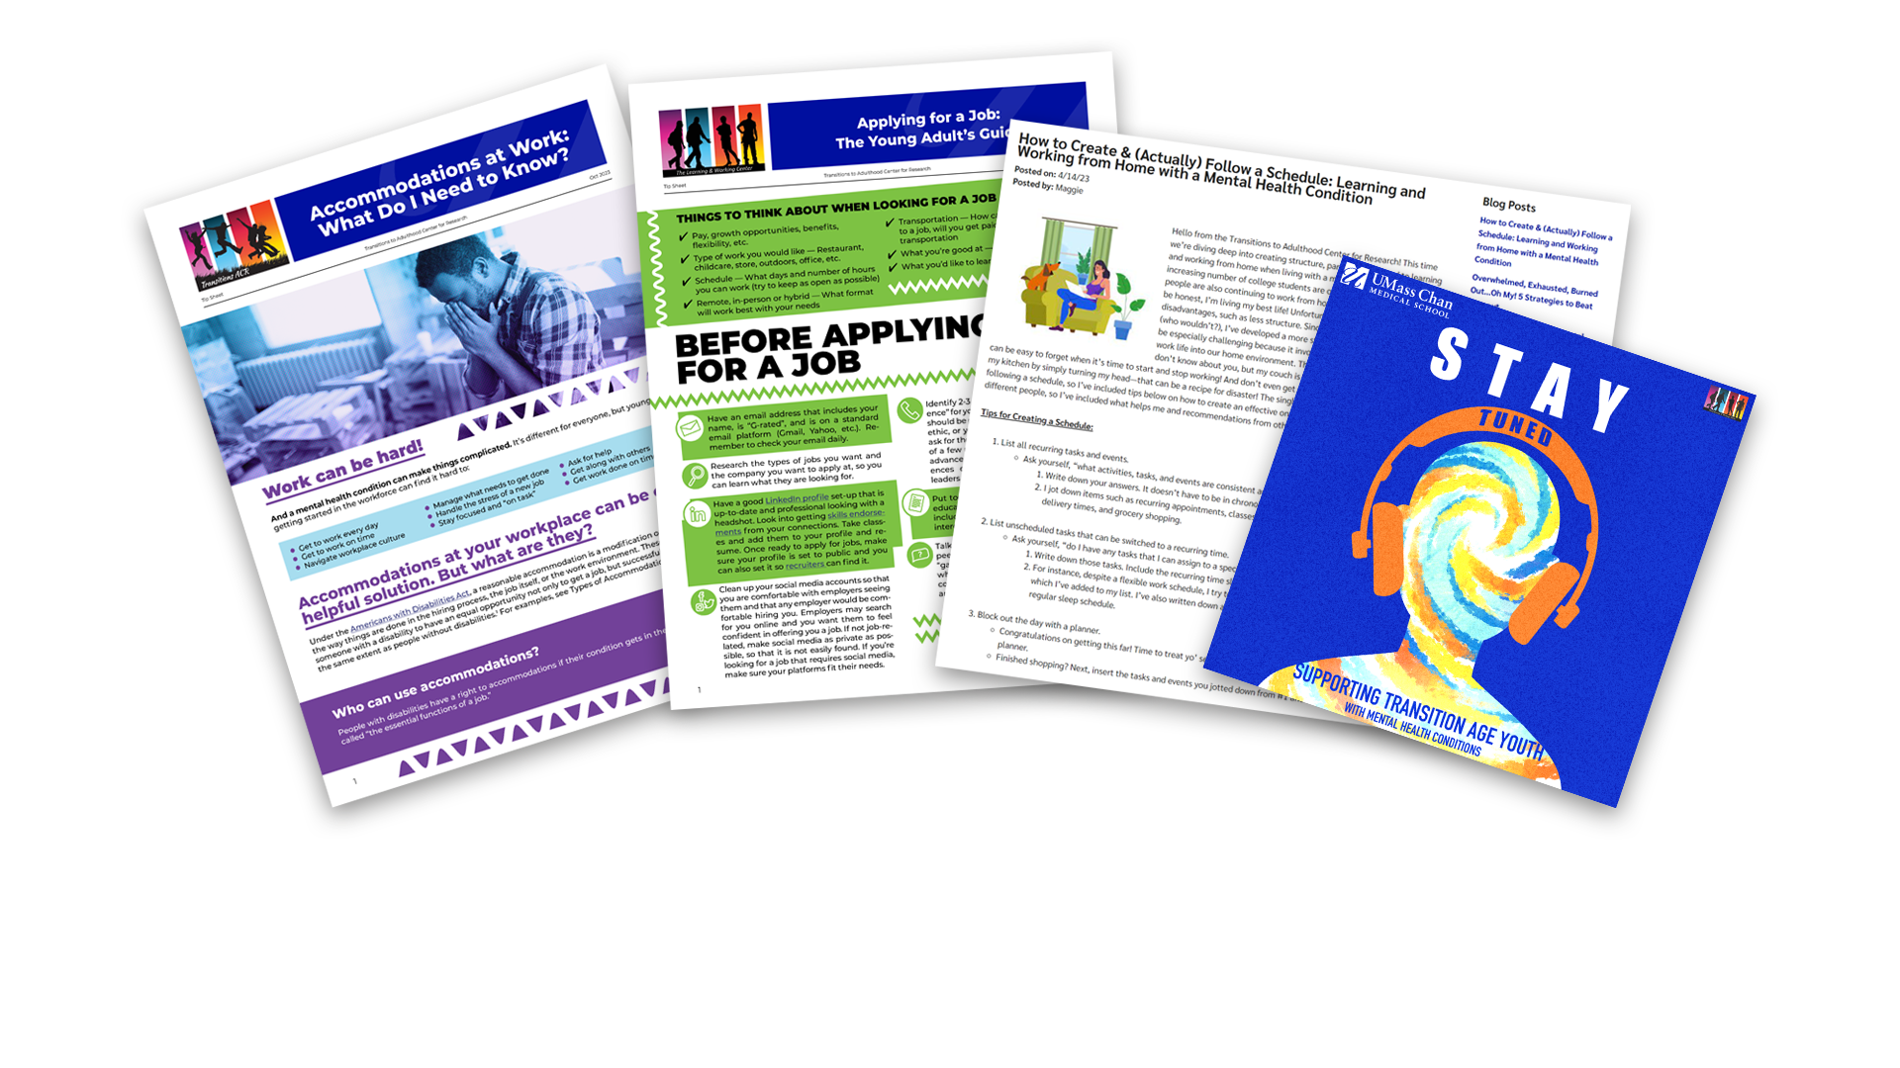
Product Outputs
Notes:
JL – populate with thumbnails re: podcasts, tip sheets (even from L&W RRTC) etc.
Kathryn - Poll #2: which modalities would you want to see more of from our center? Select that apply.

Slide 48
Check Out Our Existing Products!
Website: https://www.umassmed.edu/transitionsacr/circ
Podcast episodes:
  S.T.A.Y. Tuned Podcast Episode 13: Salsa Dancing, a Youth Advisory Board and Peer Support for Mental Health
  S.T.A.Y. Tuned Podcast Episode 17: Leveling Up Together: Gaming, Community, and Mental Health
Social media accounts:
  https://www.facebook.com/TransitionsACR
  https://twitter.com/TransitionsACR
  https://www.youtube.com/user/TransitionsRTC
  https://www.instagram.com/transitions_acr/

Slide 49

T1: Fostering Disability Justice Leadership and Civic Engagement among YAs with SMHC from Disadvantaged Backgrounds
Leadership: Barbara Ferman, PhD (co-lead); Ieshia Nelson, MA (co-lead); Ethan Rodriguez
Notes:
Liz

Slide 50
T1: Background
Civic engagement (i.e., participation in activities such as voting, advocacy, community organizing, or volunteering) promotes personal and community well-being.
Inequitable learning opportunities impede participation in civic life among youth with SMHC from disadvantaged backgrounds.
This project trains these young people to take action on social, economic, and political issues of importance to them.
Notes:
Liz
Civic engagement…is an important area of community participation. But there are inequitable learning opportunities among people from disadvantaged backgrounds, limiting their ability to participate in civic life.
The project will involve the development and implementation of a civic engagement education program from TAY with SMHC from disadvantaged backgrounds.

Slide 51
T1: Description & Deliverables
Dr. Ferman and Ms. Nelson will partner with young adults to:
  develop a civic engagement program specific to young adults with SMHC from disadvantaged backgrounds.
  create training sessions on topics such as disability justice, race-related power issues, the infrastructure of local systems, media as a social change tool, community outreach, voting, and volunteering.
The program will be implemented with up to 15 YAs from Philadelphia-based programs, refined, and prepared for wider dissemination.
The train-the-trainer package will be shared to offer these trainings to Young Adult Access Centers in MA.
Notes:
Liz
This exciting training project will be led by Dr. Barbara Ferman from Temple University and her colleagues from the University Community Collaborative, which provides a youth programming continuum dedicated to fostering young leaders and civic engagement among TAY in Philadelphia, many of whom come from marginalized and disadvantaged backgrounds. Dr. Ferman and colleagues will develop a succinct civic engagement training curriculum derived from the Collaborative’s ongoing programming and created in collaboration with TAY participants. The aim of the program will be to support TAY with taking civic action (advocacy, community organizing, voting, volunteering) around social, economic, and/or political issues by increasing relevant knowledge, skills, and behaviors. The program will be implemented in a first episode psychosis program in Philadelphia that serves TAY with SMHC from disadvantaged backgrounds and will be refined before the preparation of a train-the-trainer package.​
​

Slide 52

T2: Preparing the Next Generation of Healthcare Professionals to Promote Community Participation among YAs with SMHC from Disadvantaged Backgrounds
Leadership: Natalie Stollon, LCSW, MPH & Kathryn Burke, PhD
Notes:
Liz
This training project will be led by Natalie Stollon from the Children’s Hospital of Philadelphia, in collaboration with Kathryn Burke from the Institute on Disabilities at Temple University.

Slide 53
T2: Background
Many youth with neurodevelopmental disabilities also have SMHC and they face higher risks of adversities that can limit their ability to participate in their communities.
Many healthcare providers do not have enough knowledge or training to effectively support the community participation needs of these youth.
The LEND program (Leadership Education in Neurodevelopmental and Related Disabilities) provides training to pre- and in-service professionals from multiple disciplines and seeks to improve systems of care for youth.
We will partner with the Children’s Hospital of Philadelphia (CHOP) to develop new training content to incorporate into the LEND training on promoting community living among YAs with SMHC and neurodevelopmental disabilities from disadvantaged backgrounds.
Notes:
Liz
There is a high level of comorbidity between young people with neurodevelopmental disabilities and SMHC. Many healthcare providers are not prepared to effectively support these youth with their community participation, especially when they also come from additional disadvantaged backgrounds.
LEND is a unique program which provides graduate level training to pre- and in-service professionals from multiple disciplines (social work, nursing, psychology, PT/OT) and seeks to improve systems of care for youth with neurodevelopmental disabilities and chronic health (including mental health) conditions.
This project will develop and implement new curriculum content related to promoting community living and participation and TAY with co-occurring SMHC and neurodevelopmental disabilities from disadvantaged backgrounds into CHOP’s LEND Training Program. ​

Slide 54
T2: Description & Deliverables
We will recruit 2-4 LEND fellows to create up to eight new training modules that follow cultural competence best practices and Center research findings.
The modules will cover SMHC overview, disadvantaged youth populations with SMHC, and community inclusion and participation.
Dr. Stollon will implement the new modules within the 2025-2026 cohort of CHOP LEND Fellows, and the Association of University Centers on Disabilities will share them with other LEND programs.
Notes:
Liz
We will partner with LEND fellows to develop the curriculum, which will cover topics such as SMHC, disadvantaged youth populations with SMHC, and community inclusion and participation. It will then be implemented with the 2025-2026 cohort of CHOP LEND Fellows.
This is an exciting opportunity to prepare the next generation of healthcare professionals to promote community living and participation among TAY with SMHC. It will also have impact beyond the Philadelphia region, as the Association of University Centers on Disability (AUCD) that supports LEND has agreed to disseminate the curriculum content to its other 60 programs throughout the United States. ​

Slide 55

T3: Community Participation StorySlams: A Train the Trainer Approach
Leadership: Gretchen Snethen, PhD (co-lead); Kyra Baker-Short, MSRT (co-lead); YouthMove consultants
Notes:
Liz
The last training project will be led by Dr. Gretchen Snethen from the Temple University RRTC in collaboration with YouthMove.

Slide 56
T3: Background
Stories of community participation written and shared by young people have the potential to highlight strengths and strategies young people can use to engage in their communities.
This project supports peer support providers who work with young adults with SMHC from disadvantaged backgrounds to develop and share their own stories of community participation and use this process to support young adults in doing the same.
Notes:
Liz
Storytelling can be a powerful tool for people to share their experiences and inspire hope and behavior change. Community participation stories feature experiences of participation and focus on self-selected topics like education, new jobs, independence, or friendships/family tales. This project will support peer providers with learning how to develop and share their stories of community participation and use this process to support the TAY with SMHC from disadvantaged backgrounds with whom they work in doing the same. ​

Slide 57
T3: Description & Deliverables
Dr. Snethen and Ms. Baker-Short will work with Youth MOVE National representatives to adapt an existing storytelling training manual for YAs.
They will train peer providers from 10 Youth MOVE chapters through online workshops and ongoing technical support.
The finalized training materials will be shared through various networks.
Notes:
Liz
The project will involve the adaptation of a storytelling training manual and the implementation of this training with peer providers from at least 10 YouthMove chapters.
The training materials will be refined and a train the trainer package will be prepared for broad dissemination. ​

Slide 58
Opportunities for Collaboration and Technical Assistance
Notes:
Kathryn to end

Slide 59

Ways To Collaborate
Possible collaborations on ongoing research projects (e.g., working together to address a “sub-question” of interest)​
Possible collaborations on future research projects (during (hopefully) next cycle of Center funding)​
Possible collaborations on dissemination activities (e.g., via social media) – if you are doing work or if you know of work that aligns with our mission, please feel free to share!​
You could request “technical assistance” from us to support your work​

Slide 60
Technical Assistance Responding to Stakeholder Requests for Technical Assistance
What is Technical Assistance? Guidance informed by emerging findings from research projects and based on extensive knowledge of our RRTC faculty, staff, and collaborators.
  Special Feature! Consultation opportunities with YAB and FAB to gain reactions, feedback, and input on relevant ideas/activities related to community participation among YAs with SMHC from disadvantaged backgrounds.
Who can request TA? Diverse stakeholders who support young adults with SMHC from disadvantaged backgrounds and their families
TA requests may be made via our website here: Request TA
Notes:
Kathryn

Slide 61

Questions?
For more information about supporting young adults with serious mental health conditions from disadvantaged backgrounds with community participation or about CIRC, please send an email to kathryn.sabella@umassmed.edu or elizabeth.thomas@temple.edu

