Slide 1
YOUTH & YOUNG ADULTS with SERIOUS MENTAL HEALTH CONDITIONS: REFLECTIONS ON 30 YEARS
Part 2 - Research
Amanda Baczko
Maryann Davis
Nancy Koroloff
June 2, 2025

Slide 2
Webinar Housekeeping
This webinar is being recorded and will be available on our website.
ASL Interpreters are available.
Live captions are being auto-generated by Zoom. The icon to enable them is in the control panel at the bottom of your Zoom window.
Participants are automatically muted with webcams off.
There will be a moderated Q&A session at two points, before 1PM and again after the presentation. Please use the Q&A button or Chat to send questions to the presenters. If you have to leave by 1PM please put * at the beginning of your question.
Problems? Send a DM to Dee Logan or an email at Deirdre.Logan@umassmed.edu
Notes:
Dee

Slide 3
ACNKOWLEDGEMENT & DISCLOSURE
Notes:
Dee

Slide 4
Why reflect on 30 years?

Slide 5
MH Services
1995
13 states had NO separate child mental health system, but most systems split into child/adult (Davis et al., 1995)
SED referred to children with “emotional disturbance” and SMI referred to adults with “mental illness”
Only scattered services throughout the U.S. focused on youth transitioning into adulthood with SMHC
Rusty Clark’s paper (1993)
Nominated model services to help youth & young adults transition into work, education & independent living
No term for the age group –– “transition-age youths” (Cook et al., 1997) Emerging Adults (Arnett 2000)

Slide 6
Policies 1995
Interest in transition-aged youth was sparked by federal legislation
Public Law 98-199 Education of the Handicapped Act Amendments of 1983.
Required transition services for youth with disabilities between ages of 12 and 22.
Focus was on youth in special education and on transition planning, not on development of services.
Data collected in 1988 (Koroloff, 1990) found 4 states that required transition planning for all students with disabilities and 3 states that established a state level body to coordinate transition services across divisions.
Individuals with Disabilities Education Act mandated Transition Planning in 1990
Notes:
MARYANN:
Actually several public laws passed in early 1980’s that sparked interest in youth with disabilities transitioning into adulthood.
-Public Law 98-527 The Developmental Disabilities Act of 1984. Required employment related activities be provided by agencies serving youth with developmental disabilities.
-Public Law 98-524 The Vocational Act of 1994 or Carl D. Perkins Vocational Education Act mandates that students with disabilities and their parents be informed of vocational education opportunities available to them one year prior to the date the youth becomes eligible or by 9th grade.
Perhaps most significantly, the Education of the Handicapped Act was passed in 1975, and in the amendments of 1983, it authorized new transitional services into work, postsecondary education and adult services. It encouraged the Secretary of Education to develop model secondary and transitional programs to assist handicapped youth in the transition to postsecondary life through grant programs. It also emphasized the need for research on this topic. But it wasn’t required and Nancy’s research found that only 4 states required transition planning in 1988.
Using knowledge developed from these initial efforts to develop transition programs, transition planning for all special education students was mandated in 1990, in the renamed “Individuals with Disabilities Education Act”, requiring both planning and provision of transition programs.

Slide 7
1995
Advocacy
National Alliance on Mental Illness (NAMI) existed – focused on families of adults with mental illness
Consumer movement (adults with mental illness) – very separate from NAMI
Federation of Families for Children’s Mental Health – became national in 1989
No national advocacy organization for youth/young adults until 2001 (National Youth Development Board) which became YouthMove international in 2007
Notes:
MARYANN:
Advocacy is also a foundation of mental health services and
There were 3 major forums in 1995
The best-established one was the National Alliance on Mental Illness (NAMI), which started in the 1970’s by families of adults with schizophrenia. In 1995 it was still primarily an advocacy organization run by families of adults with mental illness,
The Adult Consumer Movement was very active. There was not one unifying organization, but many smaller organizations in many states. This was an era in which consumer lead services became much more common. Many of the adults in these organizations had experienced long periods of very restrictive hospitalization.
The Federation of Families for Children’s Mental Health was the only advocacy organization focused on children and adolescents.
None of these organizations had a focus on the issues of young people who were becoming adult or who were young adults. That occurred in 2001 with the formation of the National Youth Development Board that advised SAMHSA, and later became YouthMove International

Slide 8
Research 1995
National Longitudinal Transition Study of special education students (NLTS 1987-1994)
Several reports issued starting in 1993
Reported poor school performance and postsecondary outcomes in students with SED
Children’s Mental Health Conference in Tampa, 1993, Symposium on studies following youth with SED into adulthood
All reported alarmingly poor functional outcomes starting at age 18, and suggested that few services were accessed in young adulthood
Patrick McGorry published description of early psychosis intervention model in Australia (1993 ) – little work on early psychosis in the US at this point
Notes:
MARYANN:
The NLTS was a congressionally mandated longitudinal study that followed a nationally representative sample of special education students in secondary school for 8 years (1987-1994) (poor outcomes for those w SED)
https://eric.ed.gov/?id=ED365085
https://eric.ed.gov/?id=ED365086
Tampa conference symposium 1993 (including NLTS), shared findings from 4 studies, including the NLTS, that had followed a sample of adolescents with SED who were receiving some kind of services – special education or child mental health services, into young adulthood. All found young people struggling with the tasks of young adulthood.
Patrick McGorry published description of early psychosis intervention model in Australia (1993 ) – little work on early psychosis in the US at this point, but this was the starting point of the international movement to provide early intervention in psychosis that eventually became the focus of NIMH in 2007, and resulted in SAMHSA’s mental health block grants mandating a 5 then later 10% setaside for the treatment of early psychosis that started in fiscal year (FY) 2014
McGorry, Patrick. (1993). Early psychosis prevention and intervention centre. Australasian Psychiatry, 1(1) 32-34. https://doi.org/10.3109/10398569309081303
Bill McFarlane started the PIER clinic in Maine in 2000 to identify those with early psychosis
The RAISE (Recovery After an Initial Schizophrenia Episode ) study wasn’t funded until 2008

Slide 9
WHAT GOT YOU INTO THIS FIELD OF RESEARCH?
Notes:
MaD answers then asks Nancy, Nancy asks Amanda

Slide 10
Maryann
In 1995, SAMHSA funded the National Resource Center on Homelessness and Mental Illness to convene experts and produce a white paper reviewing what is known about The Transition to Adulthood among Adolescents who have Serious Emotional Disturbances; At Risk for Homelessness
Maryann Davis and Ann Vander Stoep wrote the briefing paper which became Davis & Vander Stoep (1997)
Davis, M., & Vander Stoep, A. (1997). The transition to adulthood among children and adolescents who have serious emotional disturbance Part I: Developmental transitions. Journal of Mental Health Administration, 24 (4), 400-427.
Notes:
I attended that conference in 1993, and that symposium completely captured my interest. I, myself, had experienced many difficulties, including with my mental health, in the immediate years after graduating in from high school, so this resonated with me.
I was also working for a non-profit children’s mental health agency in the Boston area as “data” person, and I asked the program directors of their numerous adolescent programs what they knew about their clients as they aged out of services, and they described that they were often completely unable to help them obtain adult services, and knew that many weren’t doing well.
I started by interviewing as many of those youth as I could, and they often described not receiving any more help, being out of school and not able to work. I had presented some of these findings at the Tampa Children’s conference in 1995.
Then I got a call from someone at the National Resource Center on Homelessness and Mental Illness who described that SAMHSA had asked them to convene an experts panel to find out what was known about youth with SED transitioning into adulthood, and their risk of homelessness. They asked if I would be willing to write the briefing paper for that meeting. I asked that Ann Vander Stoep work with me on it, and we produced a scoping review for that meeting. The bottom line from the review was that there was lots of evidence that SED continued beyond age 18 and that these youths were struggling in young adulthood. Ann and I developed that briefing paper into the review that we published in 1997.

Slide 11
Nancy
1984-2009 RRTC on Family Support and Children’s Mental Health
One of the RRTC’s research projects in 1984-89 cycle was on programs designed to support transition aged youth with SED. Did a companion study on state policies related to mental health services for transition aged youth.
Continued to do research on family advocacy and support groups, aware of concerns for children as they moved into adulthood.
Became involved with Partnership for Youth Transition (2002)as evaluator for Clark County. Hired first young person with mental health challenges as research assistant.
Notes:
NANCY

Slide 12
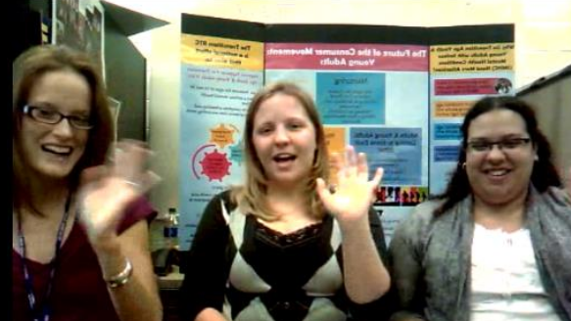
Amanda
Notes:
AMANDA:

Slide 13
From your perspective, what are 2-3 important studies or projects from these 3 decades, and why?
Notes:
AMANDA intro the question, and answer for yourself.

Slide 14
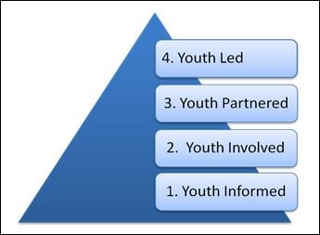
Value Add: Impact the Researchers
Research teams historically made up of seasoned researchers infused with lived experience and youth culture.
Change in practice, belief systems, and team dynamics
Stigmas and biases altered head on
Notes:
AMANDA:

Slide 15
Peer Academic Supports for Success
Peer academic coaching program, developed in partnership with Learning & Working RRTC, Boston University and Wright State University
Notes:
AMANDA:
Origins of PASS
PASS was inspired by the Raiders on the Autism Spectrum Excelling (RASE) program, a successful peer coaching initiative at Wright State University in Dayton, Ohio. RASE was developed to support college students with autism spectrum disorder as they transitioned from high school to college.
RASE peer coaches help students develop five essential competencies for navigating college life and academic responsibilities.
PASS is a modified version of RASE, specifically adapted to meet the needs of college students with mental health conditions.
PASS Program Structure
PASS is a highly structured, peer-based mentoring program that provides transitional support and fosters growth in five key competency areas:
Structure – Developing organization, time management, and self-discipline skills.
Technology – Utilizing digital tools and resources for academic success.
Advocacy – Learning to communicate needs effectively and seek support.
Campus Culture – Navigating social and academic life on campus.
Commitment – Building motivation, resilience, and long-term academic goals.
Role of Peer Coaches:
Peer coaches undergo specialized training and receive close supervision by a PASS Peer Coach Supervisor, a professional on campus who serves as both a mentor and role model.
The Peer Coach Supervisor acts as a liaison between the PASS program, university faculty, campus staff, and family members to ensure a supportive and collaborative environment.
Through PASS, students gain the tools, guidance, and confidence needed to succeed in college and beyond.
15

Slide 16
Konrad, E. (1996). A Multidimensional Framework for Conceptualizing Human Services Integration Initiatives. New Directions for Evaluation. Vol 59, Spring.
Notes:
AMANDA asks NANCY:
NANCY:
Read in 1996 when came out and it was like a light bulb—
Showed me how to conceptualize multi level service systems, individual; agency/community; service system;-state/federal. Beginning of my work on logic models. Helped to shape program evaluation design by separating outcomes for individual from outcomes for service system.. Assigned this article for reading for planning, management and policy classes that I taught in social work.

Slide 17
Articles
Johnsen, M., Morrissey, J., & Calloway, M. (1996). Structure and Change in Child Mental Health Service Delivery Networks. Journal of Community Psychology, (24) 3, 275-289
Davis, M., Koroloff, N., and Johnsen, M. (2012). Social Network Analysis of Child and Adult Interorganizational Connections. Psychiatric Rehabilitation Journal, (35), 3, 265-272
Notes:
NANCY:
Read first article long after 1996, when MAD and I were working on second article. Important to thinking about how to present data, how to think about results. Gave me a new took– social network analysis– way of measuring change at the system level.

Slide 18
Special Issue of Focal Point
Focal Point, (2019). Evaluation of Innovative Transition Programs. Vol. 33.
https://www.pathwaysrtc.pdx.edu/focal-point-S19
Featured local evaluation project done by Healthy Transition Initiative (HTI) grantees.
https://www.pathwaysrtc.pdx.edu/pdf/fpS19.pdf
Notes:
NANCY:
Focal point is a publication of the RRTC Pathways to a Positive Futures, Portland State University, Portland Oregon)Read this article later than 1996 when it was written. Read when started working with MAD. First research done using social network analysis applied to child mental health services. Most important to me was the method used, less important were findings.
Issue of Focal Point that featured the findings from the local evaluation studies done by 10 HTI grantees, grants funded 2014-2019. Eileen Brennan and I were editors, we solicited the articles, helped people write them, nudged people that we thought had good evaluations. The NOMS were the only national evaluation, didn’t fit transition aged young people well. Used adult NOMS because had employment. Only a few are examples of good evaluation design. Most had data of some kind but one or two just describe a project.
Putting together this issue reminded me of the importance of local evaluation– doing evaluation on a question that is really important to the people in the program– either staff or consumers. Answering that question and getting results back to stakeholders. Research with a small r may not be as rigorous as big R research but it has a place and can make a difference in how project are run and made more relevant to needs and preference of young people.

Slide 19
Healthy Transitions Initiative (HTI) Programs Featured:
YouForward, Low-barrier access: Massachusetts
TAYLRD, Drop-In Centers: Kentucky
OYEAH, Wraparound: Milwaukie,Wisconsin
CT Strong, Wraparound: Connecticut
CORE, Early Intervention for FEP: Delaware
Coordinated Specialty Care for FEP: Rohde Island
MindStrong & Emerge, TIP and CSC: Thresholds, Chicago.
Youth Empowered Solutions, Modified NOMS: Wisconsin
Improving Academic Supports: Maryland
Notes:
NANCY:
Truncated names of the programs that wrote up their program evaluation for Focal Point.
Not all research and evaluation is perfect, can still tell us something, point us in a direction. Take your data where you find it. Use strategies that served us in past when no funding; local and state evaluations, pilot research and secondary analyses of existing administrative databases

Slide 20
SAMHSA*-funded Projects to Assess TAY Supports in Child and Adult MH Systems in Each State
Davis, M. (2003). Addressing the needs of youth in transition to adulthood. Administration and Policy in Mental Health, 30, 495-509.
Davis, M., & Sondheimer, D. (2005). Child mental health systems’ efforts to support youth in transition to adulthood. Journal of Behavioral Health Services and Research, 32, 27-42.
Davis, M., Geller, J., & Hunt, B. (2006). Within-state availability of transition-to-adulthood services for youths with serious mental health conditions. Psychiatric Services, 57, 1594-1599.
*Substance Abuse and Mental Health Services Administration
Notes:
NANCY ASKS MARYANN THE QUESTION
I really struggle with this question. There is a lot of important research in this area, yet still so much more that needs to be done.
The 1997 paper had described a lot about the nature of this population of young people, but we needed to know more about the systems serving them.
The first project is the result of two surveys that SAMHSA funded me to conduct in 2000 and 2003, to assess what each state’s MH authority for children in 2000, then adults in 2003, was doing specifically to support youth with SMHC transitioning to adulthood (e.g. preparing adolescents for adulthood, helping young adults lay the foundation for a strong mature adulthood).
Allowed me to describe public mental health systems’ efforts that impacted TAY - starting with an overview in 2003, then with papers specifically describing and comparing those efforts in child and adult systems.
One-quarter of child state mental health systems and one-half of adult state mental health systems offered no transition services, and few provided any kind of transition service at more than one site. Most types of transition services were available at all in less than 20 percent of the states.

Slide 21
NIMH/NIDA*-funded Studies to Develop Multisystemic Therapy for Emerging Adults (MST-EA)
Davis, M., Sheidow, A.J., & McCart, M.R (2015). Reducing recidivism and symptoms in emerging adults with serious mental health conditions and justice system involvement. Journal of Behavioral Health Services and Research, 42(2), 172-190. DOI: 10.1007/s11414-014-9425-8
Sheidow, A.J., McCart, M.R., & Davis, M. (2016). Multisystemic therapy for emerging adults (MST-EA) with serious mental health conditions and criminal justice involvement. Cognitive and Behavioral Practice, 23 (3) 356–367. DOI: 10.1016/j.cbpra.2015.09.003.
Davis, M., Sheidow, A., McCart, M., & Perrault, R. (2018). Vocational coaches for justice-involved emerging adults. Psychiatric Rehabilitation Journal, 41(4), 266-276. DOI:10.1037/prj0000323
* National Institute of Mental Health/National Institute on Drug Abuse
Notes:
The second is a series of research that was initially funded by the national institute of mental health, and later also by the national institute on drug abuse.
As I saw it, there were 3 major approaches to having evidence-based interventions for TAY, one was to look at existing clinical trials that included this age group and analyze the data just for them to see if the effects were significant, Gary Bond and colleagues did this for the Individual Placement and Support (IPS) model in 2012, another was to adapt EBI for either younger or older populations for use with this age group and test that adapted version, and the third was to develop a new intervention specifically for this age group.
From earlier work, we had identified that one of the most pernicious young adult outcomes for youth with SMHC was justice-system involvement.
Recognizing the absence of evidence-based interventions for TAY. So, my wonderful colleague Ashli Sheidow and I applied for grants to enact the second approach – adapt Multisystemic Therapy, which was an EBP for adolescents to reduce recidivism. Those grants supported the work to develop then test MST-EA. Ashli, is an expert in Multisystemic therapy, was the main developer of the adaptations which were for 17-24 year olds with SMHC, and a later version for SUD, and overseeing the implementation of the intervention, and I was the person in charge of conducting the research (recruiting participants, conducting all data collection).
In many ways the value of these studies was in the knowledge gained about needed adaptations. We had to convert a home-based intervention that was largely delivered to parents/parental figures to help their adolescent, into one delivered directly to the young person. We learned a lot about what it takes to engage young people who have very challenging circumstances in this treatment, which included a variety of innovations. We also learned a lot about how to assess including families in the intervention and engaging them in ways the young person was open to. We also added adaptation to directly treat MH conditions, and to focus on developing skills for adulthood. I think a lot of what Ashli and her colleague Mike McCart built into MST-EA are good foundations for other interventions for this age group, particularly those with a combination of SMHC and other very challenging life circumstances, including co-occurring problem substance use.
We also learned a lot about the challenges of retaining young people with very challenging circumstances in research over time – it has been the most challenging research of my career.
Still completing final analysis of the effectivenss trial - hoping for positive results.

Slide 22
NIDILRR-funding of Rehabilitation Research and Training Center: Learning & Working During the Transition to Adulthood (2009-present)
Research to inform the development & tested interventions to support school/work/careers: PASS, BRYT, FSST, HYPE, TEST
Learned/Learning how to partner authentically with youth with lived/living experience of SMHC to design/conduct/disseminate research
Learned/learning how to do effective Knowledge Translation
https://www.umassmed.edu/TransitionsACR/
Notes:
In 2008, my own research had focused on mental health systems and policies, and on TAY involvement in the justice system, and mental health treatments for them. Then NIDILRR issued the first RFA for RRTC’s for TAY with SMHC. 2 Thinks led to me applying for one of the RRTC’s. First, was the realization through all of the research on TAY struggles, that if we could crack the nut on how to help them succeed in schooling/training and launching adult worklives, we would make a tremendous contribution to the field. Second, Marsha Ellison had recently joined our faculty, coming from the Boston University RRTC on adults with psychiatric disabilities. She was familiar with NIDILRR as a granting agency and their expercetations, as well as what constitutes an RRTC. So, we worked 15 hour days, 7 days a week for 8 weeks in the summer of 2009 and submitted a proposal that was awarded to us in October 2009.
We have been fortunate to be awarded another 2 of them under me as PI, and a 4th under Marsha Ellison and Michelle Mullen as coPI’s. And Kathryn Sabella, who has been part of the leadership of these RRTC’s, with Liz Thomas at Temple U, were awarded one on community inclusion in 2023.
In 2009 no intervention had evidence of efficacy in helping TAY w SMHC in school or work. Since then, we have conducted research on understanding the population and the context of their school and work lives, we’ve developed and begun to test numerous interventions to strengthen those capacities including PASS, BRYTE, FSST, and HYPE, TEST. Go to our website to find more on all of this research.
One of the joys of research is discovering things you didn’t expect, and weren’t the focus of your research. I’ll mention two things; Kathryn Sabella, in investigating factors that contribute to school and work functioning after high school, discovered the tremendous impact that the diagnosing and prescribing processes of our medical providers has on young adults’ self-identities, which has implications for help seeking and other aspects of their lives., second, with Ian Lane, they discovered who changeable gender identity in young adulthood, and developed better research methods to assess this.
2 other things, quickly, that comes with NIDILRR funding – they require genuine partnership with people with lived experience, which put us on a path of developing capacities to do so with young people, which has improved our research tremendously, and has allowed us to use what we’ve learned to help others in related fields, and in services, to do the same.
NIDILRR also requires that you share the knowledge gained from research with those who will use the research in their lives and work, not just with other researchers. Marsha Ellison has become a national leader in knowledge translation as a result of her work in our RRTC’s, and in particular, doing what she calls Participatory Knowledge Translation with youth. Amanda is going to tell you a little more about that.

Slide 23
One more point…
Settersten, Furstengberg, & Rumbaut (Eds.) 2005
National Academies: Bonnie, Stroud, & Breiner (Eds.) 2015
Osgood et al (Eds.) 2005
Notes:
MaD:
some of the most important research that has informed research in this field came from outside the field: in particular the research that describes how the transition to adulthood has changed from post WWII and more recently post the great recession, then post the pandemic, as well as research shedding light on the implications of these major events or eras for those at-risk of poor outcomes (MacArthur network, IOM Investing in the Health and Wellbeing of Young Adults)

Slide 24
From your perspective, how has dissemination and/or use of research findings changed in this time-frame?
Notes:
NANCY: One of the most important aspects of doing research is effectively communicating the findings of that research to those who should hear about it.

Slide 25
From a Researchers Perspective: Biggest Changes in Dissemination
Increase in number of audiences researchers try to reach
Use of internet to disseminate findings
Increase in diversity of methods. No longer just journal articles
Notes:
NANCY:
in 1995- mostly articles for other researchers
--slowly began to target service providers and policy
Today-- publications that target families, young people, general population
NANCY TO AMANDA:
From your perspective, how has dissemination and/or use of research findings changed during this period?

Slide 26
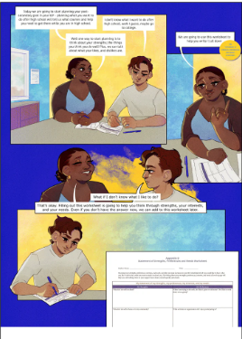
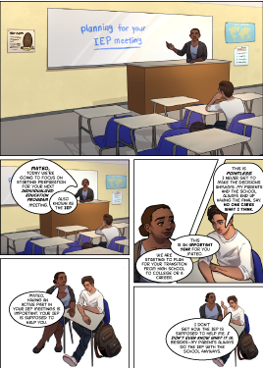
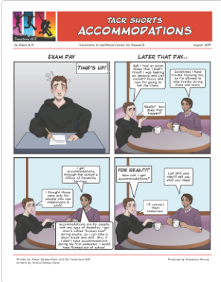
Easy to Digest Information
Notes:
AMANDA

Slide 27
Multimedia Dissemination
Notes:
AMANDA:
Youtube- 17 episodes, ranging topics on therapy animals, jedcampus, what to wear during interviews, mental health awareness campaigns, live at the tampa conference, accommodations etc.
-Researchers and colleagues who share information from their studies and interventions designed to support transition aged youth and young adults navigating school or work. -Young adults with mental health conditions who share their journeys navigating high school, college, and post-grad life. These authentic conversations offer an inside look into what it’s like transitioning to adulthood when you have a mental health condition.
27

Slide 28
Mental Health Memes
Notes:
AMANDA:

Slide 29
Given the current political climate, what from the past 3 decades do you find hopeful about the future of research in this field?
Notes:
Amanda asks MaD
The forces that demand research remain. We have all established that services, policies, and practices need to be tailored to young people, and that well established knowledge base will support those who continue to advocate for that and for the research base that improves that system. Moreover, young people and their adult allies, and those who provide services for them will continue to ask or demand for services and supports to be helpful and to work, and that is a demand for research. Researchers who are passionate about this research will continue to keep an eagle eye out for opportunities to expand our knowledge base.
MaD asks Nancy
Nancy – New young researchers interested in this population especially new researchers like Amanda and Brie Masselli, individuals who experienced the services system and want to know more about what works. Involvement of young people with mental health challenges in research.
Nancy asks Amanda
Amanda – fuel your champions

Slide 30
Discussant Reflections
Past, present and future
Kathryn Sabella, Ph.D.

Slide 31
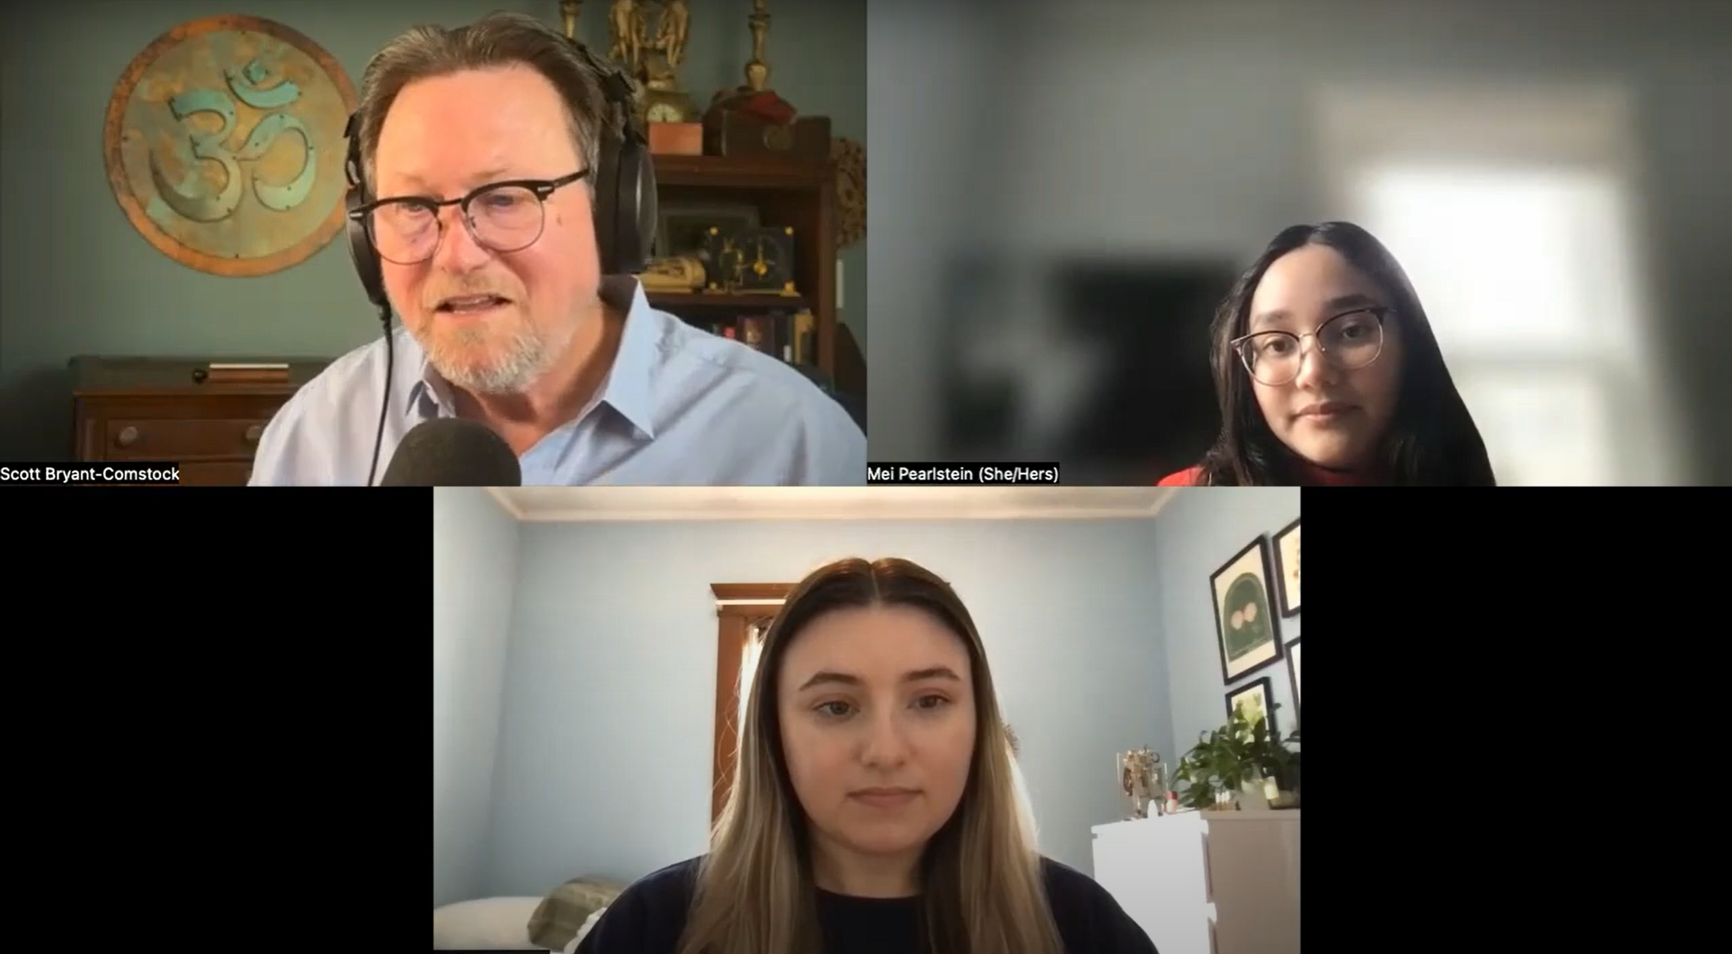
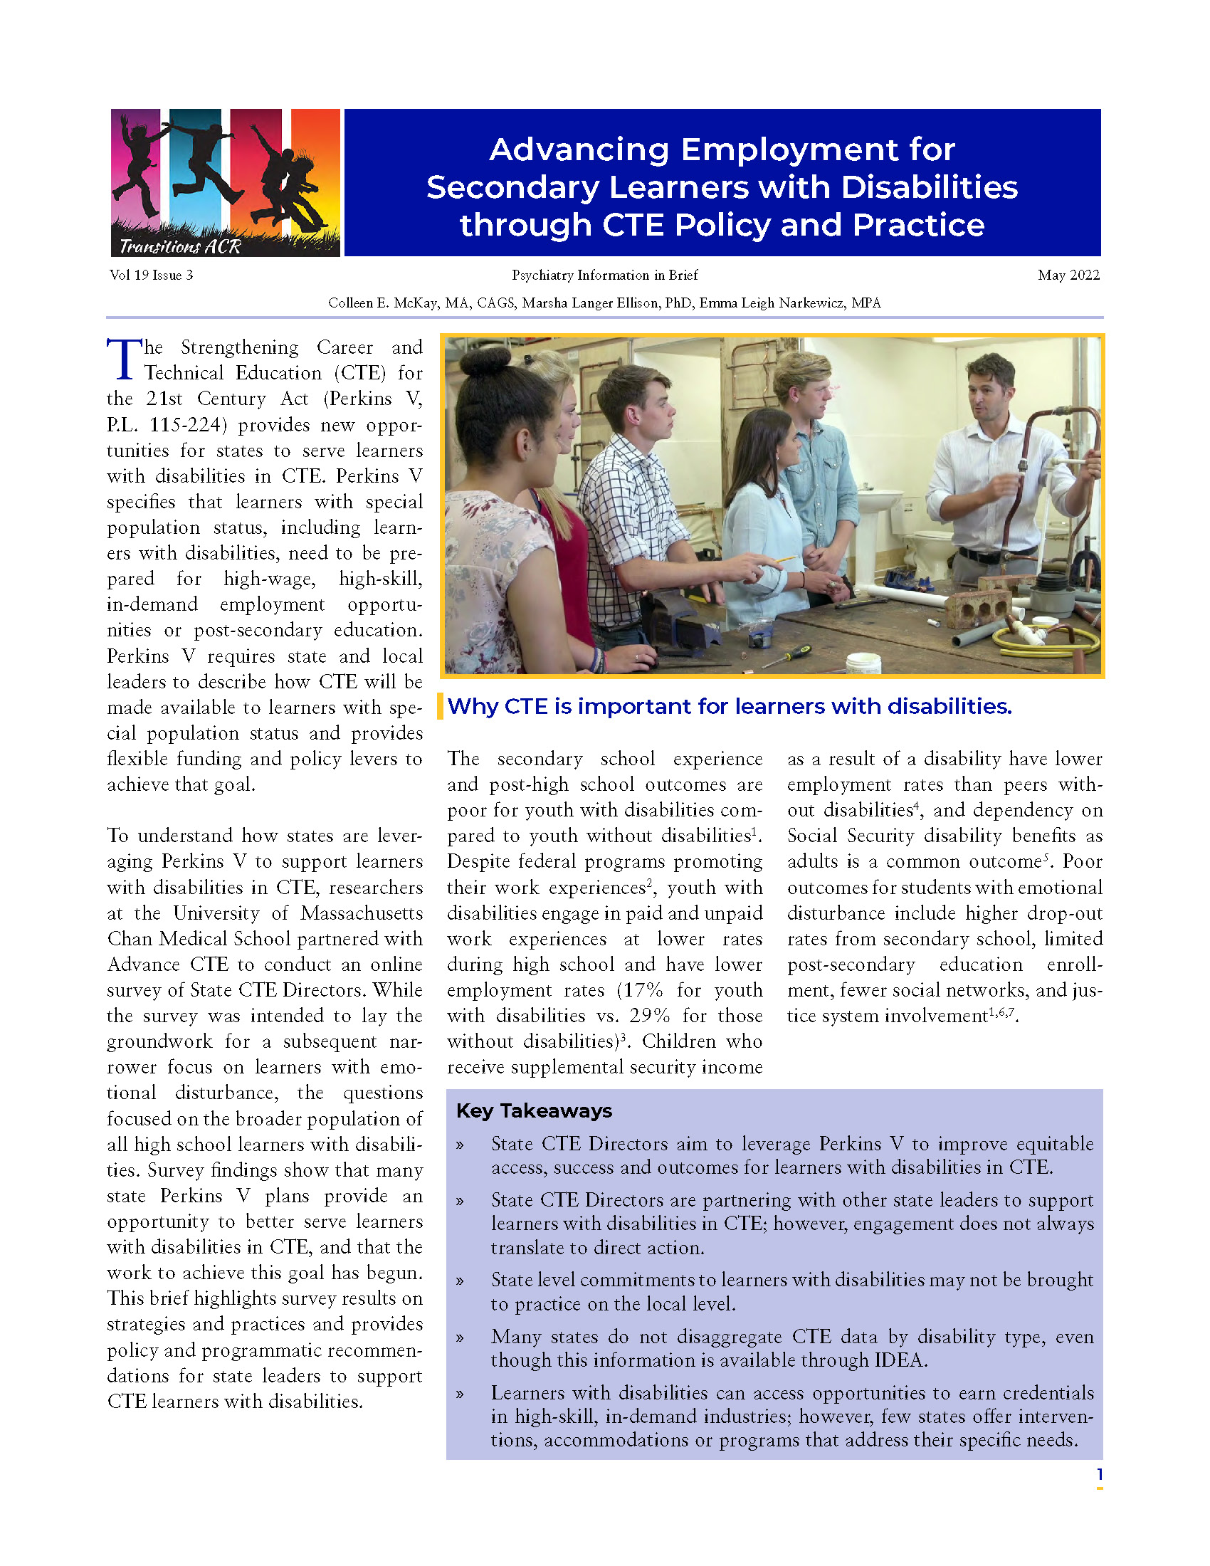
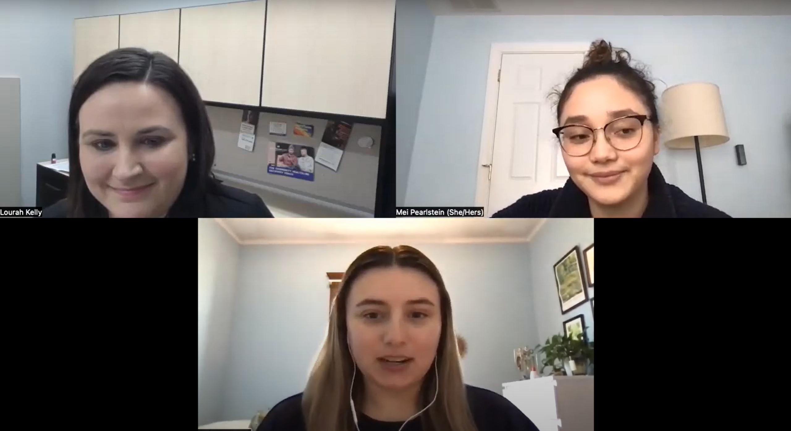
Learning & Working RRTC Products
Podcasts
Tip Sheets
Webinars
https://www.umassmed.edu/TransitionsACR/research/ center-grants/learning-working-rrtc-2024-2029/

Slide 32
Thank You!

