Slide 1






Introduction to the Academic Health Collaborative of Worcester
Current Partners:

Slide 2

What is an academic health department, exactly?

Slide 3

Why an academic health department?
Why an academic health collaborative?

Slide 4
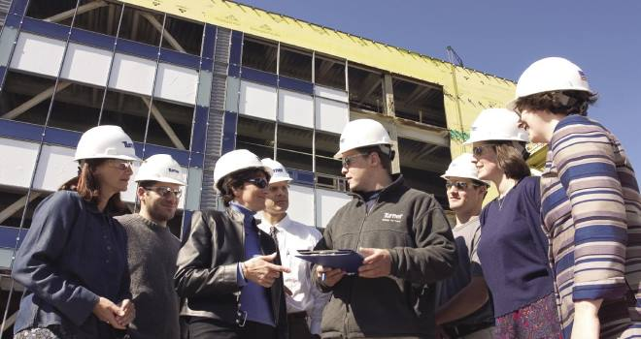
The AHD model better prepares our public health workforce

Slide 5

The AHD model improves the flow of information

Slide 6
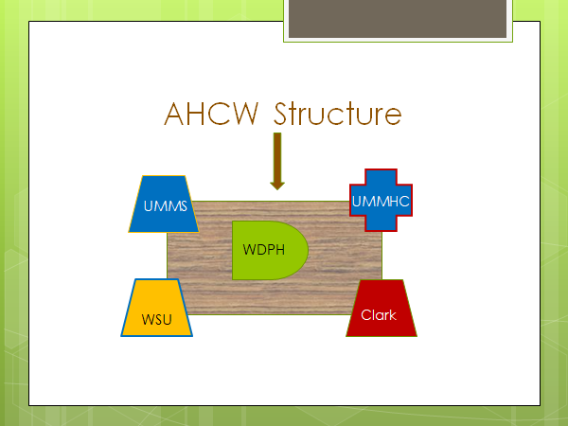

Slide 7
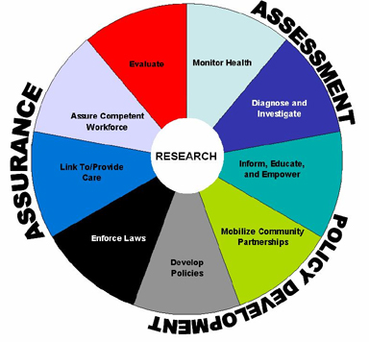
Core functions of public health

Slide 8
Assessment
ASSESS the health needs of the community
INVESTIGATE the occurrence of health effects and health hazards in the community.
ANALYZE the determinants of identified health needs.

Slide 9
Policy development
ADVOCATE for public health, build constituencies, and identify resources in the community.
PRIORITIZE among health needs.
PLAN and develop policies to address priority health needs.

Slide 10
Assurance
MANAGE resources and develop organizational structure.
IMPLEMENT programs.
EVALUATE programs and provide quality assurance.
INFORM and educate the public.

Slide 11
Our municipal structure
Office of the City Manager
Dept of Health and Human Services
  Division of Public Health
    Community Health
    Emergency Preparedness
    Nursing
    Environmental Health
Notes:
Different in every city and town

Slide 12
Opportunities for learners
WDPH Internship program
Extended learner involvement (ELI)
    Capstone, thesis, or graduate research
Faculty-directed research studies or service initiatives with planned student involvement

Slide 13
Opportunities for practitioners
Teaching and mentoring students in the WDPH Internship program
Guiding extended learner involvement (ELI)
Receiving faculty and student assistance with research studies

Slide 14
Opportunities for community
Benefit from efforts of students in the WDPH Internship program
Improved understanding of public health issues because of student intern outreach activity and AHCW dissemination activities
Reduced research fatigue and accumulation of valuable local knowledge

Slide 15
Benefits of Participation
Higher Ed
Public Health
Health Systems
Better health in community

Slide 16
Benefits of Participation
Institutional
  Progress toward meeting mission
  Collaboration and community engagement
Individual
  Learners get real world exposure
  Researchers get access to timely real data
  Practitioners get analysis and assistance
Shared
  Community Health Improvement Plan areas get broader input
  Inter-institutional relationships expand capacity for all
  City gets better health

Slide 17
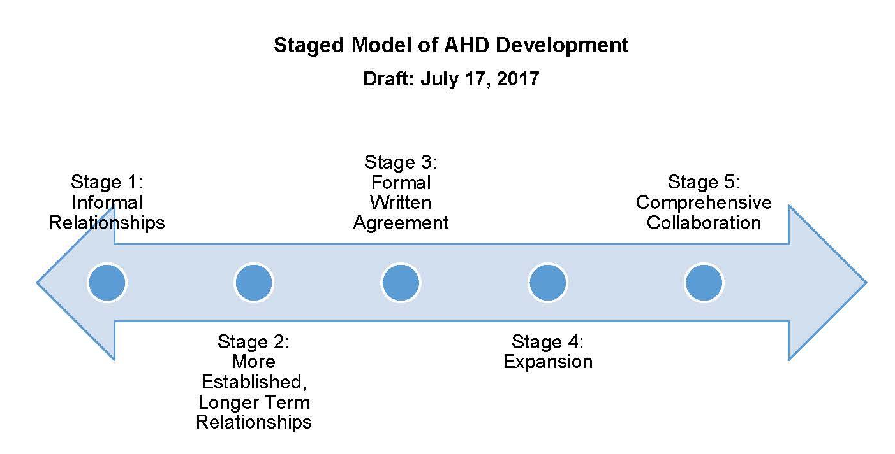
Public Health Foundation
Council on Linkages Between Academia and Public Health Practice

Slide 18

Invitation to faculty
Design projects together
Address prioritized needs
Answer specific questions
Share progress
Celebrate success together

Slide 19

Resources
Prevention specialists
Community connections
Health assessment results
Online resources
Real-time consulting
Financial support
Faculty effort
Centers and special programs

Slide 20
Still have questions?
Contact the AHCW coordinator
or the primary point of contact
for your institution.
See website for details:
http://Academic.HealthyCentralMA.com

