Slide 1
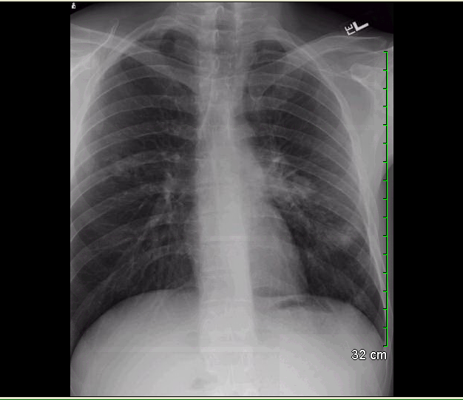
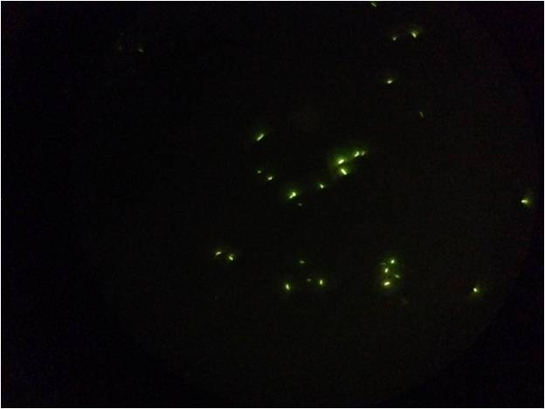
Patient Communication
LTBI ECHO
Kelly Holland, MD
September 30, 2021

Slide 2
Challenges
Imperfect testing
Latency
Side effects
Probability
Nitrosamine
Stigma
Notes:
Grateful,

Slide 3
Getting Started
What do you know about tuberculosis?
Notes:
Grateful,

Slide 4
Assessing risk factors
Family members
Health departments
X-rays and medicines
Notes:
Grateful,

Slide 5
Potential Tools
Active versus waiting
COVID analogies
Automobiles
10 patients
One medicine or many
Colleagues
Notes:
Grateful,

Slide 6
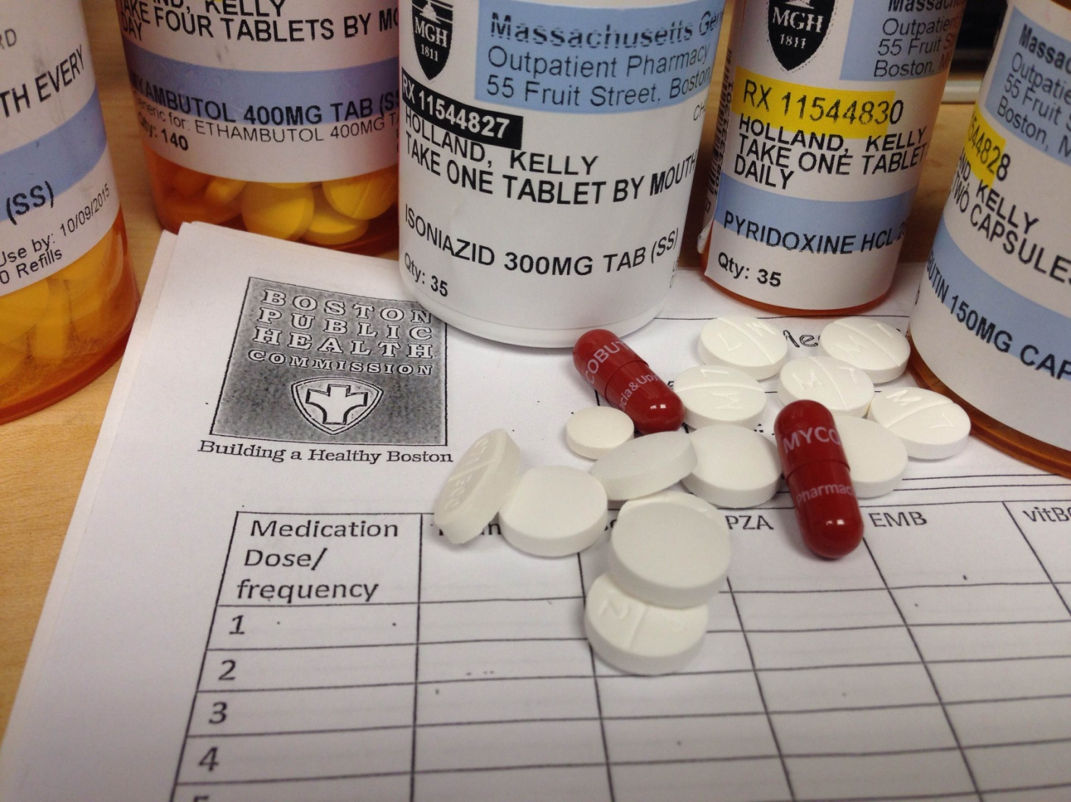
One medicine or many?

Slide 7
Common Responses
“I was vaccinated”
“Everyone from my country tests positive”
“I don’t have any symptoms”
“Will I get active TB?”
“Should I stop eating hot dogs?”

Slide 8
Your Experiences?

Slide 9
Vignettes
46yo female refugee recently arrived to US 8 weeks ago. You are conducting her second refugee health visit. Her initial labs demonstrated a positive quantiferon gold. She was asymptomatic at the first visit and her chest x-ray is negative. You talk to her about latent TB infection and the important of treatment. She states “I was told at my health screening in Kenya that I do not have TB so I do not need treatment”. How do you respond?
A 30yo father presents with his 8 year old daughter for a well child check at the beginning of the school year. They recently immigrated from Vietnam and the patient had a ppd planted for school by nursing two weeks ago which was positive (13mm). When you tell the father, he laughs and says “oh yes, everyone back home has positive TB tests because of the BCG vaccine. It doesn’t mean anything and we know that there is not any TB in the United States” How do you respond?

