Slide 1
Common PCP questions along the LTBI care cascade
Daria Szkwarko, DO, MPH

Slide 2
Learning Objectives
Describe the components of the LTBI care cascade
Consider the most common LTBI questions in primary care that come up throughout the cascade and how to address them
Identify an individual who can help answer other LTBI questions quickly so that care can continue in primary care

Slide 3
The LTBI Care Cascade
Step 1: Identification
At-Risk individuals need to be identified
Step 2:
LTBI Screening
High-Risk individuals undergo LTBI screening
Step 3:
Active TB Evaluation
Individuals who test positive for LTBI undergo active TB evaluation with symptom screen and chest X-ray
Step 4:
LTBI treatment initiation
Individuals who do not have active TB disease are started on LTBI treatment
Step 5: LTBI treatment completion
Individuals started on LTBI treatment need to follow up monthly and complete therapy
LOSSES
LOSSES
LOSSES
LOSSES
LOSSES
Notes:
REBECCA

Slide 4
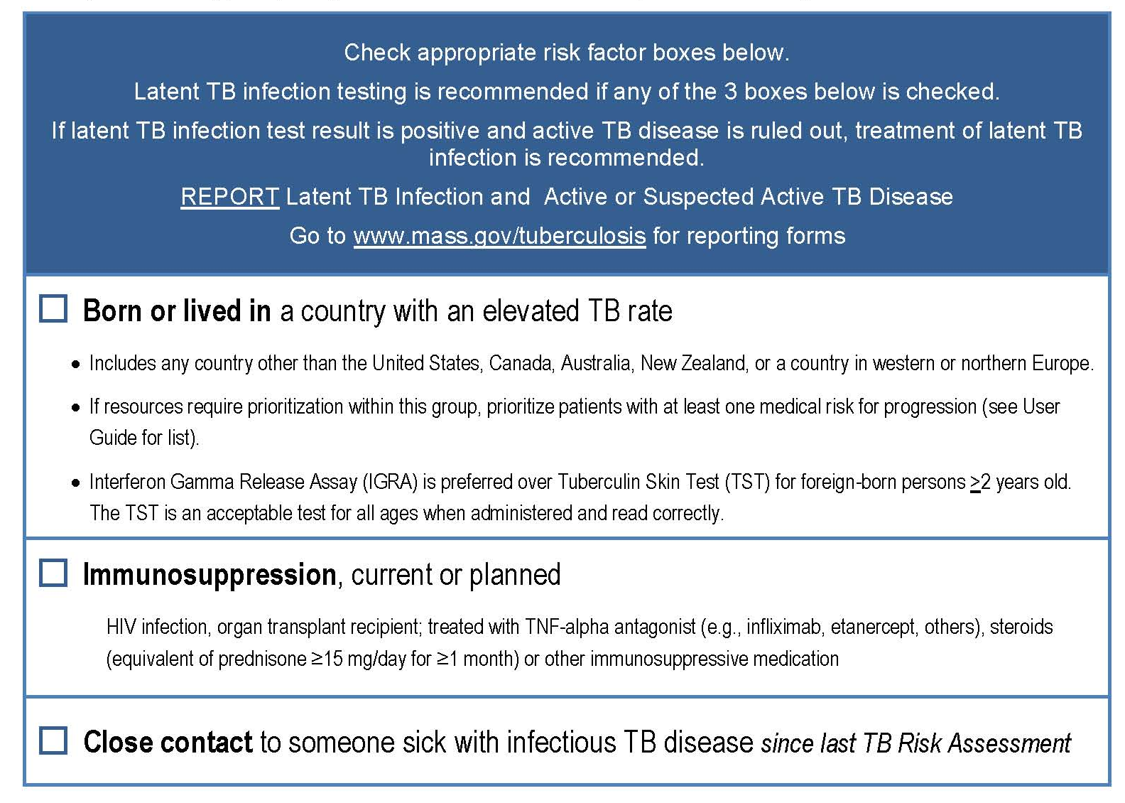

Slide 5

Just remember…Screen if patient is from a country other than…
US
Canada
Australia
New Zealand
Western and Northern
Europe

Slide 6
But what about....
A patient who immigrated from Puerto Rico 20 years ago?
A six month old refugee who moved to the US from Afghanistan with family 2 months ago
A medical student who worked in a rural hospital in Kenya for a year
A 50 year old who visits family each year in Liberia for two months

Slide 7
A Decision to Test, is a Decision to Think....
What is the risk of exposure to TB infection?
  Consider risks such as family members who have had TB, where was the patient living while in a TB endemic region etc.
What is the risk of TB disease progression?
  Consider factors that increase risk of progression to TB disease such as immunocompromised state, age. Don’t forget the risk to others if patient progresses to TB disease (i.e medical student)
What is the post-test probability – in other words, if the test is positive in your patient, how likely is it that they have TB infection?
  Consider factors that may impact the specificity or sensitivity of your tests (BCG vaccination, immunosuppression)

Slide 8
Context matters for all scenarios below....
A patient who immigrated from Puerto Rico 20 years ago?
A six month old refugee who moved to the US from Afghanistan with family 2 months ago
A medical student who worked in a rural hospital in Kenya for a year
A 50 year old who visits family each year in Liberia for two months

Slide 9
The LTBI Care Cascade
Step 1: Identification
At-Risk individuals need to be identified
Step 2:
LTBI Screening
High-Risk individuals undergo LTBI screening
Step 3:
Active TB Evaluation
Individuals who test positive for LTBI undergo active TB evaluation with symptom screen and chest X-ray
Step 4:
LTBI treatment initiation
Individuals who do not have active TB disease are started on LTBI treatment
Step 5: LTBI treatment completion
Individuals started on LTBI treatment need to follow up monthly and complete therapy
Notes:
REBECCA

Slide 10
TB Infection Testing Interpretation
  Neither PPD or IGRAs differentiates b/w latent TB infection or active TB disease
  Neither is used to follow response to treatment
  After TB infection both may remain + for life

Slide 11
But what about...
A low risk patient who was screened for work and has a positive TST?
An 8 month old from Afghanistan with a 15mm TST?
A patient who will start a biologic medication and has had two indeterminate IGRAs?

Slide 12
Consider an alternate test?
A decision to test is a decision to think!
  Will it change your management? (e.g. perhaps the low risk patient works in a NICU, if the IGRA is positive in an 8 month old you may go ahead and treat, if the TST is negative in the person starting a biologic you may not treat)
Context matters – again risk of exposure, risk of progression, risk of disease transmission to others

Slide 13
TB infection testing interpretation, Context matters!
+ PPD, - IGRA test
  8 yr old healthy girl from Brazil, PPD 10mm, IGRA neg
  60 yr old female from Brazil, uncontrolled DM and CKD, PPD 10mm, IGRA neg
  60 yr female from Brazil, PPD 0mm 2 yrs ago, now a contact of an active smear + case, current PPD 10mm, IGRA neg
  8 yr old healthy girl from Kenya, PPD 30mm, IGRA neg
  40 yr healthy male from Russia, PPD 10mm, IGRA neg, works in a neonatal ICU

Slide 14
The LTBI Care Cascade
Step 1: Identification
At-Risk individuals need to be identified
Step 2:
LTBI Screening
High-Risk individuals undergo LTBI screening
Step 3:
Active TB Evaluation
Individuals who test positive for LTBI undergo active TB evaluation with symptom screen and chest X-ray
Step 4:
LTBI treatment initiation
Individuals who do not have active TB disease are started on LTBI treatment
Step 5: LTBI treatment completion
Individuals started on LTBI treatment need to follow up monthly and complete therapy
Notes:
REBECCA

Slide 15
Evaluation Recap
History and physical examination are key
  Don’t forget to ask questions and perform physical exam to look for extrapulmonary disease!
X-ray recap
  In adults, one single PA view is sufficient
  In children, two views needed!
  Need chest x-ray within 2 months of starting treatment

Slide 16
But what about....
An abnormal X-ray with evidence of ? Old TB disease or hilar lymphadenopathy
  Remember, our specialists are always there for us. An abnormal X-ray usually always warrants a discussion with a specialist!
A 6 month old X-ray
  Repeat it!
History and PE suggestive of an abnormality that may or may not be TB (e.g. persistent unilateral adenopathy, fatigue, chronic cough without other symptoms)
  TB infection treatment is not an emergency! As PCPs we are experts in working up non-specific complaints. Take the time to feel good about finding another diagnosis prior to initiating LTBI treatment

Slide 17
The LTBI Care Cascade
Step 1: Identification
At-Risk individuals need to be identified
Step 2:
LTBI Screening
High-Risk individuals undergo LTBI screening
Step 3:
Active TB Evaluation
Individuals who test positive for LTBI undergo active TB evaluation with symptom screen and chest X-ray
Step 4:
LTBI treatment initiation
Individuals who do not have active TB disease are started on LTBI treatment
Step 5: LTBI treatment completion
Individuals started on LTBI treatment need to follow up monthly and complete therapy
Notes:
REBECCA

Slide 18
Treatment Regimens for LTBI
Drugs, dose | Dosing frequency | Duration
Rifampin 600 mg (4R) | Daily | 4 months
Isoniazid 300 mg (6-9H) | Daily | 6-9 months **9 months preferred
Isoniazid 900 mg + Rifapentine 900 mg (3HP) | Once weekly | 3 months

Slide 19
But what about...
Those nitrosamines!
prescribing 3HP as self- administered?
those kids who just won’t swallow the medication??

Slide 20
N-nitrosamines, Cancer Risk and TB Medications
Everyone is exposed to N-nitrosamines in every day life
  Drinking water, foods (grilled or cured meats, dairy products, and veggies), tobacco exposure and some latex and rubber products
  There are multiple N-n with varying mutagenic potential
  In 2018, health authorities starting looking at medications for N-n contamination
    API, drug synthesis products, cross contamination, recovery processes for solvents or drug degradation
Acceptable Intake (AI) = daily exposure approximates a cancer risk of 1:100,000 after 70 years of exposure; regulatory bodies have set minimum daily intake limits to remain under this break point
Present levels of N-n in 4R would be between 1 and 12 months of exposure
Pharmaceutical companies are working to continue to reduce N-n in all Rifampin compounds and must monitor all batches for specific contamination levels

Slide 21
Nitrosamines and Rifamycins: Some Considerations
Treatment of TB disease:
  Continue use of rifampin if acceptable to the patient, as the risk of not taking rifampin likely outweighs any potential risk from nitrosamine impurities.
Treatment of latent TB infection:
  Currently receiving rifampin or rifapentine: continue this treatment, although a change to isoniazid (INH) is acceptable if preferred by the patient.
  Newly diagnosed LTBI: Until more information becomes available, counsel patient regarding rifamycin risks and engage in shared decision making with the patient
Notes:
In pts on rifampin for active TB, generally we continue; risk is low and risk of resurgent active TB is high
For latent TB, we should engage in shared decision making, but in general, can continue patients who are already on treatment. Patients starting treatment should be preferentially offered alternative treatment (for now, 9mo of INH) until more info is available.

Slide 22
Suggested Scripts for Nitrosamine Counseling
“Nitrosamines are chemicals that with cumulative exposure can increase risk of cancer. They are found in foods such as smoked meats, liquids such as beer or some water supplies, tobacco and some latex products. The FDA has found the level of nitrosamines in rifampin may be above the accepted limit; the company is working on reducing this level. With this careful oversight, CDC and FDA recommend that rifampin remain available for use due to the importance of treating TB. Taking rifampin for 4 months to treat LTBI is a very small contribution to the total amount of nitrosamine we are exposed to in daily life.
If low risk....“It is important for you to choose what feels best for your body. If the risk of rifampin does not feel right to you and you would prefer not to take INH – a longer regimen, we can revisit this discussion in a year or two to see if the company can reduce further the risk”
If high risk.... “You have several risk factors that make you at higher risk for progressing from your TB infection to TB disease, making you both ill and possibly spreading this infection to others. The benefits of treatment for your TB infection likely outweighs the risk of rifampin at this time. I would recommend that you choose a regimen that you are comfortable with and receive treatment as soon as possible”

Slide 23

Isoniazid + Rifapentine
Isoniazid 900 mg p.o. + rifapentine 900 mg p.o. weekly x 3 months
DOT (Directly Observed Therapy)
Not approved in:
  Children <2 years of age
  Individuals with presumed infection with INH- or RIF-resistant TB
  Pregnant women
  PLHIV

Slide 24





Medication administration
RIF capsules can be broken and powder sprinkled and mixed with foods
RIF syrup (preferred) or INH syrup for exclusively breastfed infants
Crushed pills can be mixed with food (don’t let the kid see)
  Pudding
  Chocolate syrup
  Nutella
  Applesauce
  Yogurt
  Double-Stuffed Oreo

Slide 25
The LTBI Care Cascade
Step 1: Identification
At-Risk individuals need to be identified
Step 2:
LTBI Screening
High-Risk individuals undergo LTBI screening
Step 3:
Active TB Evaluation
Individuals who test positive for LTBI undergo active TB evaluation with symptom screen and chest X-ray
Step 4:
LTBI treatment initiation
Individuals who do not have active TB disease are started on LTBI treatment
Step 5: LTBI treatment completion
Individuals started on LTBI treatment need to follow up monthly and complete therapy
Notes:
REBECCA

Slide 26
Monitoring of patients on treatment for LTBI
Baseline laboratory testing not needed except for:
  HIV infection
  Pregnancy
  History of liver disease/heavy alcohol use
  Patient on chemotherapy
Evaluate monthly for:
  Adherence
  Signs/symptoms of adverse reactions
  Laboratory studies in persons at-risk (LFT, CBC)
    If following LFTs: stop treatment if LFTs >3 times upper limit + symptoms OR if LFTs >5 times upper limit + no symptoms

Slide 27
But what about....
My patient had baseline LFTs done by another provider and I felt obligated to continue checking monthly. Now they are elevated 3 times at month 3! When do I repeat?
  If asymptomatic, could repeat in 2 weeks to see if stable. Likely would repeat one additional time and then ensure that patient knows to stop medication if any symptoms develop
  If LFTs are continuing to increase, can call specialist for further guidance

Slide 28
Who are these ‘TB specialists’???
How do I find them???

